Slide 1
PORTLAND CITY COUNCIL
JUNE 21, 2018
BRIEFING ON THE AFFORDABLE COMMERCIAL SPACE BONUS PROGRAM

Slide 2
Presenters
Kyra Straussman, Prosper Portland
Director of Development & Investment
Alison Wicks, Prosper Portland
Project Coordinator II
PORTLAND CITY COUNCIL
JUNE 21, 2018
BRIEFING ON THE AFFORDABLE COMMERCIAL SPACE BONUS PROGRAM
Notes:
Good afternoon Mayor Wheeler, Commissioners
Kyra Introduction – background, role at Prosper Portland
Alison And I are here today, to provide a briefing on the Affordable Commercial Space Bonus Program and the accompanying Administrative Rules.
We’ve received a significant amount of input in drafting the rules and are looking forward to adding this program to the suite of tools Prosper Portland is using to address issues across the city on Commercial Affordability.
We’ve worked closely with the Bureau of Planning and Sustainability, the Bureau of Development Services and the Portland Housing Bureau.
As well as a Stakeholder Advisory Committee to refine zoning code language and the create the Administrative Rules for the Affordable Commercial Space Bonus.

Slide 3
AFFORDABLE COMMERCIAL
SPACE BONUS PROGRAM
Notes:
Today we will:
Review the Prosper Portland Affordable Commercial Framework
Review the Affordable Commercial Space Bonus Program
And the Administrative Rules which will guide the program implementation

Slide 4
Affordable Commercial Framework
ACCESS TO PUBLIC & PRIVATE SPACE
Prosper Portland master lease/ownership
Partnership with City Bureaus
Lease agreements with private developers
Affordable Commercial Bonus Program
BUSINESS COACHING & TECHNICAL ASSISTANCE
Inclusive Business Resource Network (IBRN)
Mercatus PDX
Retail workshops and financial review
FINANCIAL SUPPORT
Prosperity Improvement Program (PIP) Grants
Tenant Improvement Loans
Notes:
Before we jump in I wanted to take a slide to review how Affordable Commercial Space Bonus Program fits into the Prosper Portland Affordable Commercial Framework.
Commercial Affordability is not just one thing – its not a reduced rent rate, or free space.
At Prosper Portland we are developing a comprehensive framework to address city wide issues of Commercial Affordability
The Framework is made up of three sets of tools:
- Access to Publicly and Privately- Managed Space – we have 4 projects under way testing these tools, which include master leasing, ownership, and partnering with public and private partners
- Business Coaching and Technical Assistance – Prosper Portland has a dozen partner organizations that provide culturally-specific business advising to underrepresented entrepreneurs and business owners
- Existing and new financial tools to support businesses.
ACS Bonus is one tool of many

Slide 5
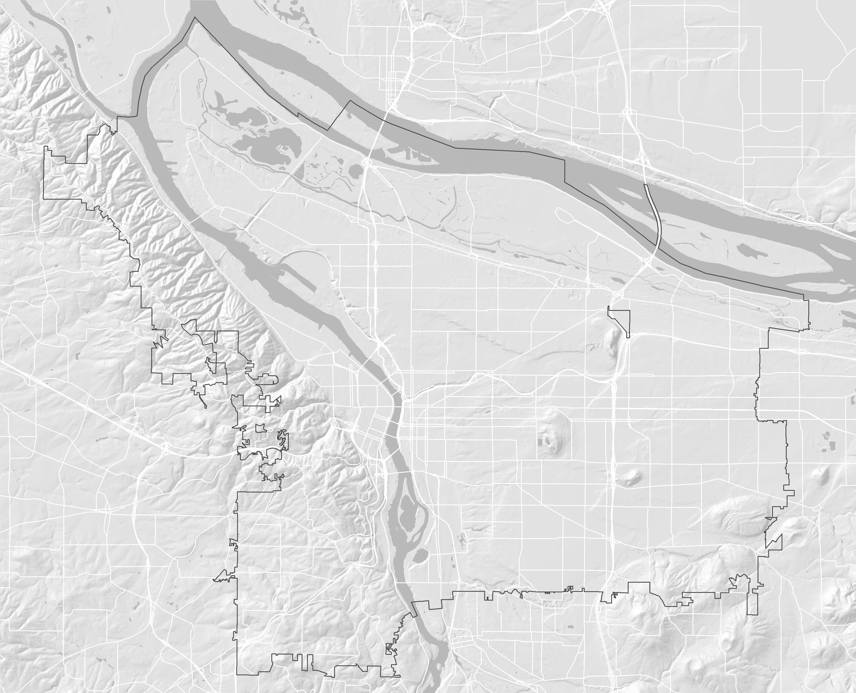
PILOT PROJECTS
ALBERTA COMMONS
10TH & YAMHILL GARAGE
LENTS COMMONS
OLIVER STATION
Notes:
4 pilot projects
Two located in Lents Town Center – Oliver Station and Lents Commons
One in NE Portland – Alberta Commons
And one Downtown – 10th and Yamhill Garage

Slide 6
Pilot Project Summary
 | Alberta Commons | 10TH & Yamhill | Lents Commons | Oliver Station | ACS Bonus
ACCESS TO SPACE | 5,100 SQFT | 21,000 SQFT | 3,725 SQFT | 4,000 SQFT | Est. Up To 40,000 SQFT
 | Master Lease from Private Partner | $$\text{Master} \text{Lease} \text{from} \text{Public} \text{Partner}$$ | $$\text{Pros}\text{per} \text{Portland} \text{Ownership}$$ | Consent to Let from Private Partner | Covenant with Developer
TECHNICAL ASSISTANCE | $$✓$$ | $$✓$$ | $$✓$$ | $$✓$$ | $$✓$$
FINANCIAL SUPPORT | $$✓$$ | $$✓$$ | $$✓$$ | $$✓$$ | $$✓$$
Notes:
4 pilot projects each with different tools to access space, but all include all 3 components of the framework
We have been working with the Bureau of Planning and Sustainability on a Mixed-Use Zones Affordable Commercial Bonus

Slide 7
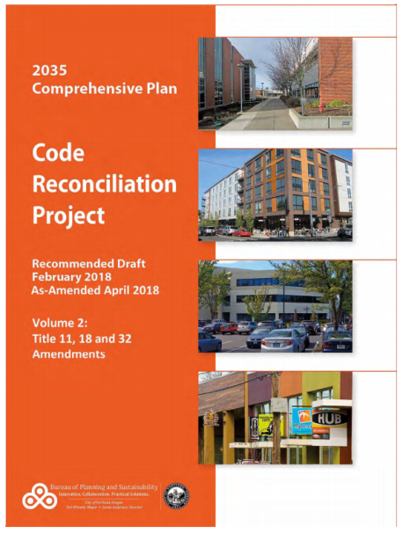
Process Overview
MAY 2017 – JUNE 2018
Coordination with Bureau of Planning & Sustainability, Bureau of Development Services and Portland Housing Bureau
Stakeholder Advisory Committee discussions & recommendation
Planning and Sustainability Commission review
Approval of Zoning Code by Portland City Council (May 2018)
Approval of Administrative Rules by Prosper Portland Board (June 2018)
Notes:
The concept of an Affordable Commercial bonus came out of an effort to consolidate available bonuses in the City of Portland 2035 Comprehensive Plan.
And code language for the ACS Bonus was edits through the Code Reconciliation Project – which was just approved by City Council this past month.
Prosper Portland staff stared working with BPS on the Affordable Commercial Space Bonus structure and Administrative Rules about a year ago
Prosper Portland was asked to look at the original Affordable Commercial Code Language and decide if this was an Affordable Commercial tool we wanted to pursue and implement
We convened a Stakeholder Advisory Committee which reviewed Program Options and made a recommendation
This recommendation was presented to the Planning and Sustainability Commission last fall and this spring as they worked through the Code Reconciliation Project and vetted the program.
Today we are here to have the Prosper Portland Board of Commissioners approval the Administrative Rules to guide the Affordable Commercial Bonus Program
Next week will present this item to City Council

Slide 8
Affordable Commercial Floor Area and Height Bonus Program
GOALS
Help to provide and stabilize commercial space along mixed –use commercial corridors
Ease the challenge of commercial gentrification and business displacement
Support businesses led by owners from communities of color and marginalized individuals
Increase availability of affordable commercial space
Reduce barriers of entry to new construction commercial space
Notes:
The Affordable Commercial Space Bonus Program has five goals-
Support businesses led by owners from communities of color and marginalized individuals that have not fully participated in, or benefited from, economic opportunities.
Increase the square footage of Affordable Commercial spaces available to businesses.
Reduce barriers of entry to new construction commercial space for those facing greatest disparities in wealth creation.
Ease the challenge of commercial gentrification and business displacement in the City of Portland’s Commercial/Mixed-Use zones areas.
Advance Prosper Portland goal to build and equitable economy.

Slide 9
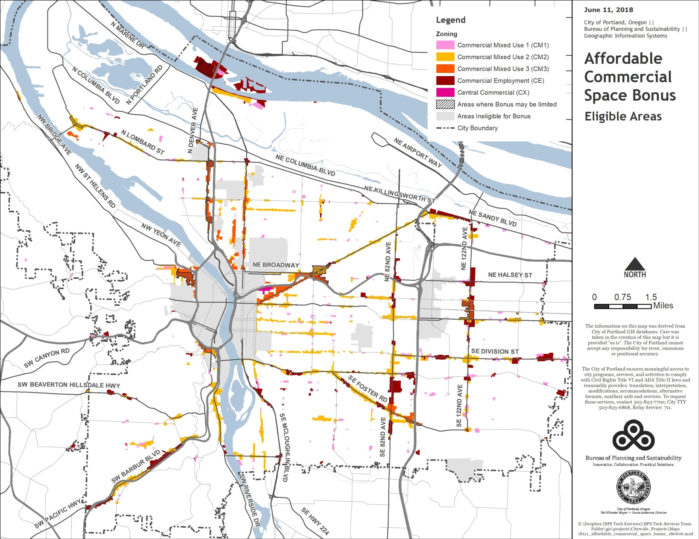
Notes:
The ACS Bonus is available across the City of Portland’s mixed-use zones including – Commercial Mixed Use, Commercial Employment, and Central Commercial.
The bonus is not available in the Central City, in the Gateway plan districts, or in Historic or Conversation districts.

Slide 10
Affordable Commercial Floor Area and Height Bonus Program
OVERVIEW
Not mandatory
Only for projects with 20 or fewer residential units
On-Site Option and Affordable Commercial Fund Option
Projects currently have access to FAR bonus via Inclusionary Housing voluntary fee-in-lieu
Qualified businesses
Long-time local businesses
Women-owned, minority-owned, non-profits that serve underserved communities
Meet financial standards
Notes:
The Affordable Commercial Space Program
Is a voluntary program
Is only in commercial mixed-use zones, outside of the Central City
Is only for projects with 20 or fewer residential units – so it will sit next to the Inclusionary Housing program, giving all projects an opportunity to provide an affordability component on-site.
Developers can currently access the FAR Bonus through the Inclusionary Housing voluntary Fee-in-Lieu
The Affordable spaces will be leased to local business, that are women-owned, minority-owned business, or non-profits that serve underserved communities. And that have financials that pass a Prosper Portland review.

Slide 11
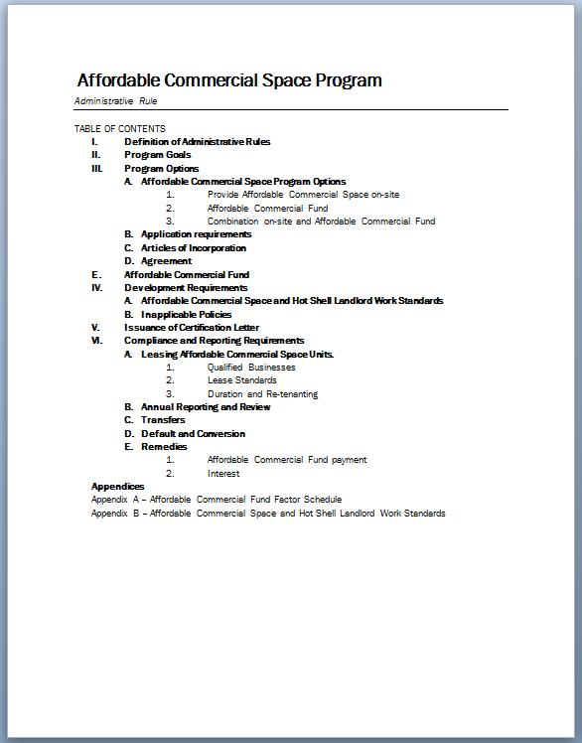
Affordable Commercial Floor Area and Height Bonus Program
ADMINISTRATIVE RULES
Affordable Commercial Space Program Options
On-Site Option
Affordable Commercial Fund Option
Combination Option
Development Requirements
Landlord Work Standards
Leasing Affordable Commercial Space Units
Qualified Businesses
Lease Standards
Duration and Re-tenanting
Notes:
The Administrative Rules define
On-site Option
Payment into the Affordable Commercial Fund Option
Flexibility to combine the two if necessary
The On-site Option requires a high level of tenant improvements (or a “Hot Shell” – instead of a Cold or Warm Shell)
This level of tenant improvements is above and beyond what a landlord would typically buildout
The Hot Shell Landlord Work Standards are the key affordability component, which lowers the barrier of entry to new space for
Locally owned businesses, owned by women, or people of color and for non-profit organizations that serve underserved populations.

Slide 12
On-Site Option
FAR bonus of 2 sq. ft. for each 1 sq. ft. of on-site affordable commercial space provided
Developer provides “Hot Shell” Tenant Improvements
Leasing Requirements
Tenants meet qualifying criteria
10-year duration
Lease terms reviewed
Re-Tenant only with approved tenants
Annual reporting
Remedies
Full payment into Affordable Commercial Fund
Notes:
The On-site Option requires a high level of tenant improvements (or a “Hot Shell” – instead of a Cold or Warm Shell)
This level of tenant improvements is above and beyond what a landlord would typically buildout
The On-Site Option requires the developer to follow the Hot Shell Landlord Work Standards
Has landlord will provide part the buildout they would not typically – including walls, electrical, HVAC, ceiling finish, fees, restrooms, flooring, and signage
Adding a single restroom to a space can be a $30,000 expense for a tenant.
Leasing Requirements
Include leasing to tenants that meet Prosper Portland qualified criteria
A local business that is woman-owned, owned by a person-of-color, or is a non-profit organization that serves underserved communities.
Pass a financial evaluation – deep look that will both drill down if a tenant is in a position to succeed in this space, and if they do not demonstrate financial need.
Business Plan
Profit and loss projections for two years
Two years of historical and personal business tax returns
Year-to-Date project and loss balance sheet
Personal financial statement
In addition Prosper Portland will provide a form lease, and will review leases to ensure that costs are not passed through to a tenant
A building owner will need to re-tenant over the 10 year period with an approved tenant
Remedies
Same compliance rules as the Inclusionary Housing program – require the payment paid in full for non-compliance at any time during the 10 year period.

Slide 13
Affordable Commercial Fund Option
FAR bonus of 1 sq. ft. for each 1 sq. ft. paid into Affordable Commercial Fund
Calculated on Bonus FAR
Mirrors Inclusionary Housing Fee-In-Lieu
Per zoning code, only 50% of maximum FAR bonus is available
Payment proceeds support Prosper Portland Affordable Commercial Framework
Notes:
Affordable Commercial Fund Option
Option available for non-residential buildings and mixed use buildings with fewer than 20 dwelling units.
Fees mirror the Inclusionary Housing Fee-In-Lieus
Fee-In-Lieu is $ per SQFT of FAR while the on-site option is 2 feet of bonus FAR or every 1 foot of Affordable Commercial space
Per zoning code, only 50% of maximum FAR bonus is available through ACS bonus program.
Additional FAR up to available maximums available through IH program.
Payment proceeds support Prosper Portland Affordable Commercial framework.
Any developer who wants to maximize the bonus FAR would pay into both the AC FAR and the IH FAR

Slide 14
Proposed Timeline & Next Steps
 | Coordinate with Bureau of Planning on Sustainability and Bureau of Development Services on implementation of the Affordable Commercial Space Bonus
 | Ongoing evaluation of pilot projects & lessons learned through marketing, tenanting, tenant improvements, and operations
 | Conduct market analysis and outreach to small businesses/business districts to refine approach.
 | Convene an Commercial Affordability Advisory Committee
 | Continue to explore new resources to fund new tools, including securing resources to launch broader technical assistance
 | Report back to Planning and Sustainability Commission
2018
2019

Slide 15
QUESTIONS?

Slide 16
Affordable Commercial Space
Bonus Program
Why 10 years?
Equivalency between the On-Site Option and the Fee-in-Lieu.
Anti-displacement tool – Local, women-owned, minority-owned, financially qualified business can access space while neighborhood is experiencing gentrification pressures.
Longer duration makes on-site option less attractive.
Why tenant improvements instead of reduced rent rate?
New construction space is the most expensive space to buildout.
Reduced rent rate would still leave barriers for tenants to access the space.
Uses of the Affordable Commercial Fund?
Support Prosper Portland Affordable Commercial framework outside of URAs.
Prosperity Improvement Program grants for tenant improvements in existing buildings.
Tenant Improvement loans.
Small business technical assistance including business planning and leasing assistance.
Notes:
Why a 10 year compliance period?
The Fee-in-Lieu is set slightly higher than the value of the FAR.
The value of the FAR equivalent to the cost of the On-Site Tenant improvements
Increase in duration would further drive a developer towards the Fee-in-Lieu option
The FAR Bonus will only be used by developers when it has value. The FAR will have value at the same time the neighborhood is feeling redevelopment and gentrification pressures.
The Affordable Commercial Bonus Program is an anti-displacement tool that will allow Local, women-owned, minority-owned, financially qualified business can access space and participate as a neighborhood is transitions
Why tenant improvements instead of reduced rent rate?
New construction space is the most expensive space to buildout.
Reduced rent rate would still leave barriers for tenants to access the space.
Uses of the Fee-in-Lieu Funds?
Support Prosper Portland Affordable Commercial framework outside of URAs.
Prosperity Improvement Program grants for tenant improvements in existing buildings.
Tenant Improvement loans.
Small business technical assistance including business planning and leasing assistance.

Slide 17
Stakeholder Advisory Committee
Stakeholder Advisory Committee
Teresa St Martin | Planning and Sustainability Commission, Windermere / EcoBroker
Andre Baugh | Planning and Sustainability Commission, Consultant, Groups AGB Ltd
Chris Smith | Planning and Sustainability Commission, Interactive Marketing, Xerox
Eric Cress | Urban Development Partners
Sara Daley | Kidder Matthews
Michael DeMarco | Our 42nd Avenue
Lauren Golden Jones | Capstone Partners
Charlotte Larson | Urban Works Real Estate
Jessy Ledesma | Beam Development
Mingus Maps | Historic Parkrose
Heather Hoell | Venture Portland
Michael Burch | Equitable Contracting & Purchasing Commission / Northwest Regional Council of Carpenters
Khanh Le | The Main Street Alliance of Oregon
Sam Brooks | Oregon Association of Minority Entrepreneurs
City of Portland Staff
Robert Fraley | City of Portland Bureau of Development Services
Kristin Cooper | City of Portland Bureau of Development Services
Barry Manning | City of Portland Bureau of Planning & Sustainability
Tyler Bump | City of Portland Bureau of Planning & Sustainability
Justin Douglas | Prosper Portland
Geraldene Moyle | Prosper Portland
Alison Wicks | Prosper Portland
Kyra Straussman | Prosper Portland
Notes:
Use this time to Thank the members of the Stakeholder Advisory Committee and the members of the Planning and Sustainability Commission
Who worked with staff and the Johnson Economics consultant team
Who volunteered their time to build this program from zoning code language to and Administrative Rule
The committee consisted of PSC members, brokers, business district managers, and developers

