Slide 1
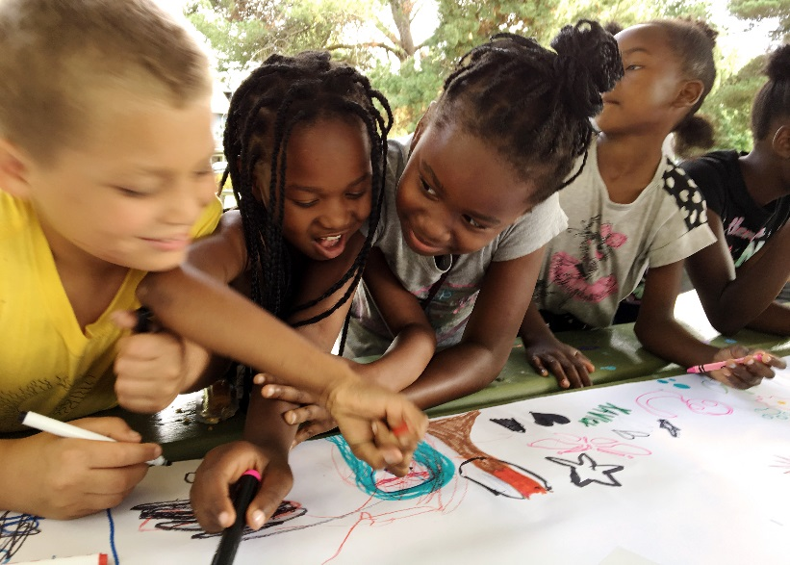
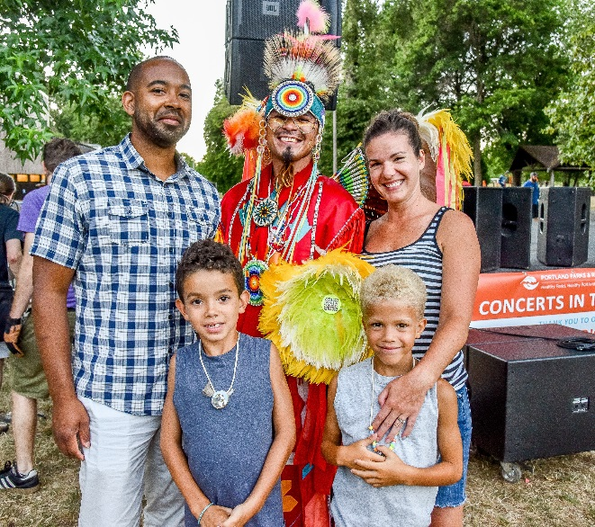
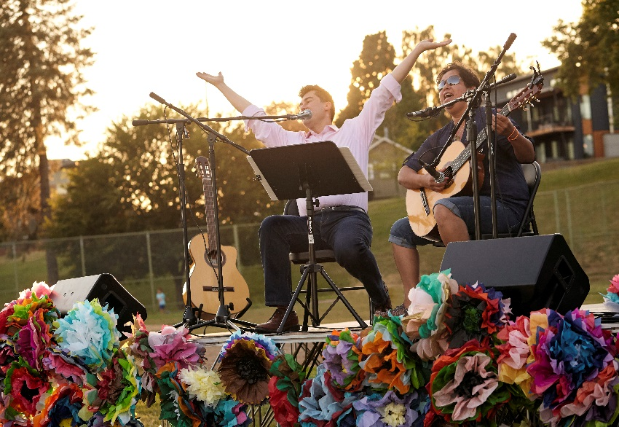
SUMMER FREE FOR ALL 2018
June 20, 2018
Eileen Argentina, Recreation Services Manager
Soo Pak, Arts, Culture & Special Events Manager | Kellie Torres, Development Manager
Notes:
OPTIONS FOR COMMISSIONER FRITZ REMARKS:
[FUN!]
Summer Free For All kicks off my favorite time of year! Today we’ll highlight some of last year’s accomplishments and preview Summer Free For All 2018.
With live music representing the cultural diversity of Portland, family-friendly movies, free lunches for kids, as well as arts & crafts and sports & games, there is something FREE and FUN for everyone in our parks this summer.
[PARTNERSHIP]
Partnership is at the heart of the program. This year we are partnering with 49 community groups including neighborhood associations, culturally-specific communities and nonprofits to bring you 65 movies and concerts across the City.
While blockbuster hit movies or joyful concerts in your park make for some of the most memorable moments, providing free lunches for kids is one of the most important things we do at Summer Free For All.
We’ll serve more than 100,000 lunches at 25 different sites this summer, which makes a real difference to the kids and families most in need. And it wouldn’t be possible without the partnership of our five local school districts, Meals on Wheels, Urban Gleaners, and Oregon Food Bank, whom we thank for your collaboration.
Now I’d like to turn it over to Parks Recreation Services Manager, Eileen Argentina. Welcome, Eileen.
(EILEEN)
Thank you, Commissioner Fritz. Mayor, Commissioners. I am joined today by Soo Pak, Arts, Culture & Special Events Manager, and Kellie Torres, Development Manager.
(EILEEN TO CONTINUE ON NEXT SLIDE)

Slide 2
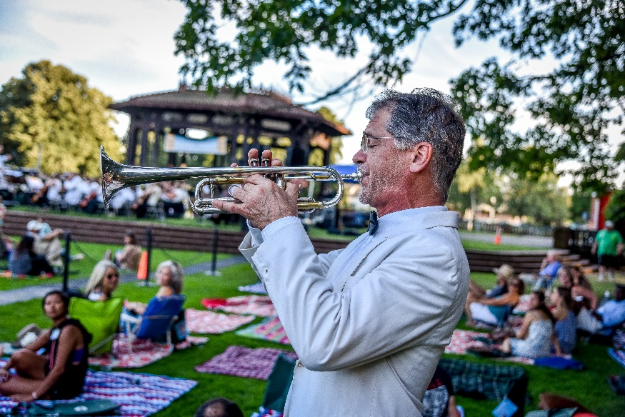
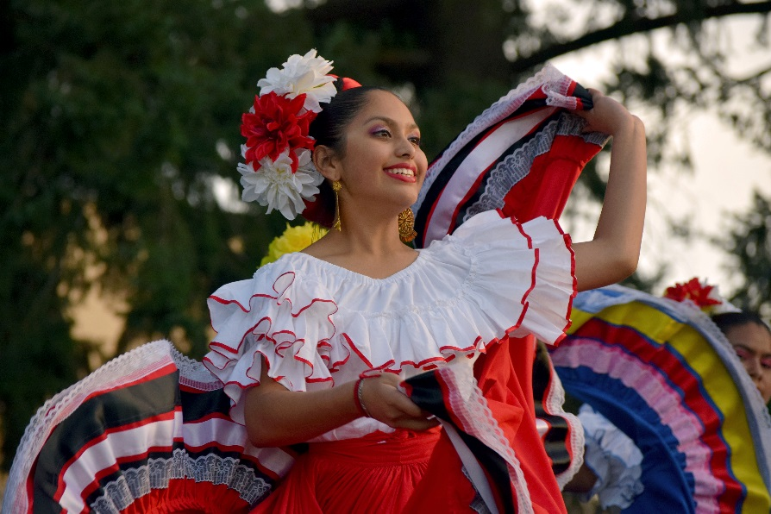
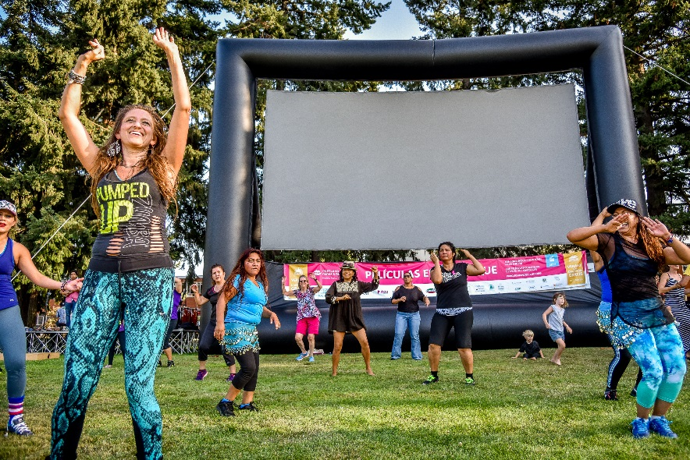
Serving Community Need
Notes:
(EILEEN)
[SERVING COMMUNITY NEED]
In 2017, Portland Parks & Recreation conducted a Community Needs Survey. The 2003 participants who responded were statistically representative of Portland, both by neighborhood coalition and by race/ethnicity. When participants were asked to rate the importance of recreation programs, outdoor arts and culture events ranked the highest with an average score of 3.8 out of five.
So we thank Council for the $500,000 General Fund support for this beloved program.
With the cost of living rapidly rising, these community gatherings for free events are all the more important to the City’s livability and to families that may not have access otherwise.
[RISING COSTS]
Minimum wage increases now through 2022 will improve livability. But these increases significantly impact Summer Free For All’s operating budget, which has gone from $850,000 last year to $1.1 million this year—a 29% increase— largely due to accelerated minimum wage increases and newly represented seasonal staff.

Slide 3
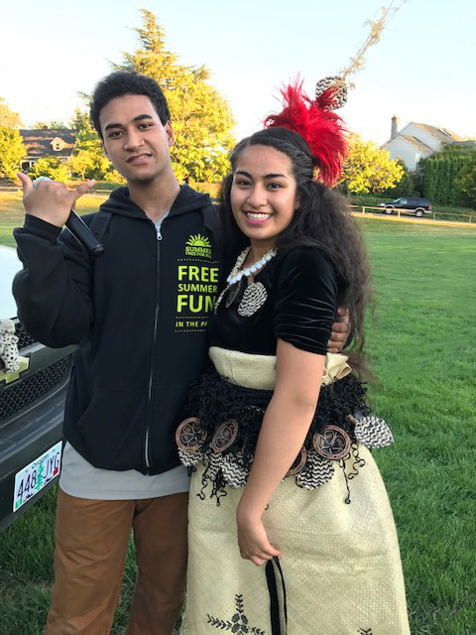
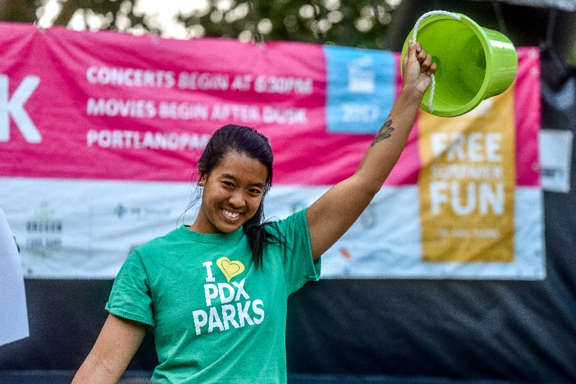
Reflecting Community
Notes:
(EILEEN)
[EQUITY]
Not only are free outdoor arts & culture programs in high demand among Portlanders, Summer Free For All is an important program advancing the City of Portland and PP&R’s Racial Equity Goals.
This summer, we’ll provide job opportunities for 110 Portlanders, including youth, and hire 315 local performing artists. As a citywide program, we are ensuring that Summer Free For All staff reflect the communities and kids we serve. This year, 50% of seasonal staff supporting the movie and concert events are people of color and 39% of Free Lunch + Play program staff speak a second language.
As you can see in the SFFA guides in the packets in front of you, the program lineup reflects our city’s rich and diverse cultures and communities.
We have also forged new partnerships this year to increase access and engagement with communities of color and immigrants and refugees. And as always, the guides are produced in 9 different languages to provide the greatest access.
So we thank you again for your continued investment in Summer Free For All and the important service it provides to the community.
And now Soo Pak, Arts, Culture and Special Events Manager will tell you more about our new partnerships.
( TRANSITION TO SOO )

Slide 4
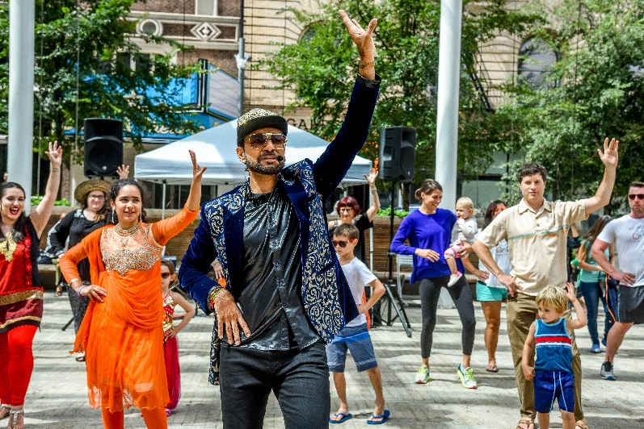
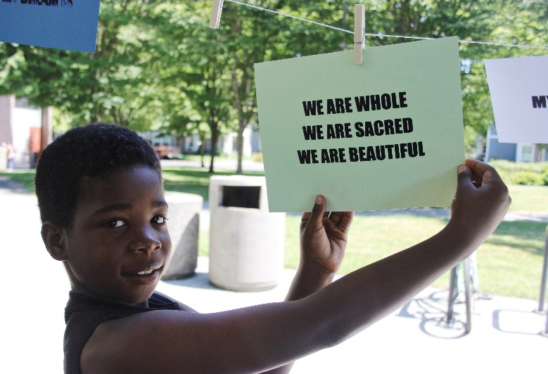
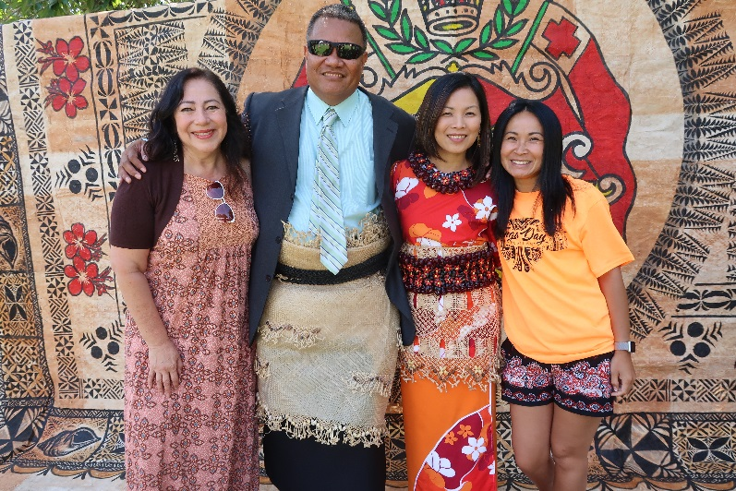
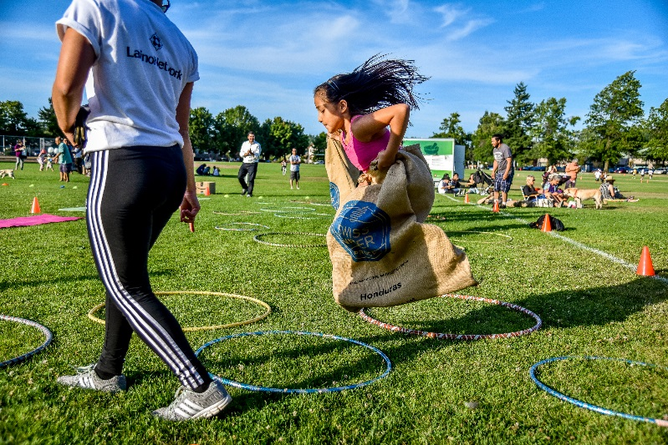
Community Partners
Notes:
(SOO)
Thank you, Eileen. Good morning, Mayor and Commissioners.
[NEW PARTNERSHIPS]
The mission of Summer Free For All is to build community and to celebrate Portland’s diversity.
Our movie and concert events are organized in partnership with community partners. Each partner group hosts an event—choosing their park location, selecting the movies and musical talent, and bringing people together from their community.
Historically, Summer Free For All’s community partnerships have been defined by geography with the majority of our partners being neighborhood associations and groups. As Portland gentrifies and communities are displaced—with the greatest impact on people of color and immigrants and refugees—we have actively worked to expand the definition of community to include culturally-specific and identity-based groups that span a citywide geography.
Some of our new community partners this year include:
APANO (Asian Pacific American Network of Oregon) – hosting a film in English and Vietnamese at Harrison Park as part of their annual Mic Check! Cultural Event Series.
Black Parent Initiative – hosting the Dawson Park concert series
Bollywood Dreams – hosting our first Bollywood movie in Hindi and English at Laurelhurst Park, in celebration of India’s Independence Day.
The Tongan Community – hosting the movie Moana as part of Tonga Day 2018 at the new Gateway Discovery Park.
And the artist collective Young Gifted and Brown or YGB Portland – hosting Black Panther at Lents Park
And our ongoing partnership with Latino Network continues, with the 4th annual Festival Latino, featuring the movie Coco in Spanish with English subtitles at the new Cully Park, built in partnership with Verde.
(SOO TO CONTINUE ON NEXT SLIDE)

Slide 5
Mobile Play: Equity in Practice
Bellrose Station Apartments
Centennial Community Association
East Portland Neighborhood Organization
Hazelwood Neighborhood Association
Human Solutions
Impact NW
Latino Learning Community
New Portlanders Program
Portland Parks & Recreation
ROSE Community Development
Russian Speaking Community Leaders Network
Notes:
(SOO)
[MOBILE PLAY AS PARTNERSHIP MODEL]
Our Free Lunch + Play program is sited in neighborhoods where more than 50% of kids qualify for free or reduced lunches. This summer we are pleased to add an additional Monday through Friday lunch site at the new Luuwit View Park. And in East Portland in areas without parks, we have the Mobile Play program, with staff traveling to apartment complexes, providing fun activities and positive social engagement to kids most in need.
This program is community driven and evolves each year with decisions being made in collaboration with an advisory committee made up of partners listed on the screen. This group was honored to receive the “Equity in Practice” Award at the 2017 Spirit of Portland Awards.
Partnership is critical to advancing Portland Parks equity goals and we are proud of Summer Free For All’s commitment and efforts in this area.
And now Kellie Torres, Development Manager will share how we are leveraging General Fund dollars to make Summer Free For All possible.
(TRANSITION TO KELLIE)

Slide 6
2018 Summer Free For All Budget $2.5M Cash & In-Kind Contributions
Hundreds of free activities at 64 sites
Notes:
(KELLIE)
Thank you, Eileen and Soo, for highlighting the many positive aspects of Summer Free For All. Sharing our diverse and impactful program options with potential sponsors in 2018 has been a privilege. Our team has the confidence to fully deliver our mission, and the results of that confidence are tangible.
From a development standpoint, the idea of “cultivating community” encouraged many sponsors, grantors, and individuals to lean in a bit more this year. We also acknowledge our philanthropic partner, the Portland Parks Foundation, and the dozens of community members who have been raising funds.
For every general fund dollar designated to Summer Free For All—we leveraged $.65 in cash and $3.27 in in-kind program support.
I would like to draw your focus to the sponsor page in our Summer Free For All guide—to highlight the commitment of local business contributors, such as Collage—an arts and crafts business with storefronts in three Portland neighborhoods. Maria, the owner of Collage, is here today with inspired crafts—like the ones she and her team encourage families to create at each and every summer concert. And we also want to feature Elmer’s Restaurant, whose local owners—in their own words—“love supporting programs that allow families to enjoy time together making memories.” Both are LOCAL businesses, and both are NEW Premier Sponsors.
We would also like you to notice the foundational support of Program Partners at the base of this page. These partners represent school districts, arts organizations, local non-profits, and corporations—all of whom fill the gap to provide critical services throughout the summer.
And now, Eileen Argentina will introduce our invited guests.
(TRANSITION TO EILEEN)
<SOO AND KELLIE LEAVE THE TABLE AND TAKE SEATS IN AUDIENCE>

Slide 7
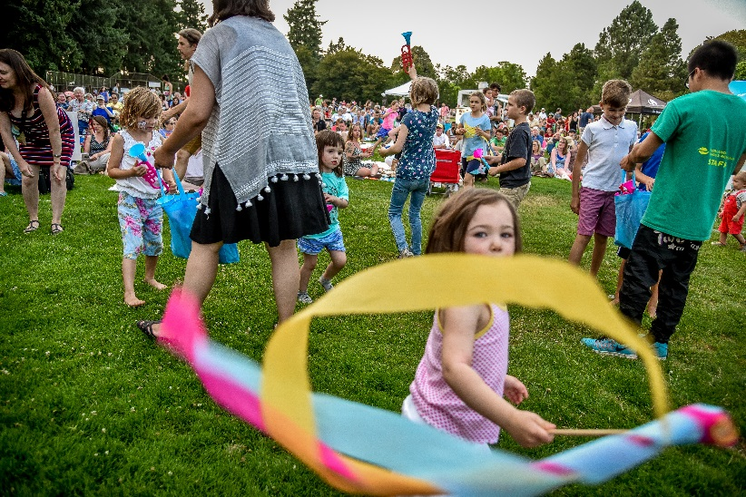
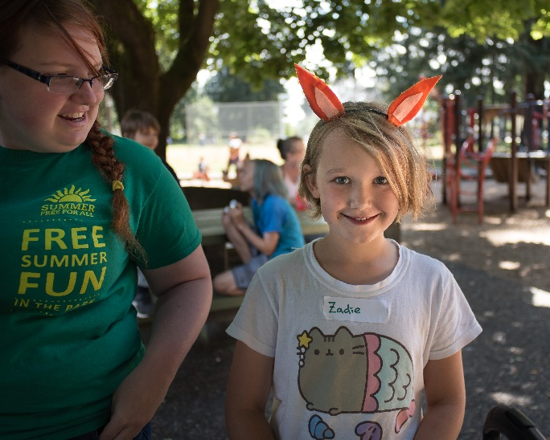
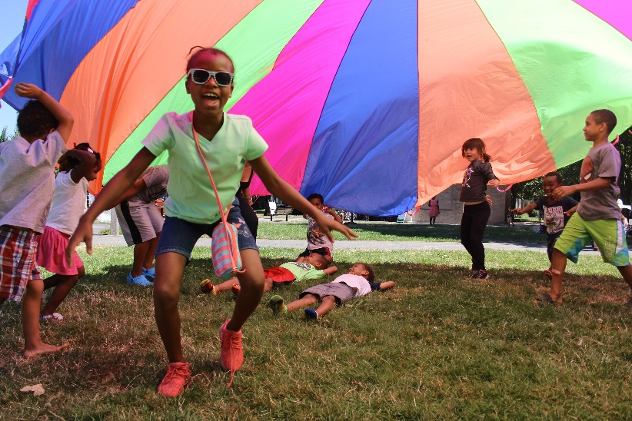
Notes:
(EILEEN)
Community Partnerships have become the heartbeat of Summer Free For All, and I am proud to introduce three community partners, to share their heart-felt testimony today.
First, I’d like to introduce Jill Ramos, Vice President of Elmer’s Restaurants.
<JILL TAKES SEAT AT TABLE NEXT TO EILEEN>
<JILL PROVIDES TESTIMONY>
Thank you, Jill.
<JILL LEAVES TABLE>
Next I’d like to introduce Maria Raleigh, owner of Collage.
<MARIA TAKES SEAT AT TABLE NEXT TO EILEEN>
<MARIA PROVIDES TESTIMONY>
Thank you, Maria.
<MARIA LEAVES TABLE>
Our final invited speaker today is Kolini Fusitu’a, Program Coordinator at Asian Family Services, a leader in the Tongan Community and a member of the Tonga Day 2018 Executive Committee.
<KOLINI TAKES SEAT AT TABLE NEXT TO EILEEN>
<KOLINI PROVIDES TESTIMONY>
*Personal Introduction
*Involvement with Summer Free For All 2017 – through the artists performing at Movies in the Park (MosiMosi Koula)
*Involvement with Summer Free For All 2018 – through the Tonga Day 2018 event at Gateway Discovery Park. Showing the film Moana.
*Importance of free outdoor arts & culture events to immigrant and refugee communities – specifically to community health and wellbeing.
Thank you, Kolini.
<KOLINI LEAVES TABLE>
<SOO AND KELLIE RETURN TO SEATS AT TABLE NEXT TO EILEEN>
Mayor and Commissioners, thank you for the opportunity to report on the 2018 Summer Free For All program. We’re excited about another amazing summer ahead in Portland’s fabulous parks system. Now, we’d like to open it up to your questions and comments.

