Slide 1
Southwest Corridor Plan Update
Portland Historic Landmarks Commission
June 11, 2018

Slide 2
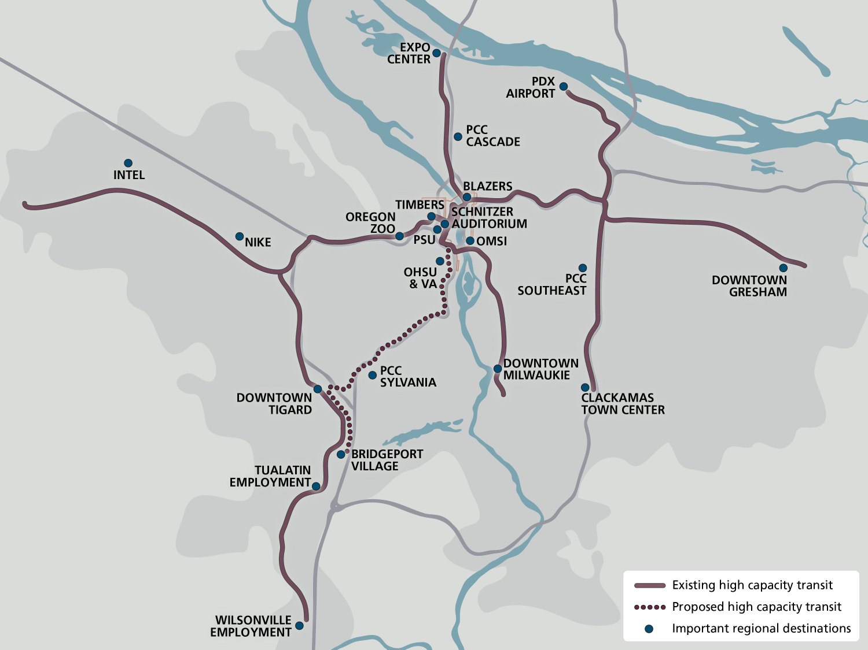
Notes:
Over 600,000 new residents in urban growth boundary
Similar to 6 new cities the size of Hillsboro

Slide 3
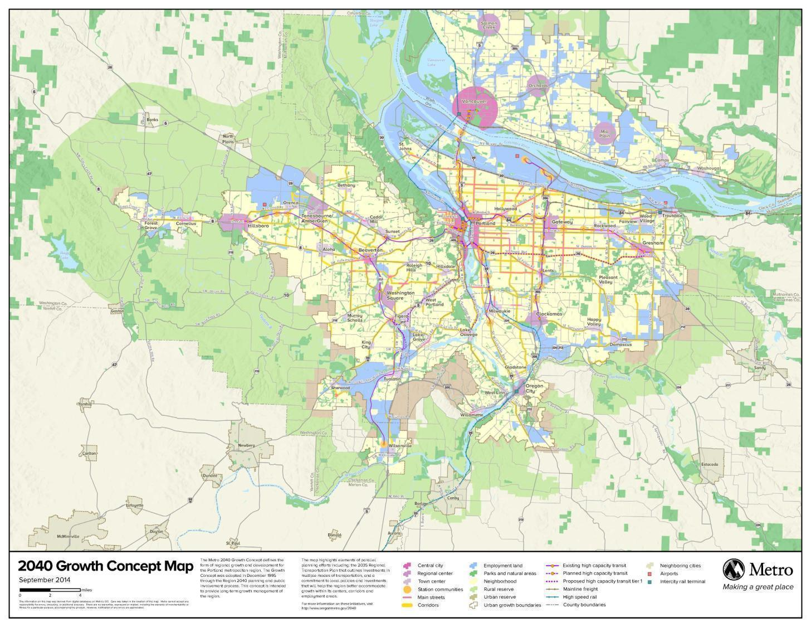
2040 Growth Concept

Slide 4
Notes:
Why the Southwest Corridor?
And lot more people are coming here. Communities in the corridor are making plans to handle this growth and keep up with the transportation demand it creates.
More transportation investments will be crucial to their success.

Slide 5
Notes:
The Southwest Corridor is a place of work. And the vast majority of people who work there commute from other cities.
As you know well, 93 percent of workers in Tualatin live outside of Tualatin
The Southwest Corridor Plan would build light rail and other projects to help workers get to the job and home again on time.
Projections show that by 2035 there could be more than 255,000 people working in the corridor. Supporting our economy means making sure people can get to work and products can move.

Slide 6
Notes:
The Interstate 5 and Barbur Blvd. corridor between Portland and Tualatin is one of the fastest growing and most congested in the State.
And as the area's jobs and population continue to grow, it is going to get worse.
Fortunately, light rail in the corridor could carry almost a quarter of peak hour, peak direction Interstate 5 commuters south of downtown Portland.
Over 46,000 students attend universities and colleges in the corridor (TriMet generated)
TriMet estimates that project design and construction would create over 23,000 jobs in the region.

Slide 7
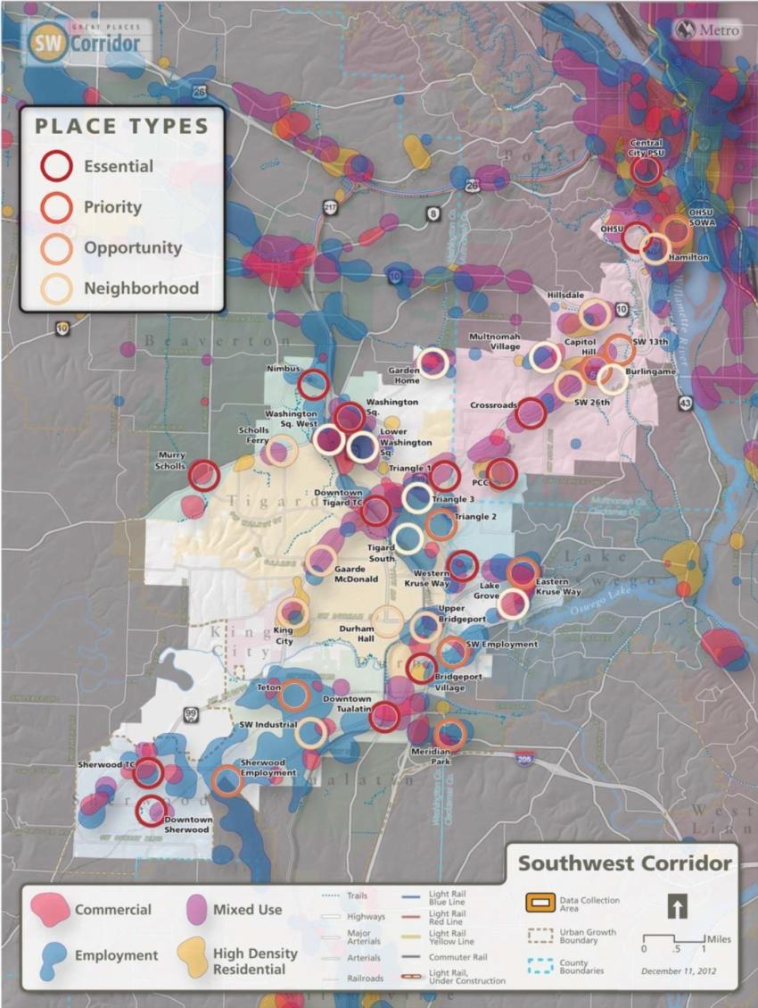
We started with land use to connect to places
Notes:
Barbur Concept Plan
Tigard High Capacity Transit Land Use Plan and Downtown Vision
Linking Tualatin

Slide 8
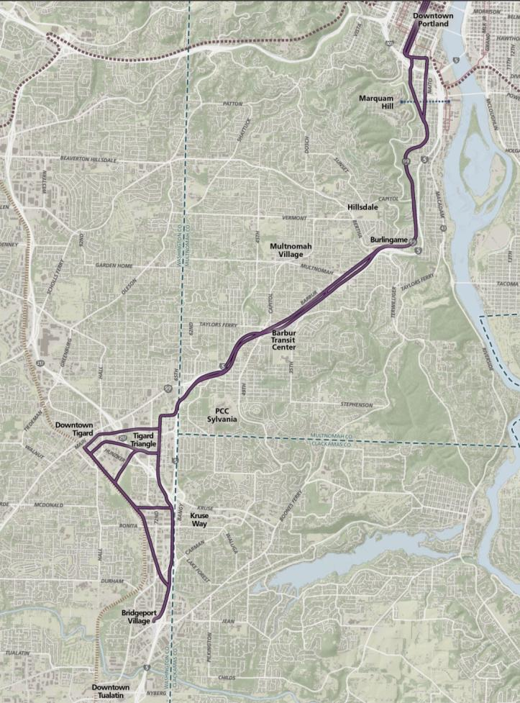
Downtown Portland
OHSU
Hillsdale / Burlingame
Barbur Transit Center
PCC Sylvania
Tigard Triangle +
Downtown
Bridgeport Village
Notes:
Route: Portland State University to Bridgeport Village in Tualatin via Tigard
Length: 12 miles (8 in Portland)
New stations: 12 or 13 (7 in Portland)
Parking: up to 7 park-and-rides (2 in Portland) with 2,000 to 3,600 spaces
Time: 30 minutes from PSU to Bridgeport

Slide 9
What’s included?
new walk and bike connector between Barbur and Marquam Hill
2-mile shared transitway (for buses and light rail) to allow buses to bypass traffic congestion in South Portland
shuttle between PCC-Sylvania and nearby stations
Continuous sidewalks on Barbur Boulevard, and protected bike lanes where LRT is in Barbur

Slide 10
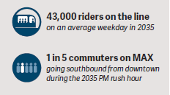
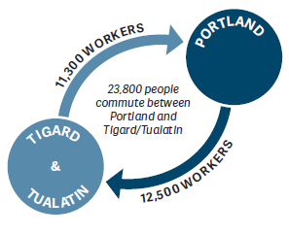
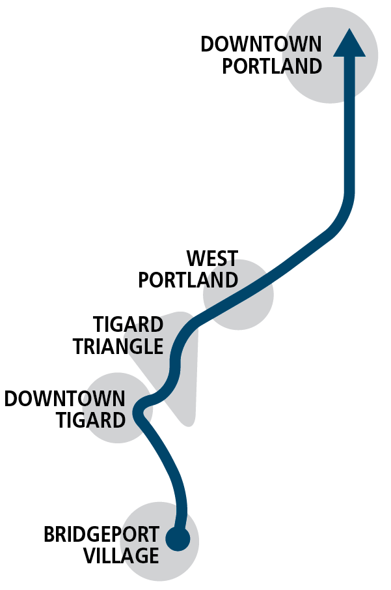
Project Benefits
Climate action goals
Infill TOD in regional town centers

Slide 11
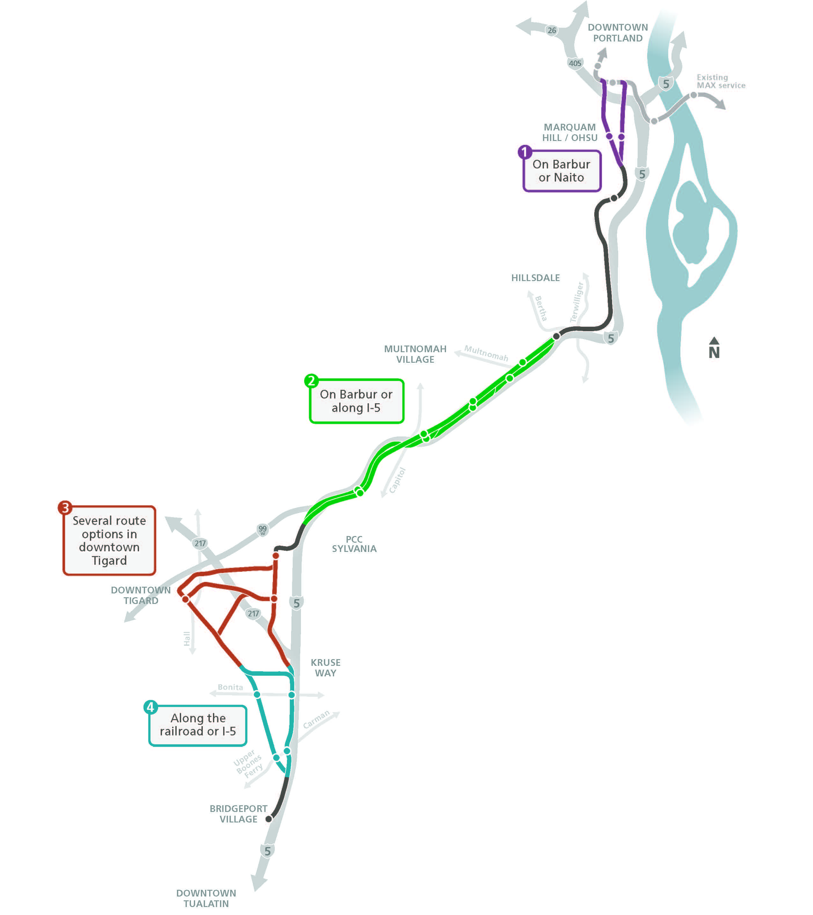
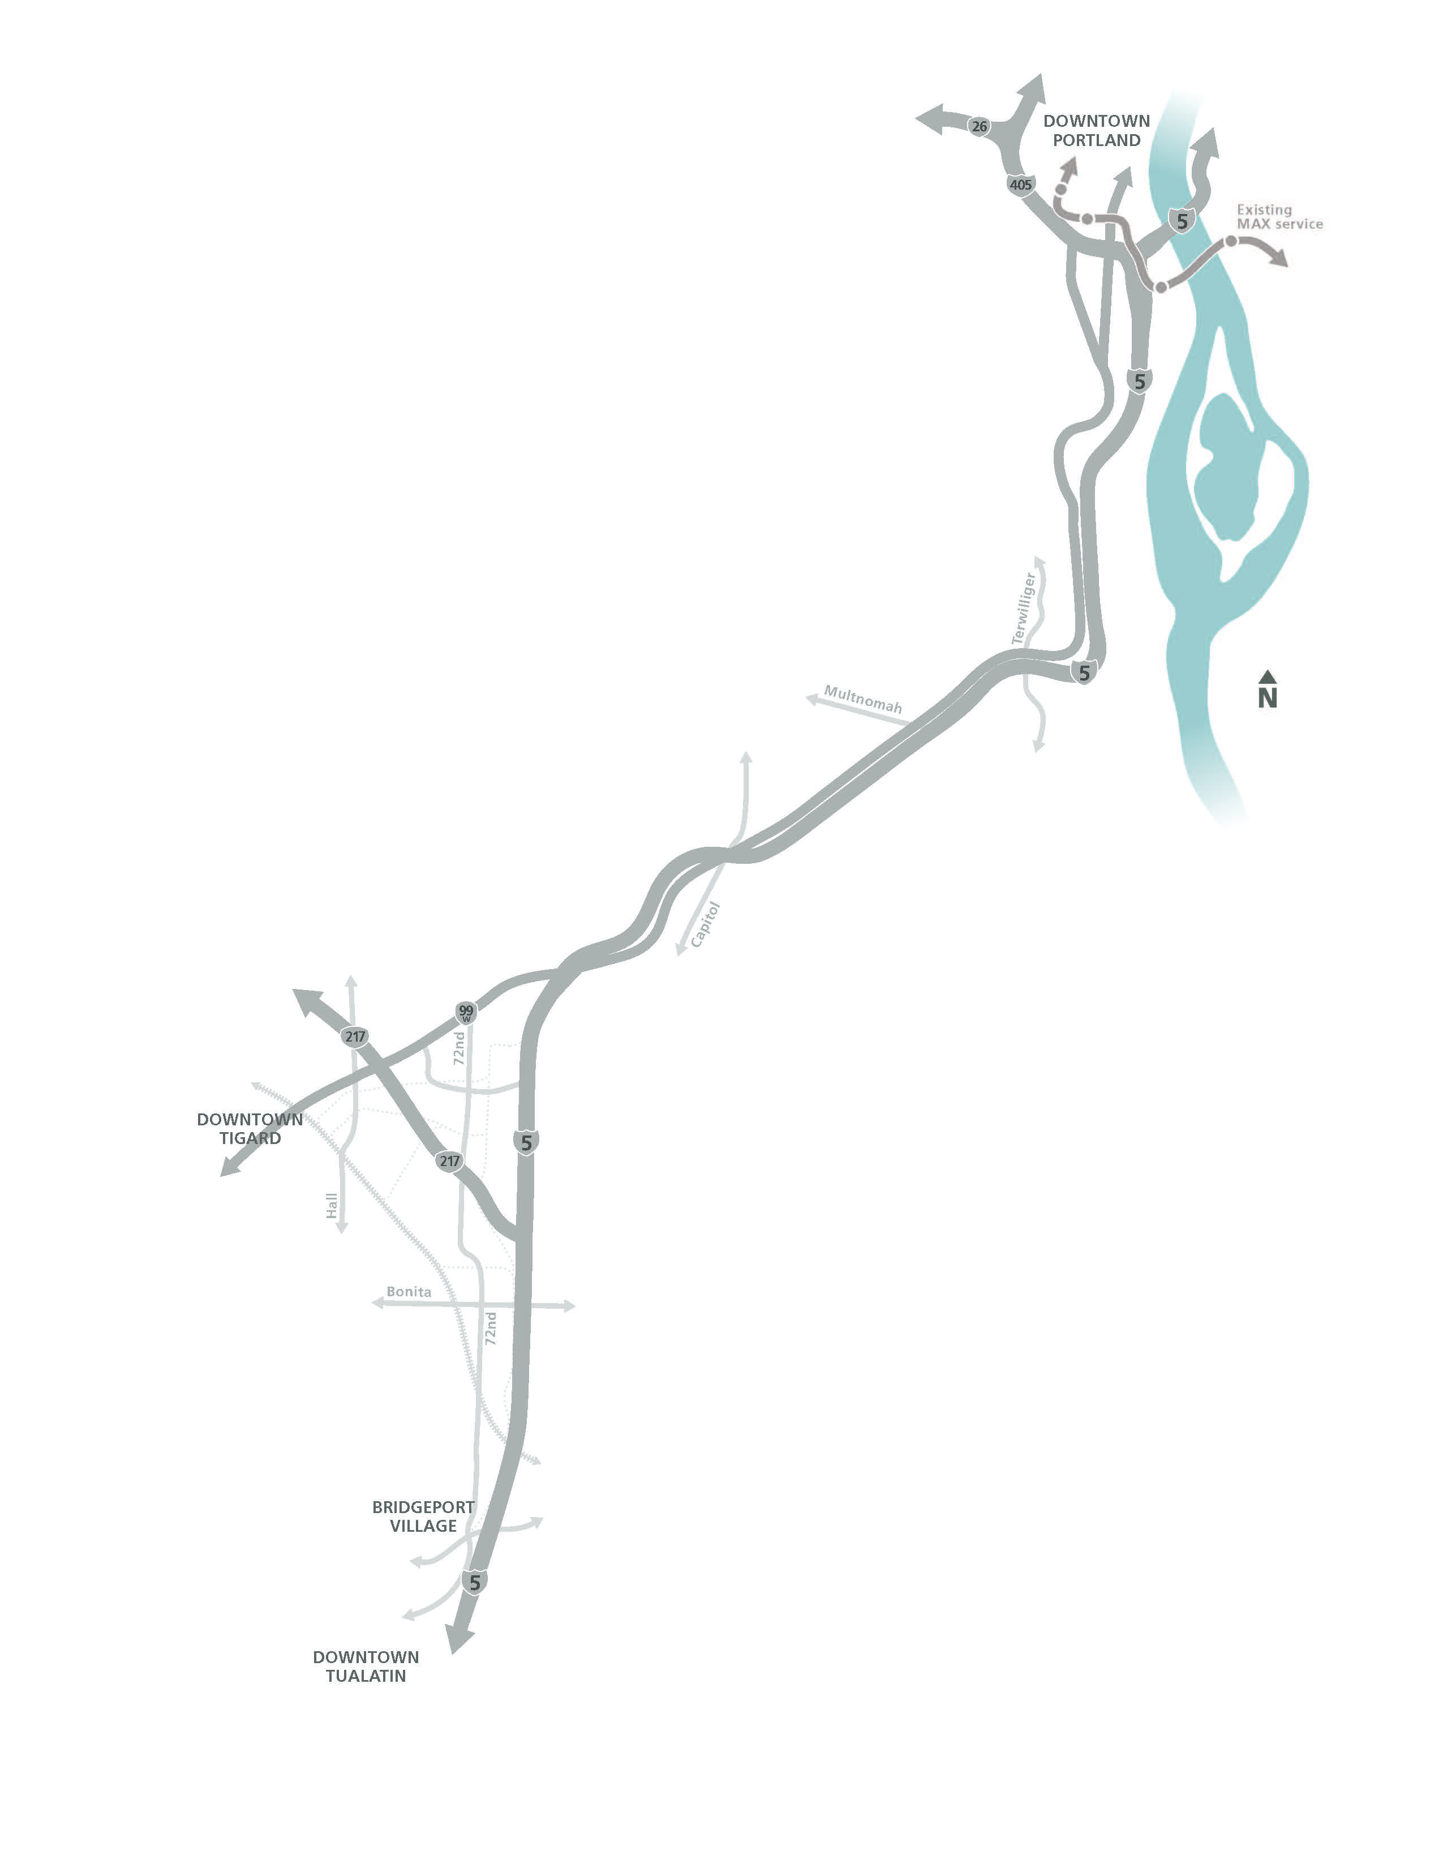
Major route decisions
Steering Committee narrowed from 60+ route options
Light rail selected over bus rapid transit
Portland
Tigard
Tualatin
Notes:
ERYN

Slide 12
Overall route Initial route proposal
Through route
Better connectivity between Tigard and Tualatin
Better transit service for Downtown Tigard
Lower operating cost
More cost-effective and reliable operations
Notes:
Initial partner staff suggestion for the light rail route (shared in March)
Required for DEIS
NOT the Locally Preferred Alternative
Includes modifications to avoid/minimize impacts to housing, business, and cost identified in DEIS
Will be further studied in Final EIS

Slide 13
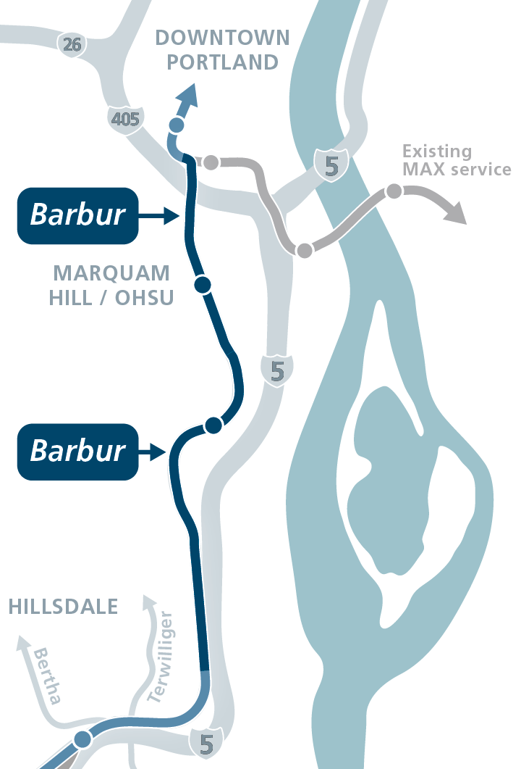
South Portland Initial route proposal
Barbur
Shorter connection to Marquam Hill
Faster travel time
Fewer property impacts (historic, residential, business)
Ross Island Bridgehead improvements necessary

Slide 14
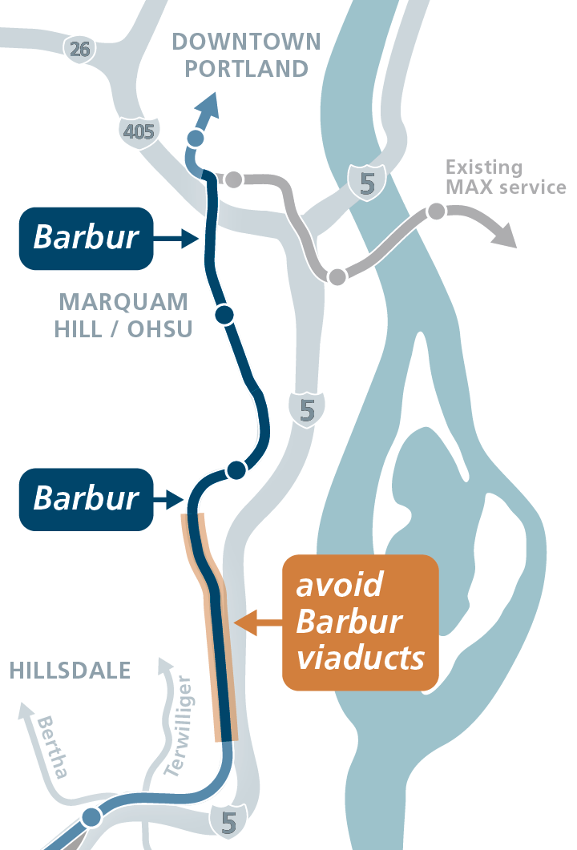
South Portland Suggested modification
Avoid Barbur viaducts
Reduce construction impacts
Avoid historic and park impacts
Reduce cost

Slide 15
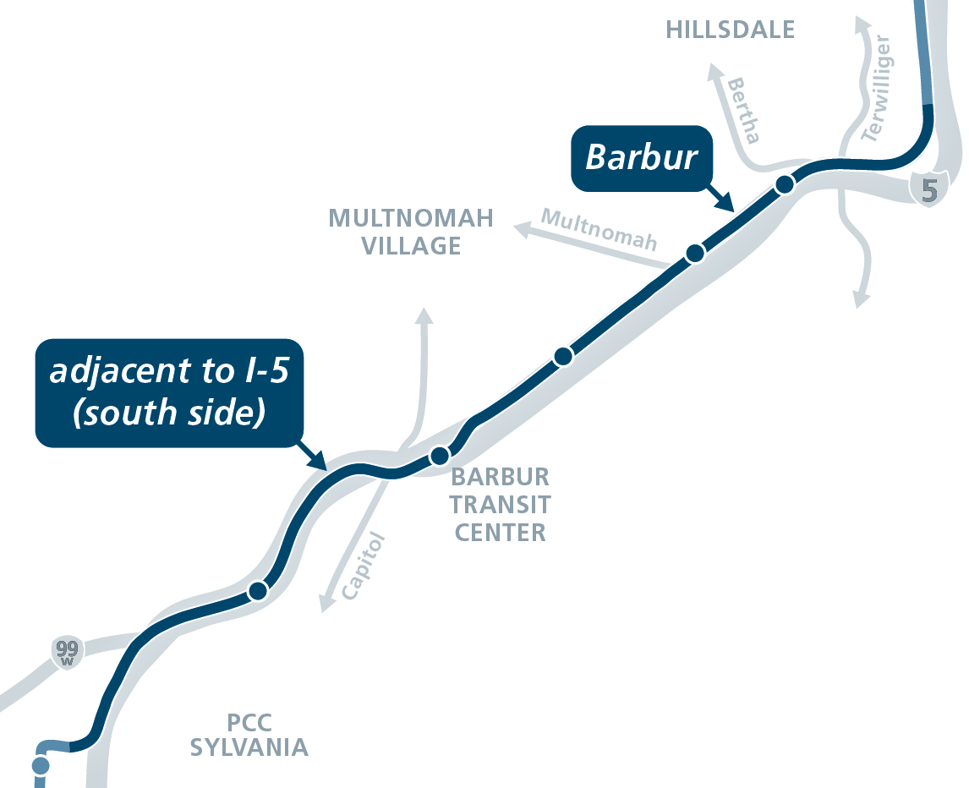
Hillsdale to Tigard Triangle Initial route proposal
Barbur to I-5 at transit center
More accessible & visible stations
More safety improvements on Barbur
Fewer residential displacements
Avoids complex I-5 bridge reconstruction

Slide 16
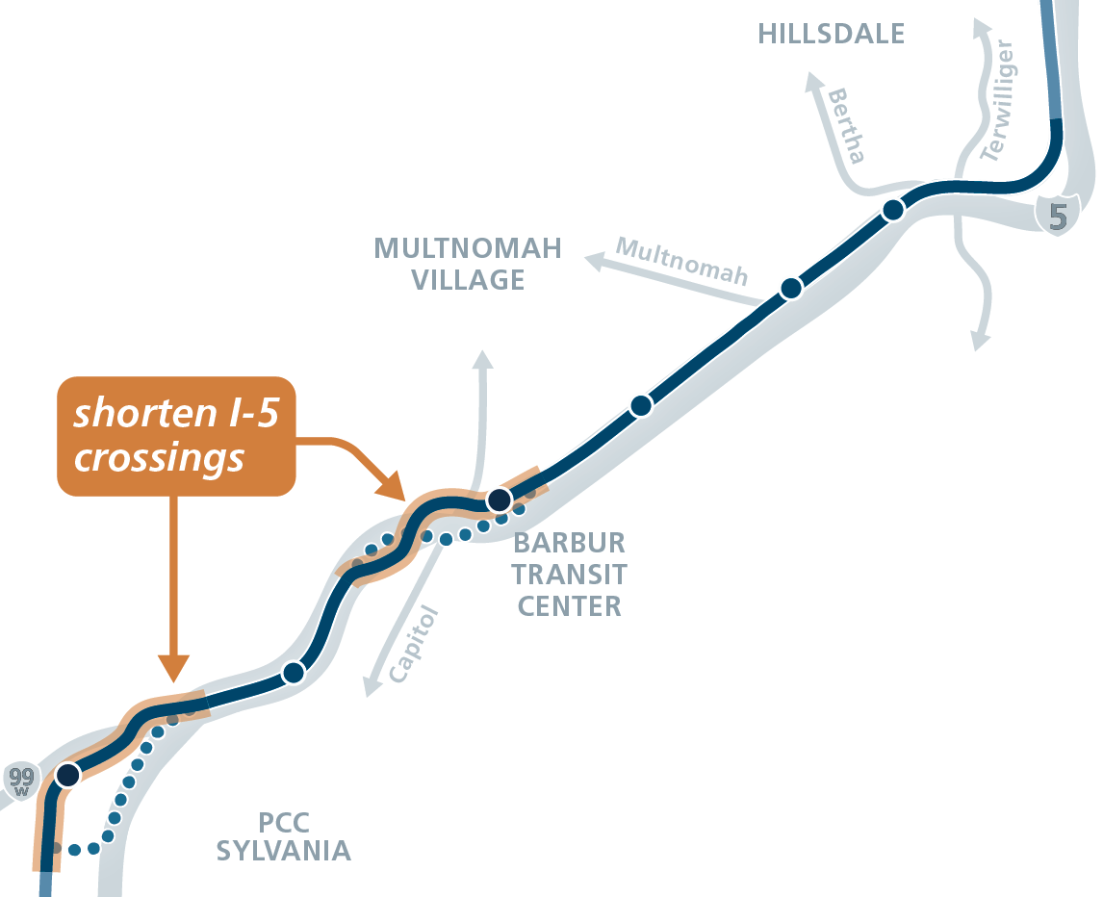
Hillsdale to Tigard Triangle Suggested modifications
Shorten I-5 crossings
Reduce visual impacts
Reduce construction impacts
Reduce cost
Allows for a station on 68th near 99W

Slide 17
NEPA process
Help decision makers understand environmental consequences
Inform public of potential impacts
Identify actions to protect, restore and enhance the environment
Consult with relevant agencies
Become eligible for federal funds

Slide 18
Draft EIS
Disclosure document, intended to be neutral
Compares Project to No Project
Analysis and findings generally at “segment” level
Identifies potentially significant impacts and ways to mitigate
Based on frozen 5% designs
Not a permitting document

Slide 19
Impact Reduction
NEPA compels the project to
Avoid (preferred)
Minimize
Otherwise mitigate
Section 106 has its own process in addition to NEPA
Full acquisition of an eligible resource will trigger Section 4(f)

Slide 20
Historic Resources
Consulted with SHPO on methods
Evaluated within 50 feet of anticipated construction footprint
Identified potentially eligible historic resources (NHRP or recognized local)
584 structures reviewed and documented
After selection of Preferred Alternative
Section 106 public engagement
Determinations of eligibility
Notes:
NHRP = National Register of Historic Places
Any parcel or historic property that is intersected by the APE will be evaluated, including historic districts and parks
Only those historic resources that are listed in the NRHP, are potentially eligible properties for listing in the NRHP based on recommendations, or have recognized local significance are considered to be historic properties
Review found 144 historic resources that are either listed in or are considered potentially eligible

Slide 21
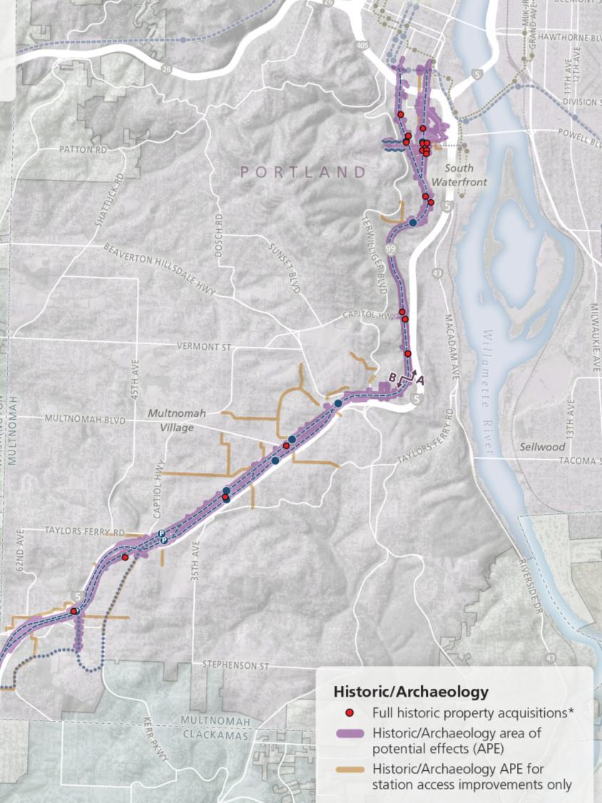
Notes:
All of the NRHP‐listed properties in the APE are located in Segment A, which includes one of Portland’s oldest neighborhoods (Lair Hill), although potentially eligible properties exist in each segment.

Slide 22
Historic Impacts
Segment A (PSU to Terwilliger)
 | Full Acquisition | Partial | Easement
A1 Barbur | 5 | 18 | 10
A2 Naito Bridgehead | 7 | 20 | 25
A2 Naito Limited Access | 15 | 13 | 8
Segment B (Terwilliger to Tigard)
 | Full Acquisition | Partial | Easement
B1 Barbur | 5 | 5 | 1
B2 I-5 from BTC to Tigard | 4 | 3 | 1
B3 I-5 from 26th to Tigard | 3 | 4 | 0
B4 I-5 from Custer to Tigard | 2 | 3 | 0
Notes:
In Segment A, there are 5 properties that all options would impact (3 by LRT, 2 by Marquam Hill connection).
Of the A2-LA full acquisitions, 7 are to properties contributing to the South Portland Historic District

Slide 23
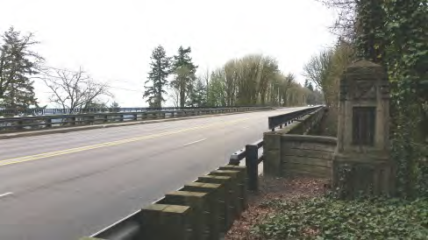
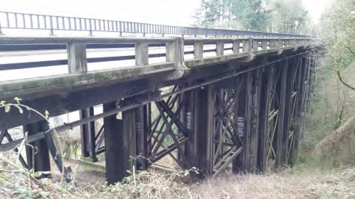
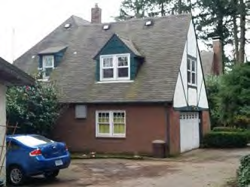
Seg A full acquisitions
All 3 options would impact…
Newbury and Vermont viaducts
5910 SW Ralston Dr

Slide 24
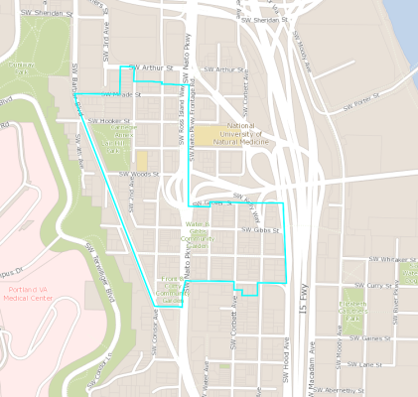
South Portland Hist. Dist.
APE contains 75 contributing properties
A1 would fully acquire 2
A2-BH would full acquire 3 plus 1 additional listed NRHP property
A2-LA would fully acquire 7 plus the 1 listed property

Slide 25
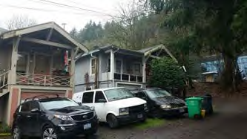
A1 full acquisitions (inner Barbur)
3124 SW Barbur Blvd
(contributing resource)
338 SW Meade St
(contributing resource)

Slide 26
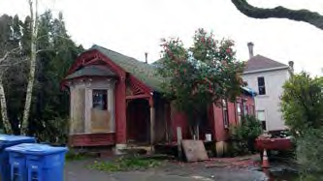
A2-BH full acquisitions (inner Naito with bridgehead)
018 SW Grover
(contributing resource)
015 SW Gibbs
(contributing resource)
017 SW Whitaker
(contributing resource)

Slide 27
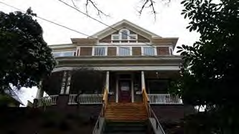
A2-BH full acquisitions (inner Naito with Bridgehead)
4133 SW Corbett
Jewish Shelter House
LISTED

Slide 28
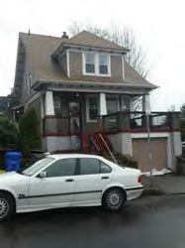
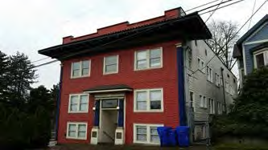
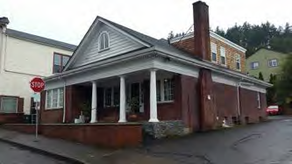
A2-LA full acquisitions (inner Naito with limited access)
25 SW Woods
(contributing resource)
16 SW Porter
(contributing resource)
3323 SW Naito
(contributing resource)

Slide 29
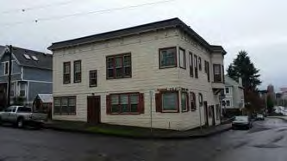
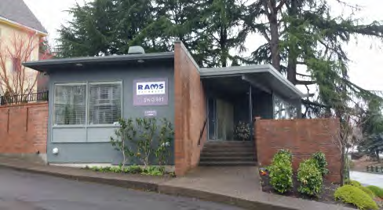
A2-LA full acquisitions (inner Naito with limited access)
5 SW Whitaker
(contributing resource)
11 SW Gibbs
022 SW Lowell

Slide 30
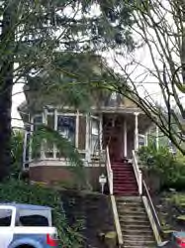
A2-LA full acquisitions (inner Naito with limited access)
4145 SW Corbett
4205 SW Corbett
Plus same full acquisitions as option A2-BH

Slide 31
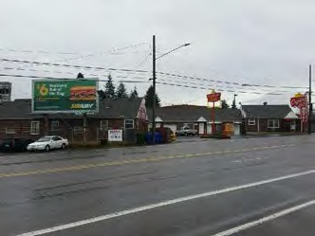
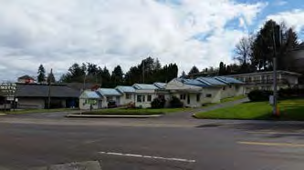
Seg B (outer Barbur) full acquisitions
Capitol Hill Motel
9110 SW Barbur
By options B1 and B2
Stash's Hollywood Motel /
Antler Motel / Ranch Inn
10138 SW Barbur
By option B1

Slide 32
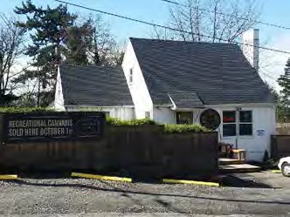
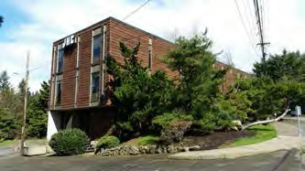
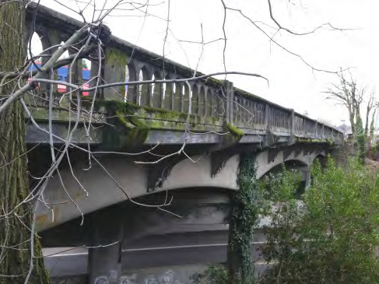
Seg B (outer Barbur) full acquisitions
5350 SW Pasadena
By all options
11125 SW Barbur
By all options
Barbur Bridge over Multnomah
By options B1, B2 and B3

Slide 33
Marquam Hill options
Elevator / bridge options
Elevator/Bridge and Path
Elevator/Bridge and Recessed Path
Elevator/Bridge and Tunnel
Full tunnel

Slide 36
Upcoming decisions
Notes:
ERYN
In December (2016) the steering committee approved which project components and alternatives to study in federal environmental review.
This action marked a critical milestone for the light rail project. The review, a necessary step to qualify for federal matching funds, will assess the proposed alternatives and propose ways to avoid, minimize or mitigate significant impacts.
Around this same time, decision makers in all the jurisdictions will approve a locally preferred alternative, which defines the project’s location and all it’s components (scheduled for early 2018)
HANDOUT OF IRP + MODIFICATIONS

Slide 37
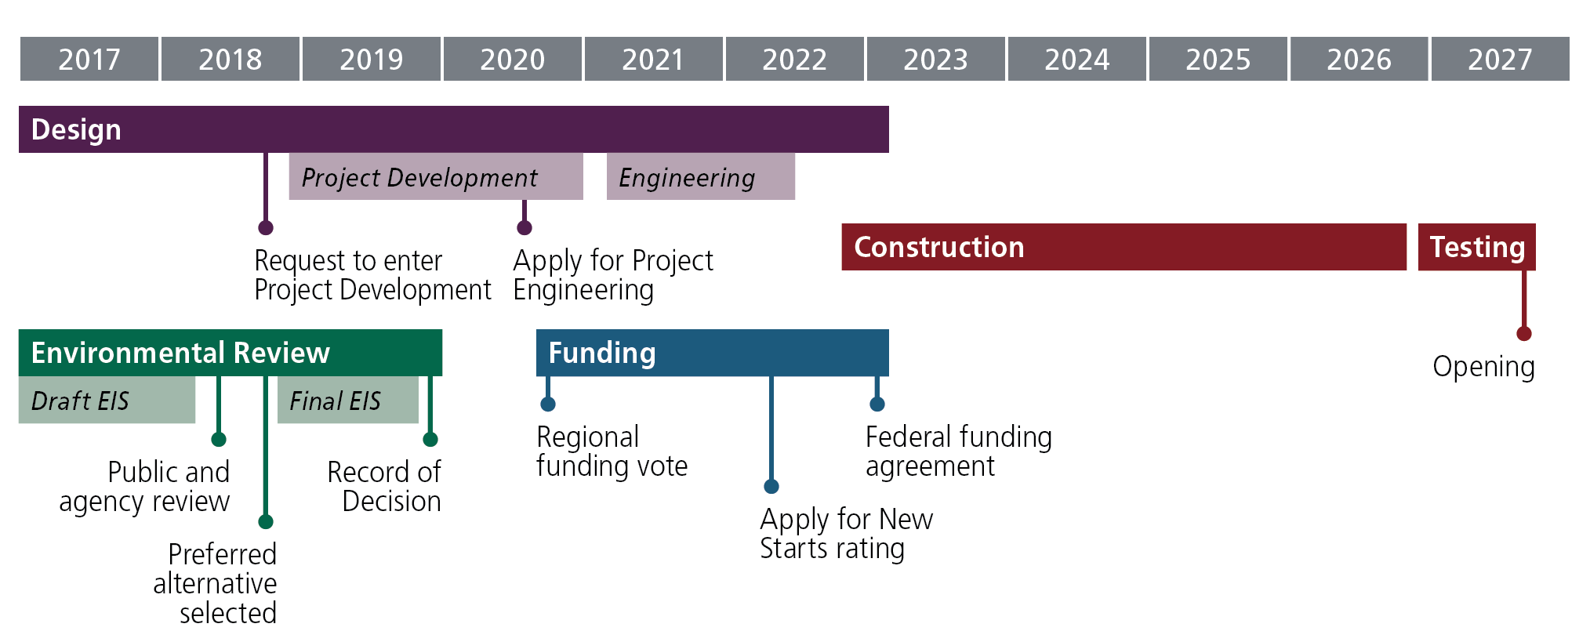
Long-term timeline

Slide 38
Questions?
Notes:
What’s the SW Corridor?
The Southwest Corridor isn't marked on any map.
But this area is home for more than 10 percent of the Portland region's population – that has a huge impact on the rest of the region.
For years, getting around has become less reliable while transit and safety for people walking and biking has lagged behind other areas of the Portland region.
That's why seven cities, Washington County, Metro, TriMet and the Oregon Department of Transportation have come together to work on solutions to handle continuing growth, support new investment and get people where they're going more quickly, reliably and safely.

