Slide 1
Vertical Infrastructure in the ROW and Cellular Antennas
Historic Landmarks Commission

Slide 2










The Problem
Rapidly growing demand for wireless and data services
Increasing pressure on 2 of Portland’s finite resources:
  Public right of way (ROW)
  City owned poles in ROW
Existing policies and guidelines do not address the needs and constraints of today and the future
Data as a Service
Devices
Connected
Vehicles
Infrastructure as
a Service
Electric
Vehicles
Autonomous
Vehicles
Mobility as a Service
Infrastructure, Environmental, &
Safety Sensors

Slide 3
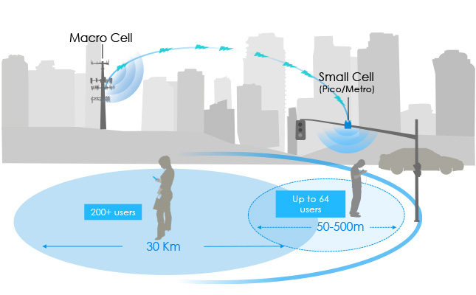
RF 101 — Small Cell Sites
Small cells or distributed antenna systems (DAS) — short range, low‐powered cellular radio access
Small because these mobile phone base stations have:
  Shorter range and handle fewer calls/sessions
  Not because of physical size
Image credit: Silicon Image
Notes:
Cellular and wireless providers are currently looking to install and expand networks of small cells throughout urban areas to
improve coverage, quality, resilience and increase cellular network capacity to meet the increasing
demand on their current networks served by cell towers

Slide 4



MacroCell Versus Small Cell
MacroCell Tower ~80 ft
(can range from 30-250 ft)
Small Cell Site on a Streetlight
Antenna, radio relay units, sometimes batteries or backup power equipment
Power supply equipment, backup generators,
climate-controlled base
Notes:
Variability in size for all components

Slide 5
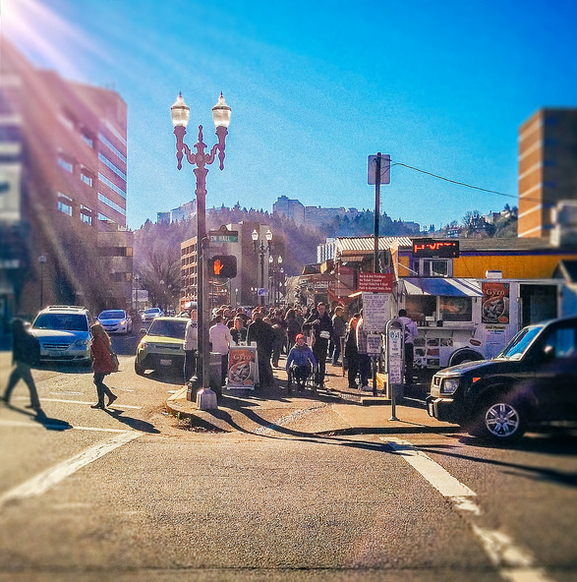
Growing Demand and Pressure
FCC requirements
< 4 carriers
hundreds of locations
But many needs for reliable connectivity
Not enough traffic signal & street light poles in downtown
Notes:
Women’s march, everyone has a cellular device, emergency access, FCC moving in that direction quickly

Slide 6
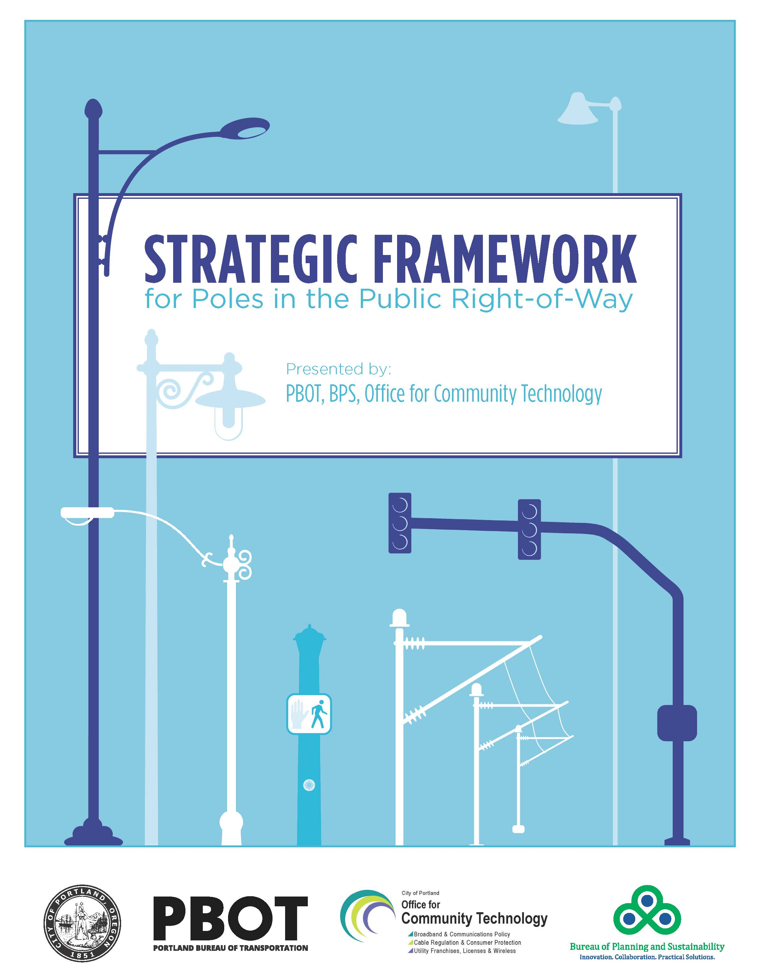
Existing City Policies and Guidelines
Framework prepared by multi-agency work group
  PBOT, OCT, BPS, City Attorney
Attachments limited in:
  Underground Wiring Districts
  Design and Historic Districts
  Scenic Corridors
Connectivity goals:
  2035 Comp Plan
  Digital Equity Action Plan
  Portland Broadband Strategic Plan
Notes:
2002 Resolution 36089 and 2009 Ordinance 182846– all wireless infrastructure approved to date have been on privately owned utility poles

Slide 7
Framework Findings
Vertical infrastructure is currently underutilized — single use only
OPPORTUNITIES
Set our own aesthetic & noise mitigation requirements
Increase upgrade investments
Innovative EV charging
Improve redundancy & capacity in communication network for emergency management & connectivity needs
ISSUES
Increasing pressure from competing uses
How to ensure policies that support equitable deployment of services
Develop comparable compensation requirements
Maintain available space for City-owned infrastructure
Notes:
General education here about the many uses and demands of our poles and so much going on in the ROW (transit priority, etc)
Emphasize certain points
Proactive management of Portland’s valuable and finite asset- ROW
Maintain Portland’s look and feel in the future by implementing aesthetic and noise mitigation requirements
Meet City’s transportation, safety, resiliency, and communication requirements

Slide 8
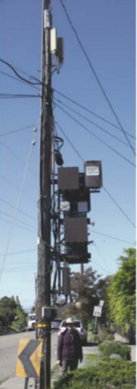
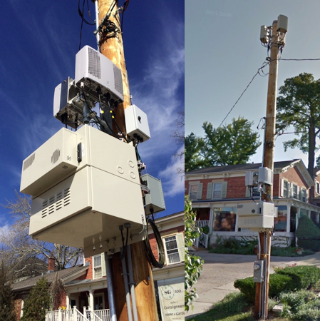
Why Camouflage and Concealment is a Priority
Exposed wires
Multiple boxes/cabinets (radio relay units, batteries)
Noise generating fans
Notes:
In California
Exposed wires, Noise generating cooling fans, diesel backup power generator
Caption for image on right (Example of a poorly designed oDAS (outdoor distributed antenna system) on a utility pole. Grey cabinets are the radio relay units (computers). Large box below features (optional) batteries (with noise generating cooling fans) for backup power. The electric meter is at the bottom of the pole, and multiple panel antennas are up top. Extra service loops of cabling were (for some unknown reason) left on pole.)

Slide 9
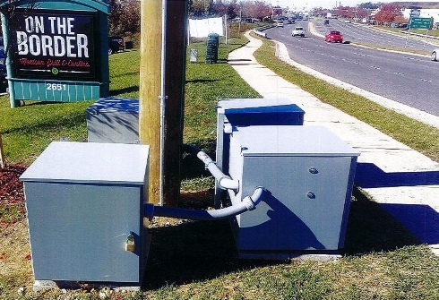
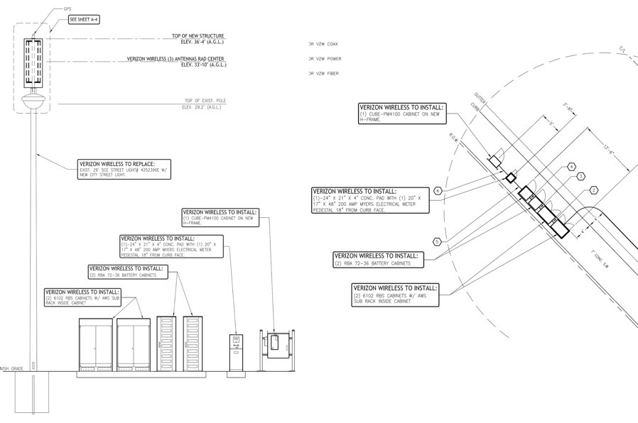
Why Camouflage and Concealment is a Priority
Intrusive ROW cabinets & support equipment
Notes:
Drawings are for proposed Verizon site, photo is from Mobilite (behalf of Sprint) site in Woodbridge, VA

Slide 10
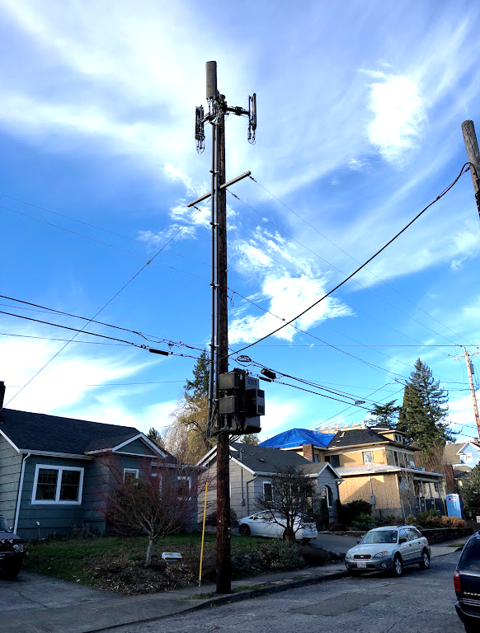
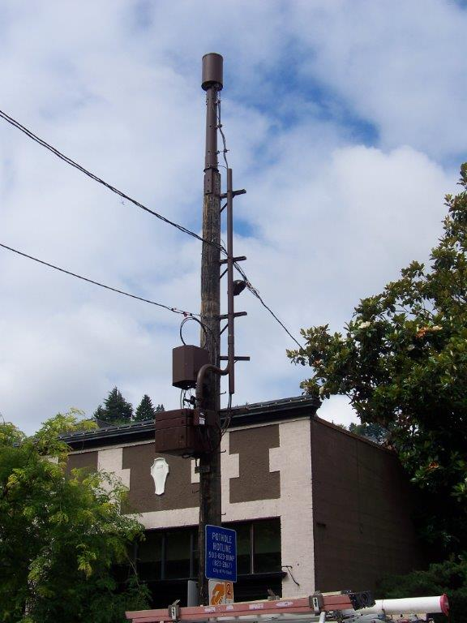
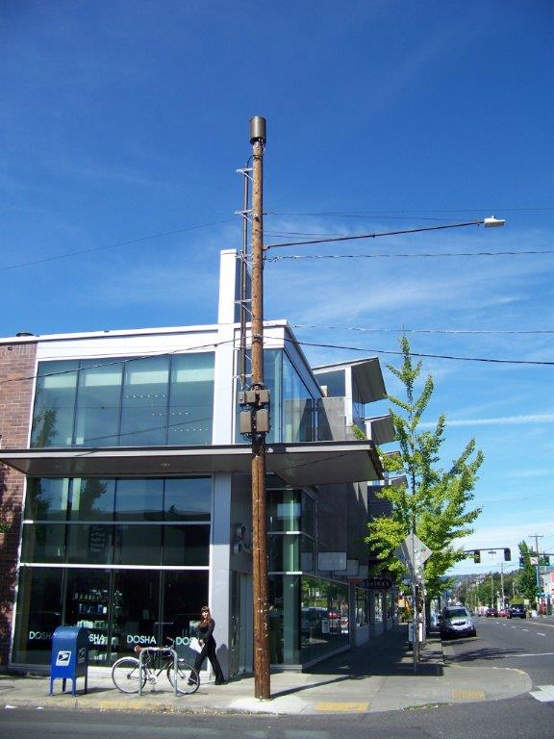
What’s Already in Portland
Notes:
On private utility owned poles, but in the ROW
Site left most photo is very noisy
Proactive code and guidelines may also be transferred to privately-owned poles in ROW as well for future installations

Slide 11
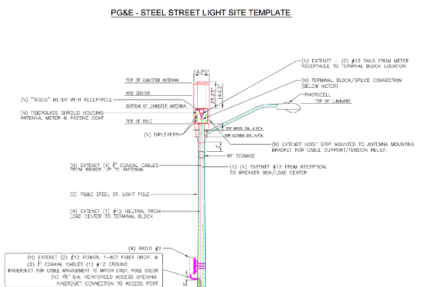
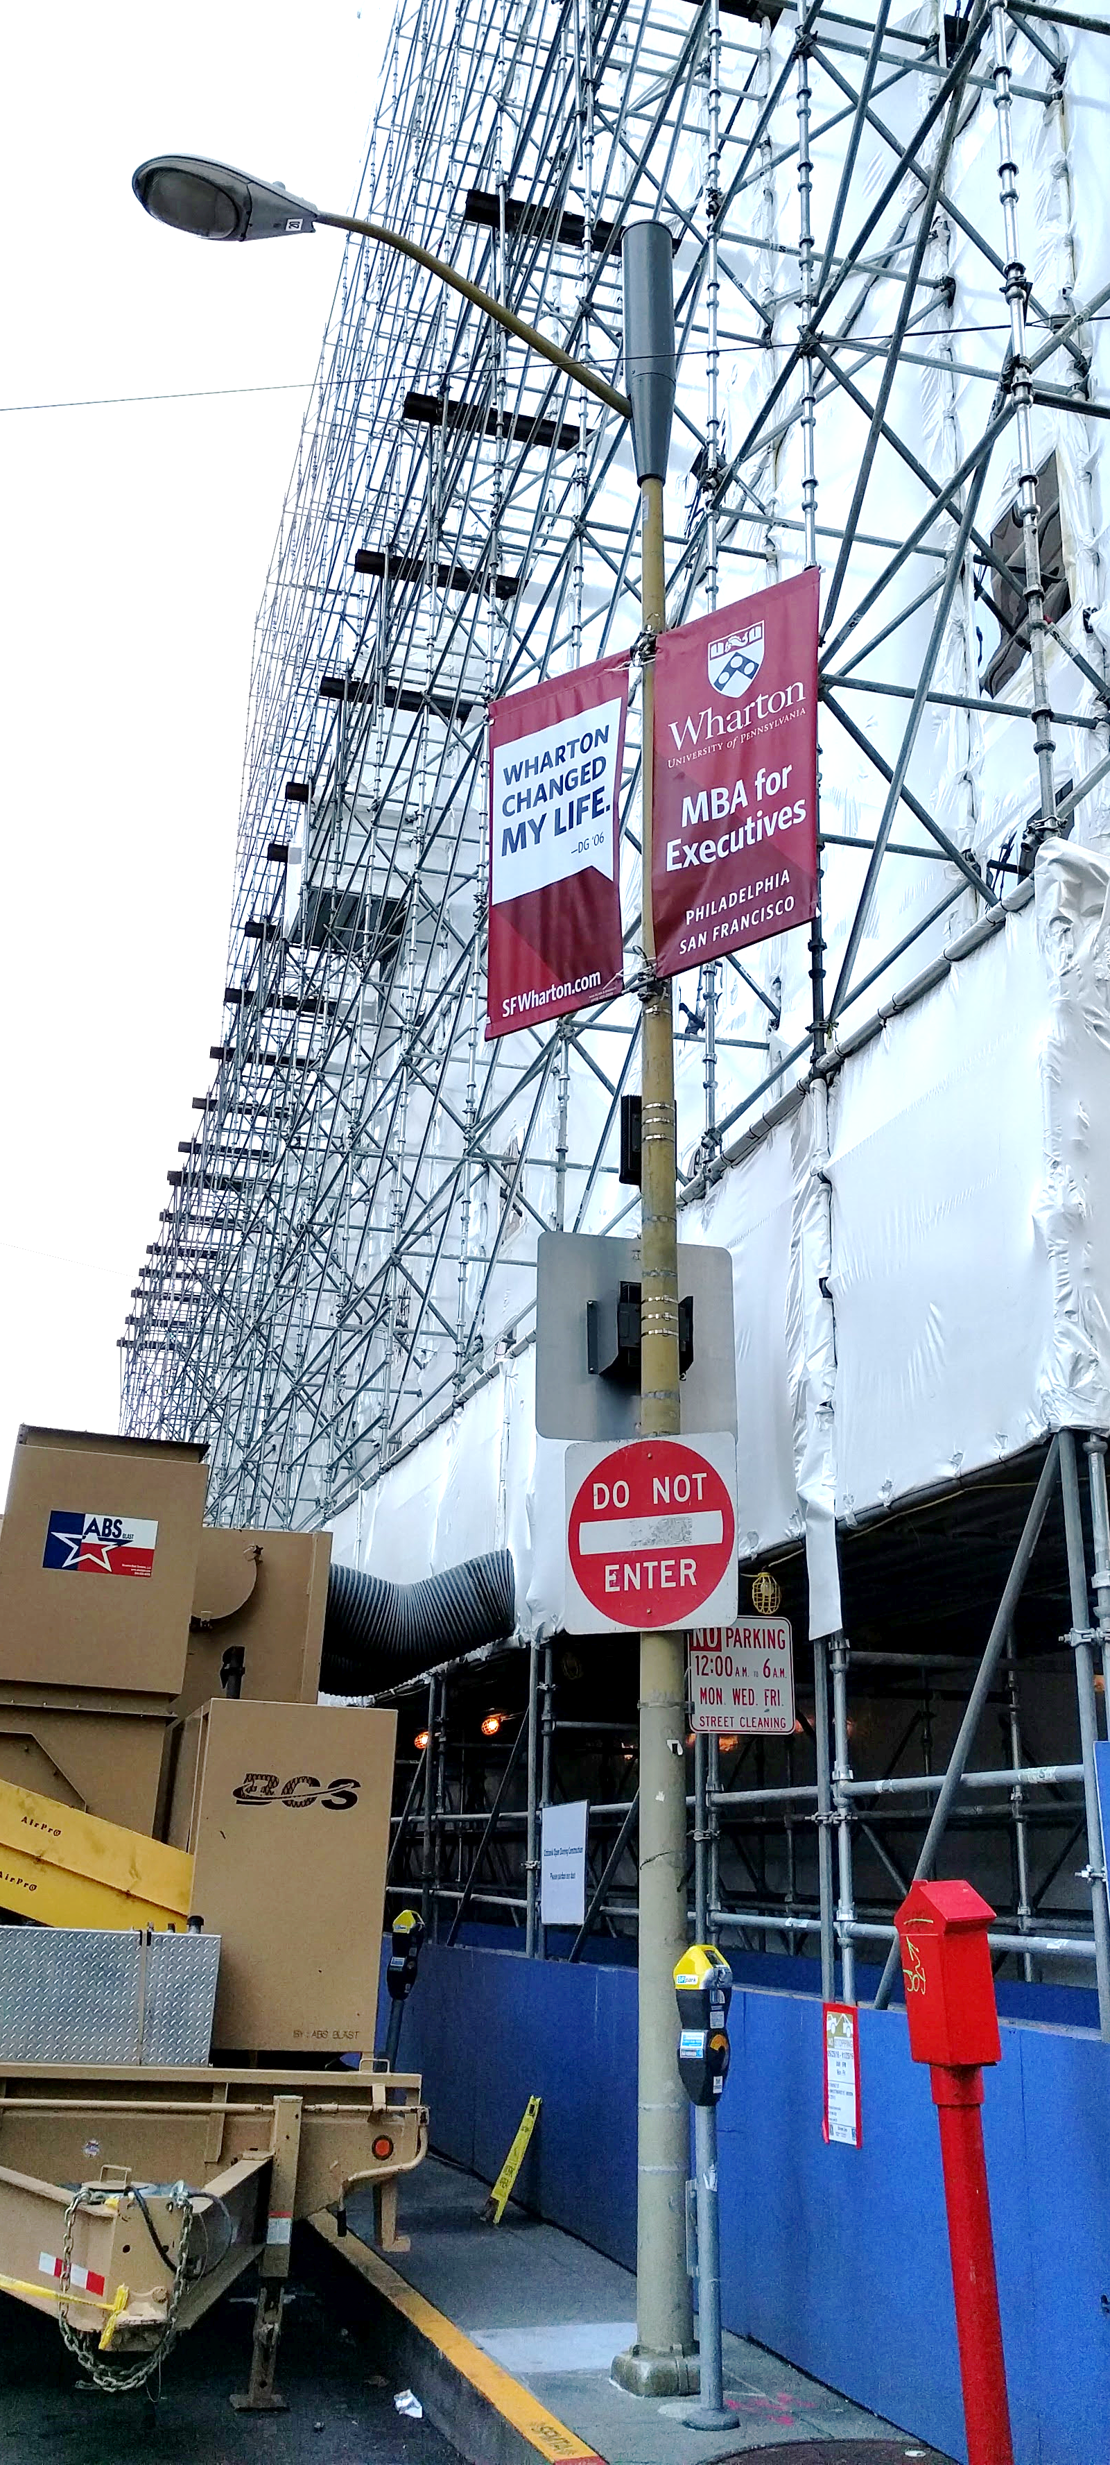
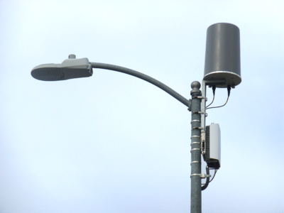
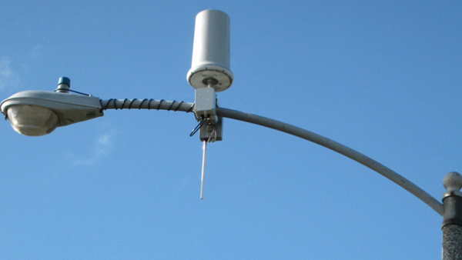
Collaborative Design Examples — Street Light
Notes:
-Stress that these designs with less on the poles and small bases have underground vault components not pictured here
-Moving equipment to vaults is possible with regulations and policy
- Important for new designs especially and using the ROW

Slide 12
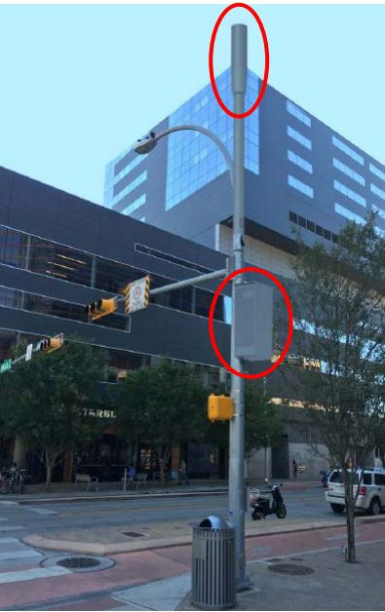
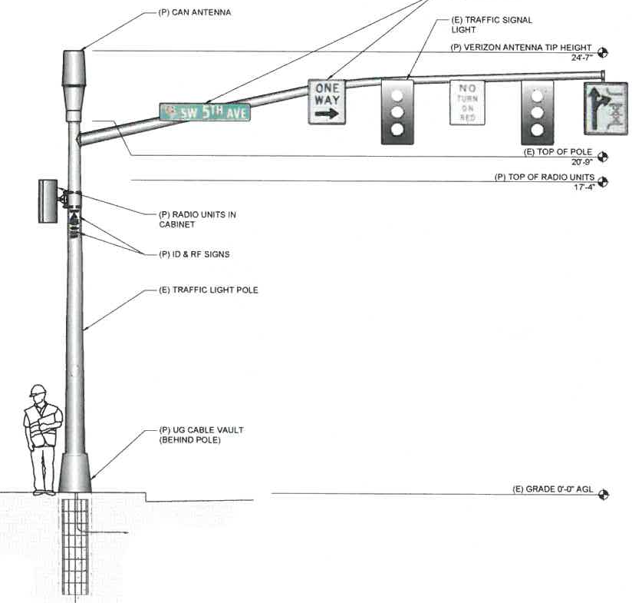
Collaborative Design Examples — Traffic Signal

Slide 13
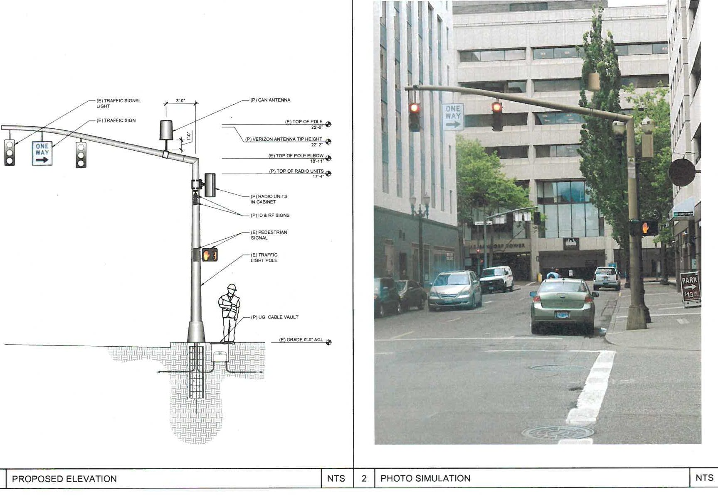
Collaborative Design Examples — Traffic Signal

Slide 14
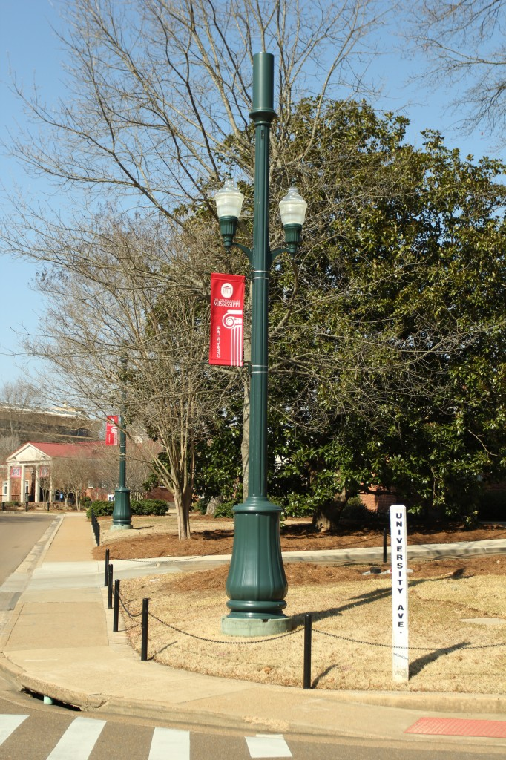
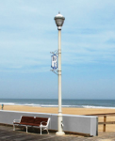
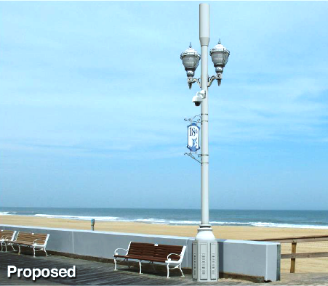
Collaborative Design Examples — Ornamental Street Light

Slide 15
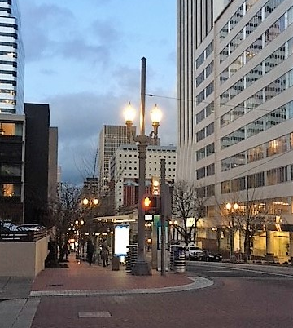
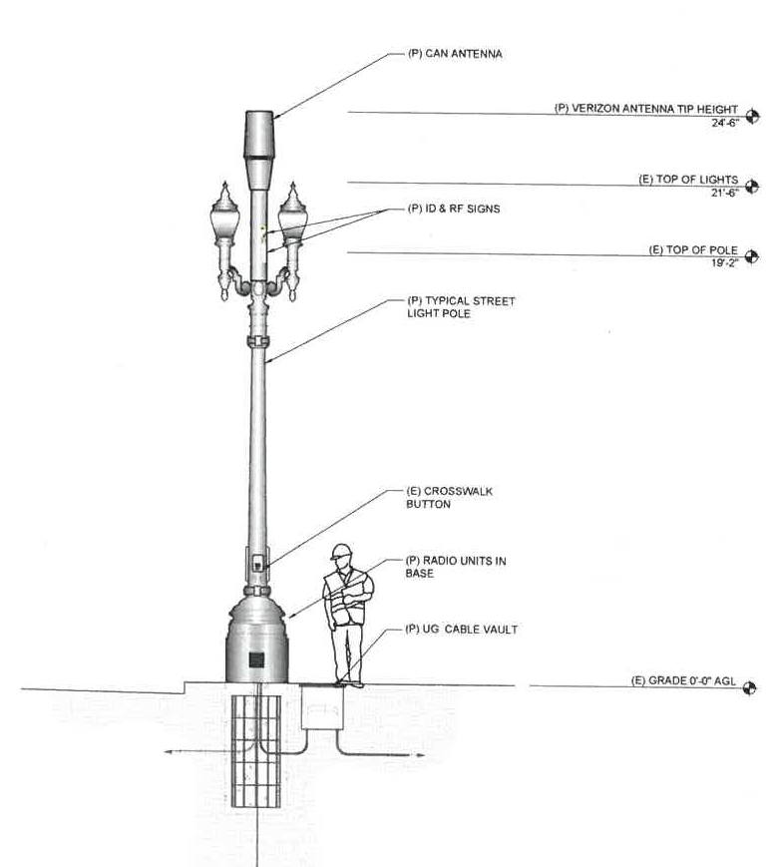
Collaborative Design Examples — Ornamental Street Light
Portland Catenary & Twin-Ornamental Example
Notes:
35 feet tall

Slide 16
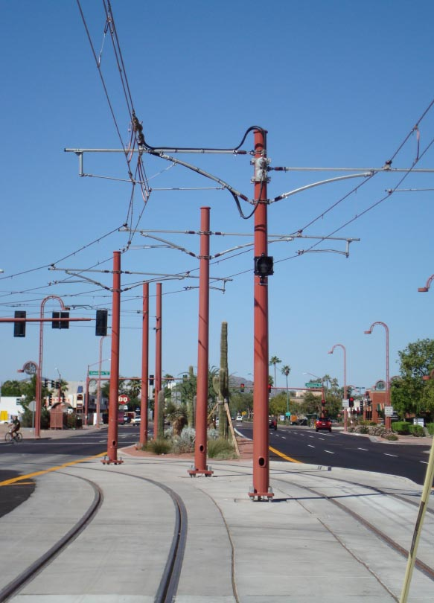
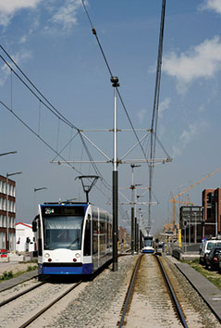
Collaborative Design Examples — Catenary Pole

Slide 17
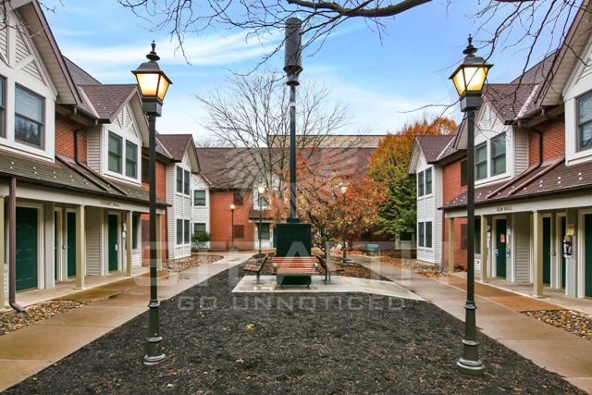
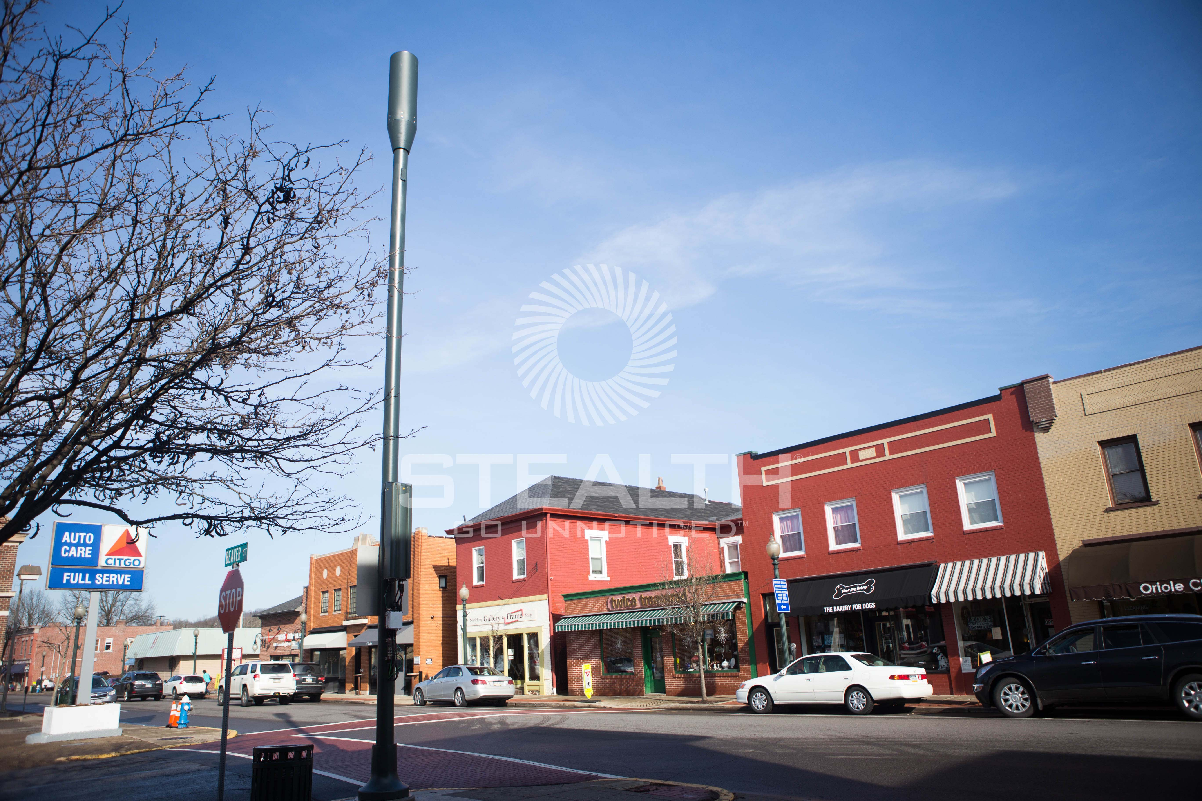
Stand Alone Poles?
Update with clean images

Slide 18
Hierarchy of Camouflage When Available
Focus on utilitarian poles when available
  Traffic Signal Poles
  Street Light Poles
  Catenary
  Ornamental Light Fixtures (Examples in Downtown, Auditorium District)
For all pole options:
  Support equipment in vault space
  Larger bases
  Cabinets in ROW
Notes:
- Stress again, no stand alone poles

Slide 19
Future Design Options Goal is Multi-Use Poles
Unique pole designs to support City needs + cellular carrier needs
  Future district design
  Capacity for EV charging infrastructure
Public art collaborative installations
Build wireless capabilities and infrastructure requirements into:
  Underground parking spaces
  Building design
  Other options for vault space in ROW
Notes:
Touch on example of South Waterfront and opportunity for joint agreement about future district pole designs
Sellwood bridge, lollipop light examples- hindsight 20/20
Issues with building- not in City control like the ROW
Usually don’t sync with developers from the beginning
Some examples

Slide 20

Your Help
Vertical infrastructure is currently underutilized — single use only
PBOT is amending code to help move forward with multi-use planning for City-owned poles in ROW
  FCC requirements + Growing City Needs
  Wireless Master Plan ready for lease agreements ~June 2018
Need your support to create the most proactive policy for our ROW:
  Aesthetic and noise mitigation
Notes:
ROW and vertical infrastructure are valuable and finite assets
FCC + Meet City’s transportation, safety, resiliency, and communication requirements
Have a quick timeline for implementation
Maintain Portland’s look and feel in the future by implementing aesthetic and noise mitigation requirements

Slide 21
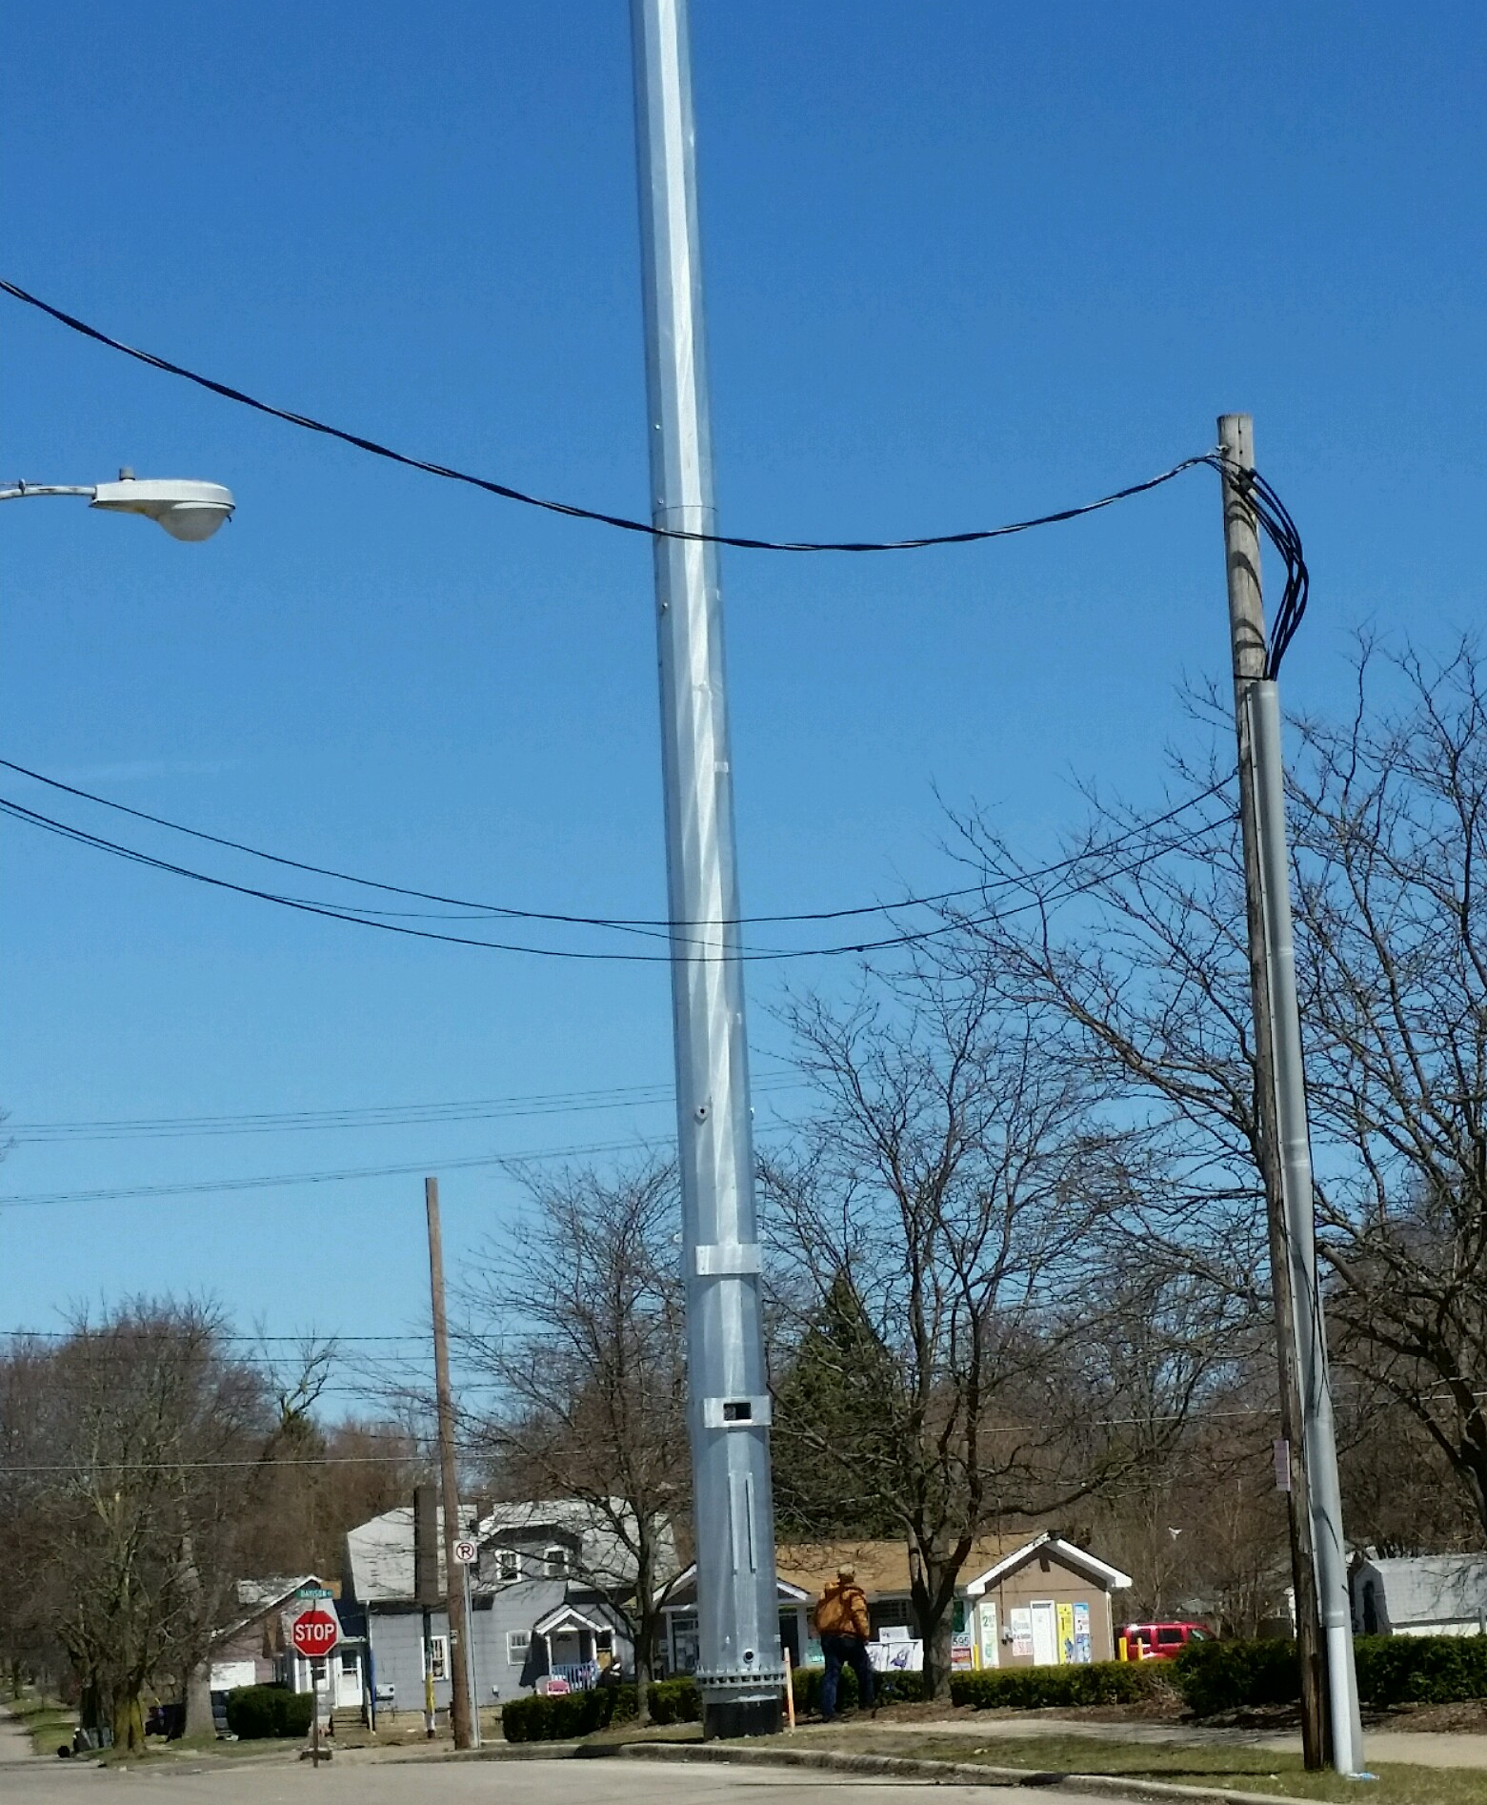
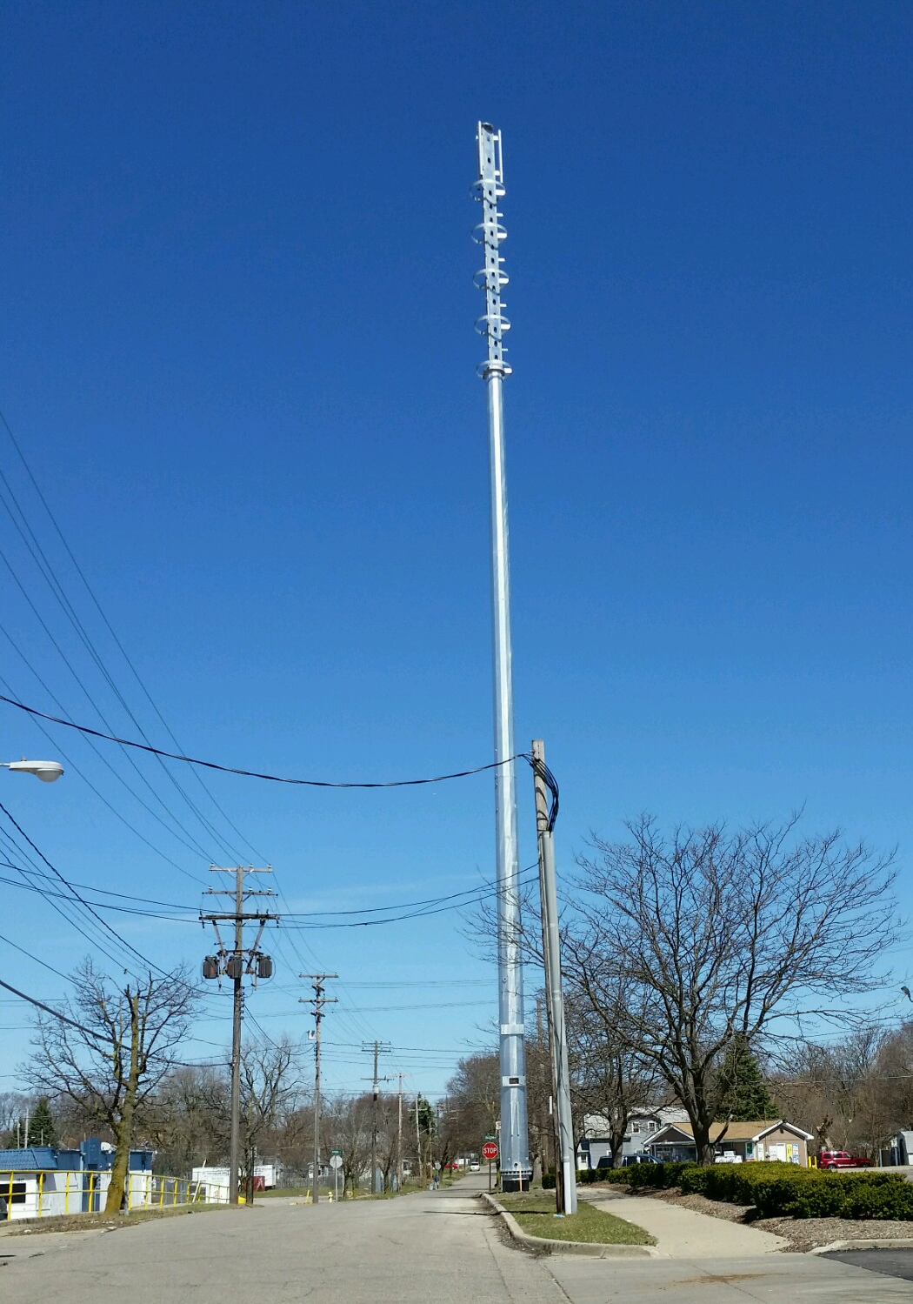
Additional Examples
Stand alone pole in Michigan

Slide 22
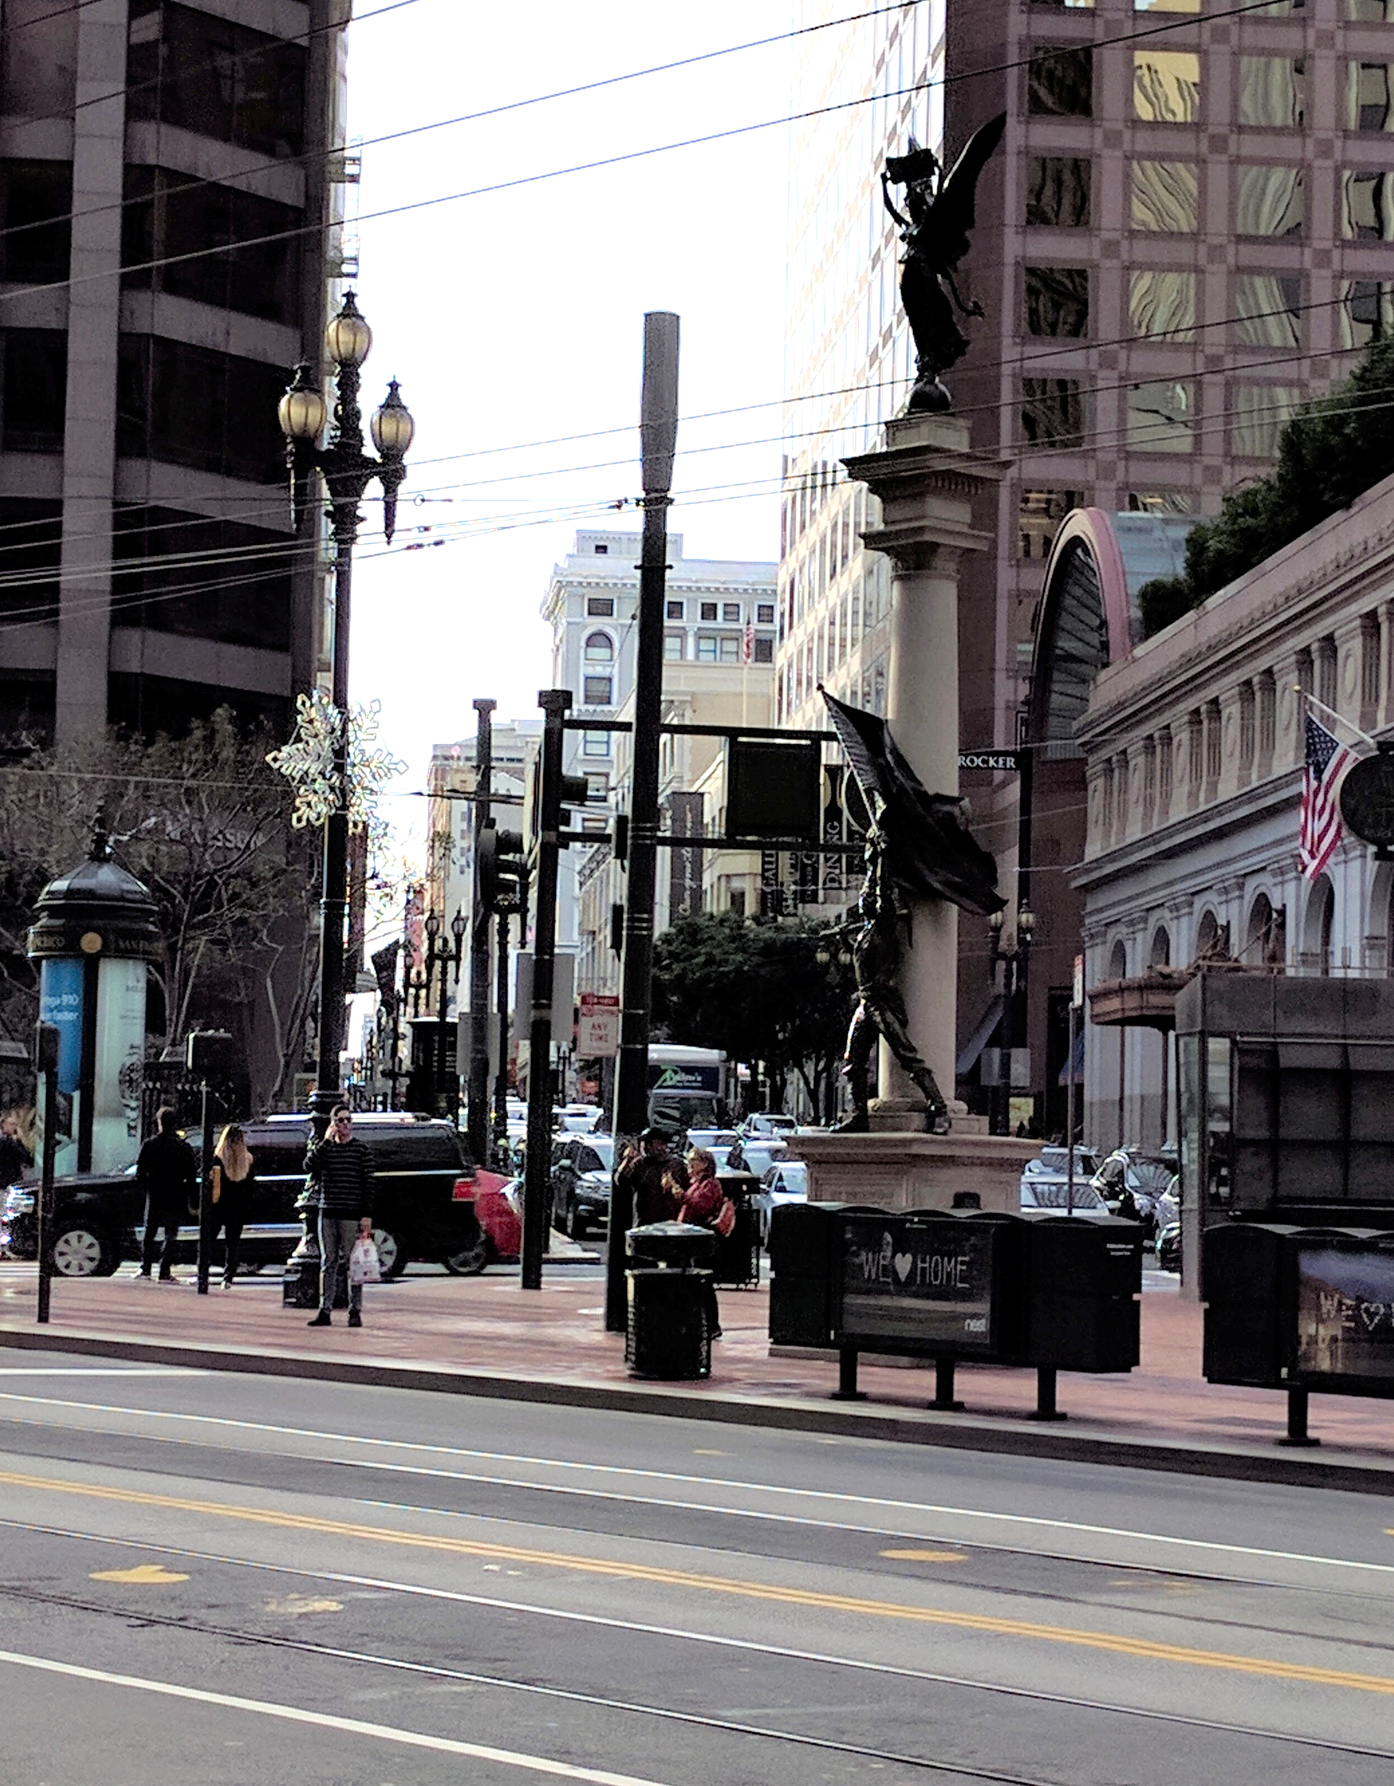
Additional Examples
Catenary example in San Francisco

Slide 23
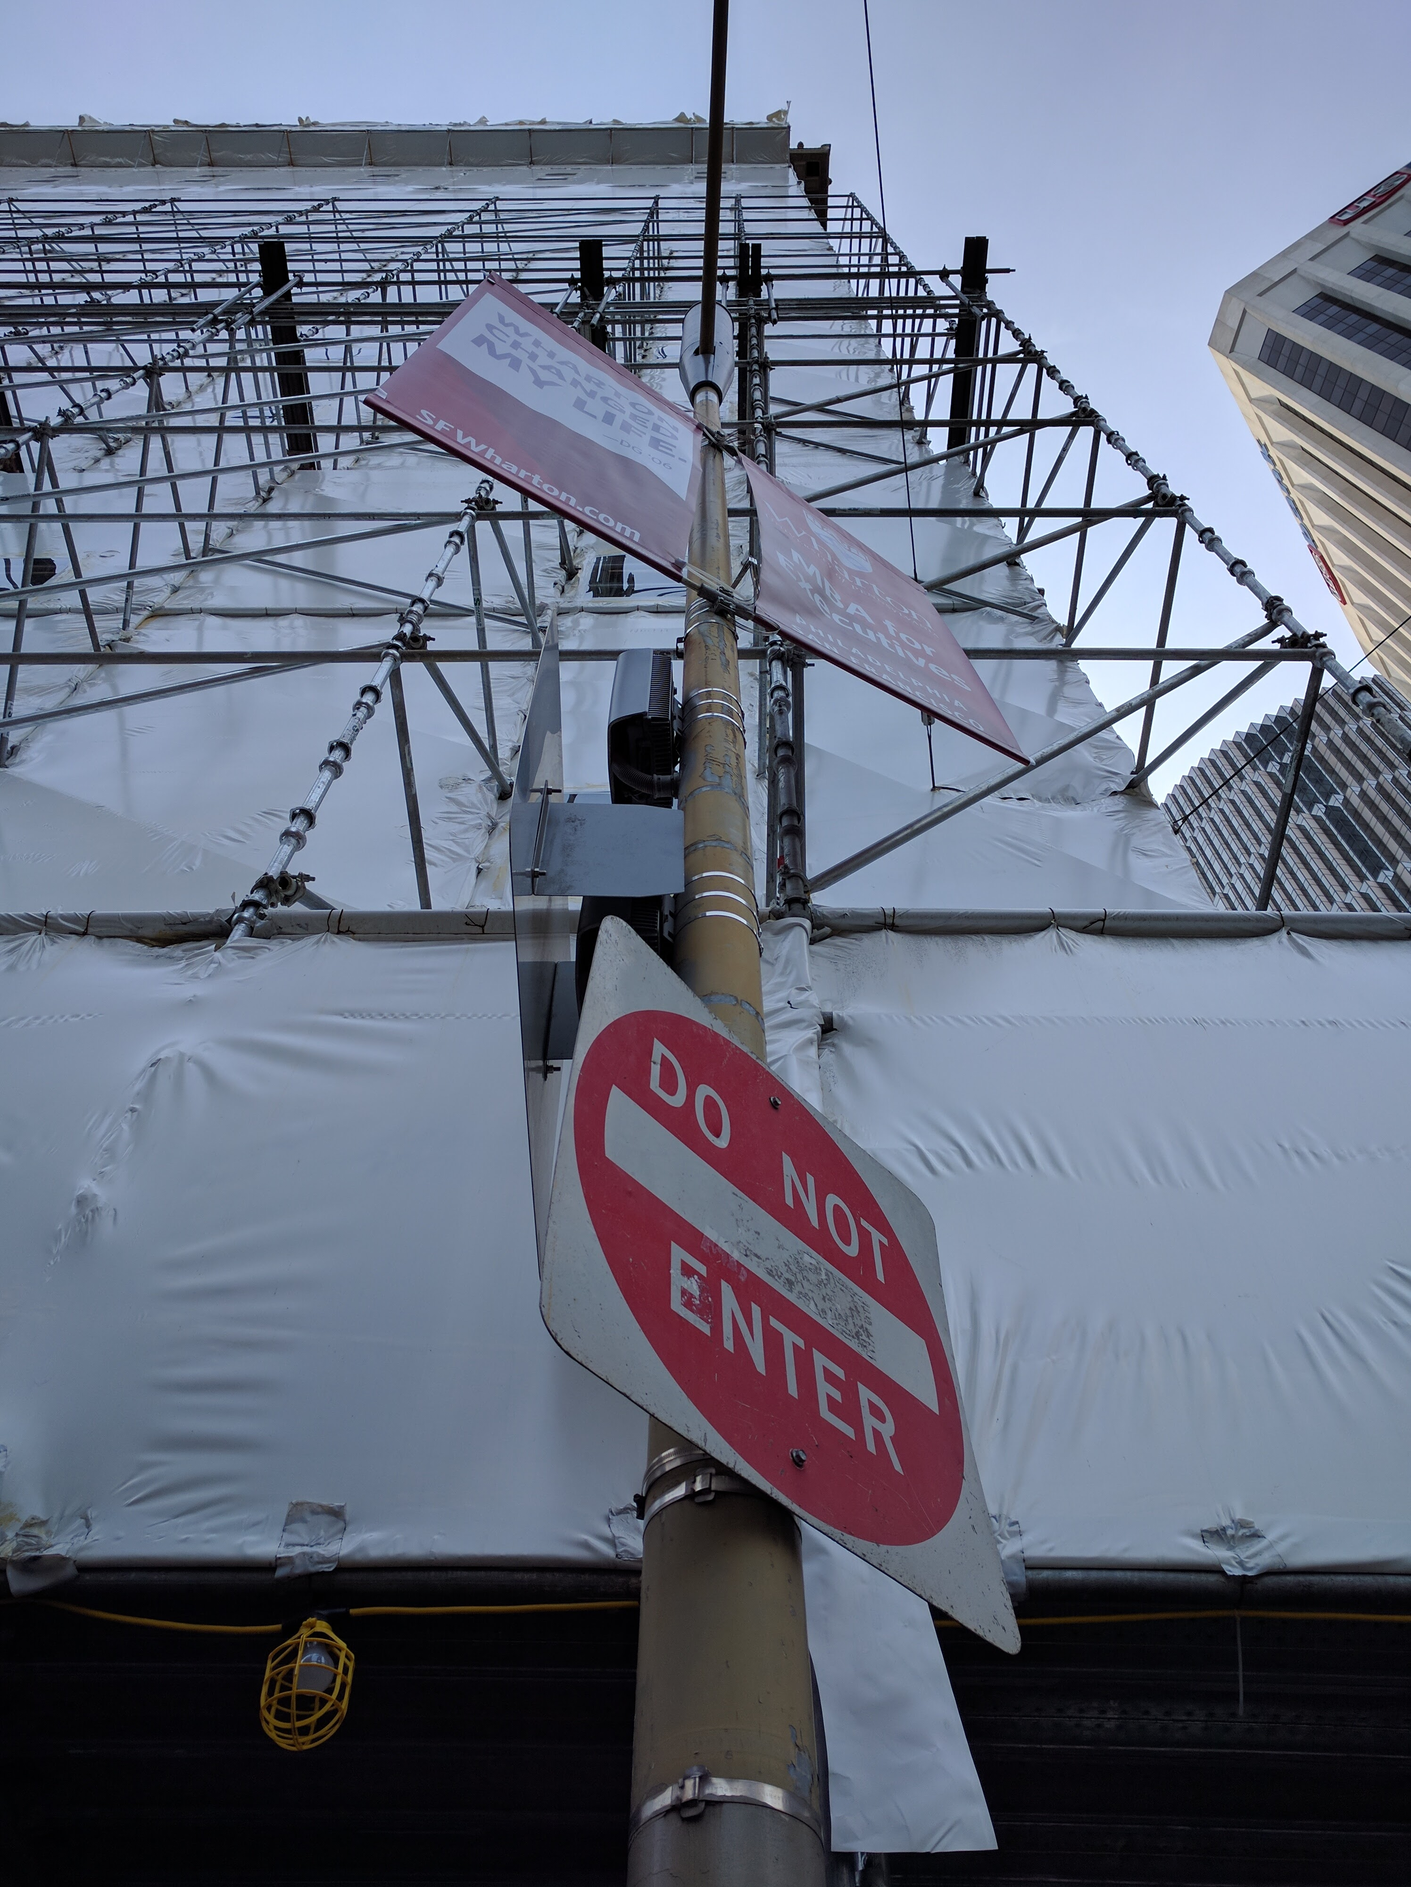
Additional Examples
Street light example
in San Francisco
Notes:
SF Main and Market

