Slide 1
CITY OF PORTLAND, OREGON
Staff Presentation to the
Portland Design Commission
2nd Design Review Hearing
LU 16-291413 DZM
Lloyd Center Redevelopment – 2nd Phase
April 5, 2018
Notes:
public comments rec’d – H.O.
Concerns & considerations highlighted incl:
Traffic
Parking & loading
Utilities
View Corridors
Aesthetics
Amenities needed w/increased density (library, police station, etc)

Slide 2
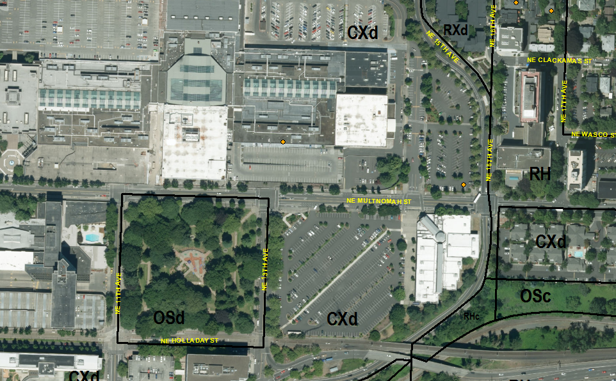
Context
154,689 SF site
Developed with surface parking for mall & cinemas
Street frontages:
NE Multnomah – 1 of 3 primary east-west thoroughfares through Lloyd District, Transit Accessway, City Bikeway
NE 16th – Transit Accessway, City Bikeway
North – South driveway aligning with vacated NE 15th

Slide 3
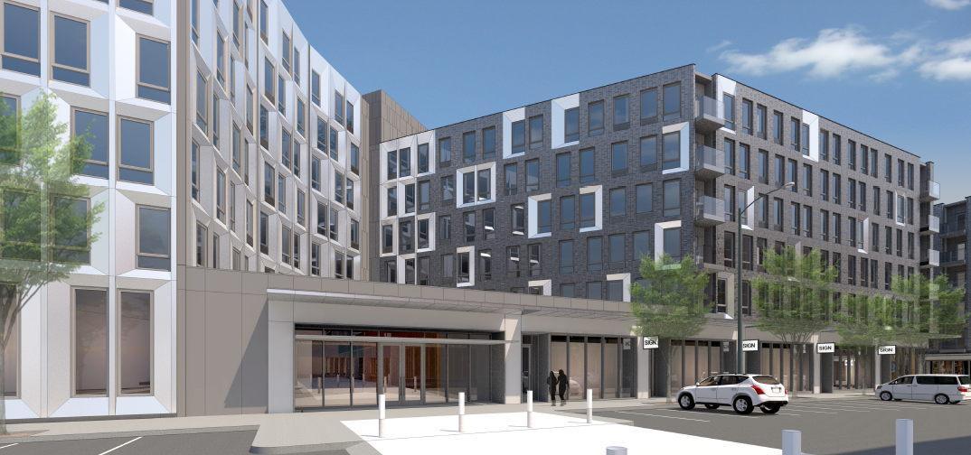
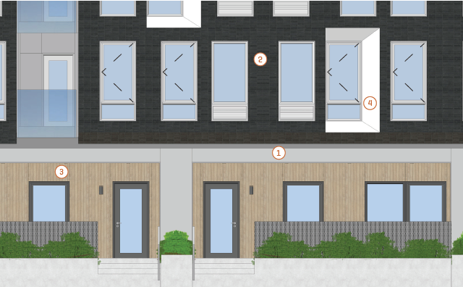
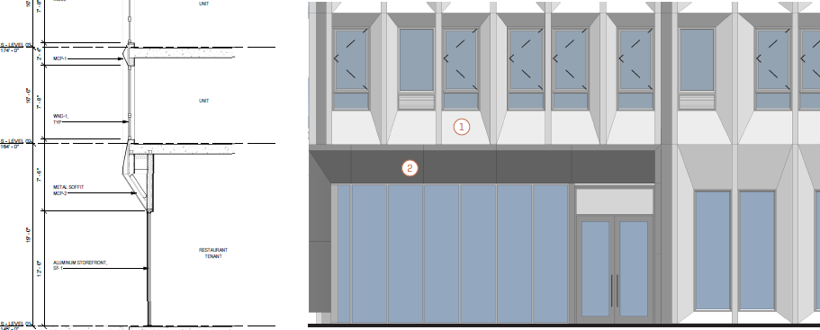
PROJECT SUMMARY
March 15th hearing
Building Design
Blending is interesting but too complex on such large buildings.
Design is too homogenous. Needs to be more contextually responsive & skin treatment more subtly nuanced.
Lighter brick is better, but not all white. Dark colored brick could be accent.
Increase glazing on walk-ups & reduce the amount of wood.
Undercut, recessed storefronts are coherent & provide shelter.

Slide 4
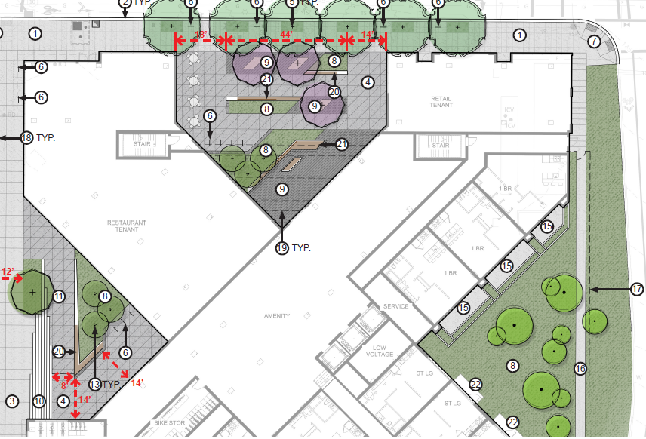
PROJECT SUMMARY
March 15th hearing
Southern Building Plazas
All elements there but need to be more logical & direct.
Northern Plaza - too many objects in the way that are not welcoming.

Slide 5
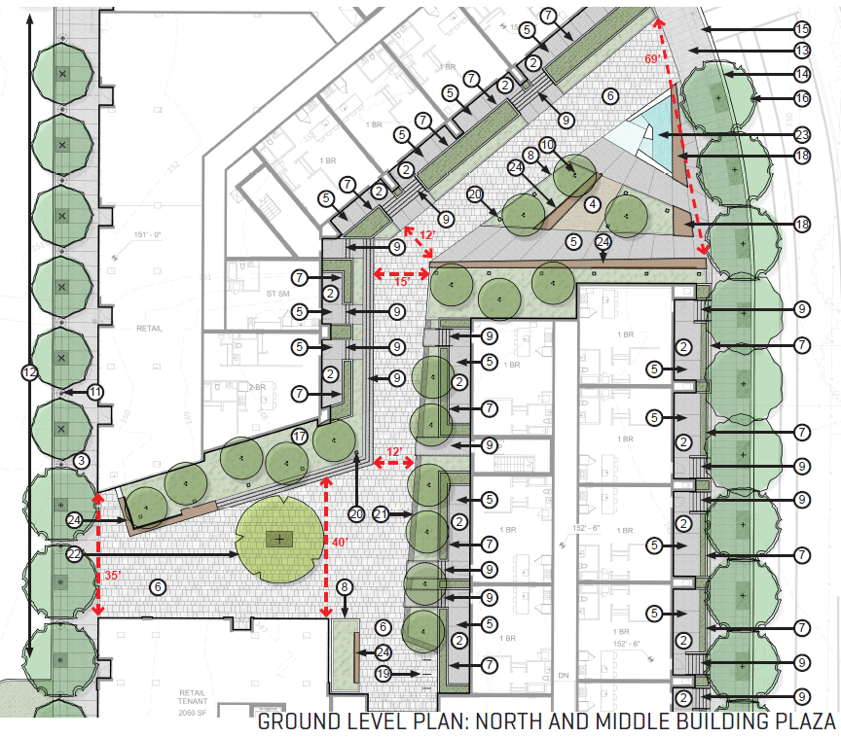
PROJECT SUMMARY
March 15th hearing
Northern Building Plaza
Widen, scale back on landscaping, remove elements obstructing circulation
More order & logic is needed. Calming it down with more seamless pavement e.g. to help public to better navigate
Walk-ups facing plaza should be unit entries, not back porches.

Slide 6
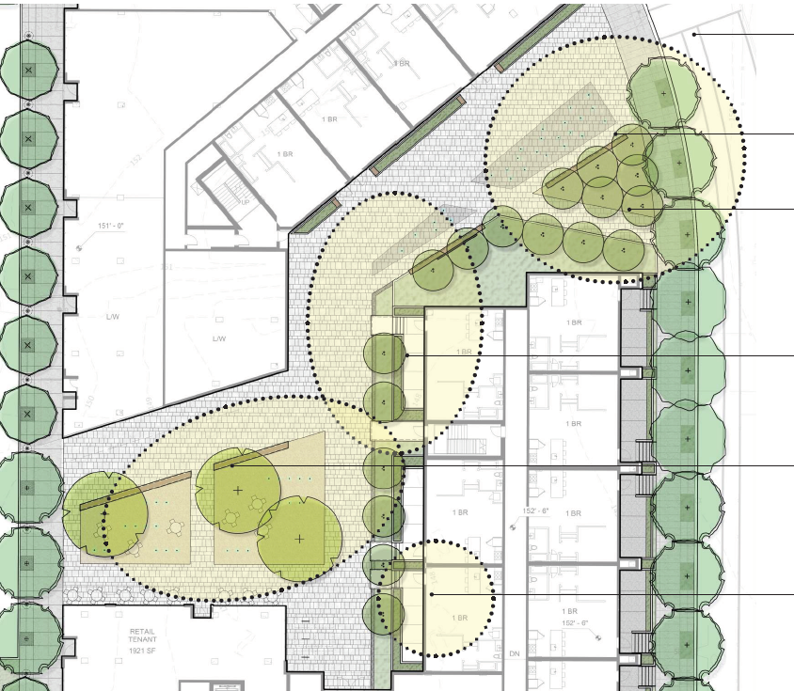
PROJECT STATUS
Revisions address feedback & include brick color & cladding options
Additional details requested by Staff meet Design Guidelines
BES & Site Development support – stormwater issues resolved
Conditions recommended:
- Remove landscape planters under canopies
- Type 2 Design Review for fountain element design

Slide 7
Recommending approval of Design Review pending
Brick color options
GF residential wall cladding options
Recommending approval of both Modifications
Superblock Walkway Width
bicycle parking width reduction
Recommending Conditions of Approval
Remove landscape planters in front of live/work units fronting Neighborhood Passage on northern building
Type 2 Design Review to resolve fountain design elements in northern pocket park and plaza spaces.
STAFF
RECOMMENDATION
Questions

