Slide 1
CITY OF PORTLAND, OREGON
Staff Presentation to the
Portland Design Commission
1st Design Review Hearing
LU 16-291413 DZM
Lloyd Center Redevelopment – 2nd Phase
March 15, 2018
Notes:
public comments rec’d – H.O.
Concerns & considerations highlighted incl:
Traffic
Parking & loading
Utilities
View Corridors
Aesthetics
Amenities needed w/increased density (library, police station, etc)

Slide 2
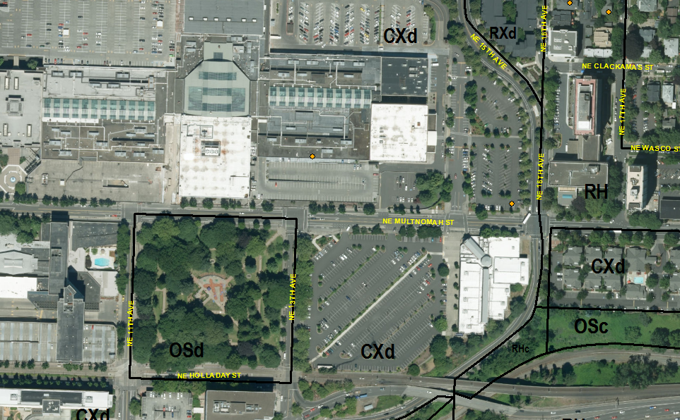
Context
154,689 SF site
Developed with surface parking for mall & cinemas
Street frontages:
NE Multnomah – 1 of 3 primary east-west thoroughfares through Lloyd District, Transit Accessway, City Bikeway
NE 16th – Transit Accessway, City Bikeway
North – South driveway aligning with vacated NE 15th

Slide 3
Context
Large projects in area
All Superblocks & include plazas and walkways
Lloyd Center – New plaza & addition of retail along Multnomah, Nordstrom building & plaza remodel, Sears building addition
AAT Phase I & II – completed & recently approved
OCCH block – under construction

Slide 4
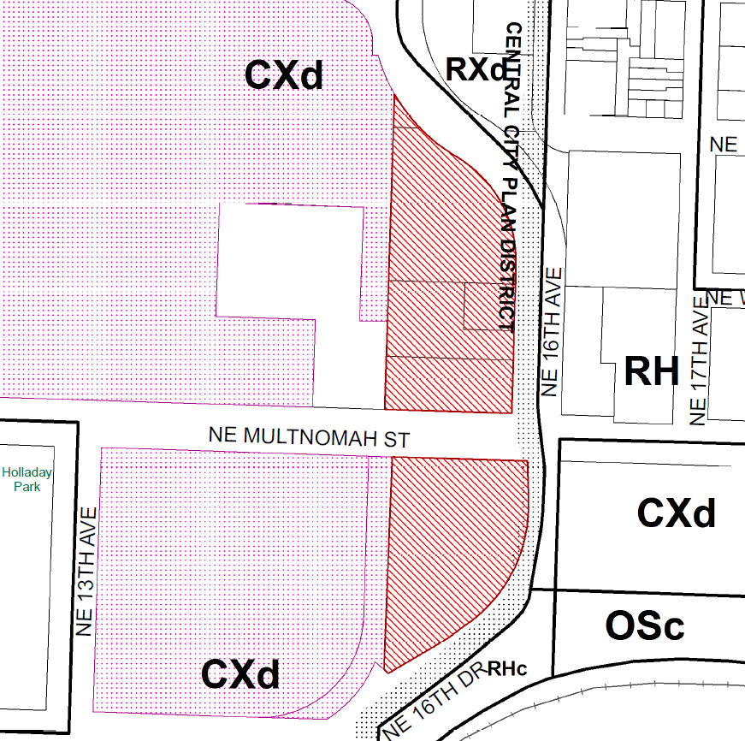
Zoning
CXd - Central Commercial zone w/a Design Overlay
Central City plan district
Lloyd sub district
Lloyd Pedestrian District
Superblocks
FAR:
4:1
Up to 3:1 additional FAR thru bonus options – 7:1 potential
Height:
150’ max
Up to 75’ height bonuses allowed – 225’ potential

Slide 5
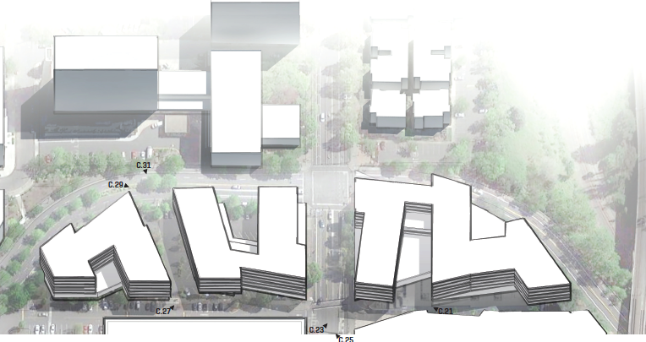
Project History
DAR 2/16/17
Break up 5/1 massing - more variety in height & articulation
Proximity to Sullivan’s Gulch - inform massing, design & pedestrian realm
A lot of sameness in the architecture - 3 separate blocks & buildings
Ground floor of all buildings need attention for active frontages
Pedestrian circulation & open space configuration needs more clarity

Slide 6
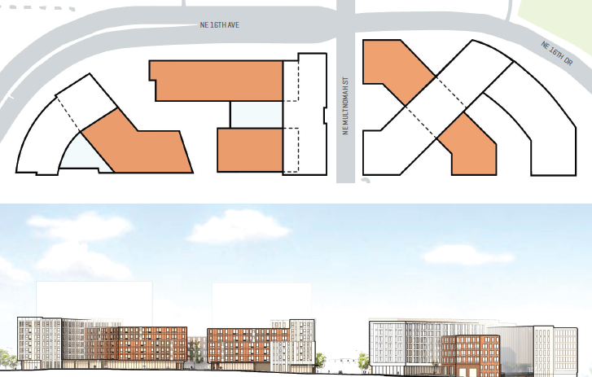
Project History
DAR 11/30/17
Design concept strong, knits two disparate neighborhoods together well.
Ground floor program works well.
Success of northern plaza is key. Focus on public vs. private nature (defensible & comfortable), articulation, use of public art, etc.
Support for “cousin” design concept, but, flexible design allows for distant cousins.
Shifting materials from south to north buildings would respond to change in context.
Materials identified are appropriate and supported. Detailing will be key.
Design concept is rich for accepting balconies & Juliettes.

Slide 7
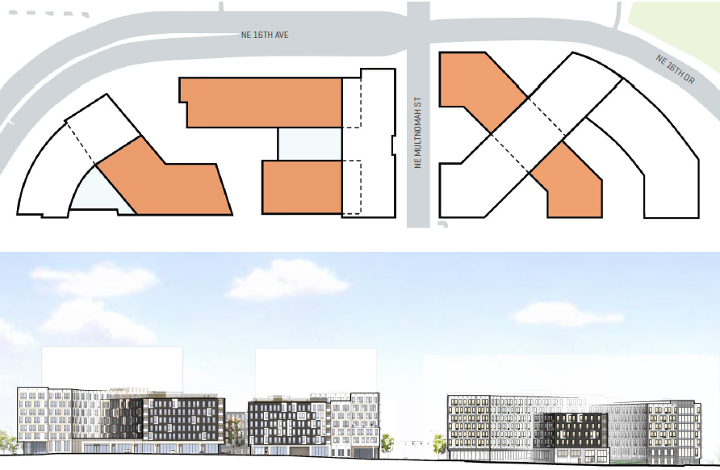
Current Proposal
Three, 7-story buildings, 85’ height
3.75:1 FAR proposed across site
668 residential units on upper floors & 20 residential walk-up units
34,300 SF of retail & 9 live/work units on ground floor
252 spaces of below-grade parking in northern buildings
Several plaza & open spaces on ground floor & rooftop amenity decks
Modifications to bike space width & Superblock walkway width

Slide 8
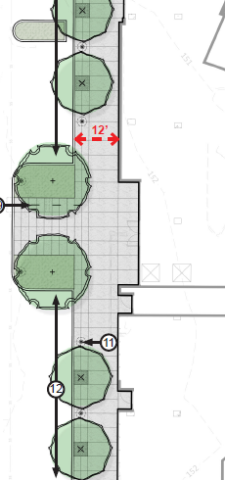
Modifications
Bike Space Width
Superblock Walkway Width
Superblock walkway width - SUPPORTED
Walkway through Superblocks that are at least 12’ wide & unobstructed
Reduced to 8’-7” in one area
Reduction varies where pedestrian lights & trees occur
Consistent with ROW conditions along street frontage
Only occurs at moments along the walkway not entire length
Plazas along walkway allow additional space

Slide 9
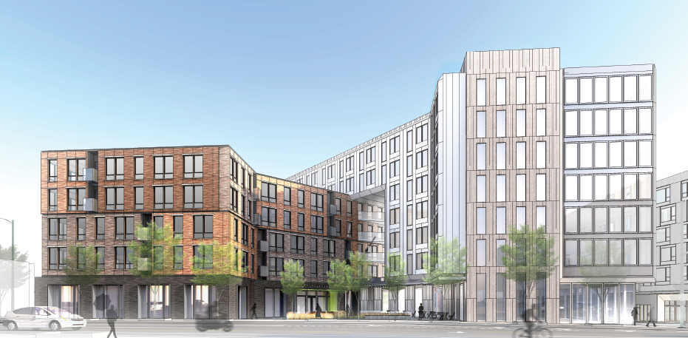
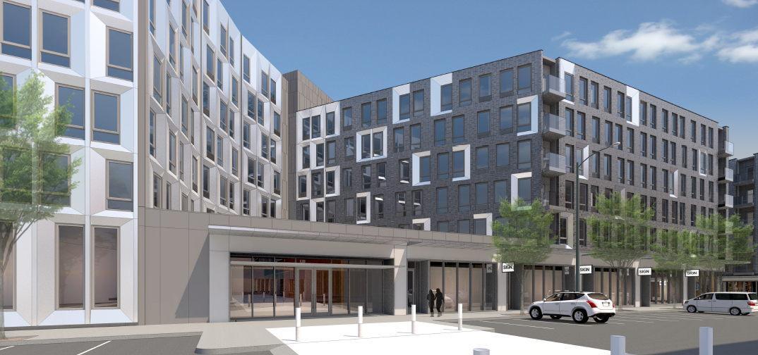
OUTSANDING CONCERN
Design
Volume & material distinction of prior design very clear & contextually responsive to both neighborhoods – supported by Commission at 2nd DAR
Current design that blends the materials and design elements muddle the distinct massing and form, which is fairly strong on its own.
Buildings are all very similar - some variation in color or material respond to context of south and north propertiesdifferent adjacent context of the north and south properties.

Slide 10
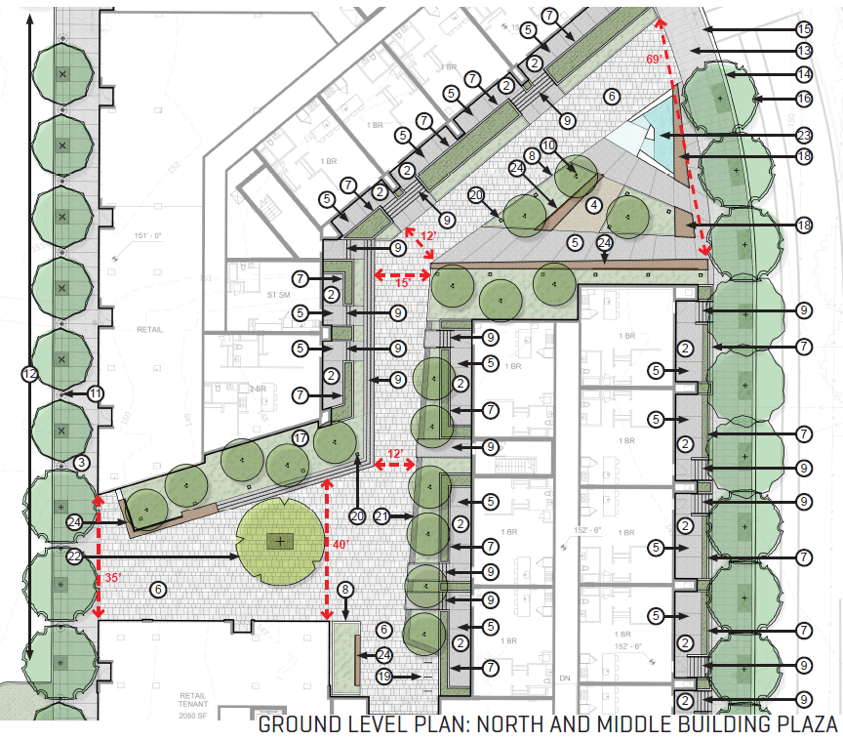
OUTSANDING CONCERN
Northern Public Plaza
Deep landscape planter along retail – barrier
Unobstructed physical connections to both retail spaces ensure activation
As primary plaza could use an element to set it apart from other public spaces on site (art or unique lighting?)

Slide 11
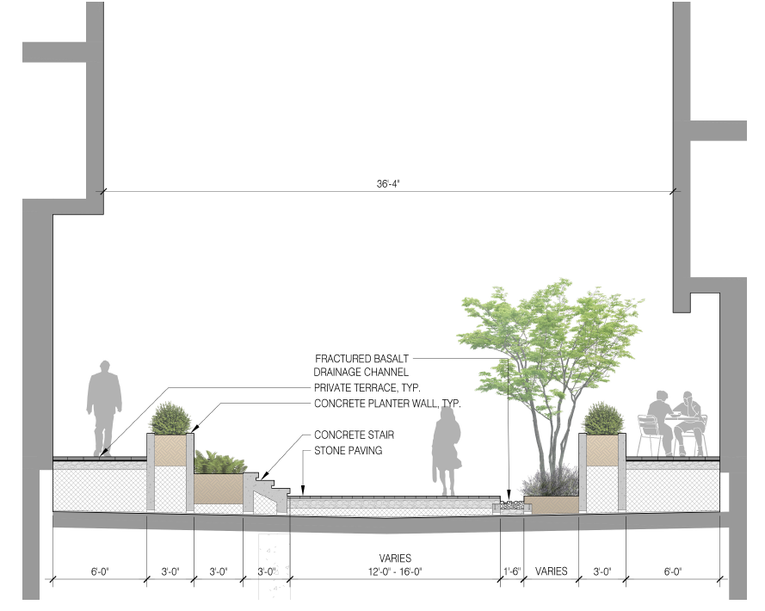
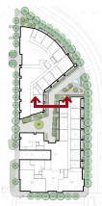
OUTSANDING CONCERN
Northern Public Plaza
Ground floor residential units facing internal plaza & passage
Up & back transition provides buffer but narrow public walkway
Plaza highly used & may be uncomfortable for pedestrians & be defended by residents, physically (gate) or visually (blinds drawn)
Live/work units – more successful activation-wise & comfortable for those using space.

Slide 12
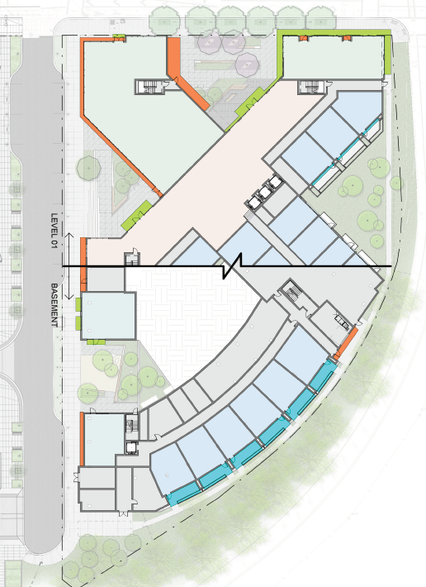
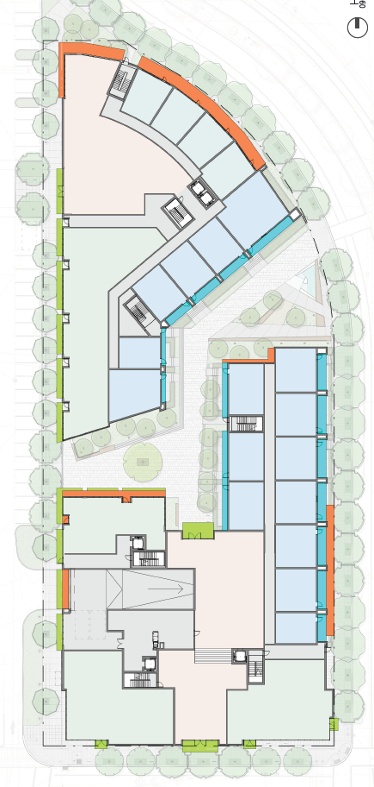
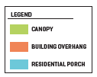
OUTSANDING CONCERN
Weather Protection
In areas highlighted:
Overhang only a couple of feet deep
Does not occur over pedestrian areas (e.g. planters)
High up on the façade at 3rd floor level
Tapered façade of overhand provides minimal shelter
Western side of southern building & southern retail end of middle building

Slide 13
Not yet recommending approval of Design Review
Outstanding Concerns:
Design - Contextual Response
Materials – Dark brick color
Weather Protection
Minor details needed
BES & Site Development
Design Guidelines not met:
B5, B6, B6-1, C3-2, C4, C6, C10-3
Recommending approval of both Modifications
Superblock Walkway Width
bicycle parking width reduction
STAFF
RECOMMENDATION
Questions

