Slide 1
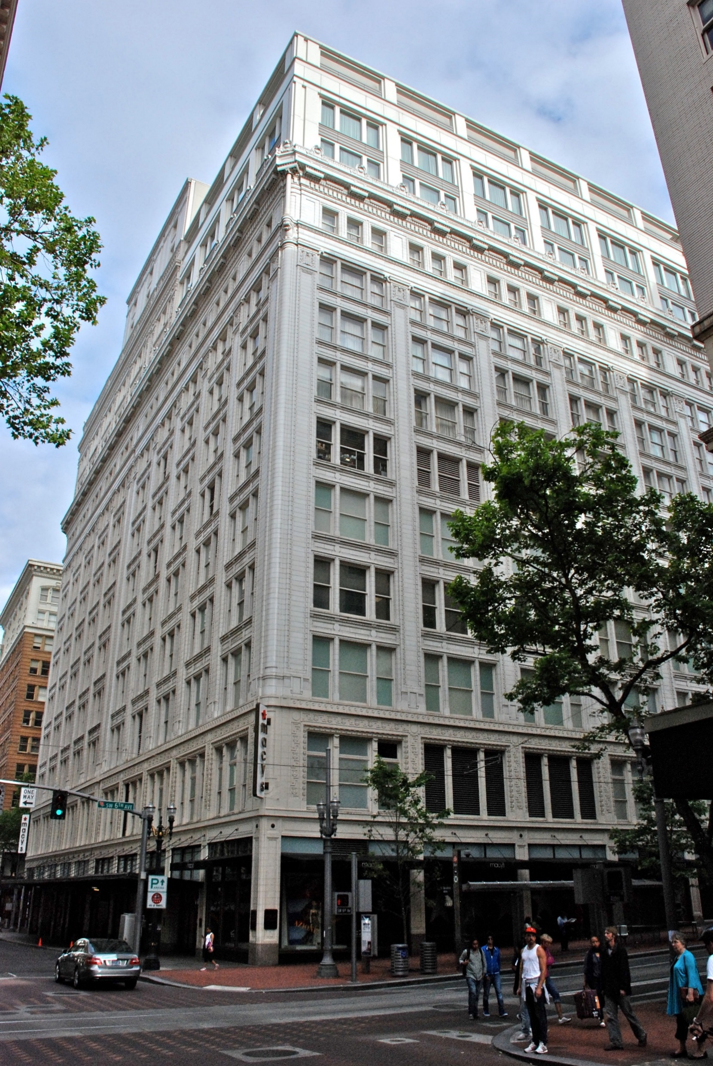
CITY OF PORTLAND, OREGON
Staff Presentation to the
Portland Historic Landmarks Commission
Type III Historic Resource Review
LU 17-171655 HR
621 SW 5th Avenue
July 10, 2017

Slide 2
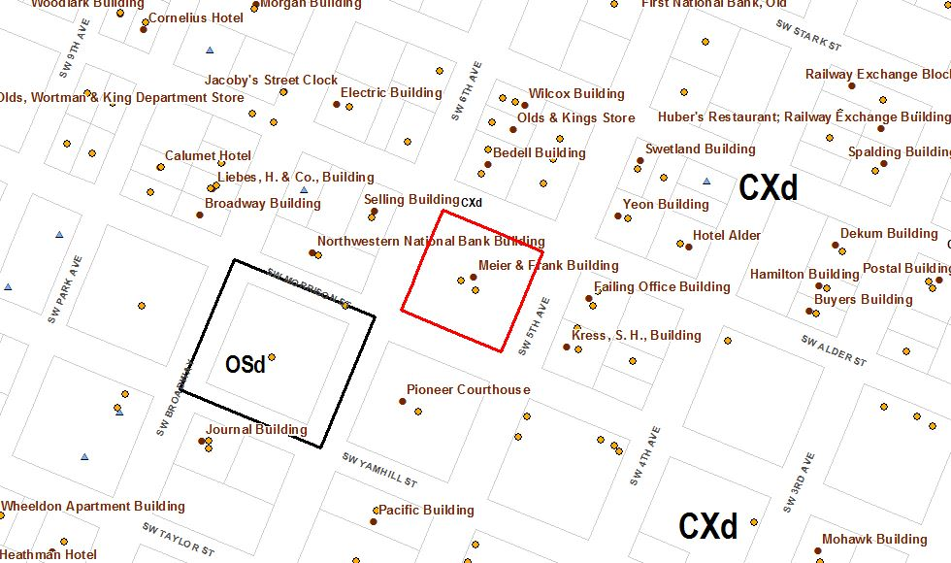
CODE CONTEXT
ZONING:
CX – Central Commercial Zone With Design Review
Height – 460’
Plan District / Approval Criteria
Central City Plan District
33.846.060.G - Historic Resource Review
Central City Fundamental Design Guidelines

Slide 3
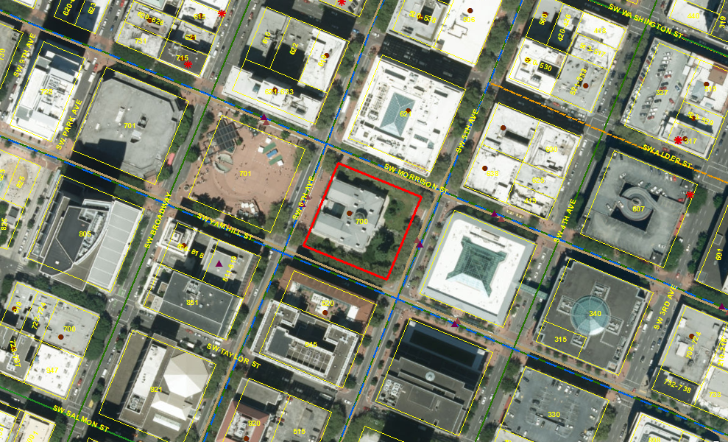
SITE DESCRIPTION
Site Area
Lot Area: 40,000 SF
Site Disposition
Sloping South to North
Existing Condition
Historic Meier and Frank Building
Street Frontages
SW 5th Avenue
SW 6th Avenue
SW Morrison Street
SW Alder Street

Slide 4
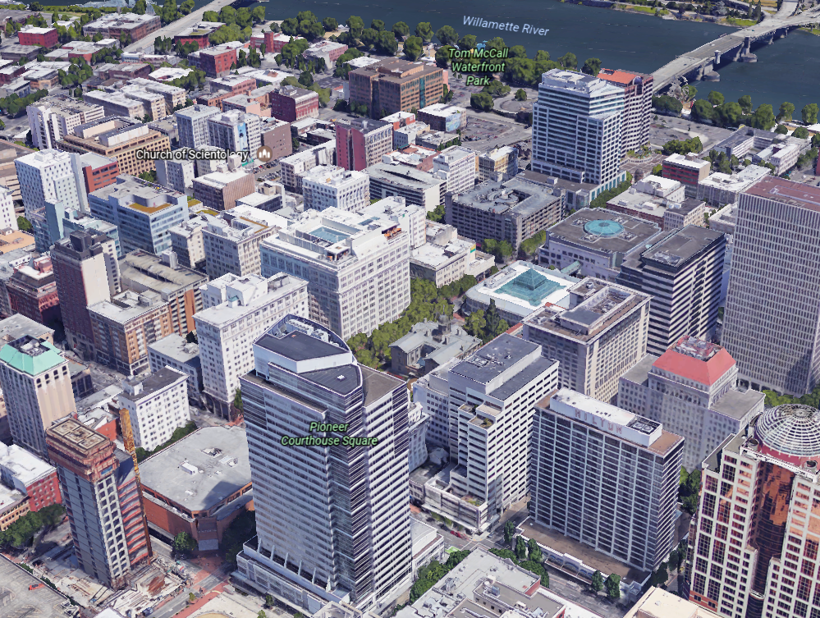
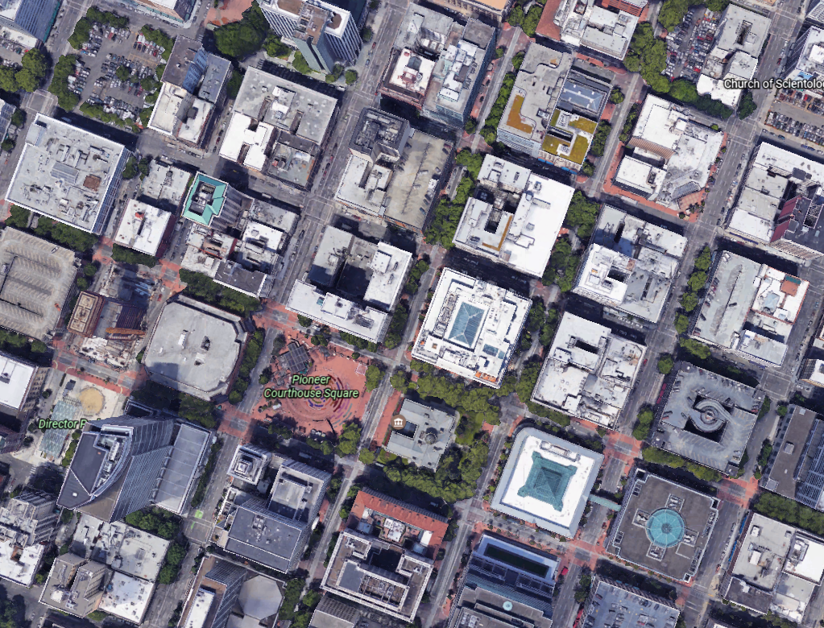
Vicinity

Slide 5
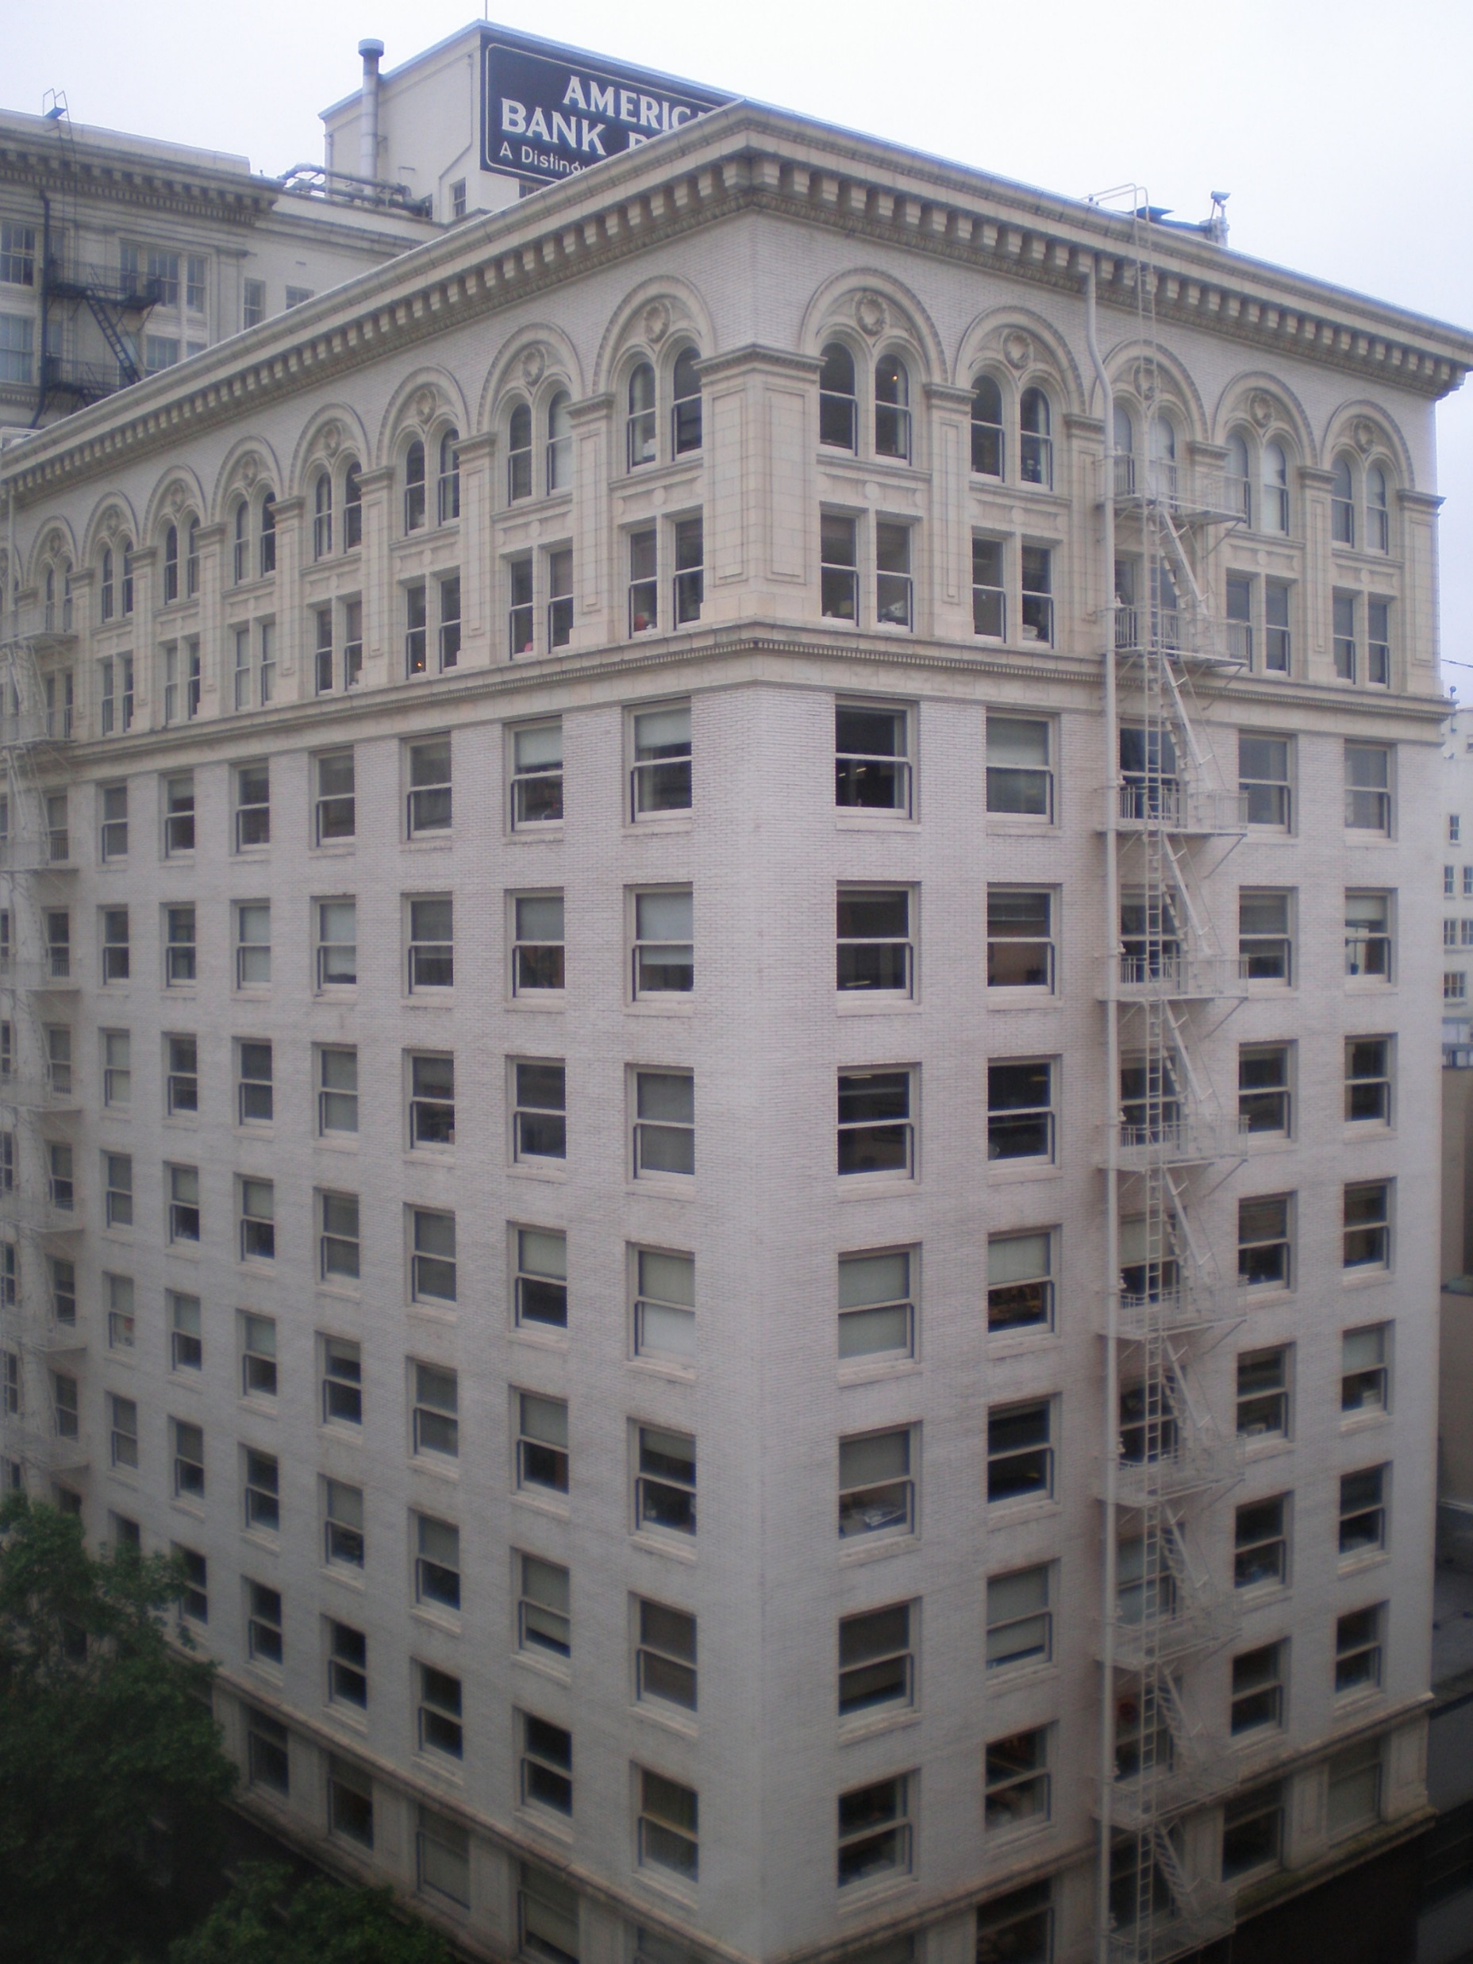
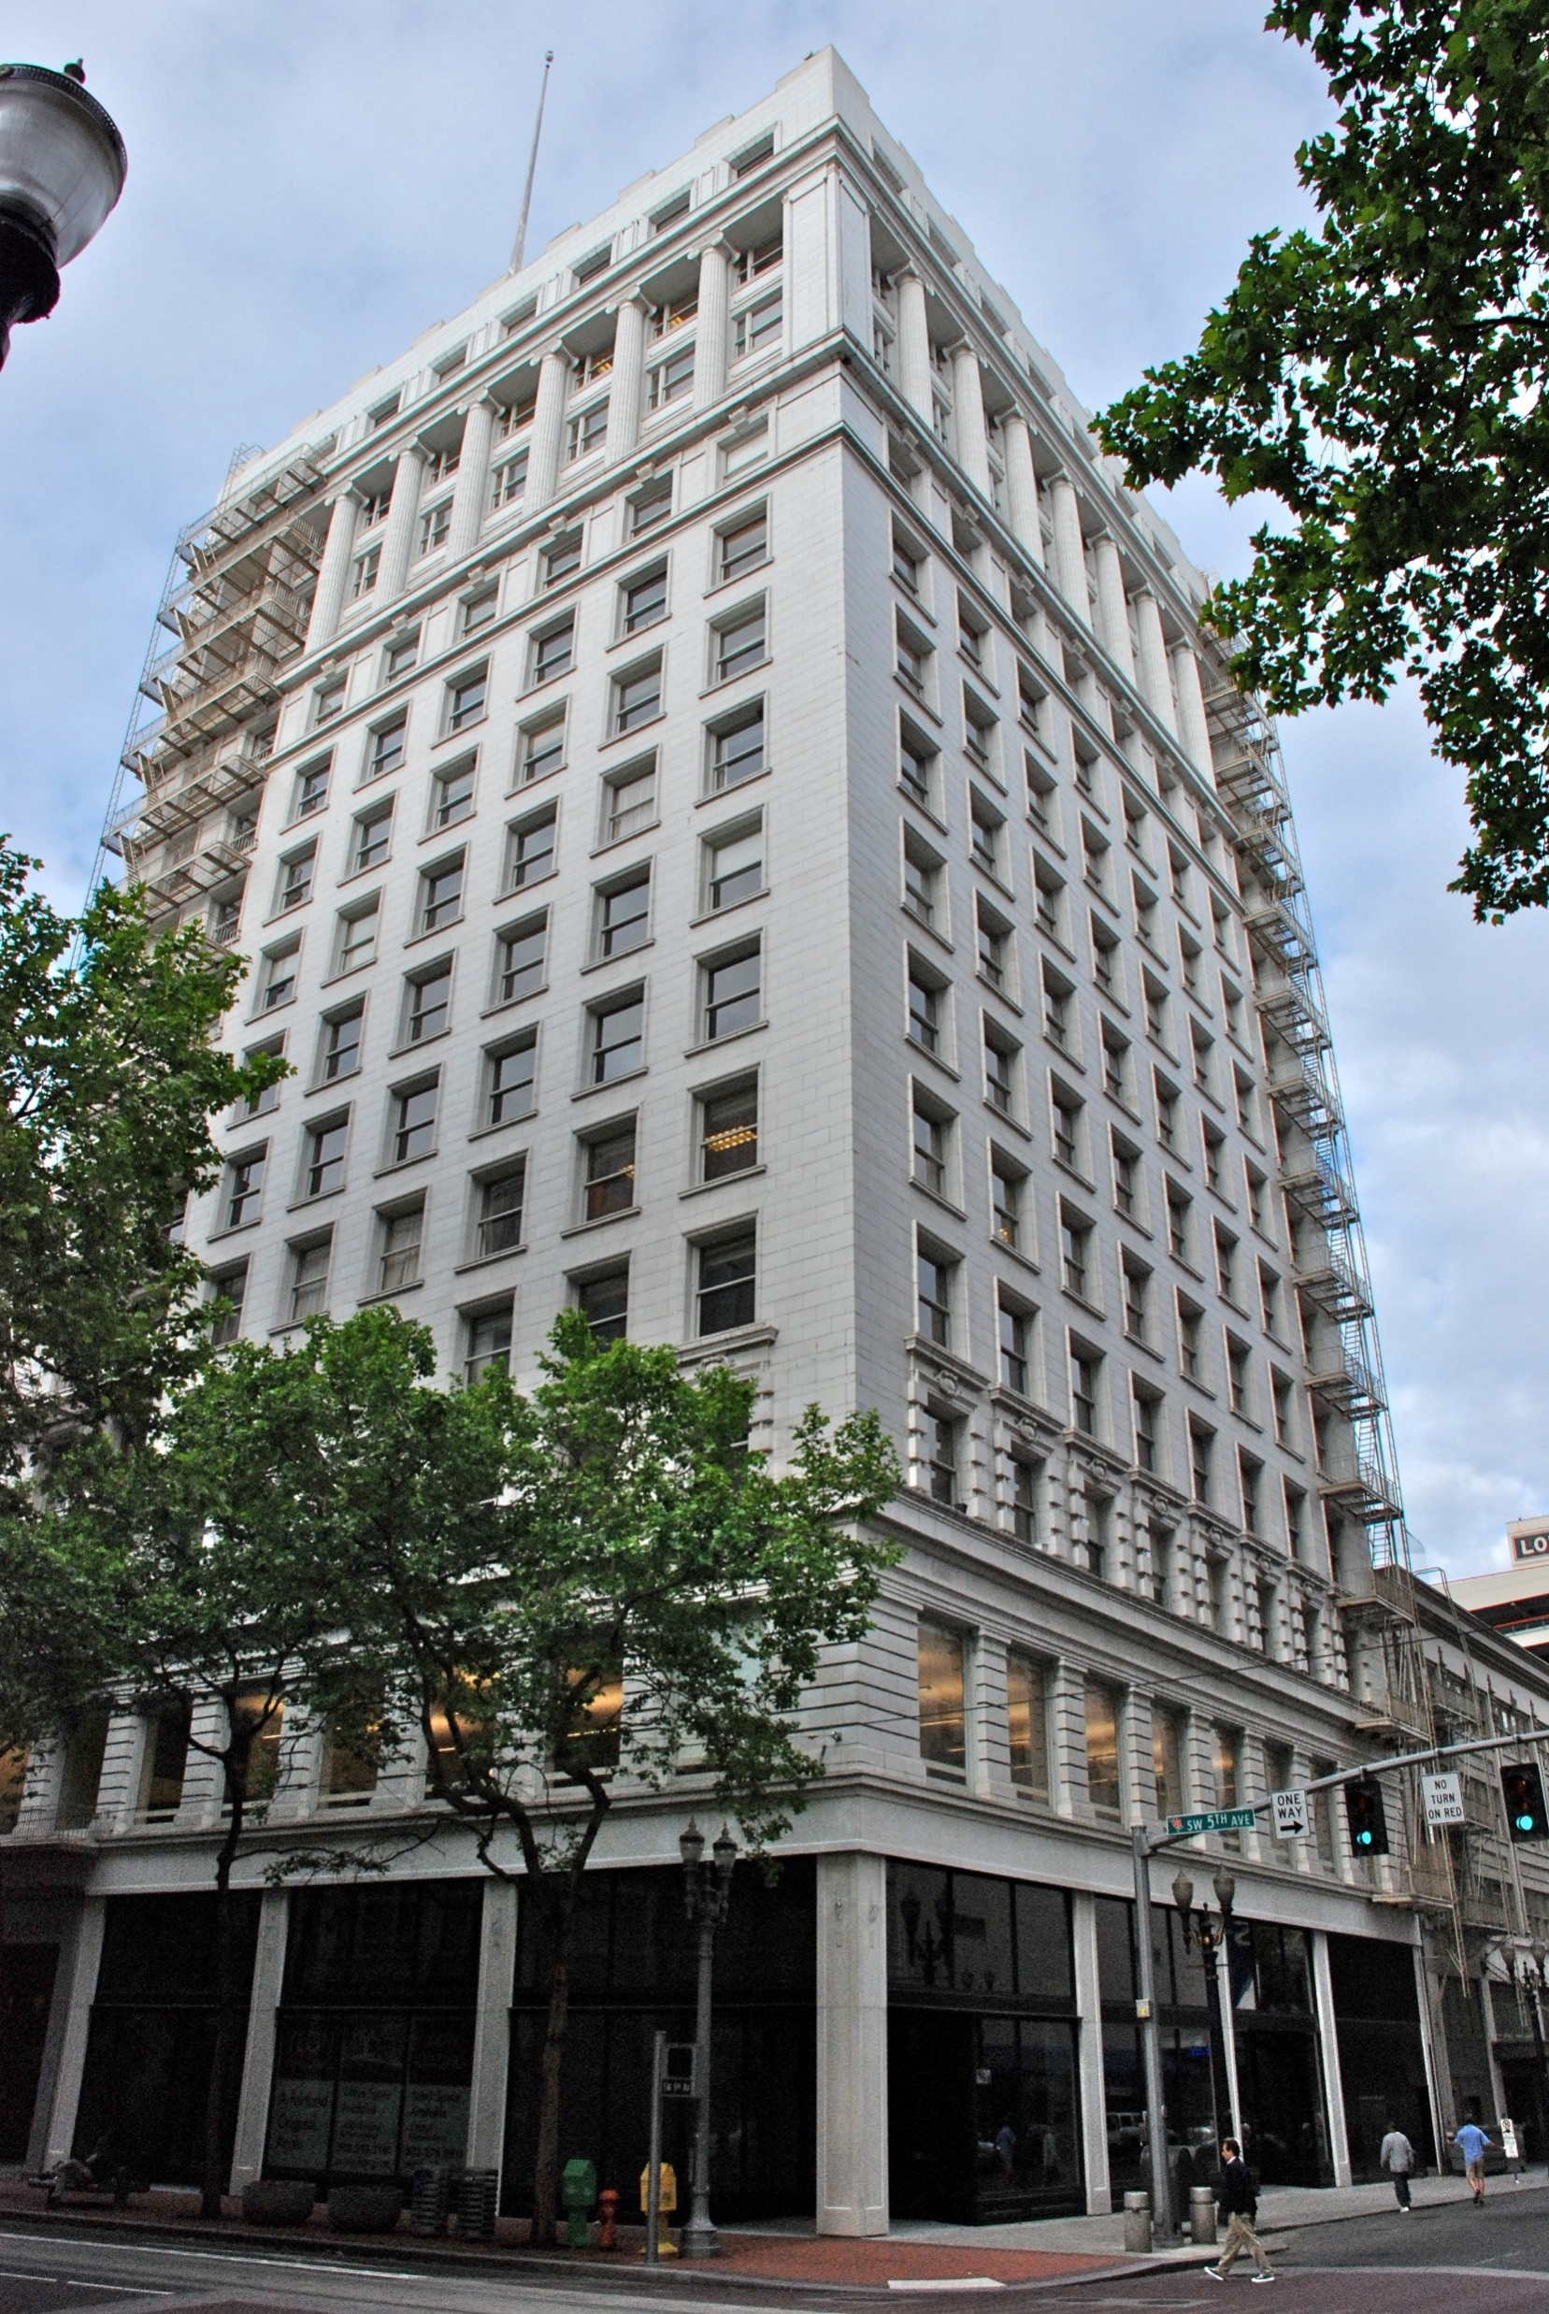
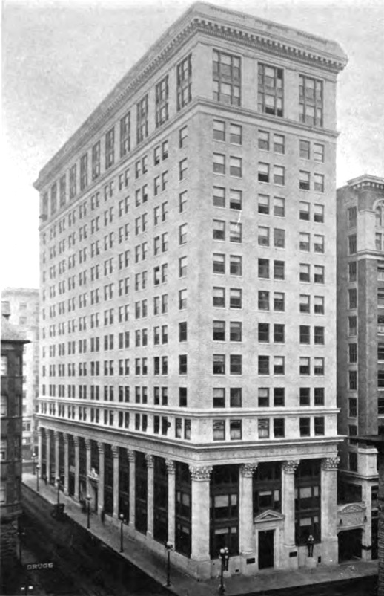
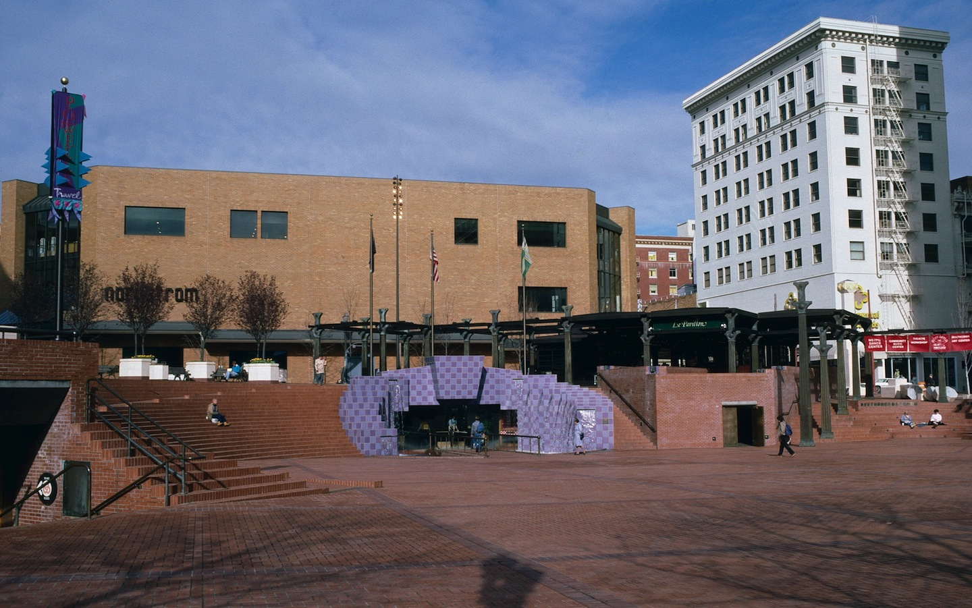
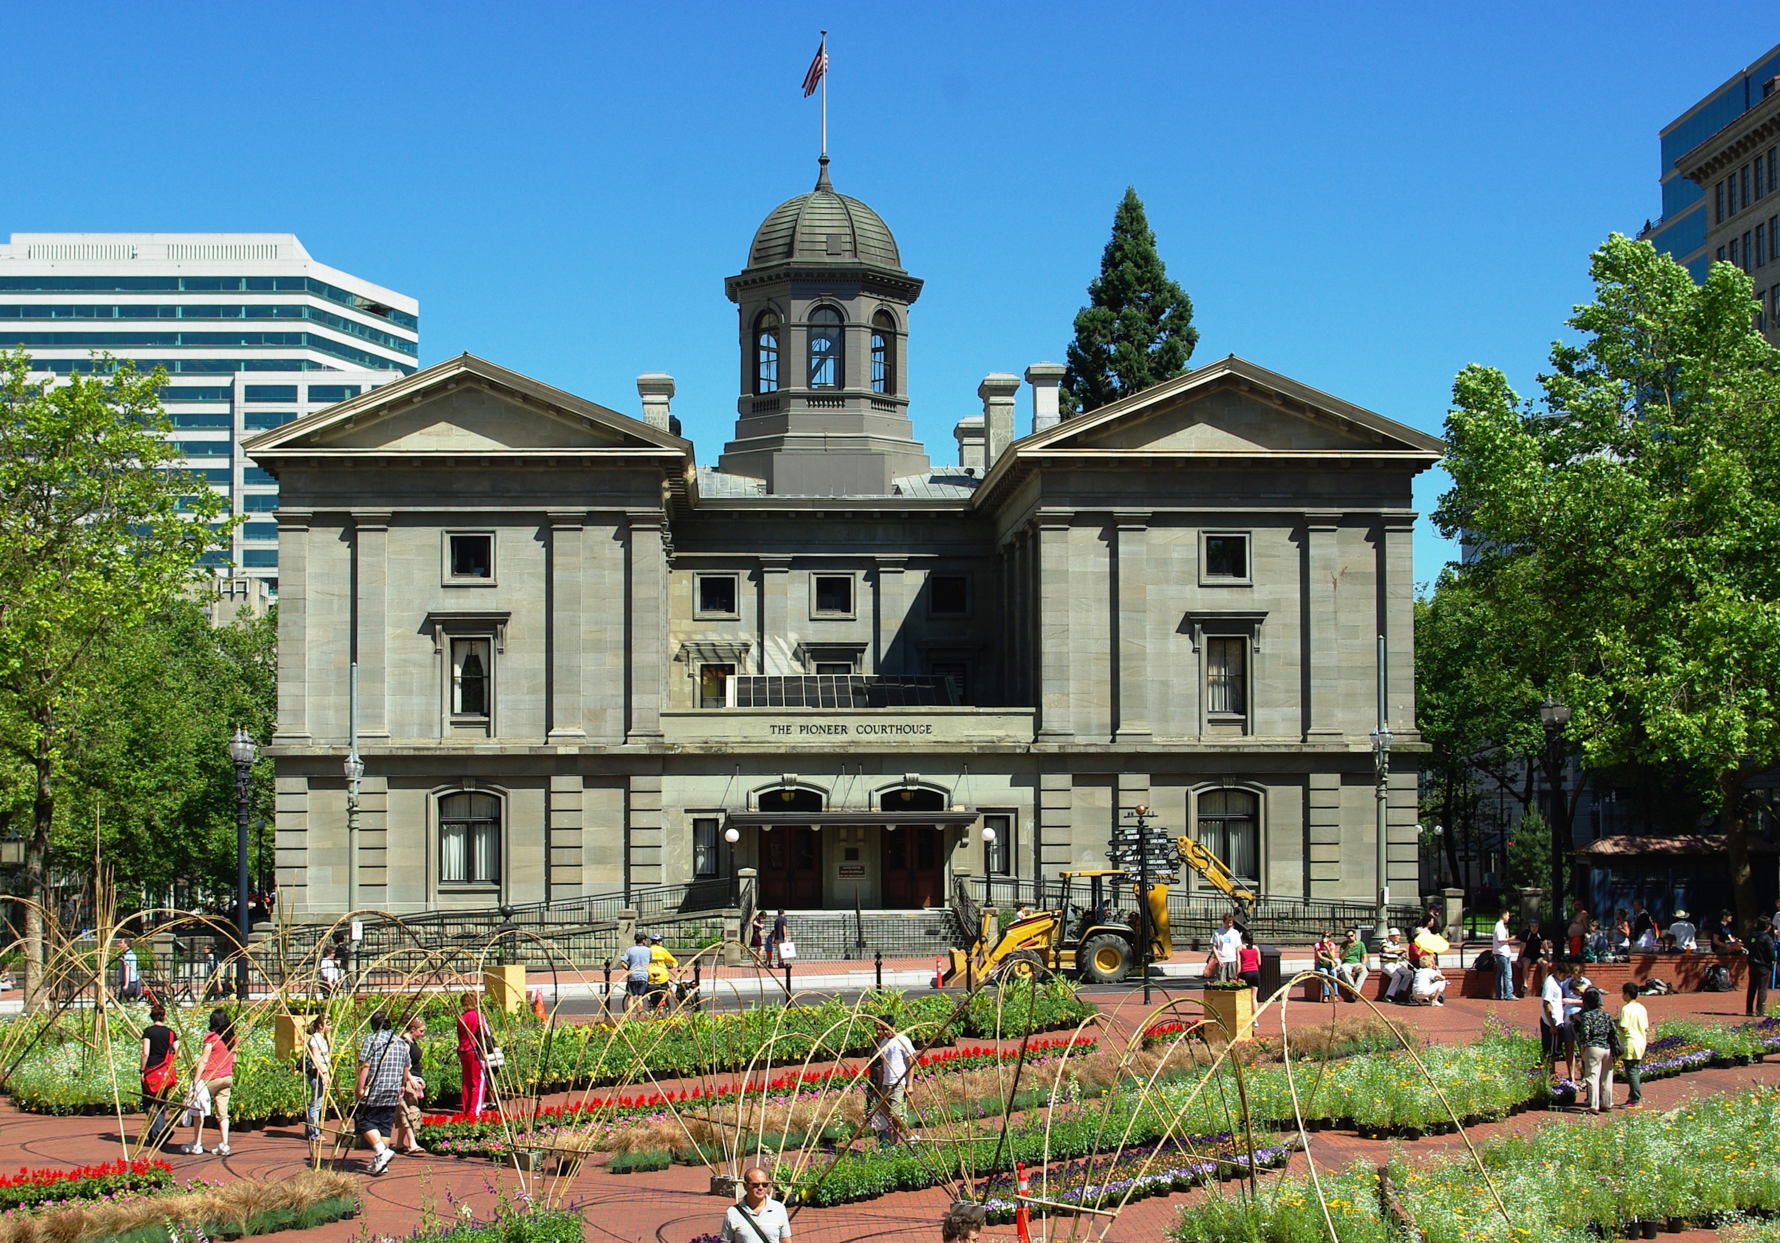
Neighborhood Context

Slide 6
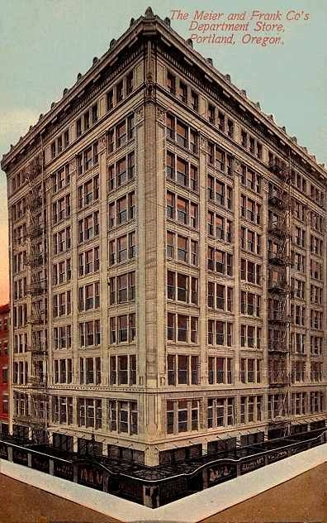
Proposal
List from DAR
Renovating the historic Meier and Frank building
Rearranging Louvers
Creation of a new storefront entry
Replacement of garage door entries with person entries
Includes alterations to thresholds for accessibility.
Proposal for an upper floor loggia
Removal of awnings
Creation of new entry awnings
Alterations to Alder St. awning
New signage*
New fascia plates at bays

Slide 7
Staff Recommendation (per Staff Report)
Approval
Outstanding Issues from Staff Report
Threshold details – Submitted last week
Signage – To be considered in a later review
Louvers and Windows
New Entry in Storefront
New Entries on Fifth and Sixth Ave
Awnings
“Mini DAR” Signage

Slide 8
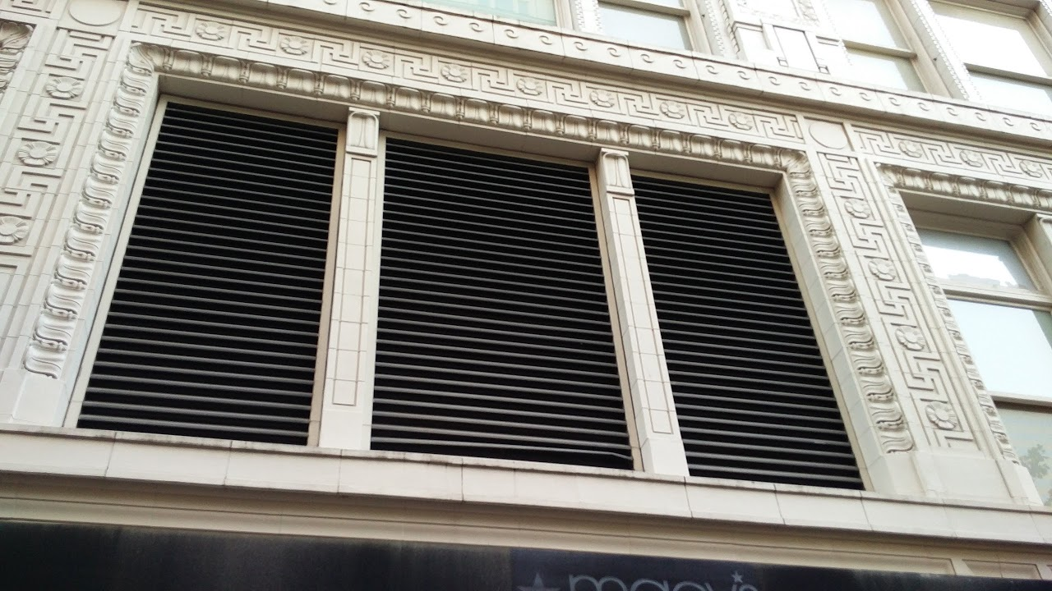
Staff Recommendation (per Staff Report)
Louvers and Windows

Slide 9
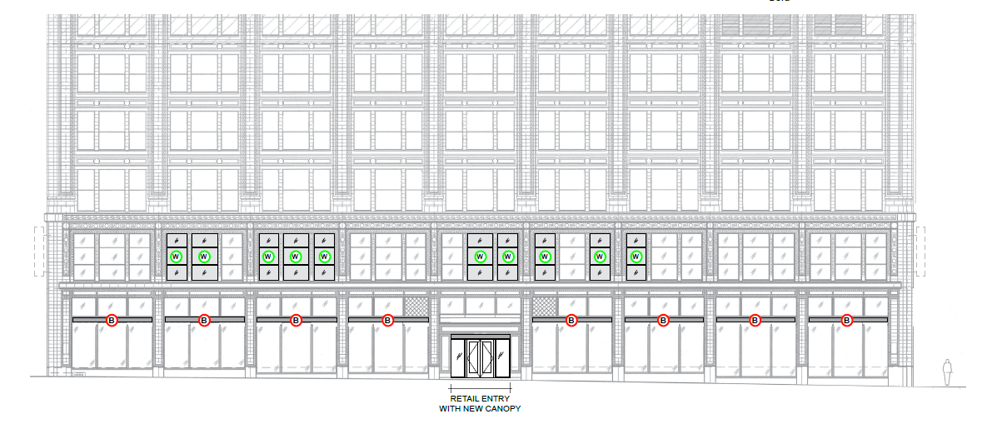
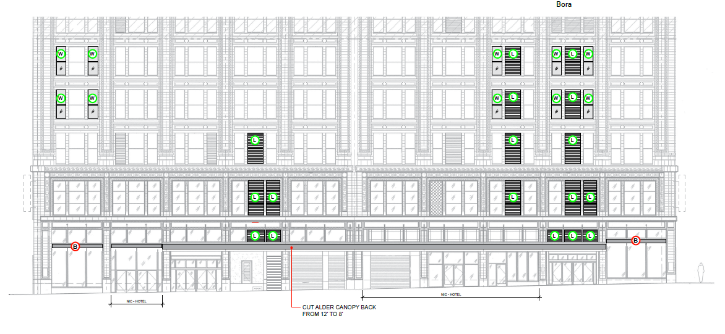

Slide 10
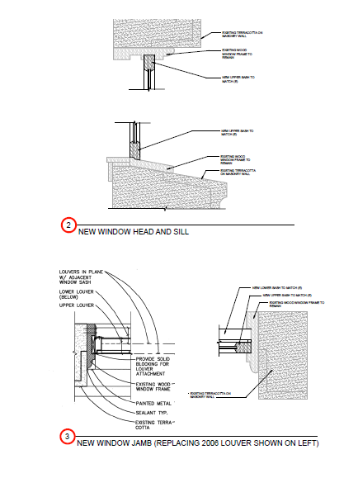
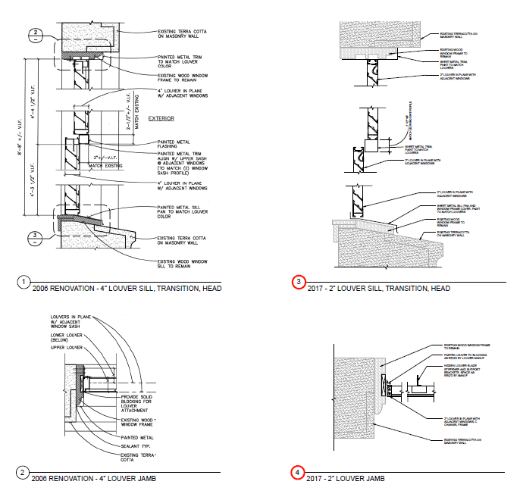
Staff Recommendation (per Staff Report)
Louvers and Windows

Slide 11
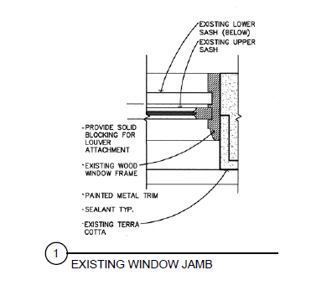
Staff Recommendation (per Staff Report)
Louvers and Windows

Slide 12
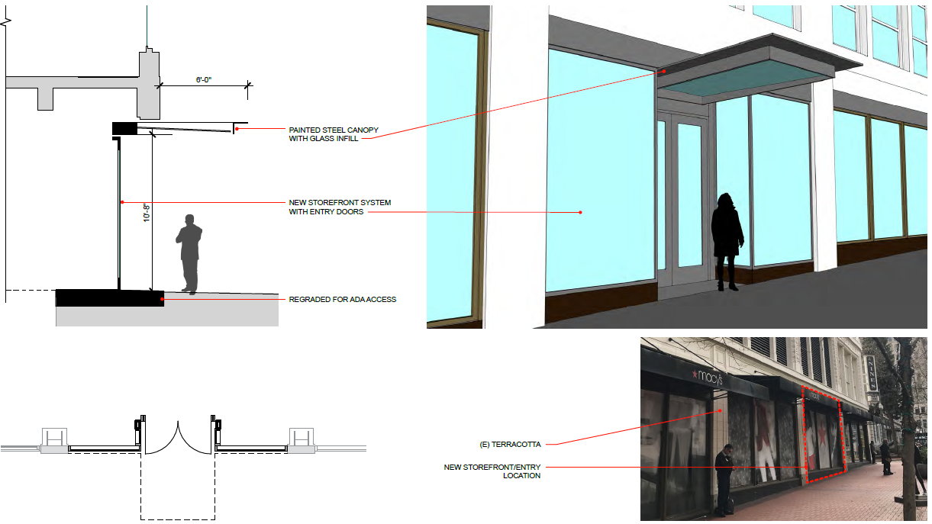
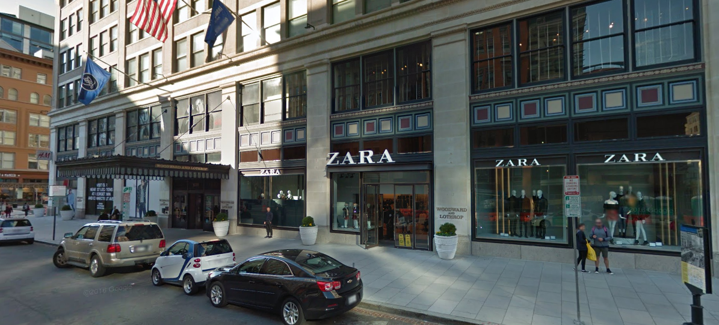
Staff Recommendation (per Staff Report)
New Entry in Storefront

Slide 13
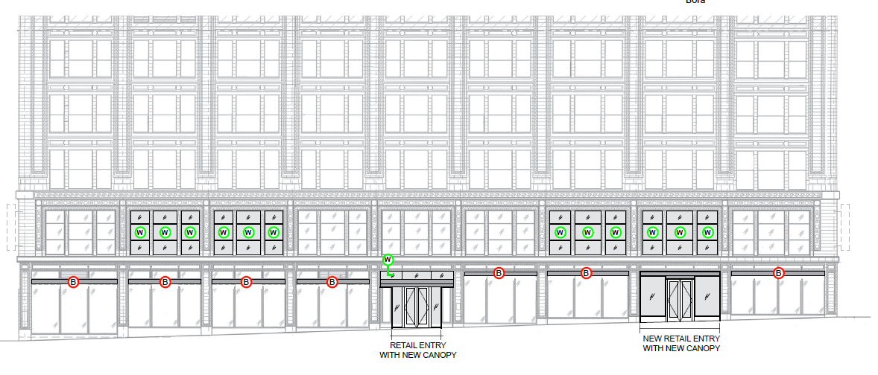
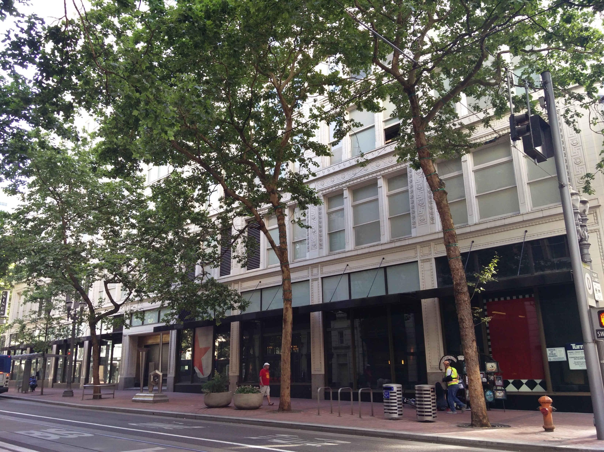
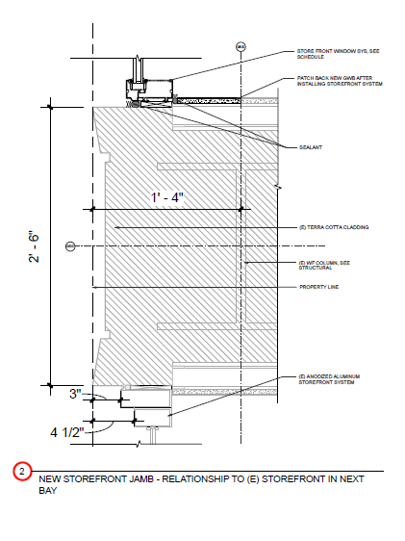
Staff Recommendation (per Staff Report)
New Entry in Storefront

Slide 14
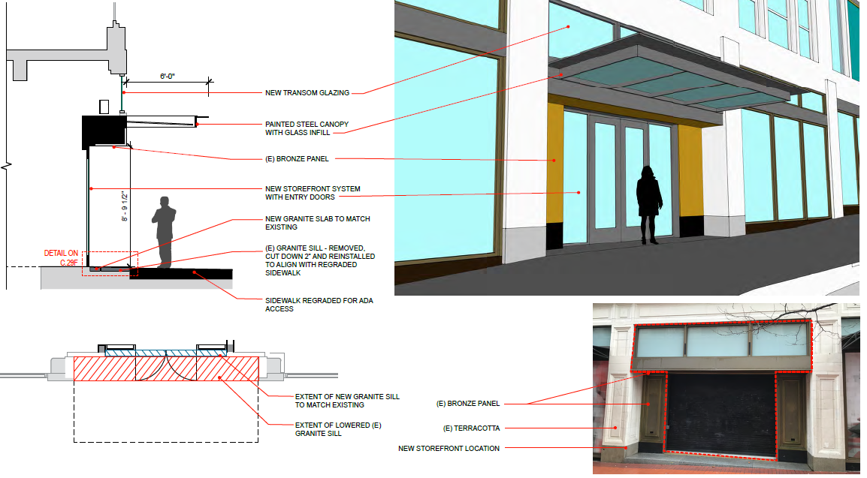
Staff Recommendation (per Staff Report)
New Entries on Fifth and Sixth Ave
Sixth Ave

Slide 15
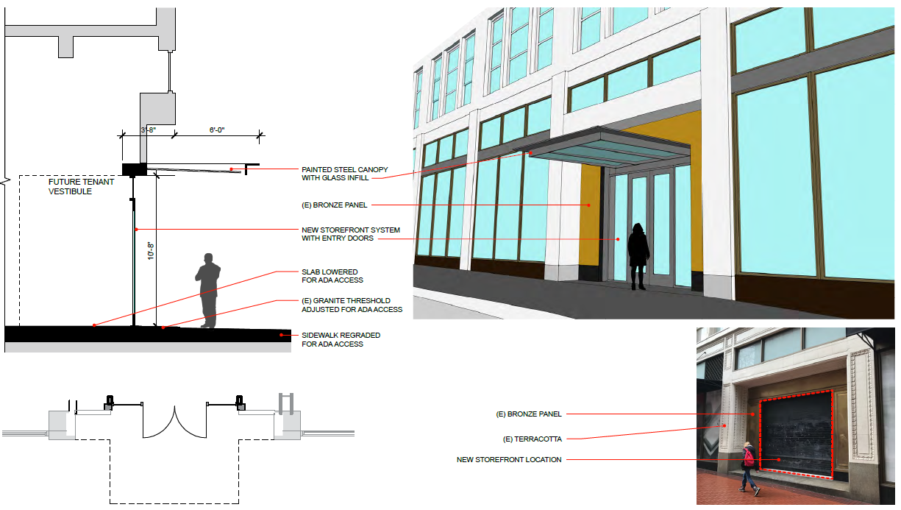
Staff Recommendation (per Staff Report)
New Entries on Fifth and Sixth Ave
Fifth Ave

Slide 16
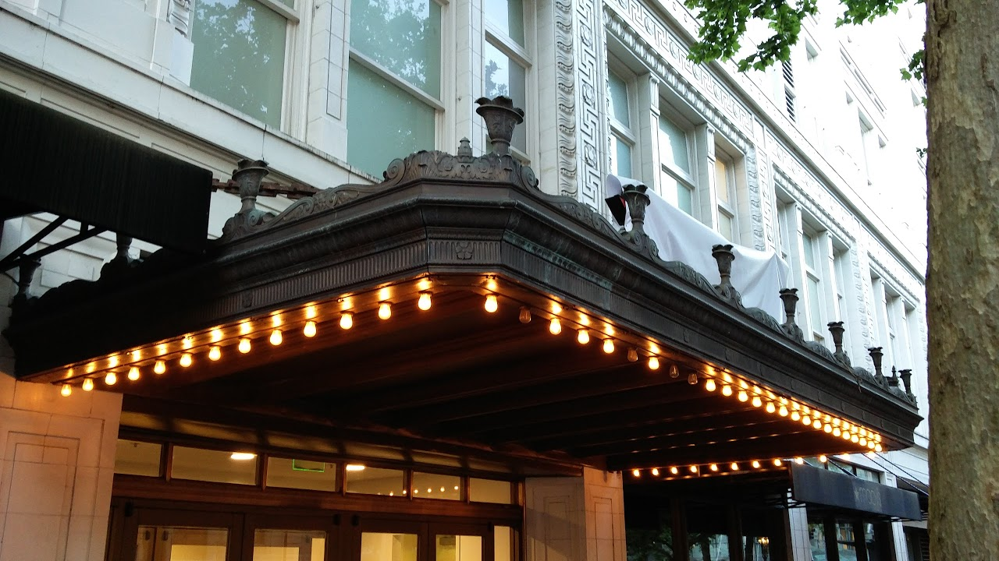
Staff Recommendation (per Staff Report)
Awnings

Slide 17
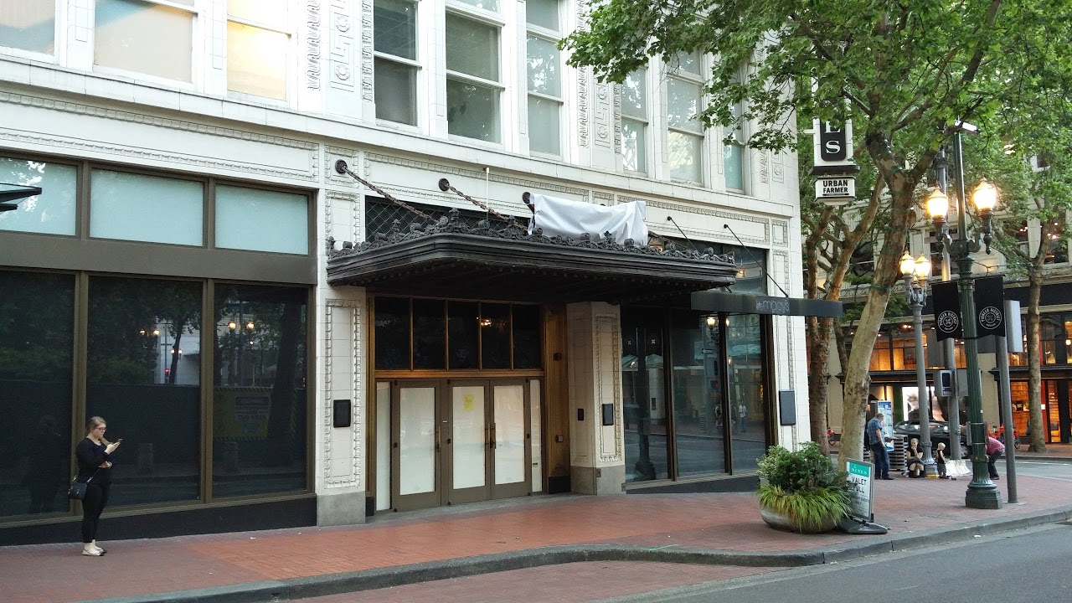
Staff Recommendation (per Staff Report)
Awnings

Slide 18
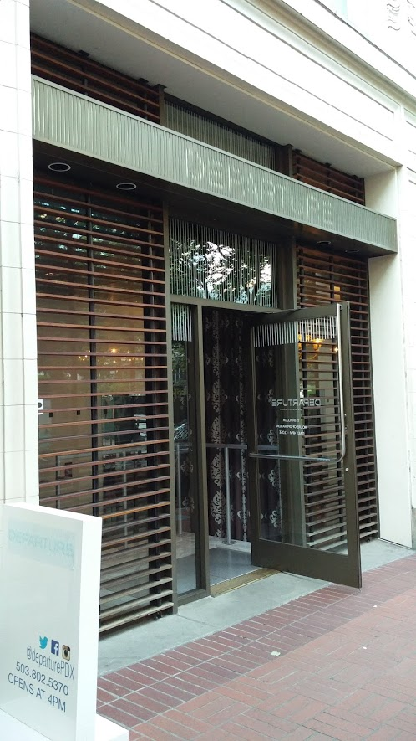
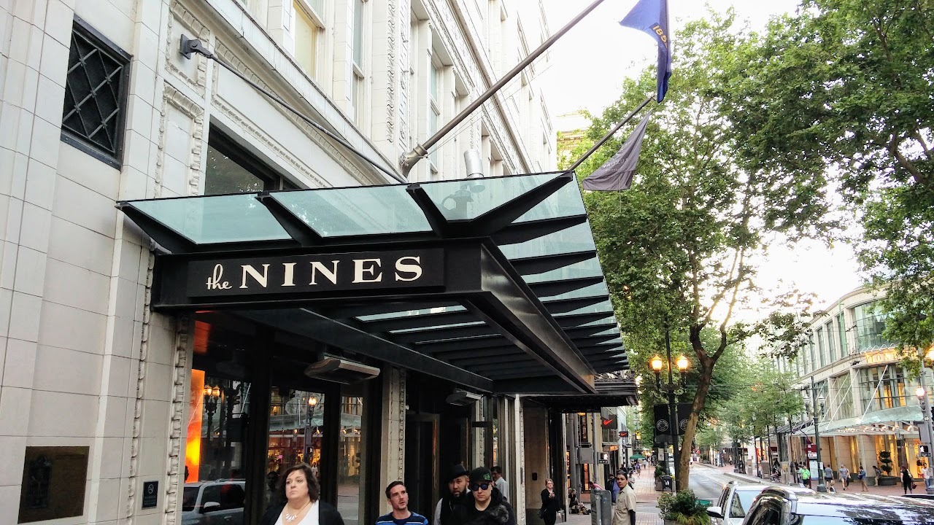
Staff Recommendation (per Staff Report)
Awnings

Slide 19
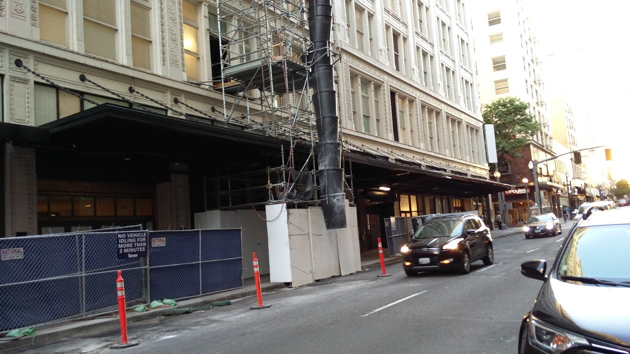
Staff Recommendation (per Staff Report)
Awnings
Alder Street Awning

Slide 20
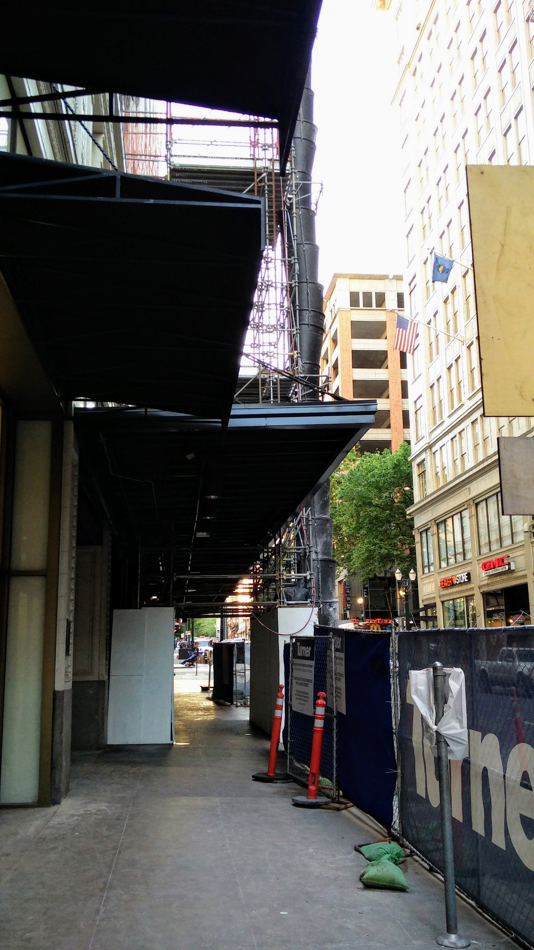
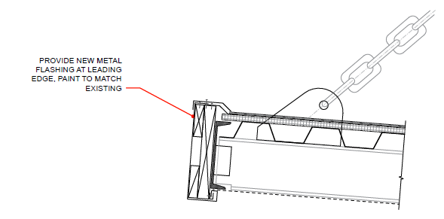
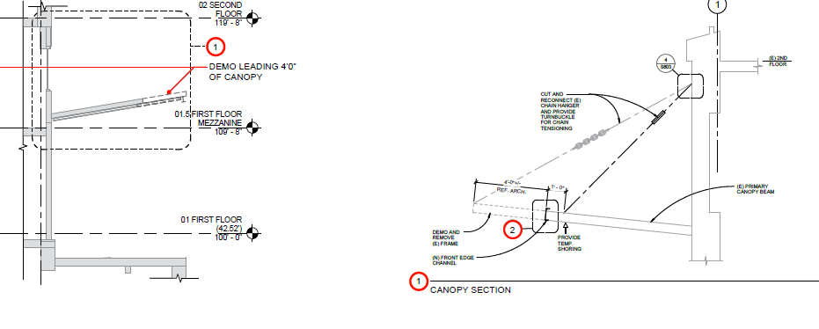
Staff Recommendation (per Staff Report)
Awnings
Alder Street Awning

Slide 21
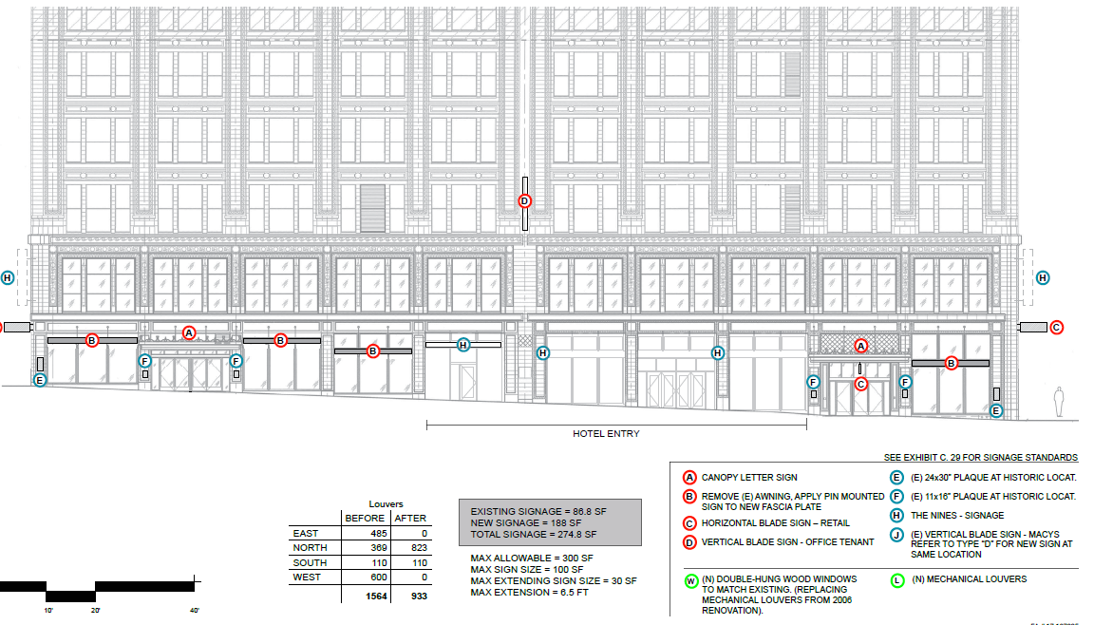
Staff Recommendation (per Staff Report)
Bonus Round: Signage
South

Slide 22
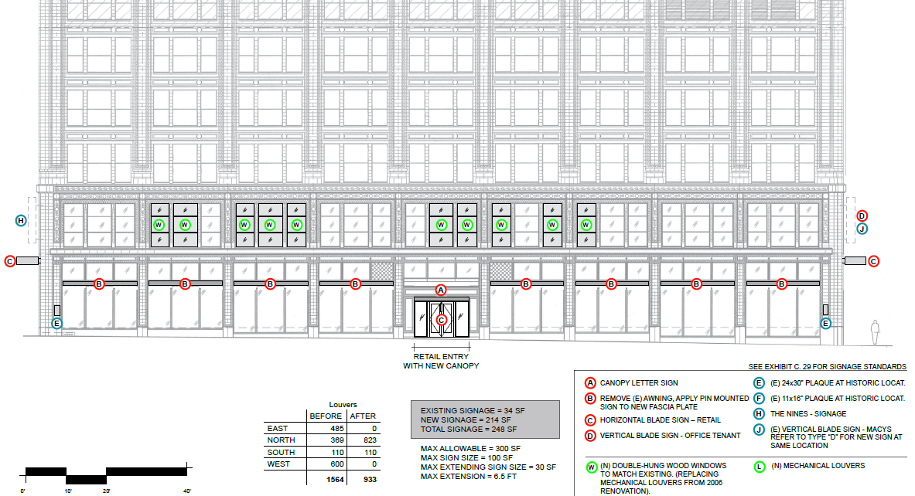
Staff Recommendation (per Staff Report)
Bonus Round: Signage
East

Slide 23
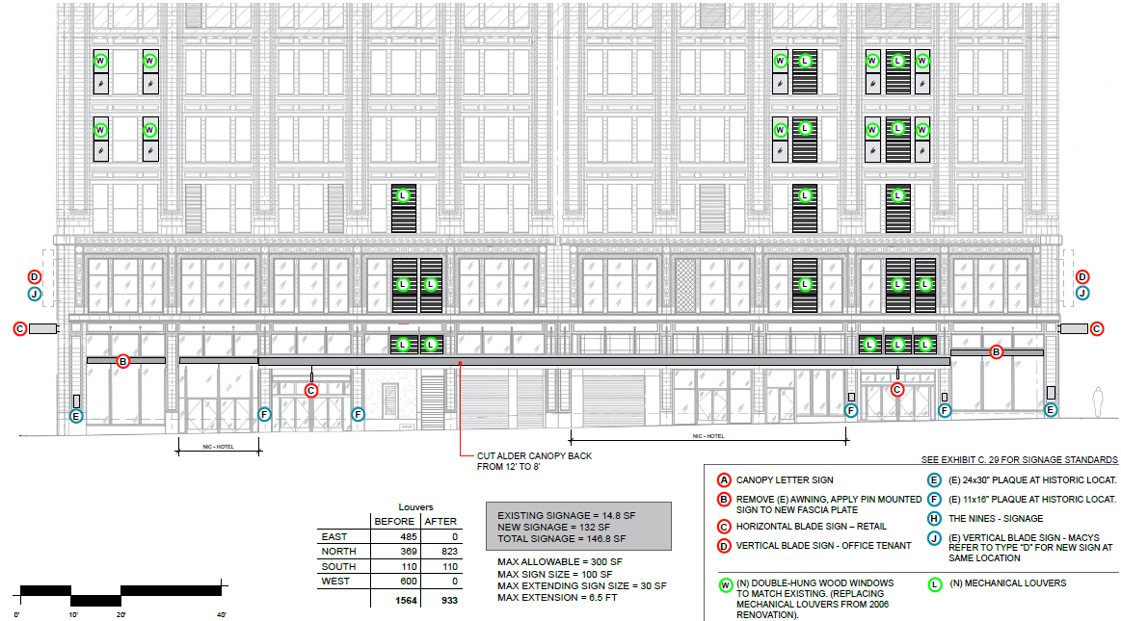
Staff Recommendation (per Staff Report)
Bonus Round: Signage
North

Slide 24
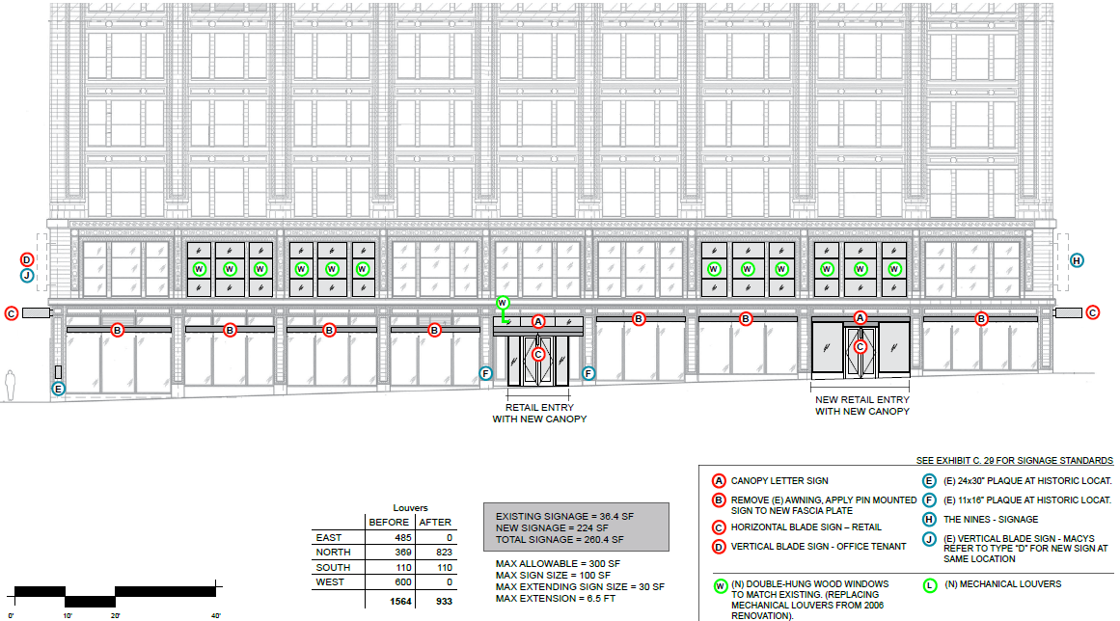
Staff Recommendation (per Staff Report)
Bonus Round: Signage
West

Slide 25
Staff Recommendation (per Staff Report)
Approval
Accept the staff report; Approve the application;
Request the Applicant to return with revisions;
Reject the staff report; Request staff to return with revised staff report of denial.

Slide 26
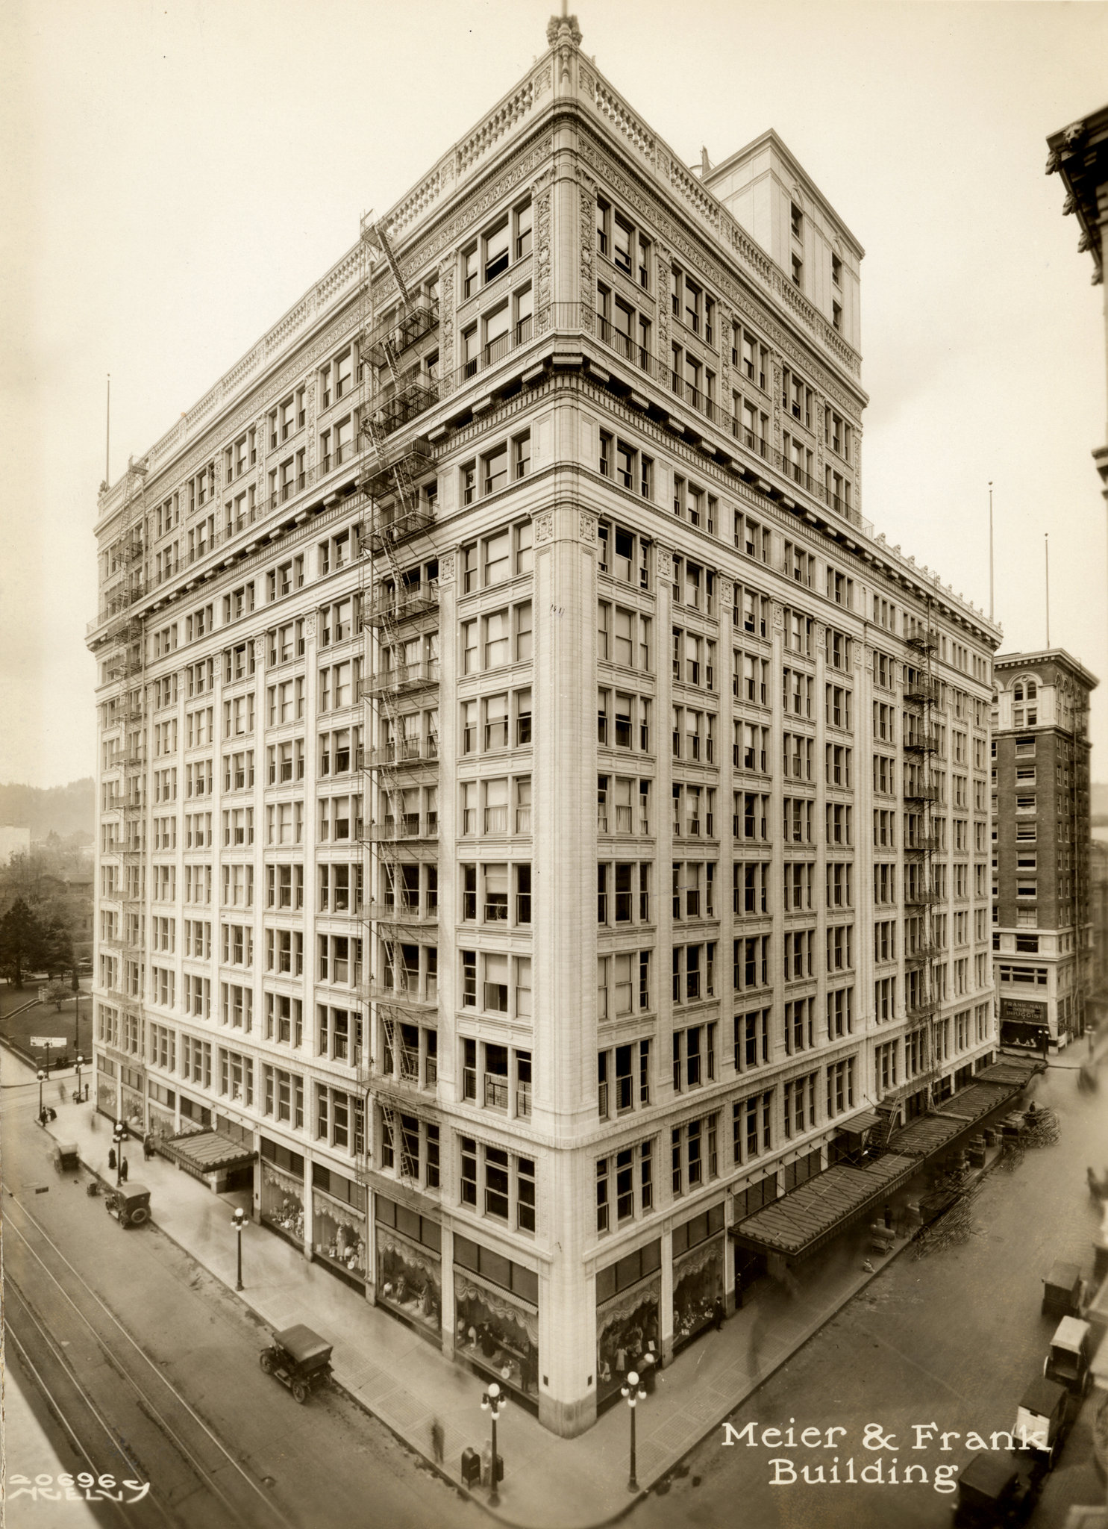
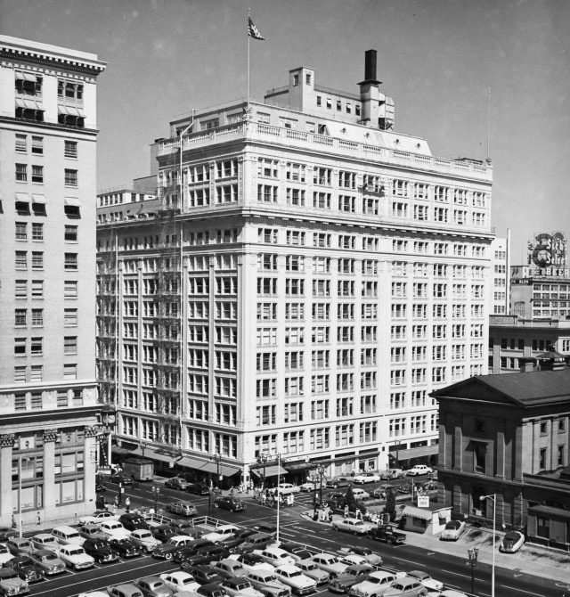
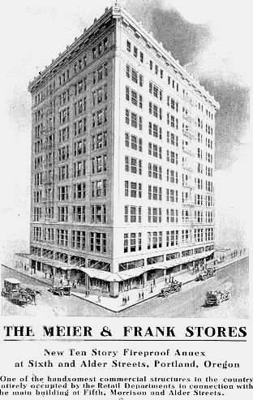
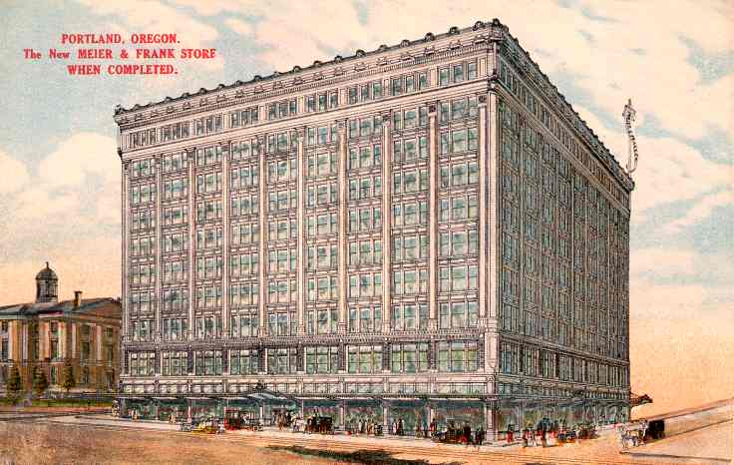
Questions

