Slide 1
Adjustment Review
LU 16-136475 AD
Staff presentation to adjustment committee
February 21, 2017

Slide 2

Site Location
SW corner of NE 53rd Ave. and NE Couch St.
1 block north of
E Burnside St.
Zoning
R1

Slide 3
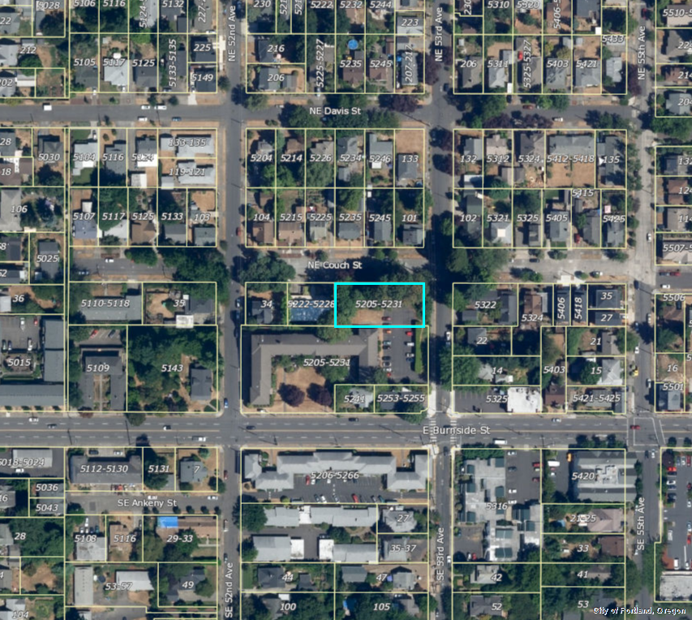
Site Location
SW corner of NE 53rd Ave. and NE Couch St.
1 block north of
E Burnside St.
Zoning
R1

Slide 4
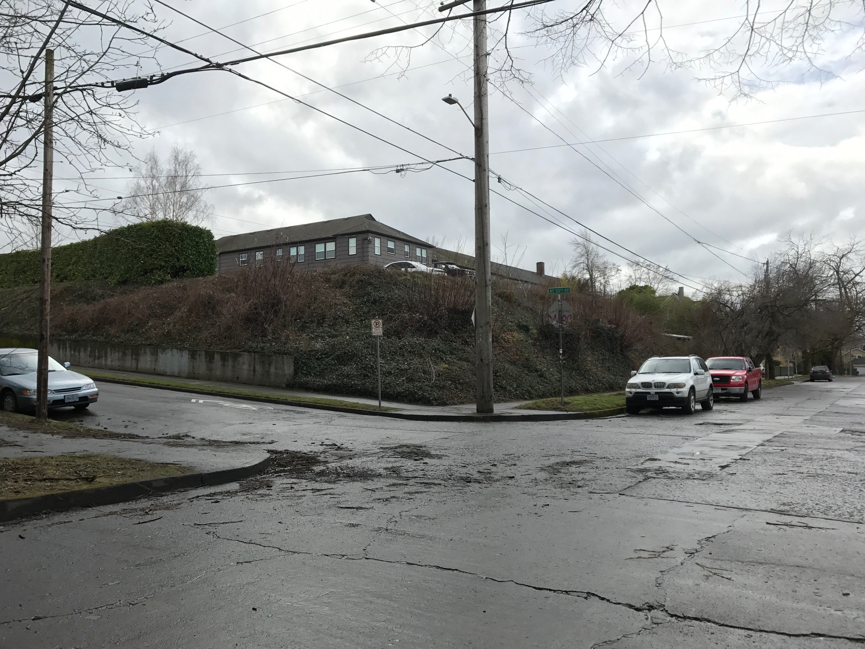
Site Location
SW corner of NE 53rd Ave. and NE Couch St.
1 block north of
E Burnside St.
Zoning
R1
Looking southwest from corner of
NE 53rd Ave. & NE Couch St.

Slide 5
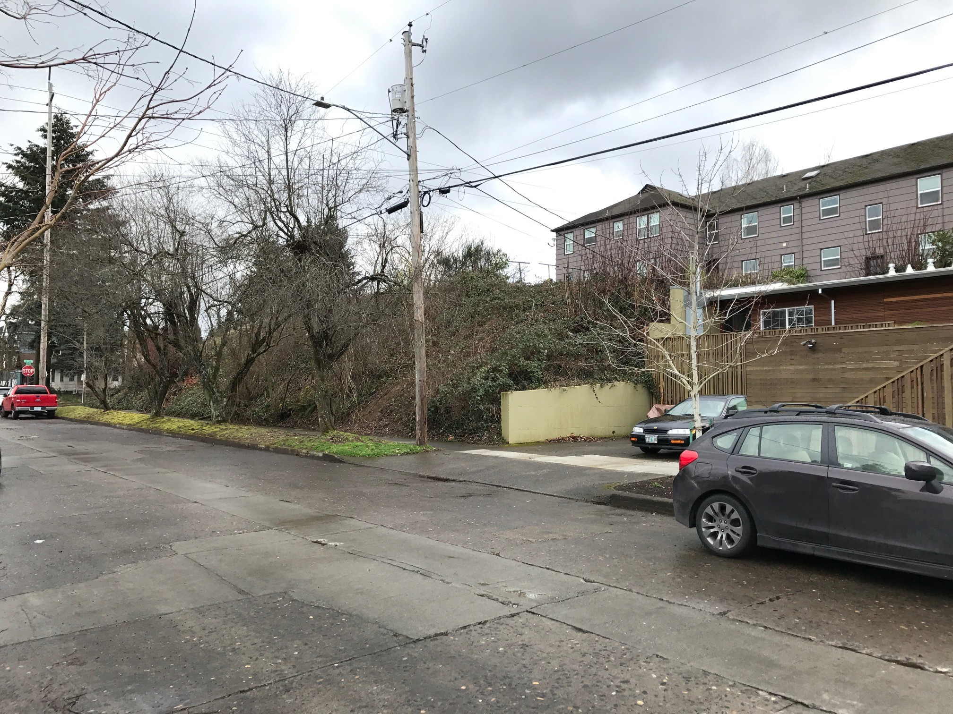
Site Location
SW corner of NE 53rd Ave. and NE Couch St.
1 block north of
E Burnside St.
Zoning
R1
Looking southeast toward the site
from across NE Couch St.

Slide 6
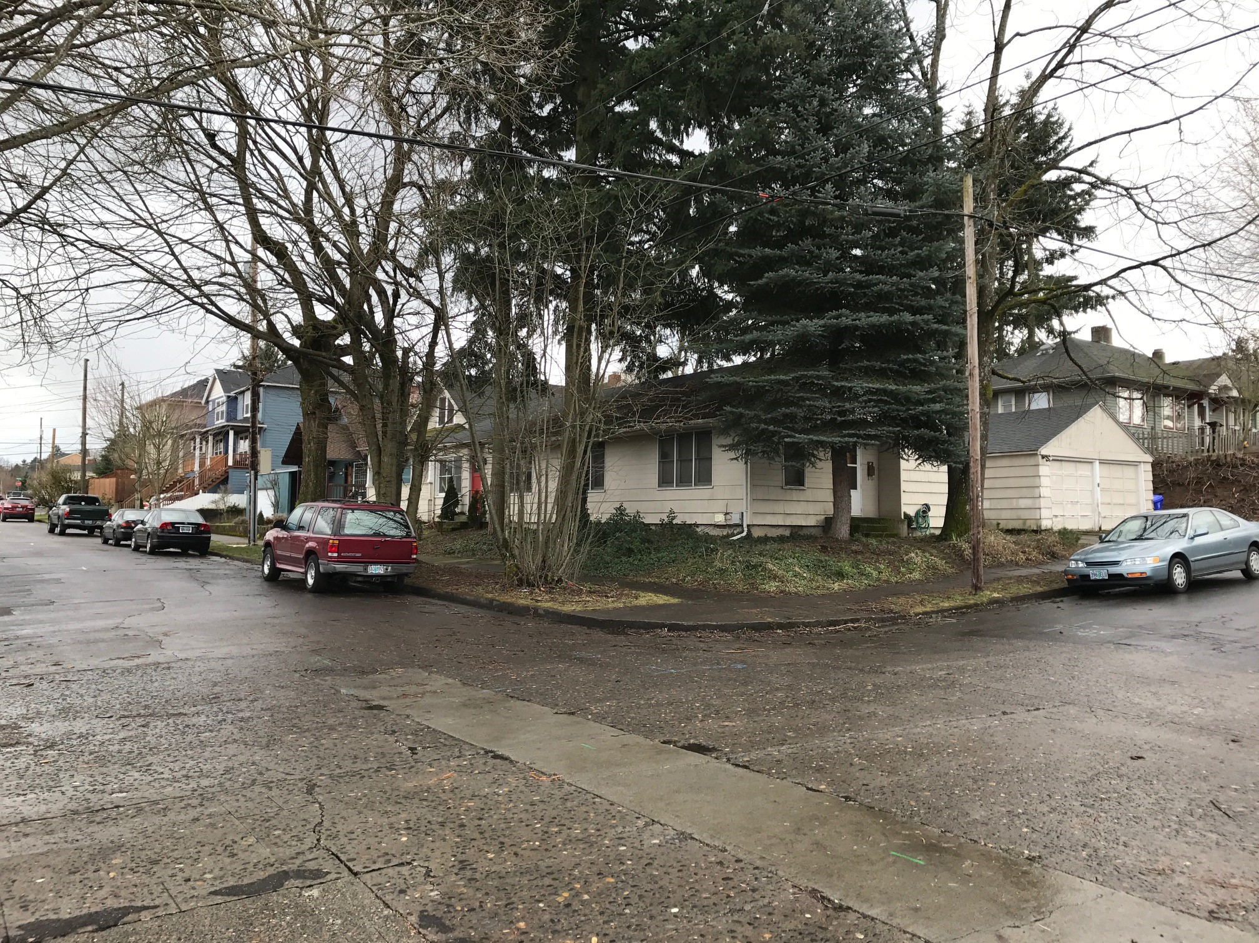
Site Location
SW corner of NE 53rd Ave. and NE Couch St.
1 block north of
E Burnside St.
Zoning
R1
Looking southeast from corner of
NE 53rd Ave. & NE Couch St.

Slide 7
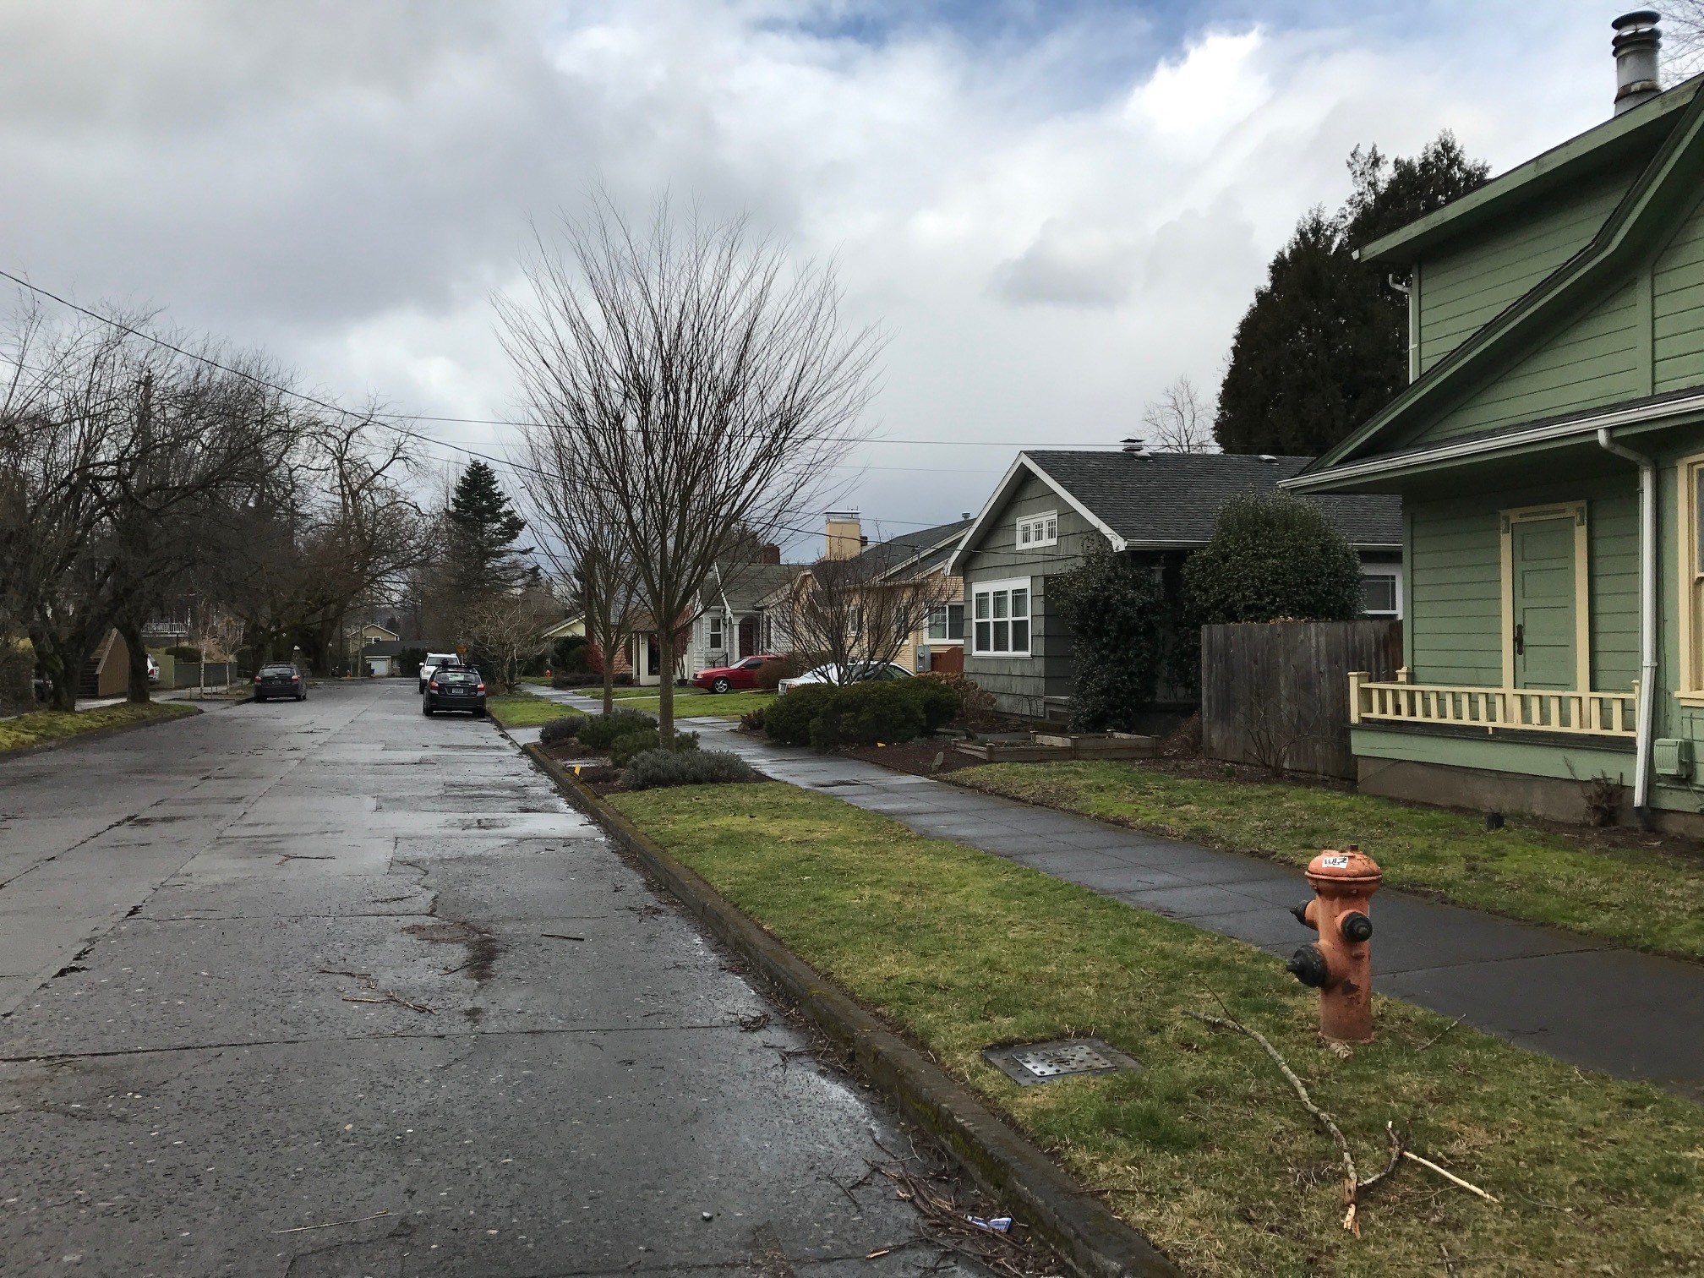
Site Location
SW corner of NE 53rd Ave. and NE Couch St.
1 block north of
E Burnside St.
Zoning
R1
Looking west at north side of NE Couch St., across the street from the site

Slide 8
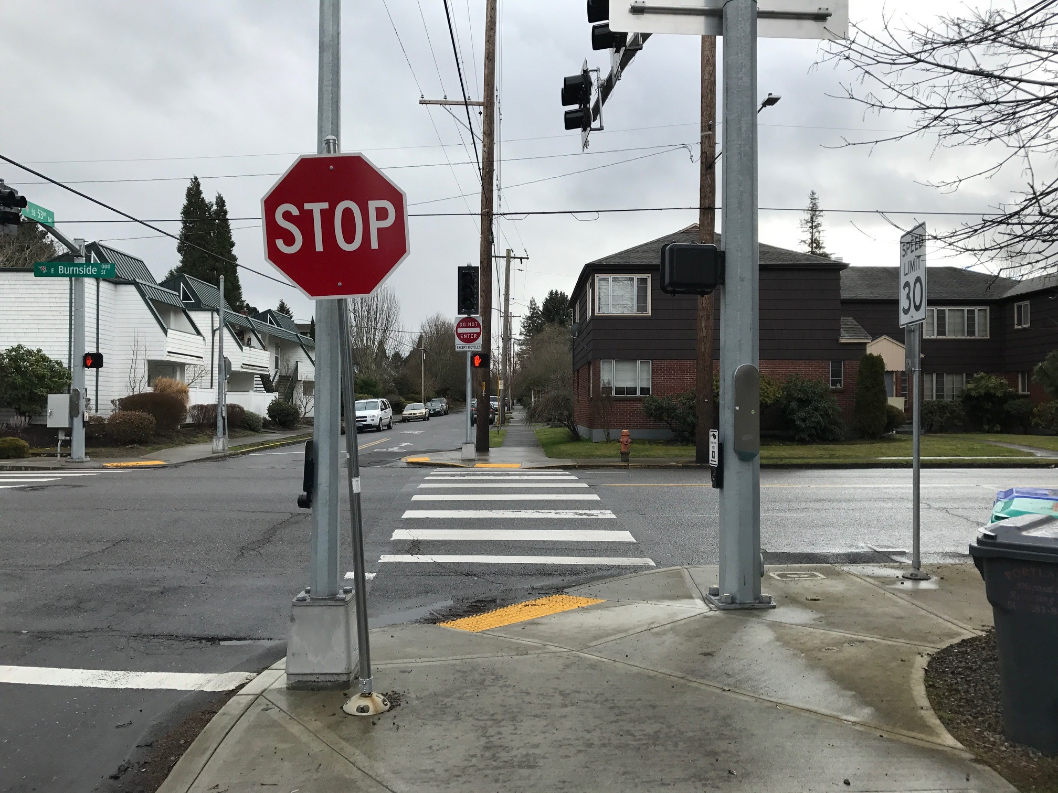
Site Location
SW corner of NE 53rd Ave. and NE Couch St.
1 block north of
E Burnside St.
Zoning
R1
Looking south toward corner of
NE 53rd Ave. & E Burnside St.

Slide 10
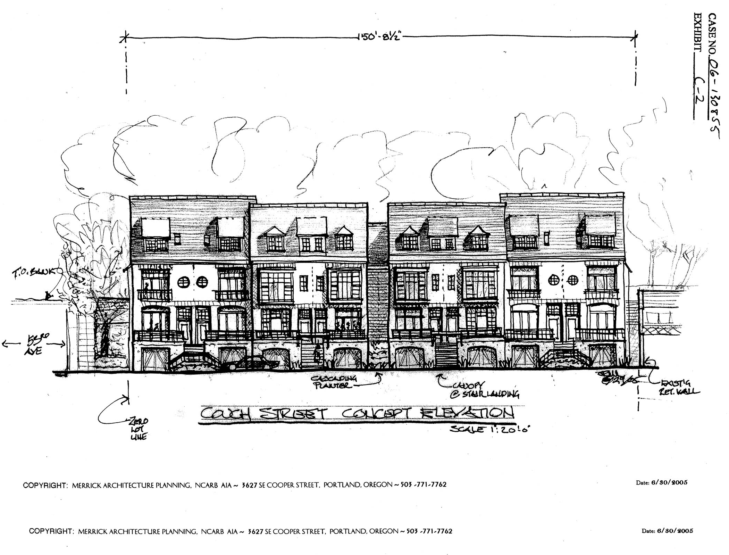

Slide 12
Adjustments Requested
Setback from east lot line (abutting NE 53rd Ave):
    Reduce required setback from east lot line from 3 feet to 1’-7” for the main wall, to 7” for bay windows, and to zero for the eave
Setback from west lot line:
    Reduce required setback from west lot line from 8 feet to 4’-5” for the main wall and to 2’-5” for the eave
Building length:
    Increase allowable building length within 30 feet of the north lot line from 100 feet to 146 feet

Slide 13
Relevant Adjustment Approval Criteria (33.805.040)
Granting the Adjustment will equally or better meet the purposes of the regulations to be modified.
Purpose of setback standard:
Maintain light, air, fire safety, privacy, reasonable physical relationship between residences, neighborhood compatibility, and reflect the general building scale and placement of multi- dwelling development in the neighborhood.
Purpose of building length standard
Limit the amount of bulk placed close to the street, ensure long building walls close to streets are broken up into separate buildings, and provide a feeling of transition from lower density development

Slide 14
Relevant Adjustment Approval Criteria (33.805.040)
B. If in a residential zone, the proposal will not significantly detract from the livability or appearance of the residential area.

Slide 15
Relevant Adjustment Approval Criteria (33.805.040)
C. The cumulative effect of the Adjustments results in a project which is still consistent with the overall purpose of the zone.

Slide 16
Relevant Adjustment Approval Criteria (33.805.040)
E. Any impacts resulting from the Adjustment are mitigated to the extent practical.

Slide 17
Appeal by North Tabor Neighborhood Association:
Adjustments not compatible with
neighborhood
Physical relationship with south neighbors
not addressed

