Slide 1
Adjustment Review
LU 16-206216 AD
LU 16-206228 AD
Staff presentation to adjustment committee
February 7, 2017

Slide 2
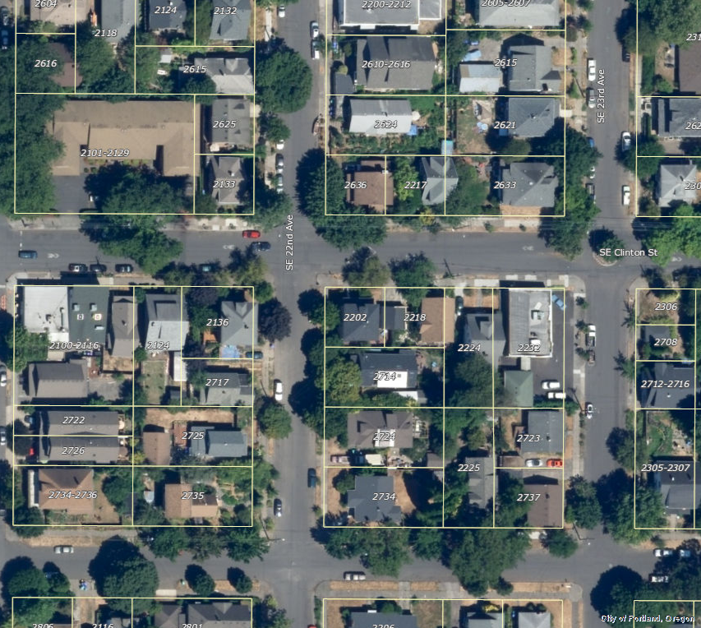
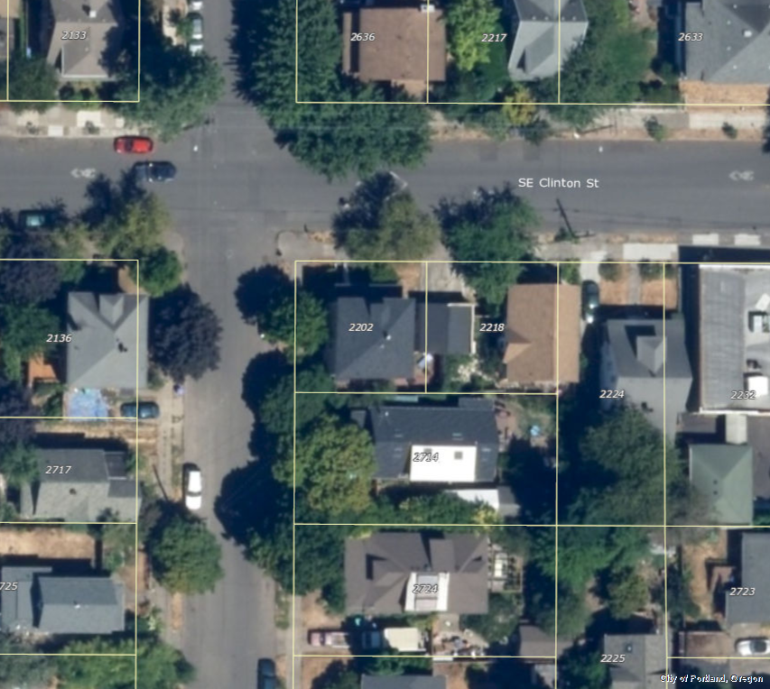

Site Locations
SE corner of SE 22nd Ave. & SE Clinton St.
2 blocks south of SE Division St.
Site Areas
2202 SE Clinton:
2,480 sf
2218 SE Clinton:
2,520 sf
LU 16-206216 AD
LU 16-206228 AD
LU 16-206216 AD
LU 16-206228 AD

Slide 3
Site Locations
SE corner of SE 22nd Ave. & SE Clinton St.
2 blocks south of SE Division St.
Site Areas
2202 SE Clinton:
2,480 sf
2218 SE Clinton:
2,520 sf
LU 16-206216 AD
LU 16-206228 AD

Slide 4
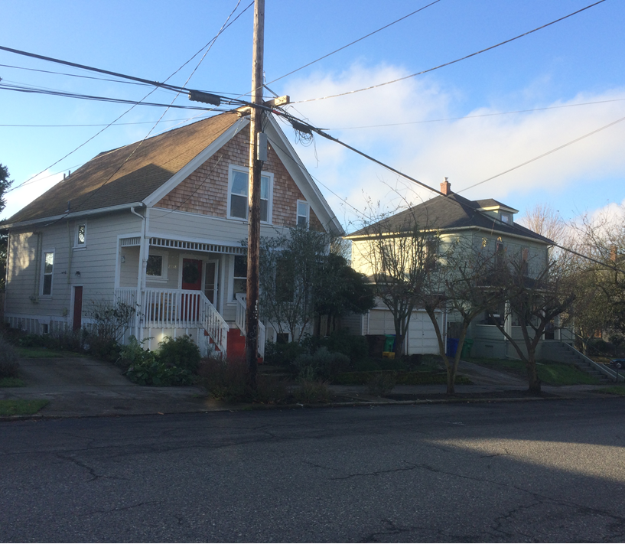
Site Locations
SE corner of SE 22nd Ave. & SE Clinton St.
2 blocks south of SE Division St.
Site Areas
2202 SE Clinton:
2,480 sf
2218 SE Clinton:
2,520 sf
INSERT PHOTO

Slide 5
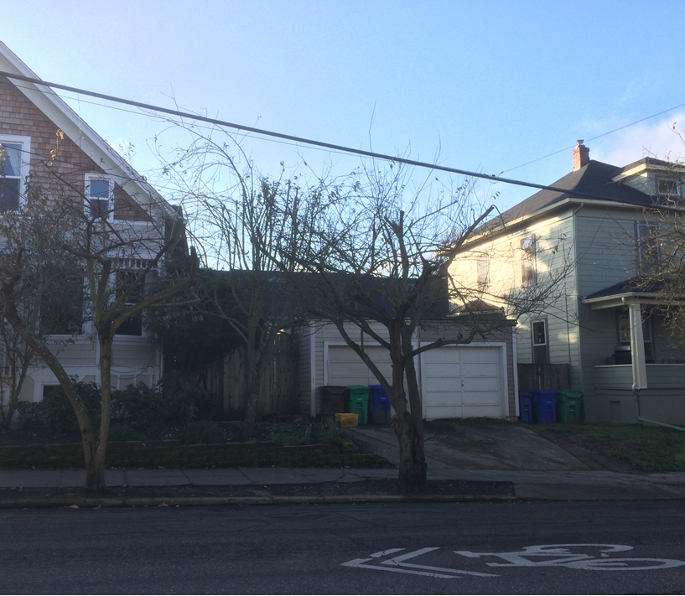
Site Locations
SE corner of SE 22nd Ave. & SE Clinton St.
2 blocks south of SE Division St.
Site Areas
2202 SE Clinton:
2,480 sf
2218 SE Clinton:
2,520 sf

Slide 6
Site Locations
SE corner of SE 22nd Ave. & SE Clinton St.
2 blocks south of SE Division St.
Site Areas
2202 SE Clinton:
2,480 sf
2218 SE Clinton:
2,520 sf

Slide 8
Adjustments Requested
Outdoor area:
    Reduce minimum width of outdoor area from 12 feet to 7.5 feet for LU 16-206216 AD and to 11.25 feet for LU 16-206228 AD
Side setback:
    Reduce side setback requirement from 5 feet to zero on both sites to allow buildings to be attached
ADU front setback:
    Reduce minimum front setback for a detached ADU from 40 feet to 16 feet for both sites

Slide 9
Relevant Adjustment Approval Criteria (33.805.040)
Granting the Adjustment will equally or better meet the purposes of the regulations to be modified.
Purpose of outdoor area standard:
  Assure opportunities for outdoor relaxation or recreation.
Purpose of minimum side setback standard:
Maintain light, air, fire safety, privacy, reasonable physical relationship between homes, and reflect the general building scale and placement of houses in the neighborhood.
Purpose of ADU development standards (including 40’ setback):
Ensure that ADUs are smaller than primary houses and are compatible with neighborhood character and the general building scale and placement of structures in the neighborhood.

Slide 10
Relevant Adjustment Approval Criteria (33.805.040)
B. If in a residential zone, the proposal will not significantly detract from the livability or appearance of the residential area.

Slide 11
Relevant Adjustment Approval Criteria (33.805.040)
C. The cumulative effect of the Adjustments results in a project which is still consistent with the overall purpose of the zone.

Slide 12
Relevant Adjustment Approval Criteria (33.805.040)
E. Any impacts resulting from the Adjustment are mitigated to the extent practical.

Slide 13
Adjustment Review
LU 16-206216 AD
LU 16-206228 AD
Staff presentation to adjustment committee
December 20, 2016

