Slide 1
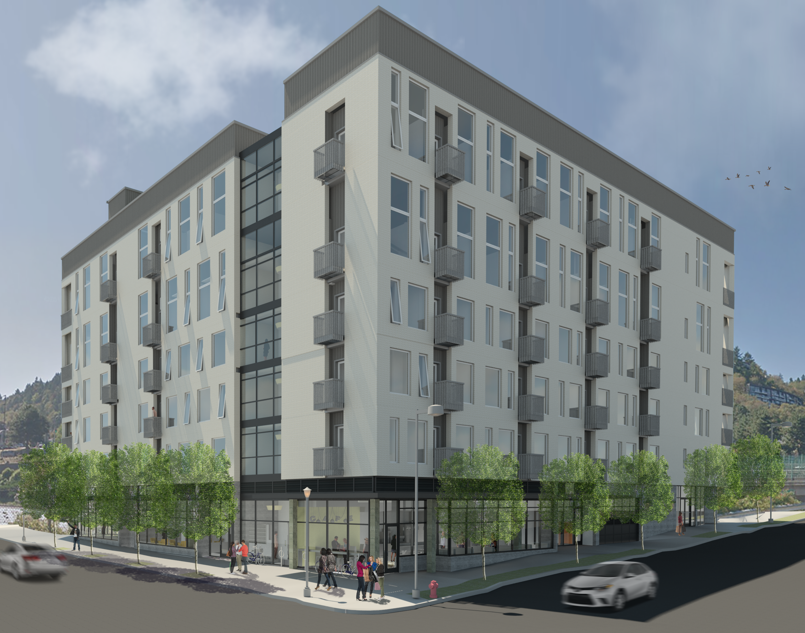

Design Review Hearing
2211 SW 4th Avenue
Portland, Oregon
LU 16-115888
July 21, 2016
Notes:
Cathy
Introduction of koz and team, run through of what we do and our plans in Portland. We own our buildings and intend to hold them. We currently have three projects in various stages of permitting.
Introduction of project / concept – refresher to those who have seen this already
Affordable rental housing of 108 units, utilizing the MULTE tax exemption program bringing 22 units to residents making 60% of AMI with all studios priced at 80% AMI with the loft mezzanine units estimated between 60% and 90% depending on size and location in the building.
Will be rented to students and nonstudents alike
Meeting a drastic present need in downtown Portland
Public outreach – we will show specifics in a moment but this will be the 8th public presentation we have made on this project in Portland. We have incorporated comments heard into the design.
Looking forward to the discussion tonight and hopefully beginning construction soon
to bring these much needed housing units to market.

Slide 2
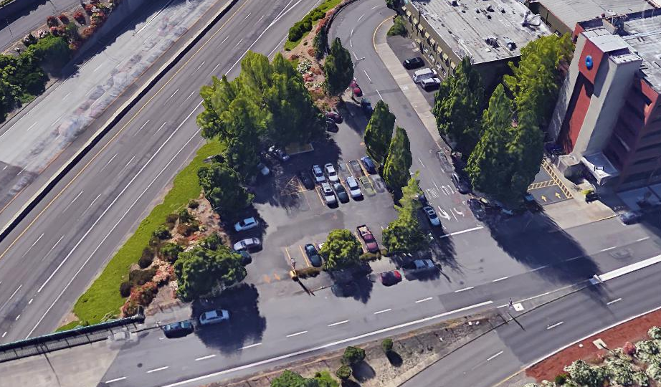
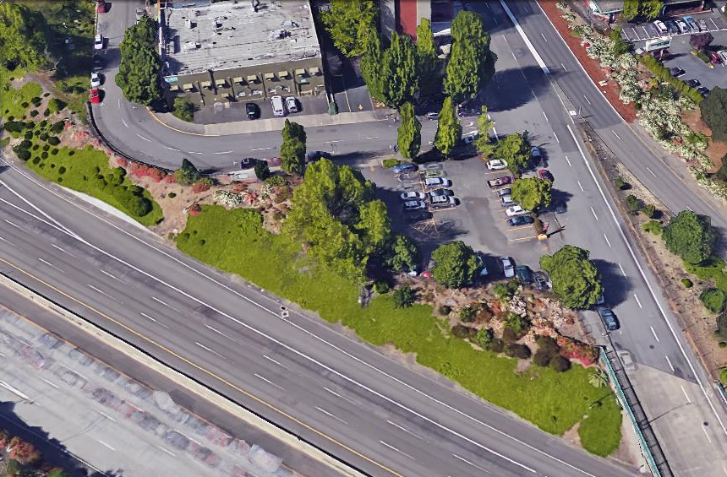
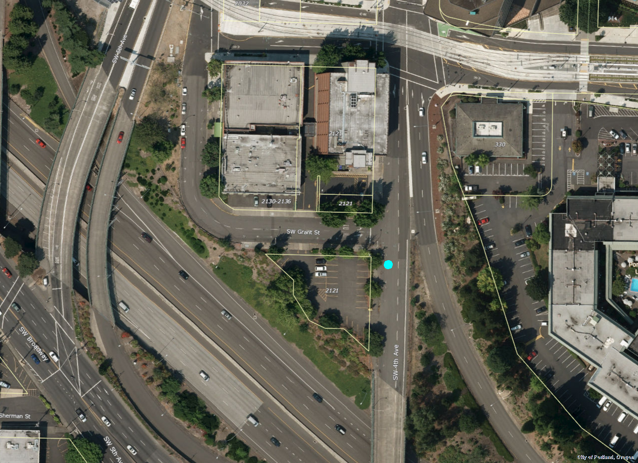
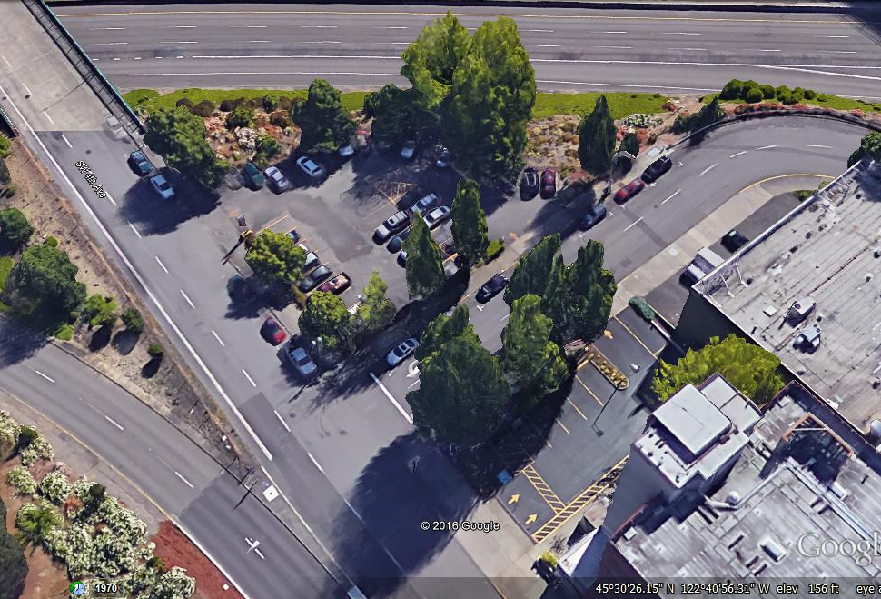
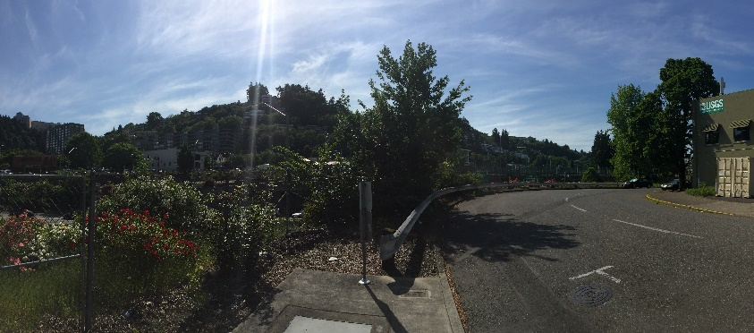
Site constraints
Pedestrian path ends into ODOT
Property and does not continue
Site topography - slopes significantly, complicating organization
Off ramp to SW 4th Avenue from I-405 prohibits pedestrian crossing to/from east
Triangular geometry restricts development potential and confines service areas to Grant and 4th.
ODOT Access Control line / I405 borders property to south restricting access and creating noise
Site opportunities
Gateway “corner” to Central City
Underutilized parcel
Key location – proximity to PSU
Activation of 4th & Grant
Affordable housing solutions
Notes:
Site location –
Just south of the required active use areas in this district
Presently undeveloped triangular parcel bordering I-405
The site brings with it some challenges:
Geometrically challenged….not an easy site on which to efficiently organize spaces
Border site – no access to over 1/3 of the site so locations for services such as garbage get pushed to sidewalks.
Not presently a strong site for pedestrians given the dead-end situation of the sidewalk along Grant street and the restricted access due to the I-405 off ramp.
In addition to shape – site slopes significantly further restricting spatial organization.
It is not without its opportunities as well:
Tremendous, gateway presence offered by the building – high visibility – “southern tip of the central city”
Location adjacent to many demand drivers makes it strong from a rental perspective
Vacant parcel – resource efficient infill opportunity for 108 market rate affordable housing units
Continue activation of the streetscape by extending the pedestrian experience from the food carts

Slide 3
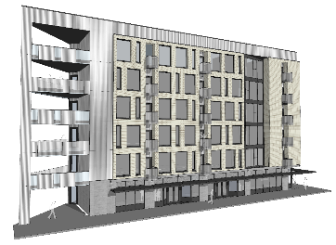
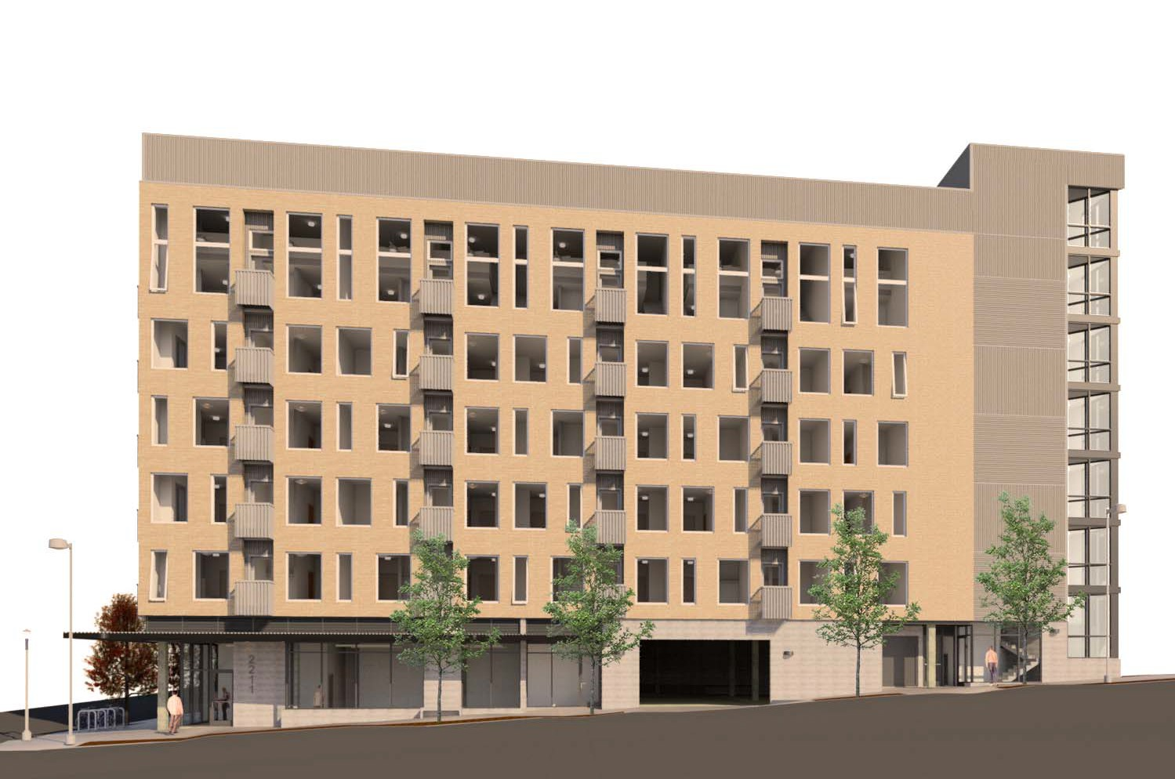
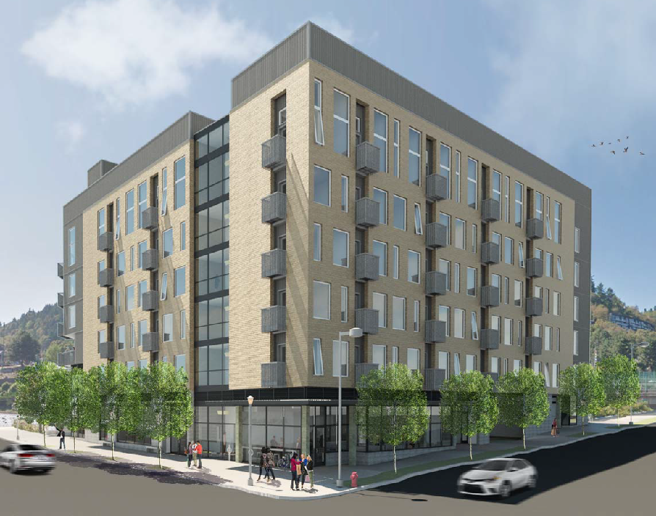

Planning Department Coordination
July 9, 2015 – Design meeting with Planner
August 24, 2015 – Design meeting with Planner
Nov. 15, 2015 – Design meeting with
Planner
Feb. 16, 2016 – Reassigned Planner for DR
Feb. 23, 2016 – Additional material
provided per request
March 21, 2016 – Review meeting with Planner
April 15, 2016 – Revised packet submitted to
Planner
April 21, 2016 – Review comments from Planner
April 29, 2016 – Review meeting with Planner
May 5, 2016 – Review comments from Planner
May 18, 2016 – Revised packet submitted to
Planner
May 27, 2016 – Final packet submitted to Planner
June 8, 2016 - Staff report received
June 16, 2016 - Design Commission Hearing
(continued with recommended changes)
June-July, 2016 Misc. back and forth with city staff
July 21, 2016 Design Commission Hearing
Public Process
Downtown Portland
Presentation
3/16/2015
South Portland
Neighborhood Presentation
6/14/2015
Design
Advice
Request
6/18/2015
Pre-application Conference
3/12/2015
DESIGN MEETINGS WITH CITY STAFF
Downtown Portland
Presentation
11/15/2015
Downtown Portland
Presentation
4/16/2016
Design Commission Hearing
June 16, 2016
Design
Commission
Hearing
July 21, 2016
Notes:
Briefly review where we have been –
High level –
We started this journey over 18 months ago. Since then:
8 public meetings soliciting comments and feedback
D.A.R. last June with the commission
Numerous exploratory design meetings with city staff exploring win-win configurations of ground floor program elements leading (in our opinion) to the balanced approach presented today – meeting the guidelines and also providing affordable units
Including recent meetings with city staff since our last hearing.

Slide 4
Remaining Issues to Discuss:
Issue 1: Massing and I-405 Frontage
-general problems with composition
-doesn’t come off as composed as other facades
-wrap around metal corners are a problem
-foundation facing I-405 seems too dominant
-bike stair and entrance not well composed
Issue 2: Building skin contextual response and coherency
-brick veneer is an improvement, still not there with the metal
-window configuration approach at corners not coherent
Issue 3: Ground Floor Activation
-Bike entry area is not well composed
-Northwest corner is inactive
-Ground floor glazing standards not met
Issue 4: Permanence and quality of materials
-Additional details needed
-General palette is good, but application needs to be refined
Notes:
As outlined by Tim, there were a few outstanding issues that have now been addressed with the current proposal.

Slide 5
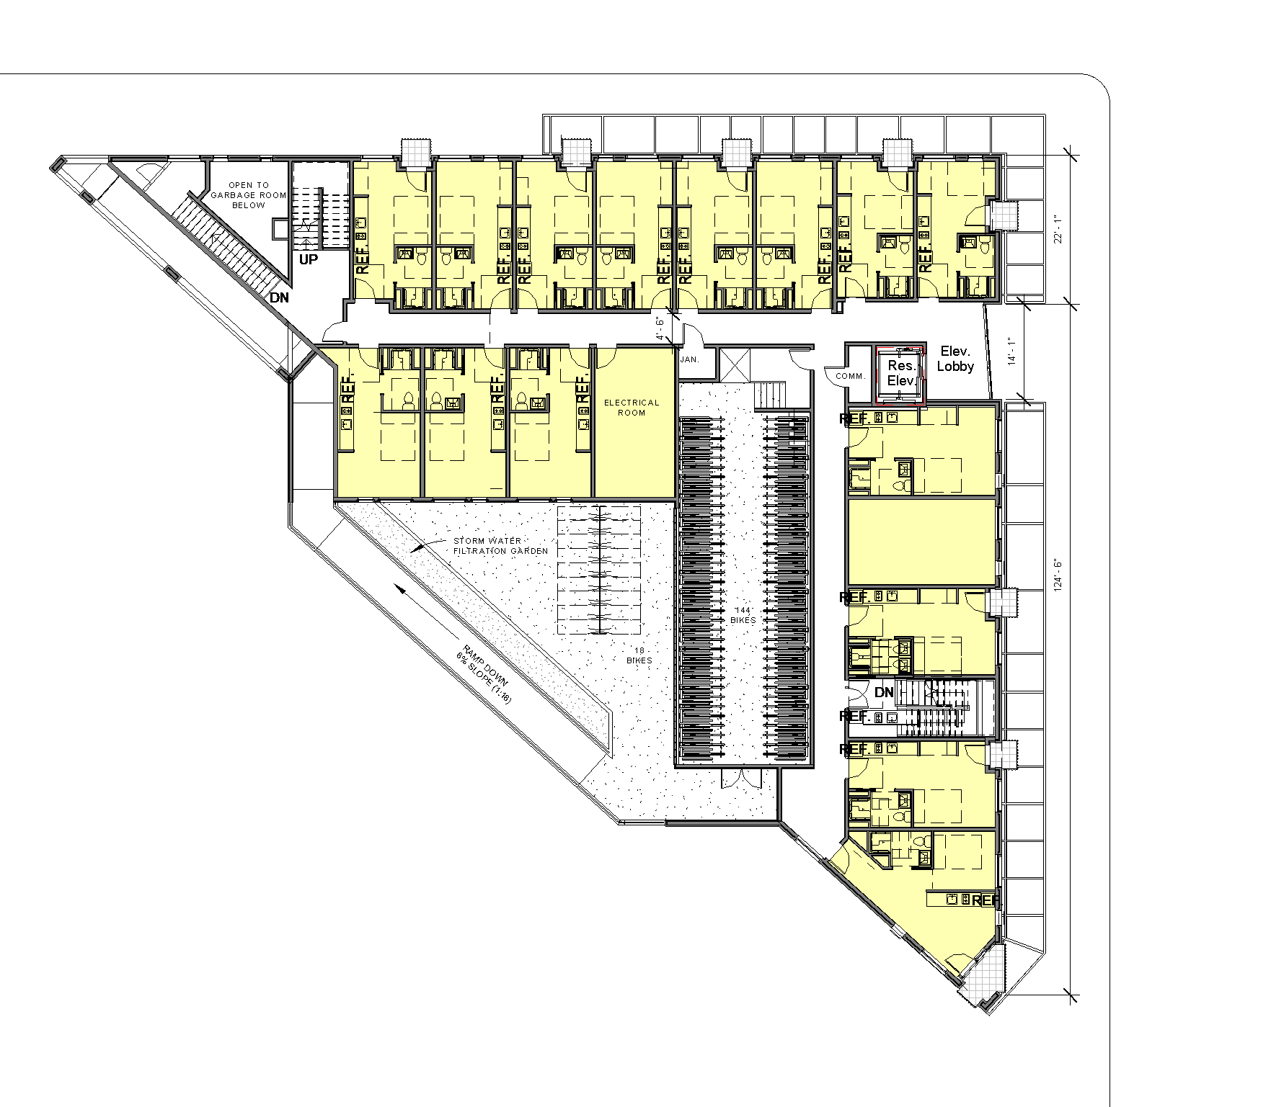
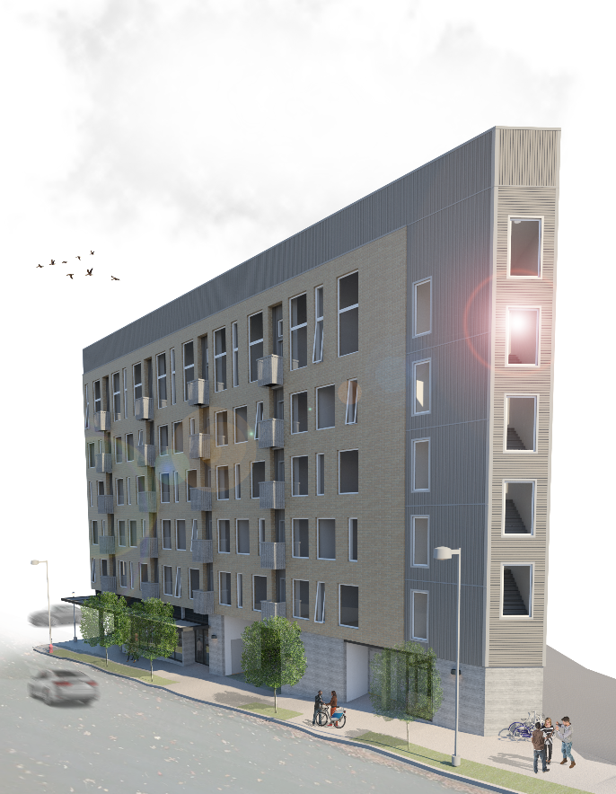
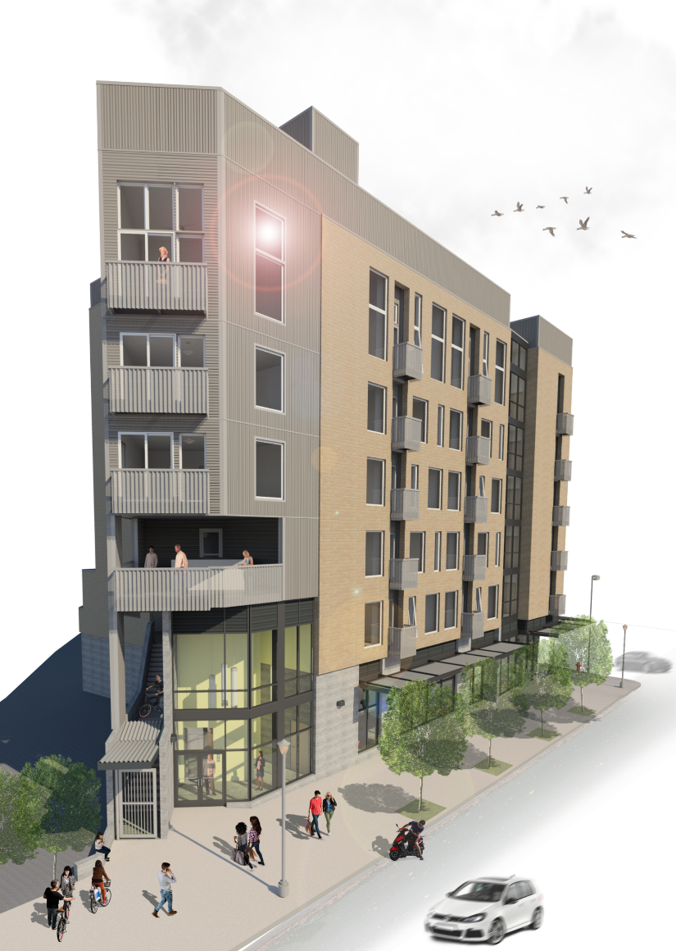
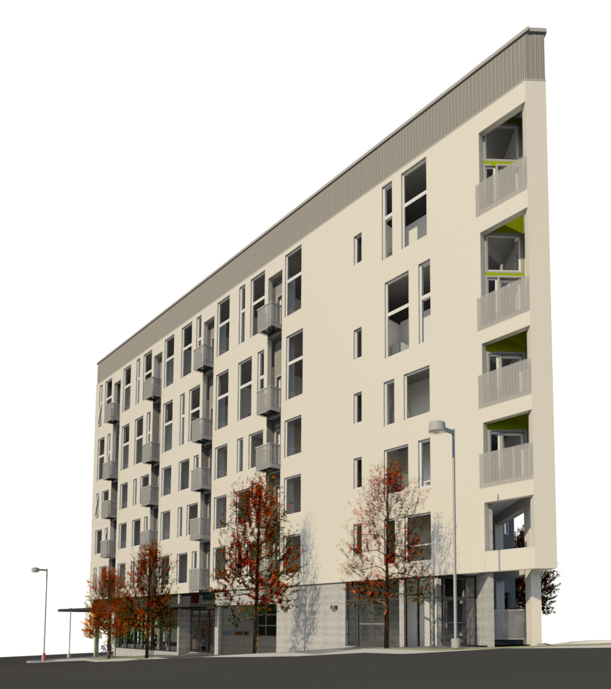
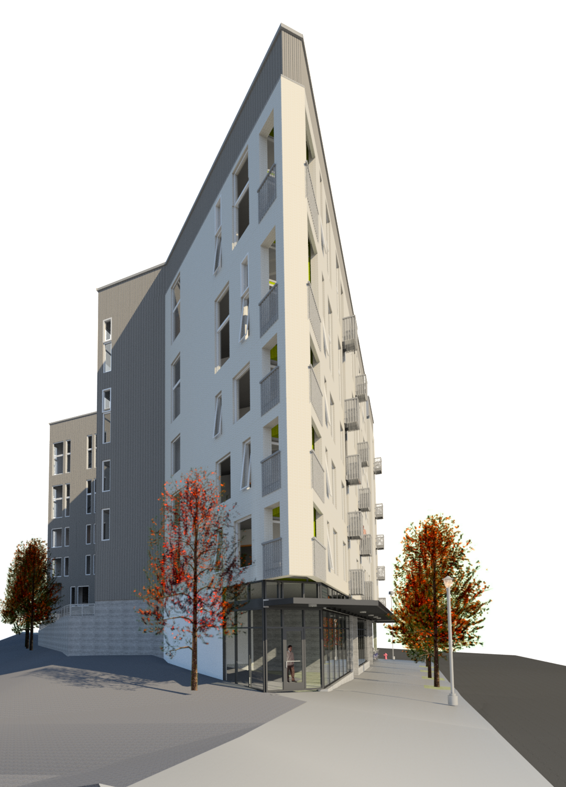
Stairway corner at Grant
Previous corner at 4th sketch
from DAR
2nd floor plan
Active corner at Grant
Active corner at 4th
Notes:
Corners of the building and how the building sits on the site have been the source of a lot of discussion and study since our June hearing
As proposed, the corners are now wrapped with brick vs. metal as before, resulting in a form much more pure to it’s site geometry.
Big change facing south was the addition of a bike ramp
I405 frontage
Building skin and contextual response
Ground floor activation

Slide 6
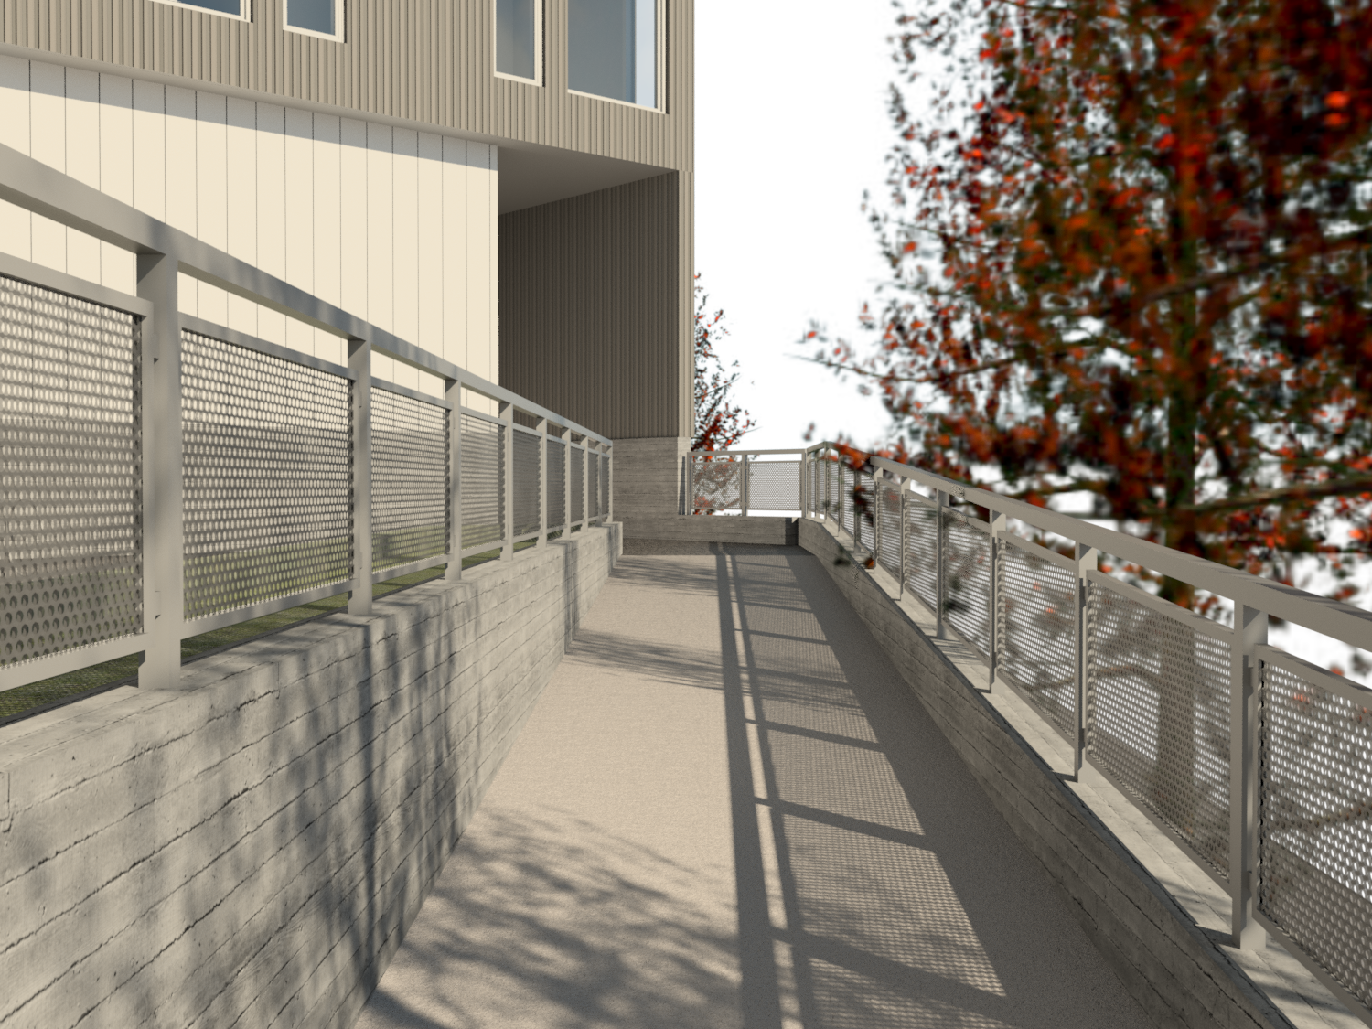
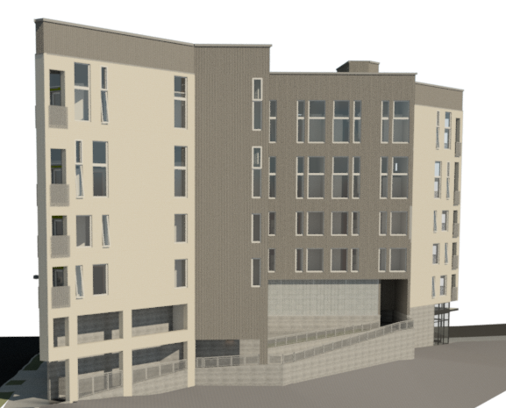
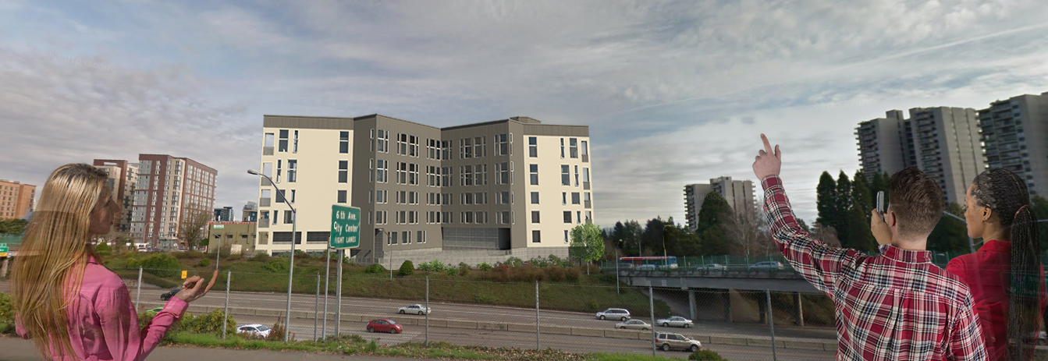
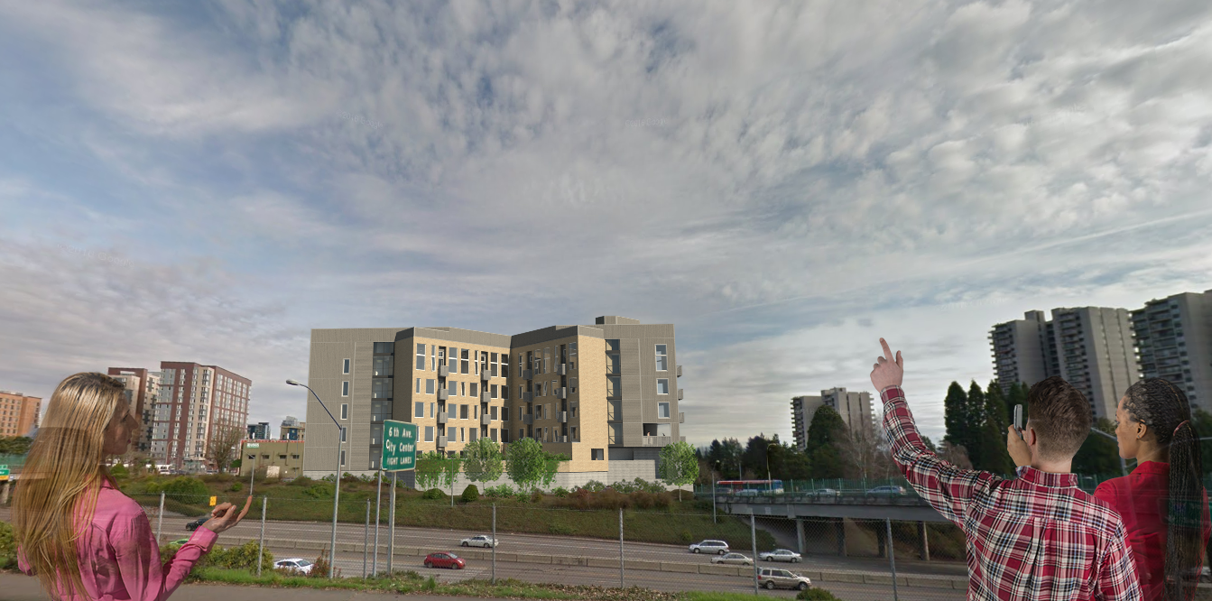
Corners now wrap in brick
Additional windows/living units at corners
Balconies from living units at corners
Regulated placement of windows within metal sided “inset” above bike plaza
Activation through addition of bike ramp, lowering elevation of foundation wall and providing interest
6.16.16 version
Notes:
I-405 frontage has been completely reworked….
Bike ramp and highlighted room at the terminus of the ramp
More cohesive approach to form and finish – providing a more ordered and clear building
I405 frontage
Building skin and contextual response

Slide 7
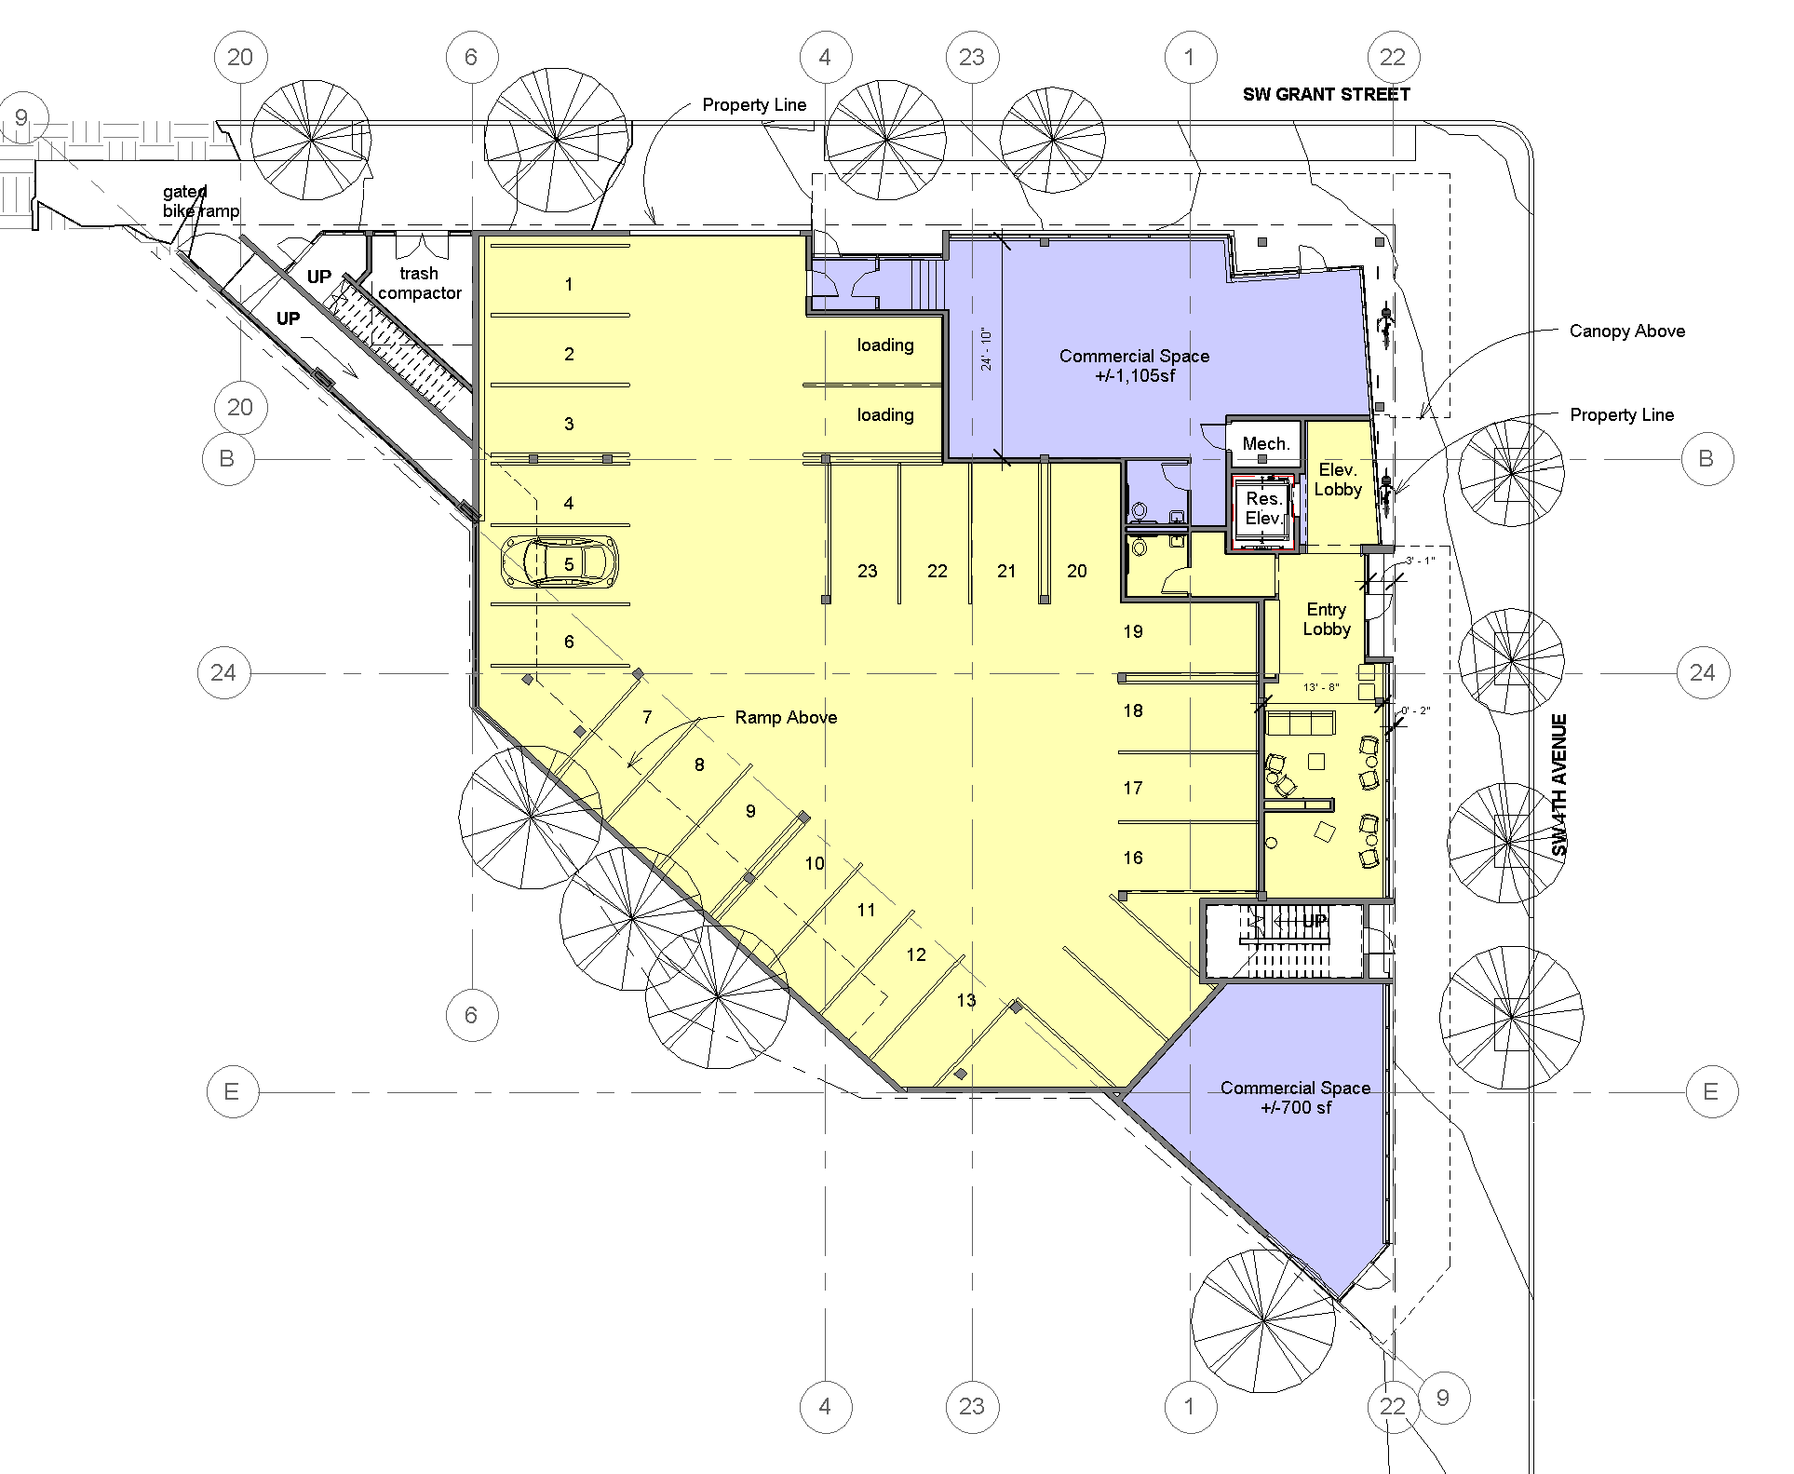
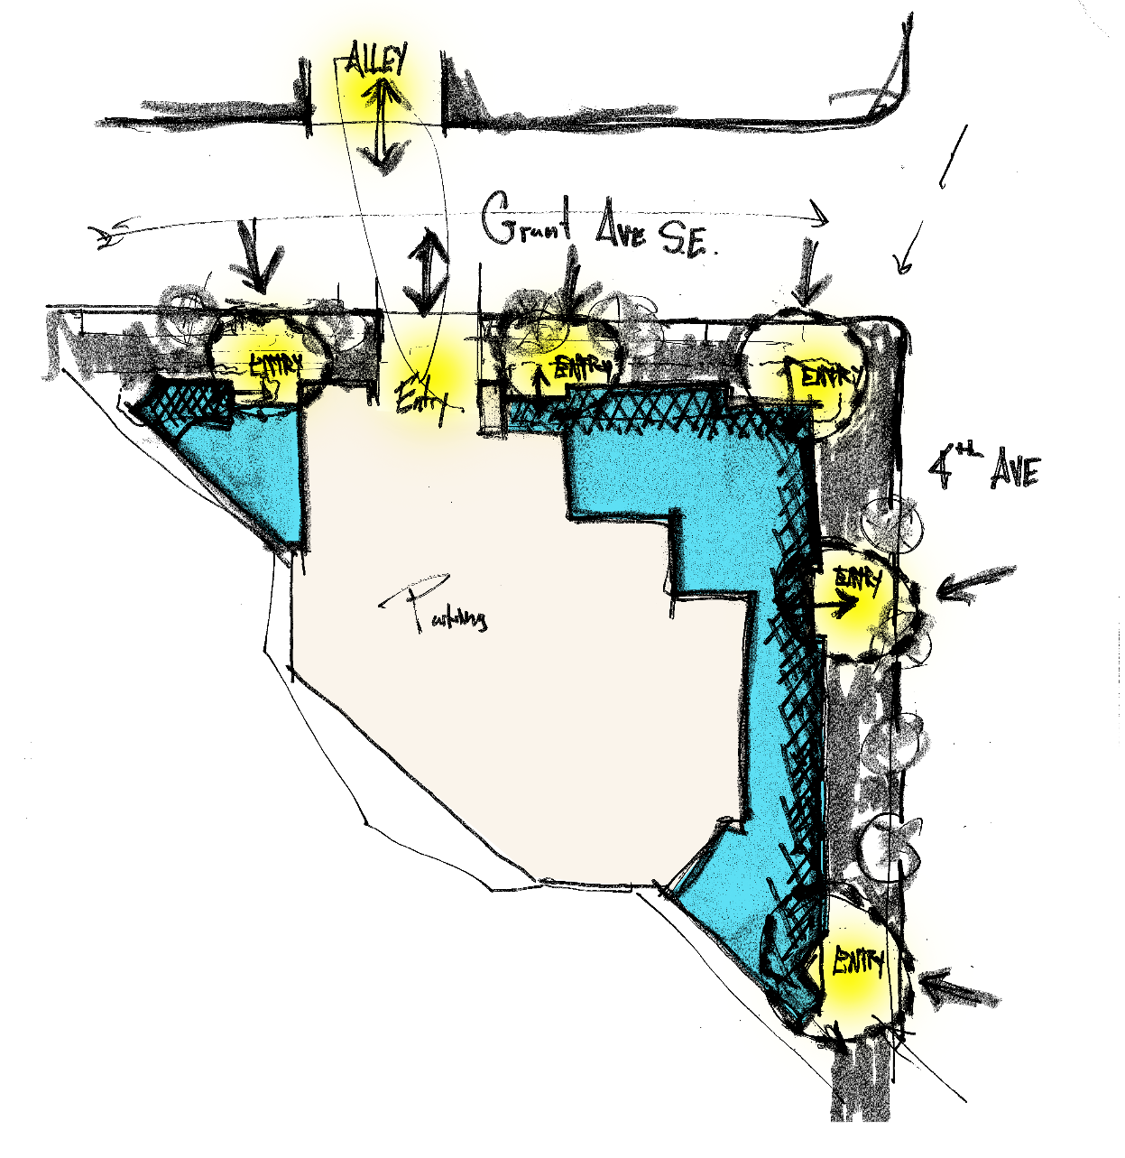
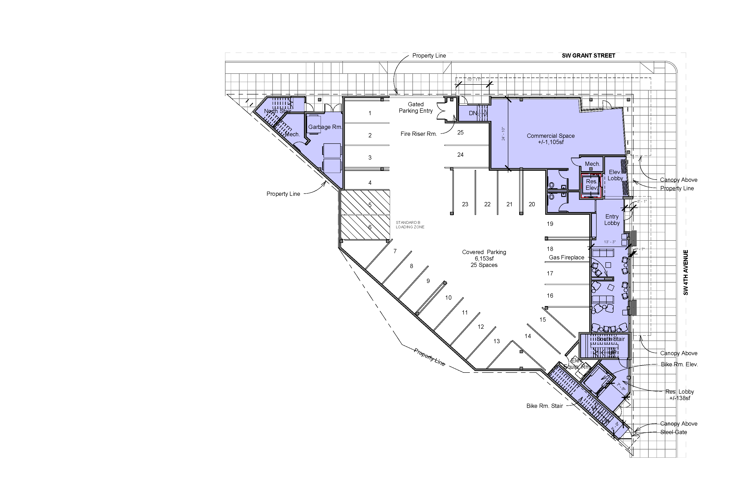
6.16.16 version
Notes:
Ground level activation has continued to be a focus for the design team.
Latest makes 2 main improvements over the past plan
Reconfiguration of northwest entry condition
Reconfiguration of southeast corner to become commercial space and eliminate the elaborate bike stair, lobby and elevator.
Activate ground floor

Slide 8
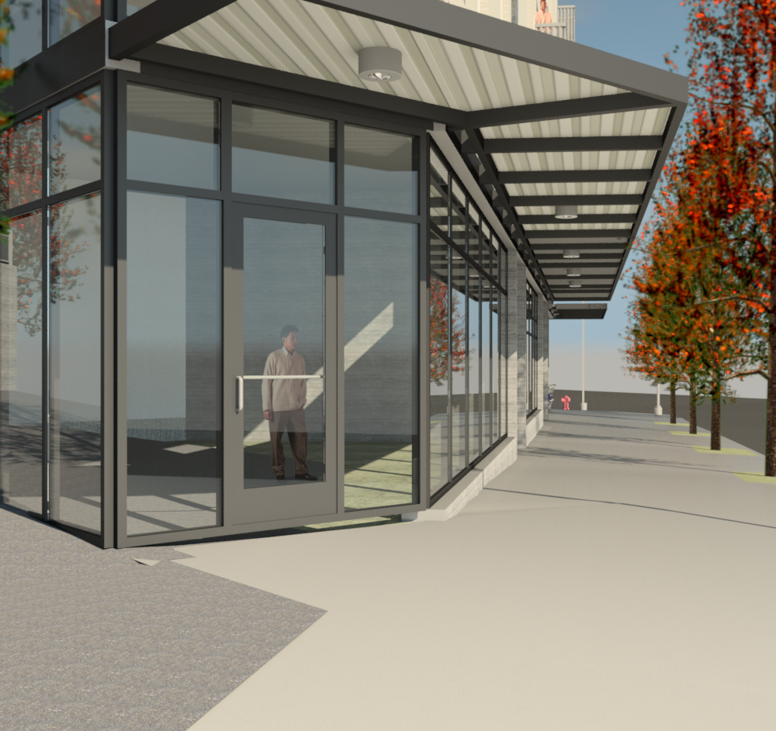
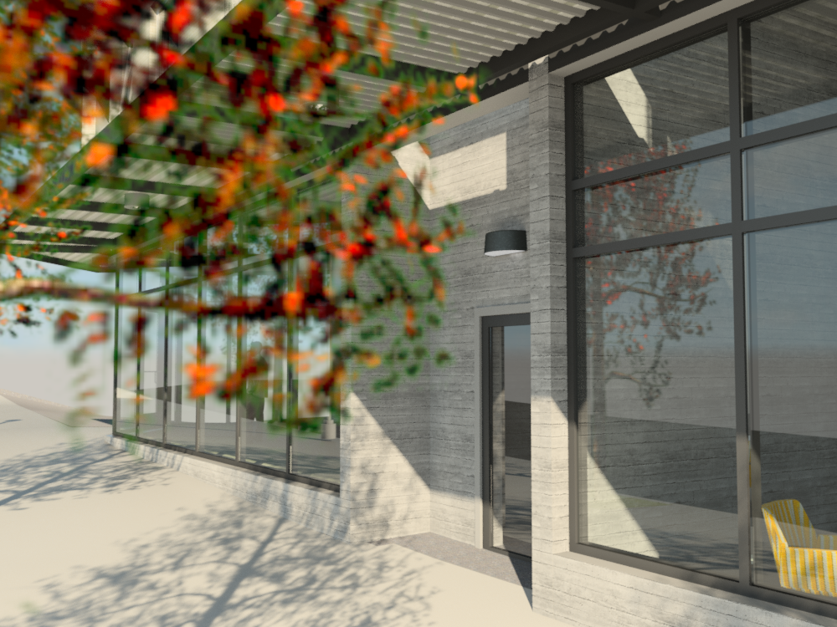
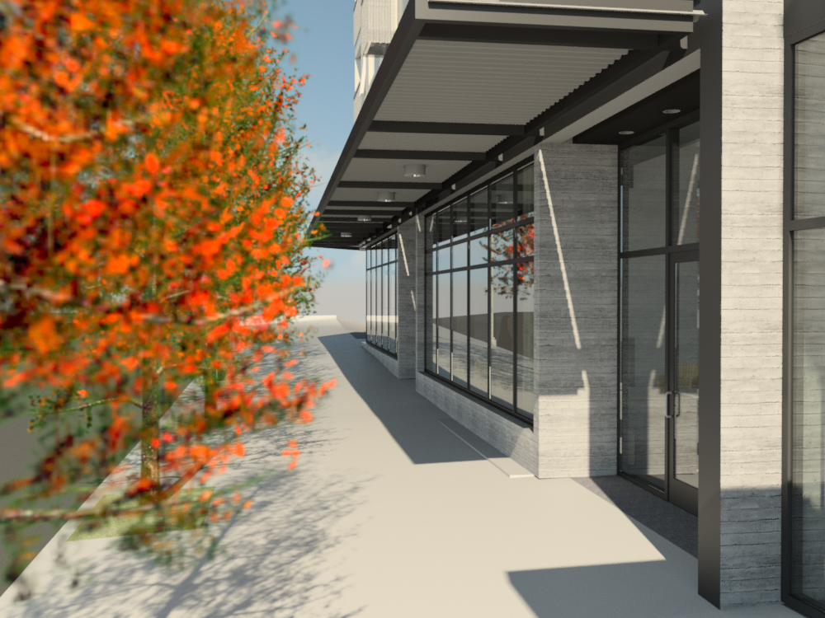
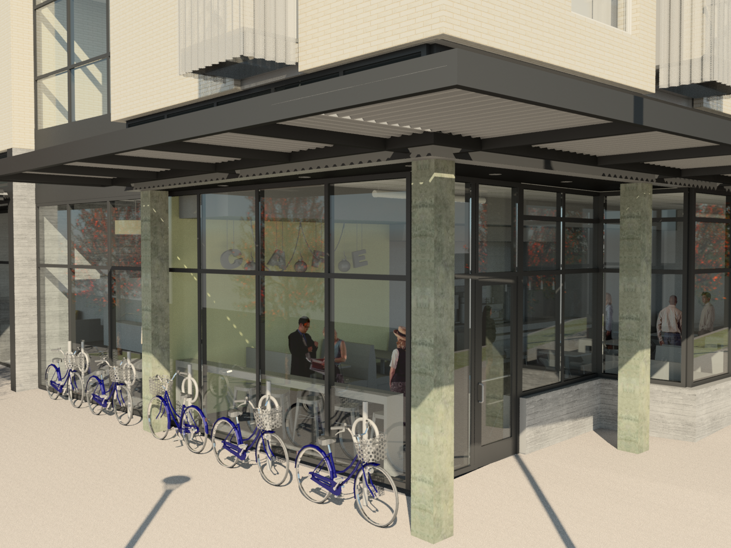
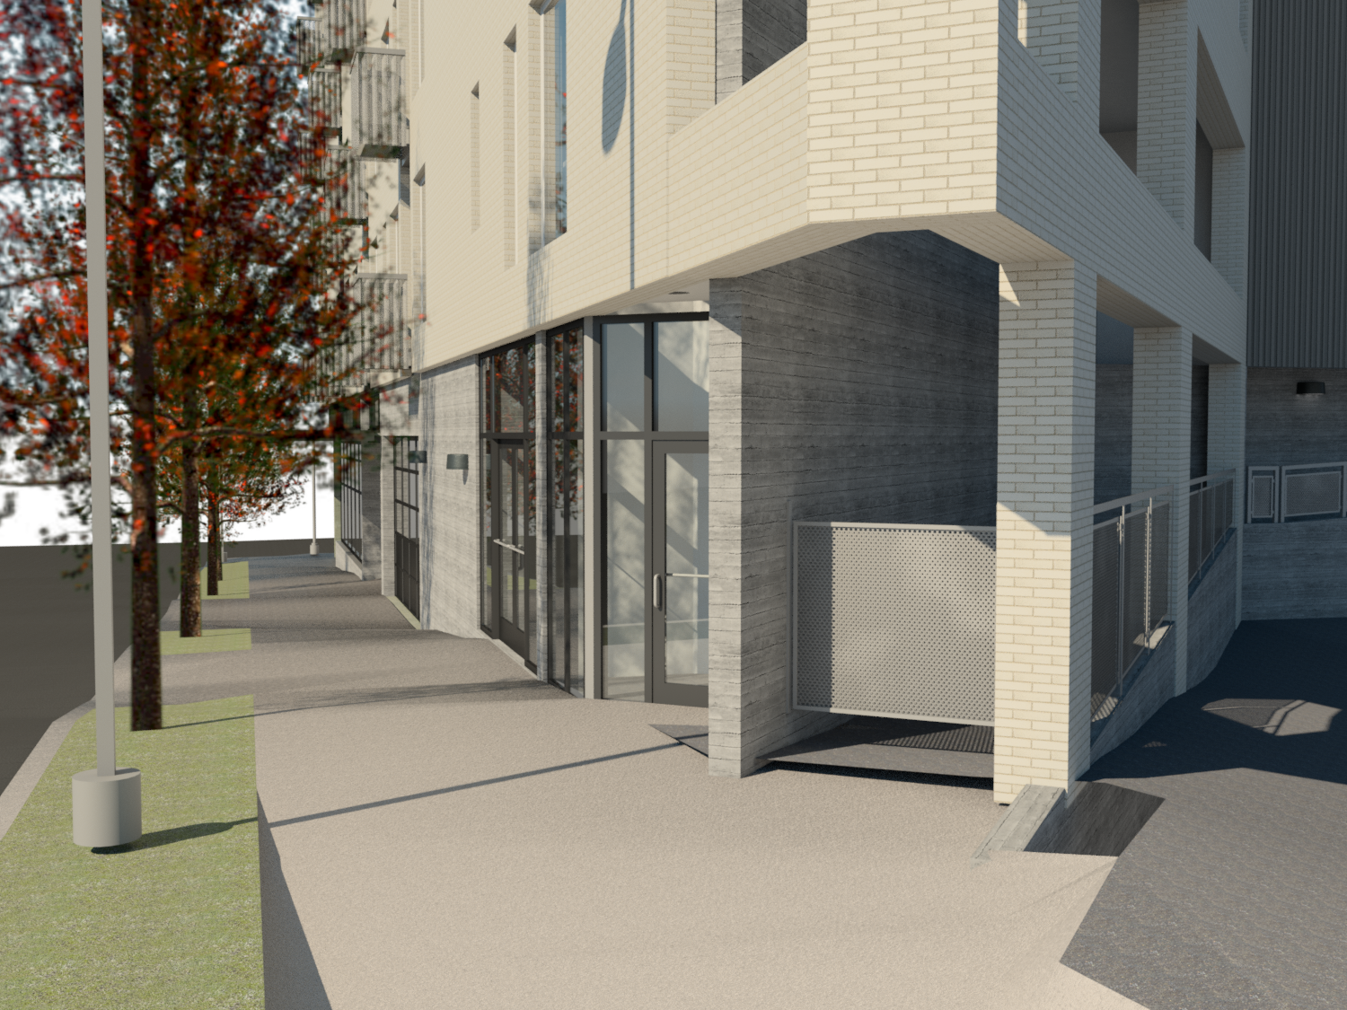
Streetscape views –
pedestrian experience and vibrant facades
Notes:
Misc. model shots of vibrant streetscape around building.
Activate ground floor

Slide 9
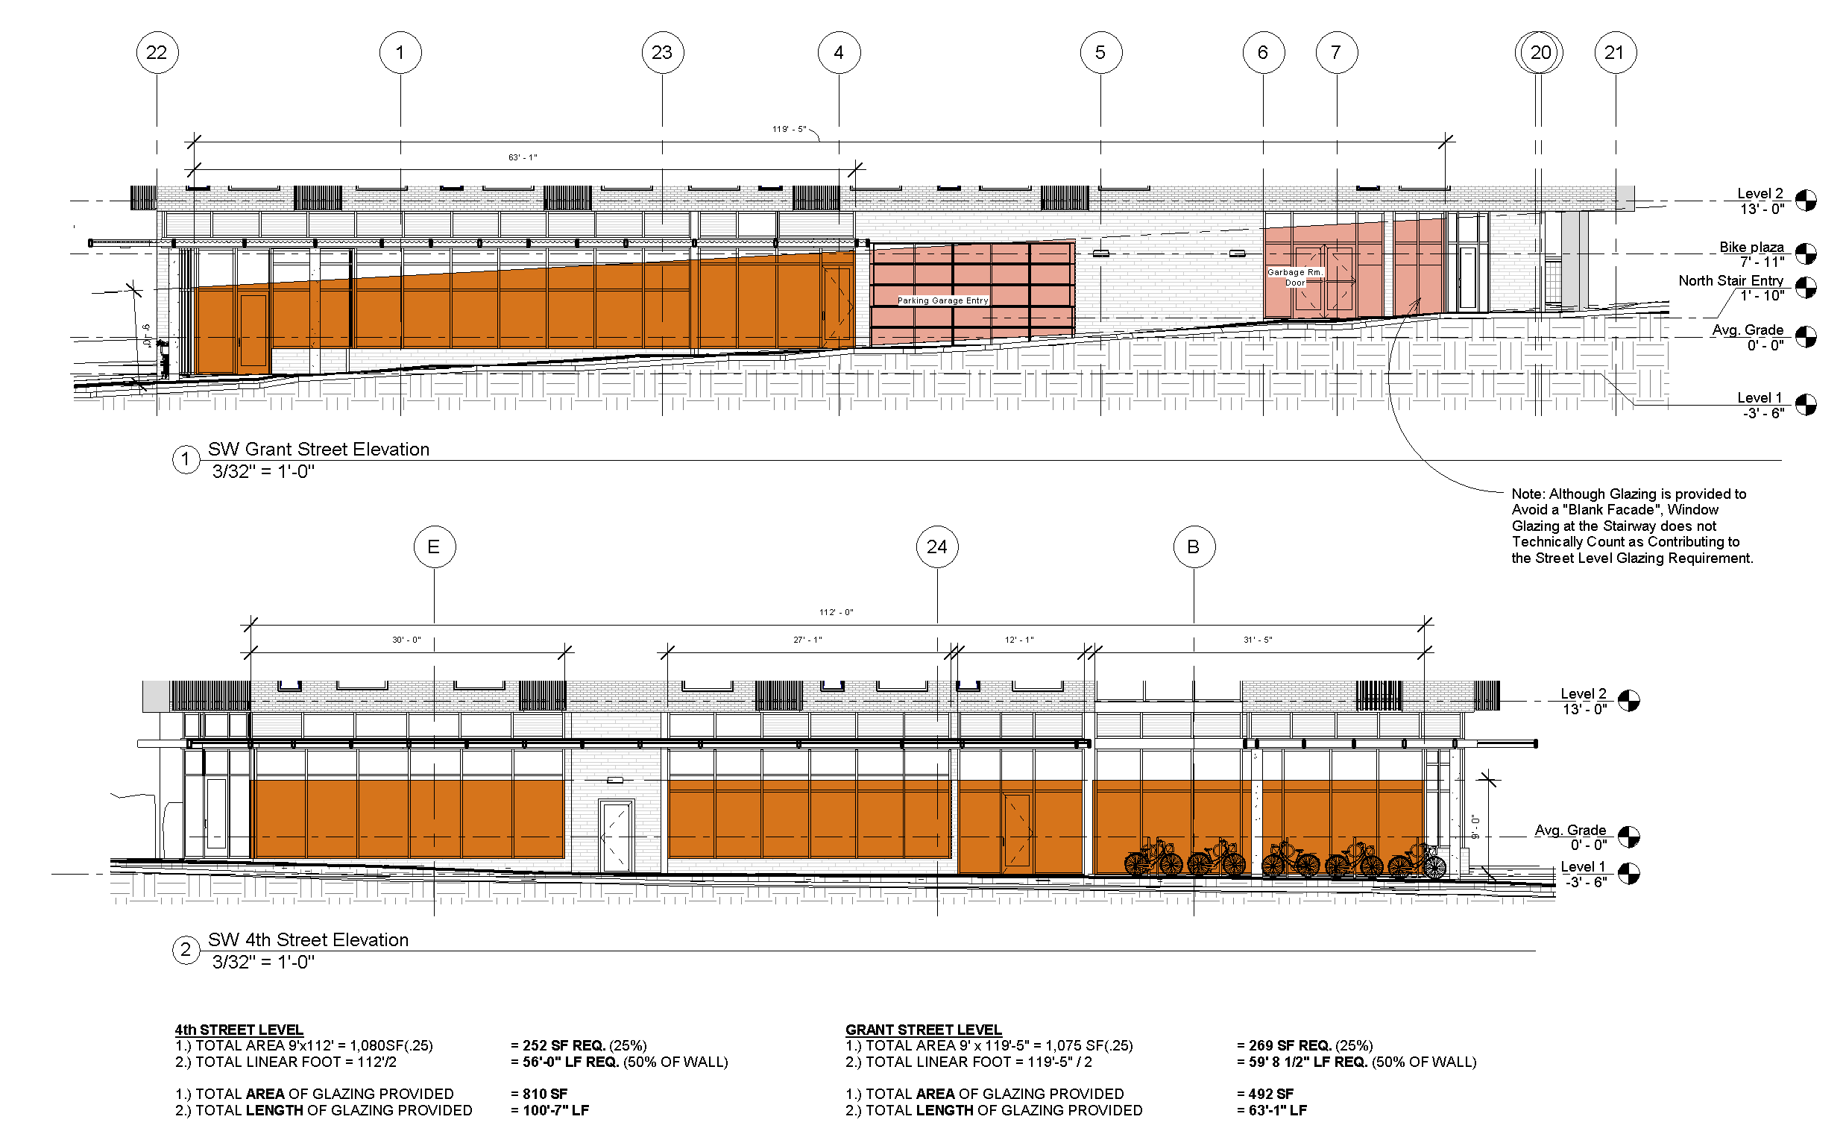
Ground floor glazing
Notes:
We have modified the design to fully comply with the ground floor glazing standard.
Activate ground floor.

Slide 10
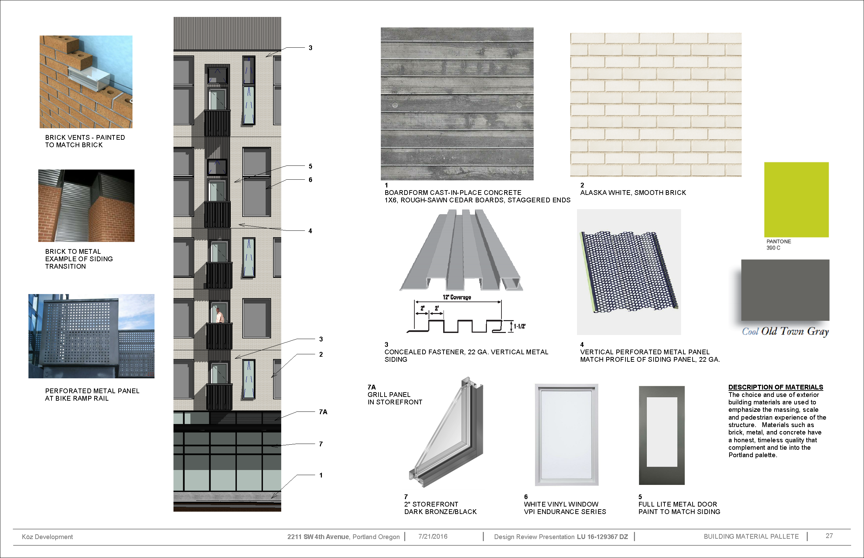
View from north
View from south
Notes:
Most of these were discussed last time…
Upon second look, we have proposed a lighter color brick than before.
Second additional color has been added to metal siding at the inset facades at the corners of the building…provide greater visual interest and project identity.
Building skin and contextual response
Permanence in materials

Slide 11
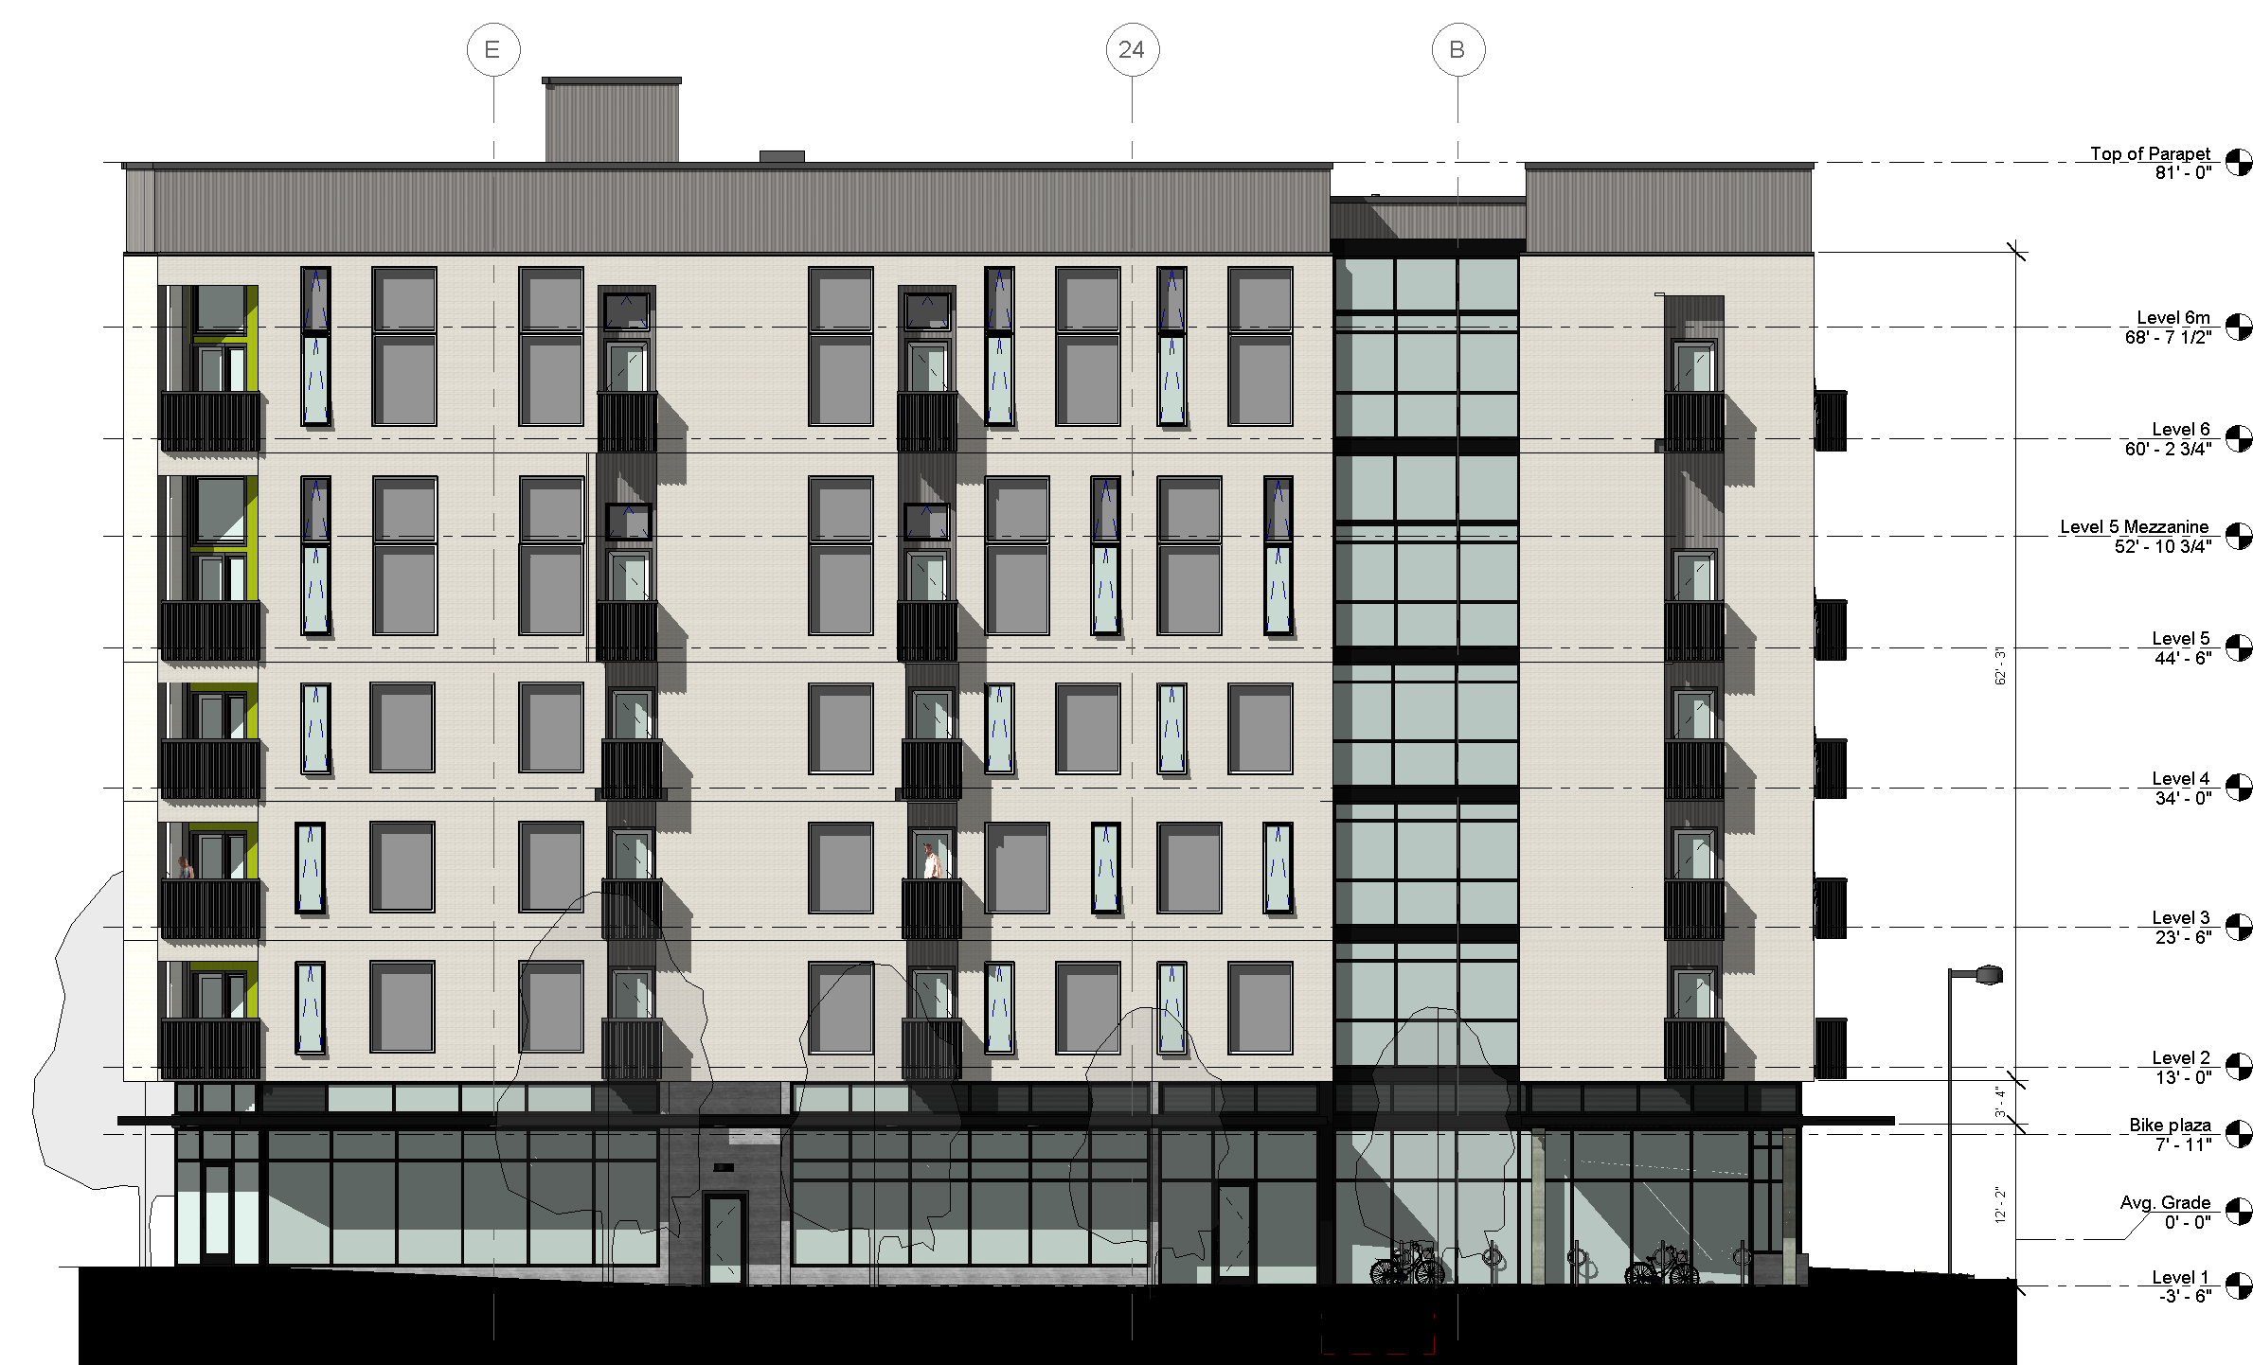
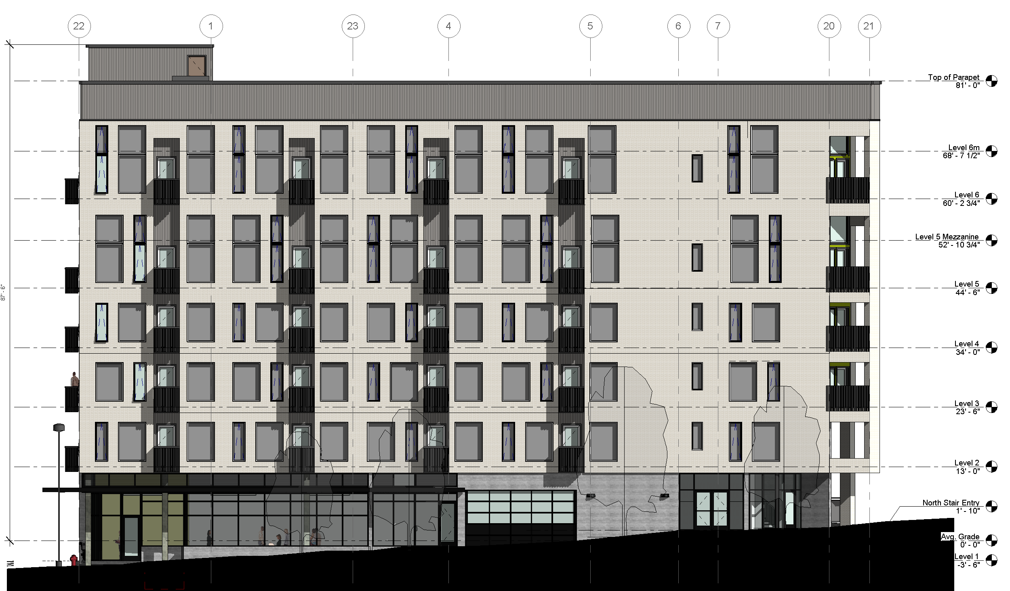
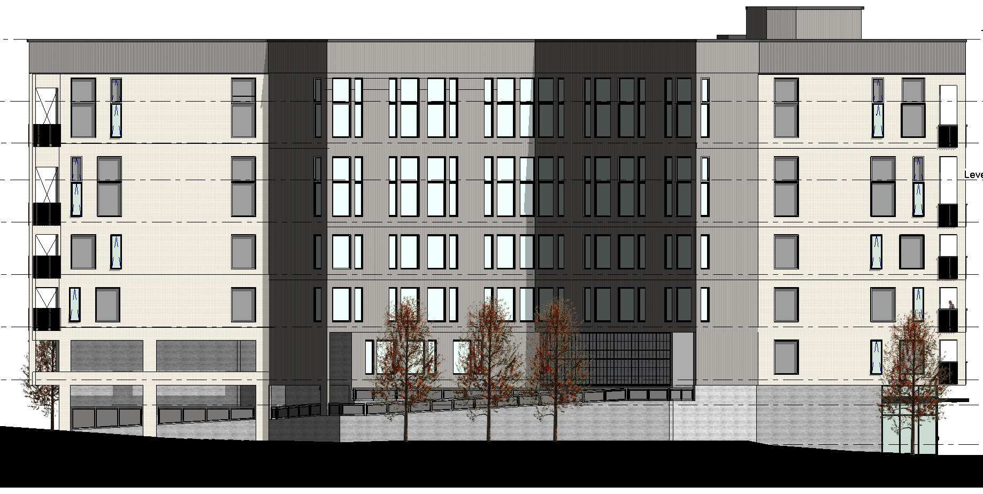

Slide 13
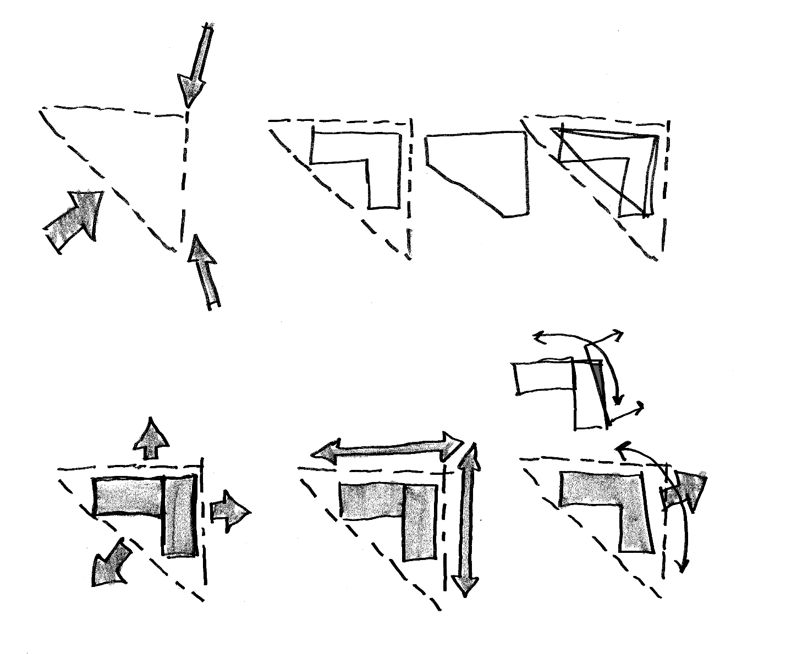
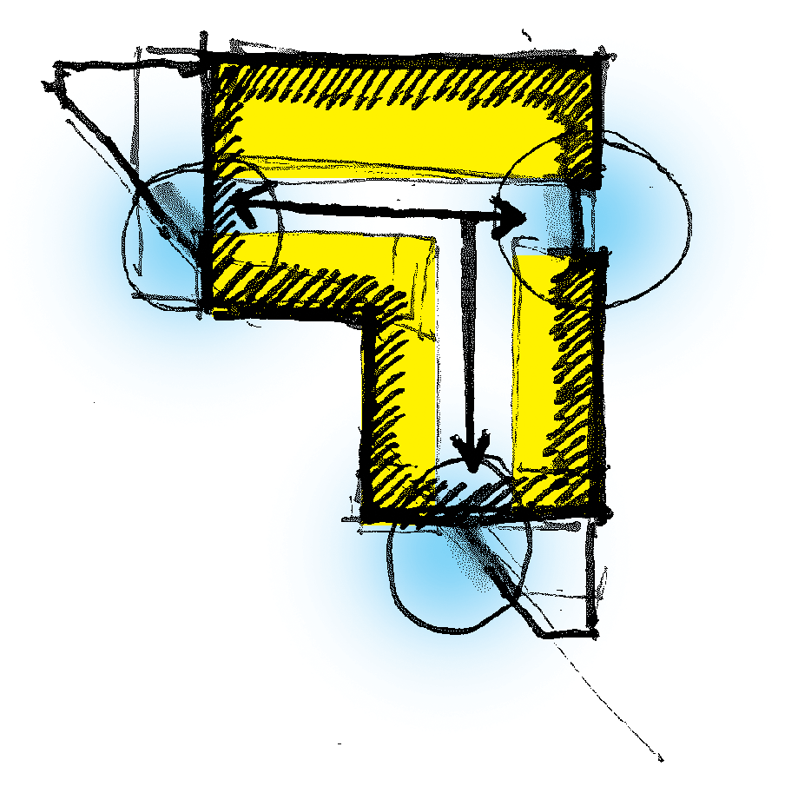
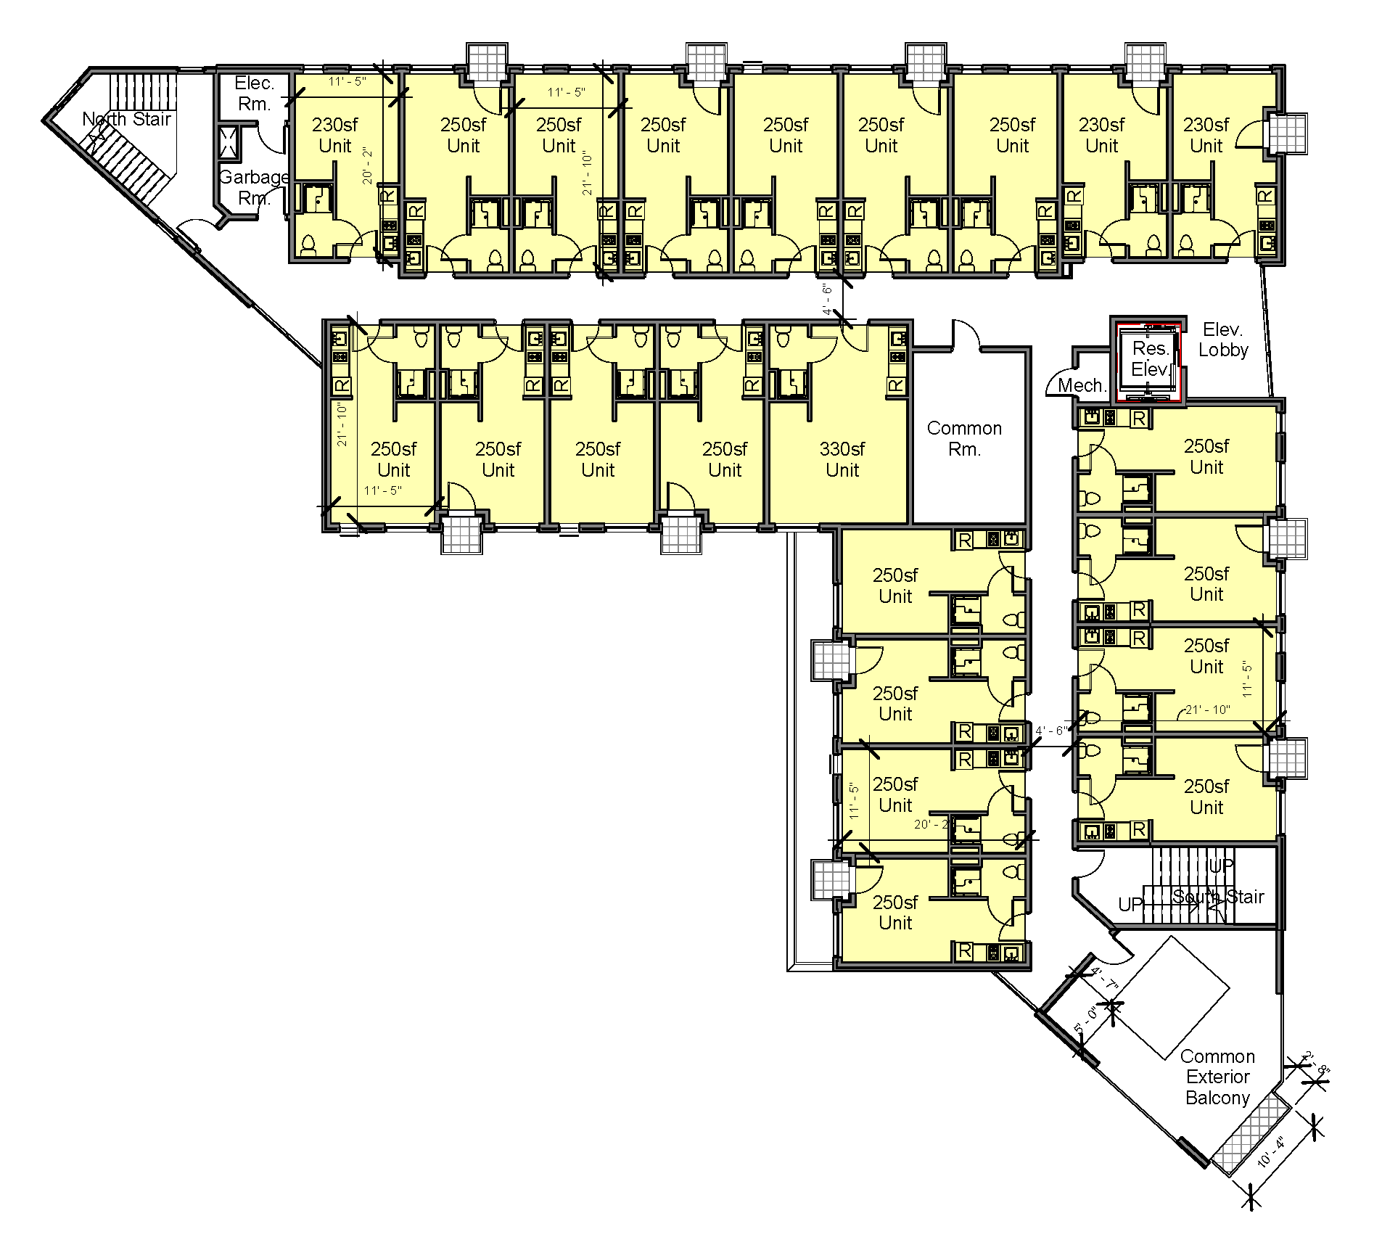
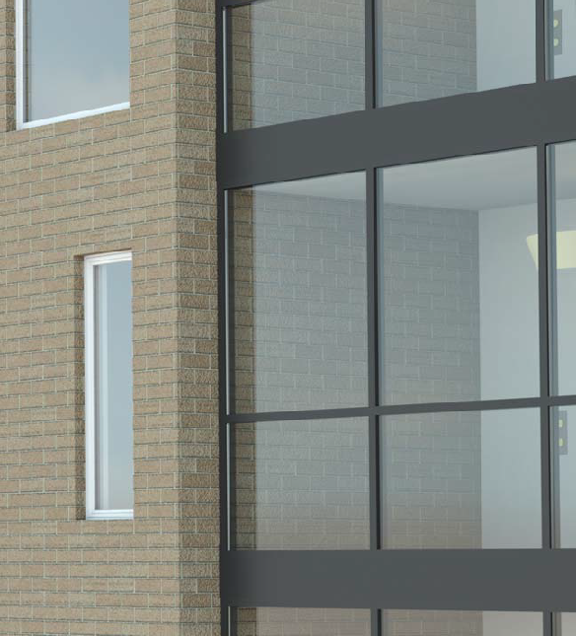
geometry
Typical upper
floor plate
transitions
efficiency
Material/form/function
juncture
Notes:
Step back in the design process a bit to discuss design parti – how we arrived at the
arrangement of spaces, masses and materials
Triangular geometry of the site and the challenges presented
Development of an efficient mass of housing (represented by the simple brick masses) above the street level podium – utilizing the site to the fullest extent possible
With the mix of geometries – the transitions became a tremendous design opportunity. These transitions give us a great spot to change materials, provide light into the spaces of the building, and give opportunities for residents to experience greater views out to the city than their individual units offer.

Slide 14

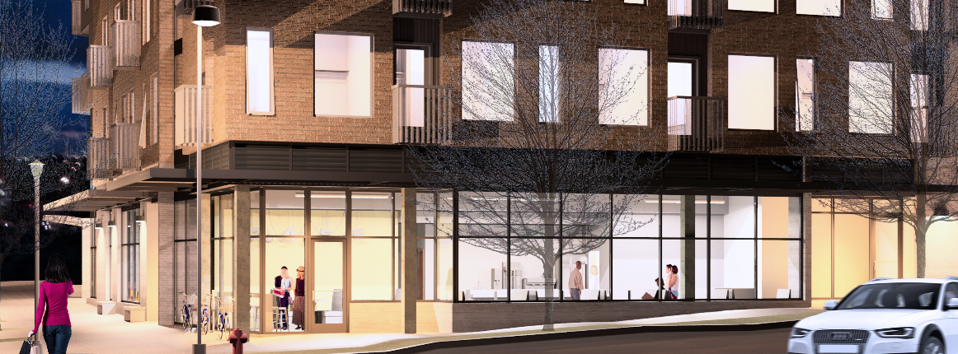
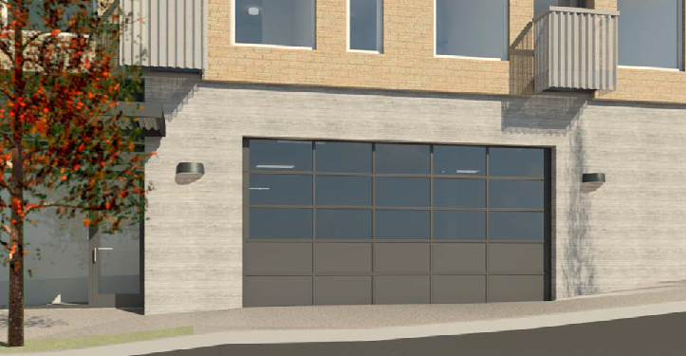
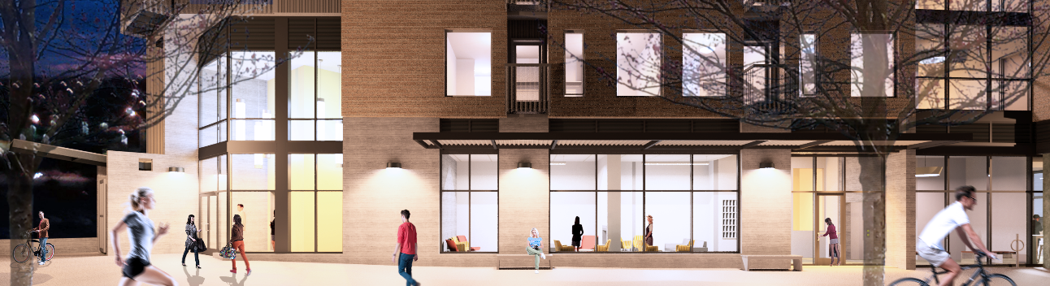
ENTRANCE SKETCH FROM DAR
GRANT FACADE SKETCH FROM DAR
SW GRANT AVENUE VIBRANT STREETSCAPE / COMMERCIAL ACTIVE USE
GLAZED DOOR AT GARAGE (CLOSED ONLY AT NIGHT)
SW FOURTH AVENUE VIBRANT STREETSCAPE
A driveway design exception has been approved by PBOT for the location, size, and mechanism proposed for the garage door.
Notes:
Review the dramatic differences / evolution of streetfront
Key feature to the building is the interesting “bike portal” at the south corner – marking the tip of the district
Primarily storefront – extremely vibrant

Slide 15
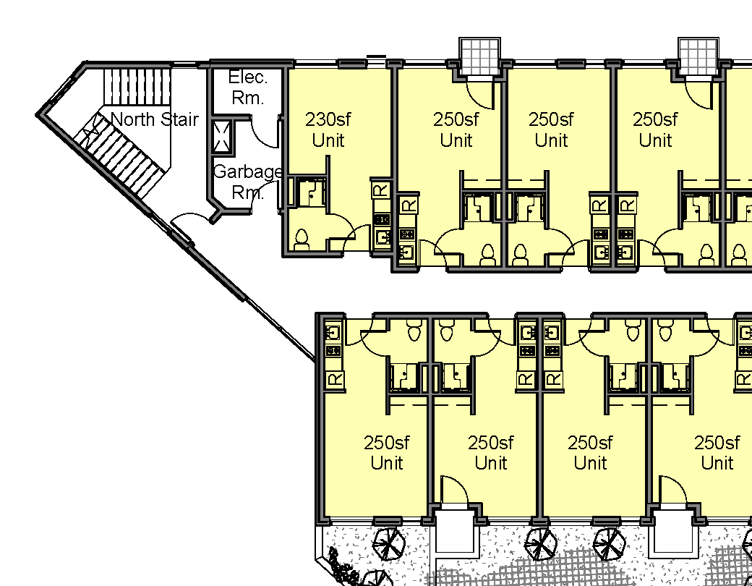
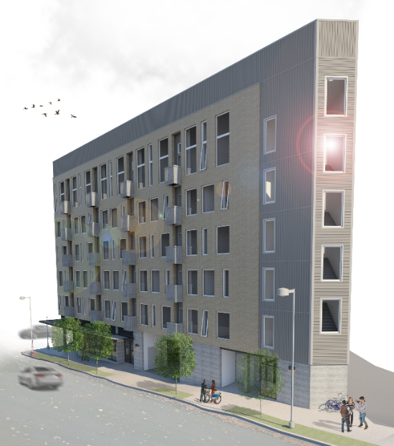
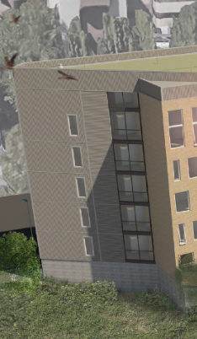
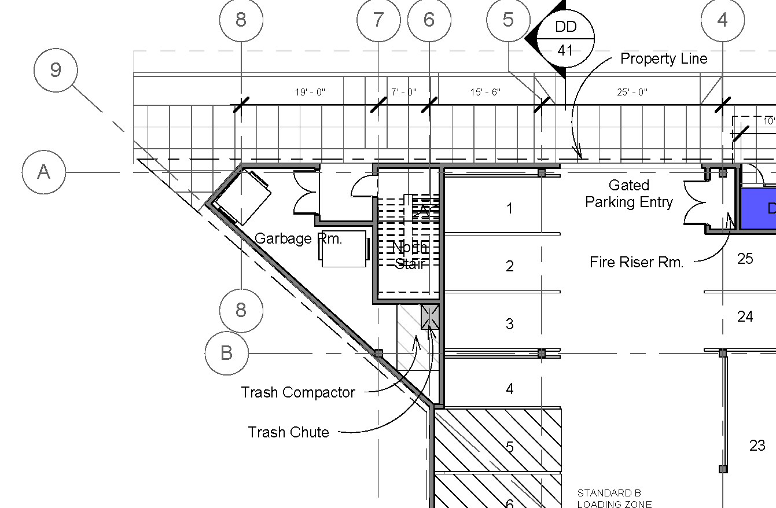
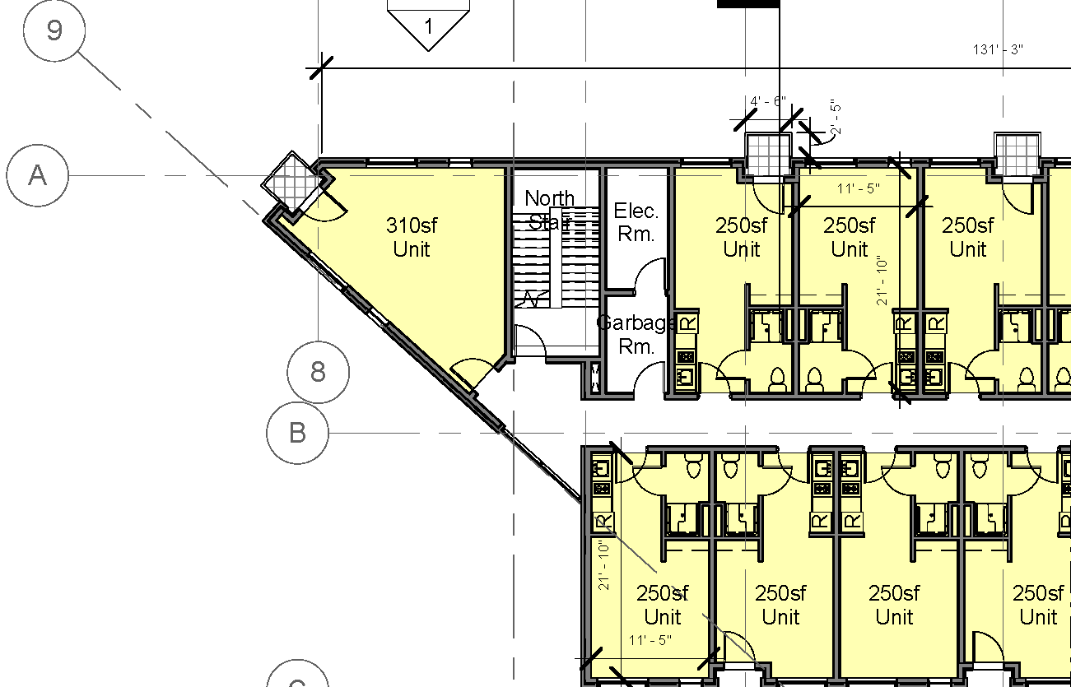
AS PROPOSED
AS PROPOSED
Alternate corner use study
Notes:
One suggested alternative that has been explored is that of shifting the north stairway into the interior of the building further and relocating a dwelling unit to the corner.
Problems are:
Functional difficulties in plan from top down – culminating in a dysfunctional trash room at the main level.
Equally interesting design resolution with proposed scheme.
Proposed scheme stays true to the parti

Slide 16
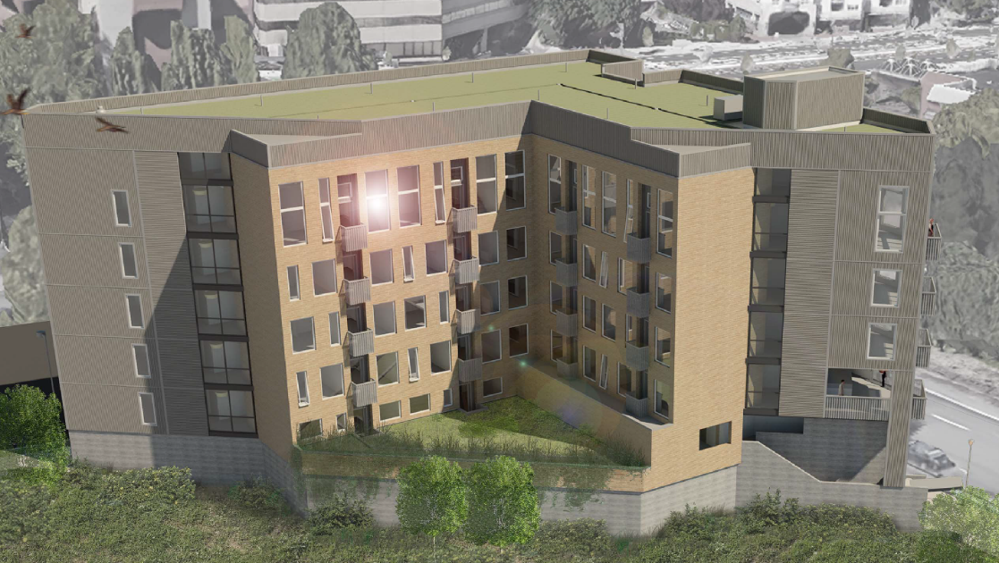
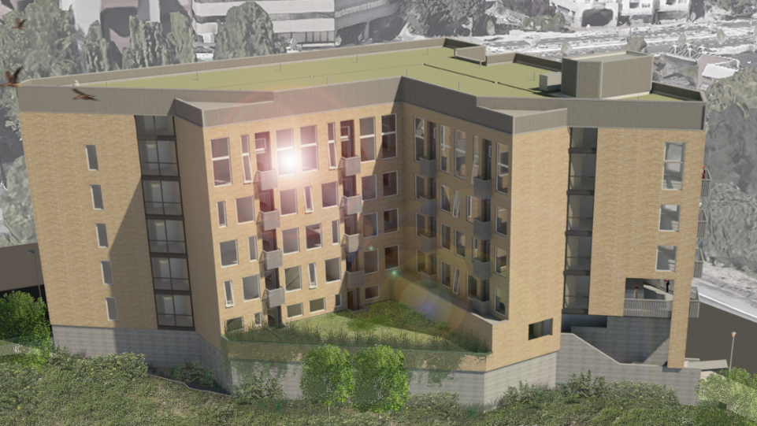
AS PROPOSED
All brick study
Notes:
Exploration of swapping out metal siding with brick veneer throughout building –
- More interesting piece of architecture with the change in materials
- High quality, permanent materials in both scenarios
- Change in materials is true to design parti
- There must be some consideration for affordability with an “on balance” design

Slide 17
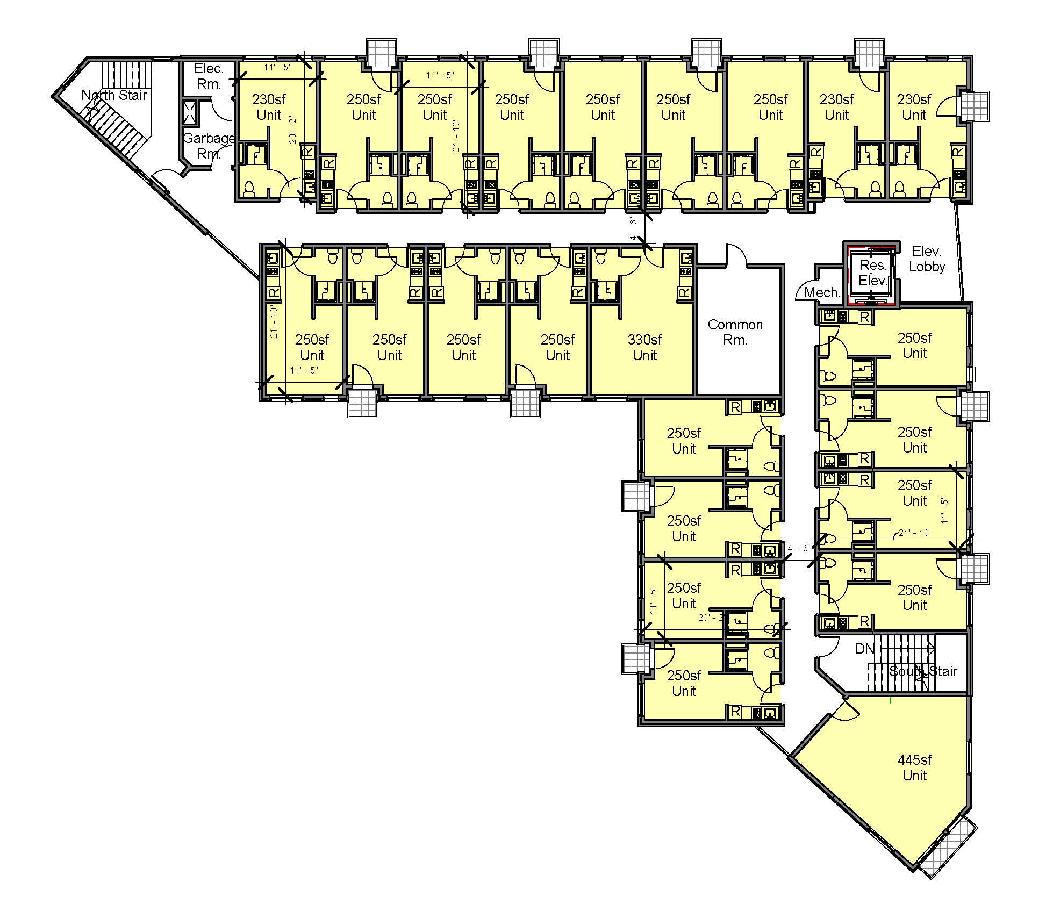
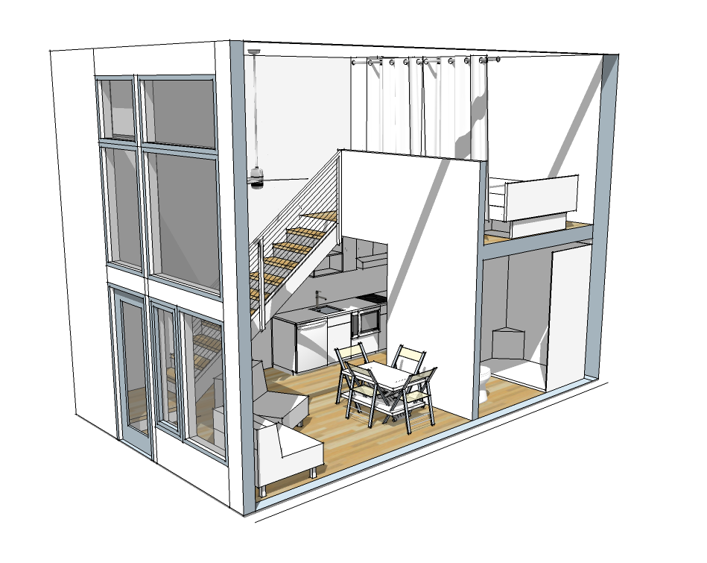
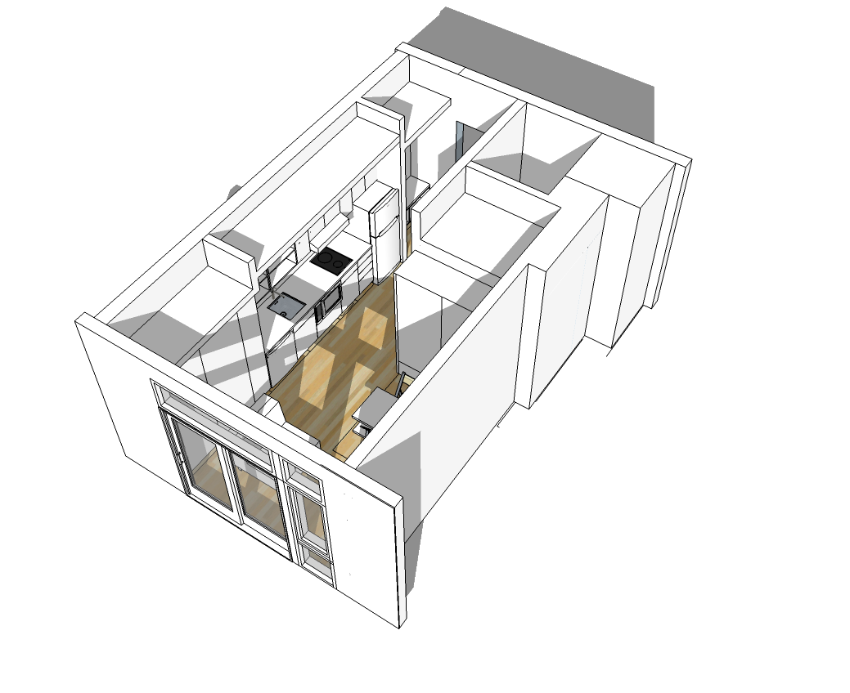
4th-5th floors, 6th similar
Typical 6th floor unit with loft
View from south
Typical studio apartment
Notes:
Unit mix (addition of loft units)
Affordability
Access and maintainability from south – arrangement of wings of building

Slide 18
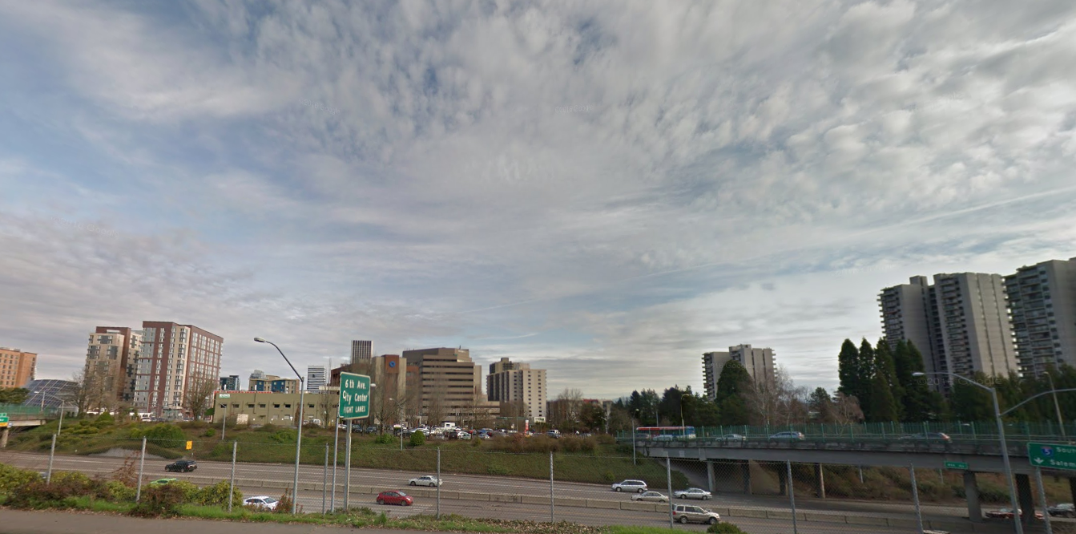
Notes:
Current view of site from south – open parking lot

Slide 19
Notes:
Overall presence of building from south

Slide 20
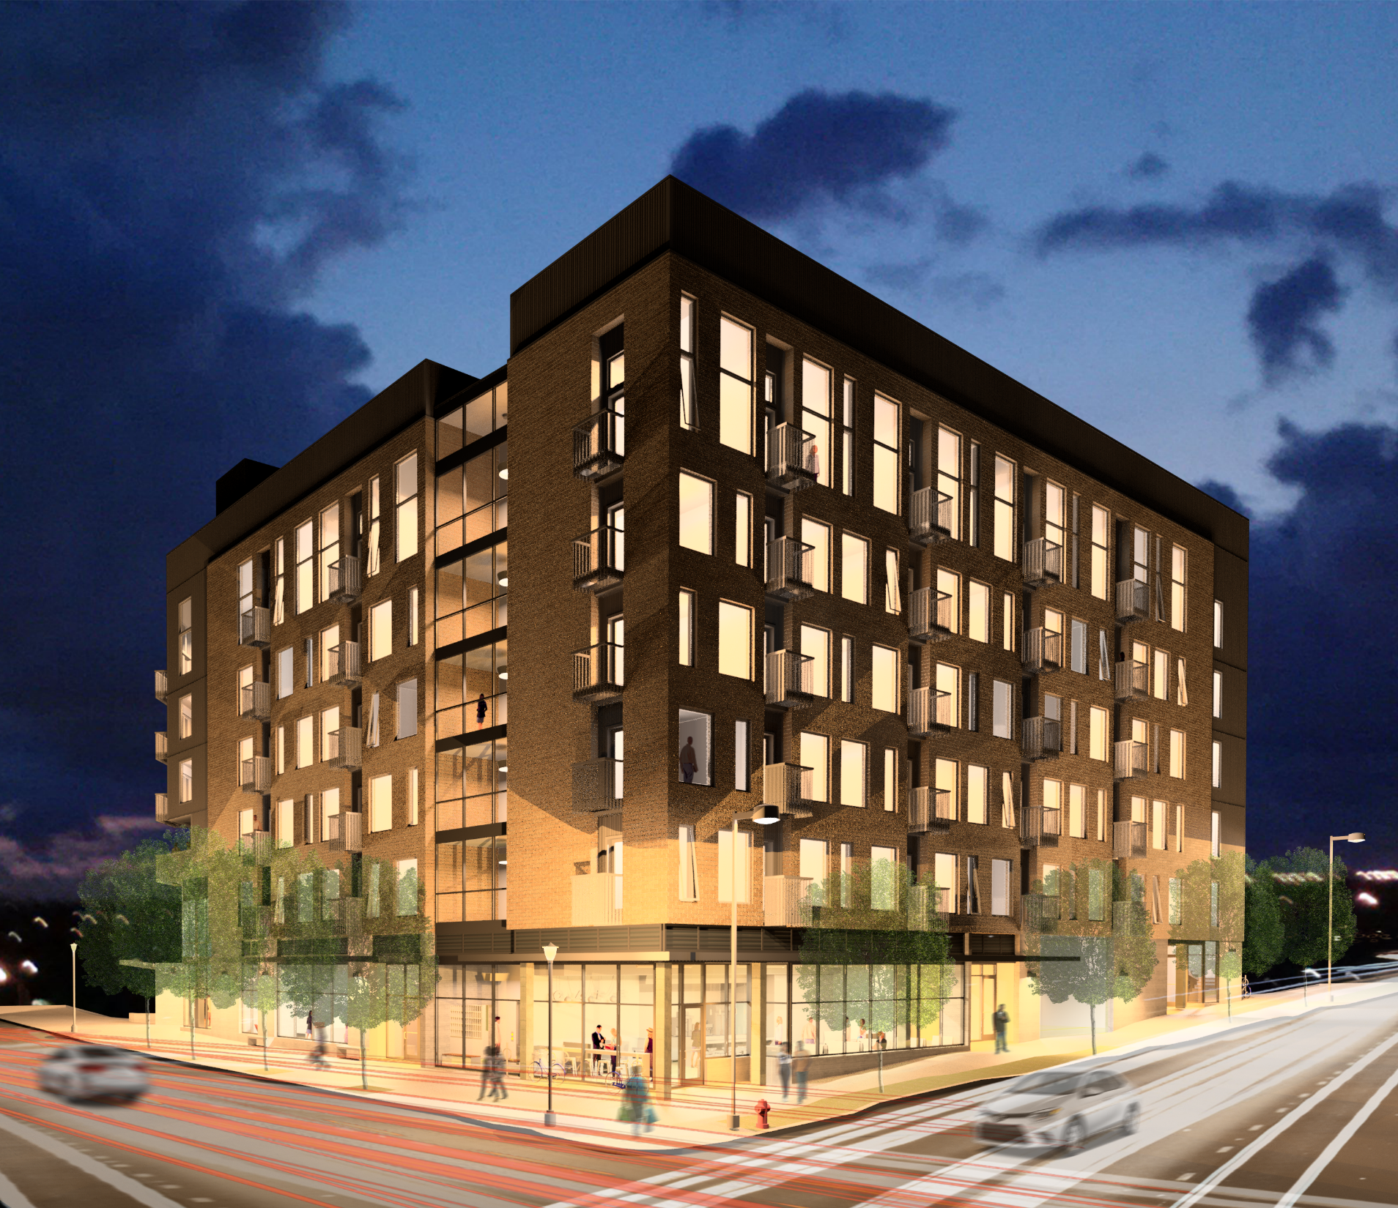
Staff Report Issues
Massing and I-405 Frontage
  Thoroughly studied
  Appropriately scaled
  Contextually positioned
Building Skin Contextual Response and Coherency
  - Mix of brick with secondary, high quality, material is
  contextually appropriate
  Design is consistent with parti and is architecturally
  resolved
Ground Floor Activation
  - Predominately active, vibrant and interesting
  ground floor facades and uses glazed at a greater
  extent (by area) than required by code
4. Permanence and Quality of Materials
- High quality and permanent materials proposed
throughout

