Slide 1
HAZELWOOD PLAZA 222 NE 102nd Ave. Portland, OR 62 RESIDENTIAL UNITS
ALBERTO RINKEVICH RICARDO BERDICHEVSKY
ARDESIGN C E N T U R Y 18 Llc.
4810 SW LOWELL CT. PORTLAND, OR 97221 3570 RIVER PARKWAY PORTLAND, OR 9729
503-927-1758 FAX 503-922-2613 503-477-4587 FAX 503-954-2612

Slide 2
Project location: 222 NE 102nd. Ave. Portland, OR Neighborhood: Hazelwood Plan District: Gateway Plan district Design Guidelines: Gateway regional district Zoning: CMd, Mixed Residential/Commercial with design Overlay Maximum building height : 75 feet Floor area ratio (FAR): Max. 4:1 Min. 1:1 Parking: Not required, 47 provided Bicycle parking: Long term : 80 provided, 74 required Short term: 6 provided, 6 required

Slide 3
Project Description
Property Address
No. Residential Units
Gross Building Area
No. Buildings
No. of Floors
Site Area
Building Construction
Roof Type
Building Exterior
Green Building Goal
222 NE 102nd Avenue
62 , 3 shops, 54 1BR, 8 2BR
59,018 sq. ft.
2
4 residential floors with tuck under parking
24,338 sq. ft.
Ground Fl. Concrete + Wood framing
Flat w/ bituminous membrane
In factory prefinished metal cladding,
prefinished cement board lap siding, gray
brick (ground floor), Metal balcony.
Comply and certify for Enterprise Green
Communities’ criteria for affordable housing

Slide 4
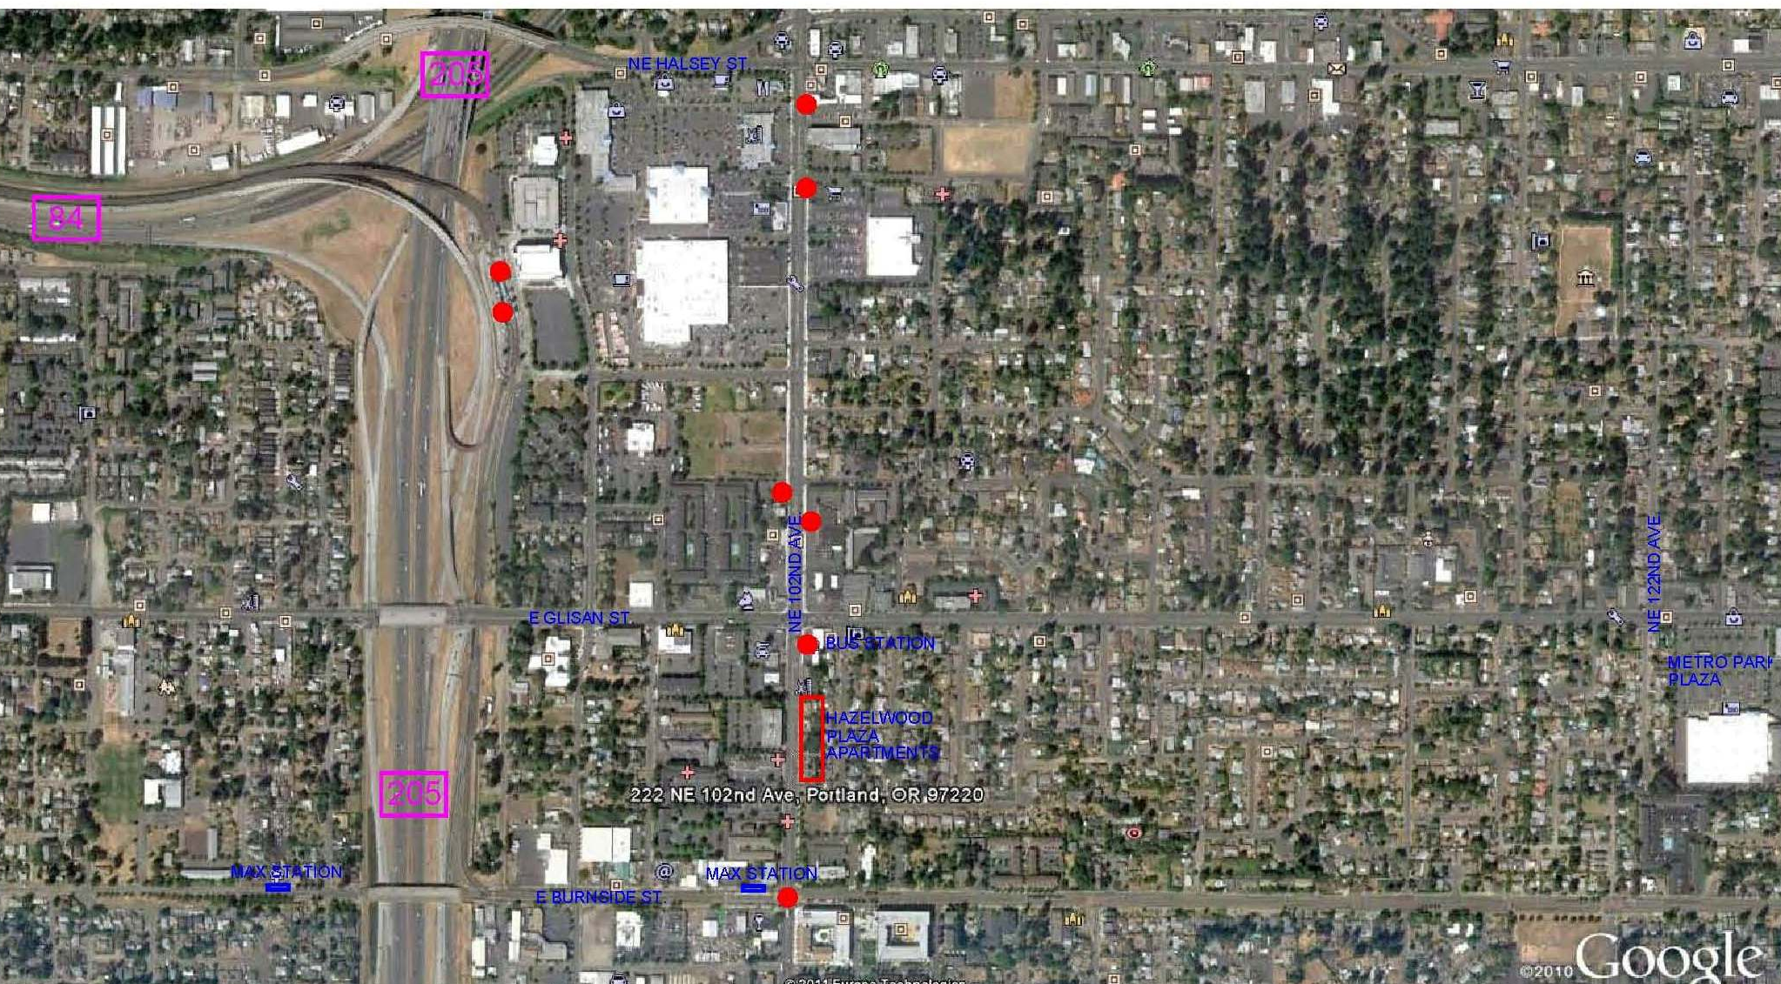
Vicinity
TRANSPORTATION CETR.
i-205 SHOPPING MALL
SE 102 ND / SE WASHINGTON ST.

Slide 5
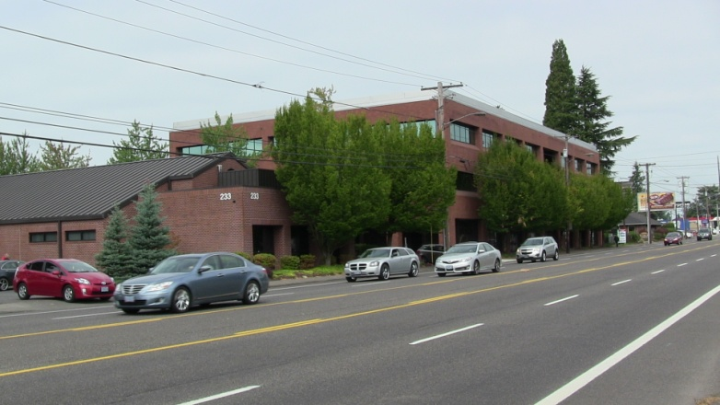
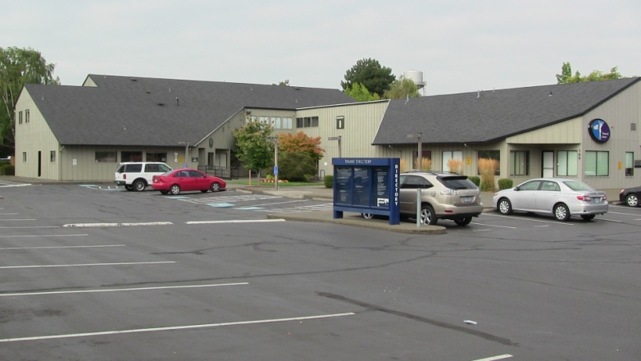
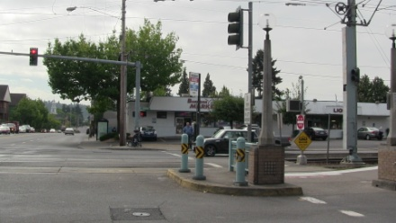
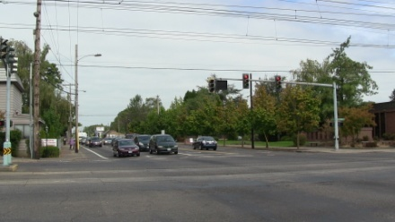
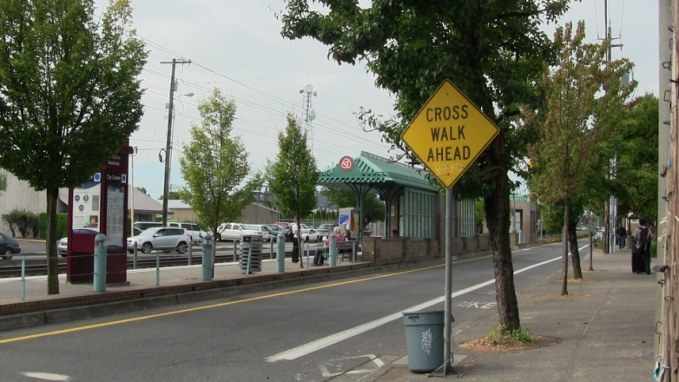
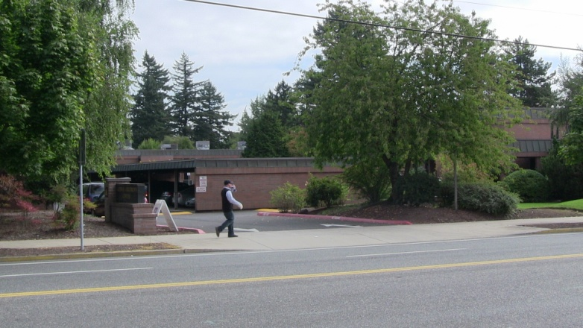
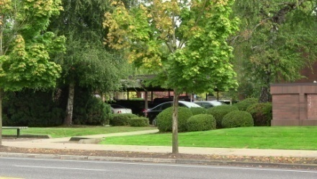
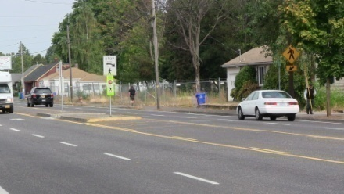
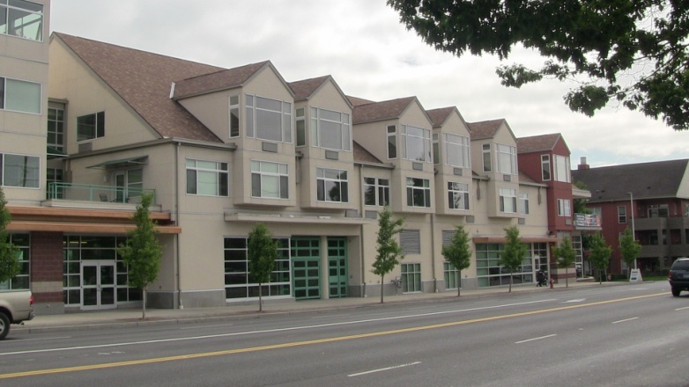
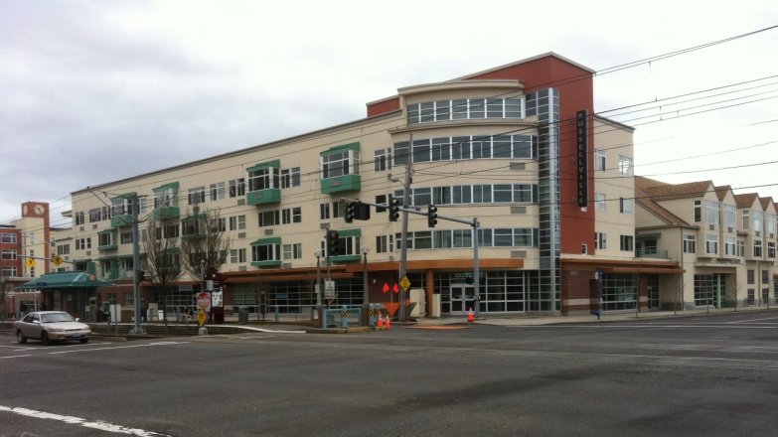
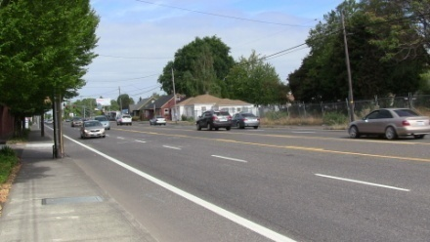
Close vicinity photos

Slide 6
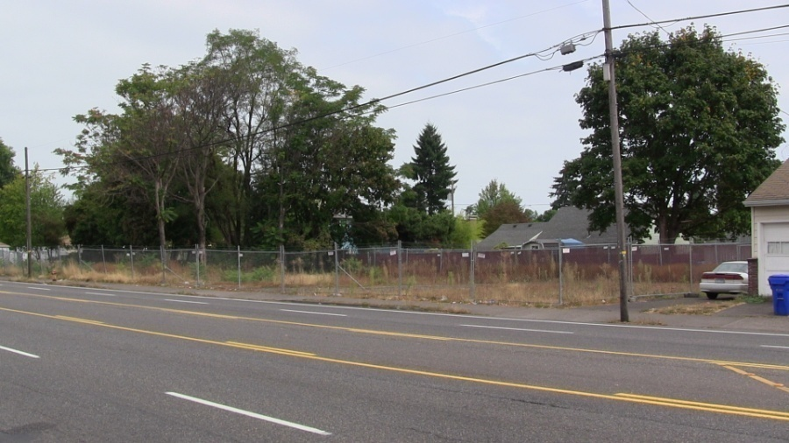
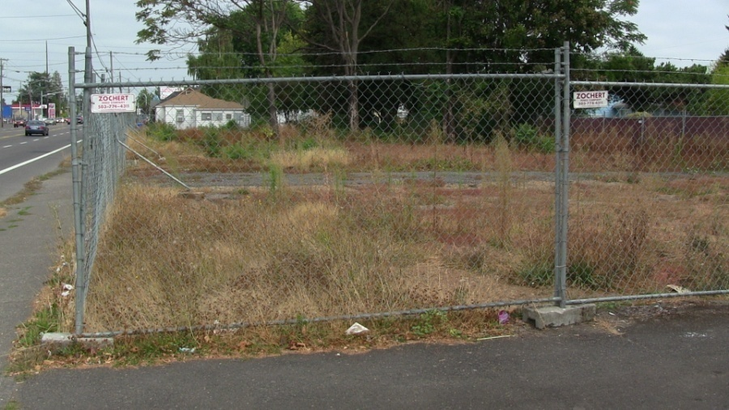
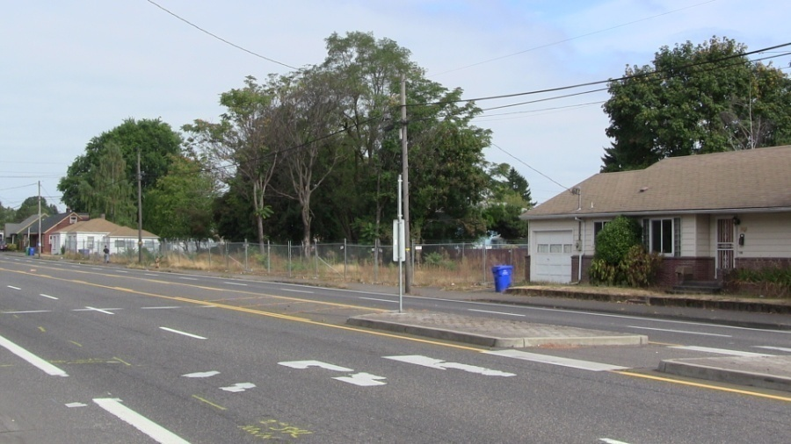
Site – current photos
the site is tapered, with one long side facing the street and one long side bounded by four small properties
the site was rezoned (consolidate 4 in 1 big lot) to replace four dilapidated townhouses with a 61-unit apartment building.

Slide 7
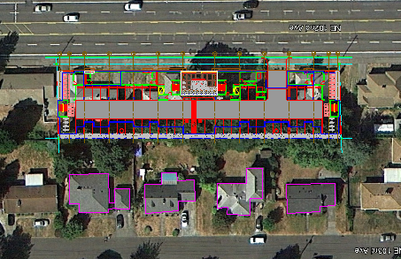
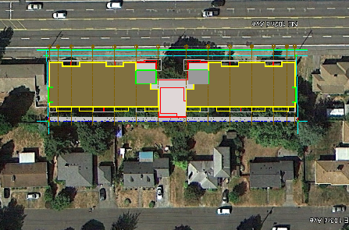
Site plans & section
New Site + 1st Fl. Plan
2 Bldg Roof Plan
-Two buildings linked by outdoor areas ( entrance plaza), each of them is less than half the length of the original design
-The flat roof decrease the bldg height facing the neighbors yards.
-Metal boxes attached on a flat light wall articulate and break the longitudinal dimension of each building on the East elevation
Previous site section

Slide 8
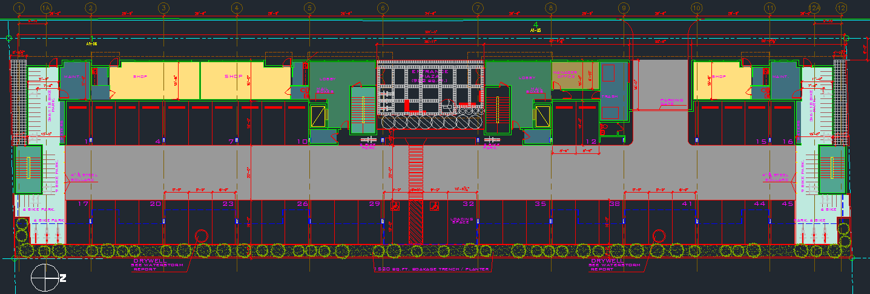
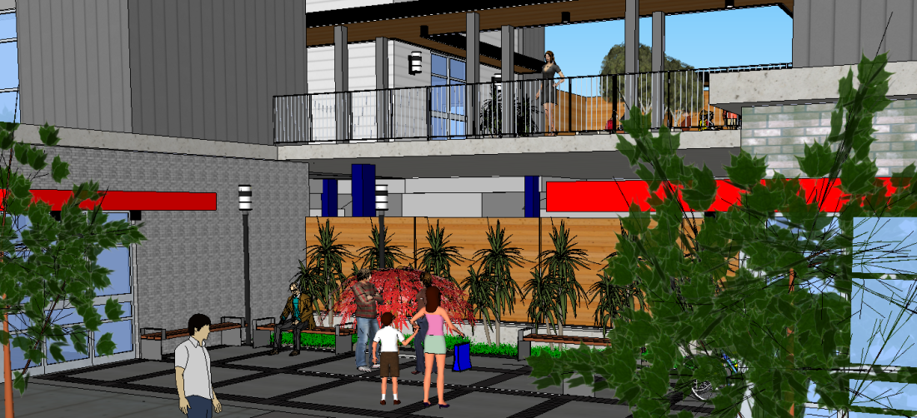
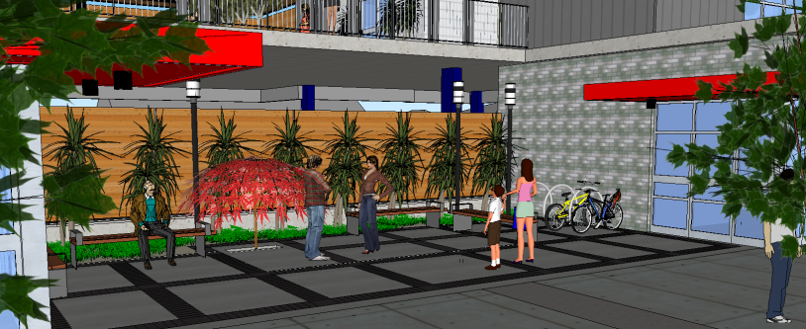
First Floor Plan
Common tuck-under parking for 44 vehicles plus 1 loading space, 3 ground floor retail spaces, and a central entry plaza

Slide 9
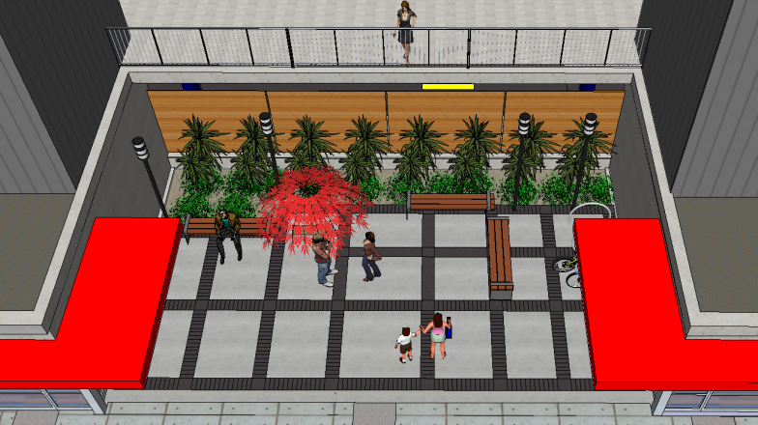
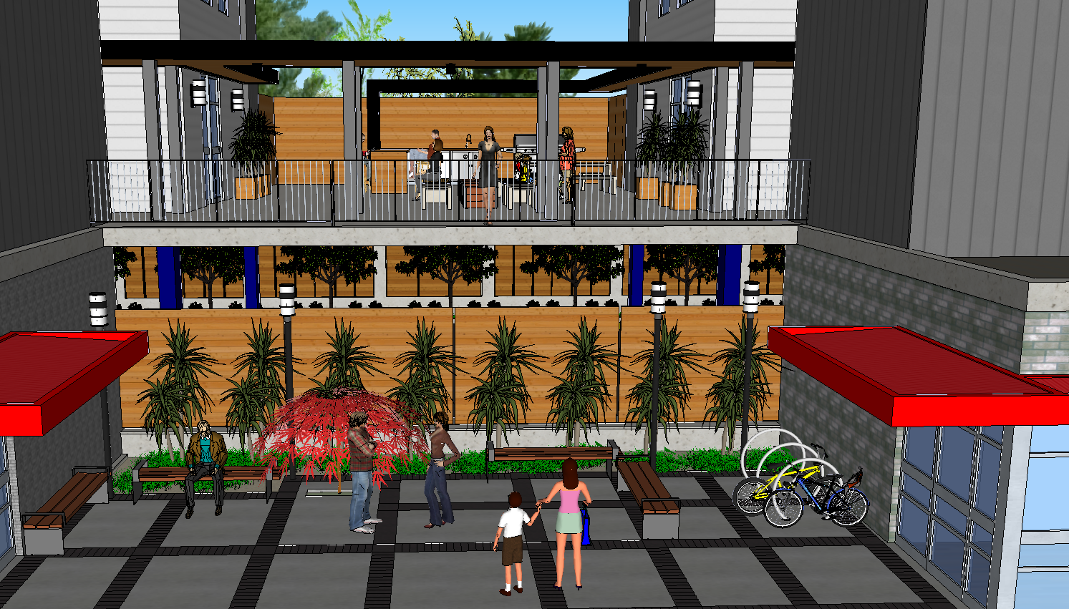
Entry plaza – access to the 2 buildings

Slide 10
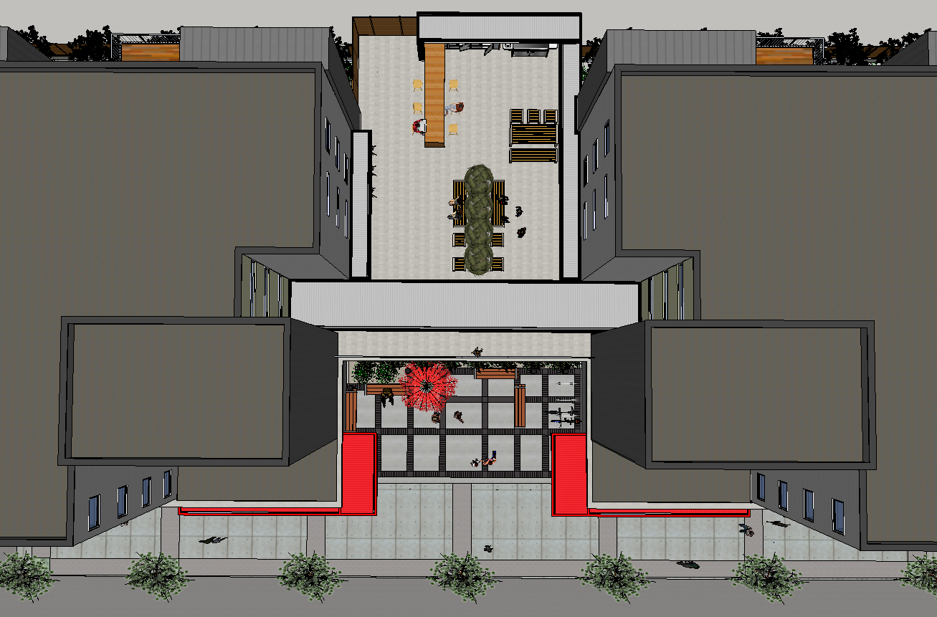
Community areas between building
(Common areas)
A private second floor outdoor deck is also oriented to the street to provide views to and from the front courtyard and main lobby entries of this active outdoor area.

Slide 11
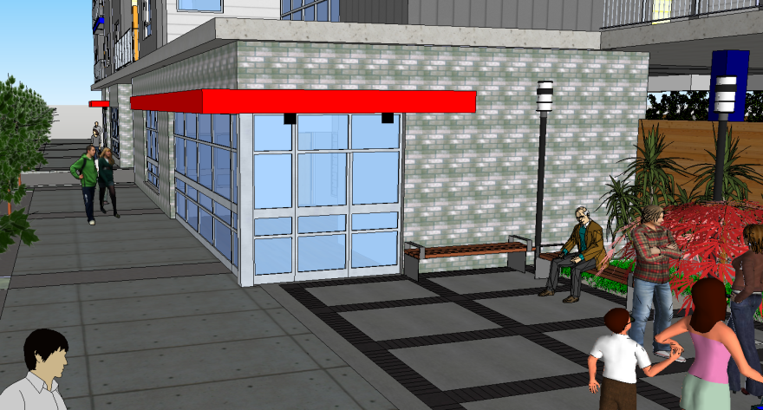
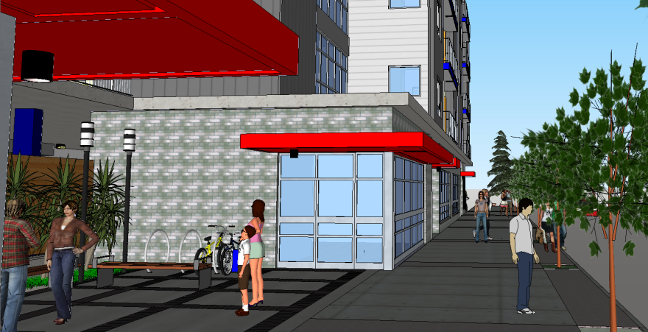
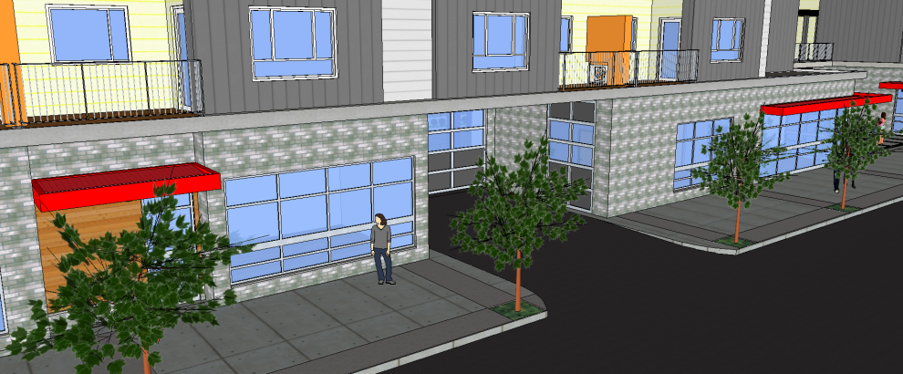
Retail units (active uses)
Storefront windows in Retail units
Open space adaptable to studios, offices or small shops
Glazed lobbies, opened to the plaza and to the street
The canopies above the doors allow entry points to be easily identified
by tenants and visitors
.

Slide 12
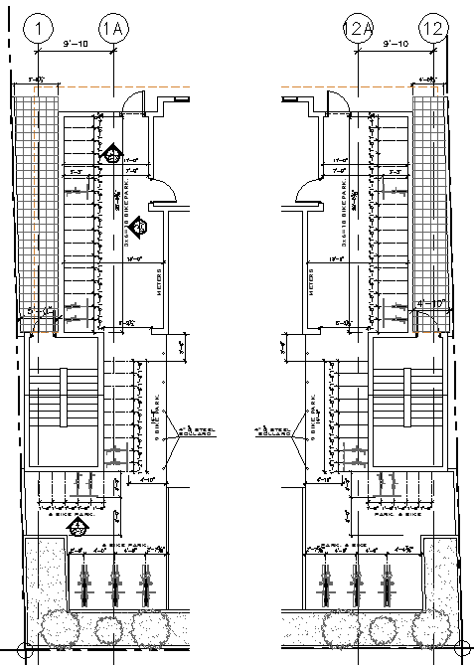
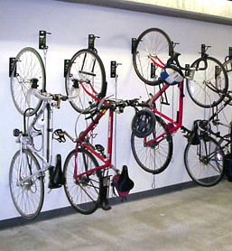
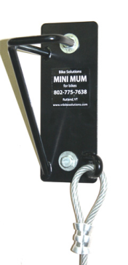
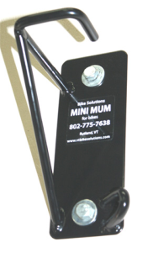
Bike Parking

Slide 13
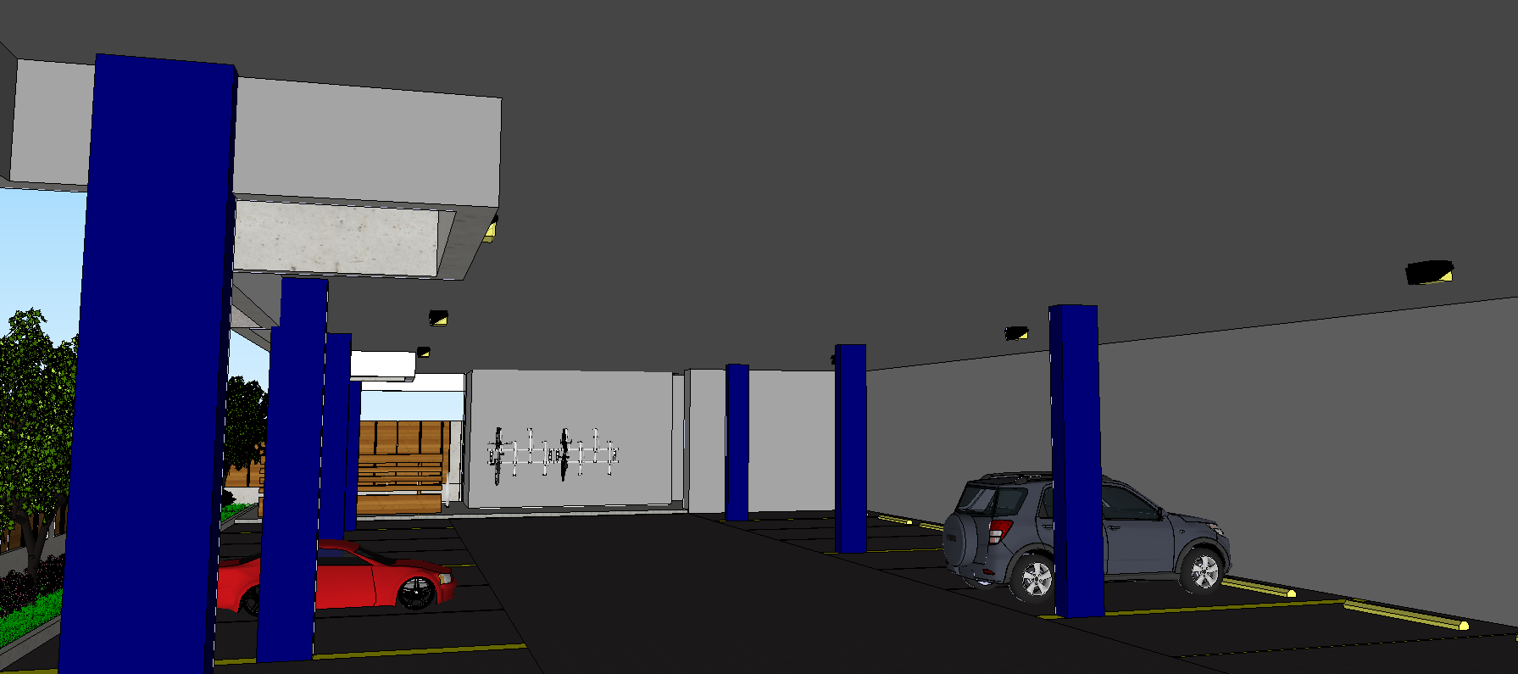
Parking Lighting Section
The rear wood fencing is solid wood with no gaps between the boards and will be thick enough to not allow lights to shine thru them
some noise from the parking area should be buffered by the landscaping and fence materials

Slide 14
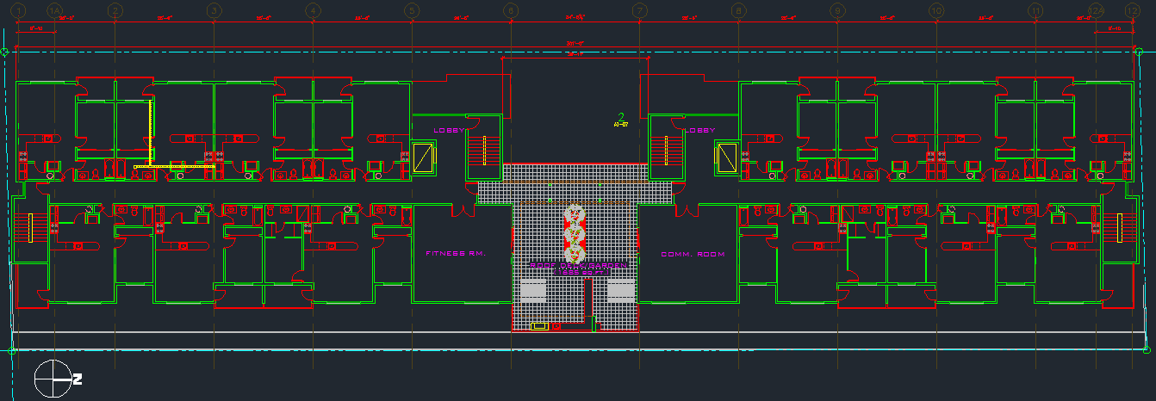
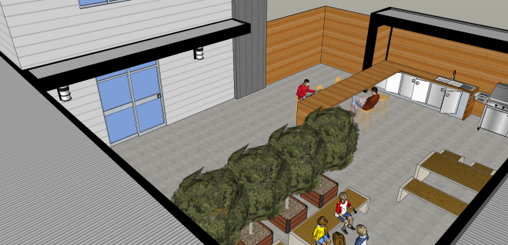
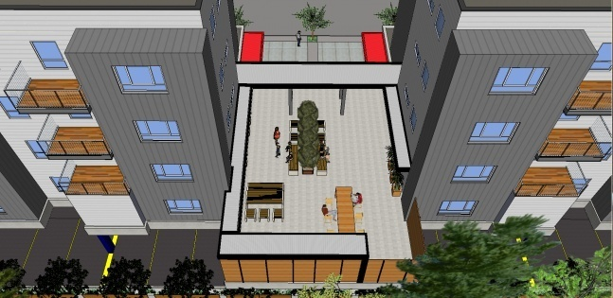
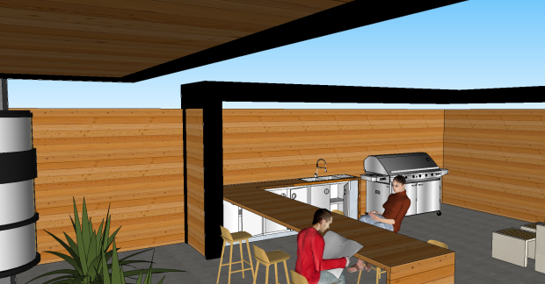
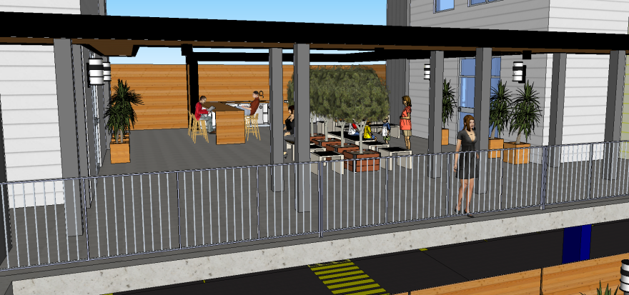
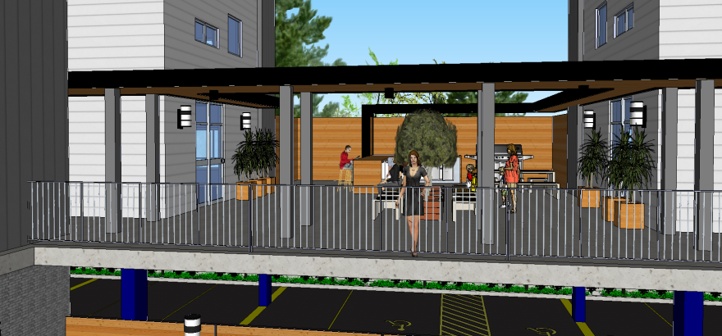
2nd Floor Plan
2nd level outdoor deck (roof garden) and common rooms

Slide 15
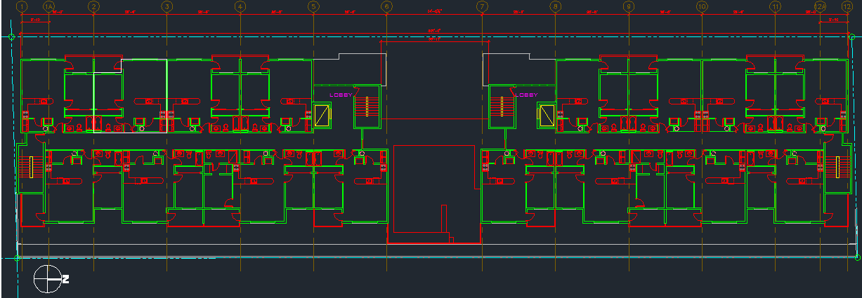
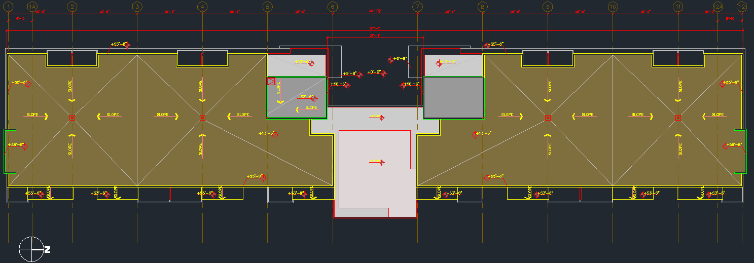
Type Floor (3rd, 4th,5th) and Roof Plans

Slide 16
Elevations W & E
The main residential entries, active retail spaces, front courtyard, parking area entry, and second floor deck are all oriented toward NE 102nd Avenue, away from the lower scale single-family homes directly east of the site. Locating these active uses along the street and toward the common spaces removes the most active building functions from neighboring residential lots, thereby reducing potential conflicts Building massing is also highest at the circulation towers which are pulled up toward NE 102nd Avenue away from the rear yards of the neighboring homes.
The rear wood fencing is solid wood with no gaps between the boards and will be thick enough to not allow lights to shine thru them. There will also be a continuous 3 foot tall line of evergreen shrubs and 22 trees planted along the inner fence line so that the landscaping will provide an additional buffer for headlights and noise

Slide 17
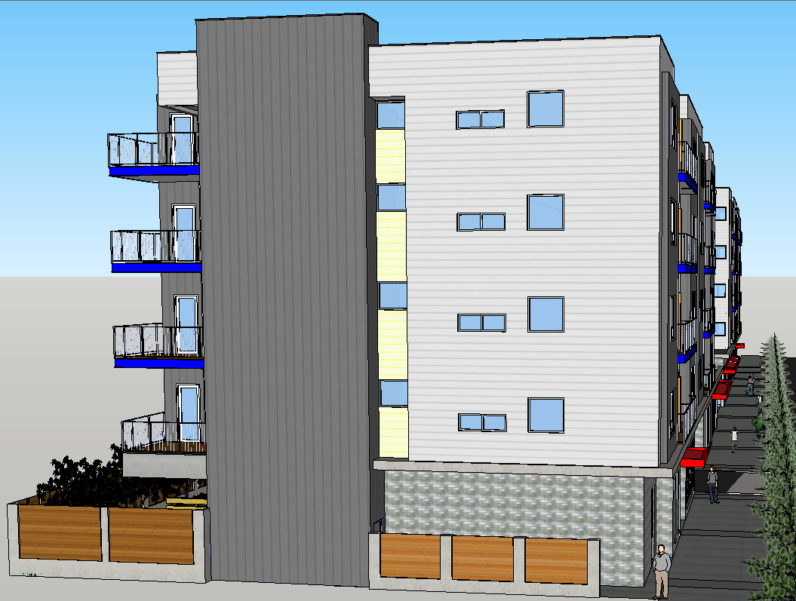
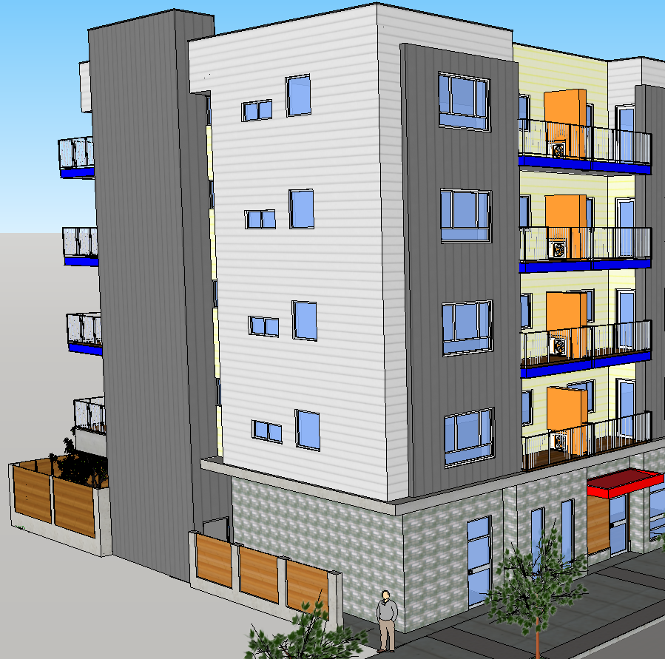
Elevations N & S

Slide 18
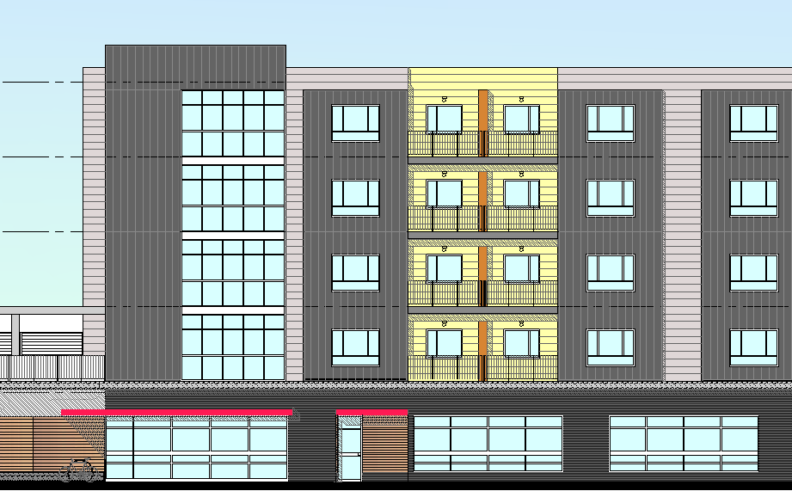
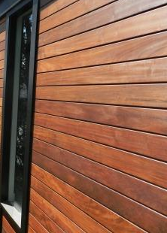
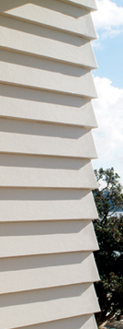
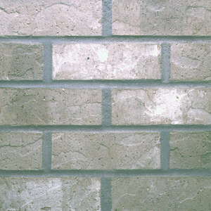
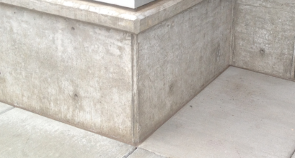
Materials
METAL CLADING CENTRIA IW-12 COLOR SILVER STM
EXPOSED SMOOTH FINISH CONCRETE
IPE WOOD
CEMENT BOARD SMOOTH ARTISAN LAP SIDING
GRAY BRICK, HARBOR MIST

Slide 19
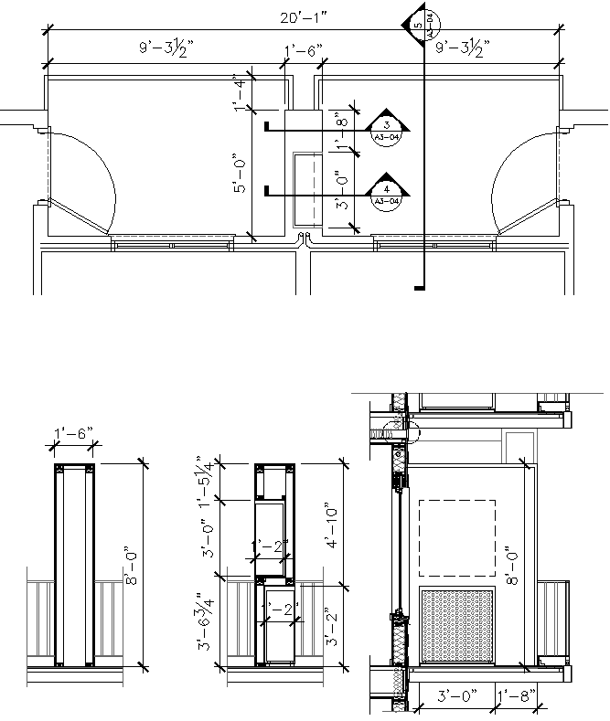
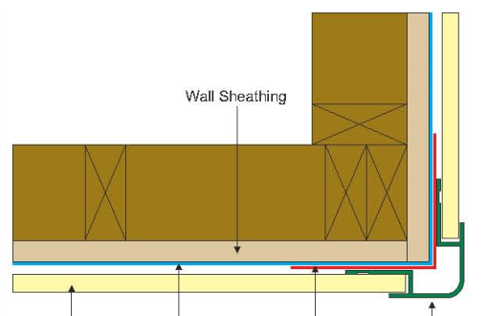
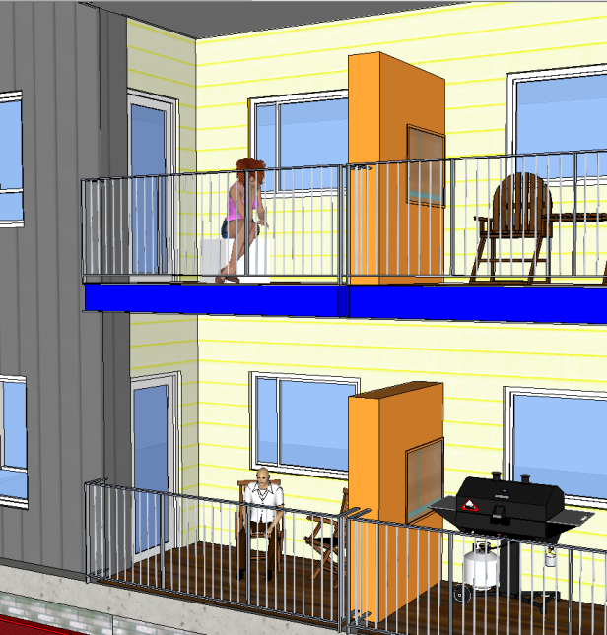
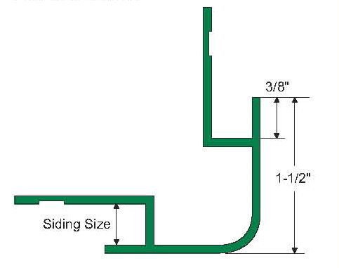
Balcony privacy partition
Individual air handling units are integrated into the overall balcony privacy wall pattern on the east and west facades and are hidden behind metal grilles that will match the color of the adjacent cement panels

Slide 20
Shop Entry
The building line does set back in places from the front lot line to allow for recessed retail entries as a sidewalk extension

Slide 21
Details

Slide 22
Details

Slide 23
Rear view with neighbors properties

Slide 27
Elevation Comparison

Slide 29
First Floor Comparison

Slide 30
Landscape Comparison
245 SF

Slide 31
Requested Modifications
33.526.280.D.2 Ground Floor Active Use. To allow the ground level retail spaces to be 13’-8” deep instead of the 25’-0” deep required in the zoning code.
2. 33.266.319.D.b Loading Space Size. To allow the required one 18’ long x 9’ wide x 10’ high loading space to be 16’ long x 10’-6” wide x 10’ high.
3. 33.266.220.B.2a Long-Term Bicycle Parking. To allow the wall-mounted bike racks to be spaced 18” on-center instead of the 24” on-center required by the zoning code.
4. 33.526.270.C Entrances. To allow the two main lobby entry doors to be rotated 90 degrees perpendicular to the street instead of directly facing NE 102nd Avenue as required in the zoning code.

