Slide 1
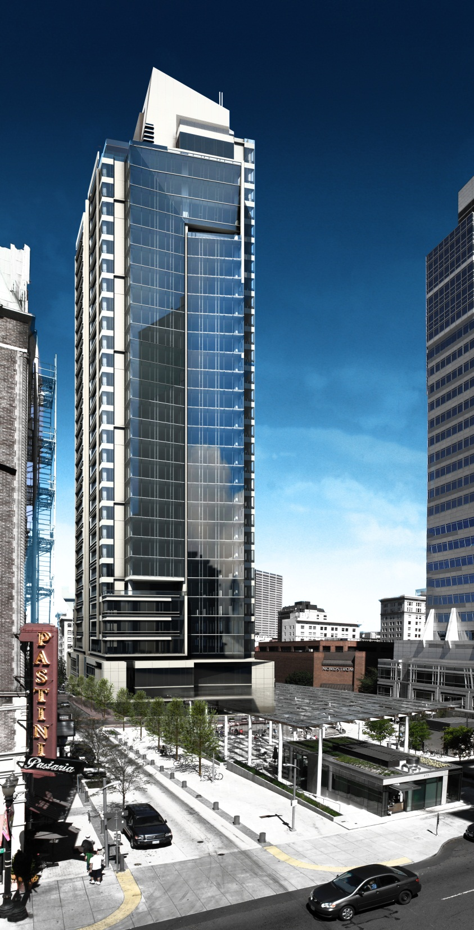
Park Avenue West Tower

Slide 2
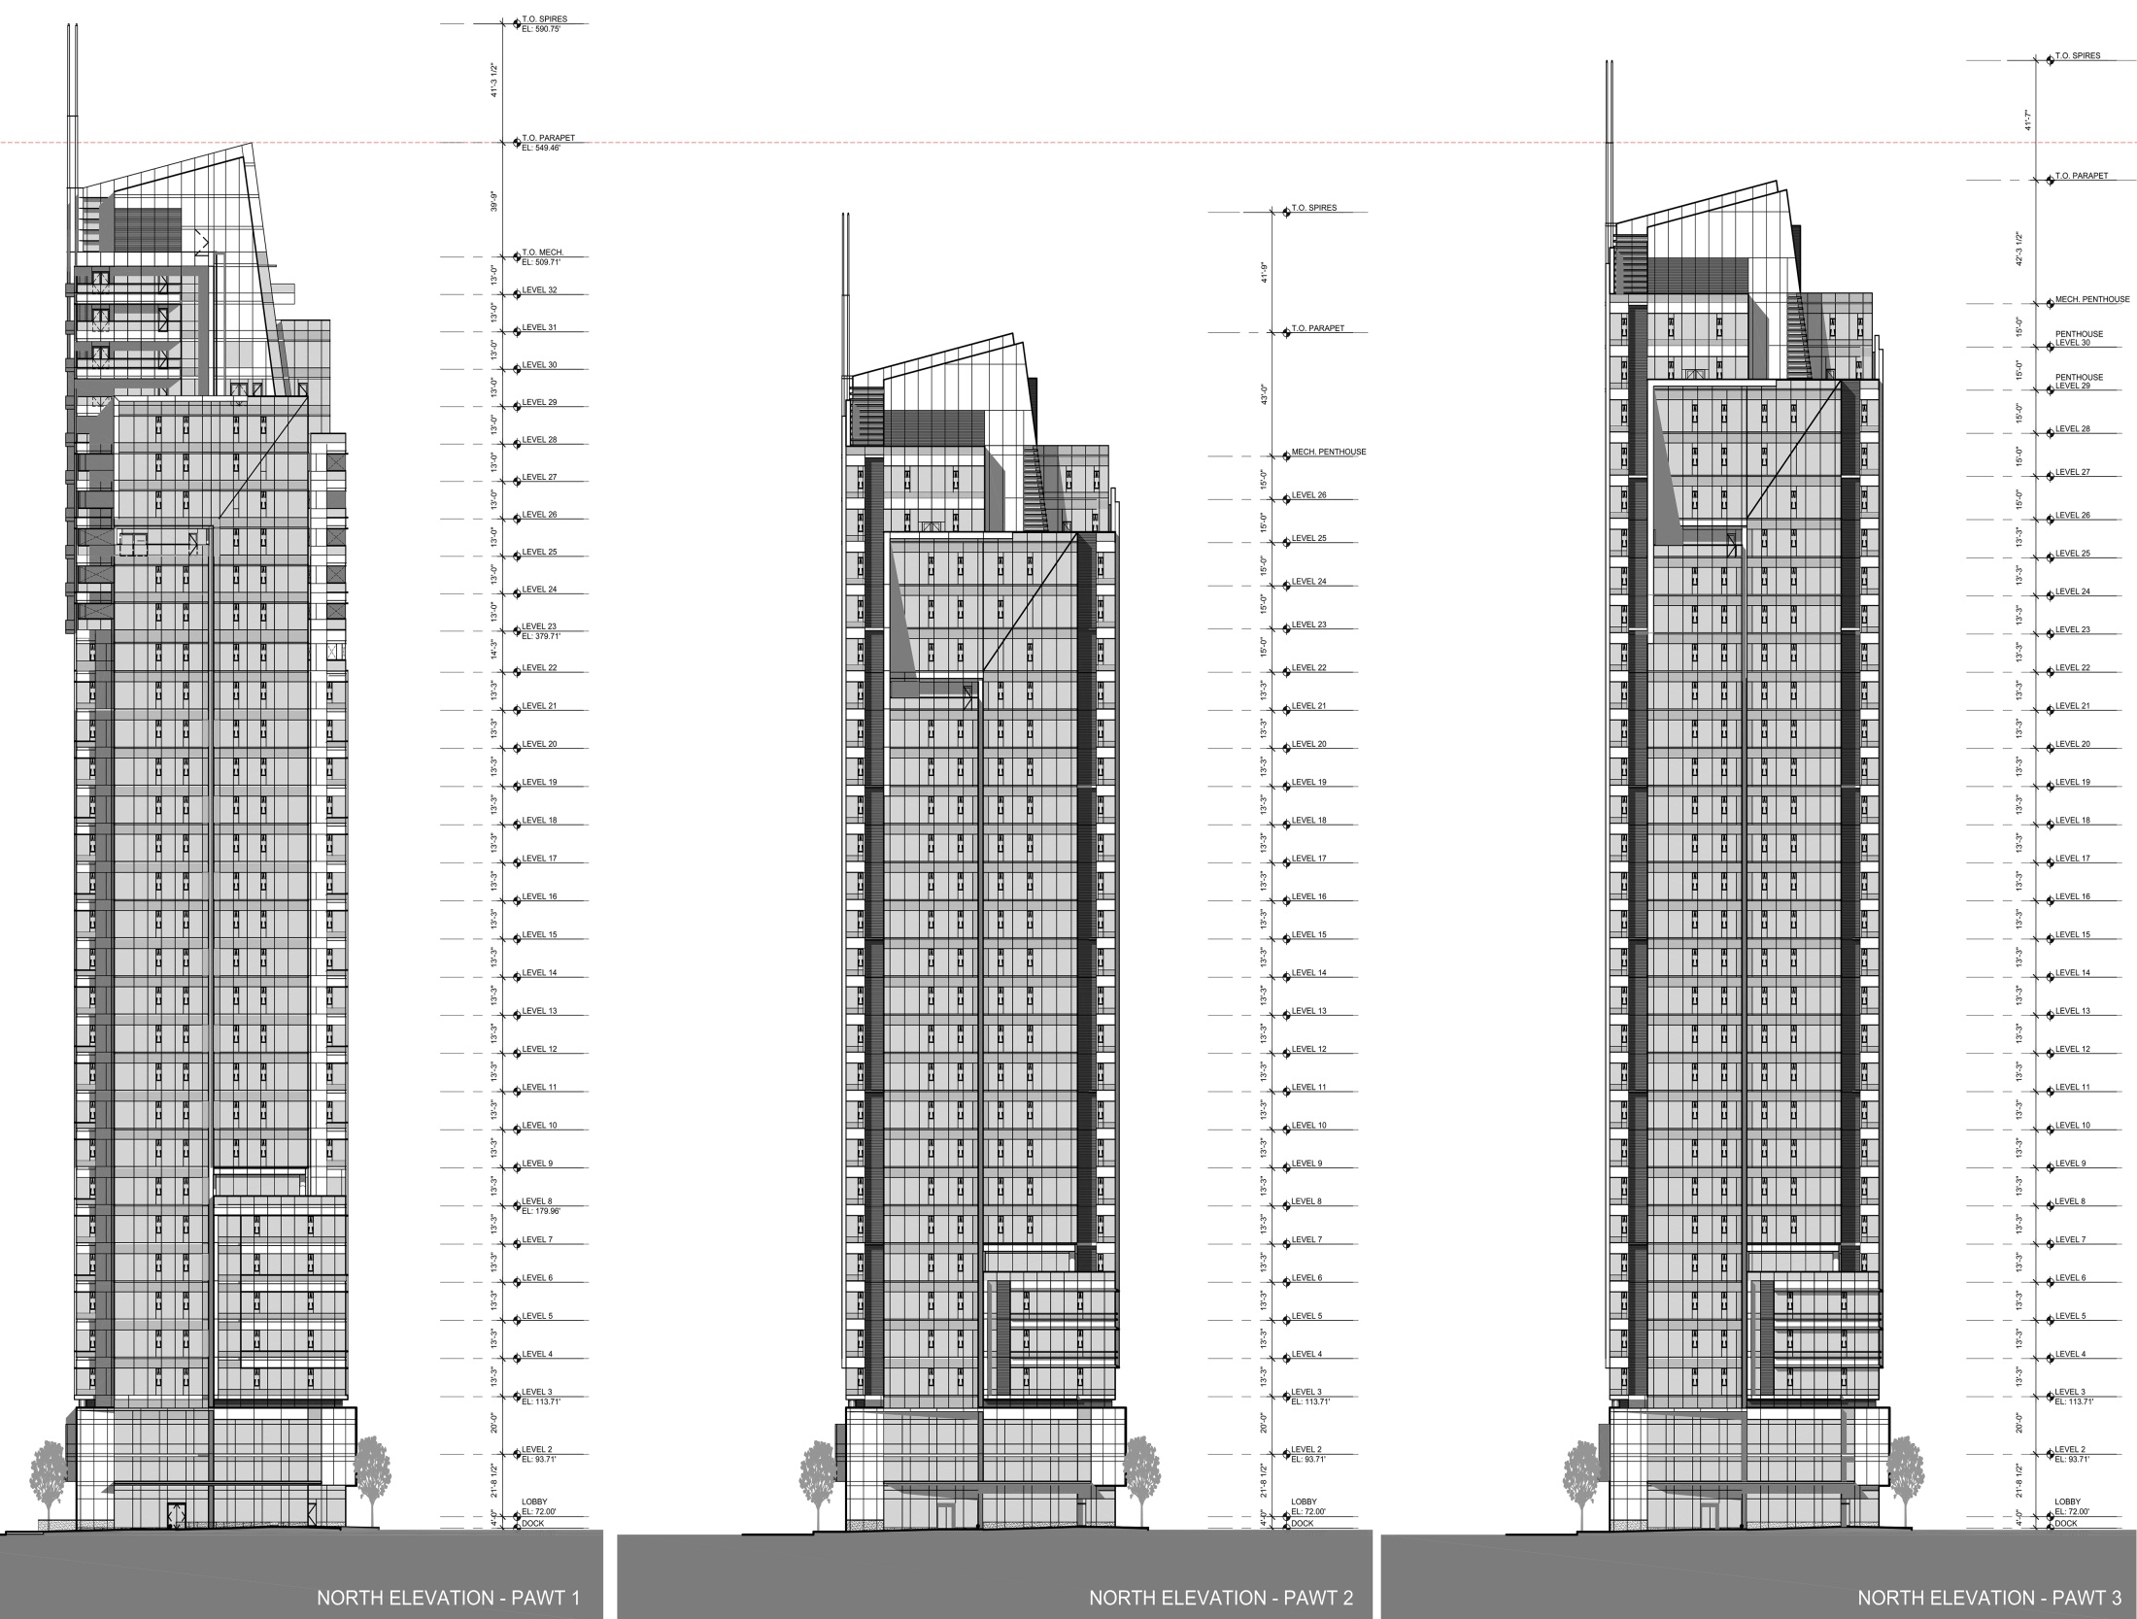

Slide 3
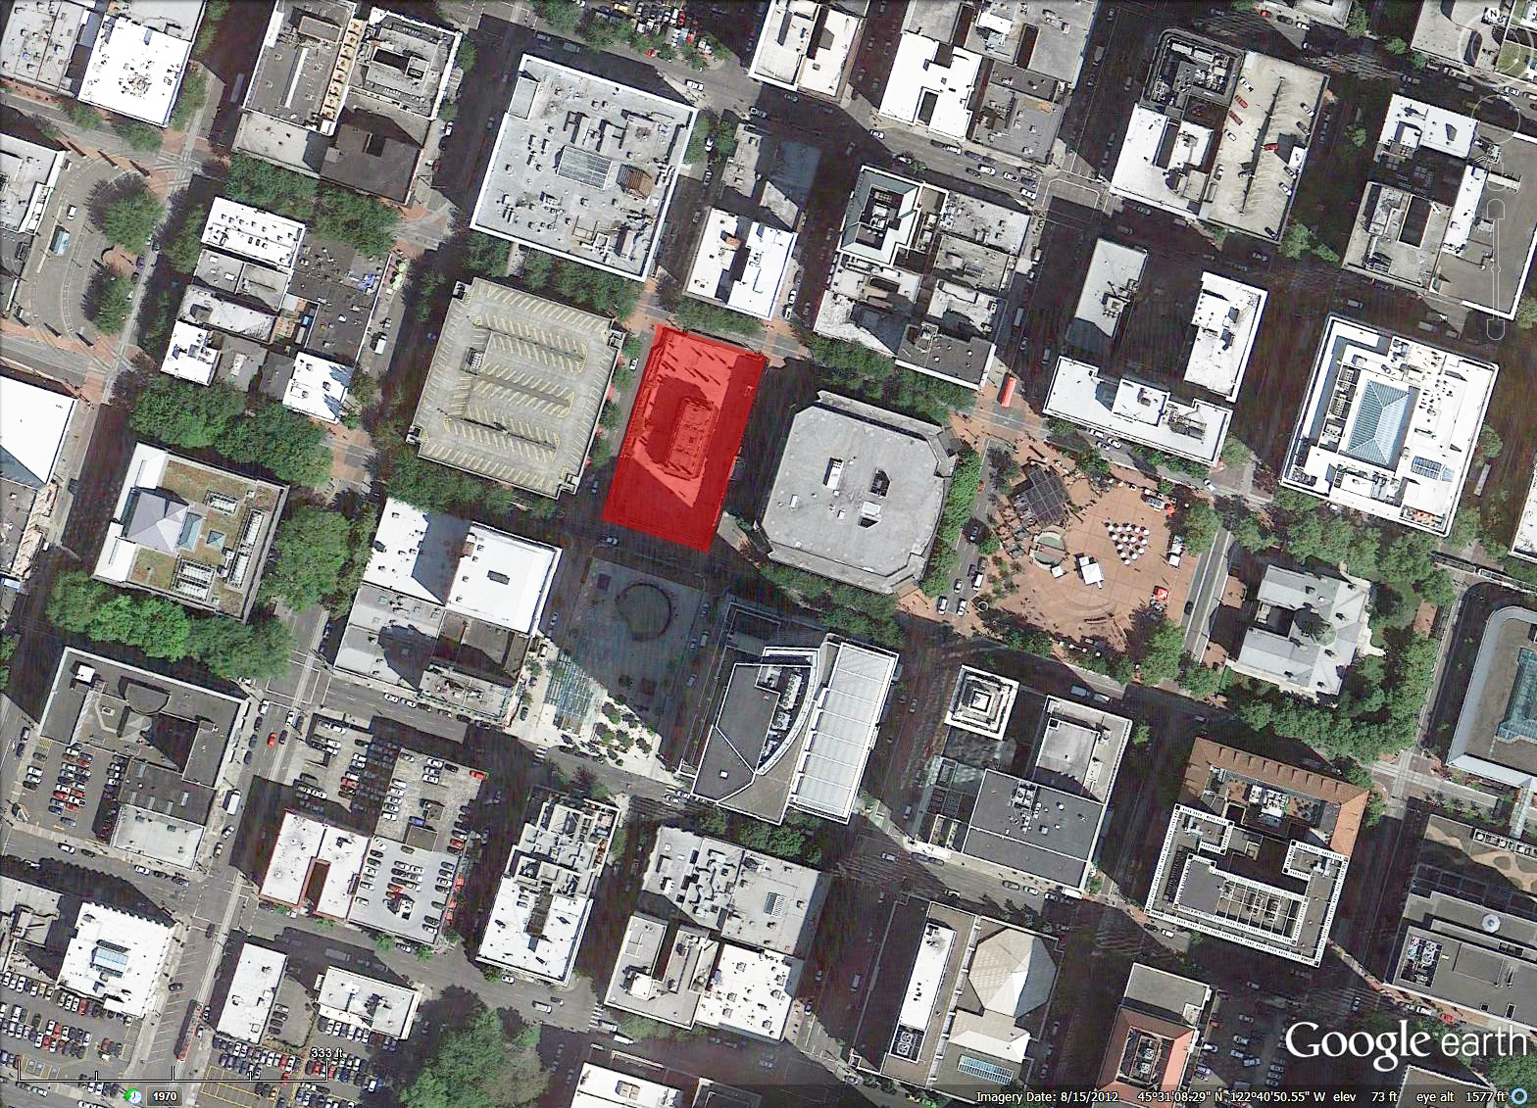

Slide 4
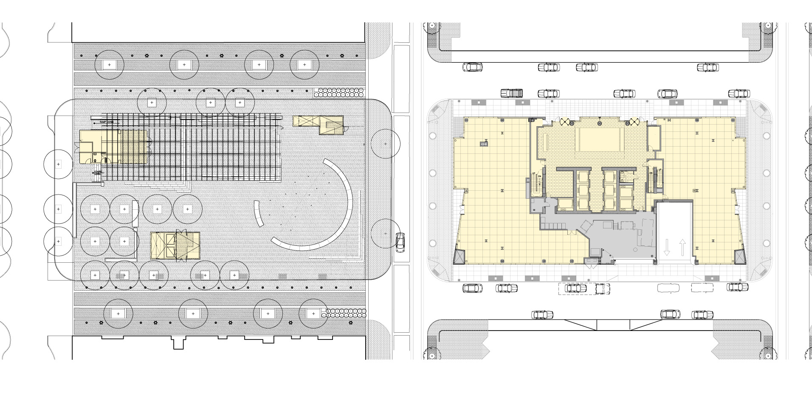
9th Avenue
Taylor
Yamhill . Lightrail Line
Morrison . Lightrail Line
5,800 sf
4,200 sf
Park Avenue
Fox Tower
Nordstrom Loading
Lobby/Site Plan

Slide 5
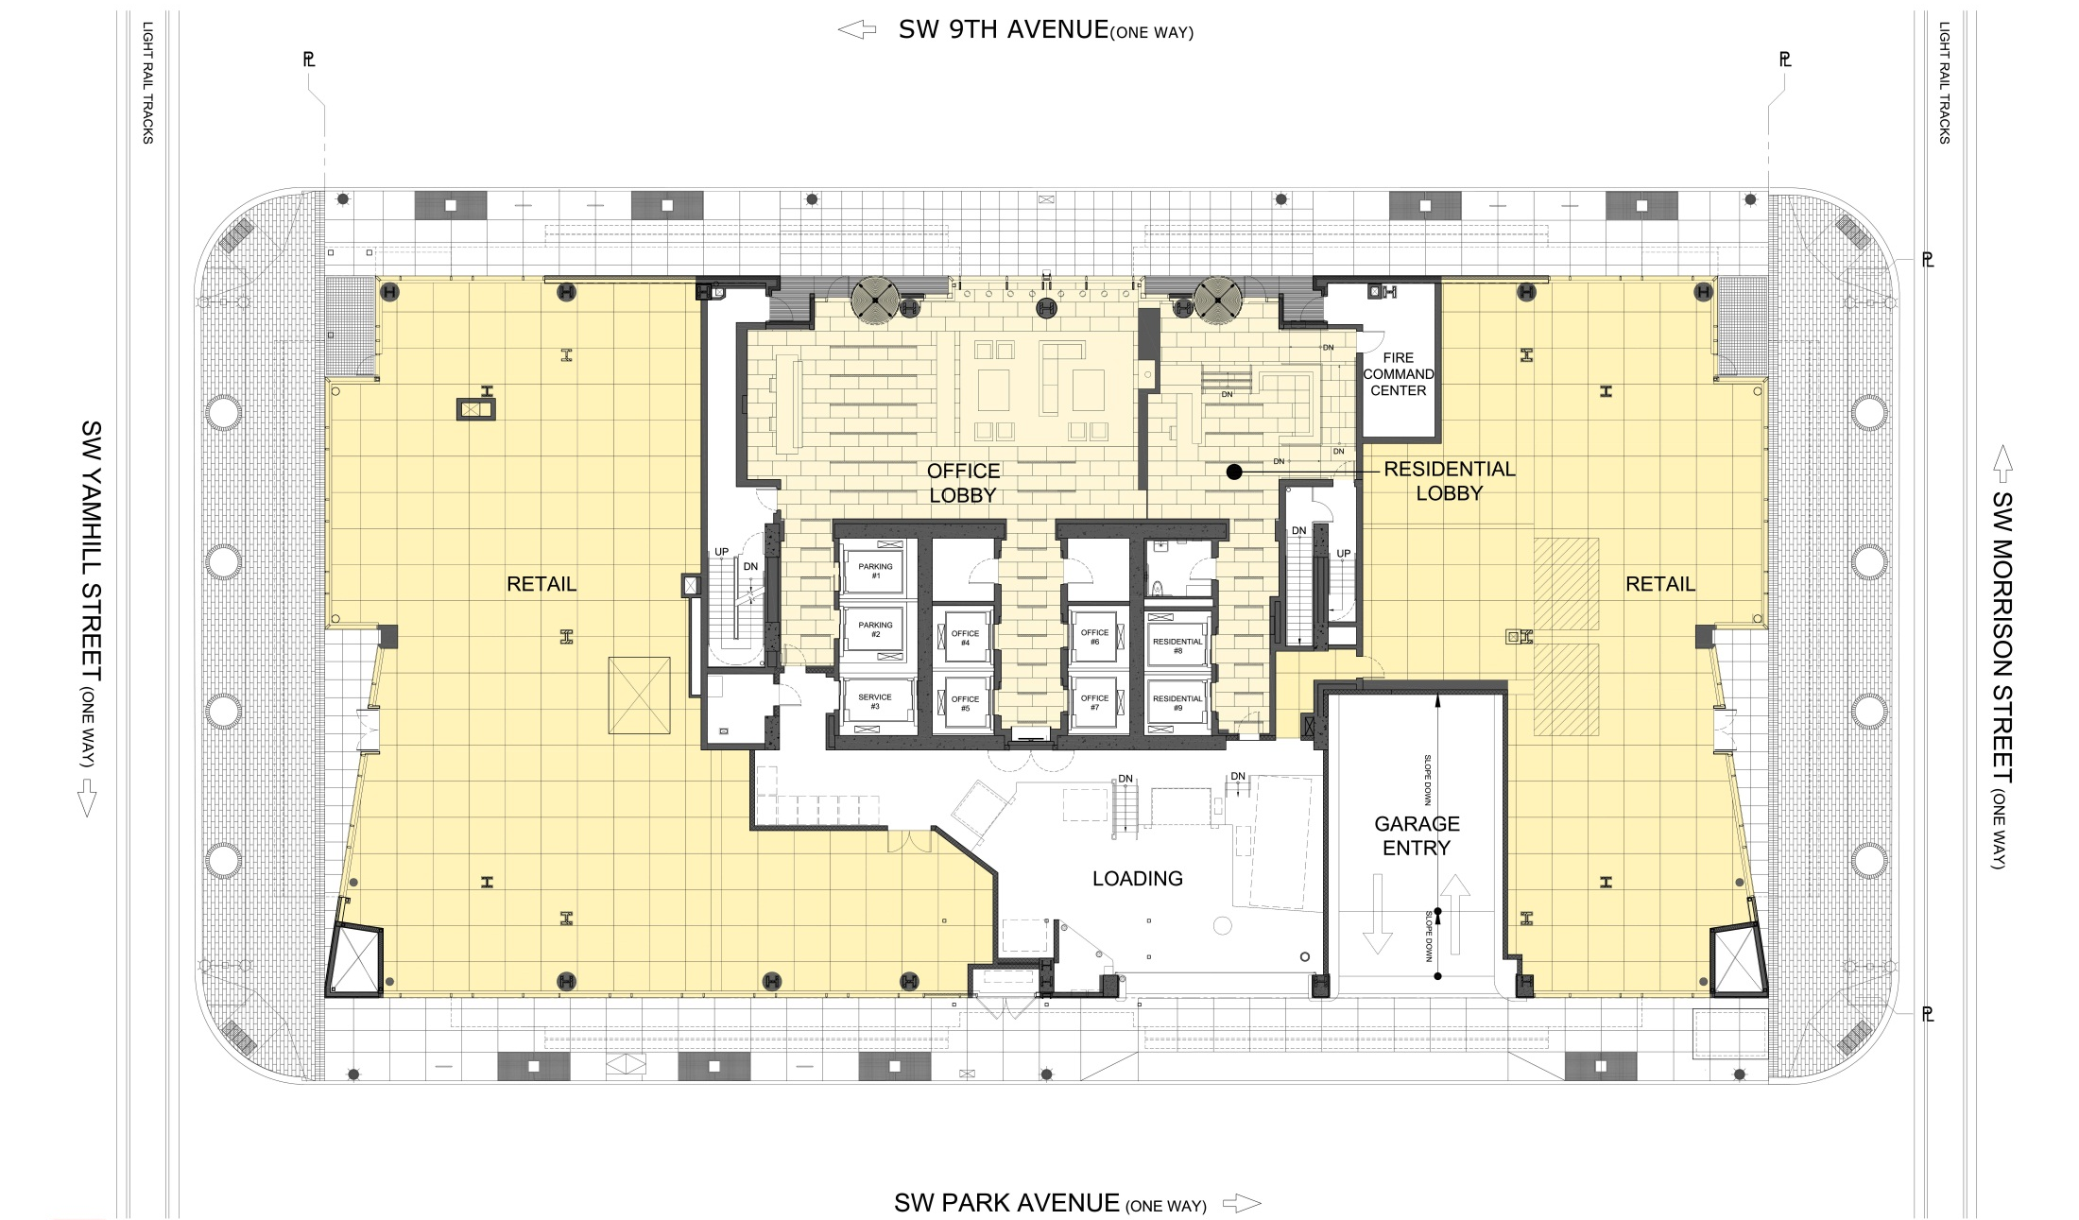
Ground Floor Lobby

Slide 6
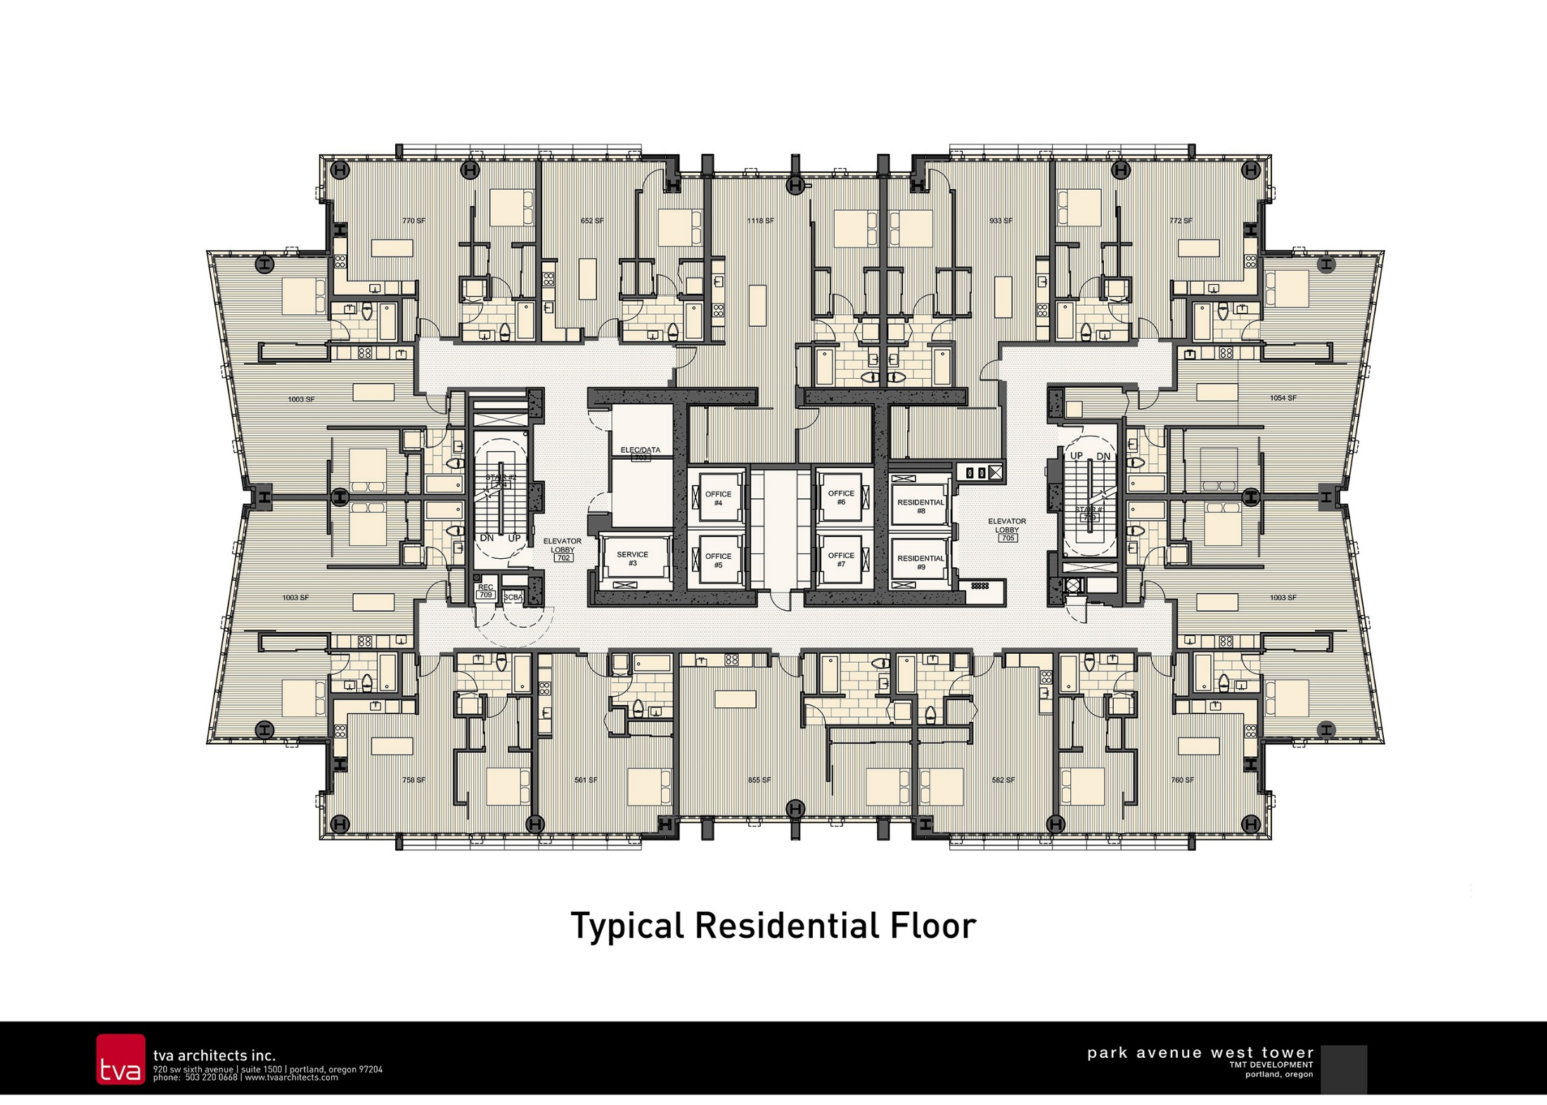
32 - STUDIO
122 – 1 BR
14 – 1 BRS
34 – 2 BRS
1 – 2 BRS+S
203 UNITS TOTAL

Slide 7
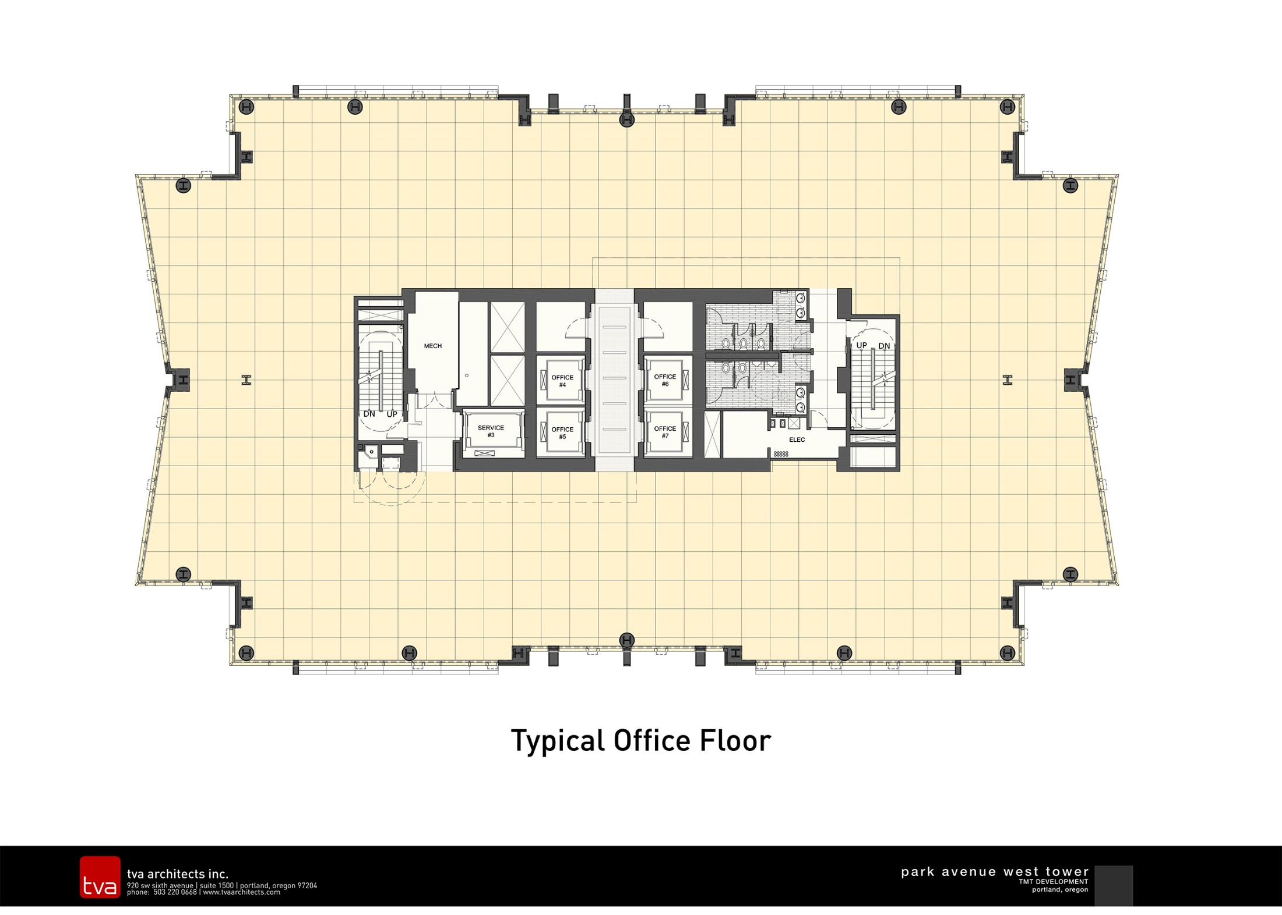

Slide 8
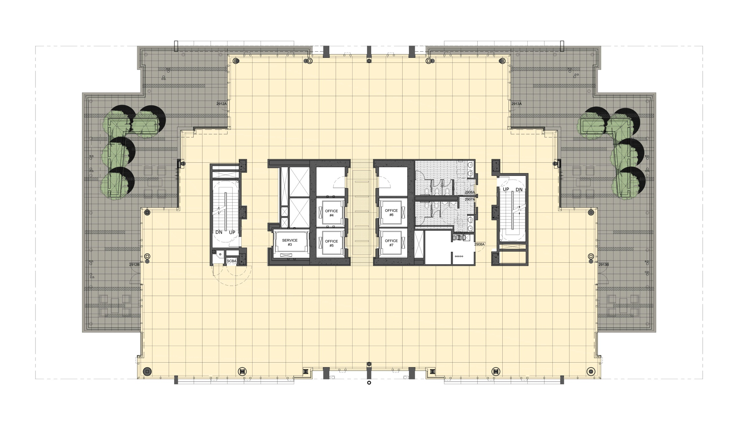
Floor 29 – Office Penthouse

Slide 9
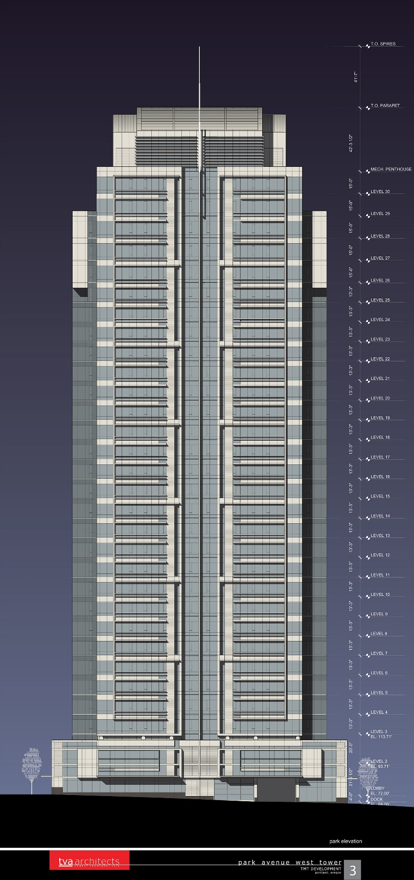
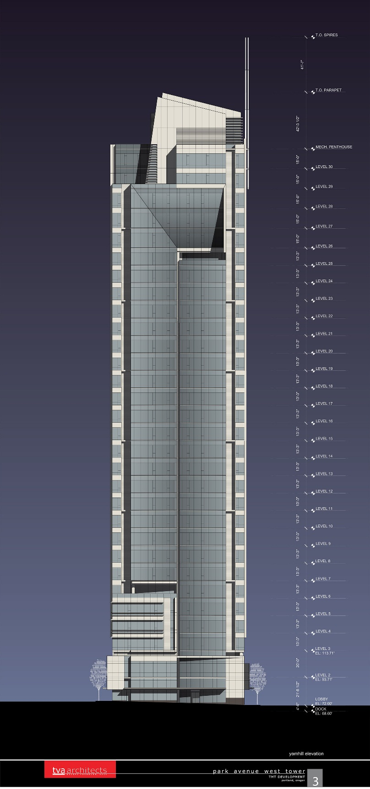
Park Avenue
Yamhill Avenue

Slide 10
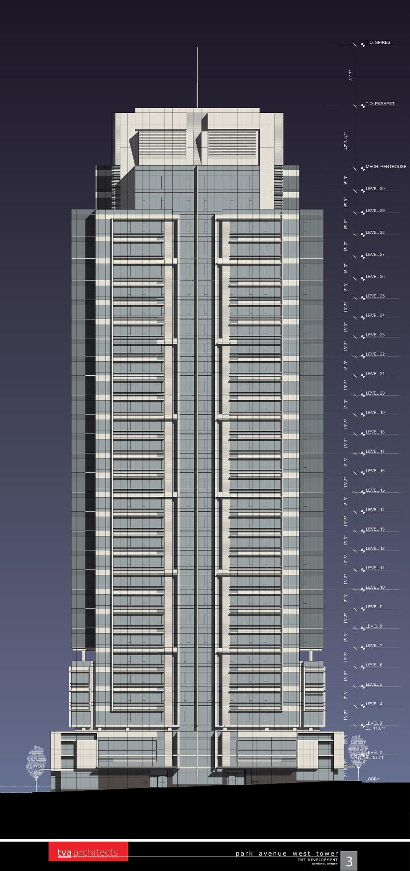
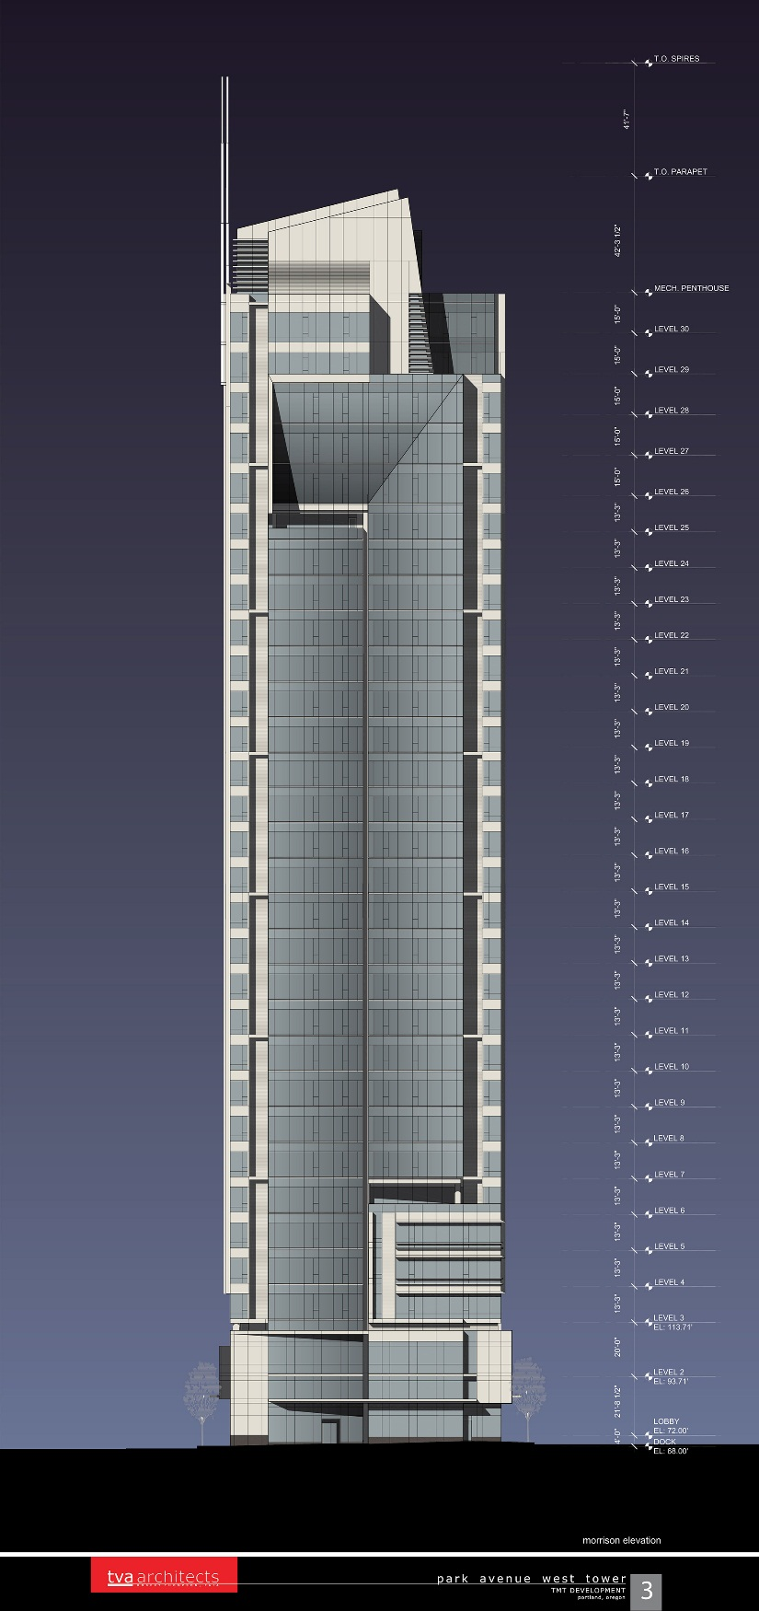
Ninth Avenue
Morrison Avenue

Slide 11
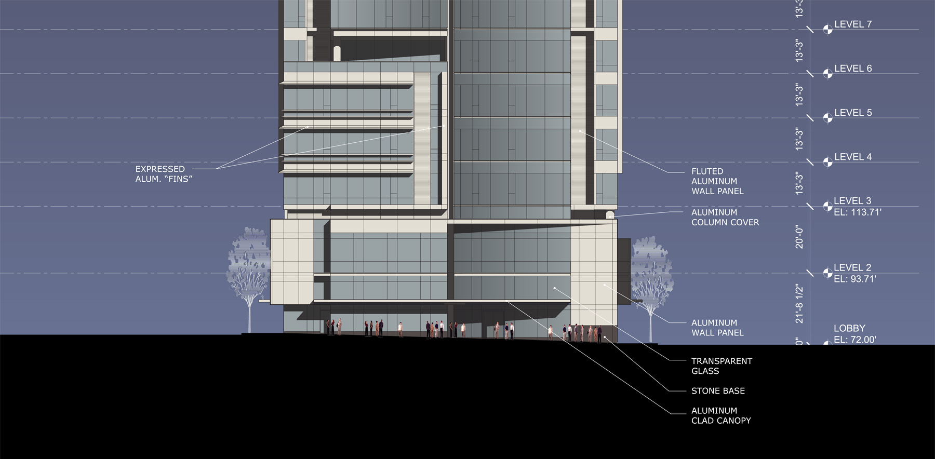
Yamhill Elevation

Slide 12
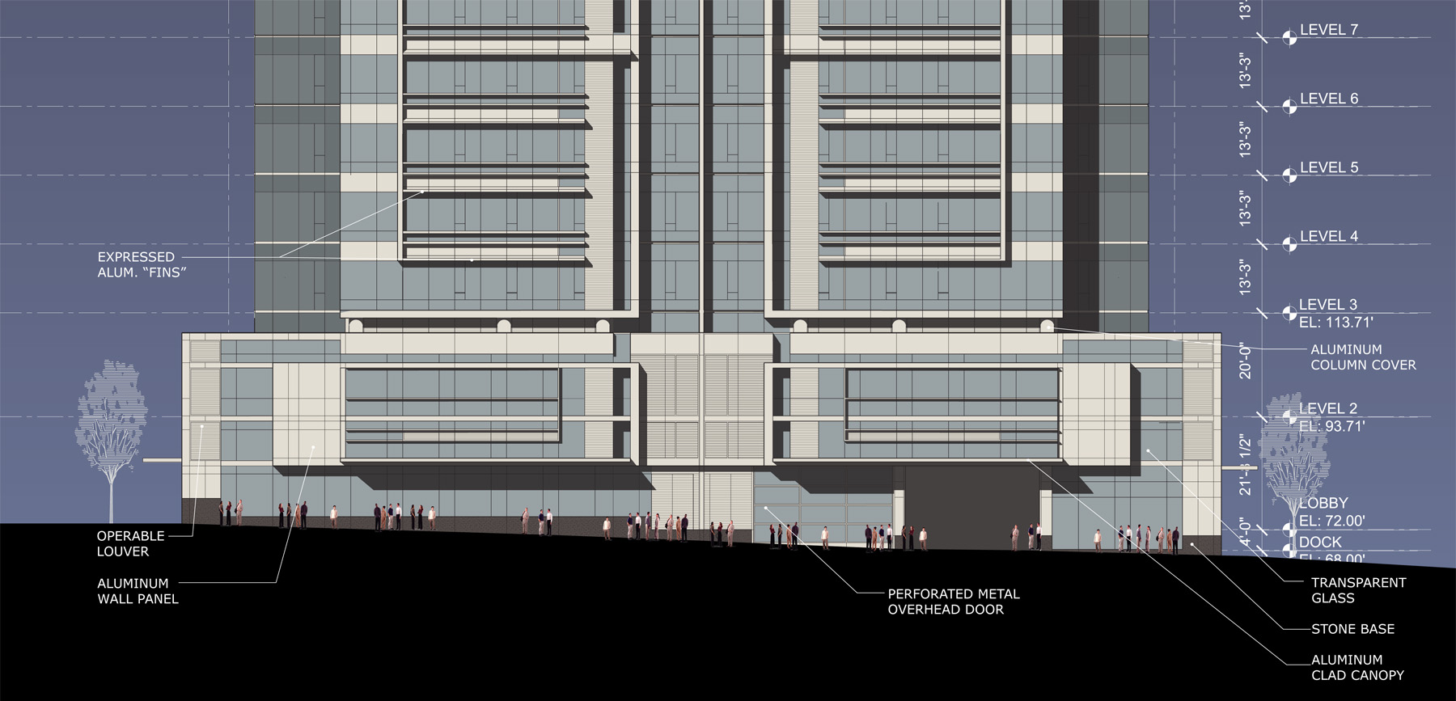
Park Avenue Elevation

Slide 13
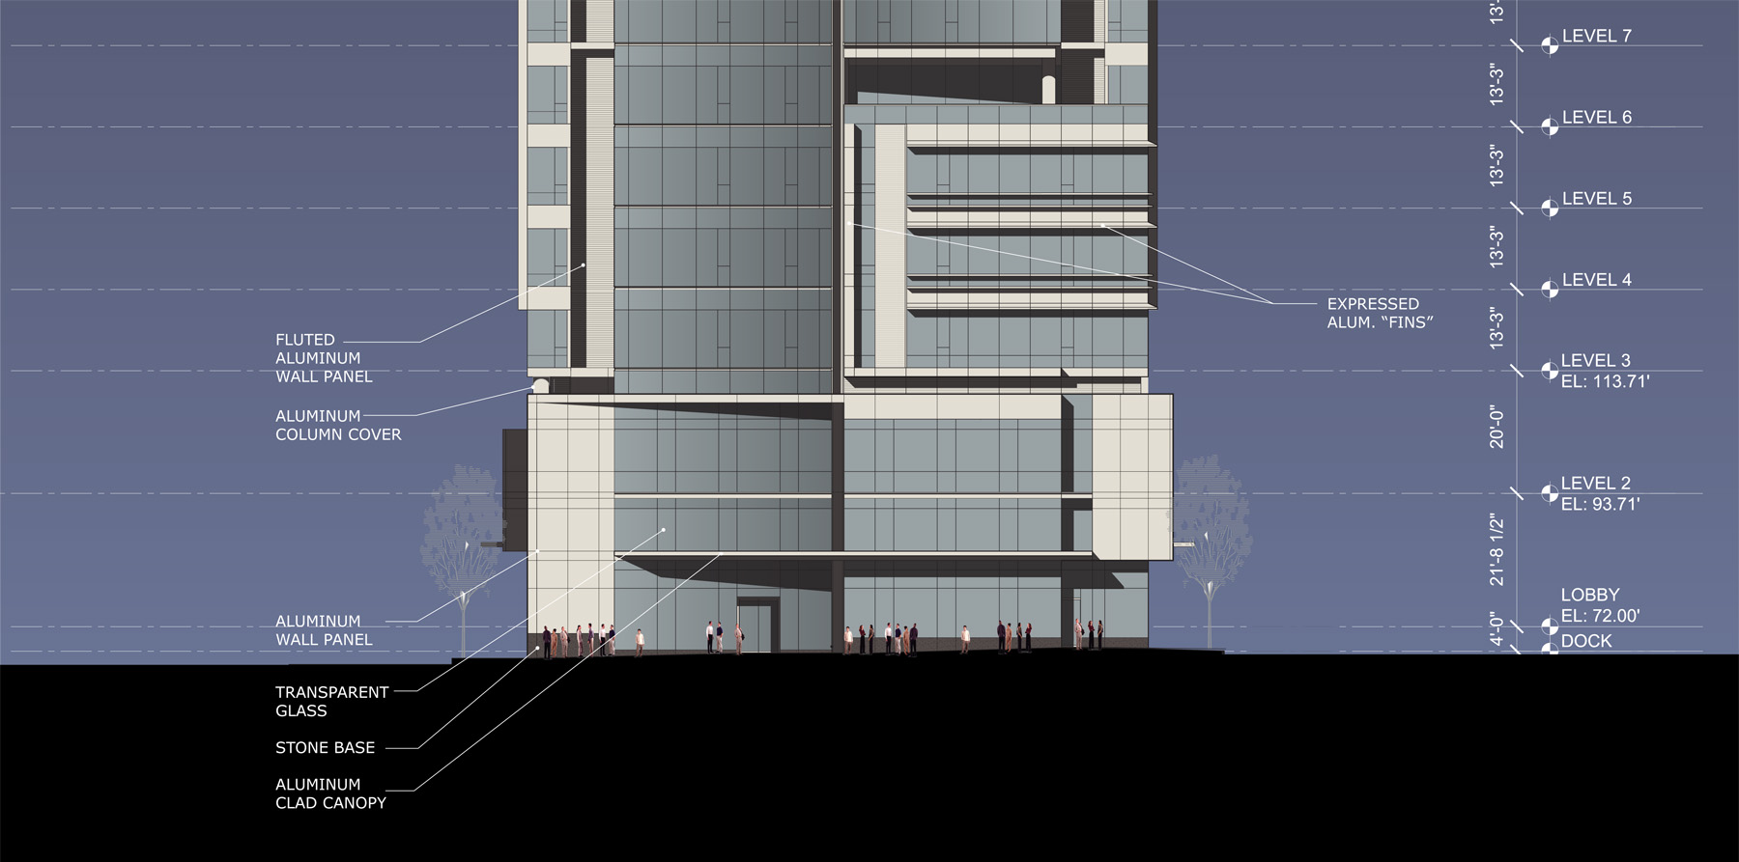
Morrison Elevation

Slide 14
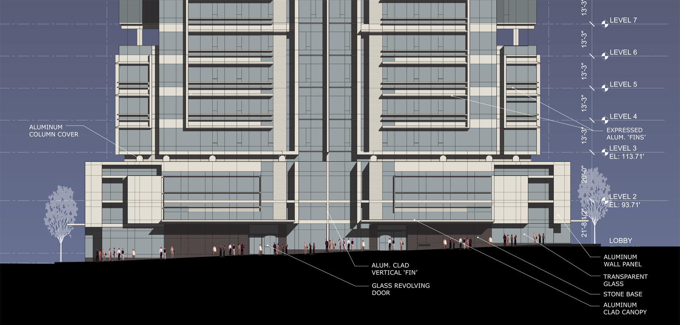
Ninth Avenue Elevation

Slide 15
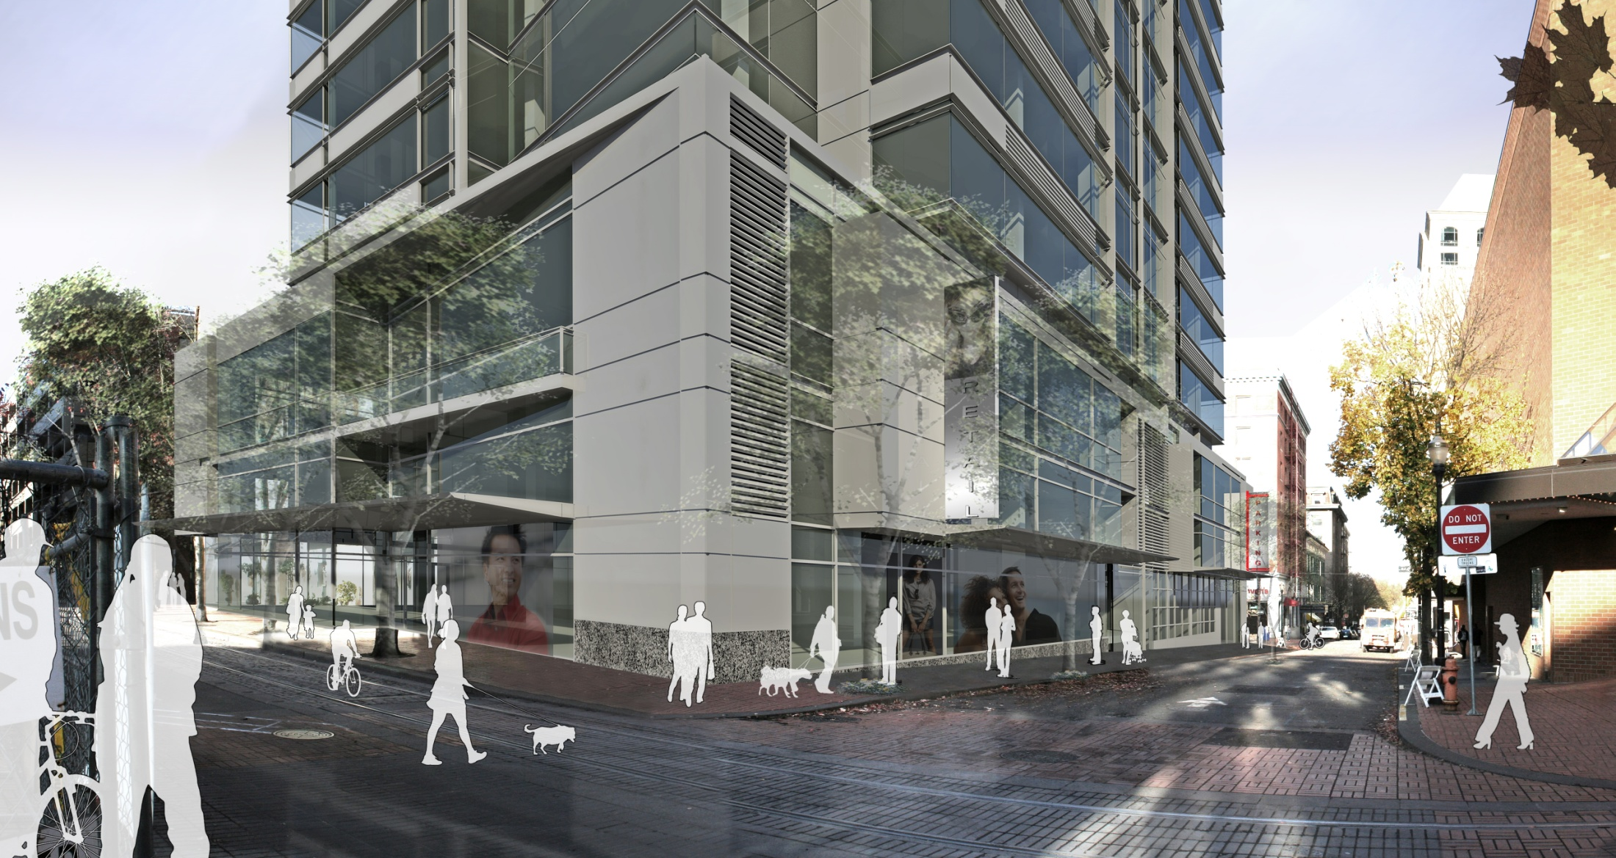
SE Podium Corner

Slide 16
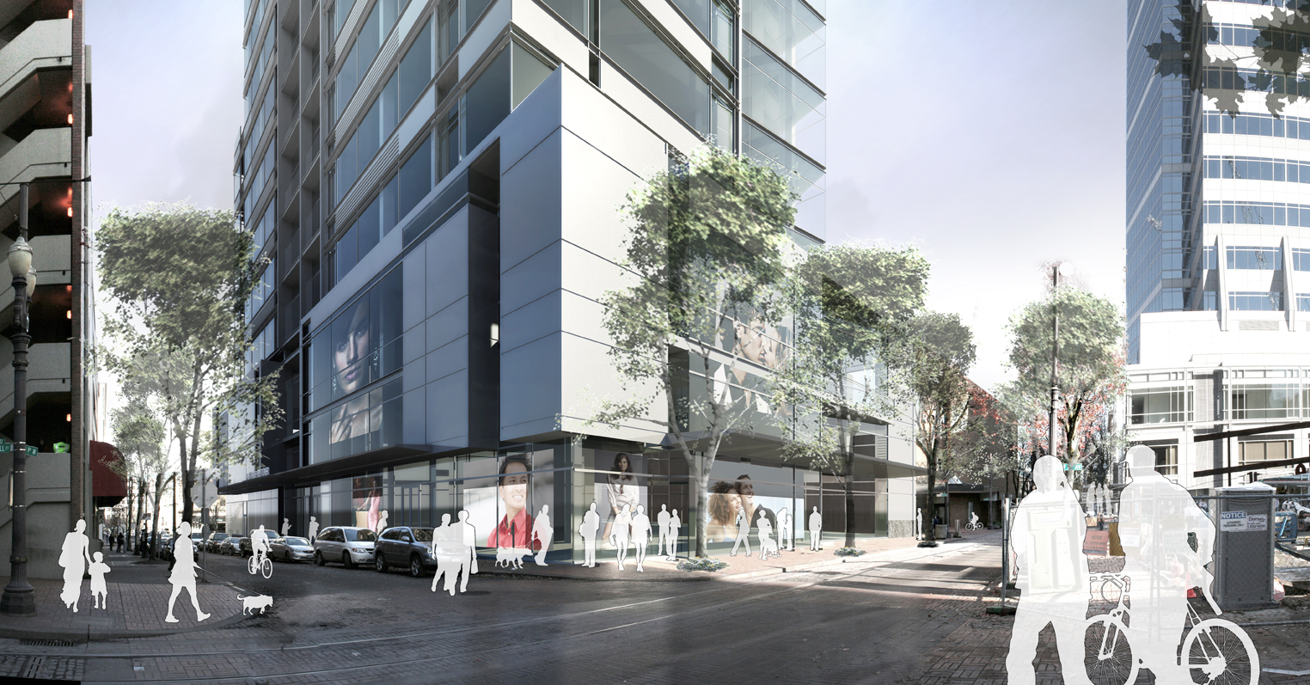
SW Podium Corner

Slide 17
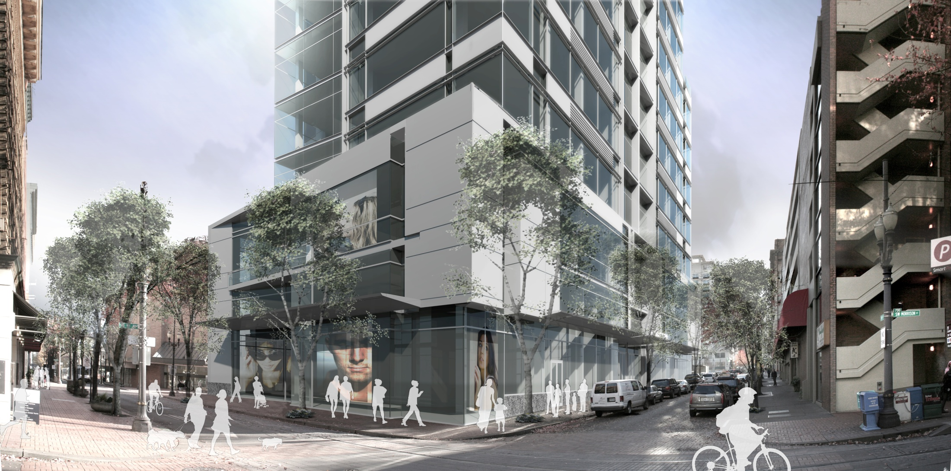
NW Podium Corner

Slide 18
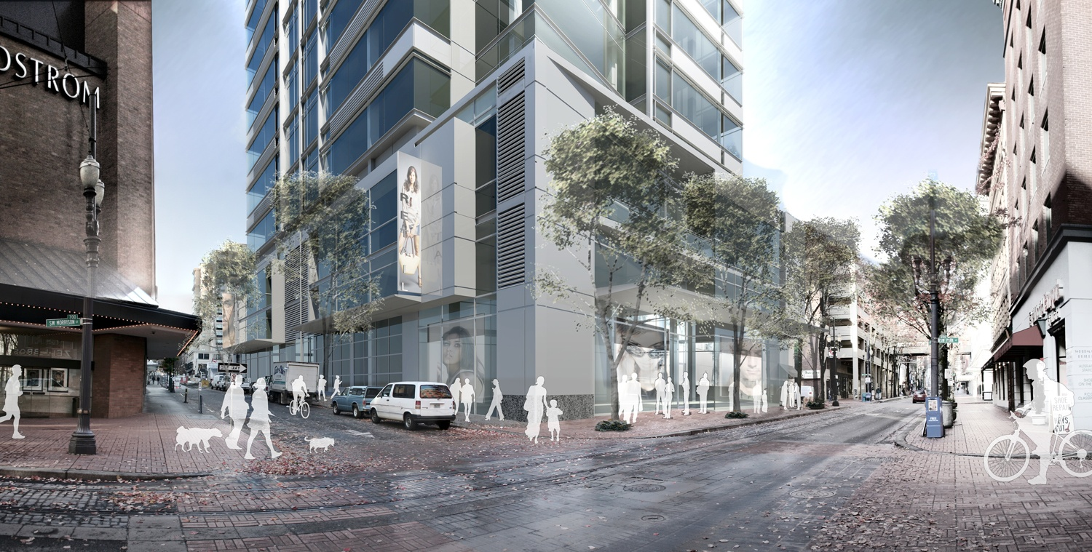
NE Podium Corner

Slide 19
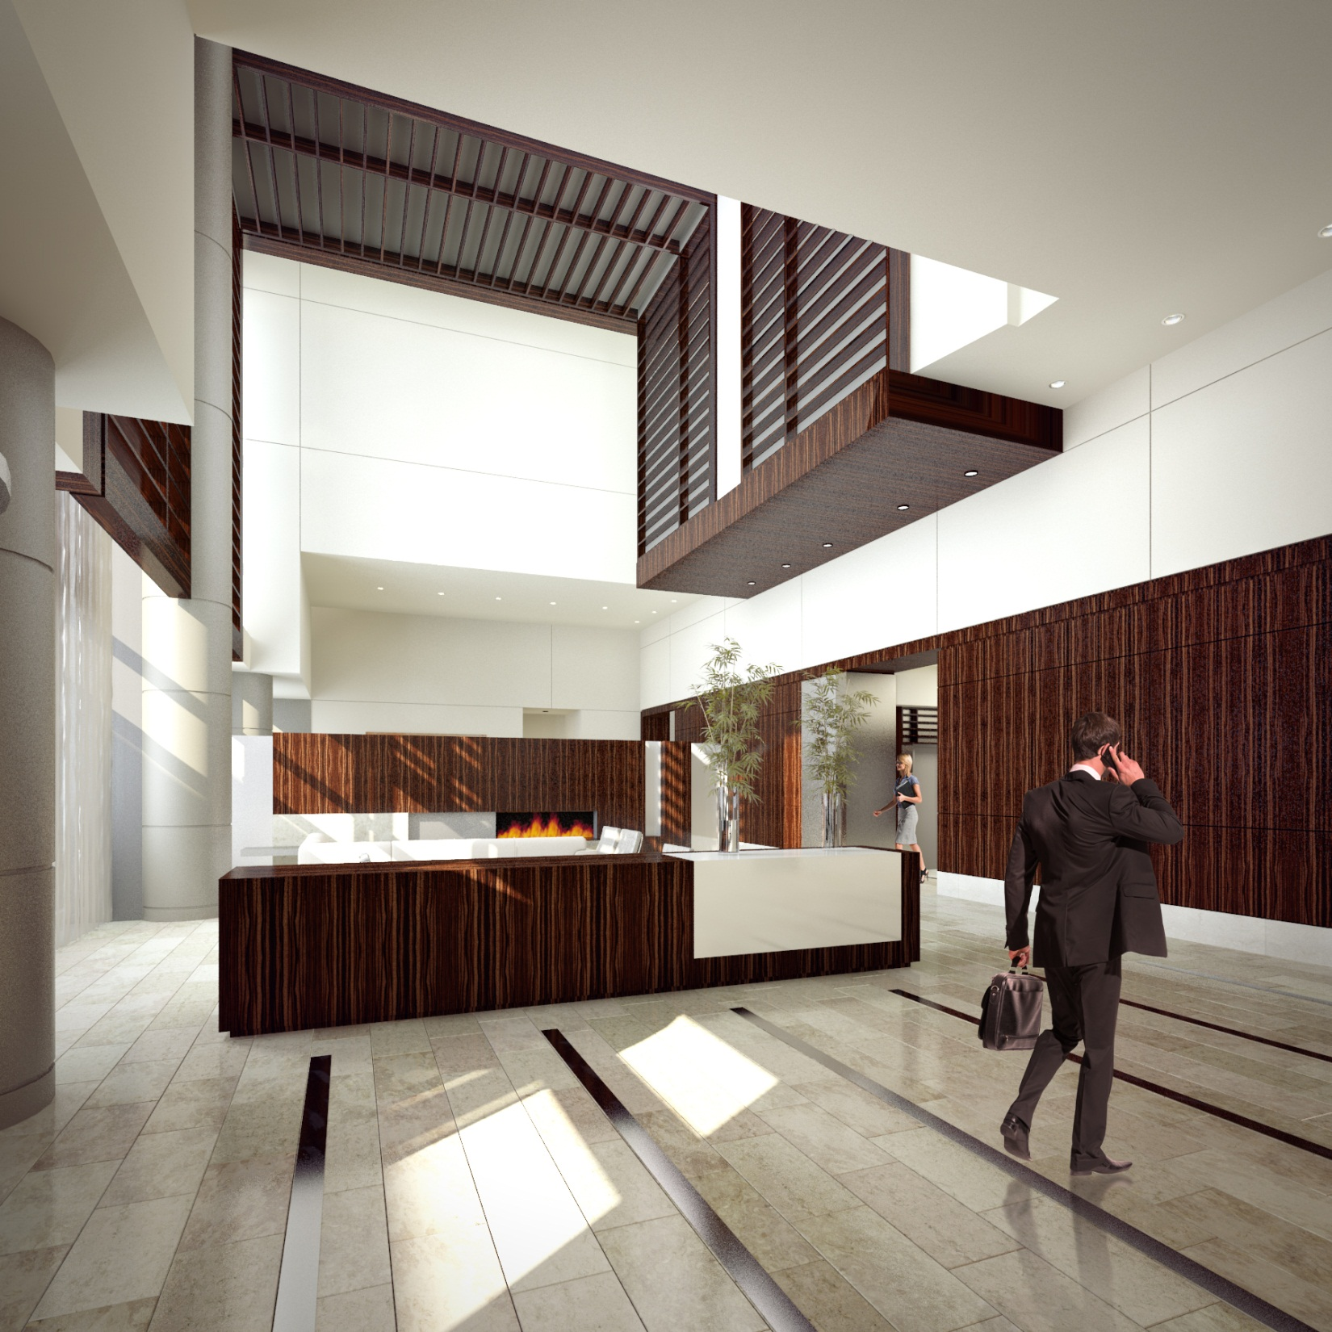

Slide 20
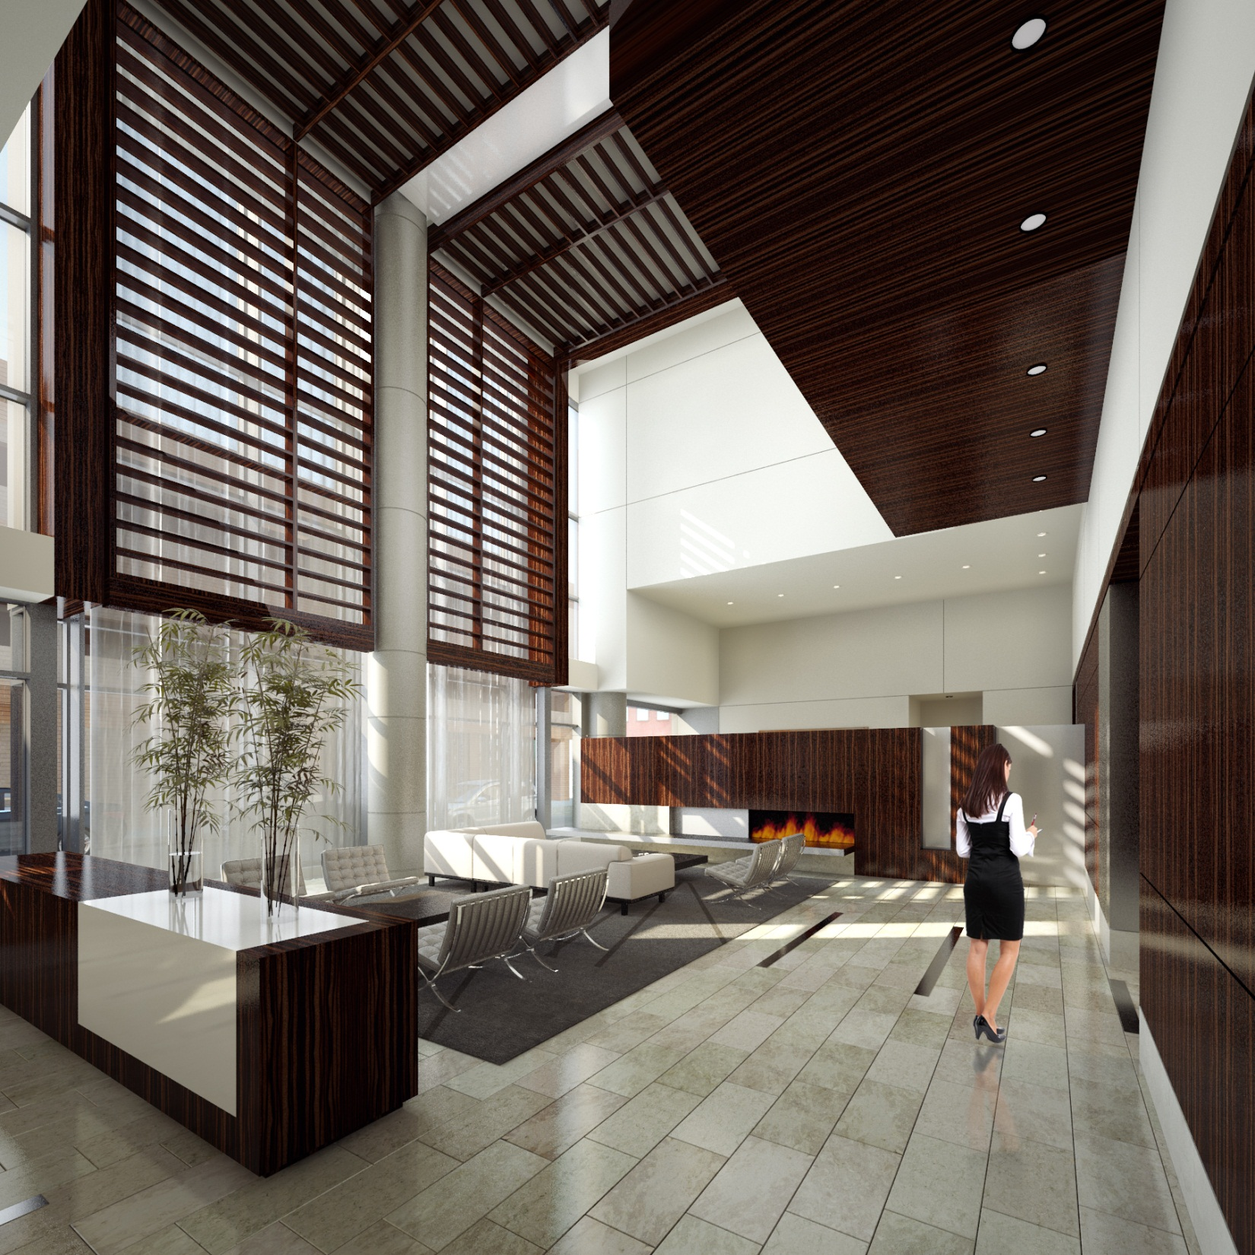

Slide 21
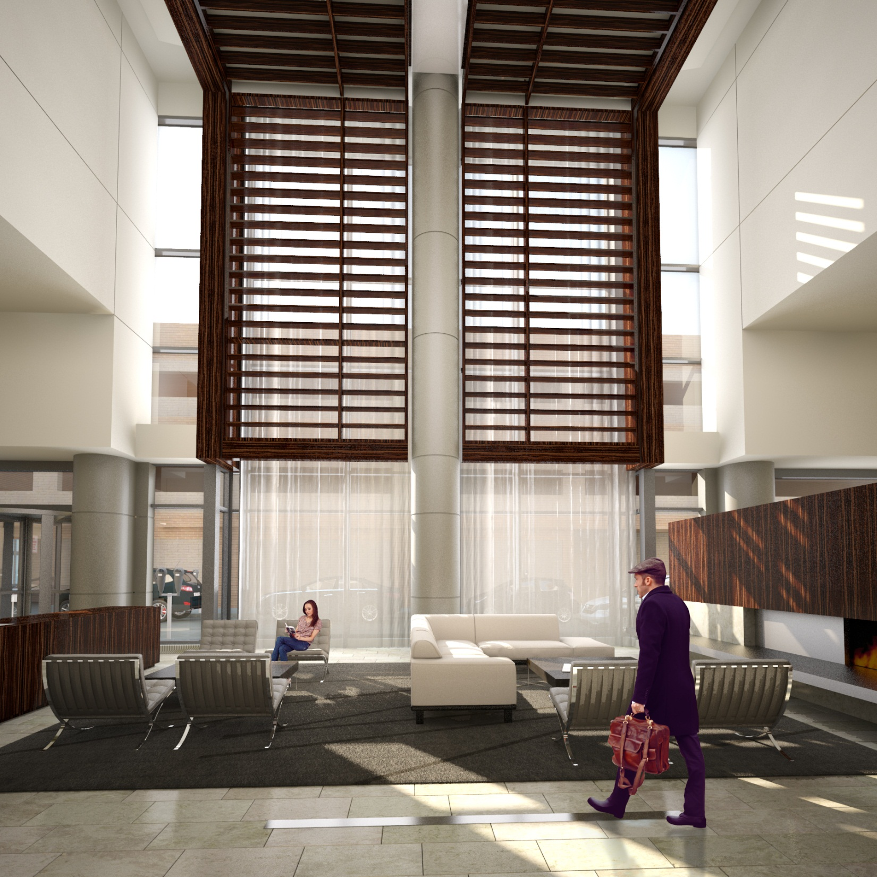

Slide 22
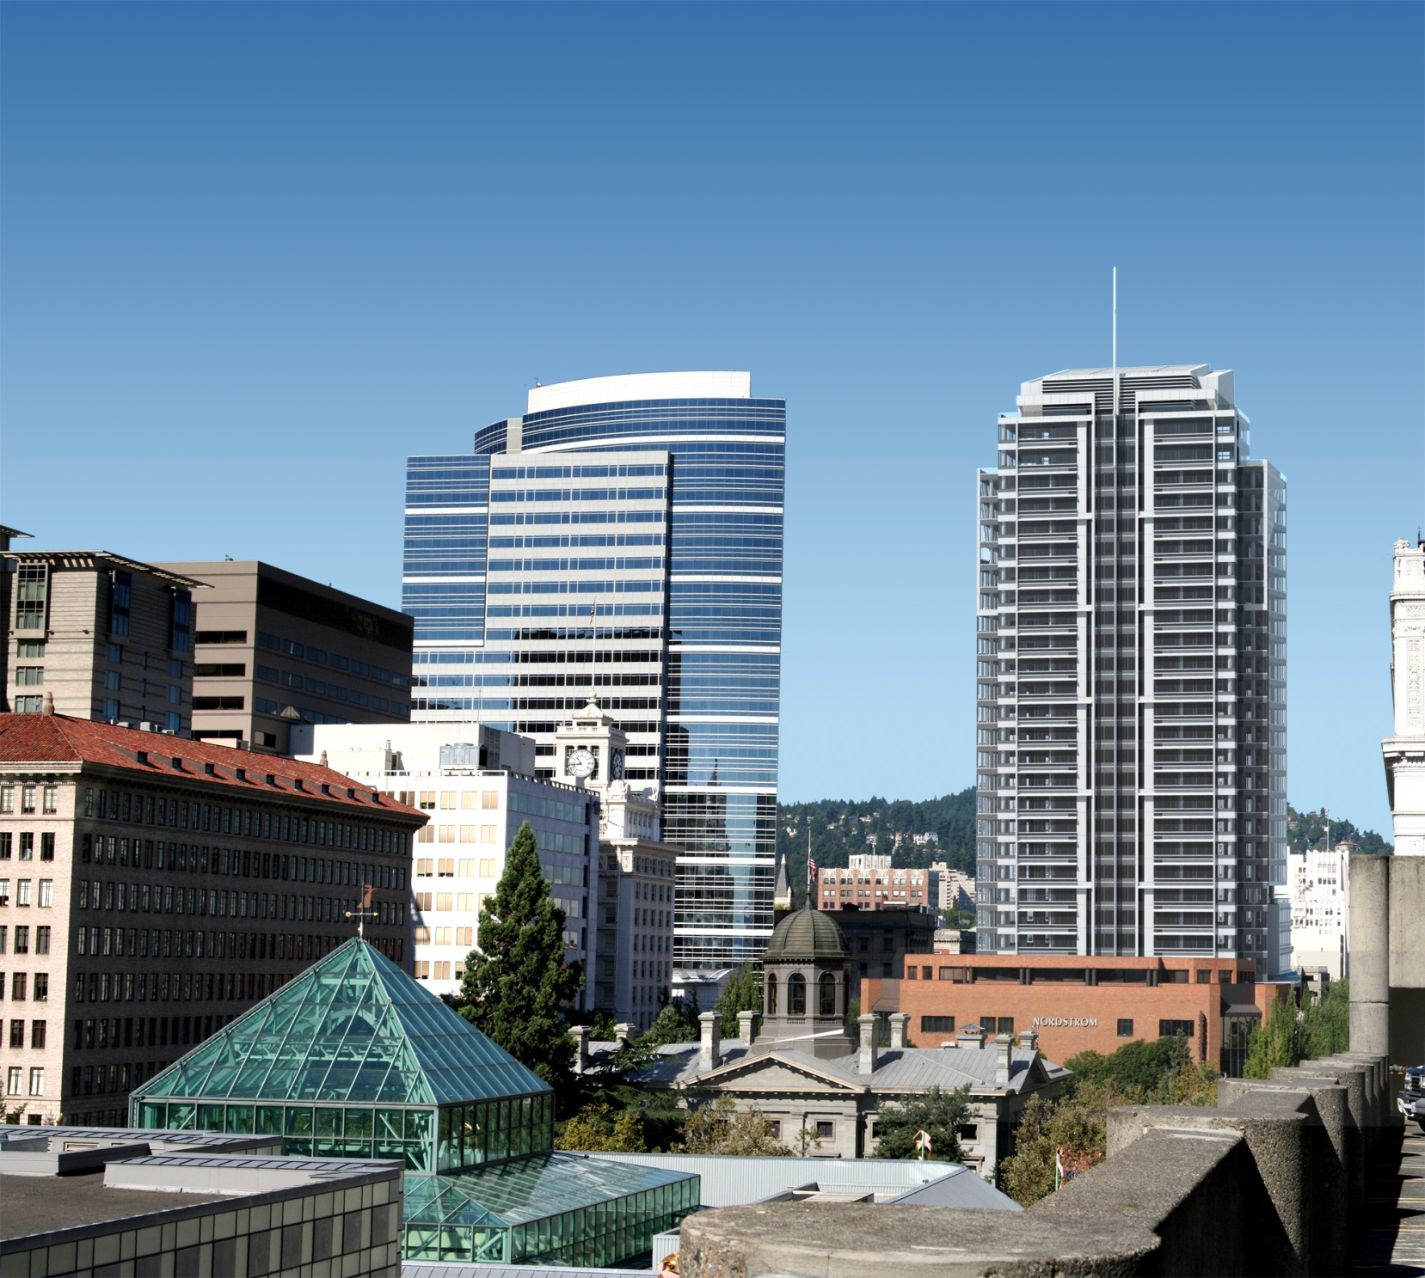
Downtown View

Slide 23
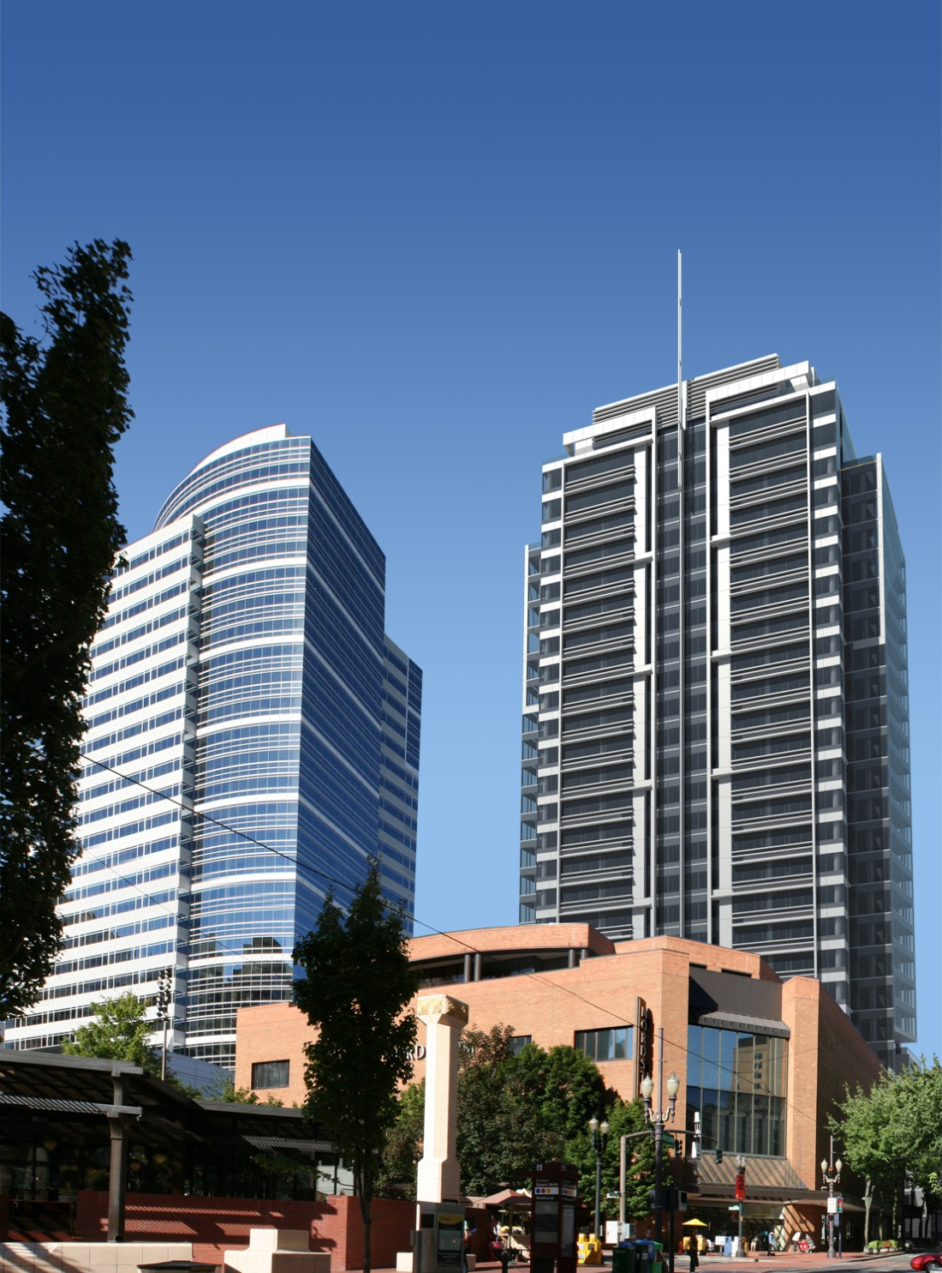
Pioneer Square View

Slide 24
East/West Views

Slide 25
Park Avenue West Tower

Slide 32
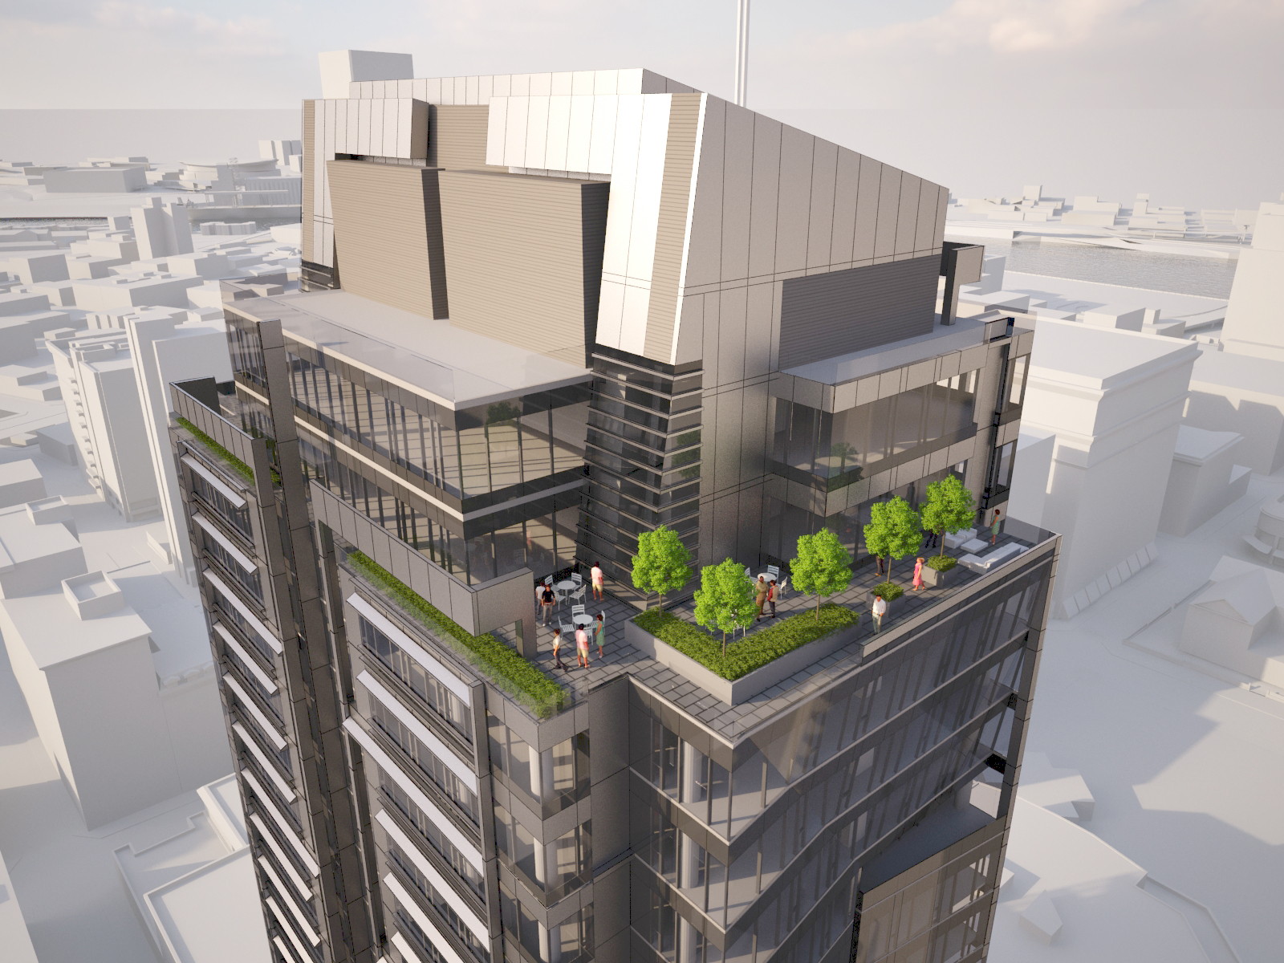

Slide 33
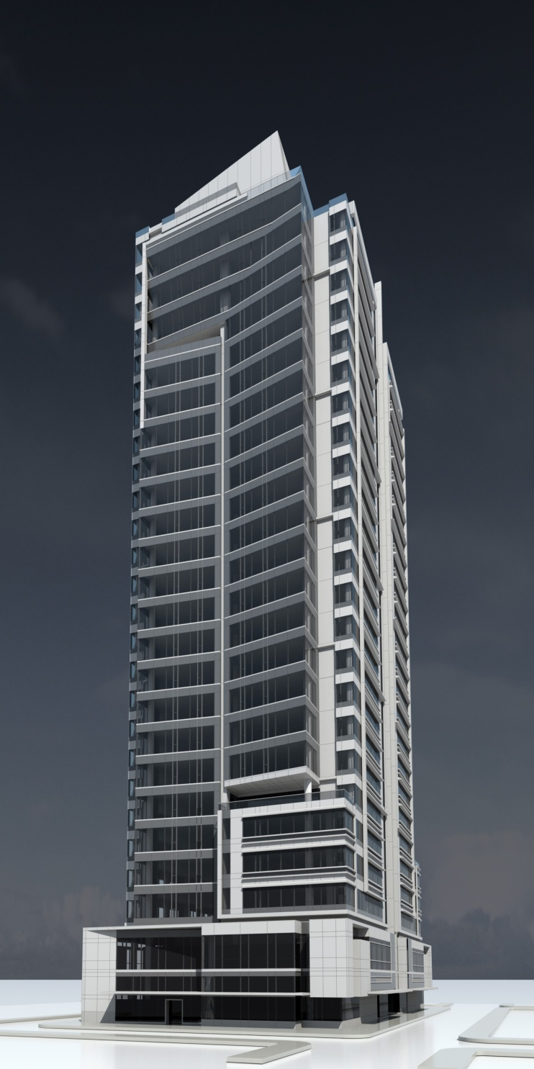
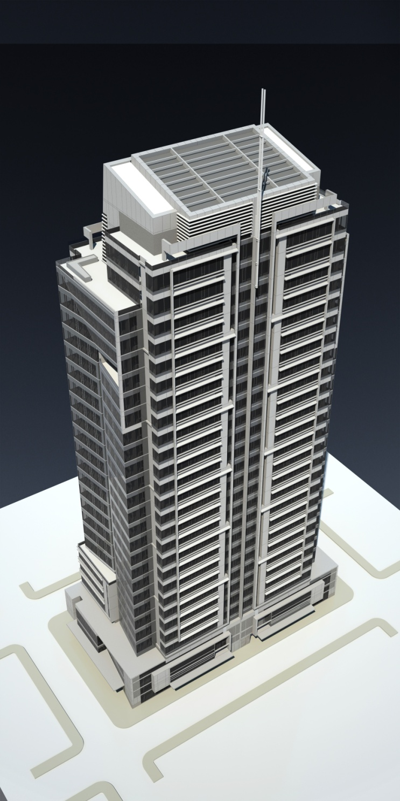
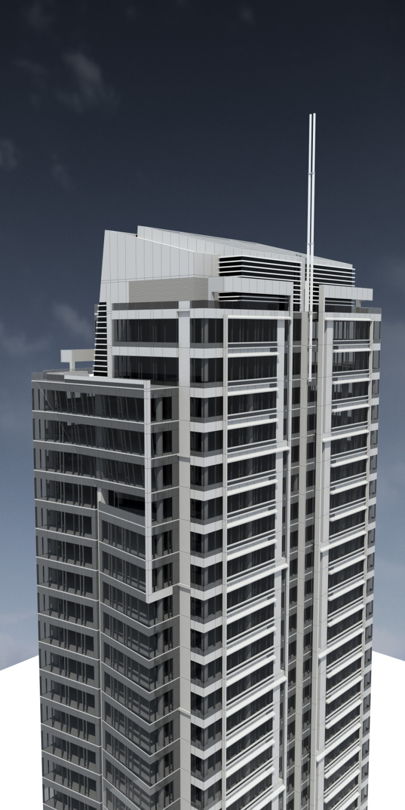

Slide 34
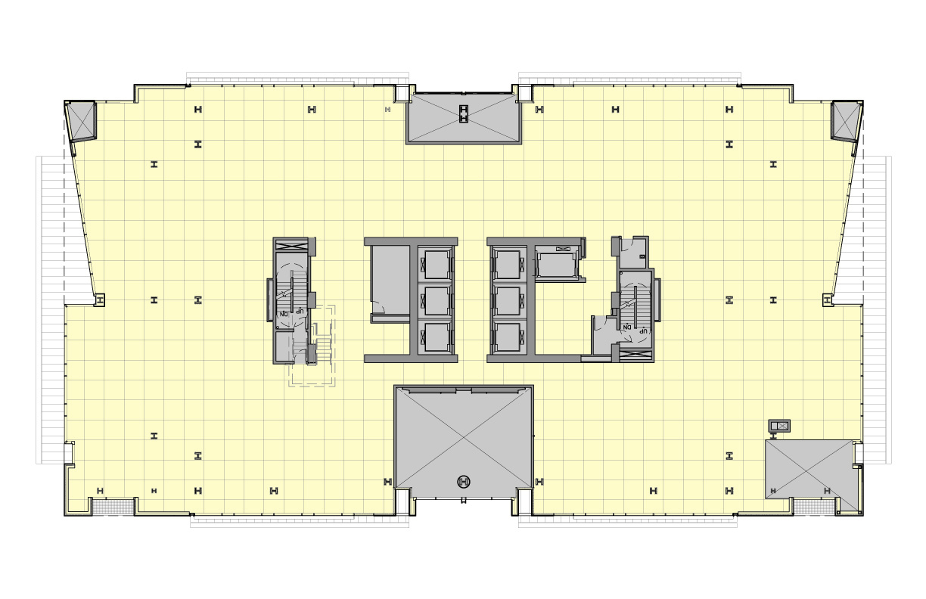
Level 2 - Retail

Slide 35
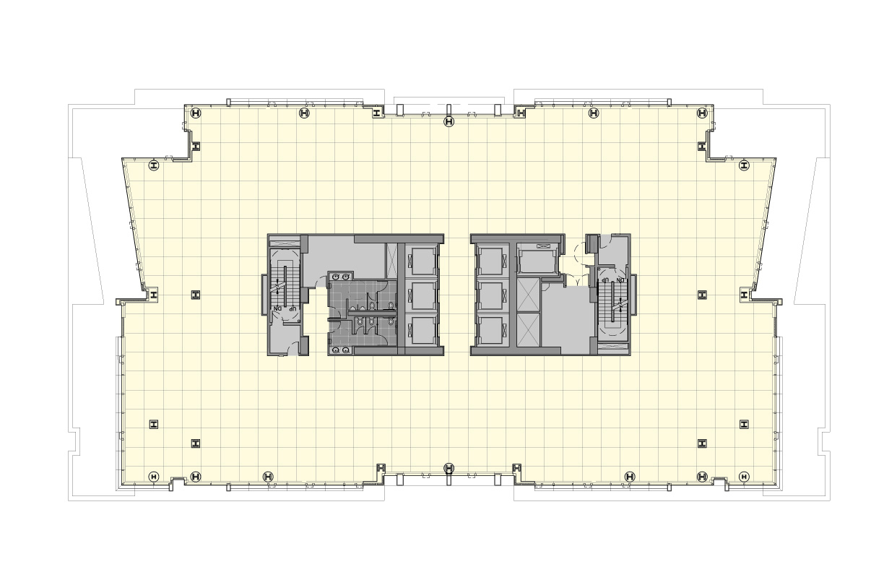
Levels 4/5 - Office

Slide 36
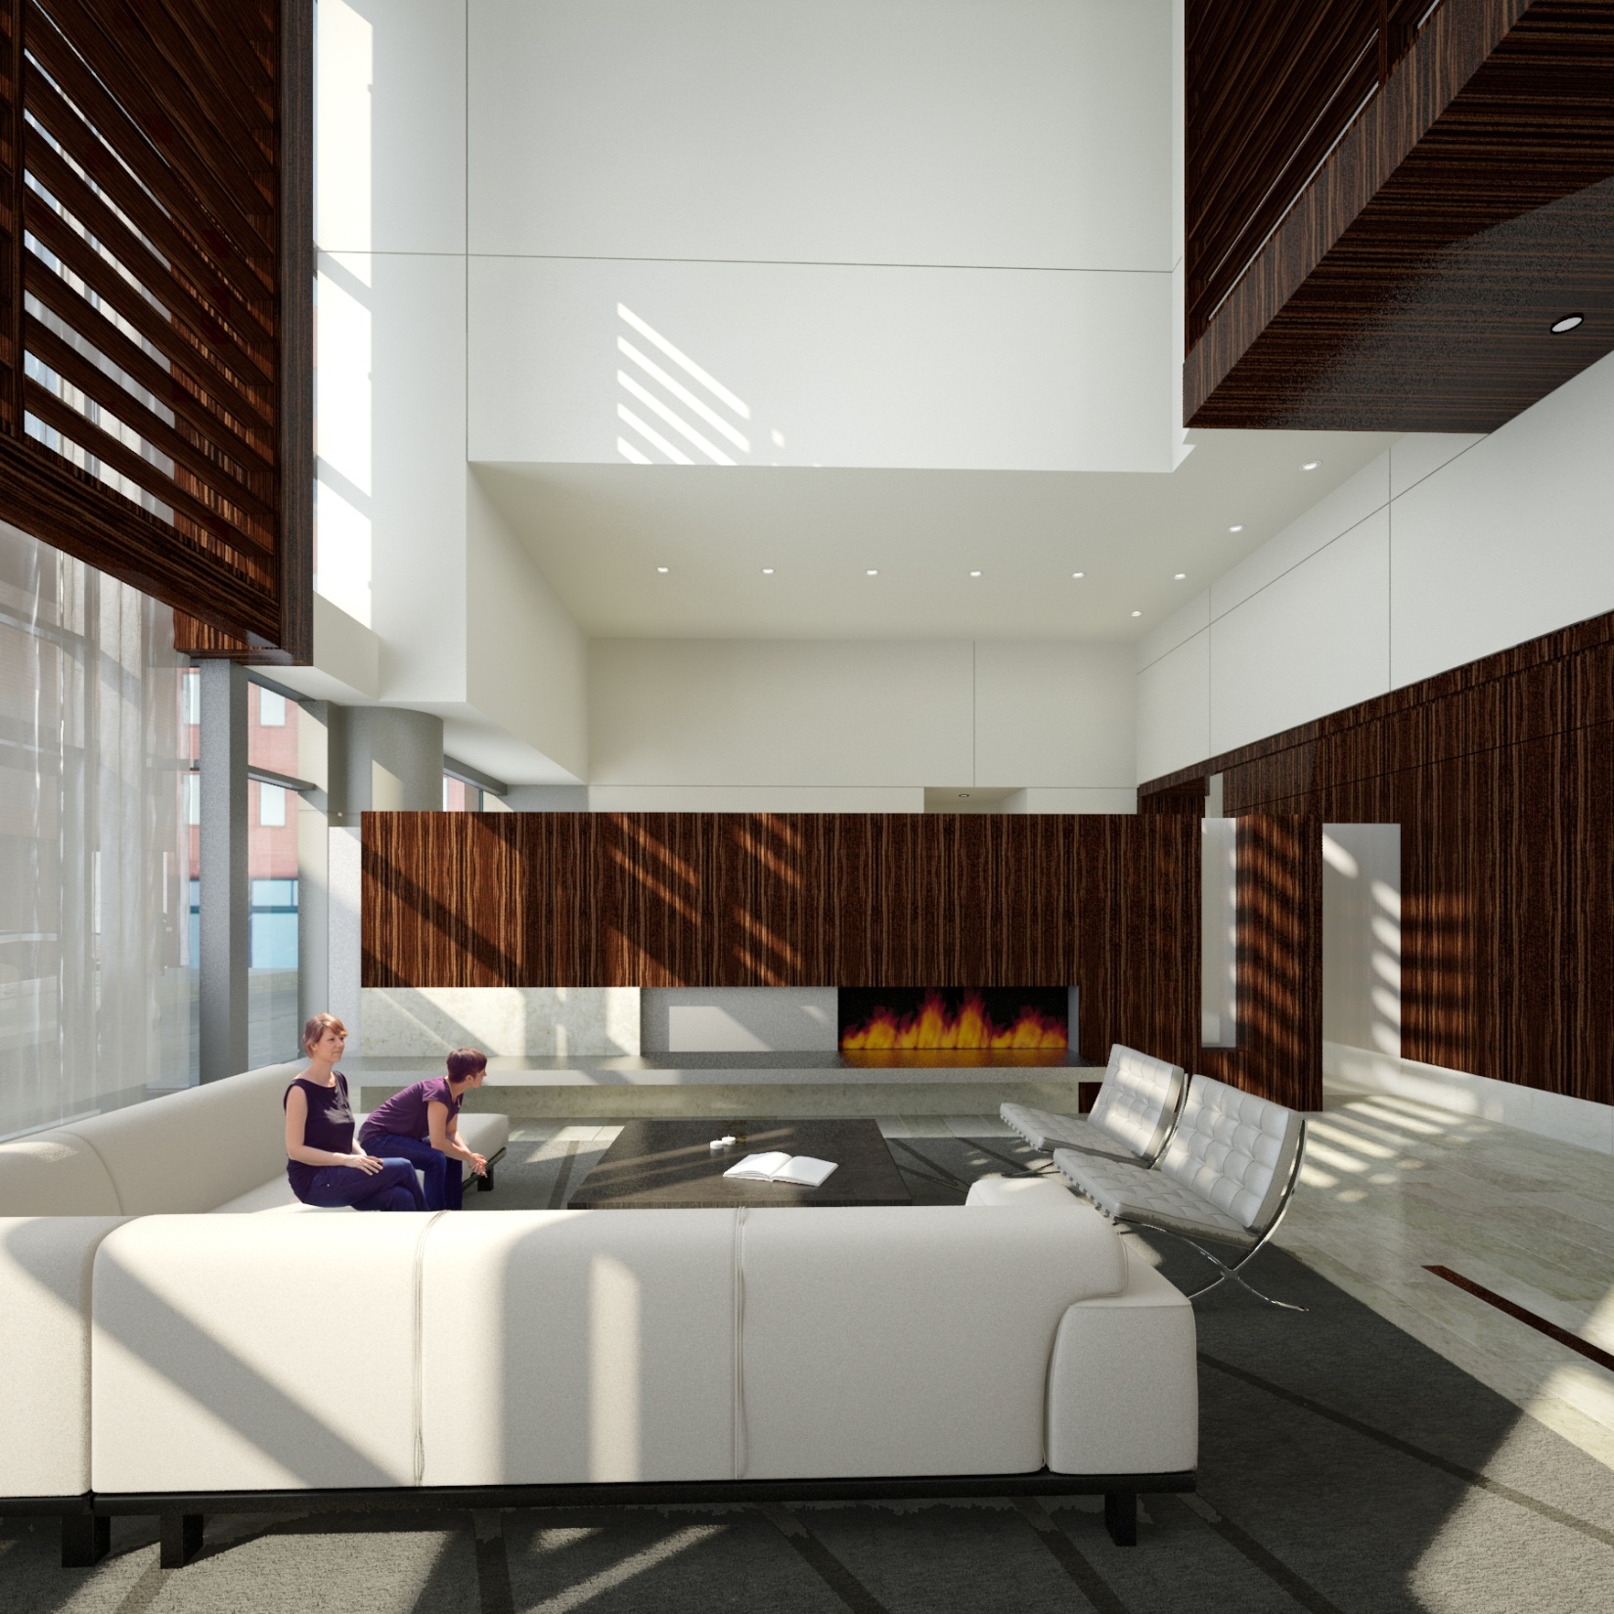

Slide 37
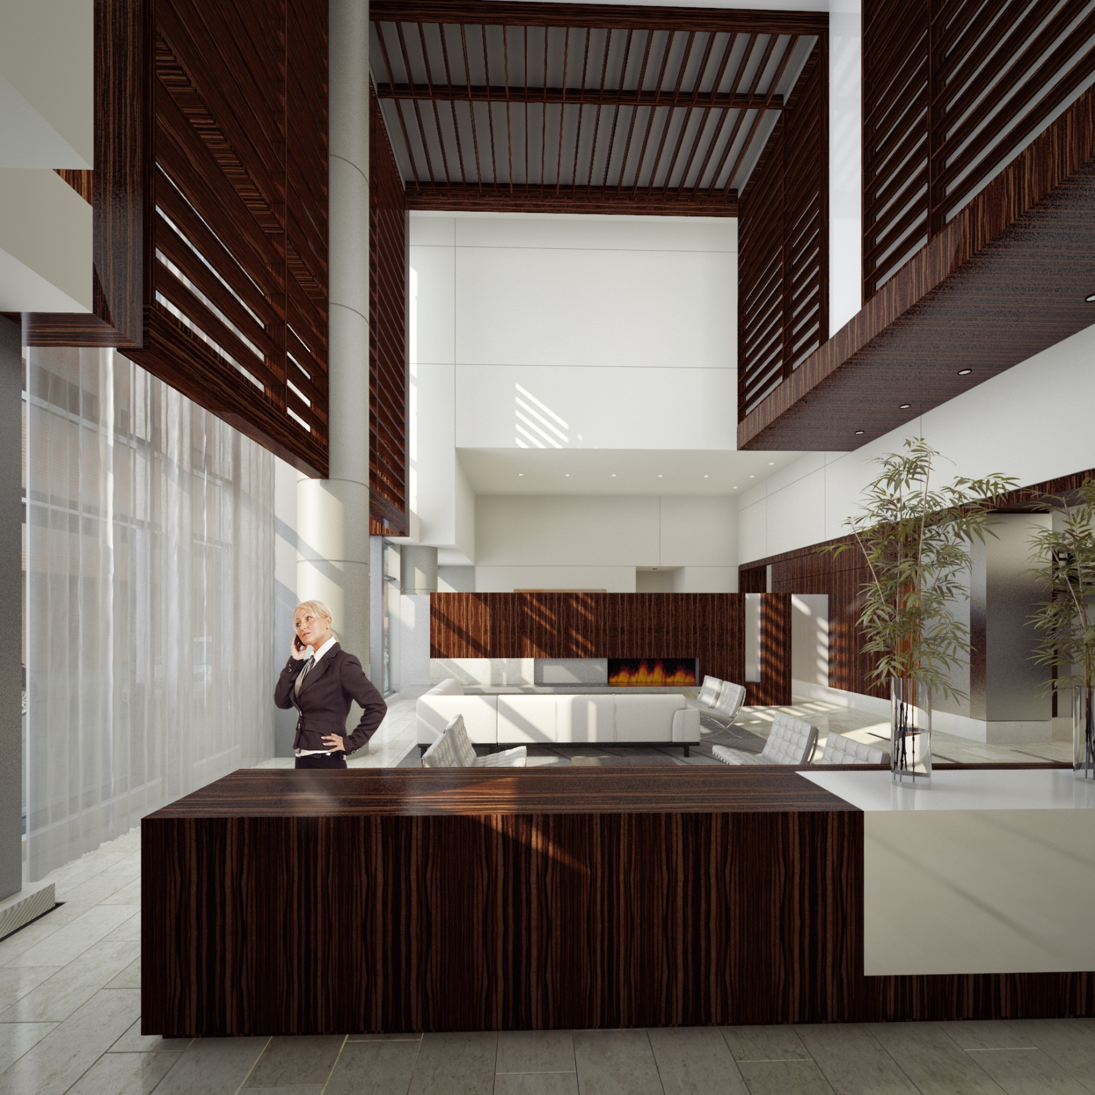

Slide 38
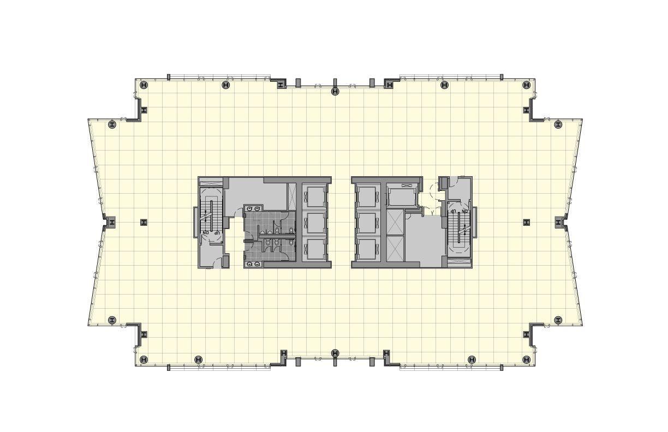
Level 7 - Office

Slide 39
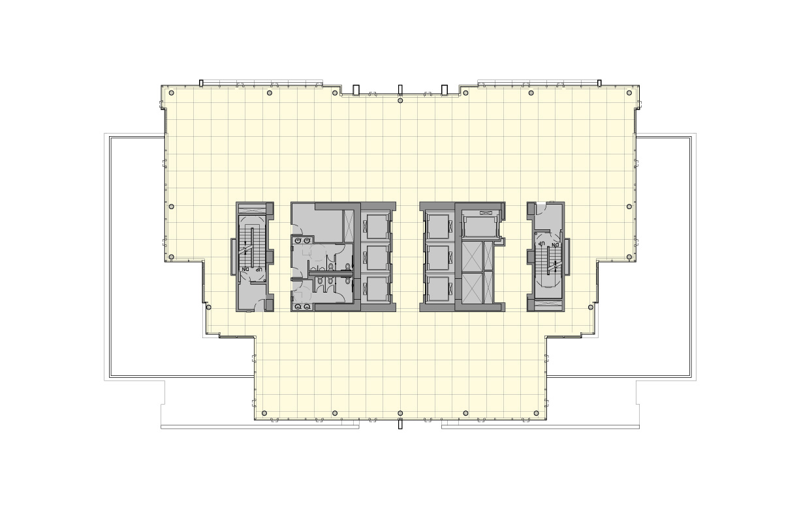
Level 26 - Office

Slide 40
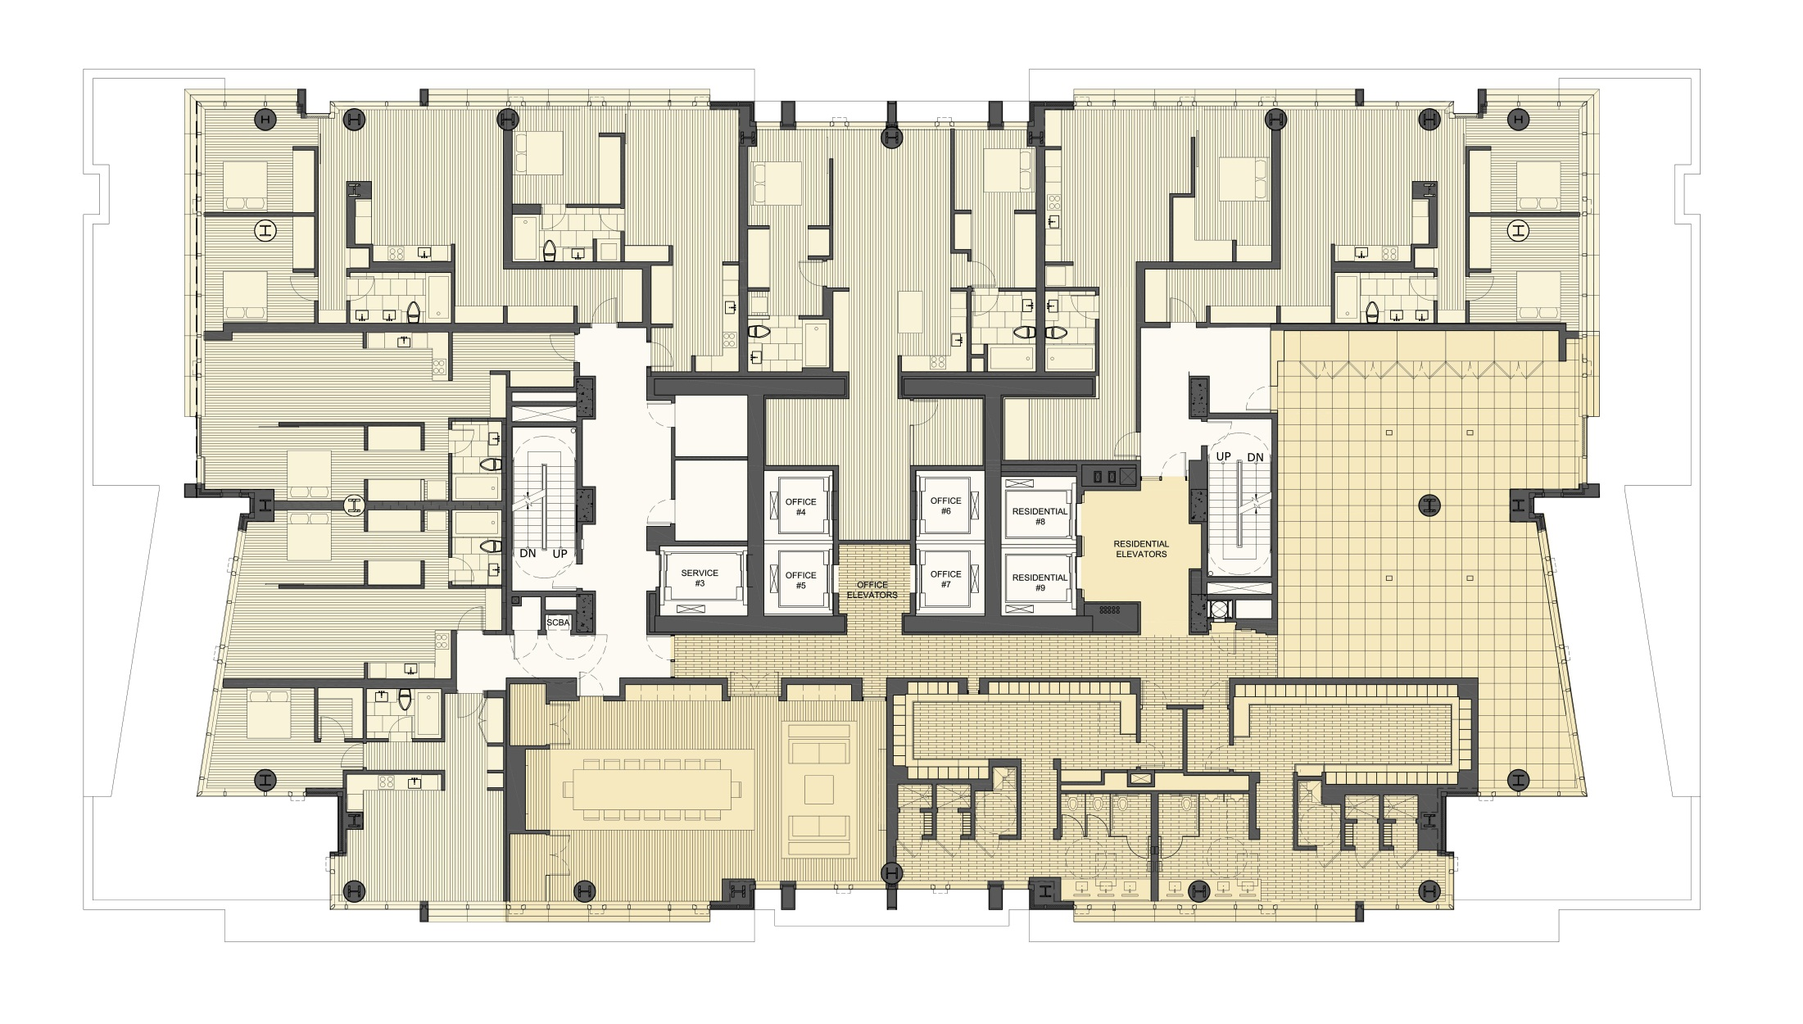
Floor 3 – Residential, Fitness, and Conference Facilities

Slide 41
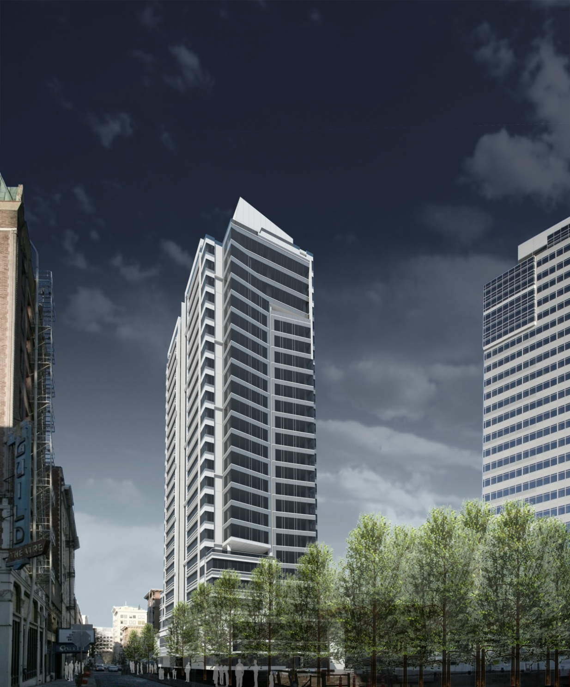
Director Park View

