Slide 1
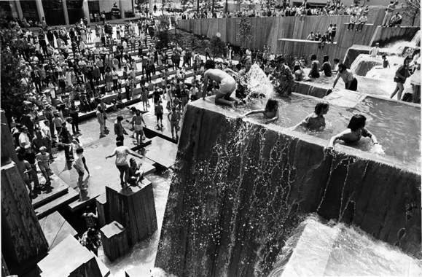
The Halprin Fountain Blocks
“One of the most important urban spaces
since the Renaissance” –Portland, Oregon

Slide 2
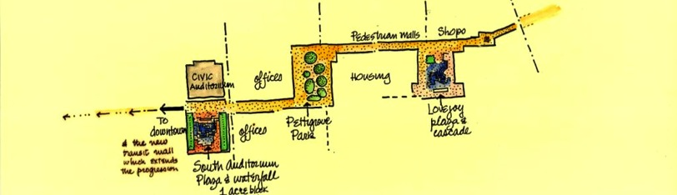
What are the Halprin Fountain Blocks?
In 1963, newly established Portland Development Commission
(PDC) recruited Lawrence Halprin and Associates to create the
Portland Open Space Sequence.
In May of 1963, PDC’s first Chairman Ira Keller had a vision to design
the public space “on such a scale of artistic excellence that it will have
real permanency. So good that in itself (it) becomes a lovely feature of
living there.”

Slide 3
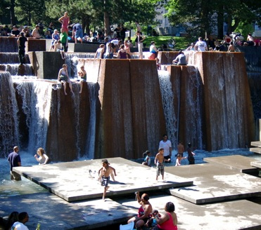
Nature/Landscape/Art/Urban Space
  From 1963 to 1970, Halprin and Associates designed a quartet of plazas that fuse nature, the urban plaza and sculpture into a seamless whole and a boldly original kind of American public space.
Portland’s first “people plazas”
  Ira Keller (Forecourt)
  Fountain Park
  Lovejoy Fountain Park
  Pettygrove Park
  The Source Fountain Plaza
  Connecting Pedestrian
  Walkways
PDC’s first Urban Renewal Area

Slide 4
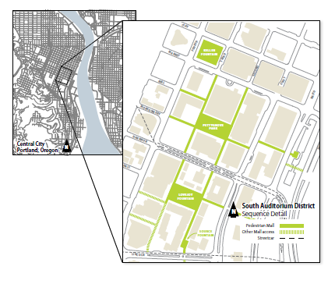
Where are the Halprin Fountain Blocks?

Slide 5
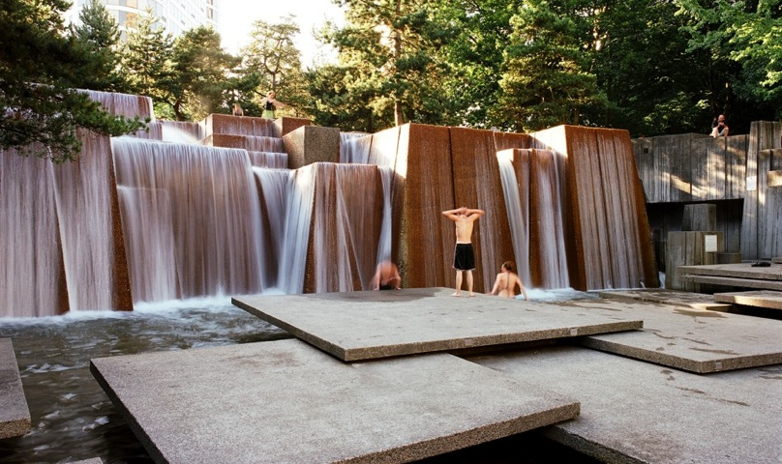
Ira Keller (Forecourt) Fountain Park

Slide 6
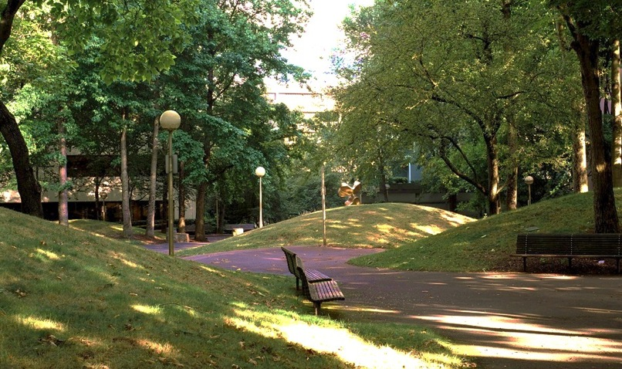
Pettygrove Park

Slide 7
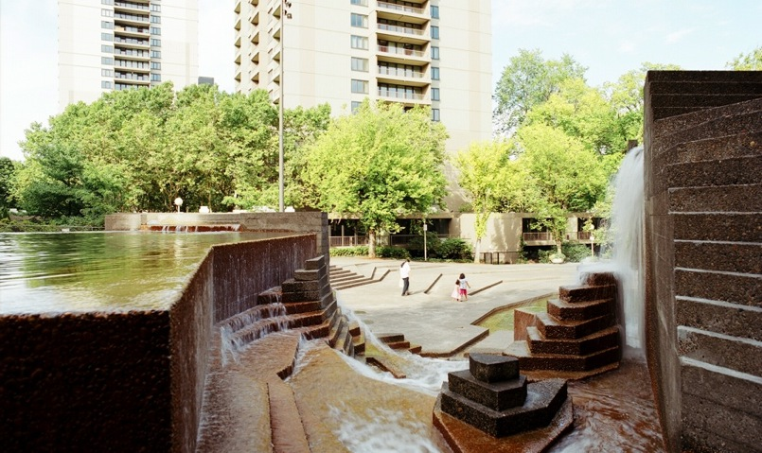
Lovejoy Fountain Park

Slide 8
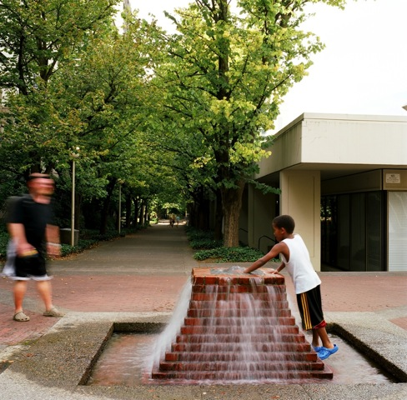
The Source Fountain Plaza

Slide 9
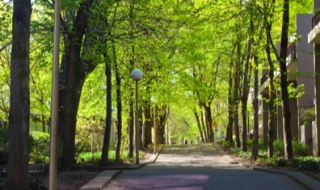
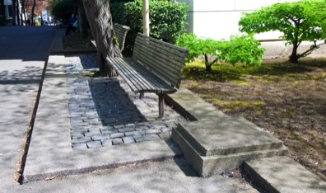
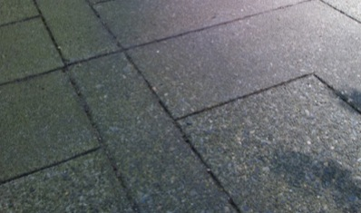
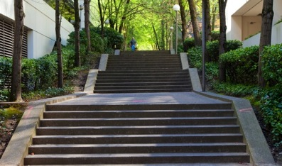
Connecting Pedestrian Walkways

Slide 10
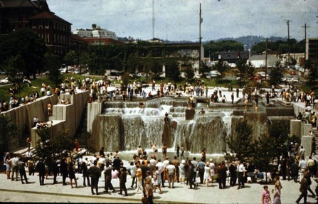
Why are the Halprin Fountain Blocks important?
“One of the most important urban spaces since the Renaissance.”
Ada Louise Huxtable, NY Times, 1970
Easily one of Portland’s most internationally influential works of architecture.
Ira Keller (Forecourt) Fountain, Opening Day, June 1970

Slide 11
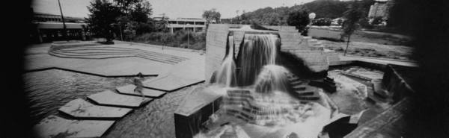
Locally Influential: The plazas showed the public the power of playful urban space, setting the precedent for Waterfront Park, Pioneer Courthouse Square, Jamison Square, Tanner Springs, and Director Park .
Historically Significant: Added to the National Register of Historic Places in
March 2013.
Life Magazine, 1968

Slide 12
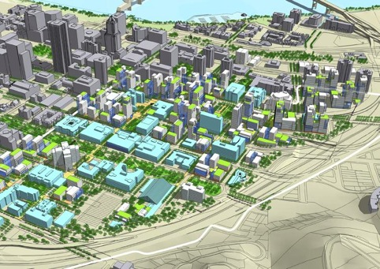
Intense Neighborhood Expansion
  PSU growth, Education URA, SoMa EcoDistrict
  Increased need for open spaces

Slide 13
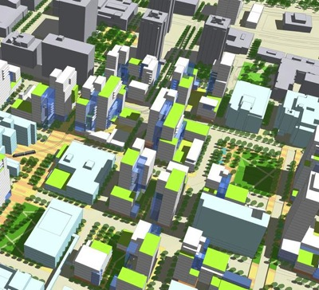
Limited New Park Space: PSU’s master plan only provides for one new park/plaza despite dramatic increase of surrounding density.

Slide 14
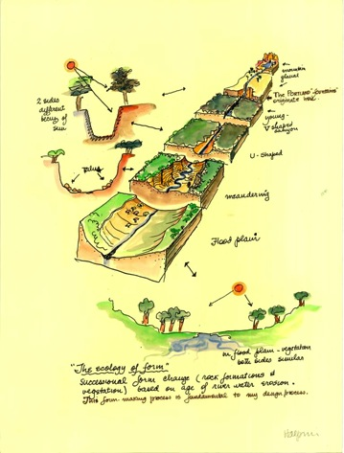
Halprin’s fountains are the original ecodistrict – Landscape historians now regard Halprin and the Portland fountains as important leaders in the urban environmental movement that we now call “ecodistricts”
Concept drawing, Portland Fountains

Slide 15
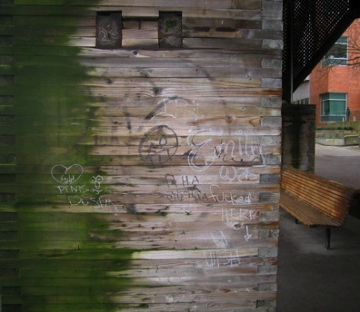
Why is action needed now?
“(Public-private stewardship) is the next big thing in our system. We provide only a baseline of services, and unless highly motivated citizens step up, we just can’t take on (all the repairs).”
Commissioner Nick Fish
The Oregonian, August 9, 2012

Slide 16
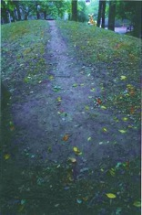
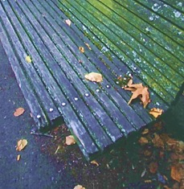
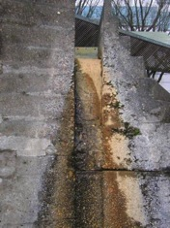
After nearly 50 years
  These assets show dramatic need for repair and restoration.
  Public funding is not available for capital repair or ongoing enhanced maintenance.
  2012 Condition Assessment Report shows $2.5 million needed to restore fountains, plazas and walkways to good condition, position for sustainability.

Slide 17
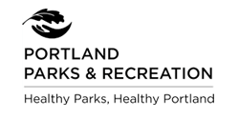
Who will make it happen?
The Halprin Landscape Conservancy, a 501(c)3 non-profit, was
formed in 2001 to:
  Activate: increase awareness of the parks as a cultural resource on par with the city’s and the nation’s greatest cultural resources
  Improve: make needed restoration and repairs according Lawrence Halprin’s original vision
  Maintain: assure the parks’ upkeep at the level of a residential garden
The Halprin Landscape Conservancy and the City of Portland executed an agreement in 2011 to support a public-private partnership for restoration and ongoing maintenance of the Halprin Fountain Blocks.

Slide 18
Public-Private Stewardship
Significant accomplishments to date:
  2009: Tree trimming at Ira Keller Fountain and Pettygrove Park, in partnership with Russell Development Company
  2011: HLC/City of Portland agreement executed
  2011: Sidewalk repairs completed
  2012: New South Auditorium District street and pedestrian lighting by PBOT
  2012: HLC commissioned Condition Assessment
  2012: Design, engineering and a portion of improvements completed at Pettygrove Park – HLC in partnership with PP&R and Russell Development Co.
  2013: Listed on the National Register of Historic Places
  2013: Lovejoy Fountain Shelter improvements planned
  Total contributions to date:
        $235,000 in cash
        Over 3,400 hours of contributed professional services

Slide 19
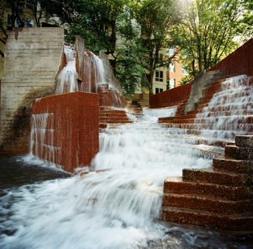
Current Funding Needs
Capital Needs Forecast $2.5 Million
Ongoing Enhanced Maintenance TBD

Slide 20
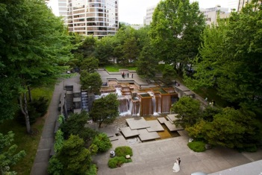
Funding Options
Private Participation Approaches:
1) Private Fundraising
2) Voluntary $2.5M Local Improvement District (LID)
3) Community Association
Public Participation: PP&R, PBOT, Portland Water Bureau continue basic services and select repairs

Slide 21
One LID Scenario
Based on land area within LID
  Halprin Open Space Sequence – in green
  Adjacent properties with frontage – in blue
  Surrounding properties – in purple
Scenario Assumptions
  Purple properties receive half the benefit of blue properties
  Use adjusted square footage (ASF) to calculate shares
    100% of blue properties’ land area
    50% of purple properties’ land area

Slide 22
Proposed LID Area
MAP

Slide 23
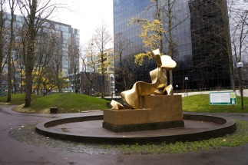
Affordable Assessments
Adjusted land square footage (ASF) of 1,303,518 SF
Divide $2,500,000 project cost by ASF
  Assume 100% participation
  49 participating properties
  Assessment would be $1.92 per ASF
Assume property owner financing over 20 years
  At tax-exempt rate of 3.5% (may vary slightly)
  Annual cost would be $.13 per ASF

Slide 24
Community Association Approach
Model after successful Hoyt Street Yards Community Association
Non-profit member organization with owner assessments to provide common area services
Member Board develops budget for capital improvements and enhanced maintenance
City bureaus continue basic maintenance services
Advantages
  Member control
  Potential private financing for capital projects
  Private control of bidding and construction
  Addresses funding for both capital and enhanced maintenance
Disadvantages
  Need to establish Association
  May need all funds upfront before construction

Slide 25
Our Stewardship is Critical
In this era of limited funding for parks, activating a public private stewardship to preserve Portland’s renowned architectural and cultural assets in the Halprin Fountain Blocks -- for the neighborhood and for the greater Portland community -- has never been more important.

Slide 26
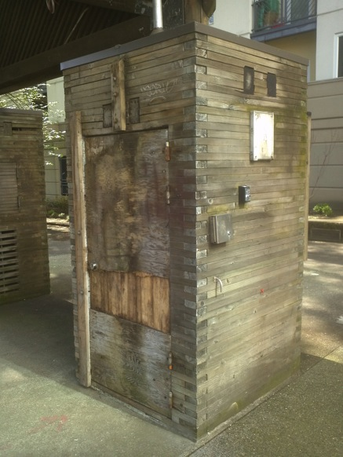
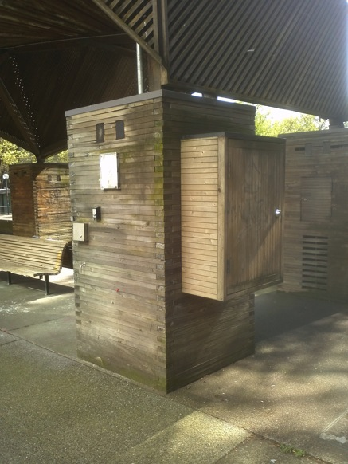

Slide 27
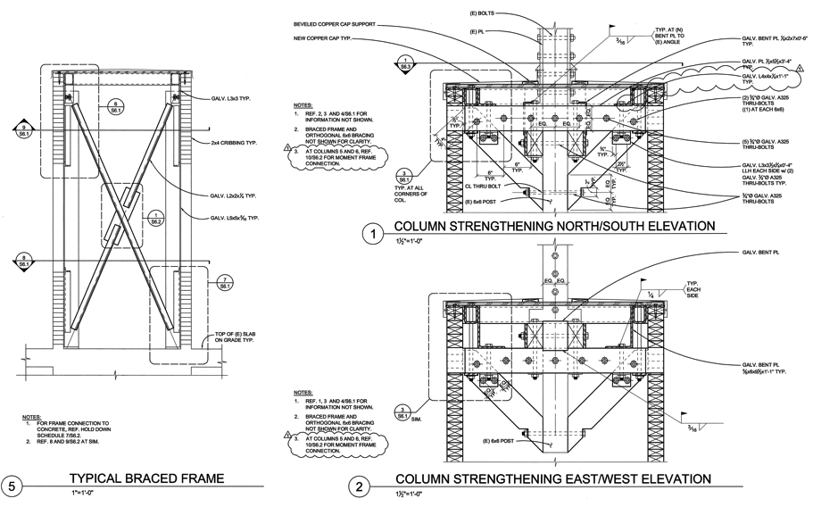

Slide 28
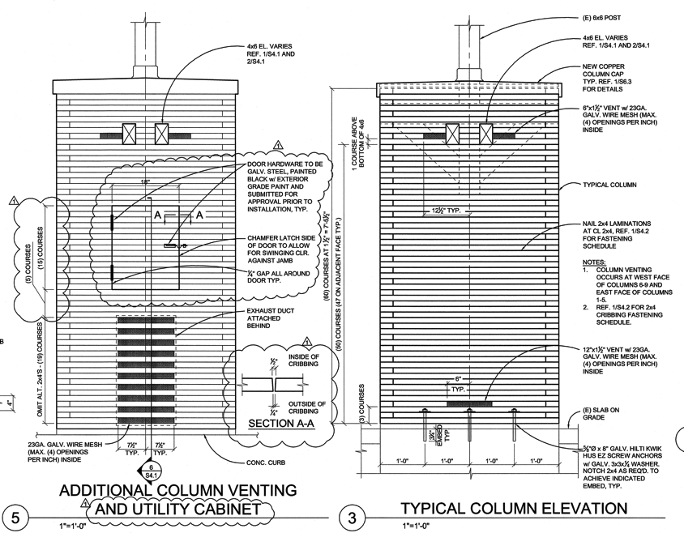

Slide 29
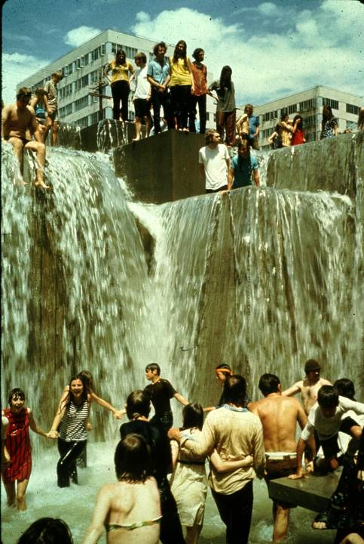
Questions/Comments

