Slide 1
Lloyd blocks
Design Advice Request

Slide 2
Lloyd blocks
Design Advice Request

Slide 4
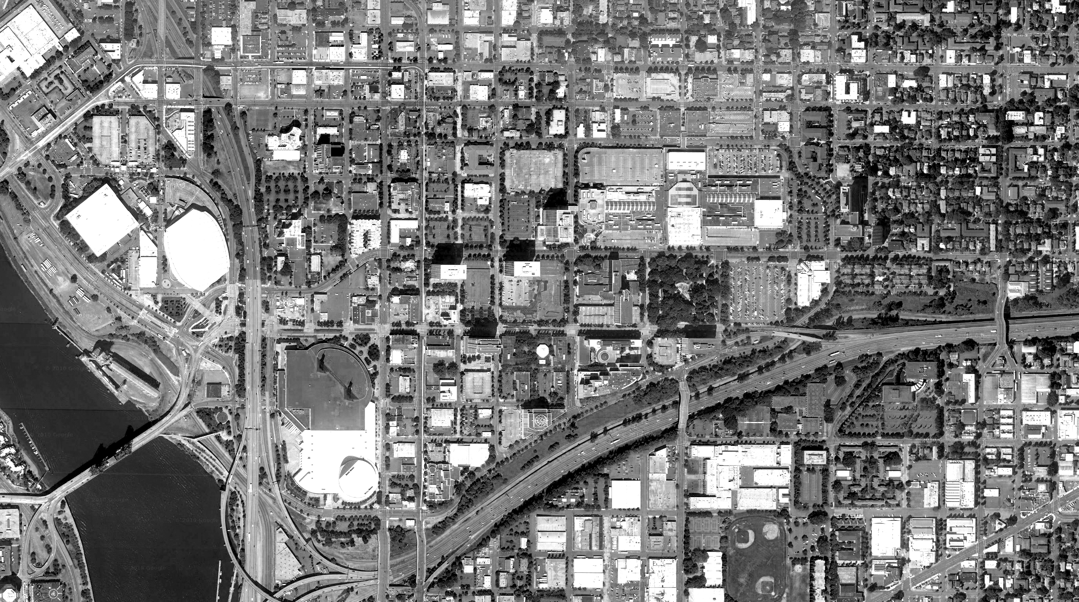
VICINITY PLAN
ELIOT
IRVINGTON
LLOYD DISTRICT
ROSE QUARTER
SULLIVANS GULCH – I-84
CONVENTION CENTER
KERNS

Slide 5
District / neighborhood analysis
What makes Portland unique?
How is this neighborhood special?

Slide 6
This is the title of the image.

Slide 7
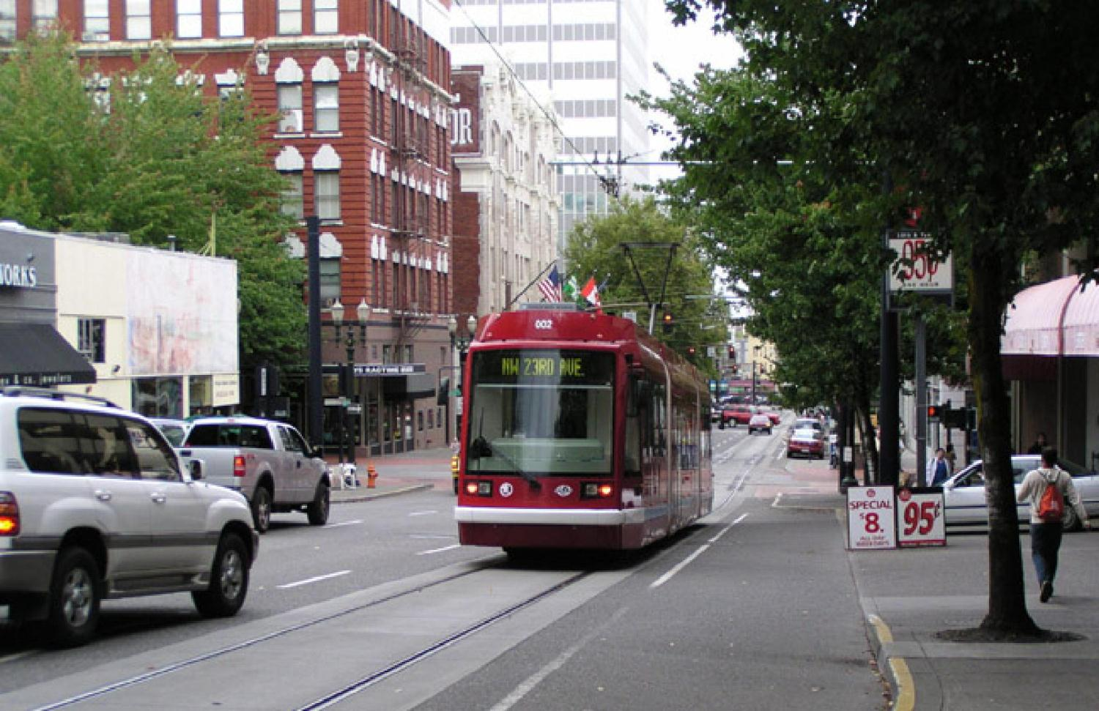
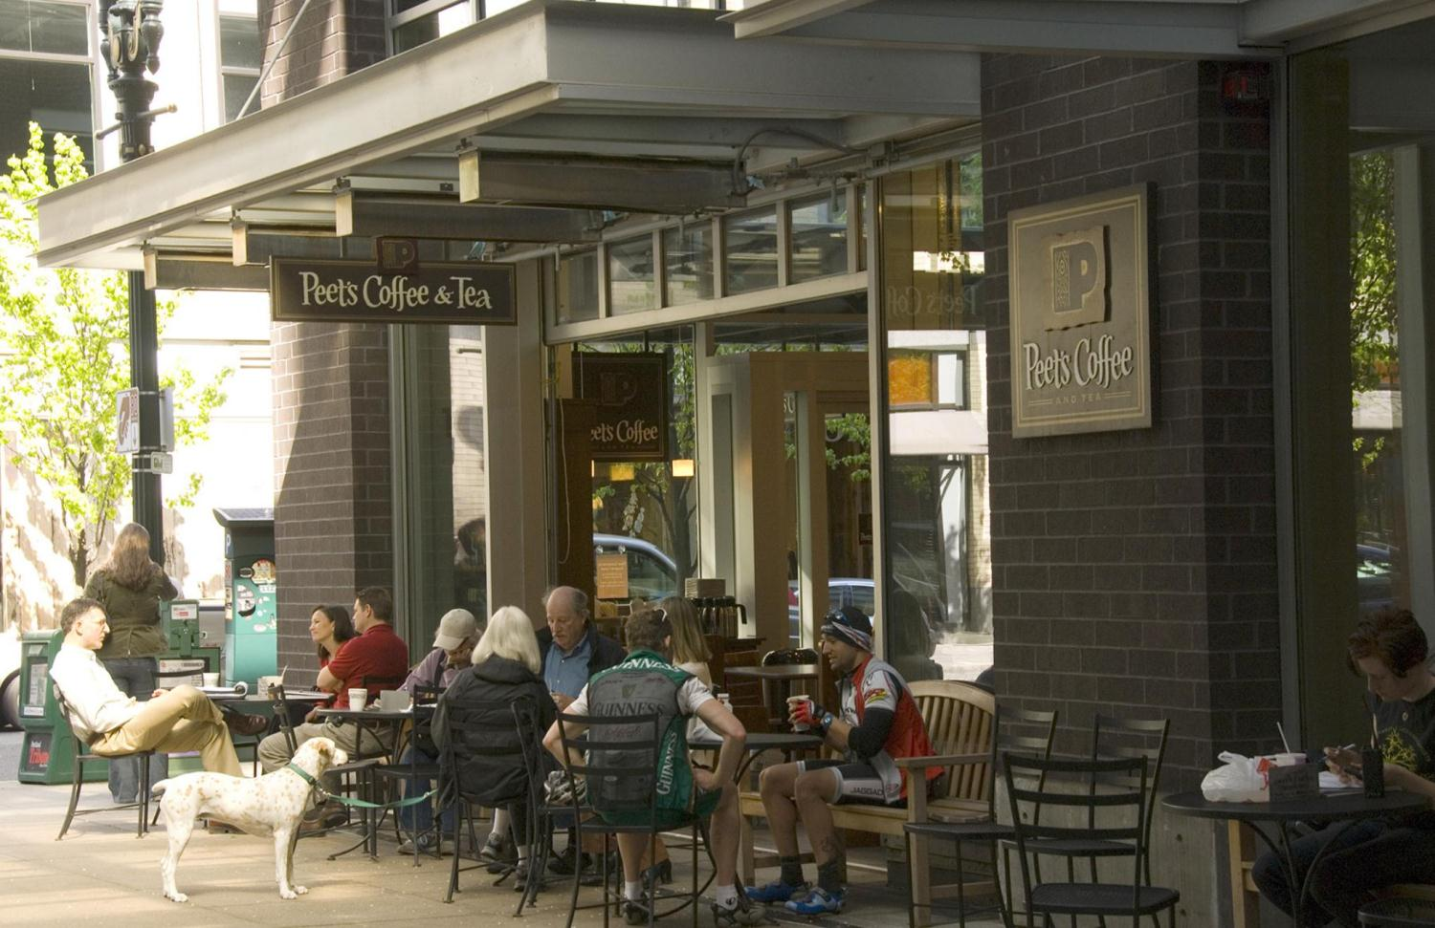
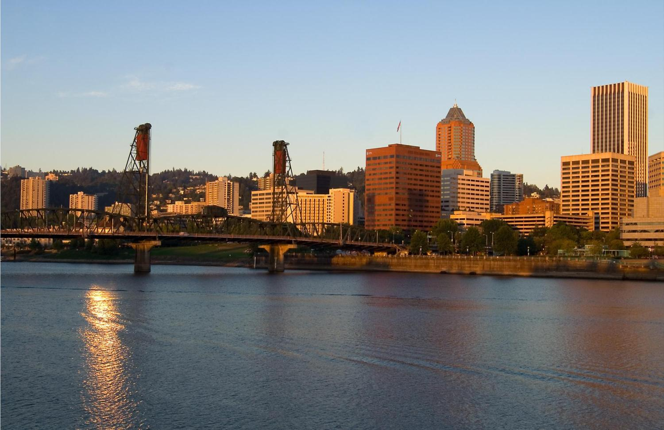
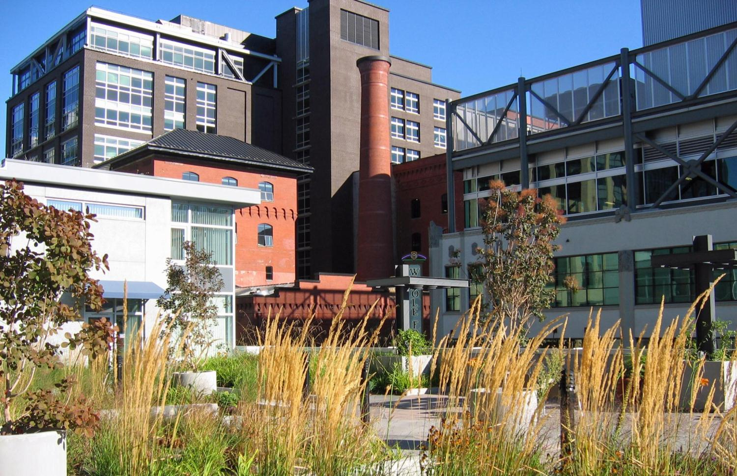
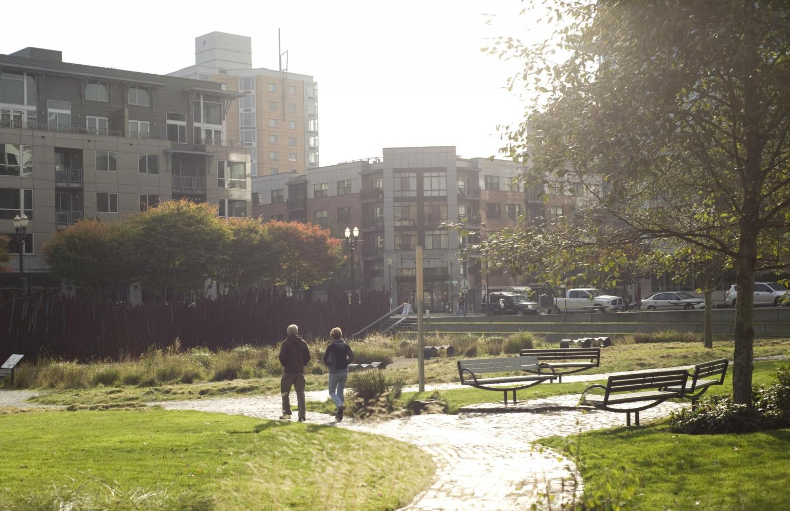
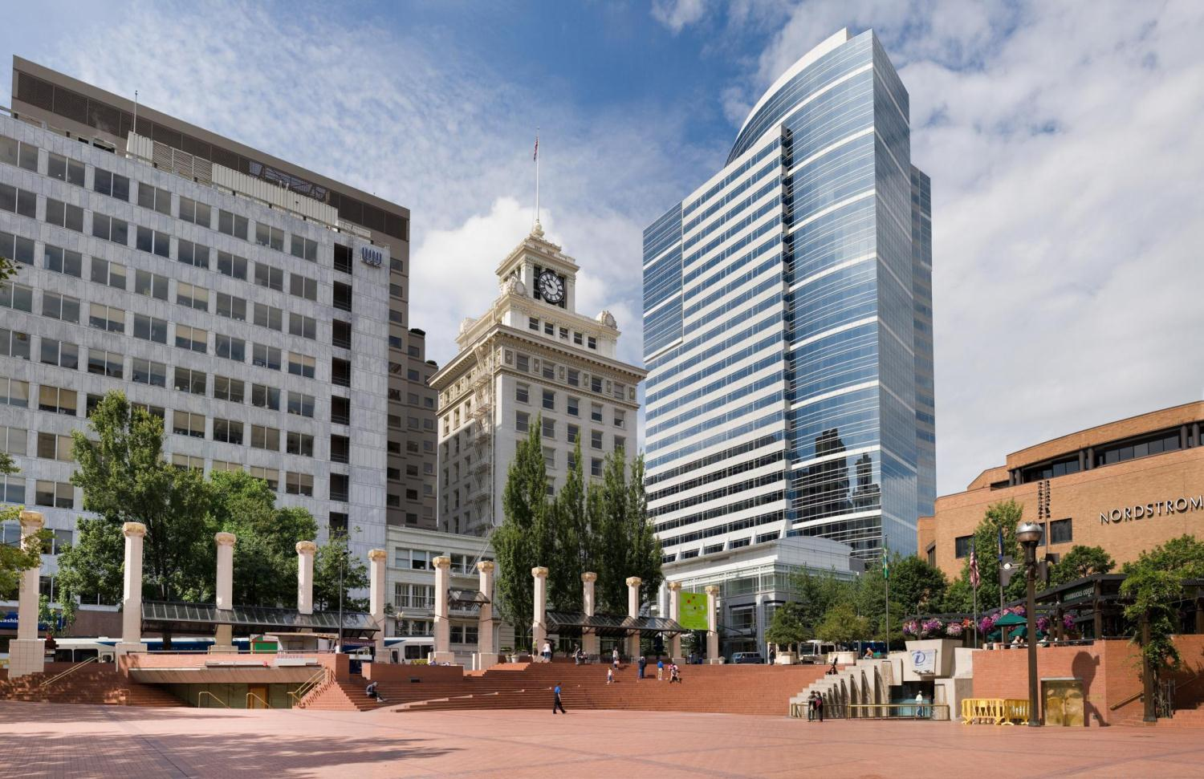
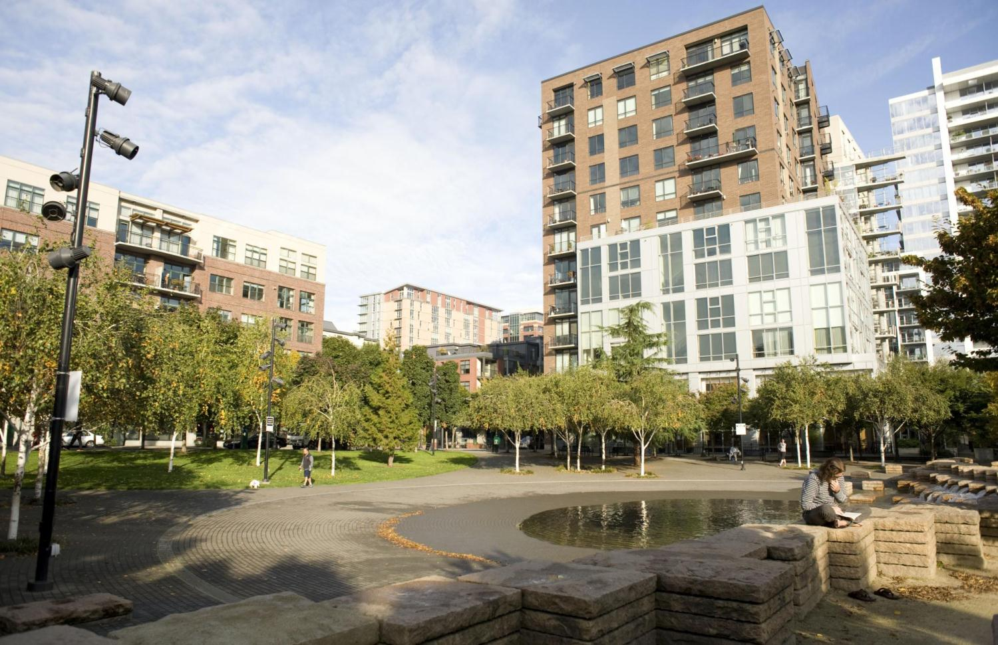
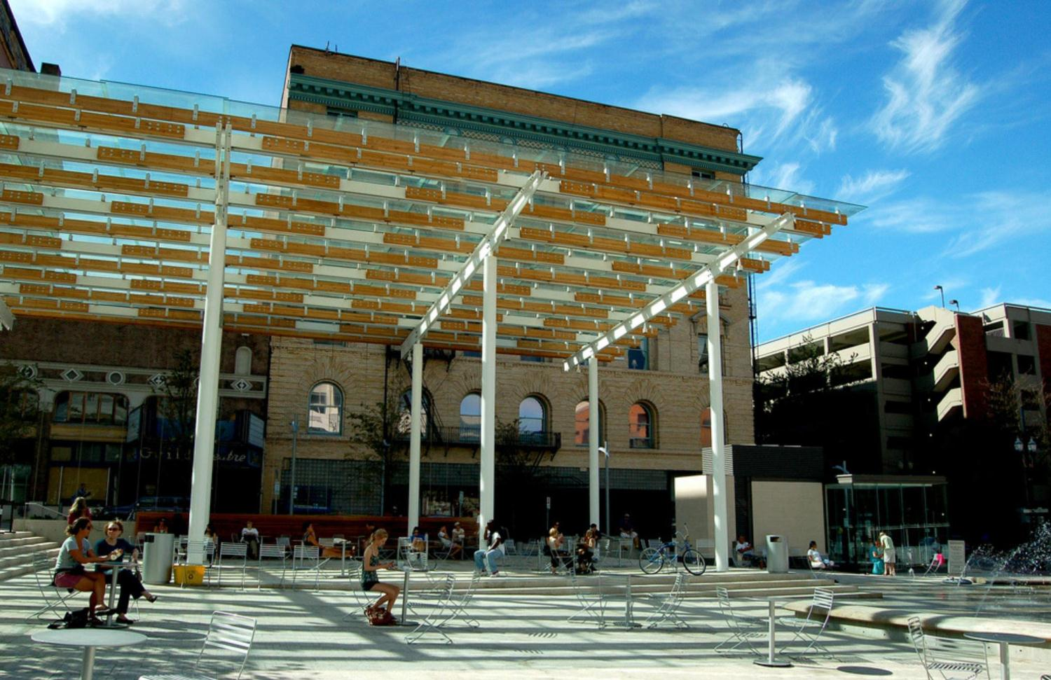
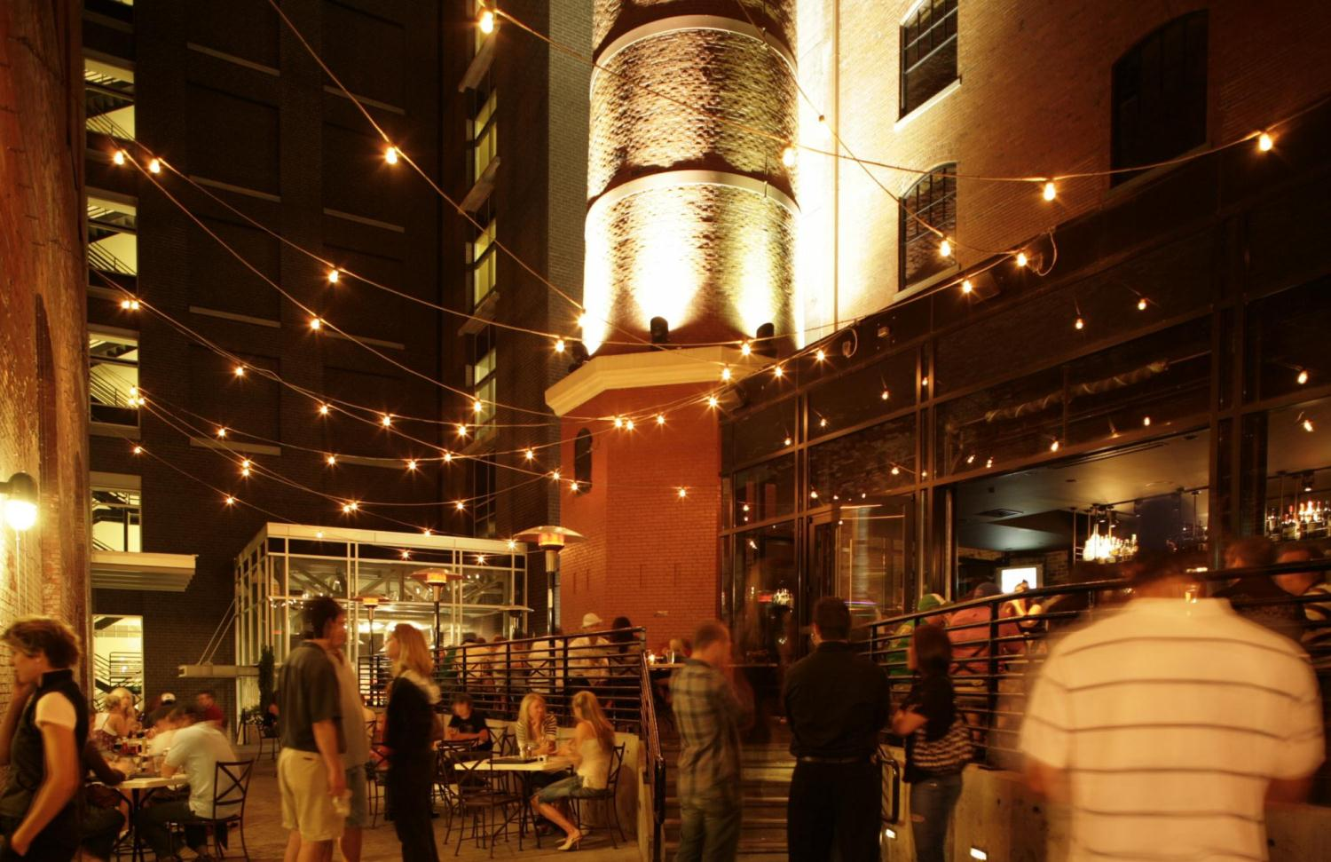
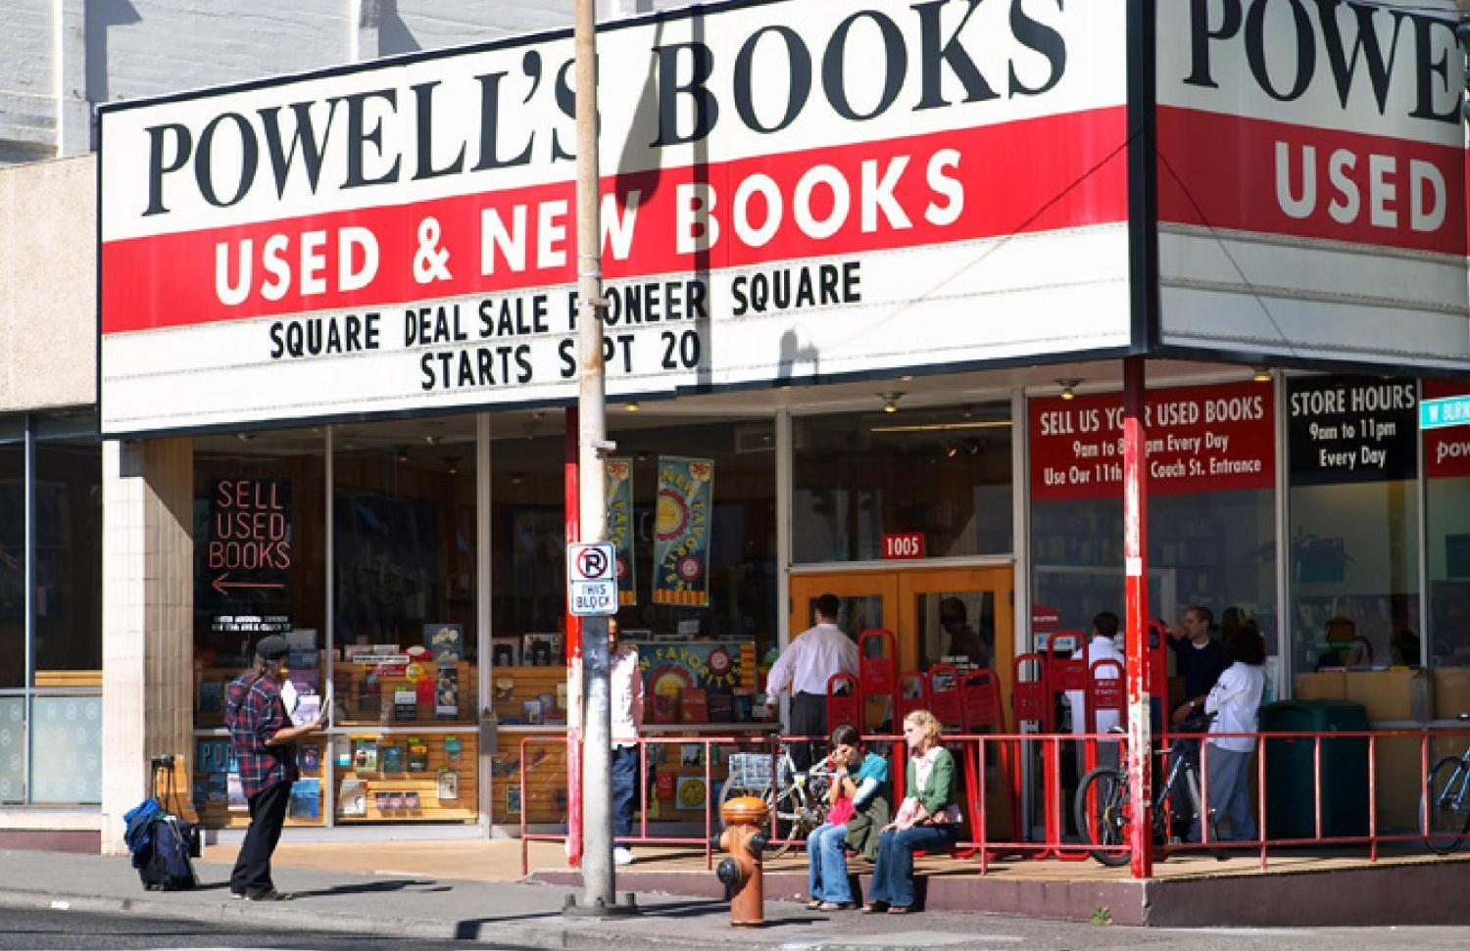
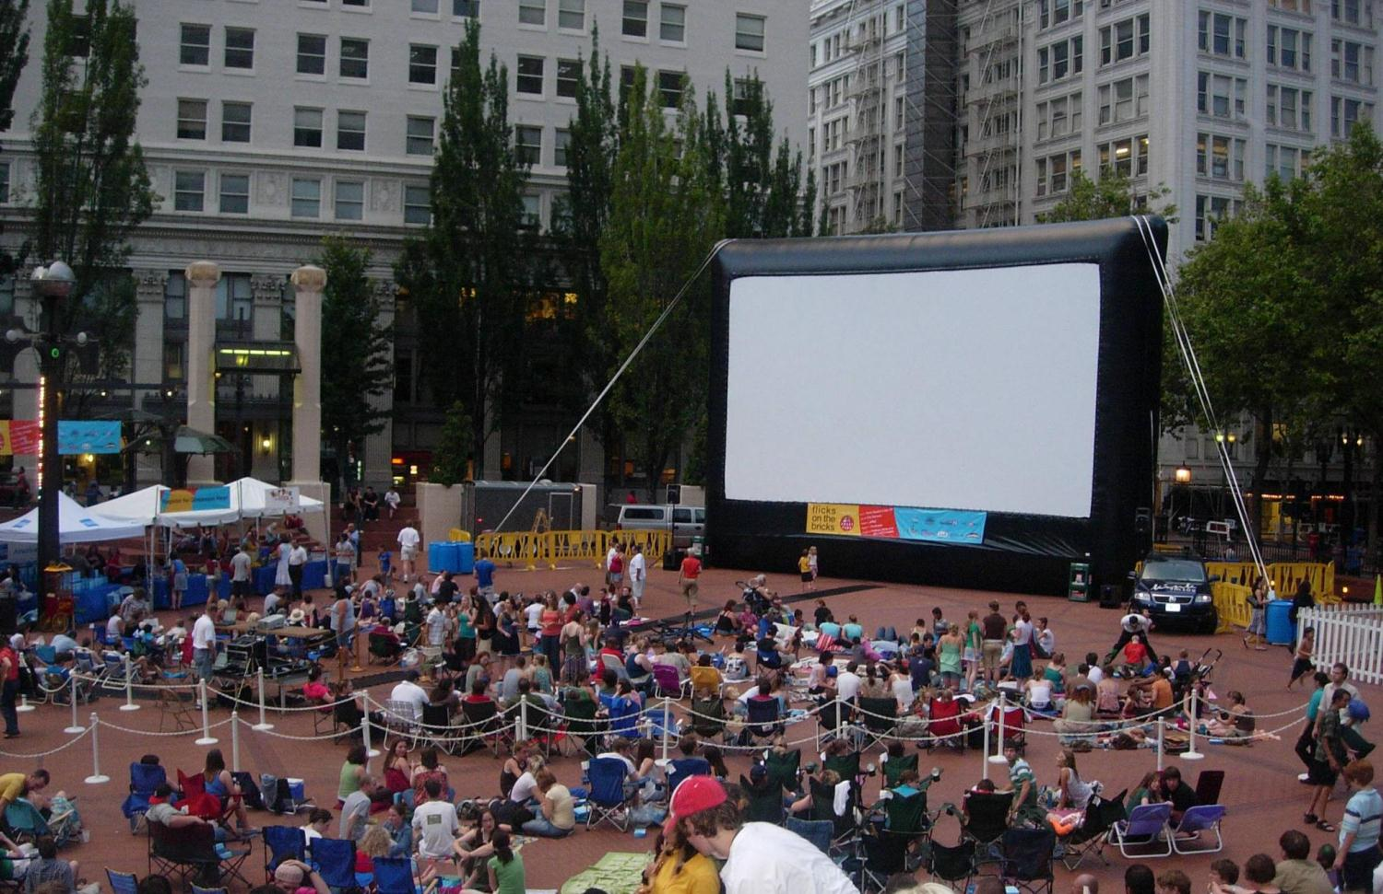

Slide 8
Vision imagery / resident profile
Who could live in this neighborhood?
What are they looking for?

Slide 11
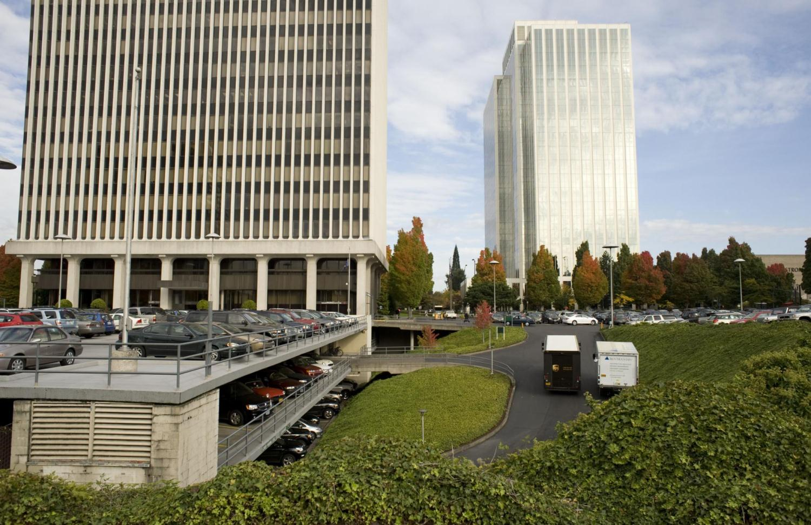
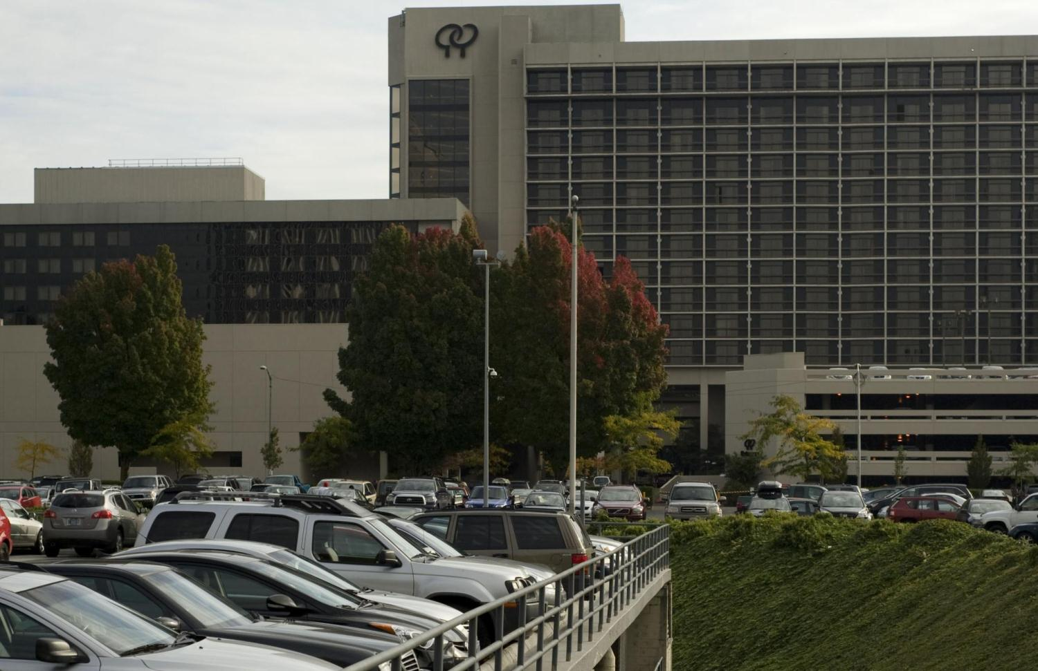
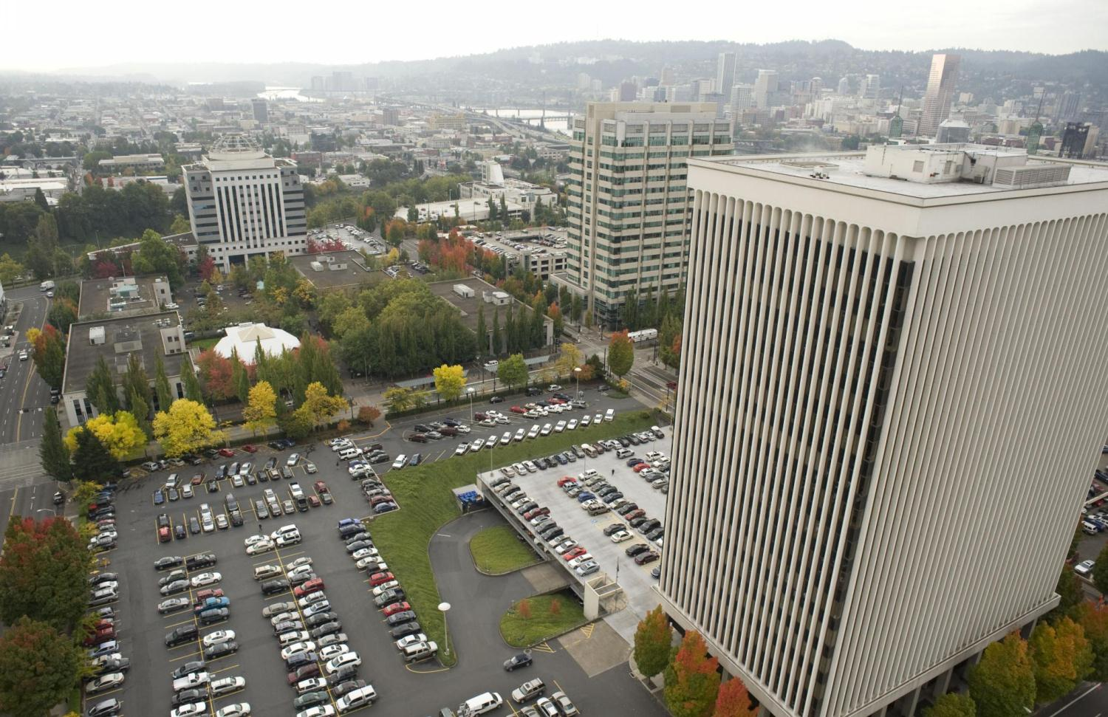
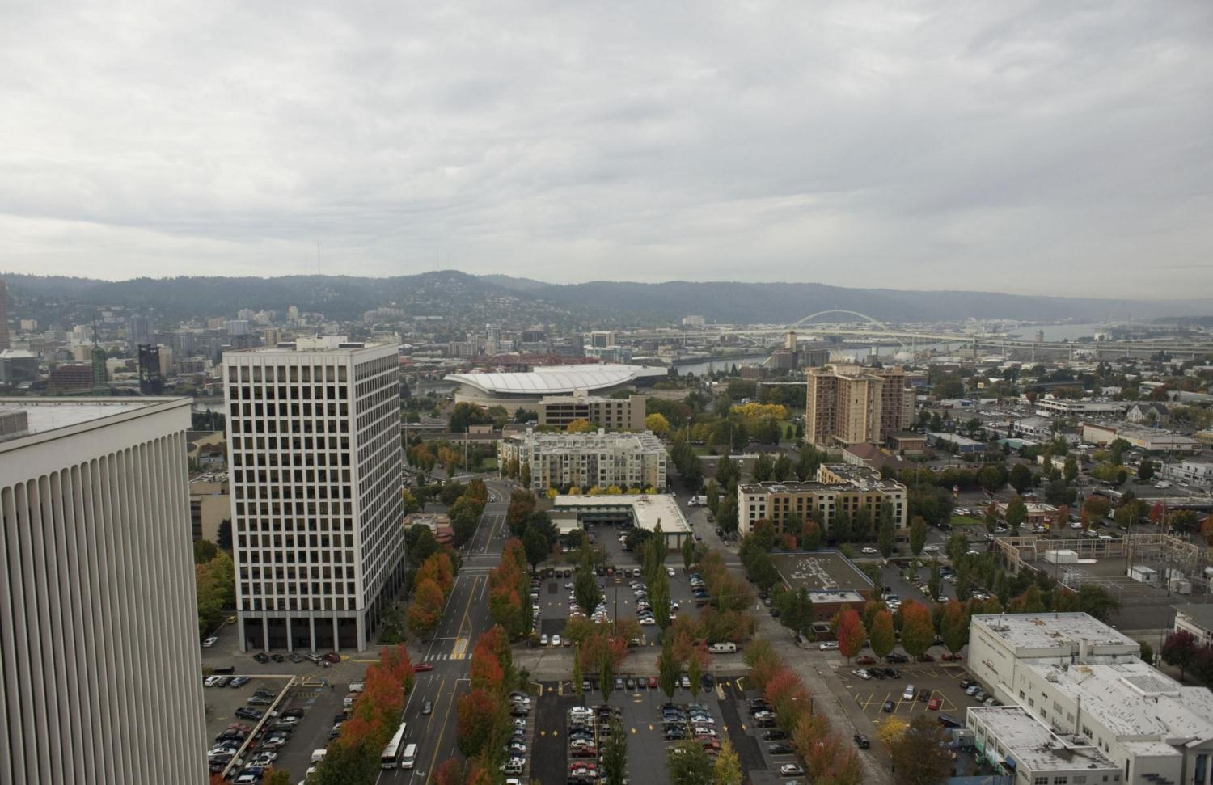
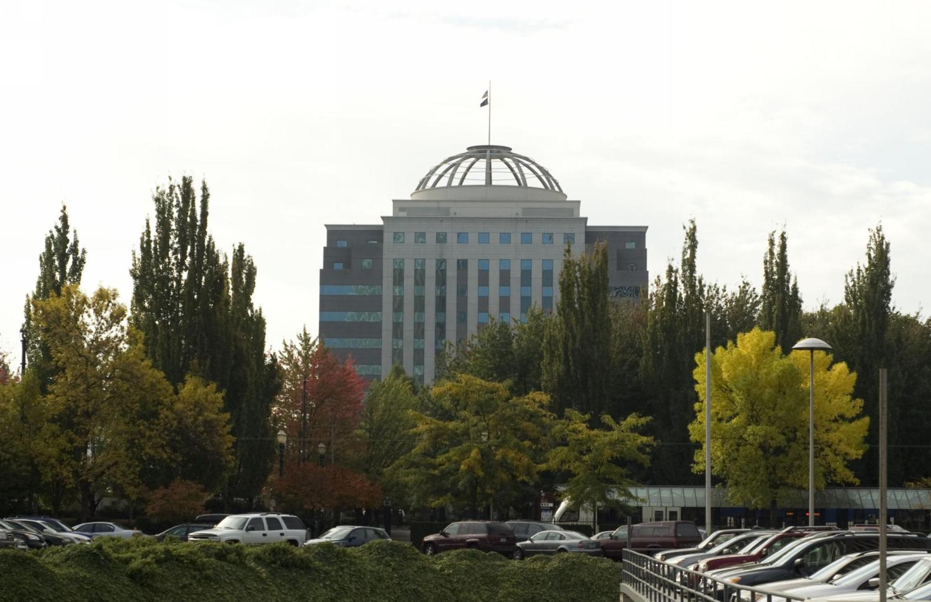
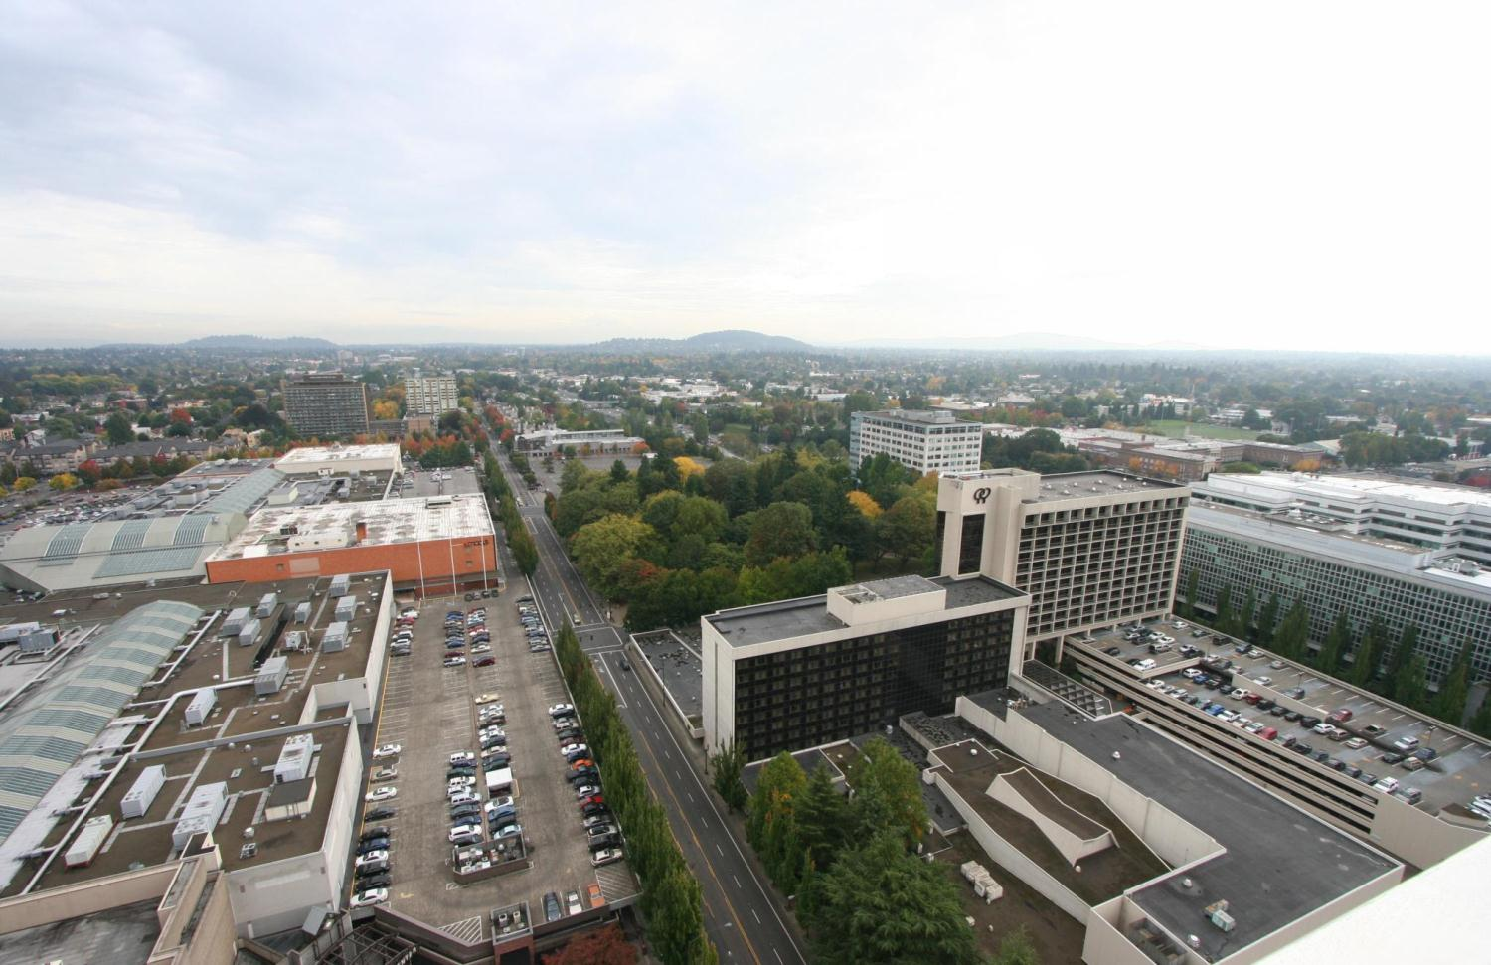

Slide 12
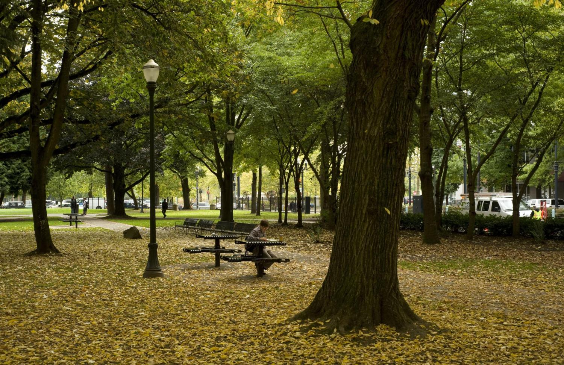
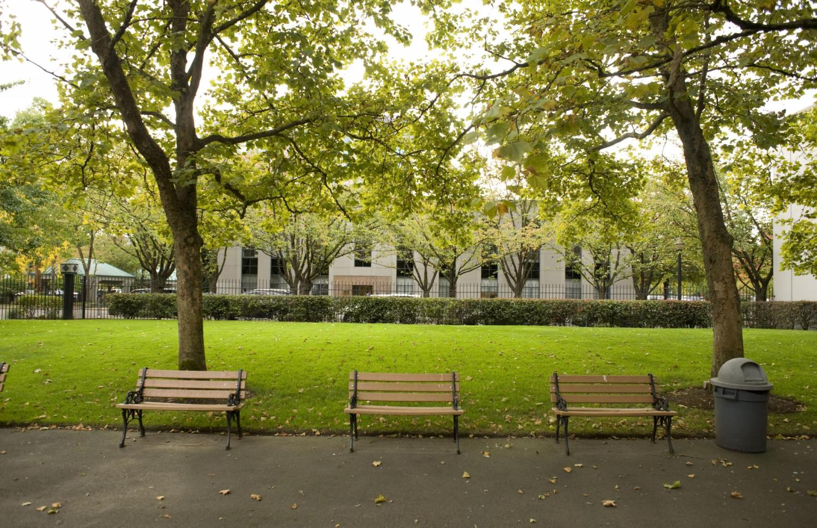
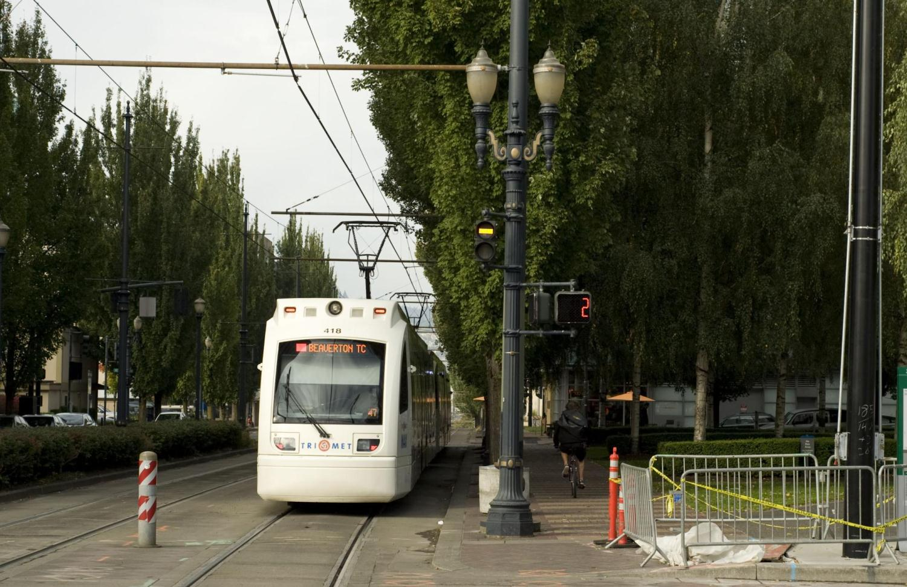
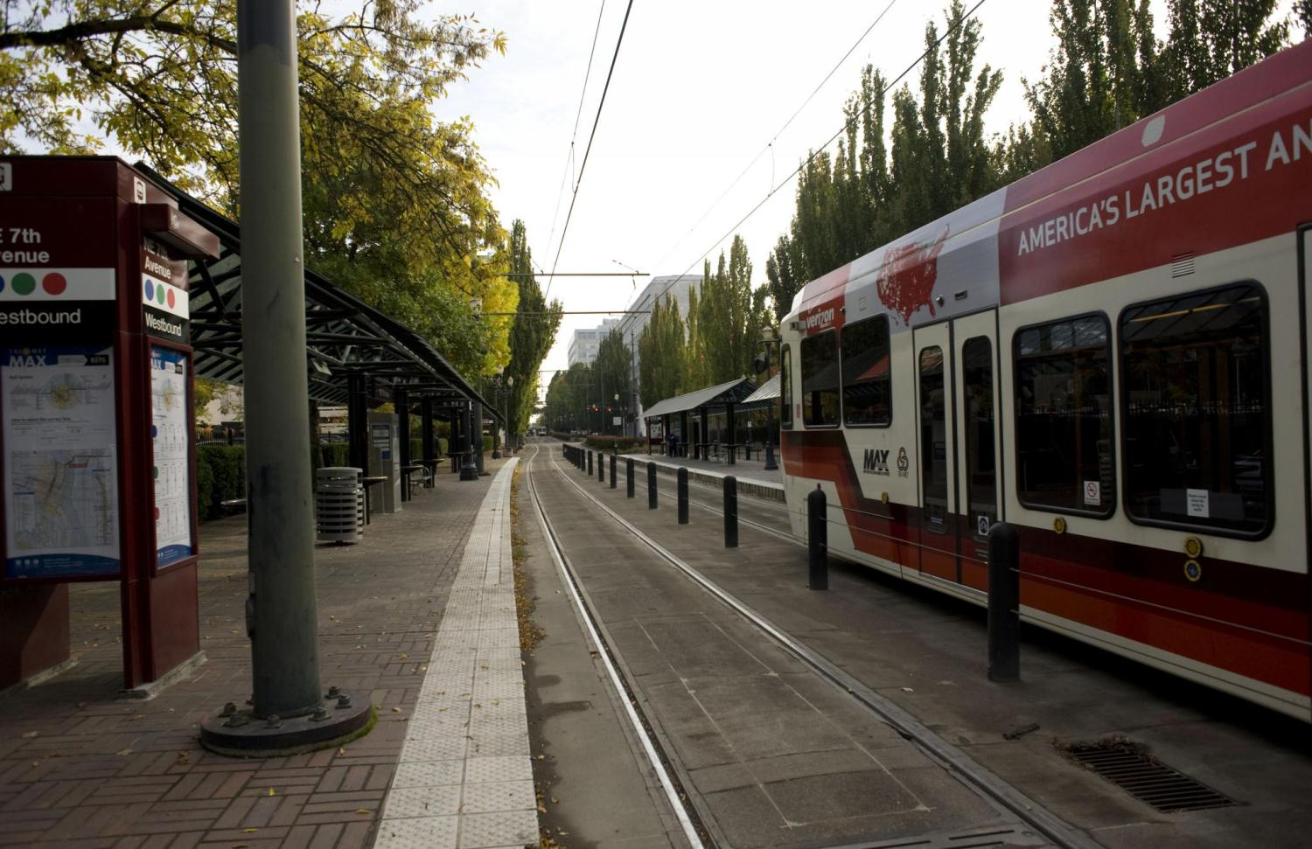
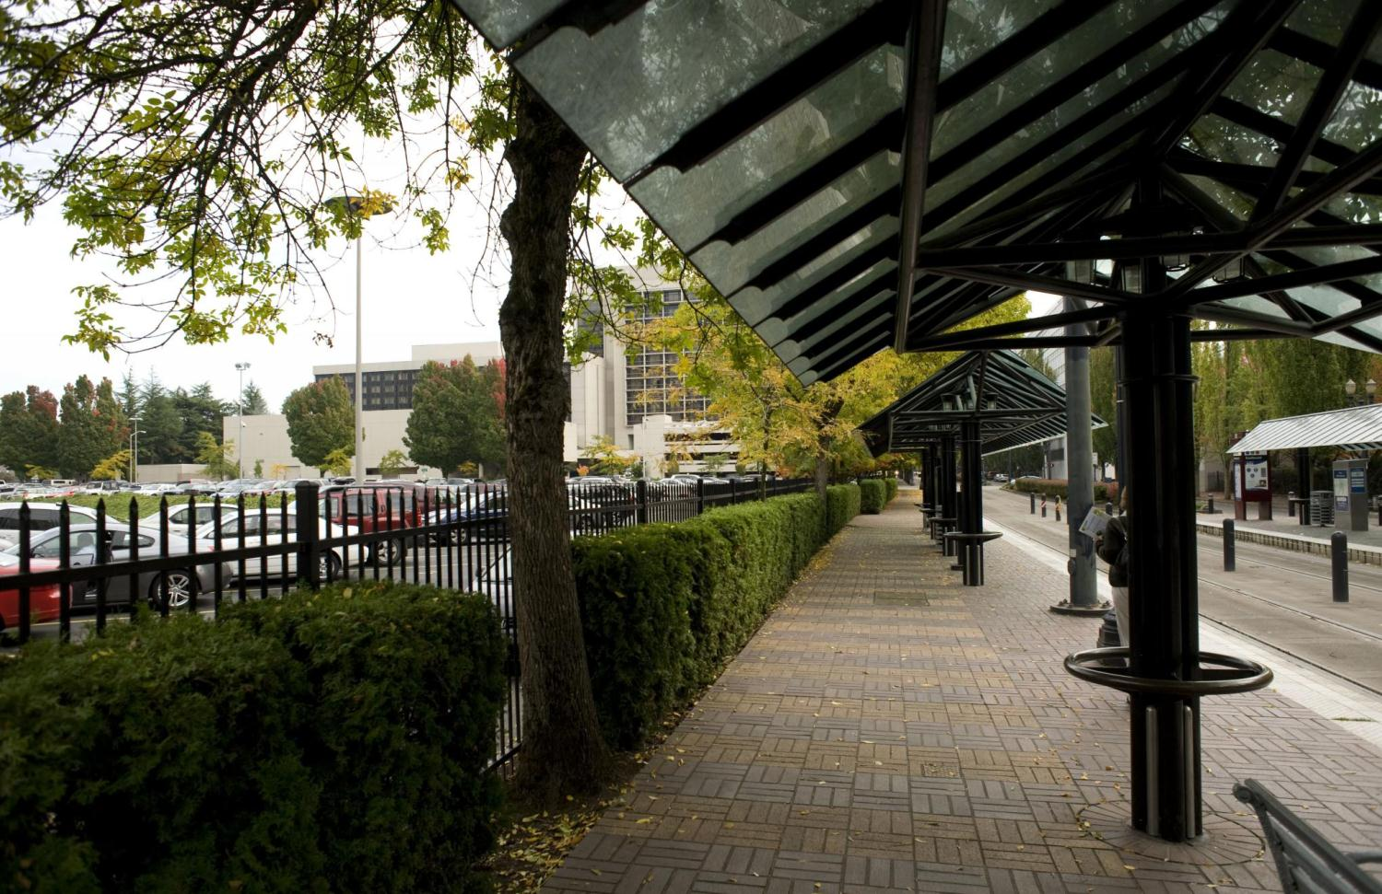
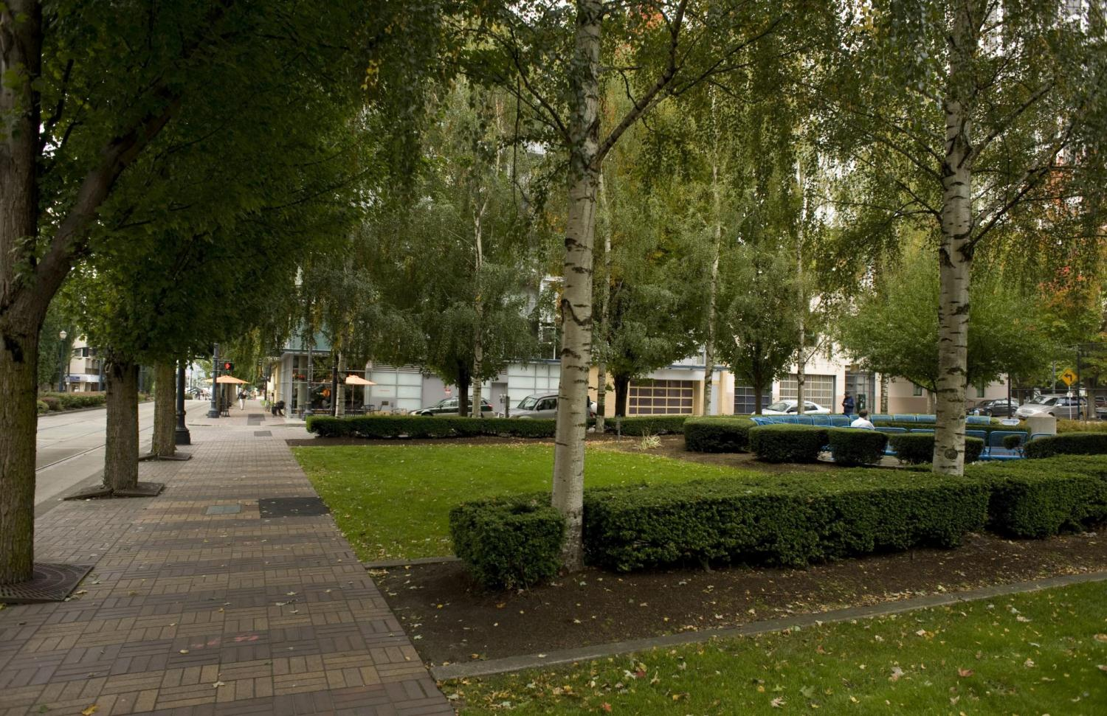

Slide 13
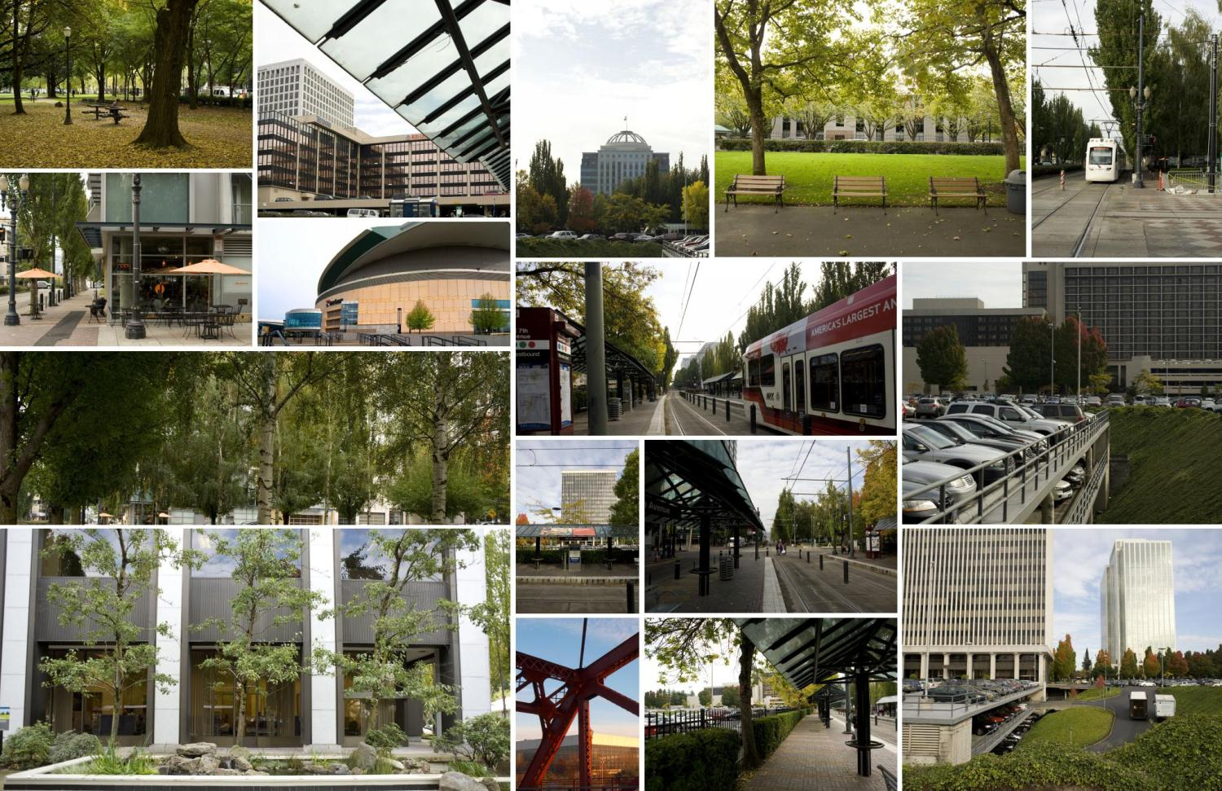
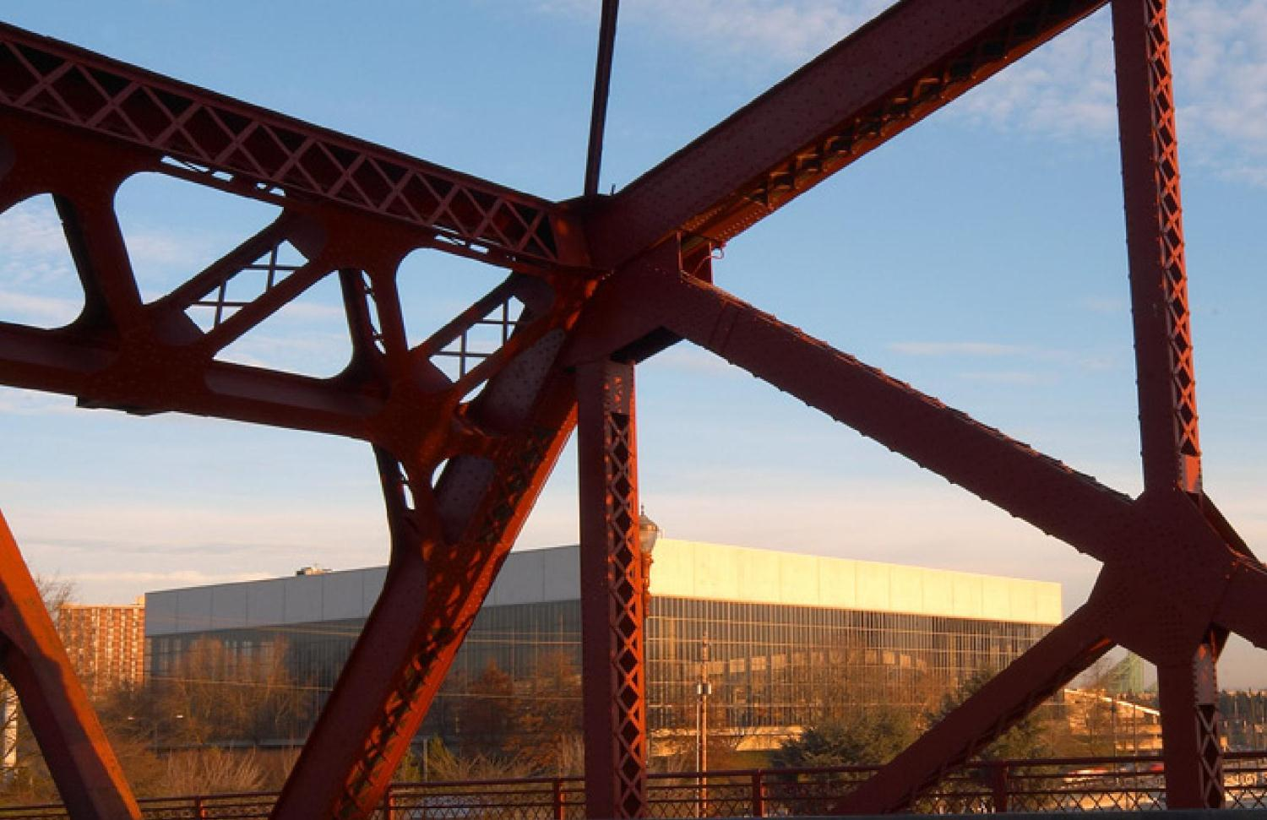
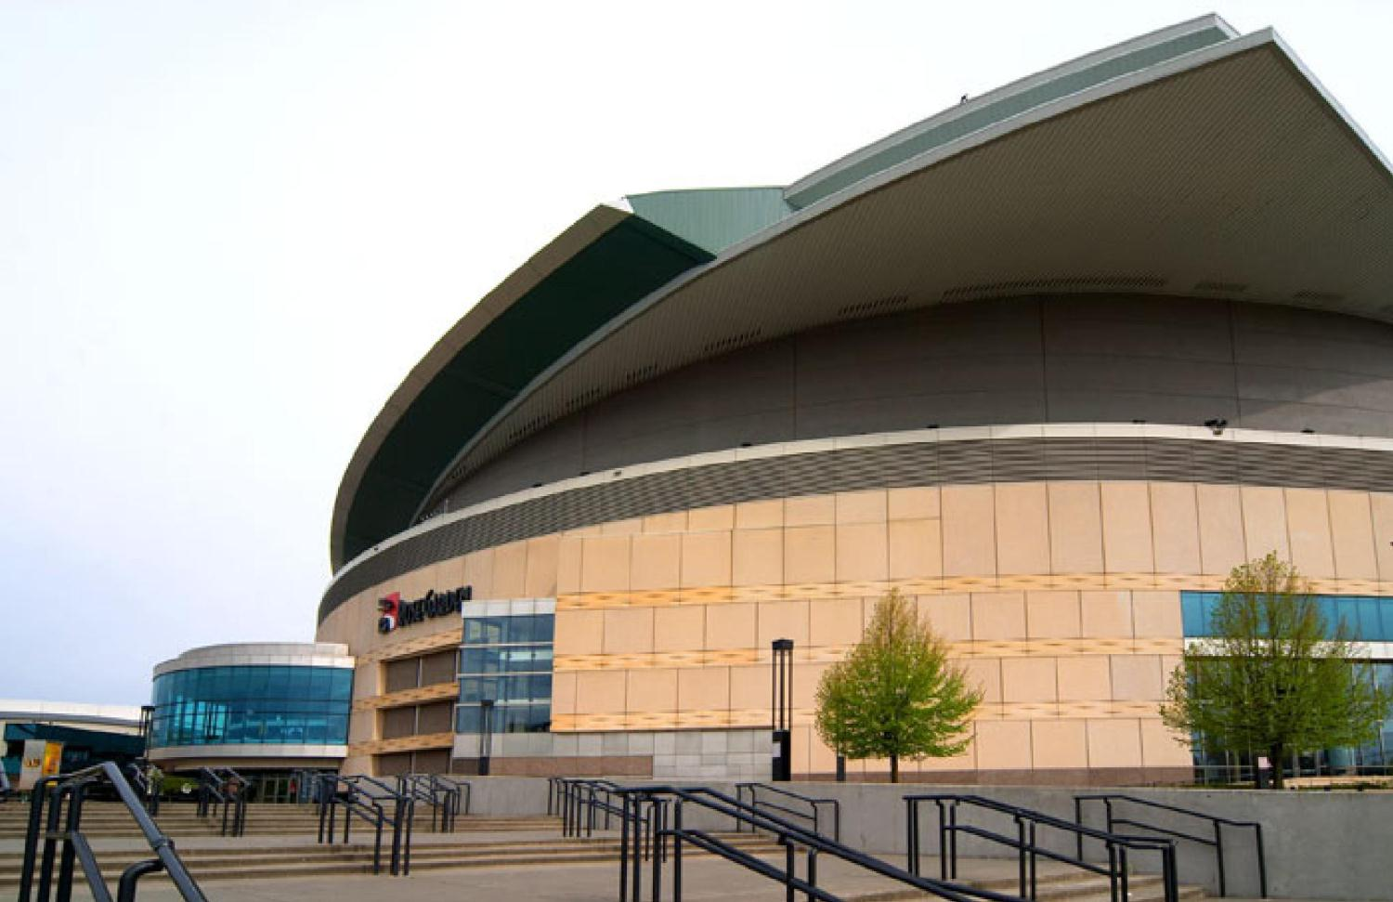
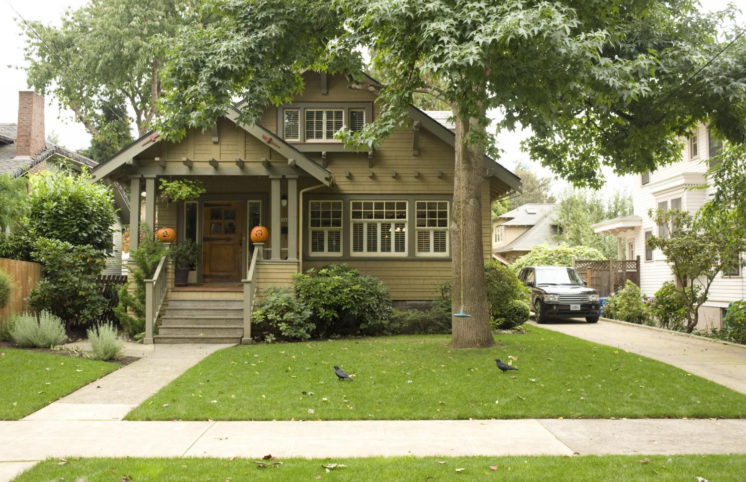

Slide 16
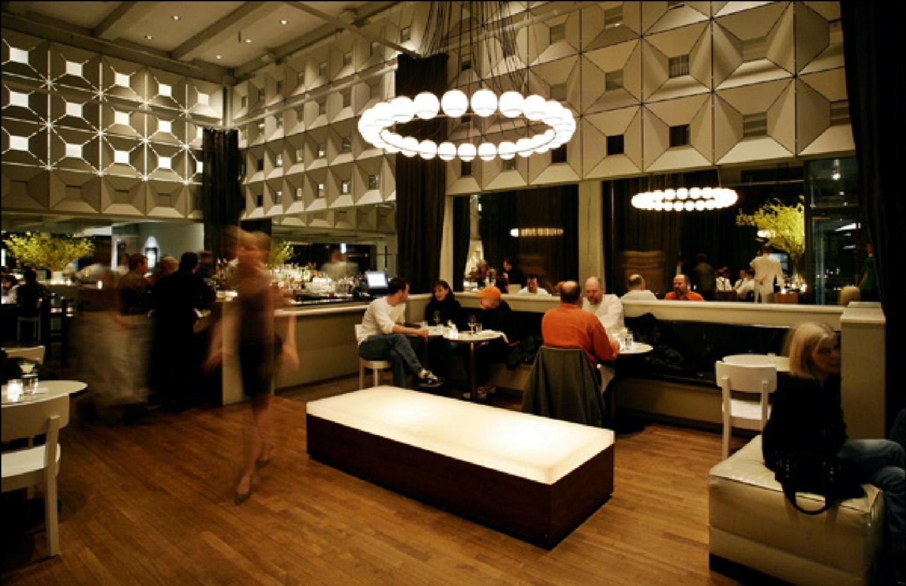
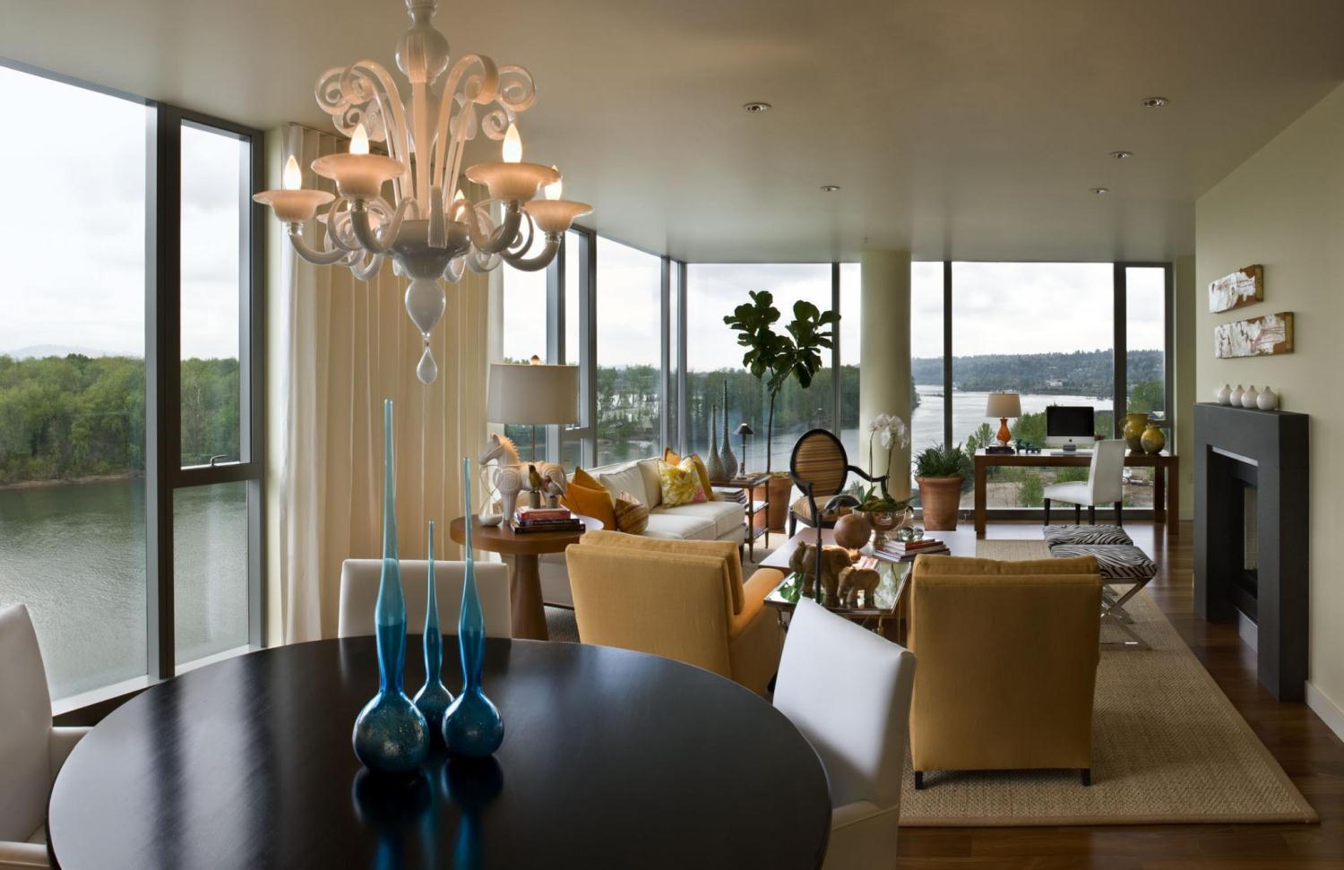
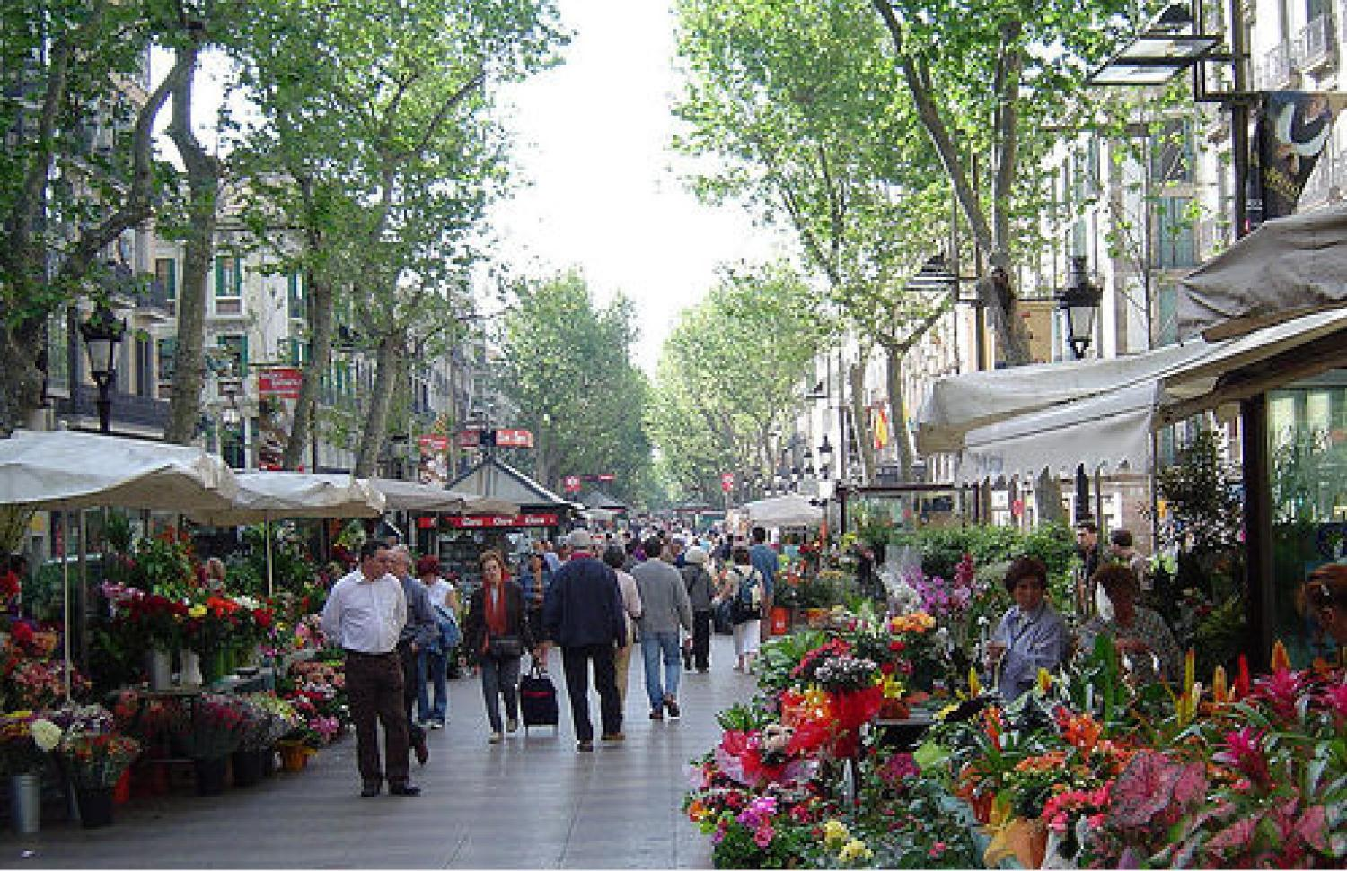
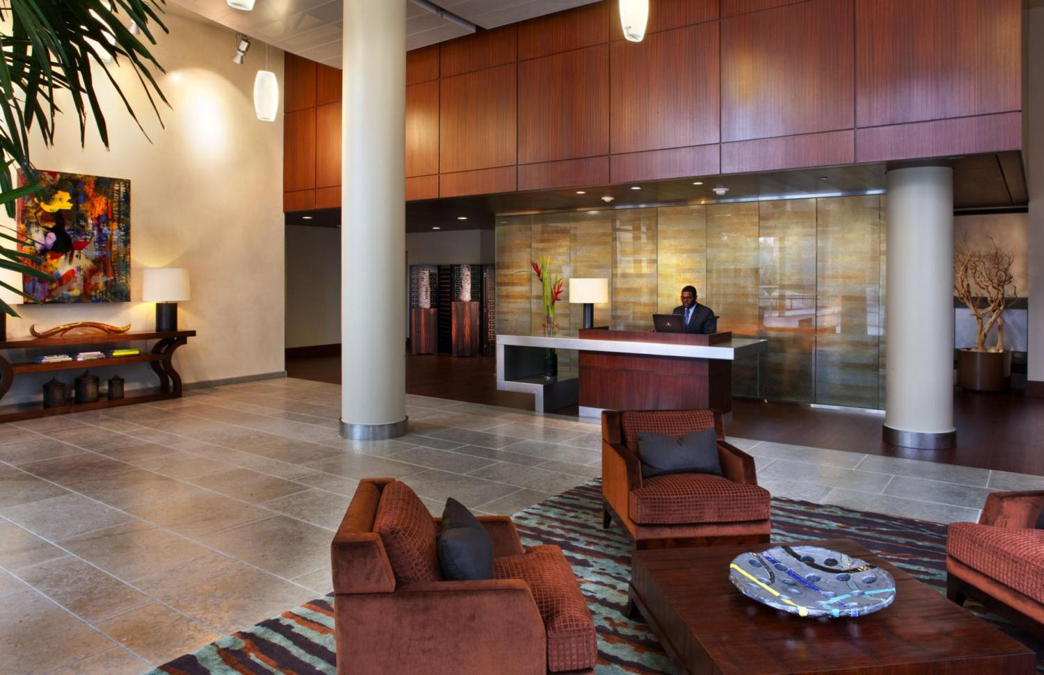

Slide 18
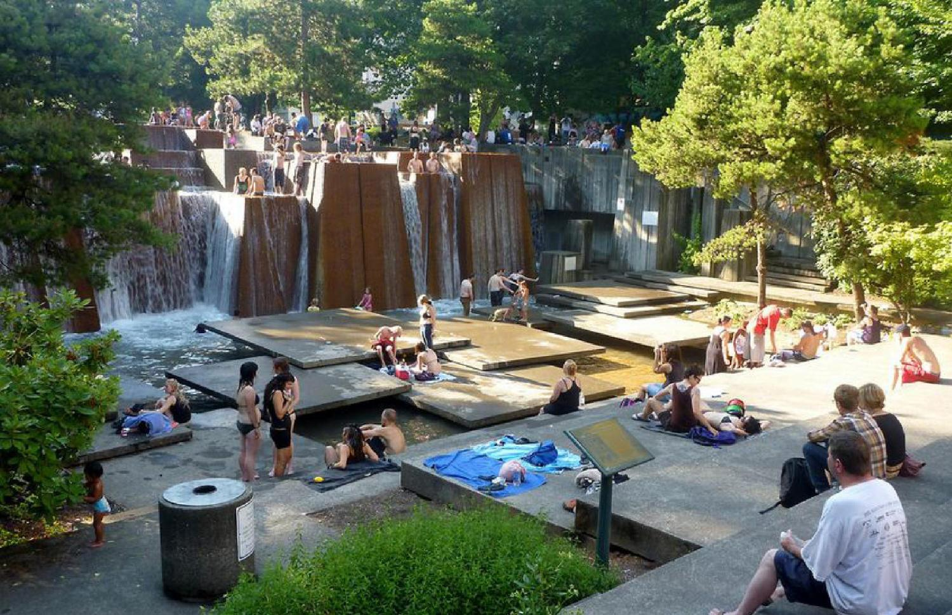
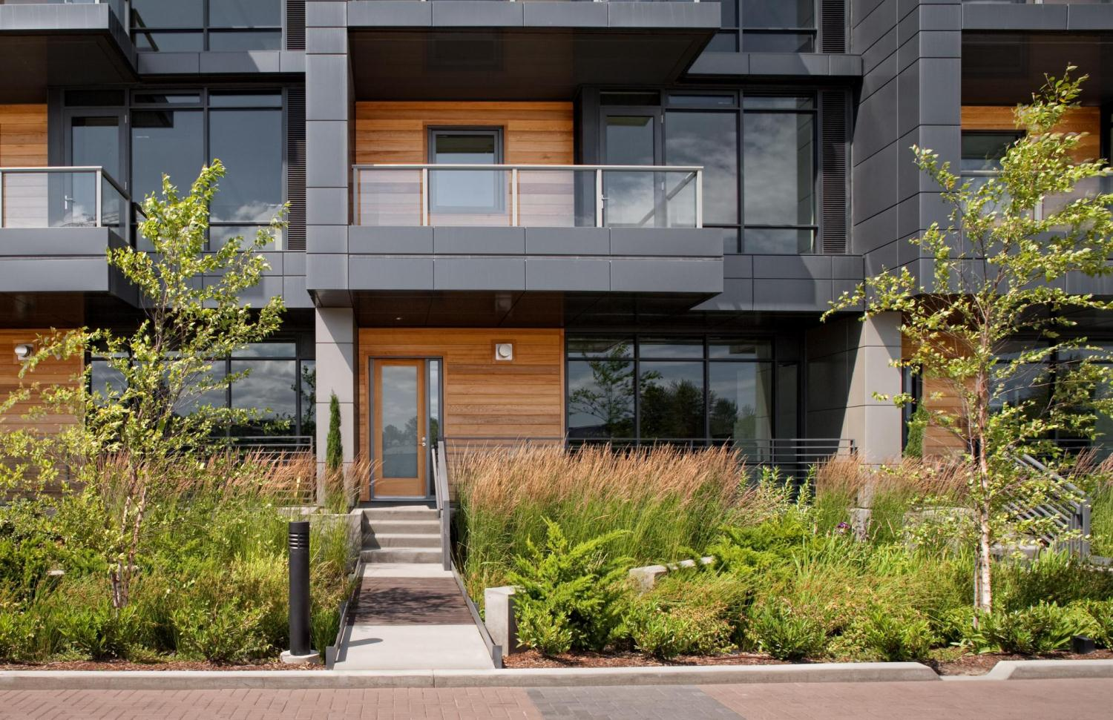
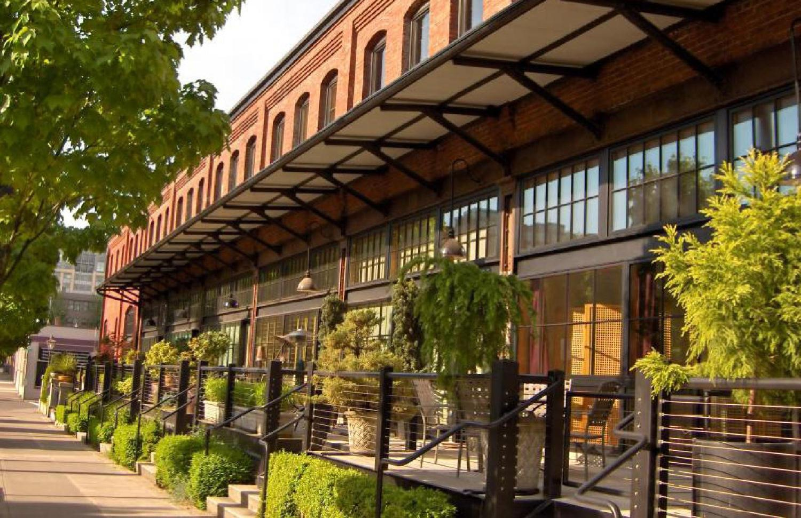

Slide 20
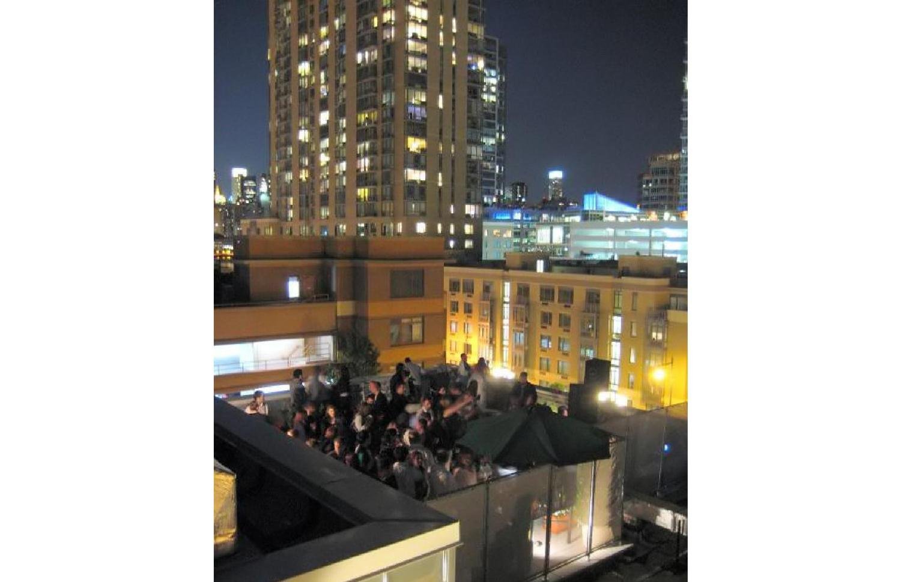
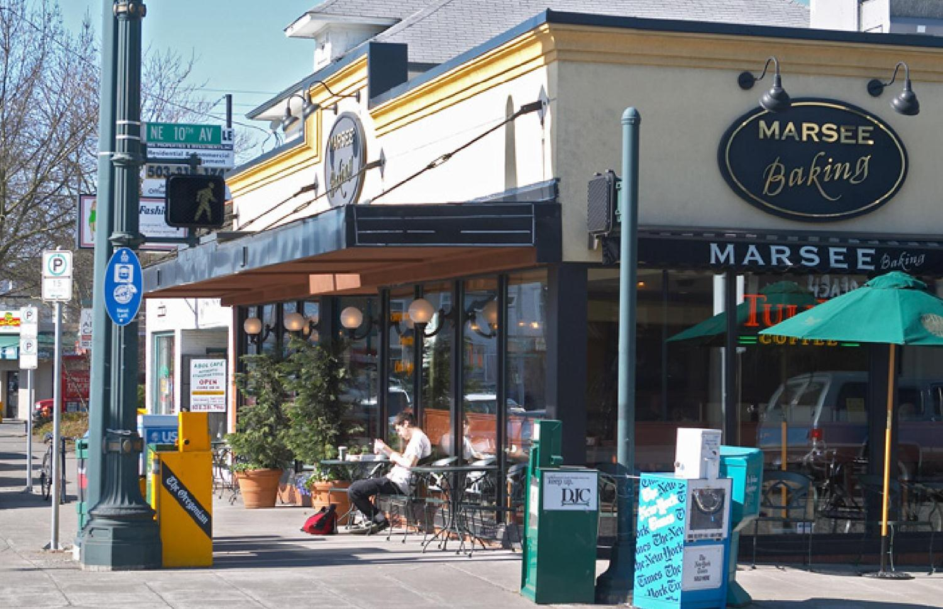
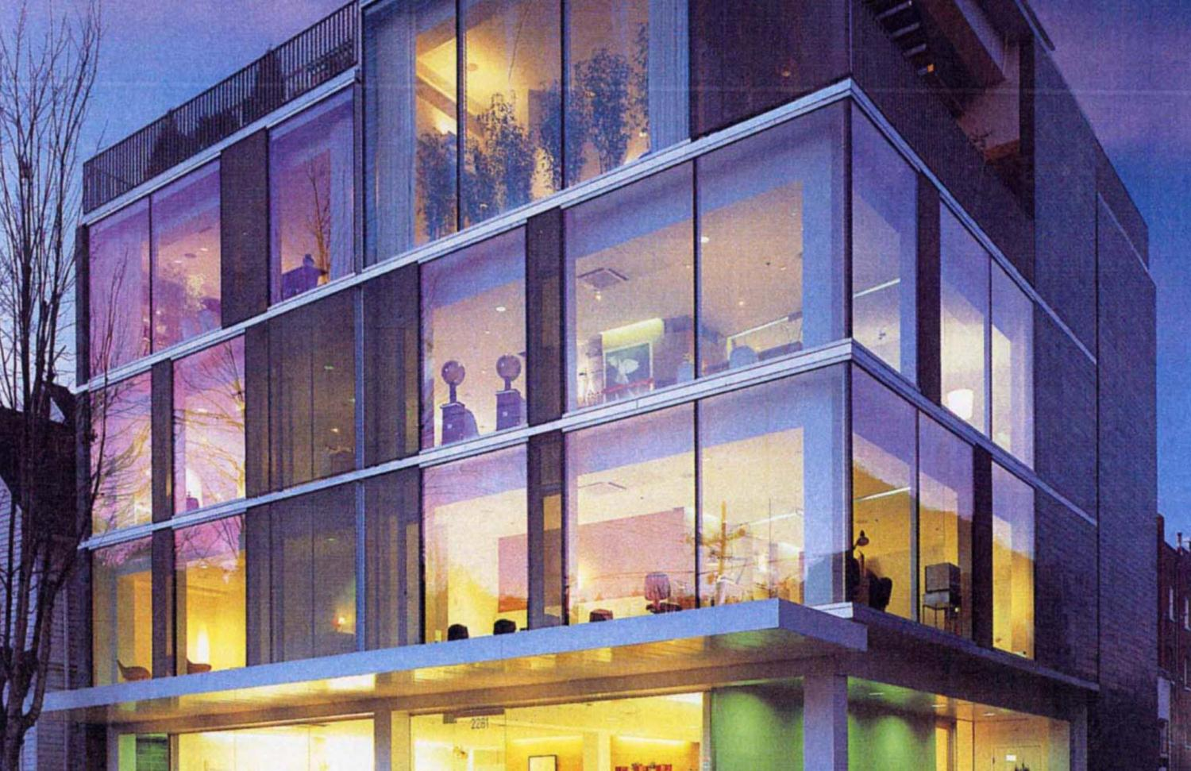
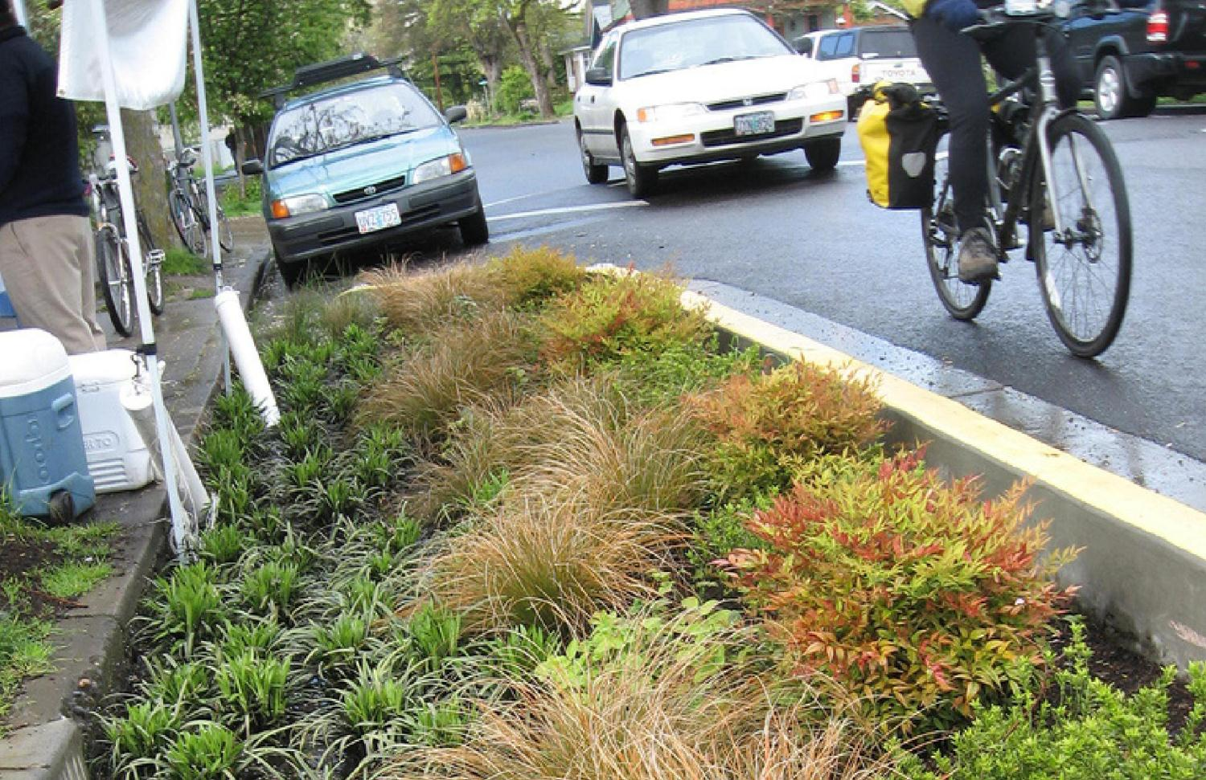

Slide 21
Project goals / positioning
What sets this project apart?
What makes this place memorable?

Slide 22
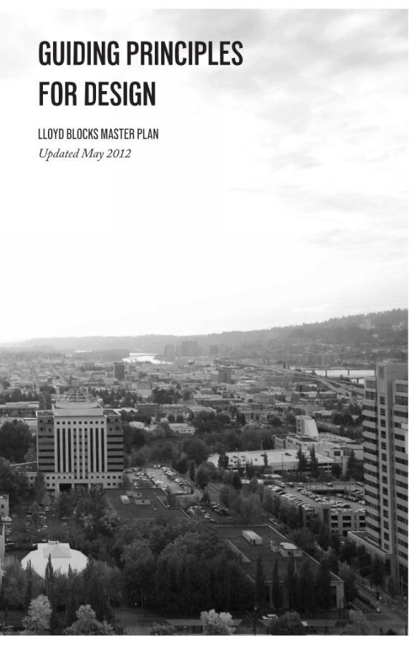

Slide 23
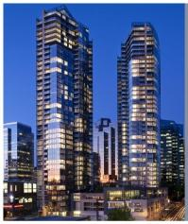
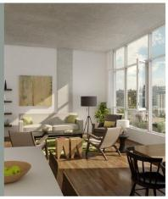
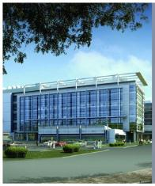
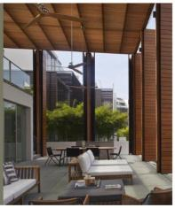
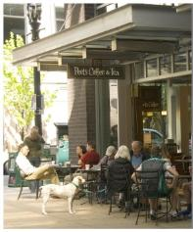
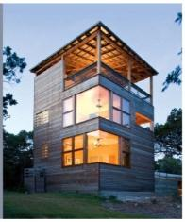
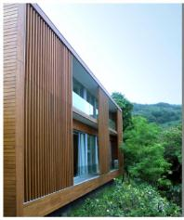
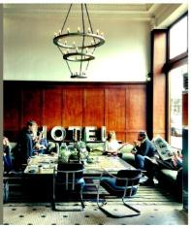
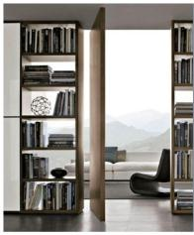
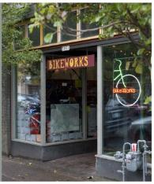
1
MAKE MOVES FOR REASON
2
MINIMIZE UNIT TYPES.
3
OPTIMIZE STRUCTURAL BAY SPACING.
4
BALCONIES AND TERRACES SHOULD OFFER A SENSE OF ENCLOSURE.
5
BASE OF BUILDINGS SHOULD BE HUMAN SCALED.
6
OPACITY AND TRANSPARENCY SHOULD WORK TOGETHER.
7
BUILDING GEOMETRY SHOULD BE SIMPLE AND WELL COMPOSED.
8
CREATE ACTIVE COMMON AREAS & LOBBIES THAT ARE MULTI-FUNCTIONAL.
9
DEVELOP STRONG INDDOR / OUTDOOR CONNECTIVITY.
10
CREATE OPPORTUNITIES FOR SMALL, ECLECTIC, AND NEIGHBORHOOD-FOCUSED RETAIL..

Slide 24
Project overview
LLOYD Blocks

Slide 25
SITE ANALYSIS
Metropolitan and Neighborhood study

Slide 26
LLOYD CENTER TOWER
LLOYD CENTER MALL
ROSE QUARTER
HOTEL
PARK
CINEMA PARKING
OREGON SQUARE
BPA - OFFICE
OREGON CONVENTION CENTER
STATE

Slide 28
GROUND LEVEL

Slide 29
ECO-DISTRICT STRATEGIES
ENERGY
WATER + WASTE
DISTRICT DOMESTIC SOLAR HOT WATER PLANT – BLOCK 100
OFFICE BUILDING PLANT CONNECTED TO RETAIL
HIGH PERFORMANCE ENVELOPE
RAINWATER RESERVIOR
STORMWATER TREATMENT
100% BLACK/GREY WATER TREATMENT AND RE-USE; IRRIGATION, FLUSH, COOLING TOWER – INFILTRATE (DEQ)
COMMUNITY
ESSENTIAL SERVICES
MULTI-GENERATIONAL LIVING
MIX OF HOUSING TYPES
EAT/DRINK/SLEEP/WORK/STUDY/
PLAY/FLIRT
AIR
TRANSPORTATION
HEAT RECOVERY FOR COMMON SPACE CONDITIONING
FRESH AIR
POTENTIAL BIKE HUB AT L700
STREETCAR
MAX LINE
ZIP CAR
CHARGING STATION
20 MINUTE LIVING

Slide 30
GROUND LEVEL
TRASH
LOADING
PLAZA / STORMWATER
ELEVATOR / STAIR PAVILLION – GLASS W/ GREEN WALL
WATER STREET; RESERVIOR, LIVING MACHINE, STORMWATER, INTERPRETIVE COMPONENT
RESIDENTIAL ENTRY
COURTYARD / ECO-TERRACE
BIKE PARKING
ENTRY LOCATIONS
LOADING / TRASH
PARKING
LOADING
RESIDENTIAL LOBBY / ENTRY
COURTYARD / ECO-TERRACE
PARKING
BIKE PARKING
LOADING
RESIDENTIAL LOBBY / ENTRY

Slide 31
TRAFFIC PATTERNS
RAMP TO BELOW GRADE PARKING [BL_101]
RAMP TO BELOW GRADE PARKING [BL_101]

Slide 32
LOADING ZONES
MODIFIED L700 BUILDING FOR TRASH COLLECTION.
LOADING AND TRASH FOR FUTURE GROCER.
MODIFIED L700 OPEN AIR LOADING DOCK - SCREENED.
LOADING AND TRASH FOR RESIDENTIAL – NO CURB CUT. [BL_100]
LOADING AND TRASH FOR RESIDENTIAL. [BL_92]
LOADING AND TRASH FOR RESIDENTIAL. [BL_101]

Slide 33
PODIUM LEVEL

Slide 34
TYPICAL LEVEL

Slide 35
LANDSCAPE
Creating a sense of “place”

Slide 36
Guiding Principles > Landscape

Slide 37
Opportunities > Improve Site Access
BLK 100
BLK 92
BLK 101

Slide 38
Opportunities > Recover City Grid
BLK 100
BLK 92
BLK 101

Slide 39
Opportunities > Maximize Building Access Points
BLK 100
BLK 92
BLK 101

Slide 40
Opportunities > Improve Pedestrian Flows
BLK 100
BLK 92
BLK 101

Slide 41
Opportunities > Provide Main Plaza | Pocket Plazas | Place to Pause
BLK 100
BLK 92
BLK 101

Slide 42
Opportunities > Develop Layered Landscape
Elements & Furnishings
Furnishings & Elements
Tree Canopy
Water Street Pathway
Living Machine
Reservoir/ Water Feature
Stormwater Gardens
Shrub Planting
Plaza & NE Hassalo St Paving

Slide 43
Site
BLK 100
BLK 92
BLK 101

Slide 44
Water Street View Looking North

Slide 45
Water Street View Looking South

Slide 46
Podium Courtyards & Gardens
BLK 100
BLK 92
BLK 101

Slide 47
Roofscape
BLK 100
BLK 92
BLK 101

Slide 48
Composite
BLK 100
BLK 92
BLK 101

Slide 49
Water Systems Diagram

Slide 50
Birds-Eye View of Central Plaza

Slide 51
Materials / streetscape
LLOYD Blocks

Slide 54
ANTICIPATED MODIFICATIONS
DISTRICT DESIGN GUIDELINES; COLOR SHOULD BE BEIGE, BUFF OR WHITE MASONARY MATERIAL.
GROUND FLOOR ACTIVE USE (MAP 510-7) GROUND FLOOR ACTIVE USE ON BLOCK 101
GROUND FLOOR WINDOWS (33.130.230.B.3 / 33.510.220)
BLOCK 100 + 101 – 9TH AVENUE
50% OF LENGTH
25% OF WALL AREA
FORWARD MOTION

Slide 55
ANTICIPATED MODIFICATIONS
DISTRICT DESIGN GUIDELINES; COLOR SHOULD BE BEIGE, BUFF OR WHITE MASONARY MATERIAL.
GROUND FLOOR ACTIVE USE (MAP 510-7) GROUND FLOOR ACTIVE USE ON BLOCK 101
GROUND FLOOR WINDOWS (33.130.230.B.3 / 33.510.220)
BLOCK 100 + 101 – 9TH AVENUE
50% OF LENGTH
25% OF WALL AREA
FORWARD MOTION

Slide 57
ANTICIPATED MODIFICATIONS
DISTRICT DESIGN GUIDELINES; COLOR SHOULD BE BEIGE, BUFF OR WHITE MASONARY MATERIAL.
GROUND FLOOR ACTIVE USE (MAP 510-7) GROUND FLOOR ACTIVE USE ON BLOCK 101
GROUND FLOOR WINDOWS (33.130.230.B.3 / 33.510.220)
BLOCK 100 + 101 – 9TH AVENUE
50% OF LENGTH
25% OF WALL AREA
FORWARD MOTION

Slide 58
ANTICIPATED MODIFICATIONS
DISTRICT DESIGN GUIDELINES; COLOR SHOULD BE BEIGE, BUFF OR WHITE MASONARY MATERIAL.
GROUND FLOOR ACTIVE USE (MAP 510-7) GROUND FLOOR ACTIVE USE ON BLOCK 101
GROUND FLOOR WINDOWS (33.130.230.B.3 / 33.510.220)
BLOCK 100 + 101 – 9TH AVENUE
50% OF LENGTH
25% OF WALL AREA
FORWARD MOTION

Slide 59
EAST ELEVATION / NE 9TH ELEVATION

Slide 60
BLOCK 100 – GROUND LEVEL USES

Slide 61
BLOCK 101 – GROUND LEVEL USES

Slide 62
EAST ELEVATION / NE 9TH ELEVATION
BLOCK 101 - 33.130.230.B.3
LENGTH AT 50% = 185FT = 93 LF
*30+5+25 = 60 FT. AT DESIGN = 32%
**TRANSLUCENT OH DOORS = 46 LF
***HIGH TRANSOM (FIRE COMMAND) = 25 LF
AREA AT 25% = 1,672SF = 418 SF
*402 SF AT DESIGN = 24%
*TRANSLUCENT OH DOORS
BLOCK 100 – 33.130.230.B.3
LENGTH AT 50% = 190FT = 95 LF
*16.5+30 = 46.5LF AT DESIGN = 24%
**TRANSLUCENT OH DOOR = 21LF
AREA AT 25% = 1,634SF = 409 SF
*125+264=389SF = 24%

Slide 63
ANTICIPATED MODIFICATIONS
DISTRICT DESIGN GUIDELINES; COLOR SHOULD BE BEIGE, BUFF OR WHITE MASONARY MATERIAL.
GROUND FLOOR ACTIVE USE (MAP 510-7) GROUND FLOOR ACTIVE USE ON BLOCK 101
GROUND FLOOR WINDOWS (33.130.230.B.3 / 33.510.220)
BLOCK 100 + 101 – 9TH AVENUE
50% OF LENGTH
25% OF WALL AREA
FORWARD MOTION

Slide 65
Q&A

