Slide 1
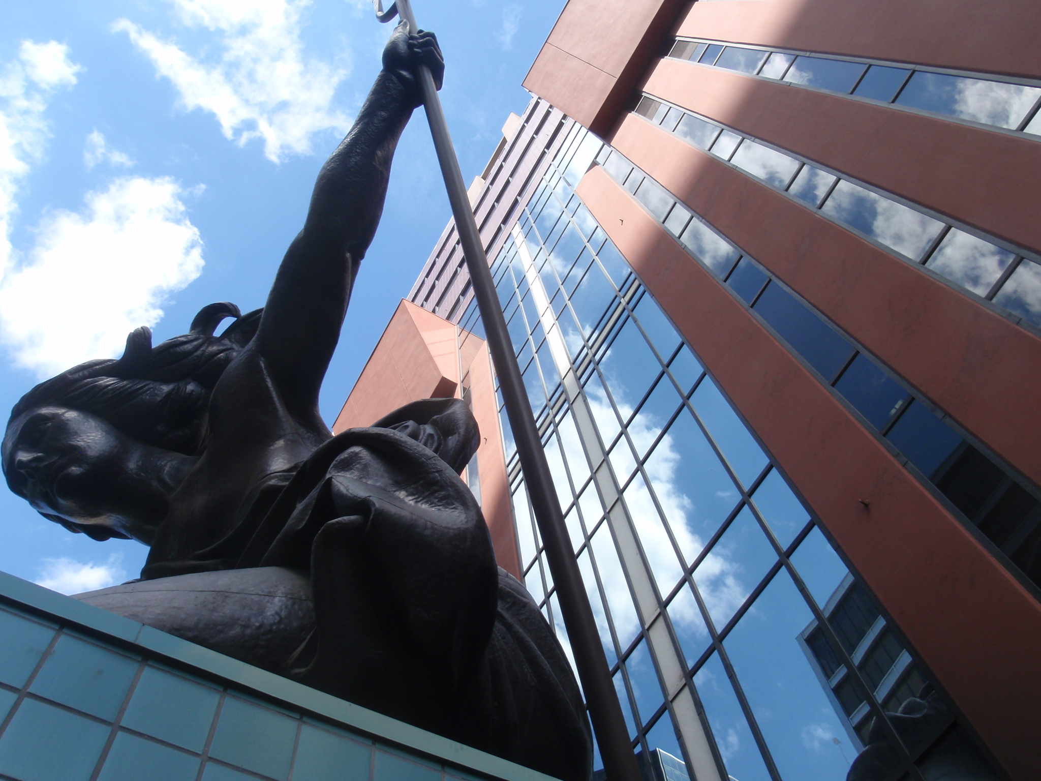
THE PORTLAND BUILDING
Portland Historic Landmarks Commission Briefing #1
November 26, 2012

Slide 2
Background
The City of Portland held a design competition in 1979 chaired by Philip Johnson.
The project was awarded to up and coming architect Michael Graves.
Graves final design was based on his conceptual ideas, energy codes of the time, and the City’s relatively low budget.
The project proceeded as an early example of a design build partnership between a project management firm, 2 architects, 2 contractors, and an engineer.
Changes to the design and construction occurred, some documented at the time and others discovered during various investigations over the past 30 years.
The building was officially listed on the National Register of Historic Places in 2011.
It is cited as nationally significant as a notable work by master architect Michael Graves and as an early and influential work of Post-Modern Classicism.
It is identified as “one of the first large-scale manifestations of a new architectural style coming on the heels of the Modern movement” qualifying for listing under special consideration for properties that have achieved significance in the past 50 years.
The Portland Building has suffered from chronic systemic water infiltration since shortly after its completion and been the subject of many studies and repair efforts over the past 30 years.

Slide 3
Modern / Post-Modern Era Construction
Approval Criteria
Consideration
Historic character. The historic character of the property will be retained and preserved. Removal of historic materials or alteration of features and spaces that contribute to the property's historic significance will be avoided;
Record of its time. The historic resource will remain a physical record of its time, place, and use. Changes that create a false sense of historic development, such as adding conjectural features or architectural elements from other buildings will be avoided;
Historic changes. Most properties change over time. Those changes that have acquired historic significance will be preserved;
The primary character-defining feature of Modern / Post-Modern architecture is often conceptual – the idea.
Same as traditional.
Same as traditional.

Slide 4
Modern / Post-Modern Era Construction
Approval Criteria
Consideration
Historic features. Generally, deteriorated historic features will be repaired rather than replaced. Where the severity of deterioration requires replacement, the new feature will match the old in design, color, texture, and other visual qualities and, where practical, in materials. Replacement of missing features must be substantiated by documentary, physical, or pictorial evidence;
Historic Materials. Historic materials will be protected. Chemical or physical treatments, such as sandblasting, that cause damage to historic materials will not be used;
Archaeological resources.
Differentiate new from old. New additions, exterior alterations, or related new construction will not destroy historic materials that characterize a property. New work will be differentiated from the old;
Predominant modern era materials are glass, metals, and mass-produced assemblies. A majority of these materials and assemblies have far shorter life expectancies than traditional materials and are not repairable in the traditional sense, especially complex assemblies. Many assemblies were in their infancy, often employing methods that were later improved or abandoned.
See Criteria 4 considerations. Same as traditional for chemical and physical treatments.
Same as traditional.
The primary CDF of Modern / Post-Modern architecture is often conceptual – the idea. See Criteria 8 considerations.

Slide 5
Modern / Post-Modern Era Construction
Approval Criteria
Consideration
Architectural compatibility. New additions, exterior alterations, or related new construction will be compatible with the resource's massing, size, scale, and architectural features. When retrofitting buildings or sites to improve accessibility for persons with disabilities, design solutions will not compromise the architectural integrity of the historic resource;
Preserve the form and integrity of historic resources. New additions and adjacent or related new construction will be undertaken in such a manner that if removed in the future, the essential form and integrity of the historic resource and its environment would be unimpaired;
Hierarchy of compatibility. Exterior alterations and additions will be designed to be compatible primarily with the original resource, secondarily with adjacent properties, and finally, if located within a Historic or Conservation District, with the rest of the district. Where practical, compatibility will be pursued on all three levels.
The original architect is most likely still practicing, as is the case with the Portland Building. Should the ability to consult the original designer on decisions about compatibility of alterations and/or design of additions be a consideration?
Same as traditional.
Same as traditional.

Slide 6
History of Repairs
Deficiencies
Repairs
Efflorescence at tile (ongoing since mid-1980’s)
Water leaks all types of window assemblies (ongoing since mid-1980’s)
Water leaks from various roofs
At tile: cleaning, mass re-grouting, parapet caps, repointing, select tile replacement, topical sealant
Gasket replacement, sealant reapplication, caulking, additional flashings
Replacement of roof assemblies including adding flashing and parapet caps

Slide 7
Studies
Repairs

Slide 8
Current Project
Goals
Status
Address water intrusion issues throughout envelope
Reduce air infiltration and increase energy efficiency at glazing assemblies
Address efflorescence in tile grout joints
Repair damaged interior finishes
Full structural evaluation
Preliminary investigations of the building envelope completed
Analysis of data collected in progress
Formulation of possible solutions in progress
Structural evaluation in progress

Slide 9
Findings To Date
Condition Assessment of Assemblies & Materials
Tile
Ribbon Windows
Curtain Wall
Punched Windows
Storefront
Concrete
Stucco

Slide 10
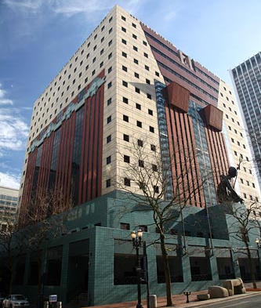
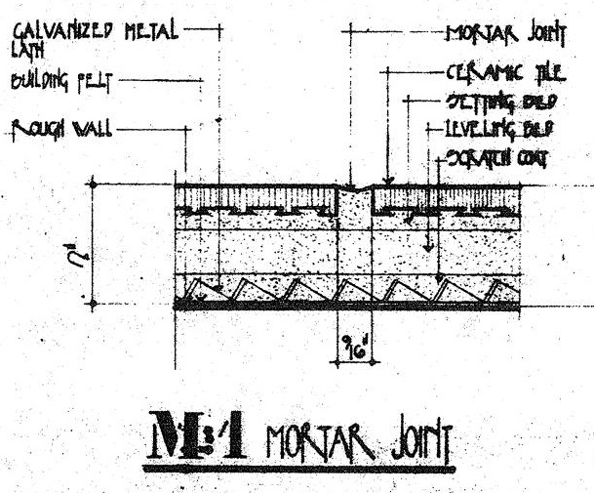
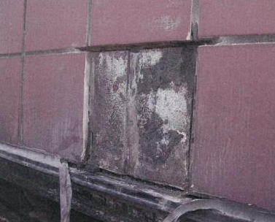
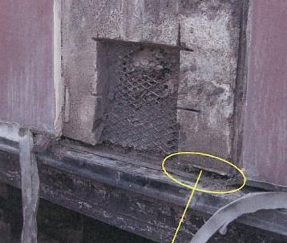
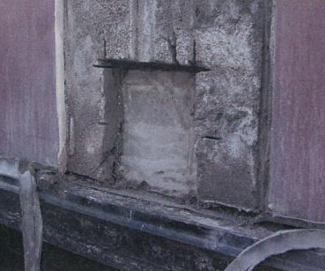
Assemblies & Materials Tile
Direct Adhered Ceramic Tile Veneer System
Important facts
Life expectancy
Design/build inconsistencies
Emery Roth and Sons Drawing 1981
Forensic Waterproofing Study 2006

Slide 11
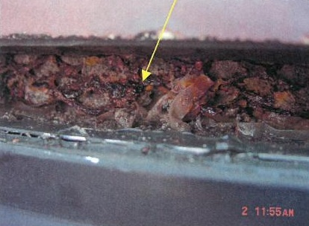
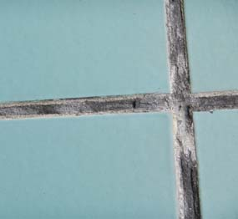
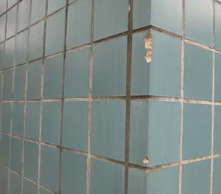
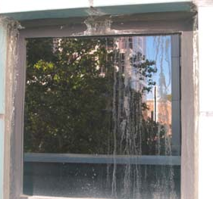
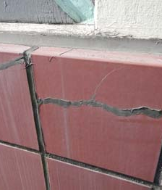
Assemblies & Materials Tile
Overall Condition
Forensic Waterproofing Study 2006

Slide 12
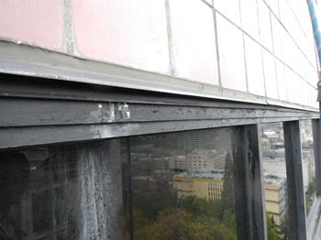
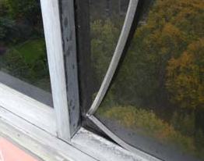
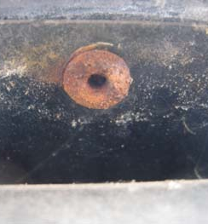
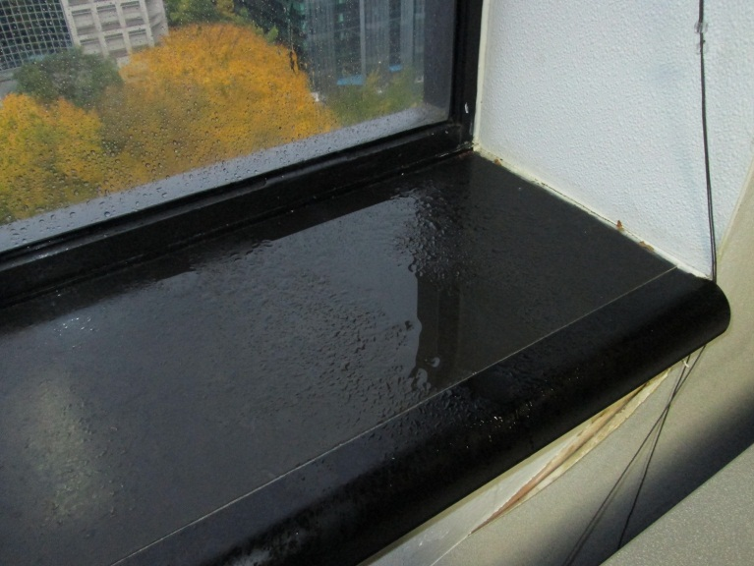
Assemblies & Materials Ribbon Windows
Aluminum Storefront Assembly
Important facts
Life expectancy
Design/build inconsistencies
Overall Condition

Slide 13
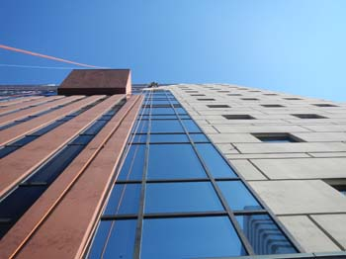
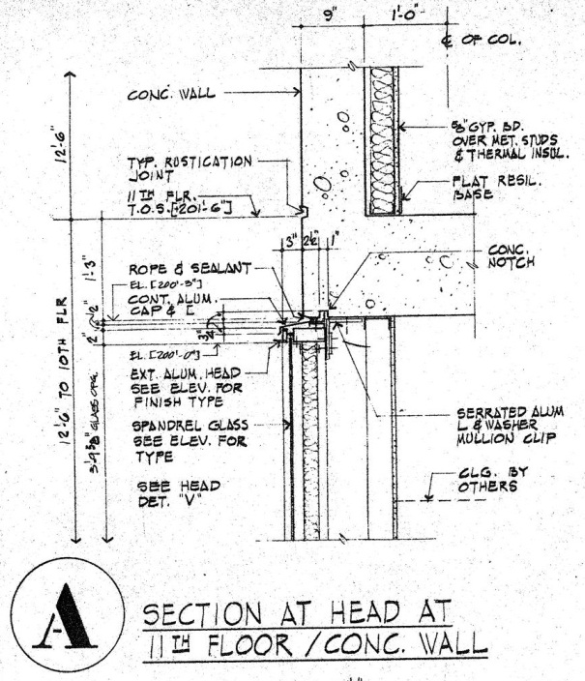
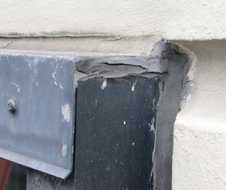
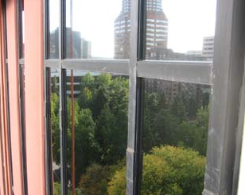
Assemblies & Materials Curtain Wall
Stick-Built, Pressure Glazed Aluminum Curtain Wall Assembly
Important facts
Life expectancy
Design/build inconsistencies
Emery Roth and Sons Drawing 1981

Slide 14
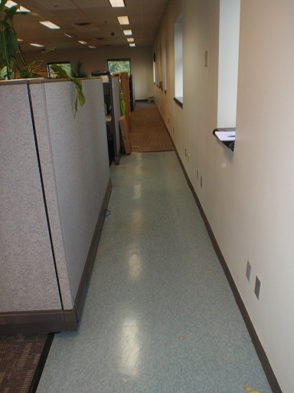
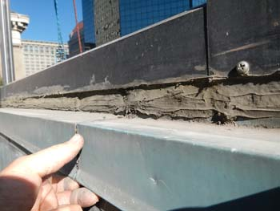
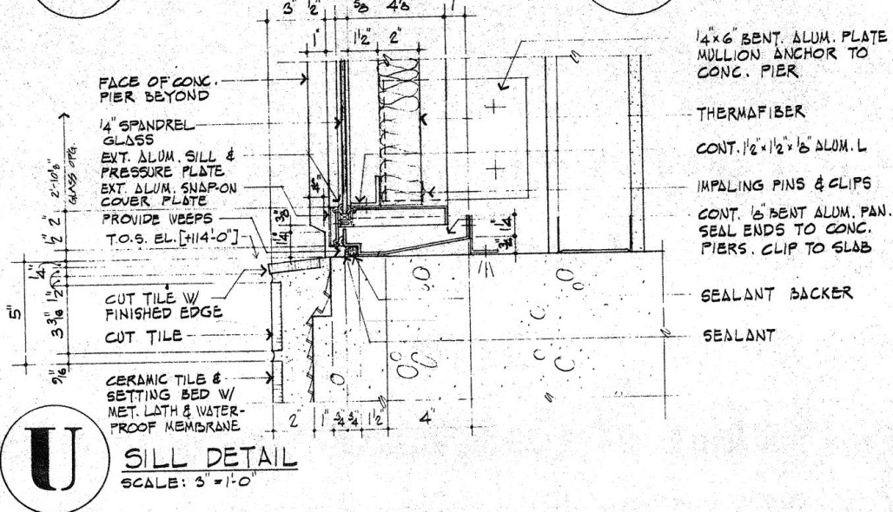
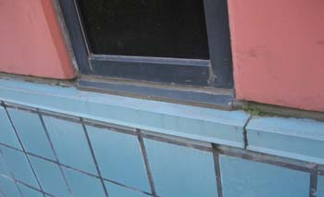
Assemblies & Materials Curtain Wall
Stick-Built, Pressure Glazed Aluminum Curtain Wall Assembly
Important facts
Life expectancy
Design/build inconsistencies
Emery Roth and Sons Drawing 1981

Slide 15
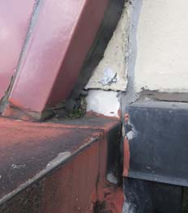
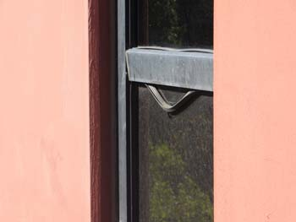
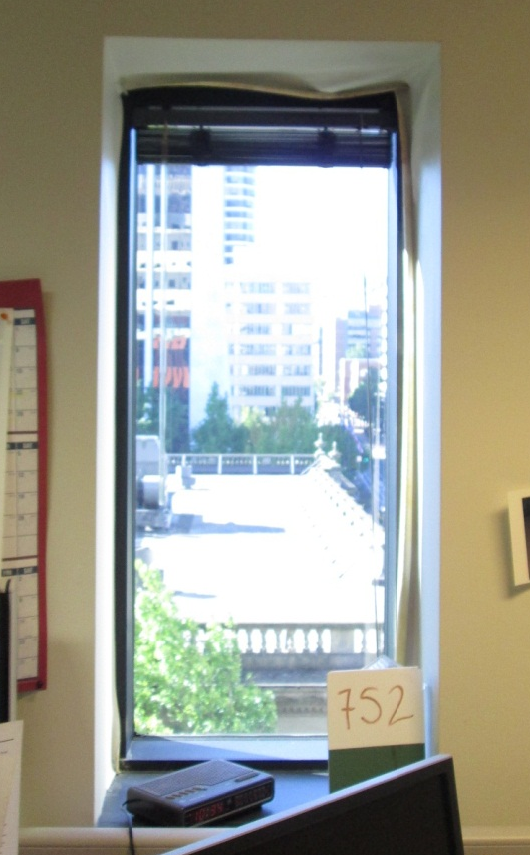
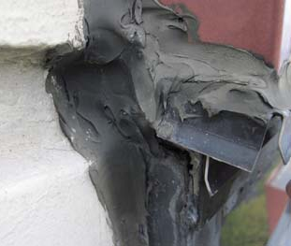
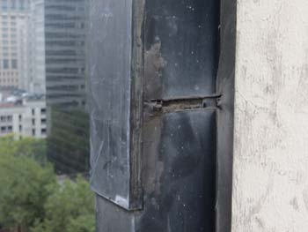
Assemblies & Materials Curtain Wall
Overall Condition

Slide 16
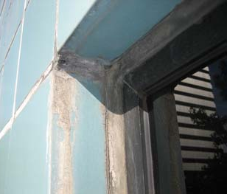
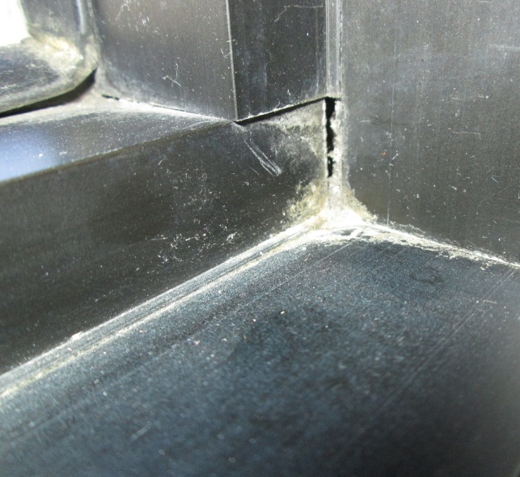
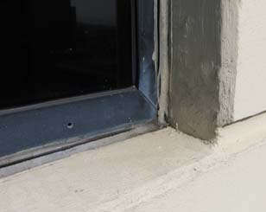
Assemblies & Materials Punched Windows
Field Assembled, Fixed Aluminum Window Units
Important facts
Life expectancy
Design/build inconsistencies
Overall Condition
Emery Roth and Sons Drawing 1981

Slide 17
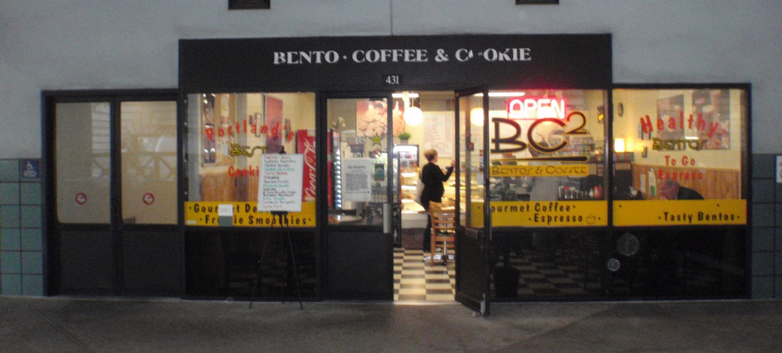
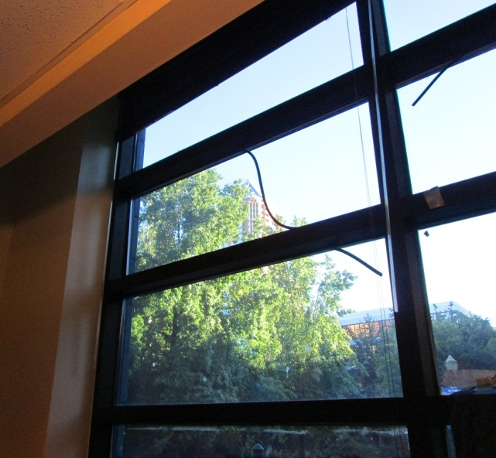
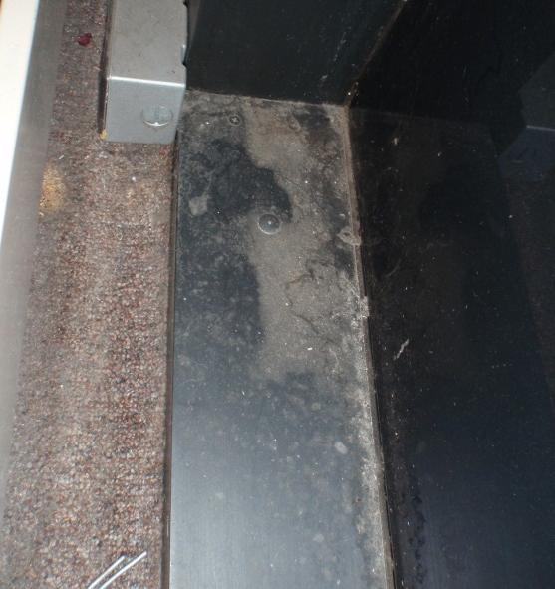
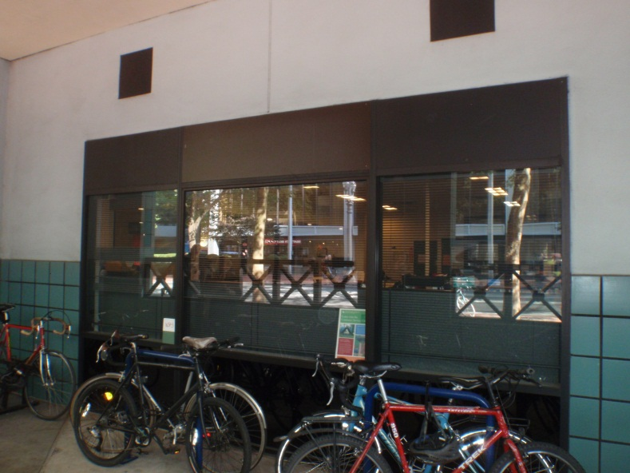
Assemblies & Materials Storefront
Aluminum Storefront Assembly at Ground Level Retail Spaces
Important facts
Life expectancy
Design/build inconsistencies
Overall Condition

Slide 18
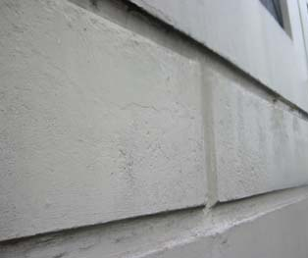
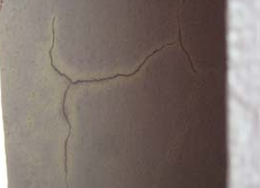
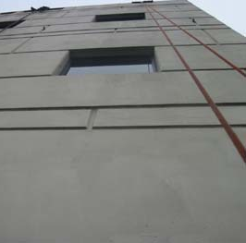
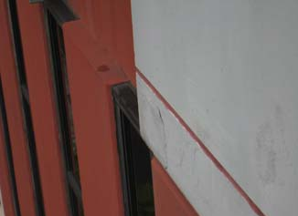
Assemblies & Materials Concrete
Poured-in-place Concrete w/ Elastomeric Coating at Exposed Concrete Surfaces
Important facts
Life expectancy
Design/build inconsistencies
Overall Condition

Slide 19
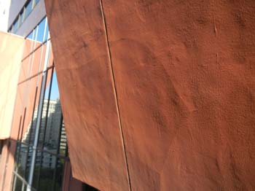
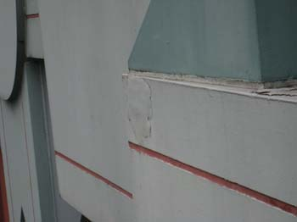
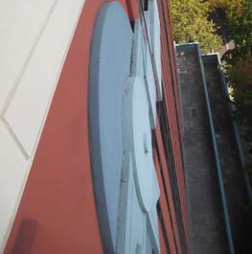
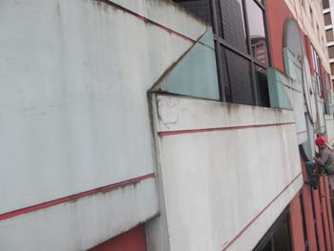
Assemblies & Materials Stucco
Stucco Finish System over Lightweight Metal Framing
Important facts
Life expectancy
Design/build inconsistencies
Overall Condition

Slide 20
Treatment Approaches
Approach A – Required
Stabilization and repairs to arrest current water infiltration and/or correct current deficiencies. Does not address the root causes or represent a long-term solution.
Approach B – Preferred
Holistic approach to address systemic deficiencies and failures that have led to chronic water infiltration and deterioration with the intent of addressing root causes and providing long-term results.
Approach C – Improvements
Upgrades that can be incorporated in addition to Option B with the intent of further improving the quality of the interior environment and/or building efficiency and maintenance.

Slide 21
Next Steps
Collect feedback from Landmarks Commission
Complete destructive envelope investigation at interior
Analyze conditions and formulate potential recommendations for treatment in draft report
Complete structural analysis
Return to Landmarks Commission for follow-up briefing with analysis of findings, structural strategies and preliminary recommendations
Submit finalized report to City of Portland

