Slide 1
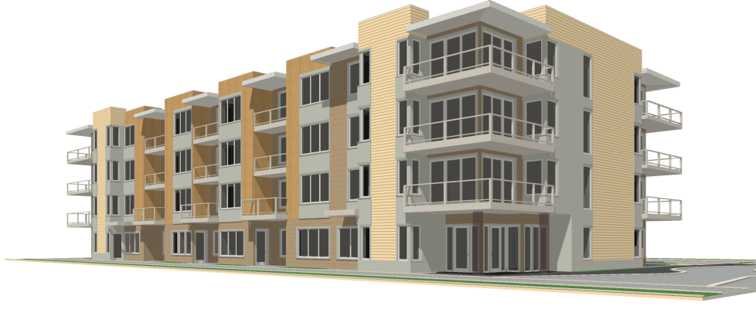

Slide 2
Context, Changes, Improvements & Clarifications
Environmental Context
Neighborhood Context and Compatibility
Architectural Compatibility & Style
Master Plan / Site Plan
Courtyards / Entries
Sidewalks
Architectural Design, Dimensions, Simplification
Materials & Fasteners
Trash & Recycling
HVAC / Eco Roofs
11
Notes:
Page 10

Slide 3
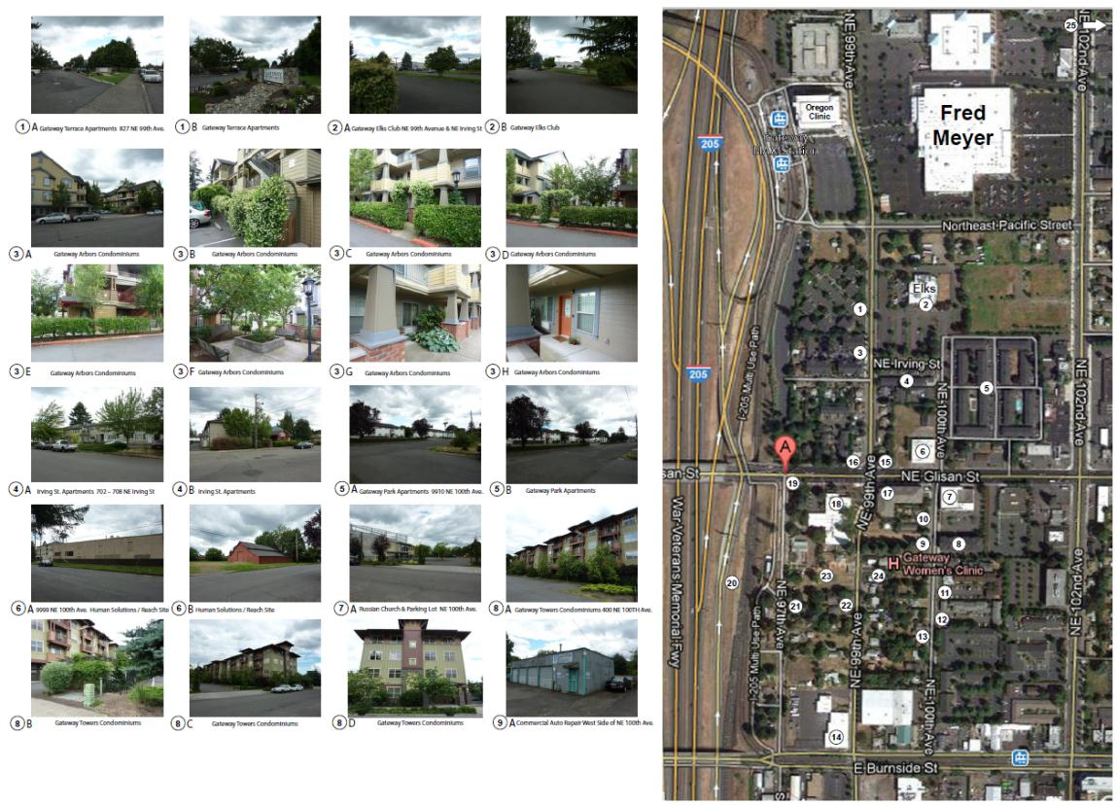

Slide 4
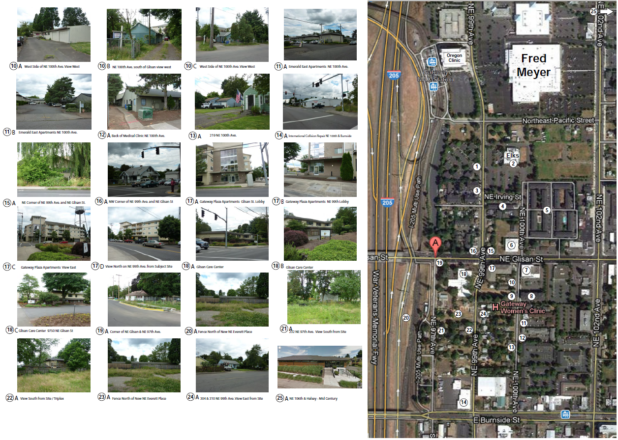

Slide 5
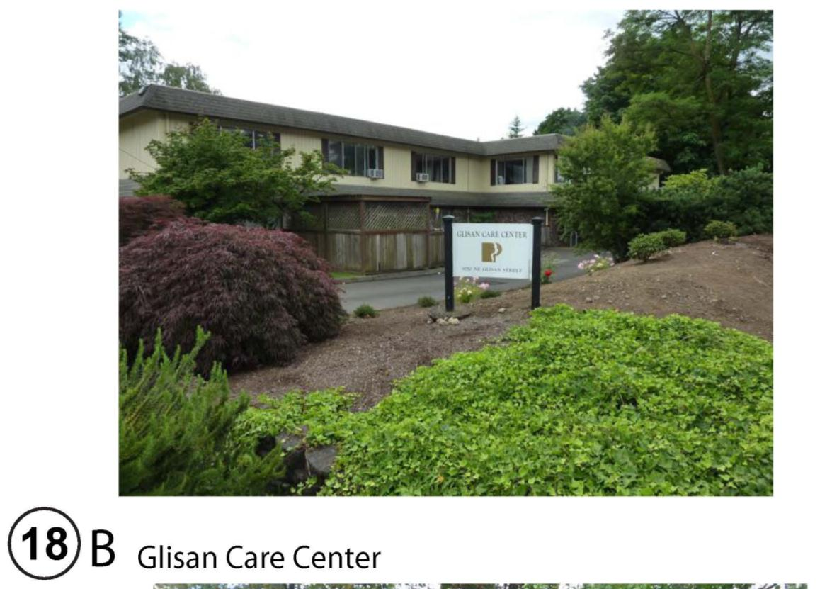

Slide 6
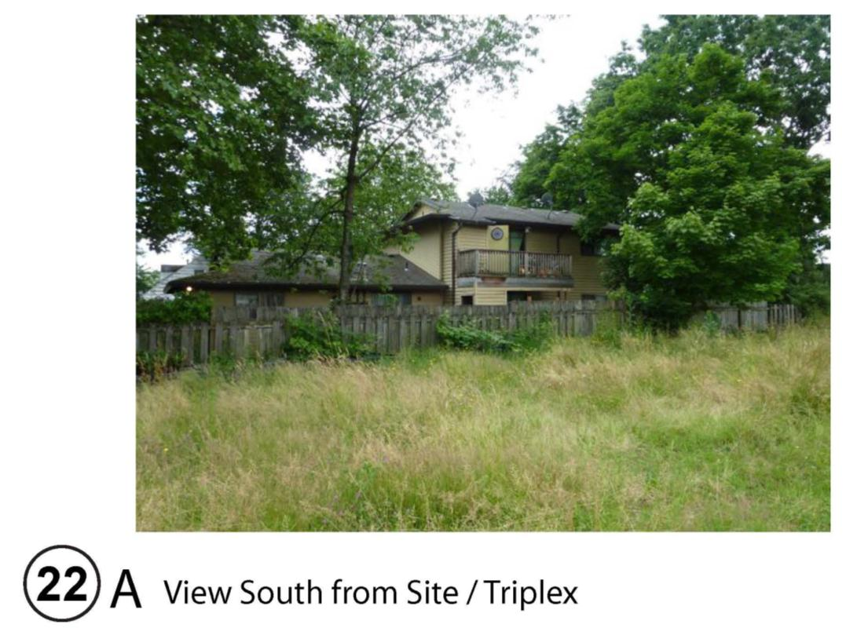

Slide 7
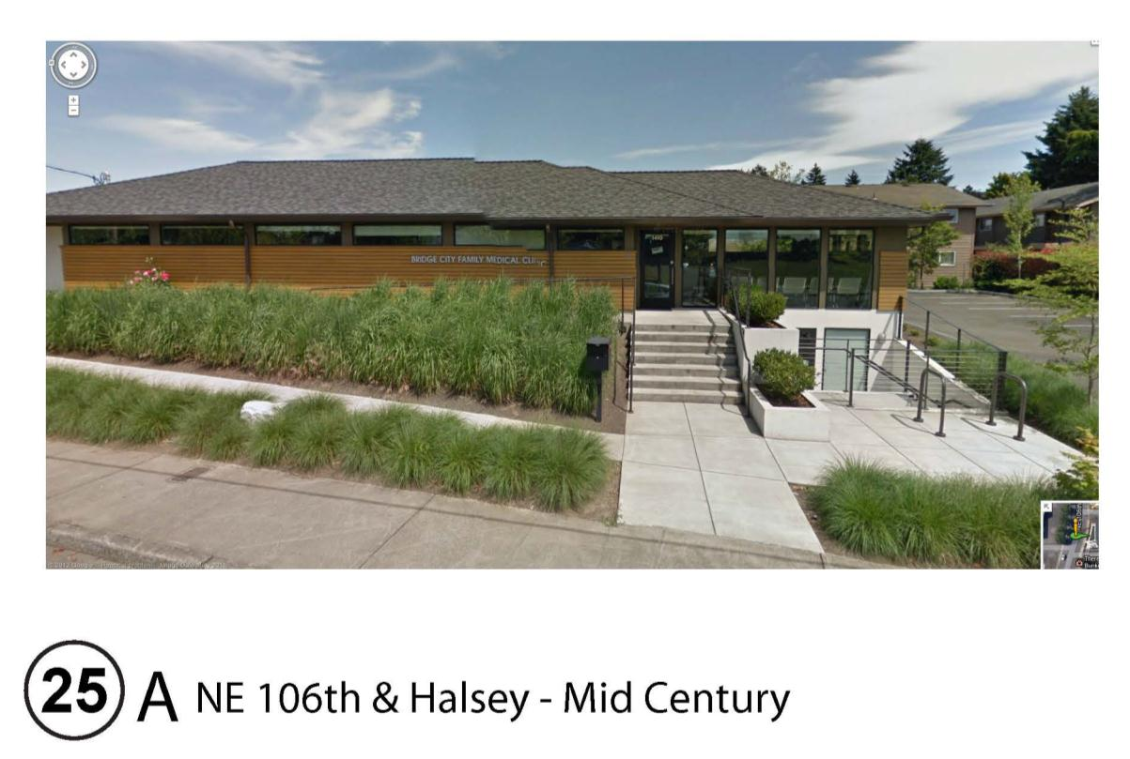

Slide 8
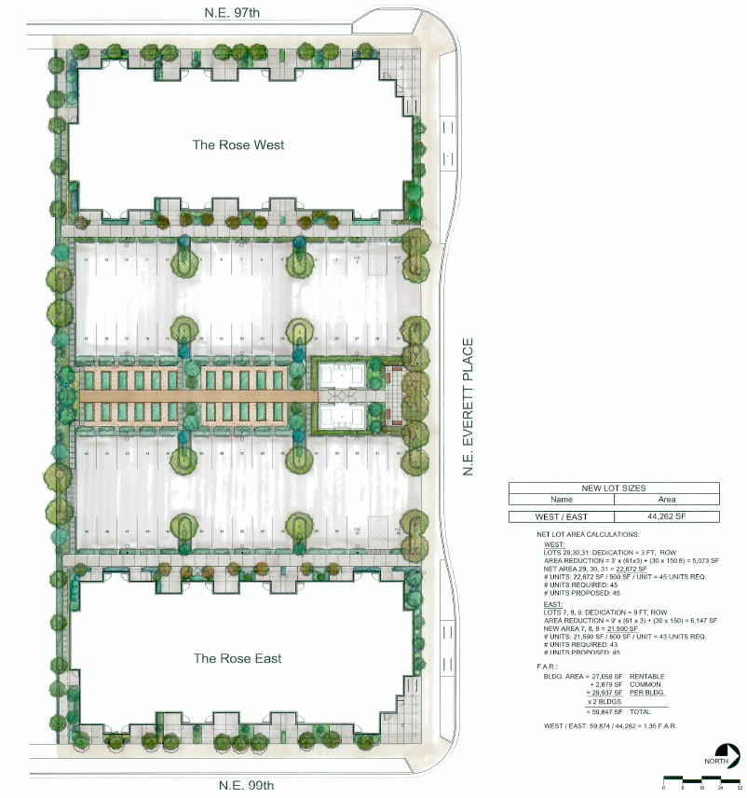

Slide 9
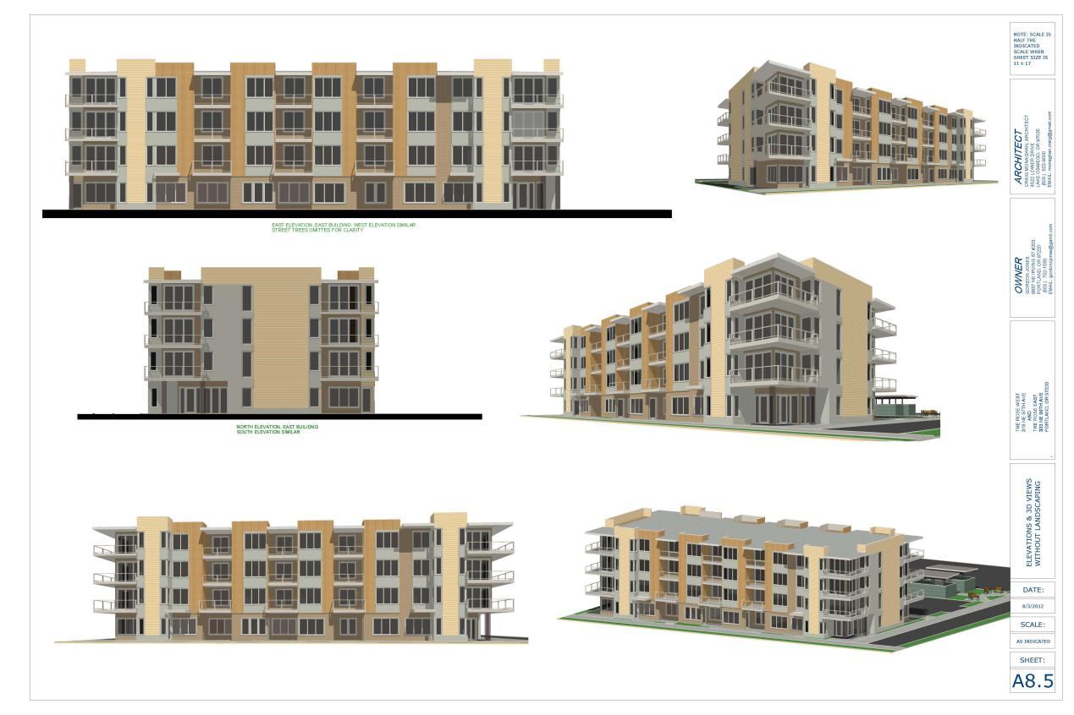

Slide 10
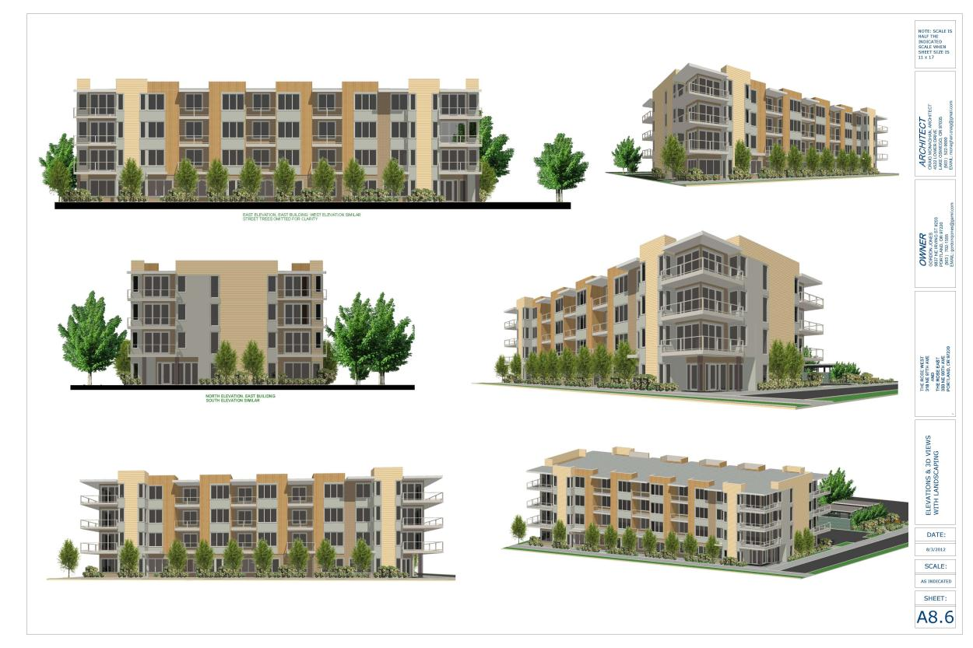

Slide 11
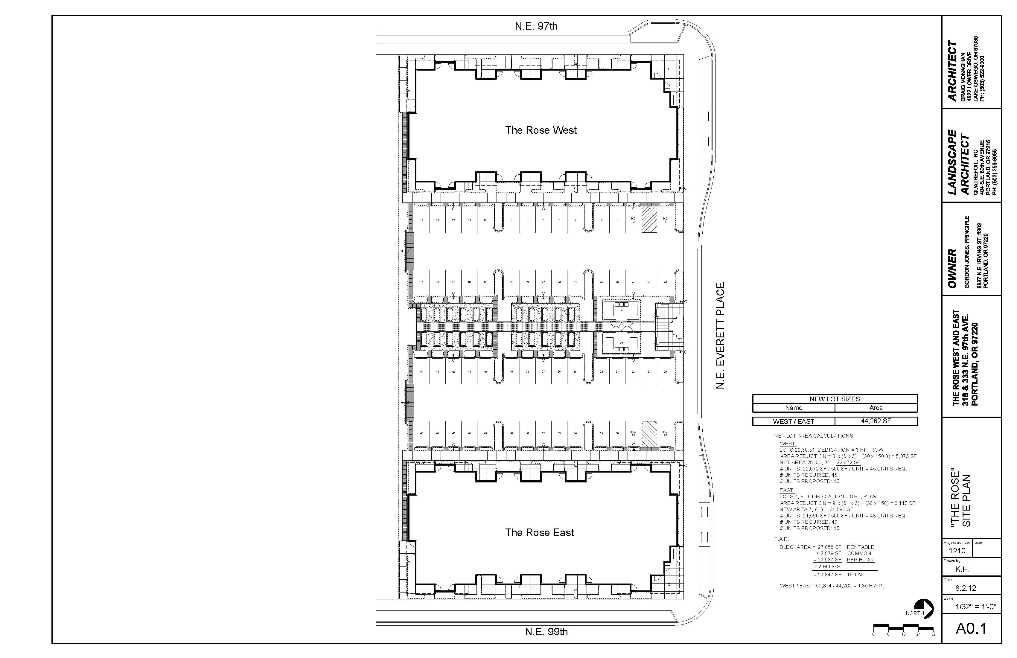

Slide 12
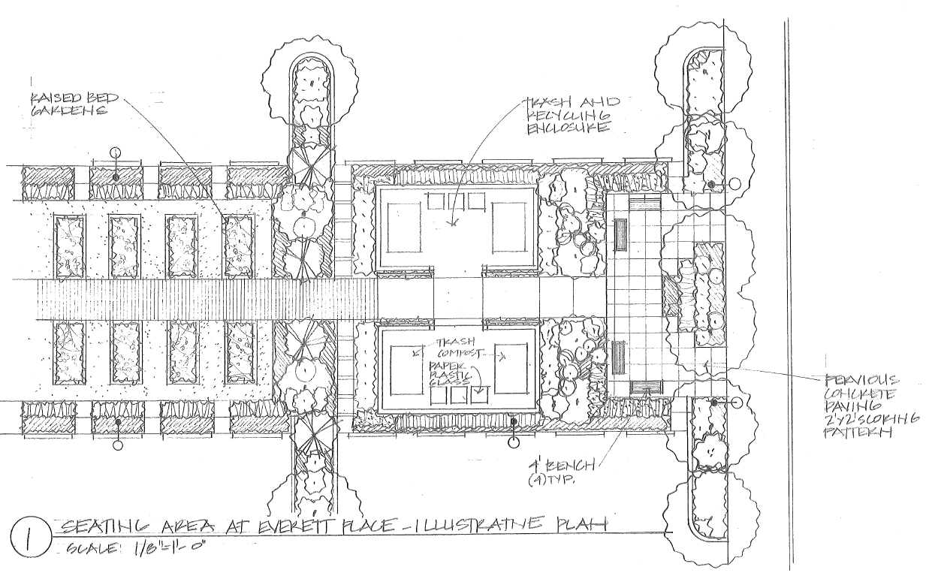
Notes:
L0.7

Slide 13
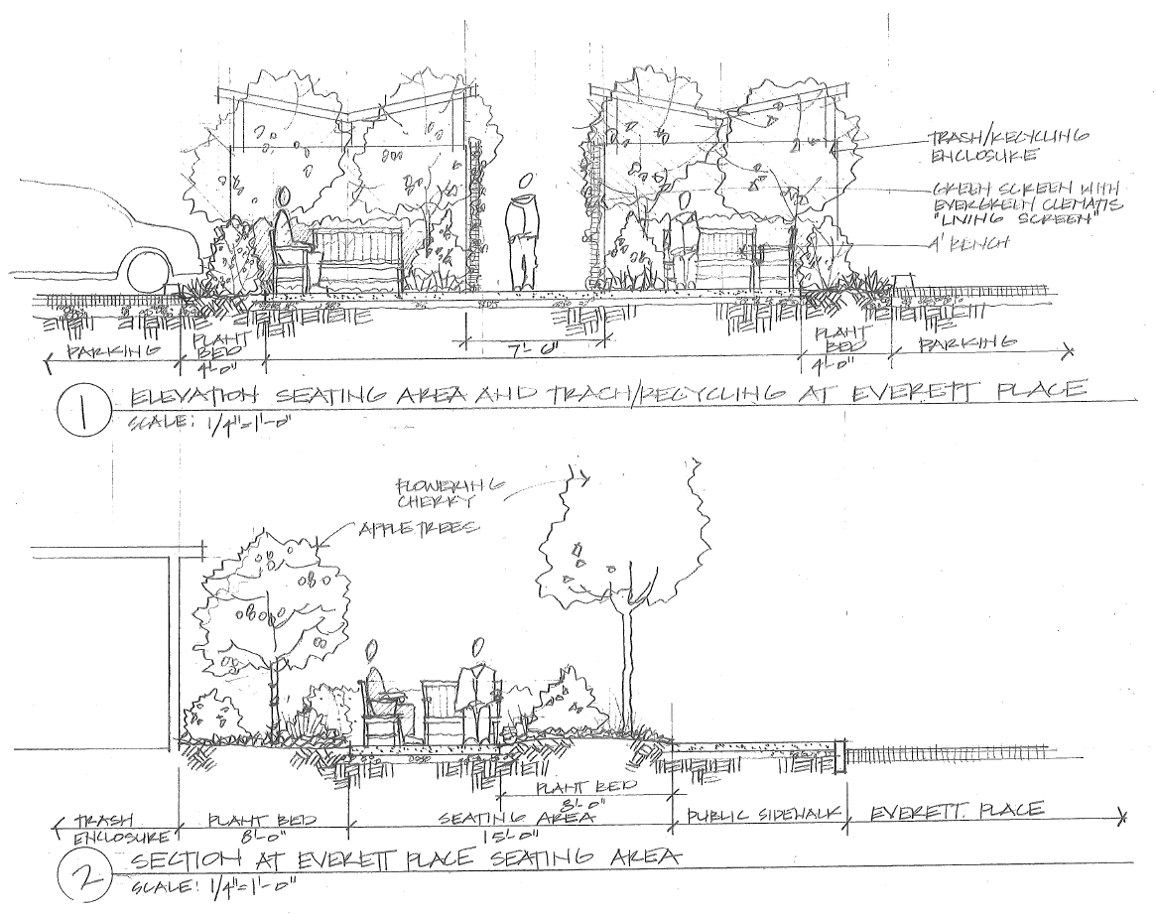
Notes:
L0.6

Slide 14
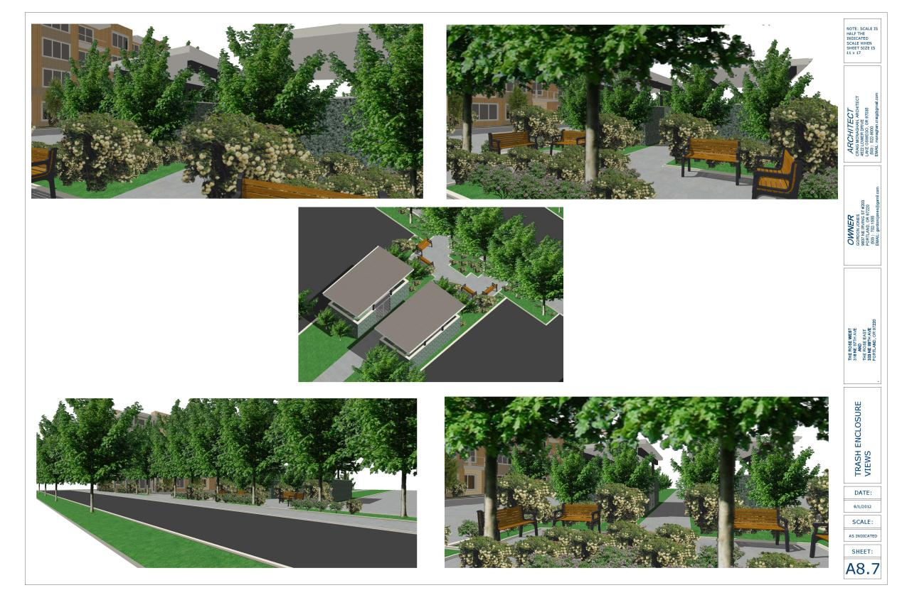

Slide 15
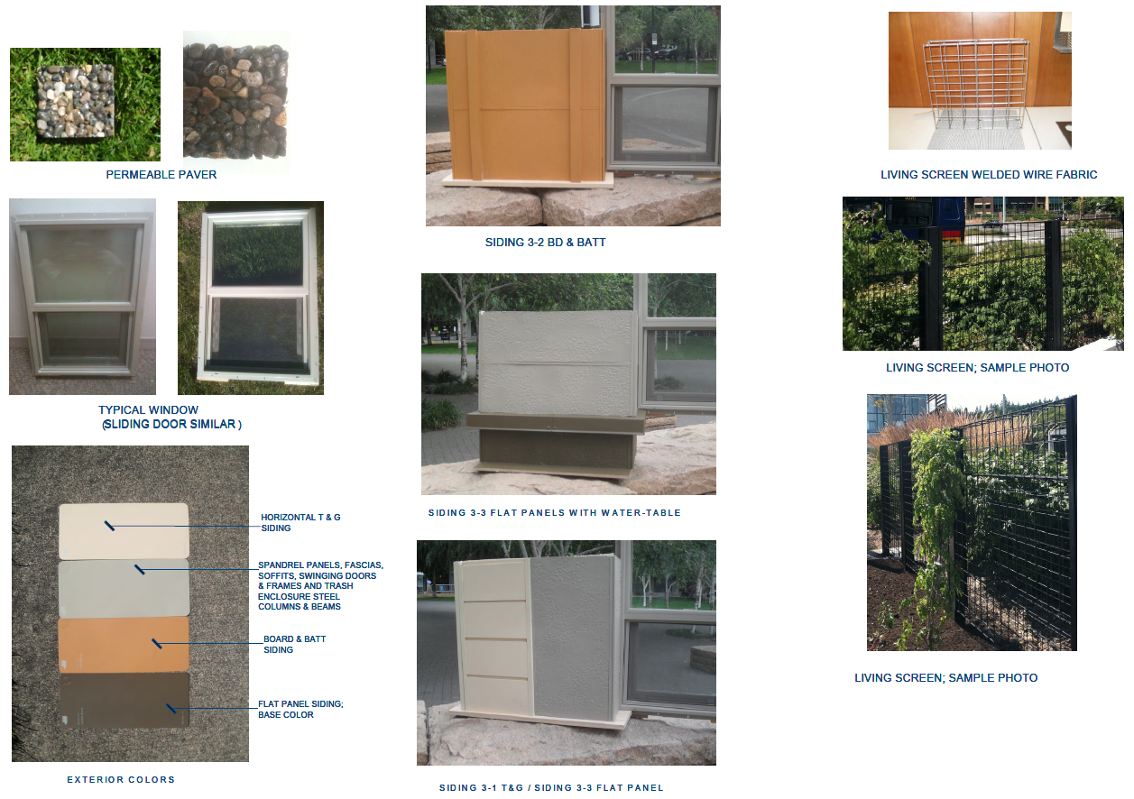
Notes:
A7.1

Slide 17
APPENDIX

Slide 18
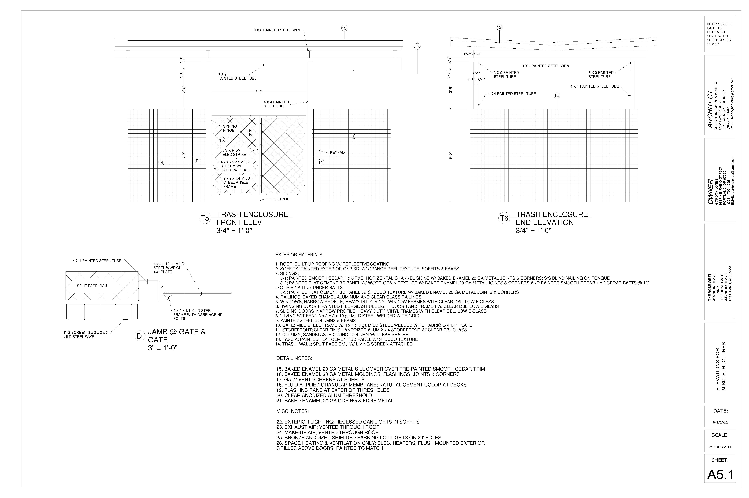

Slide 19
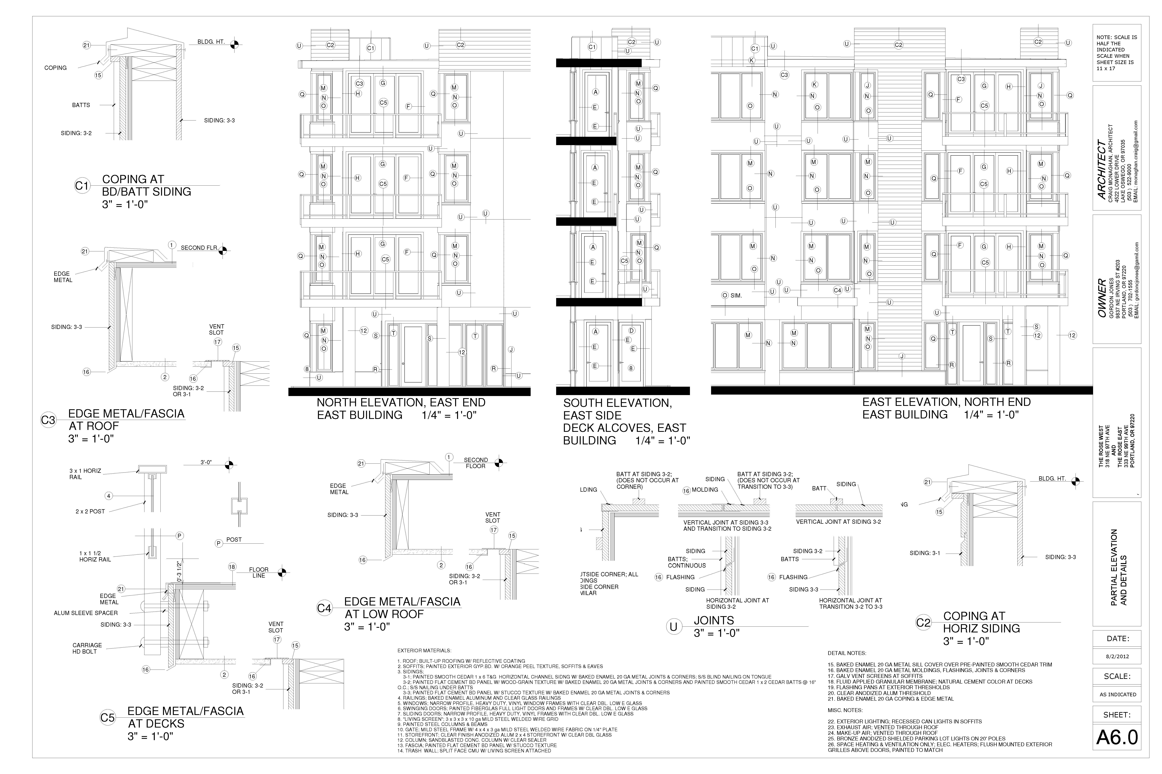
Notes:
A6.0

Slide 20
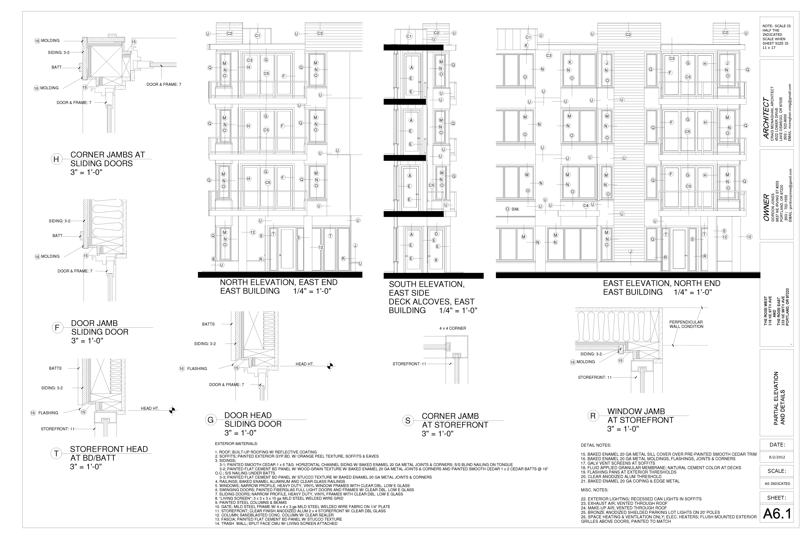
Notes:
A6.1

Slide 21
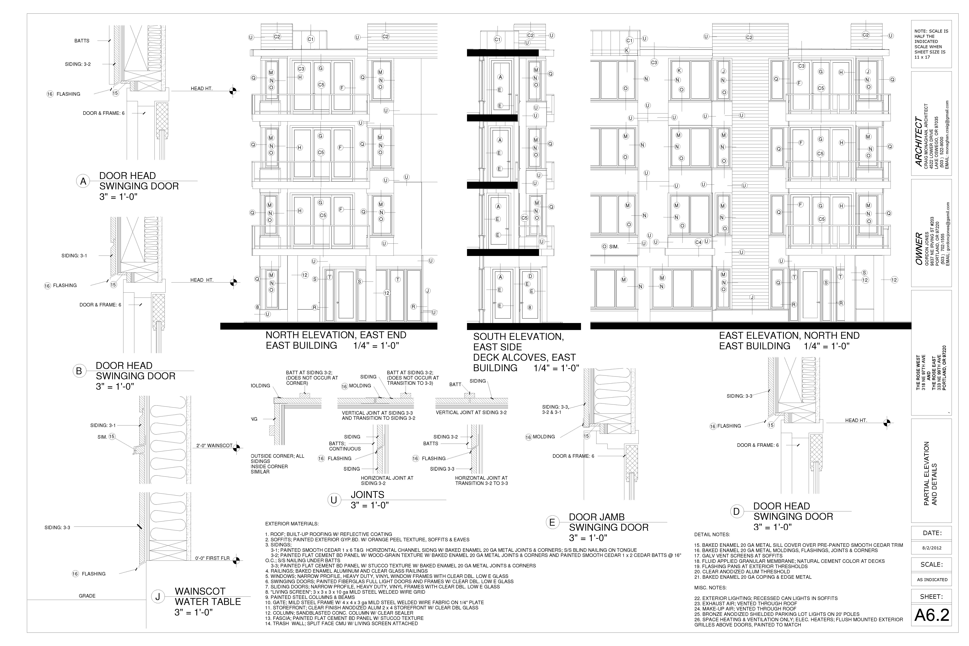
Notes:
A6.2

Slide 22
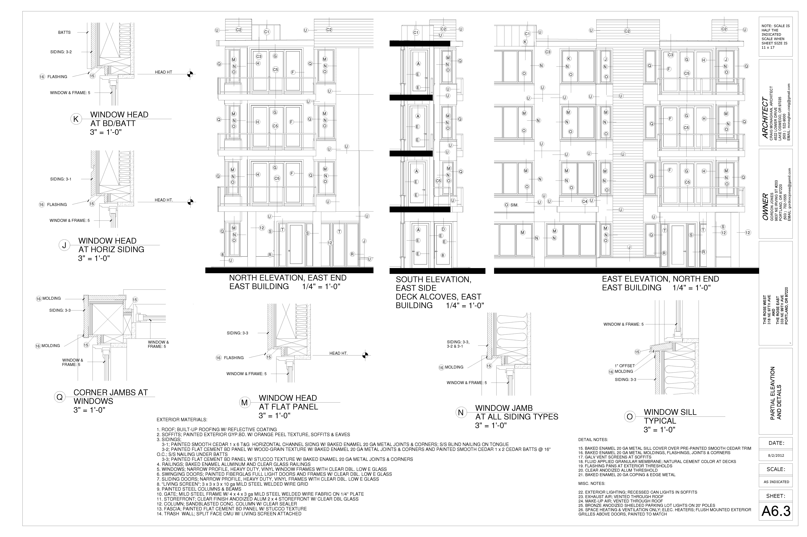
Notes:
A6.3

Slide 23
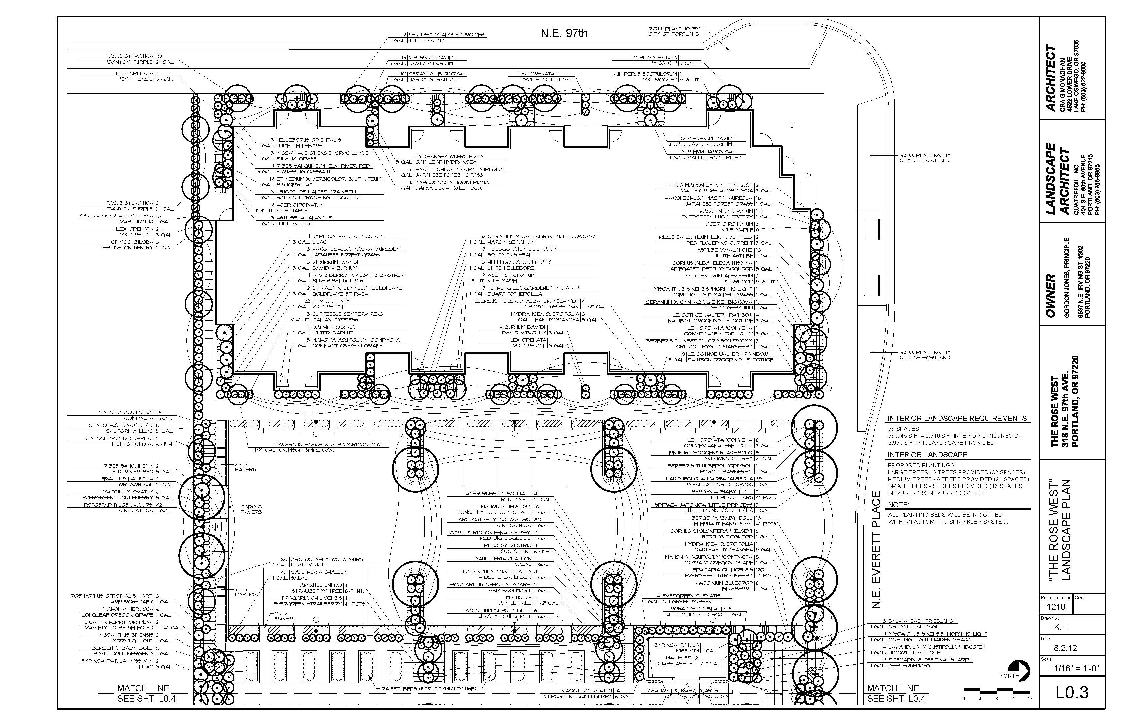

Slide 24
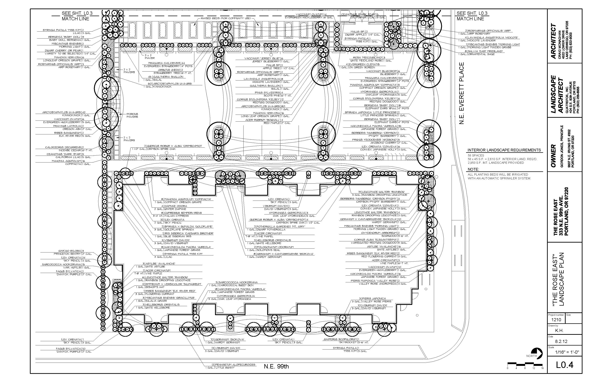

Slide 25
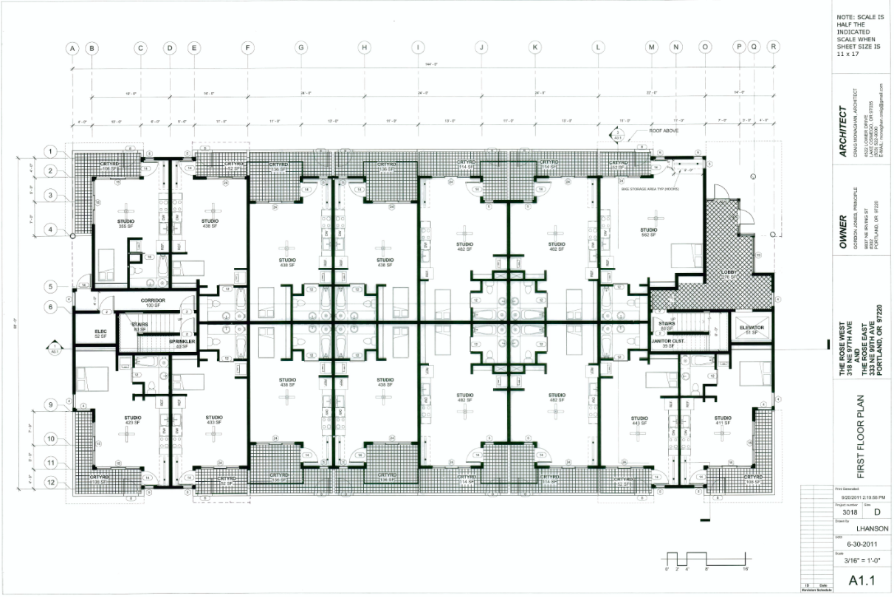
Notes:
Page 8

Slide 26
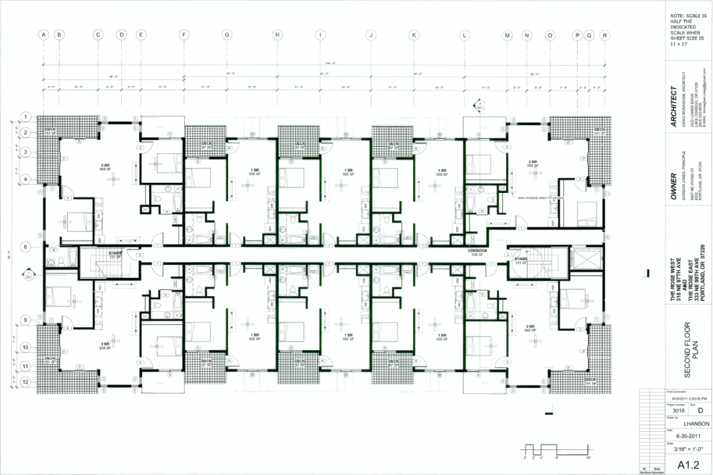
Notes:
Page 9

Slide 27
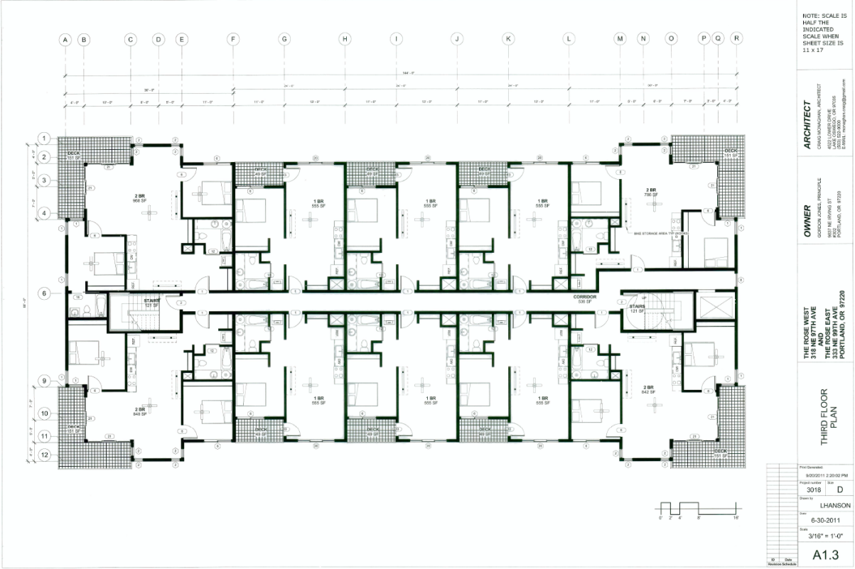
Notes:
Page 10

Slide 28
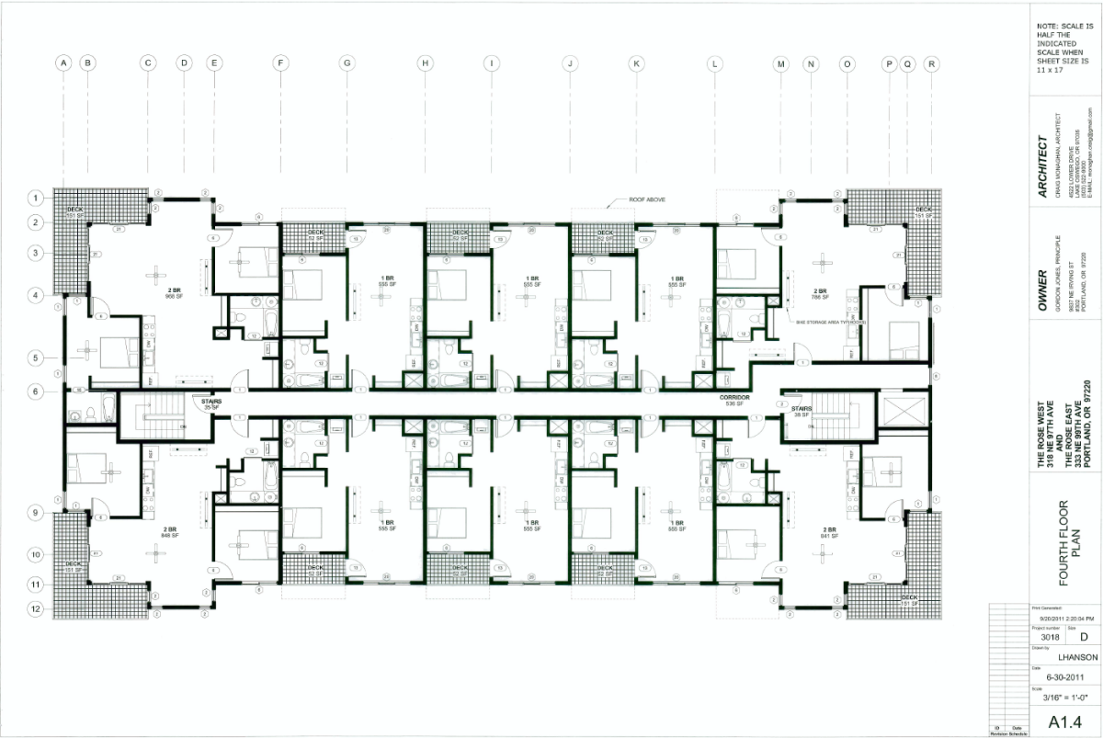
Notes:
Page 11

Slide 29
