Slide 1





Community Meetings
January 6
&
January 8, 2011

Slide 2
AGENDA
Welcome
Setting the Stage
Programs and Building
Project Costs and Sources
Operations
Good Neighbor Agreement
Timeline, Next Steps

Slide 3
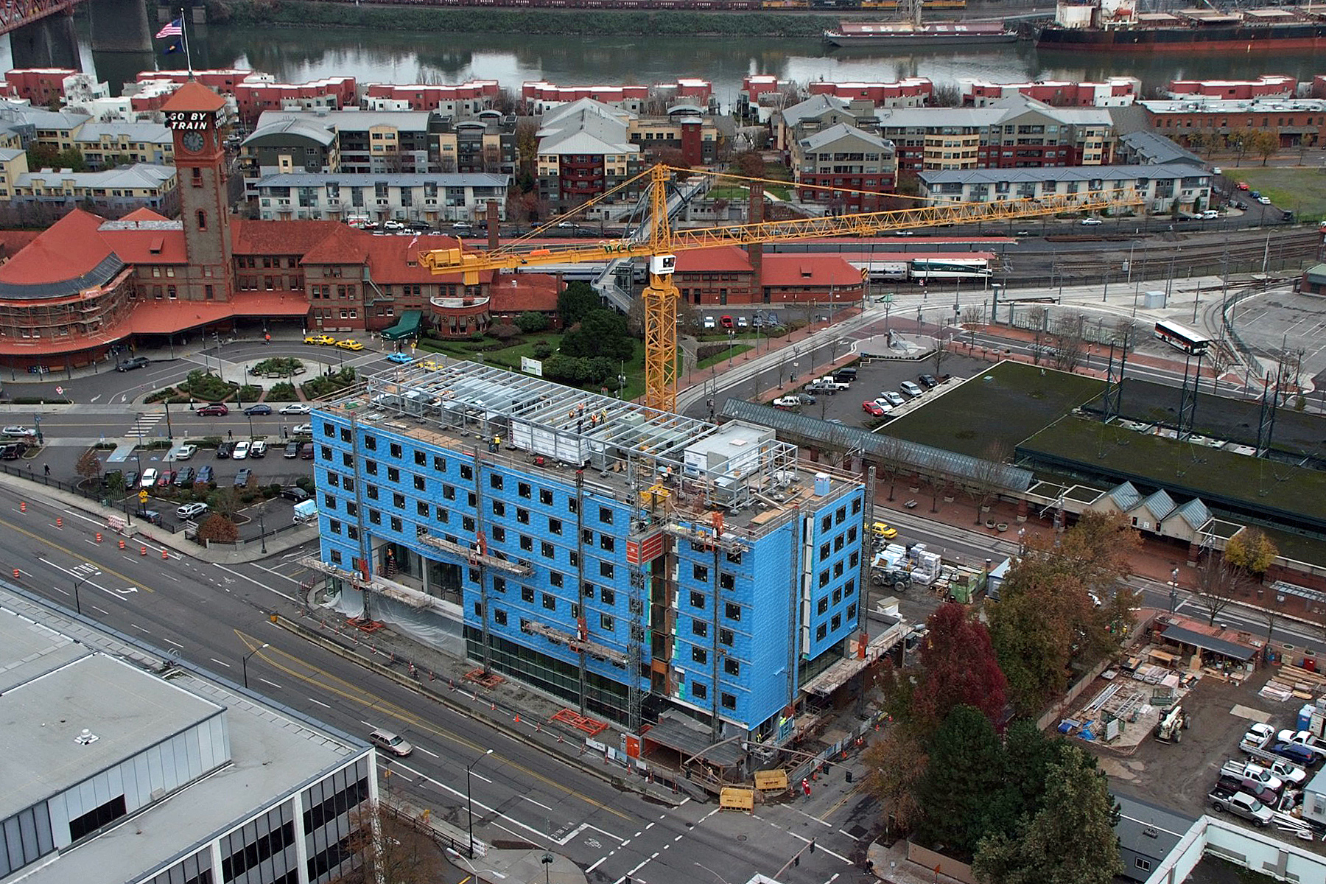
“Block U”… bordered by Broadway and Sixth (light rail), Irving and Hoyt

Slide 4
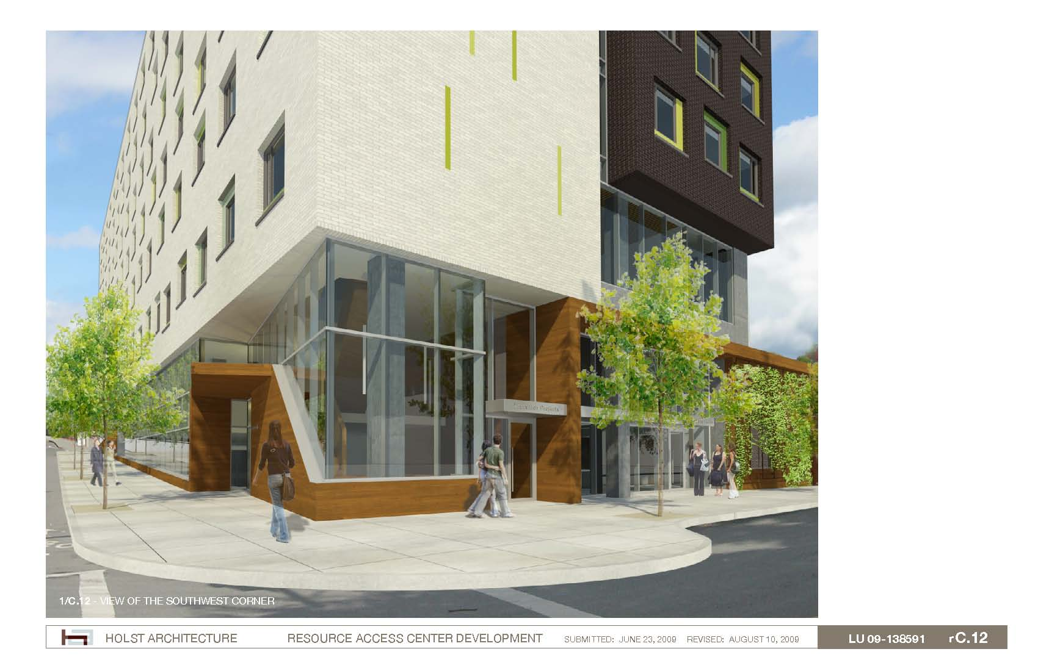
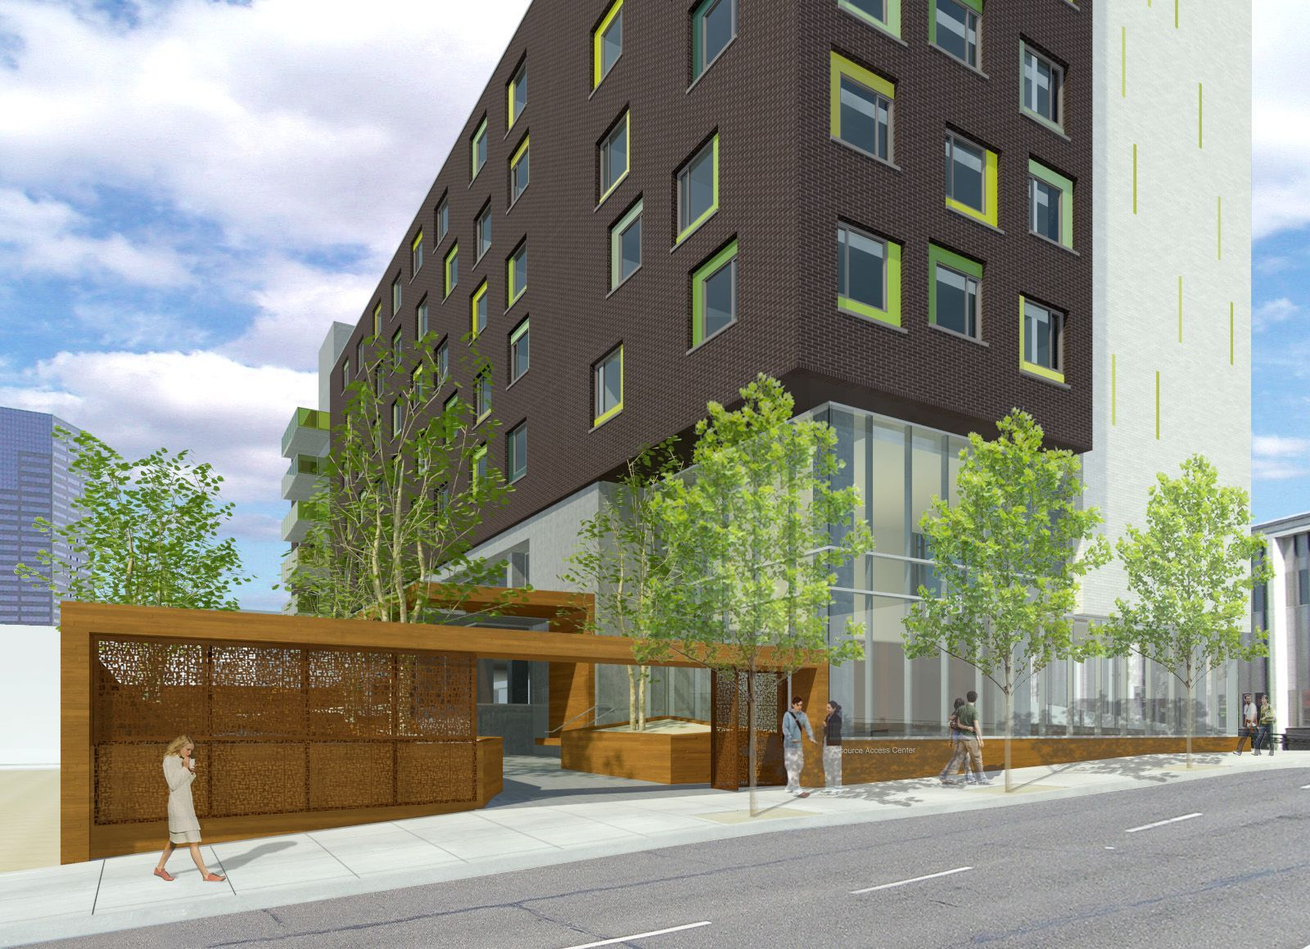
Three programs coordinated in one facility
Day Center with basic services and space for community partner services (VA, mental health, etc.)
Permanent Supportive Housing 130 studio apartments for medically vulnerable homeless people
Shelter for 90 men (replaces existing TPI Glisan Street shelter)
Notes:
Mike

Slide 5
Building Layout by Program

Slide 6
Green Building Systems

Slide 7
On-Going Sustainability
Heat recovery
CO2 sensors
High efficiency boiler
Wall insulation
Improved glazing
Reduced infiltration
Solar panels
Grey water collection

Slide 8
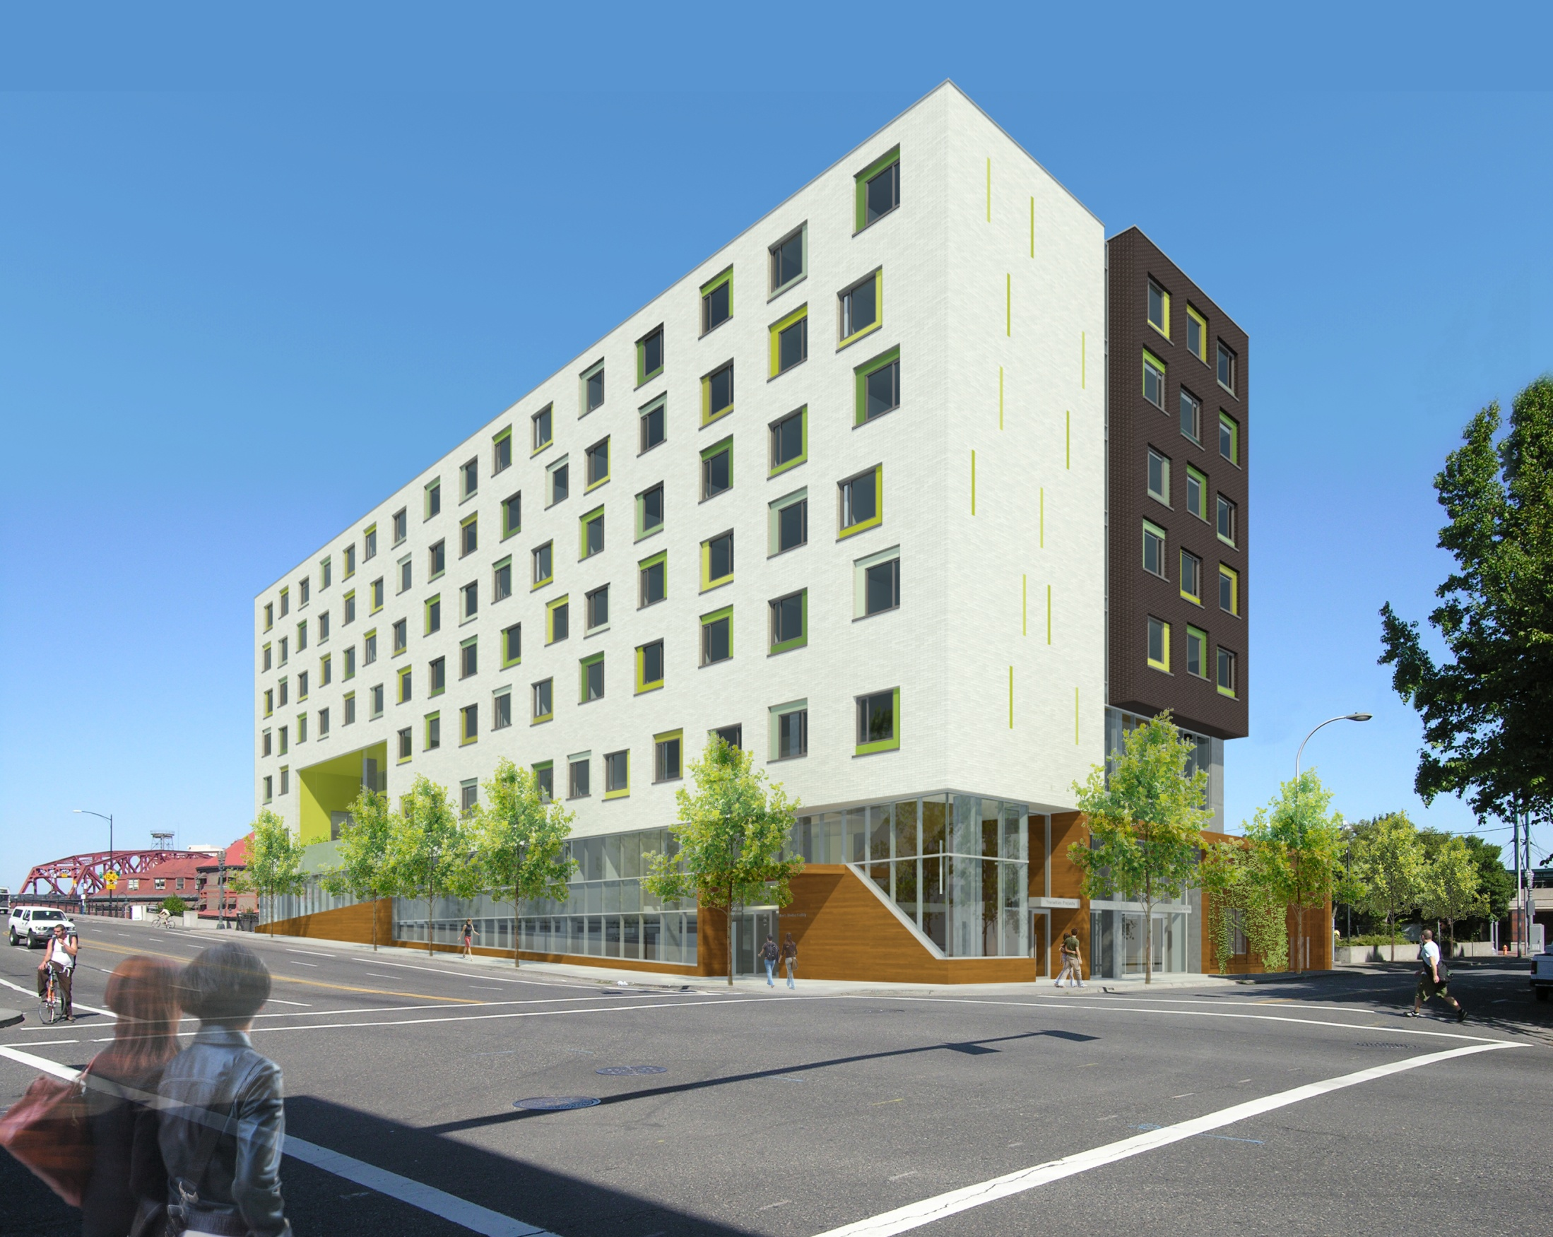
Notes:
8
BUILDING- APRIL BERG

Slide 9

Notes:
9
APRIL

Slide 10
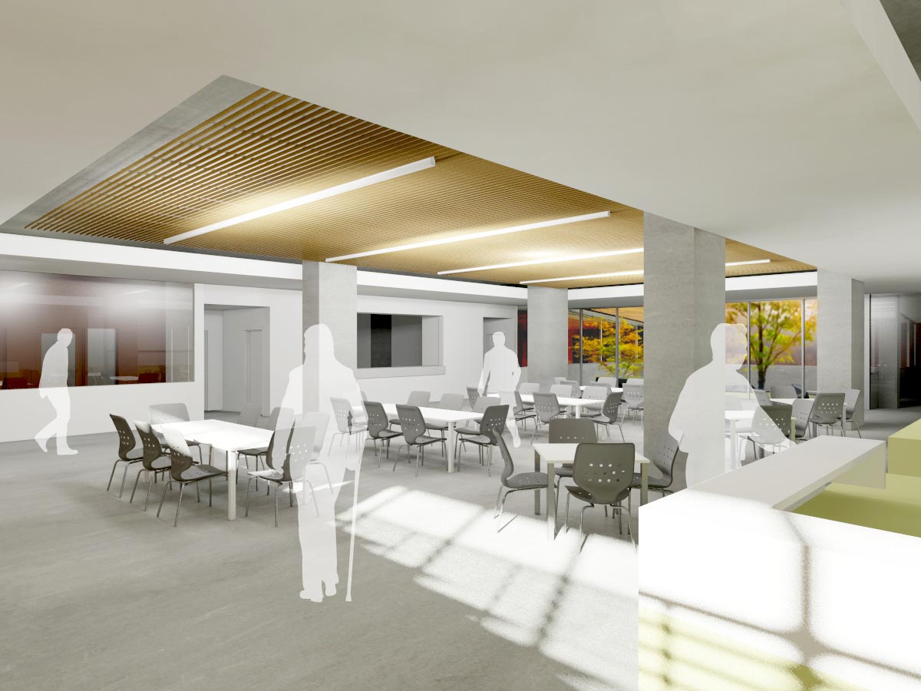
Notes:
APRIL

Slide 11
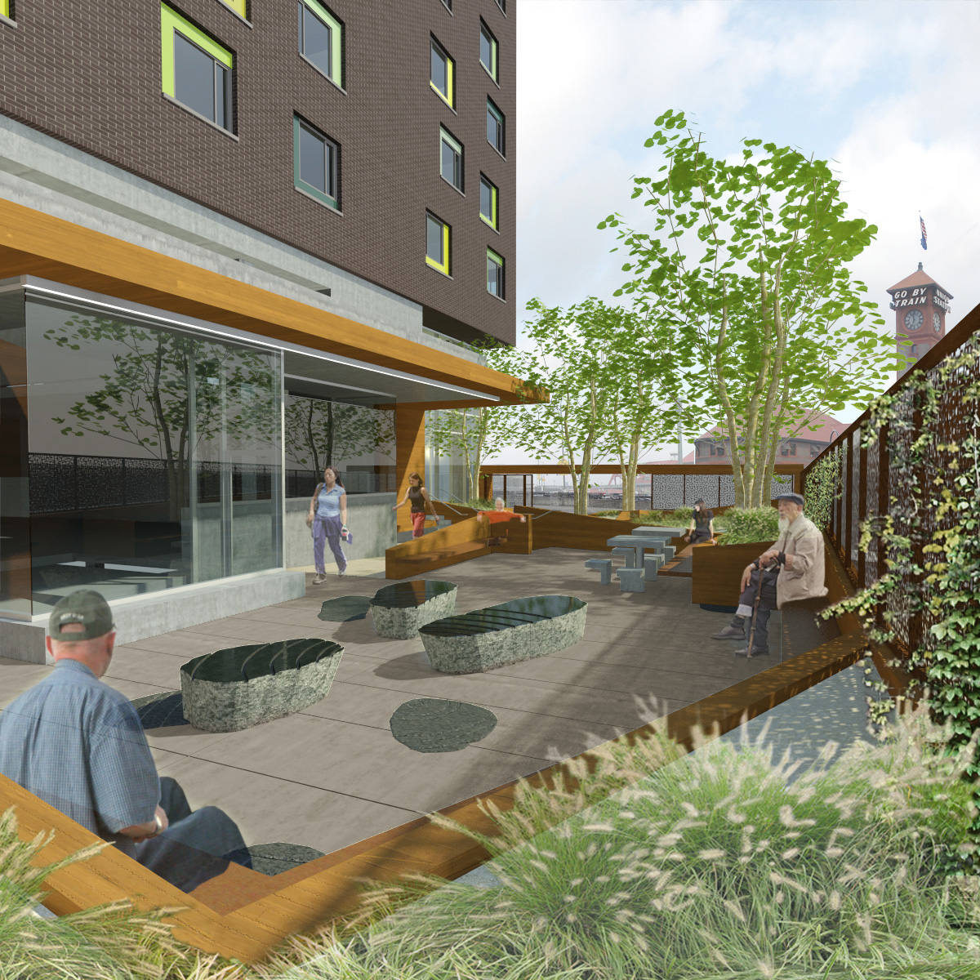
Notes:
11
APRIL

Slide 12
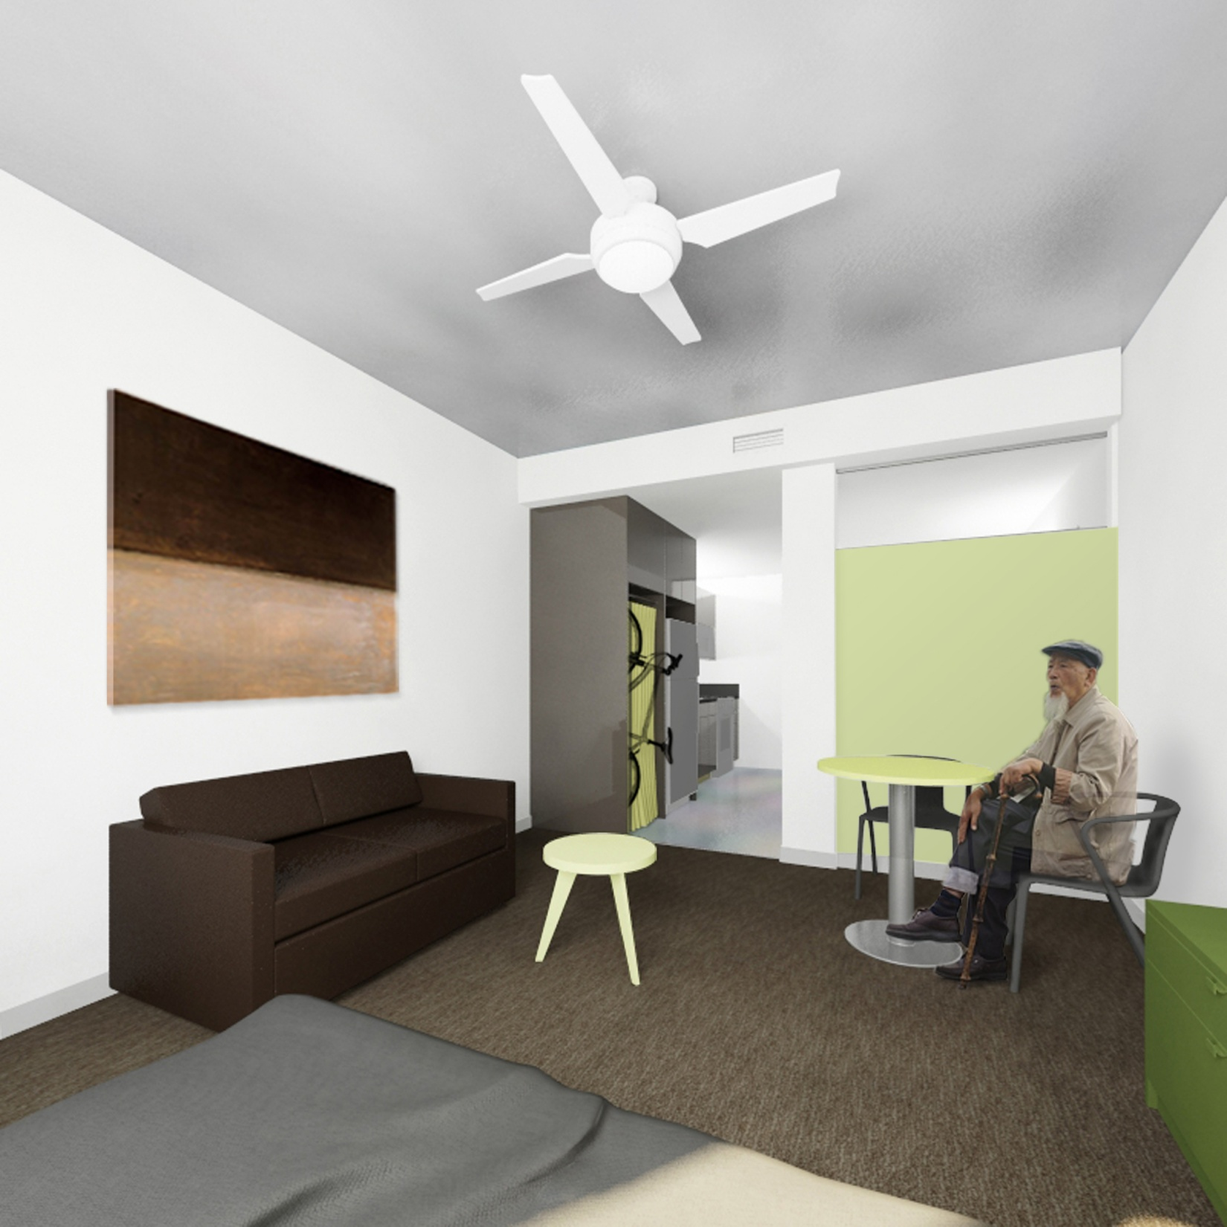
Notes:
APRIL

Slide 13
Development Sources and Uses
Project Sources
TIF $29.5 million
LIHTC $11.7 million
Recovery Act $ 3.3 million
HAP $ 1.9 million
Other $ 0.5 million
Project Uses
Construction, Sitework, FF & E $31,312,653
Development Costs,Studies, Reports & Permits $ 1,407,791
General Fees, Contracted Services & Fees $ 8,304,815
Financing and Interest Charges $ 3,260,332
Reserves, Organizational Costs & Start-up $ 2,665,484
Total Sources: $46.9 million Total Uses: $46.9 million
Notes:
Mike

Slide 14
Slide about Shelter (1 of 2)

Slide 15
Slide about Shelter (2 of 2)

Slide 16
Slide about Day Center (1 of 2)

Slide 17
Slide about Day Center (2 of 2)

Slide 18
Permanent Supportive Housing
130 units of permanent supportive housing
All units are financed with tax credits, with a mix of public housing and Section 8 operating subsidy
Supportive services are funded through City General Funds, as well as other leveraged funds
Notes:
SALLY

Slide 19
Permanent Supportive Housing
Focus on homeless people with medical vulnerabilities --accessible by the most vulnerable homeless people in our community
Leveraging primary & behavioral health care
Aligned with other supportive services such as
  ______________, _______________, ____________
Wrap-around services available on-site such as
  ____________, _______________
Assessment through clinic providers
Notes:
SALLY

Slide 20
Housing Vulnerability
Housing dedicated to serving vulnerable homeless people
Housing will serve folks who are the most vulnerable, instead of using a time and date process
Vulnerability will be measured using a housing assessment tool
Notes:
SALLY

Slide 21
Service Coordination - Process and Timeline
Planning for Shelter and Day Center services started _____________________
Work with four clinics to assess 350 people by March 2011
Housing application process starts in March 2011
Certificate of Occupancy will be issued in May 2011
June 2011 building opens! (First shelter and day center; then Housing)
Notes:
RACHAEL

Slide 22
Good Neighbor Agreement
GOALS
Initiate and maintain open communication
Develop a procedure for resolving problems that may arise
Encourage early communication
Encourage care and investment in the neighborhood
Maintain and enhance neighborhood safety and livability
Reduce crime and the fear of crime
Foster and healthy and welcoming environment for all

Slide 23
Good Neighbor Agreement
TIMELINE
October and November – Attend Old Town/Chinatown Neighborhood Association Meetings and reach out to community members
December 2010 - Informational mailing to nearby residents and businesses
January 6, 2011- Community meeting (Thursday evening)
January 8 - Community meeting (Saturday morning)
January 10- February 18 - Three facilitated GNA negotiation meetings
February 28 - Final GNA available for review
March 18 - Signature party!

Slide 24
Good Neighbor Agreement
Key Stakeholders
OTCT & Pearl District Neighborhood Associations and Business Associations
Additonal Community Groups such as Chinese Consolidated Benevolent Assoication
Adjacent neighbors and businesses

Slide 25
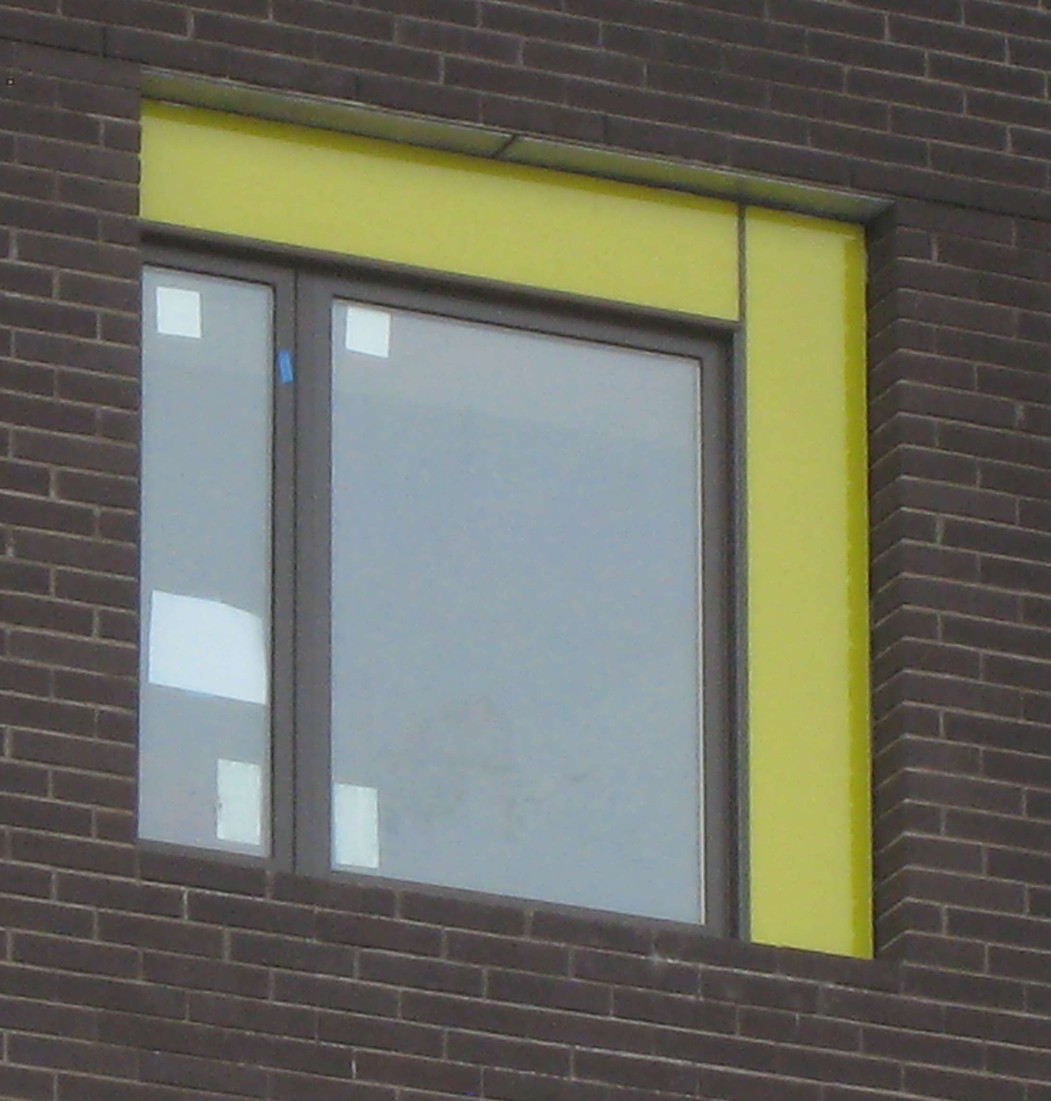
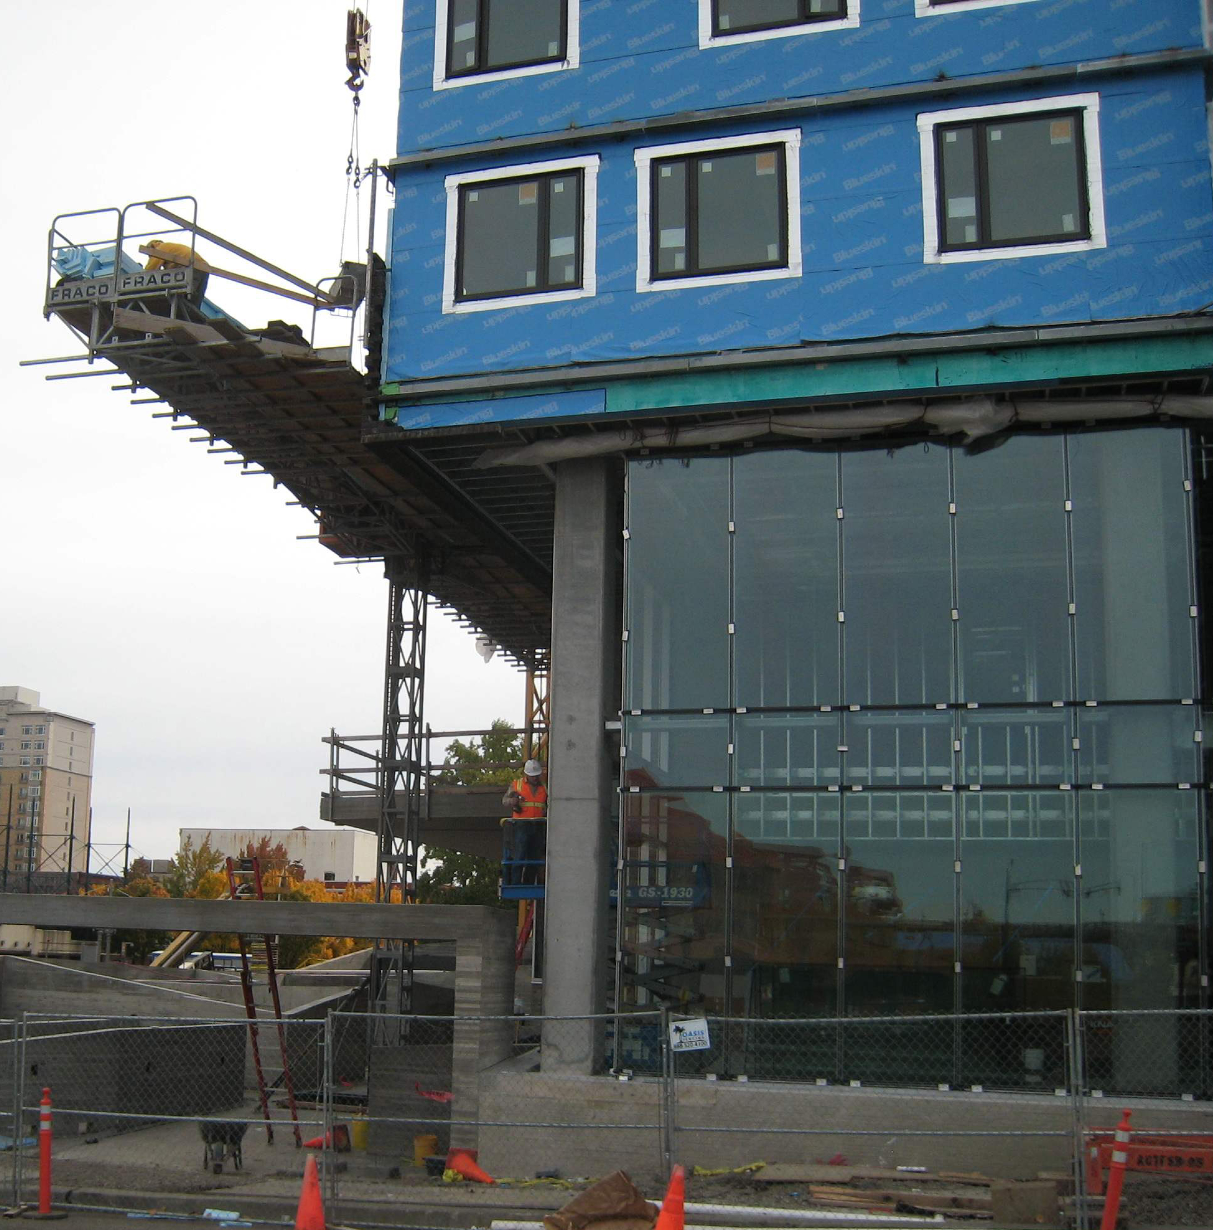
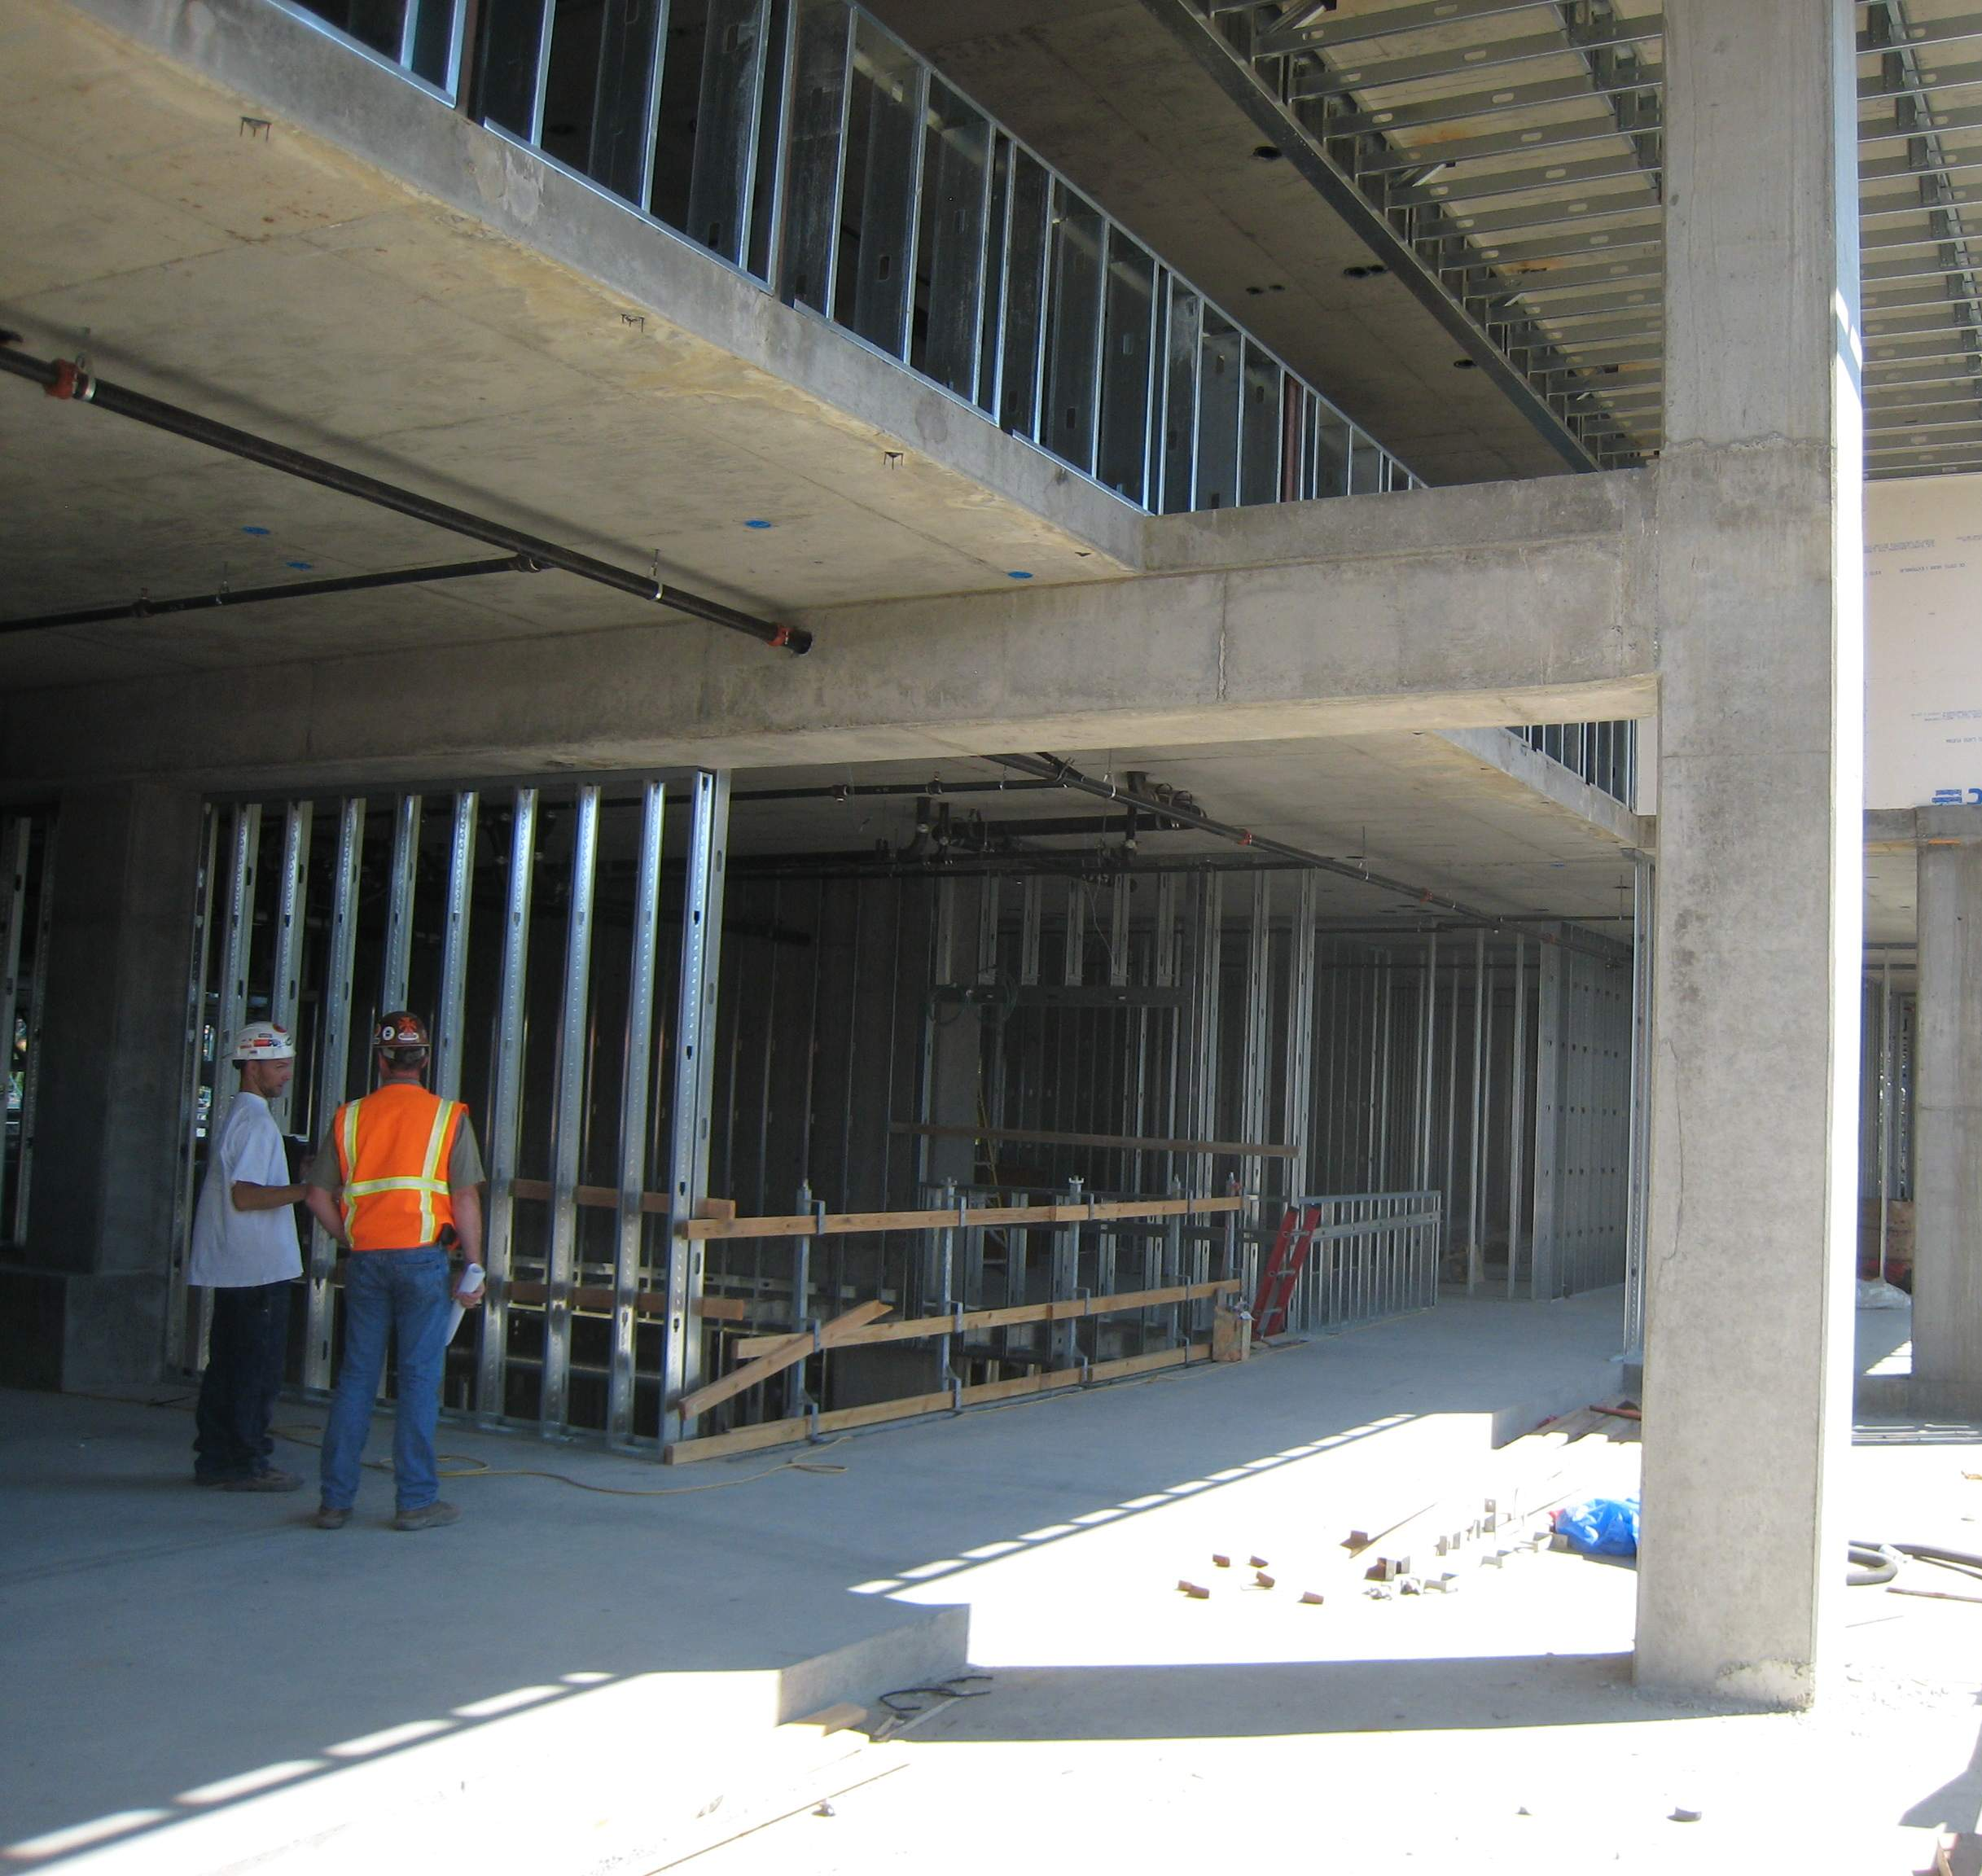
Getting Closer (pkk will get more recent photos)

