Slide 1
PBOT 90-day Transportation Decarbonization Resolution (Item 450)
May 31, 2023 Portland City Council
Art Pearce, PBOT Planning, Projects, and Policy Group Director
Kristin Hull, PBOT Planning and Project Development Division Manager
Vivian Satterfield, BPS Chief Sustainability Officer

Slide 2
+40% local greenhouse gas emissions come from transportation
1990
1990 Levels
2020
2030 Target
Notes:
VIVIAN
We are happy to see PBOT's commitment to transportation decarbonization and the action items listed in this resolution.
The transportation sector is responsible for over 40% of Multnomah county carbon emissions so it is critical for city staff to take bold action to reduce transportation related emissions and address associated pollution and health risks that disproportionately impact BIPOC and low-income Portlanders.
The City's work to decarbonize the transportation sector fits into three main categories :
The first is about developing plans that encourage or require developers to build compact and connected communities to enable people to meet their daily needs without driving. This is the work that BPS Planners focus on.
The second is reducing vehicle miles traveled by building walk, bike and transit infrastructure to support safe and enjoyable non-driving trips. This is the work PBOT focuses on.
The third is the focus of the resolution before you today - and that is to transition the motorized vehicles that remain on the road to be powered by electricity. BPS partners with PBOT, CityFleet, BDS and other bureaus to do this work.
It is important to acknowledge that not all Portlanders have equal access to connected communities, EVs or non-motorized transportation options.
Therefore, this work needs to be implemented through a climate justice lens to decrease existing disparities and ensure clean transportation options for all.

Slide 3
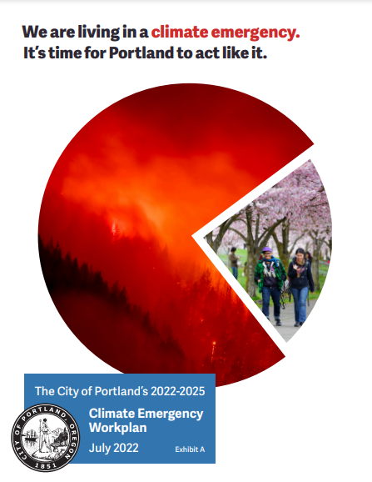
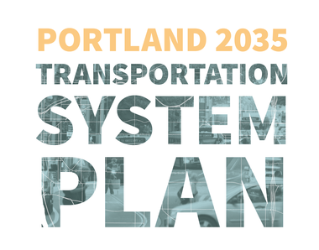
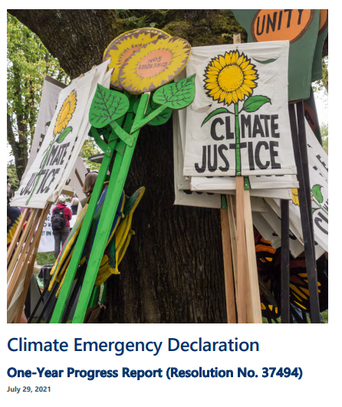
Climate Emergency Workplan as a guiding framework
The Climate Emergency Workplan will guide us to achieving the goals of:
50% reduction of carbon emissions by 2030
Net-zero emissions by 2050
This resolution includes implementation actions for the PBOT-assigned Climate Emergency Work Plan items.
Builds on a long history of Council-directed climate action.
Notes:
VIVIAN
The Climate Emergency Workplan is the most recent commitment to climate action. It builds on a long history of council actions including our current transportation system plan and comprehensive plan. BPS lead the development of the City's EV Strategy which was unanimously adopted by Council in late 2016. Several of the actions in the EV Strategy are now embedded in the City's Climate Emergency Work Plan and PBOT is an important partner in this work.
I'd like to take a moment to acknowledge several BPS lead transportation decarbonization projects that have recently been adopted by Council and are currently underway:
EV-Ready Code Project -was unanimously adopted by Council in February of this year. It requires EV-Ready infrastructure to be installed in 50-100% of parking spots at new construction multifamily buildings.
As a next step, following the EV-Ready Code update, BPS staff are partnering with Rocky Mountain Institute to discuss EV charging solutions with multifamily residents, building owners and property managers and will be working to implement those solutions and develop an EV charging toolkit to meet the needs of residents in multifamily buildings.
PCEF is developing the inaugural Climate Investment Plan which will allocate at least $100 million for transportation decarbonization projects and programs over the next 5 years to benefit people with low incomes, people experiencing disability and BIPOC communities.
Additionally, BPS Staff are partnering with PBOT staff on the right-of-way focused work that is included in PBOT's Transportation Decarbonization Resolution and we look forward to continuing to collaborate on this work. The Climate Emergency Progress Report, which includes many of these actions will be available this summer and BPS staff will brief Council Offices on that report in June and July.

Slide 4
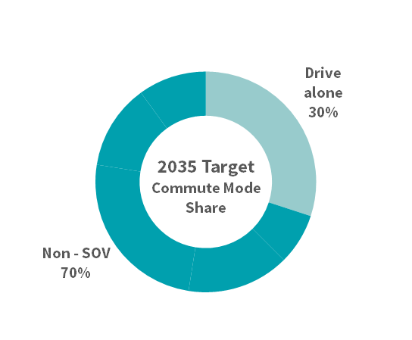
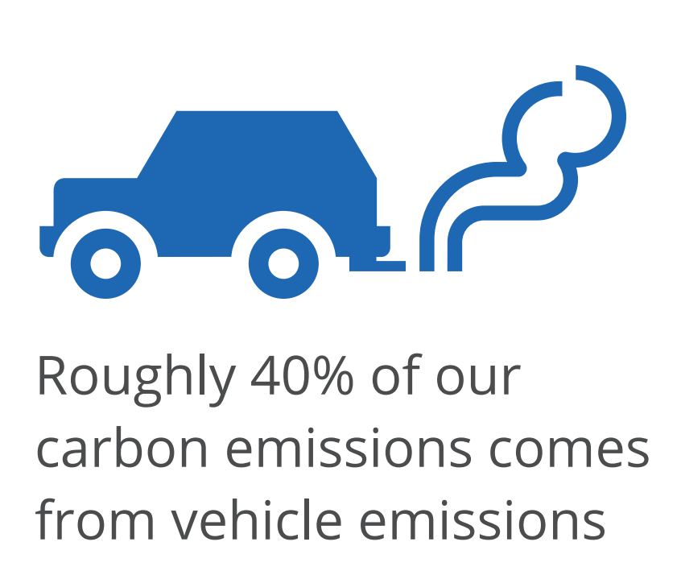
City Transportation Policy: Mode Shift and Climate Goals
The City of Portland has adopted policy to reduce transportation-related greenhouse gases AND reduce drive alone trips. Some interventions address both policy goals, while others only address greenhouse gas reduction.
Mode Shift Goal: 70% non-drive alone commute trips by 2035
Greenhouse Gas Emission Goals:
100% reduction in carbon emissions by 2050 and a 40% reduction by 2030
Notes:
ART
The City has adopted policies to reduce vehicle miles traveled. Here we are measuring this through a 2035 target of having 70% of Portlanders commute by some other means than driving alone. This shift in how people get around reduces congestion, improves safety and reduces transportation-related greenhouse gas emissions. City Council has also adopted a goal to reduce greenhouse gas emissions and reach “net zero” by 2050. This policy goal directly addresses climate and could be achieved by a combination of transportation electrification and mode shift. Meeting these policy goals is critical to addressing the climate crisis, but also further exacerbates PBOT funding challenges by reducing gas tax and parking meter revenue – our two major sources of transportation revenue.

Slide 5
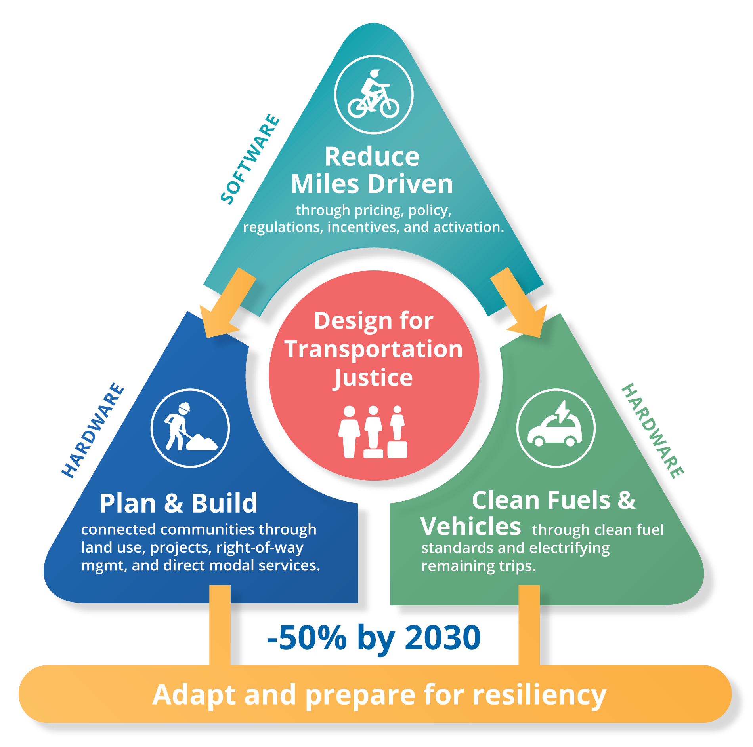
City’s strategy to address transportation-related greenhouse gas emissions
Notes:
ART
Funding pressures notwithstanding, PBOT is continuing to focus on meeting greenhouse gas reduction plan and responding to the climate crisis.
Consistent with our strategic plan and council-adopted transportation system plan, we have a three pronged approach to addressing GHG reductions from transportation….the resolution is focused on how these three things work together and how transportation electrification is a relates to the broader effort to decarbonize by fuel and mode shift. Why are we focused on electrification? Because it is the place where we can make the most carbon reductions in the shortest period of time, it is a place where the federal government is making historic once-in-a-generation investments available, and because it also relates to mode shift strategies like transit, biking and micromobility. These strategies directly relate to our strategic plan in answering the call to address climate as well as goods and people mobility, safety and managing our assets.

Slide 6
U.S. Federal government has prioritized electrification above all else
"...transitioning to clean options is expected to drive the majority of emissions reductions.”
- The U.S. National Blueprint for Transportation Decarbonization
Bipartisan Infrastructure Law allocated $7.5 billion for EV charging throughout the U.S.
The Inflation Reduction Act allocated $36 billion in Clean Fuel and Vehicle Tax credits
Oregon Department of Transportation will spend at least $100 million for EV charging in Oregon
This resolution will position the city to benefit from these federal funds and continue to be a national leader in transportation decarbonization
Unfortunately, winning federal grants won't solve PBOT's larger budget challenges
Notes:
KRISTIN
The federal government has prioritized electrification above all else, even as the National Blueprint for Transportation Decarbonization is structured much like our approach in stressing community design, improved efficiency and transitioning to clean options.
That said, recently passed federal laws will make generational investments in electrification both in the form of subsidies to households and businesses switching to electric vehicles and to support the development of a functional EV charging network throughout the country. The work that we are discussing today will position the City to benefit from these federal funds and continue to be a nation leader in transportation decarbonization.
***
The Blueprint lays out immediate actions and long-term planning to decarbonize the transportation system and meet the Federal government’s 2030 GHG goals. These three key strategies include:
Increase convenience by supporting community design and land-use planning at the local and regional levels that ensure that job centers, shopping, schools, entertainment, and essential services are strategically located near where people live to reduce commute burdens, improve walkability and bikeability, and improve quality of life.
Improve efficiency by expanding affordable, accessible, efficient, and reliable options like public transportation and rail, and improving the efficiency of all vehicles.
Transition to clean options by deploying zero-emission vehicles and fuels for cars, commercial trucks, transit, boats, airplanes, and more.
Winning some funding in this area, but does nothing to address structural problems

Slide 7
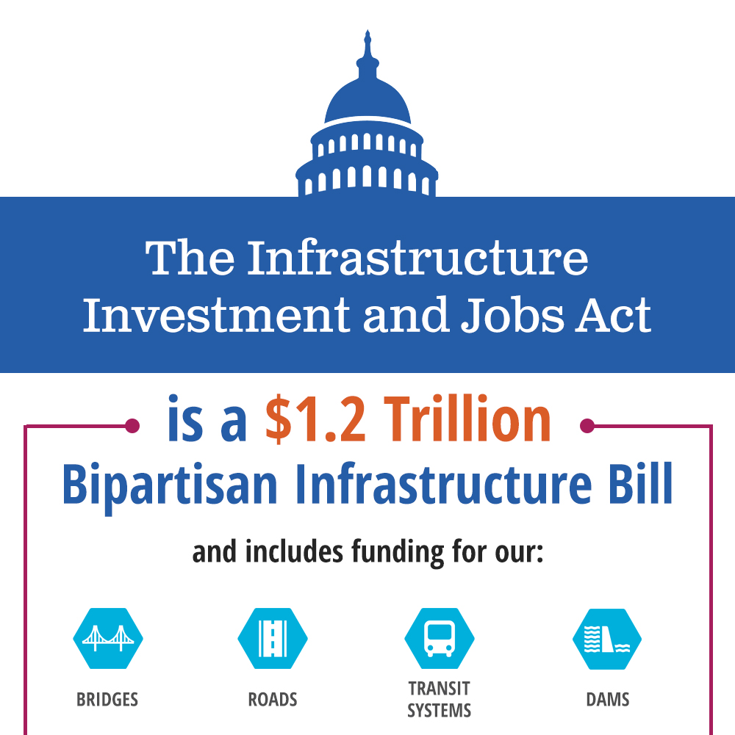
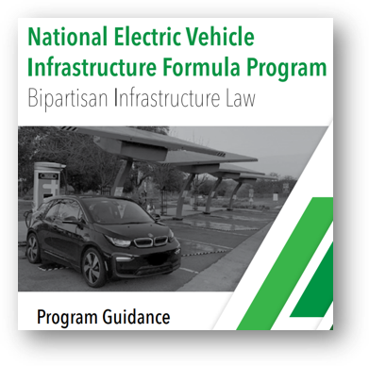
PBOT needs stable funding to effectively compete for federal funding
To capitalize on this once-in-a-generation moment, PBOT must maintain a level of resources for:
Project development
Private-sector partnerships
Grant writing
Local match (often required)
Without adequate resources, Portland will not be able to compete for federal funds
We will leave resources on the table
We fall behind on its climate commitments and not recognize equitable outcomes
Notes:
KRISTIN
With this much federal funding in play, we hope to use this moment to make gains on our electrification goals. But, we can’t do this without stable funding. Winning federal grants requires PBOT to be prepared with well thought out projects, private sector partnerships, and resources for grant writing and required match. Without these resources, Portland will not be able to compete for federal funding and will fall behind our peer cities in supporting transportation electrification.

Slide 8
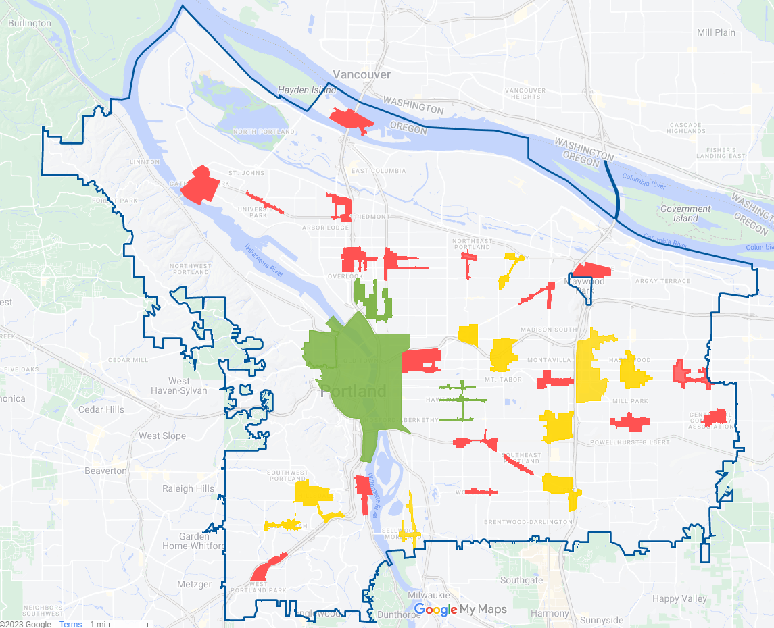
Current transition to electrification is not equitable
Current transportation electrification progress in Portland:
Over 1/3 of public chargers are in the Central City
Fewer public chargers near multi-unit dwellings & in communities likely to continue relying on personal vehicles
PBOT can use regulatory levers to influence the market to:
Ensure all Portlanders can enjoy benefits of EVs
Electrify all modes
Support income qualified pricing programs
Availability of public chargers in Portland's neighborhoods
Areas in red have 0 (zero) public EV chargers Areas in yellow have 1-5 public EV chargers Areas in green have 5+ public EV chargers
Source: PBOT
Notes:
Kristin
Government’s role in transportation electrification, particularly at this stage, is critical to achieving equitable electrification outcomes and meeting our policy goals. Today, there are nearly 400 charging ports in Portland, but they are primarily located in the Central City and inner Portland neighborhoods. Very few are located in north or east Portland. Public charging infrastructure is most important to people who live in multi unit dwellings or people who rent their homes and are not able to install EV chargers in their own homes or garages. We see our role as filling market gaps and supporting an equitably distributed EV charging network as well as a more complete view of public charging needed for other electric modes like shared scooters and shared and individually owned e-bikes.

Slide 9
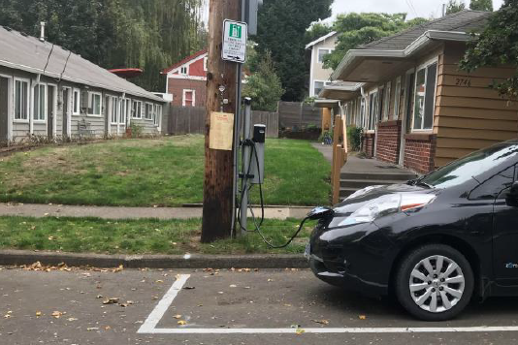
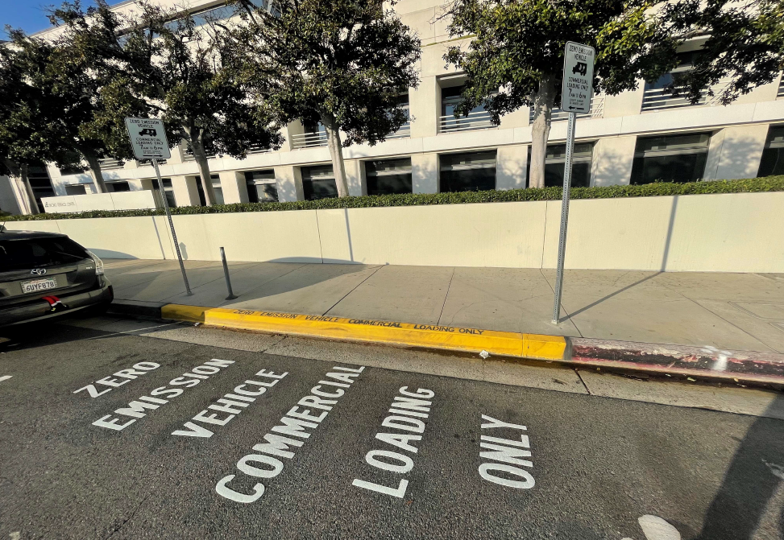
Key PBOT actions to date
Code and administrative rule changes to allow for more EV charging in public rights-of-way
$3.3 million US DOE “park and charge” grant award to install up to 50 EV chargers, conduct community engagement, and disseminate findings
$2 million US DOT SMART grant award to use data and sensors to pilot zero emissions freight strategies
Operates or oversees several zero-emission transportation options:
Portland Streetcar
All-electric BIKETOWN fleet
E-Scooter program
EV charging in City-owned parking garages
Investments in biking, walking and transit projects and programs
Notes:
Kristin
This work is a core PBOT service area with the bureau leading the city’s efforts to implement transportation decarbonization projects. PBOT already operates the electric Portland Streetcar and other transportation options.
We’re making moves to support EV charging in the ROW with code and administrative rule updates, recently approved by council, that allow charging at the curb. Our recent $3.3M grant award from US dept of energy will allow us to partner with PGE and Pacific Corp to install 50 new EV chargers.
We’re also continuing to build out safe cycling infrastructure, supporting demand management strategies like the Transportation Wallet, and improving transit speed and reliability through partnerships with TriMet. Our ability to do this work – even the work funded by grants – relies on a bureau with sufficient and stable funding and appropriately staffed planning, project development and program development functions.

Slide 10
Resolution
Notes:
Art

Slide 11
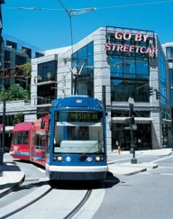
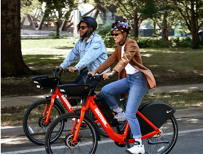
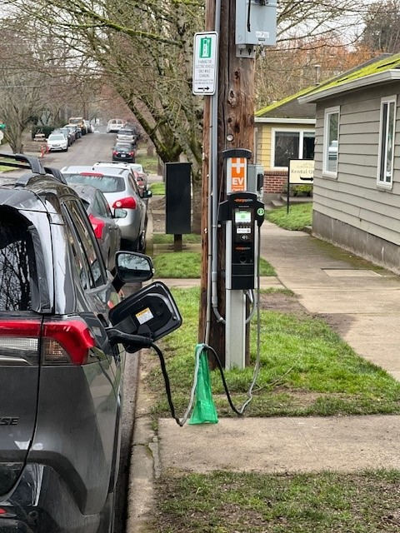
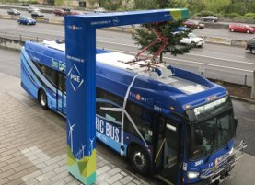
Today’s Council Action
Responds to transition priorities and confirms transportation decarbonization as a core PBOT function
Highlights transportation decarbonization strategies and confirms Climate Emergency Workplan priorities
Continues a dialogue with Council on the best way to resource this work
Directs PBOT and City resources to center the needs of frontline communities in the transition to a decarbonized transportation system
Notes:
ART
Which brings us to today’s Council Action. You have before you a resolution that responds to the 90 day transition priorities assigned by Mayor Wheeler. It seeks to confirm transportation decarbonization as a key City priority and a core PBOT function. It names implementable and actionable decarbonization strategies drawn from the Council adopted Climate Emergency Work Plan. It also highlights the continued resource challenges that PBOT faces in delivering these and other core services. Finally, it illustrates the important role that PBOT plays in implementing transportation decarbonization that centers equity and the needs of frontline communities to ensure that no one is left behind in the transition to a decarbonized transportation system.

Slide 12
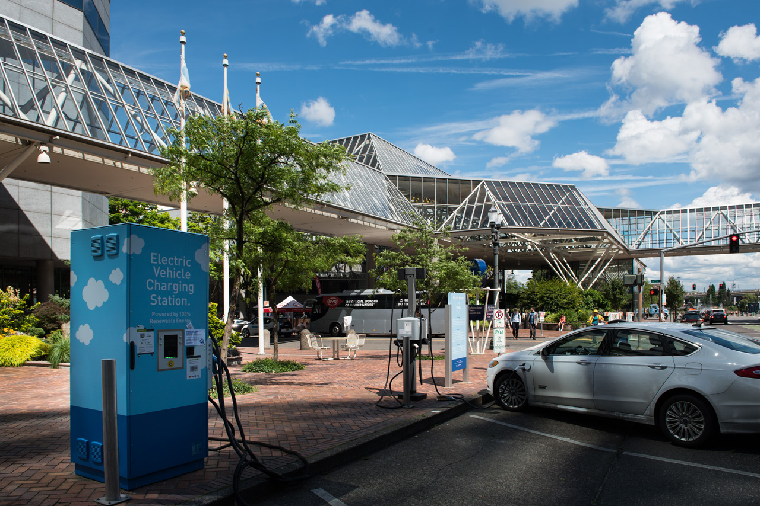
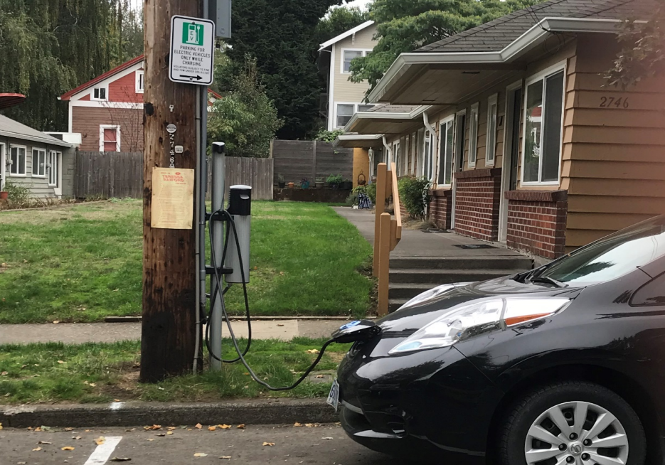
#1: Make Portland a top city for equitable transportation electrification (CEW T-6, T-7)
Notes:
Kristin
The actions in this area direct PBOT to make EV charging available to more Portlanders by expanding the availability of public charging in the ROW and on other publicly-owned sites and increasing awareness about how people can charge Evs in Portalnd. Charging is one lever that PBOT can pull to expand the benefits of transportation electrification equitably in the City. This is the area that our recently awarded USDOE public charging grant will jump start.
Identify publicly-owned sites suitable for EV charging (CEW Decarbonization Priority T-6, T-7)
Explore strategic partnerships to increase affordable, public EV charging (CEW T-6, T-7)
Streamline and simplify permitting and installation of EV chargers (CEW T-6, T-7)
Initiate public outreach and engagement on EV charging (CEW T-6, T-7)
Develop a citywide communication strategy (CEW T-6, T-7)

Slide 13
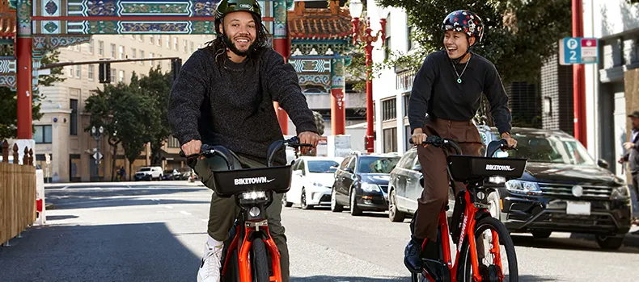
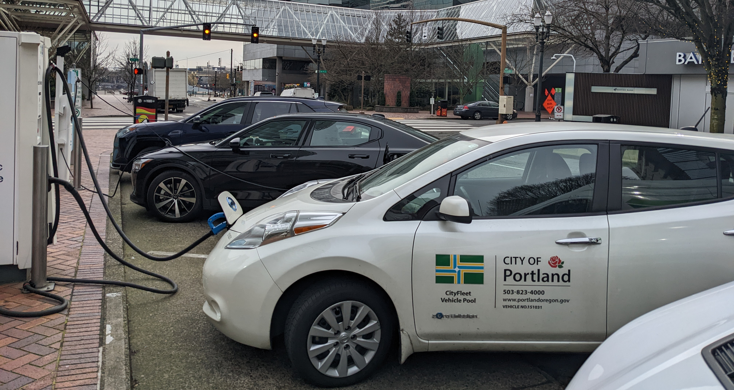
#2: Promote electric mobility options (CEW T-1, T-4, T-7 and T-8)
Notes:
Kristin
The actions in this area direct PBOT to promote more electric mobility opions by supporting zero emission delivery and goods movements strategies, expanding PBOT’s successful transportation wallet program, transitioning our own and other commercial fleets to zero emission vehicles and supporting TriMet in electrifuing and expanding use of public transit. Items on this list – expansion of the transportation wallet and match for grants that could support freight and fleet electrification – are particularly at risk as PBOT faces unprecedented funding shortfalls.
Support goods movement by zero emission vehicles (CEW T-8)
Expand PBOT's Transportation Wallet program (CEW T-4)
Increase zero emission vehicles in the City's own fleet and in commercial fleets (CEW T-1)
Support the electrification and increased use of public transit (CEW T-1, T-7)
All of these items are dependent on sufficient and stable funding. PBOT’s transportation wallet could be reduced, rather than expanded, without adequate transportation funding.

Slide 14
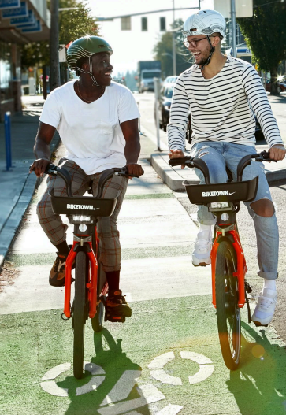
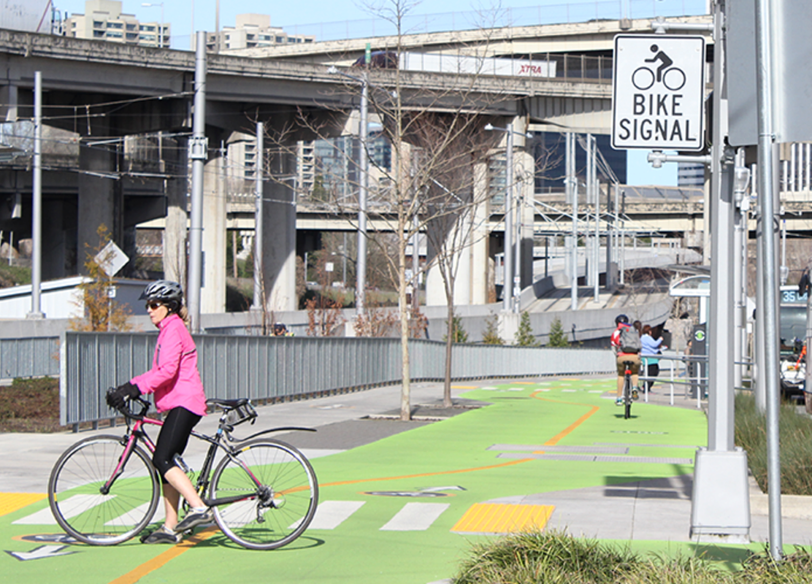
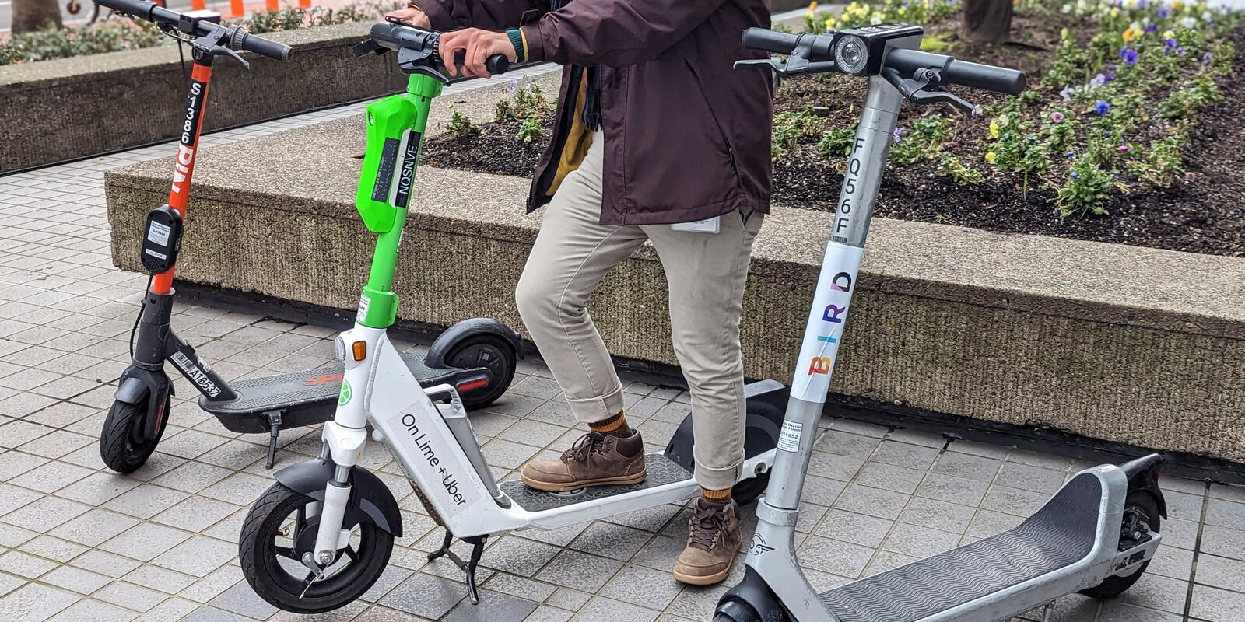
#3: Investigate strategies to support e-bikes and shared micromobility (CEW T-1, T-3)
Notes:
Kristin
The actions in this area direct PBOT to expand who is using our bike infrastructure by getting more Portlanders onto shared or individually-owned e-bikes and shared scooters. This means supporting e-bike rebate programs including the one proposed by the Portland Clean Energy Fund, expanding the visibility and use of e-bikes and scooters as a way that Portlanders can meet their daily transportation needs, and addressing barriers to e-bike ownership and shared electric mobility services by addressing safe and secure parking and charging. Putting this all together, the resolution directs PBOT staff to report to Council how shared micromobiltiy, individual and shared e-bikes, and a renewed focus on cycling can reverse the downward trend in biking mode share in Portland.
Highlight e-bike rebate program/PCEF program area.
Support funding for e-bike rebate programs (CEW T-1, T-3)
Increase the visibility of e-bikes, shared micromobility and existing bicycle facilities through engagement (CEW T-1)
Capture SOV and TNC trips by BIKETOWN and e-scooters (CEW T-1)
Increase access to safe, secure and convenient parking and charging for e-bikes and shared micromobility (CEW T-1)
Report to Council on how new mobility options and ridership habits can accelerate the vision of enabling short trips to commercial Centers (CEW T-1)

Slide 15
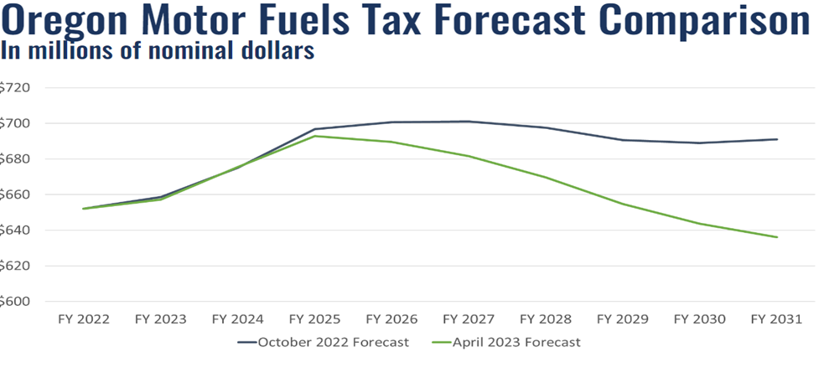
#4: Address PBOT’s funding crisis with stable, climate-supportive revenue sources to support this core PBOT service (CEW T-3, T-7)
Notes:
ART
Finally, this resolution focuses on the very real challenge presented by the current transportation funding model. Currently, PBOT’s general transportation revenue – our main discretionary funding – comes from fuel taxes and parking revenues. This chart shows ODOT’s revised forecast of fuel tax revenue. The green line is a revised forecast based on increasing fuel efficiency and the rapid rate of electric vehicle adoption – Oregon is now the #2 state for electric vehicle purchases. As we’ve discussed already, electric vehicle adoption is a critical part of meeting our climate goals, but EV adoption will also further reduce the fuel tax revenues that pay for our transportation system. When combined with our policies to reduce how much people drive which impacts parking revenue, it is clear that PBOT’s current funding model is not sustainable.
‘Identify alternative revenue sources and funding mechanisms to reduce the City's dependence on fossil fuels for transportation funding (CEW T-3)
Leverage resources by securing external funding (CEW T-3, T-7)
Explore new resources to support this work area
Continue to engage in the 2023 Regional Transportation Plan update and advocate for carbon reduction policies (CEW T-5)

Slide 16
Work is not fully funded
…BE IT FURTHER RESOLVED, the City Council recognizes that much of this work is not currently funded and requests that staff return with implementation, operational and funding plans for its further consideration during the FY 24-25 budget process, if not sooner.
Grant leverage
Required resources
Full implementation
Current budget forecast
Reduced budget forecast
Notes:
GF support in other bureaus, PCEF funding

