Slide 1
Fair Housing Month 2023
Molly Rogers, Interim Director
Portland Housing Bureau
April 5, 2023

Slide 2
Portland Fair Housing Proclamation A proclamation and a call to action

Slide 3
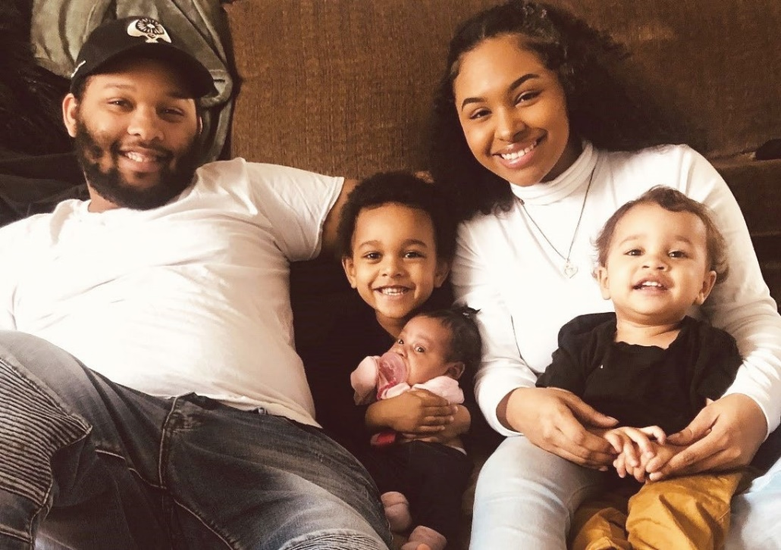
1 in every 2 renter households earn 60% AMI or below.
1 in every 4 households are paying more than 50% of their income in housing costs.

Slide 4
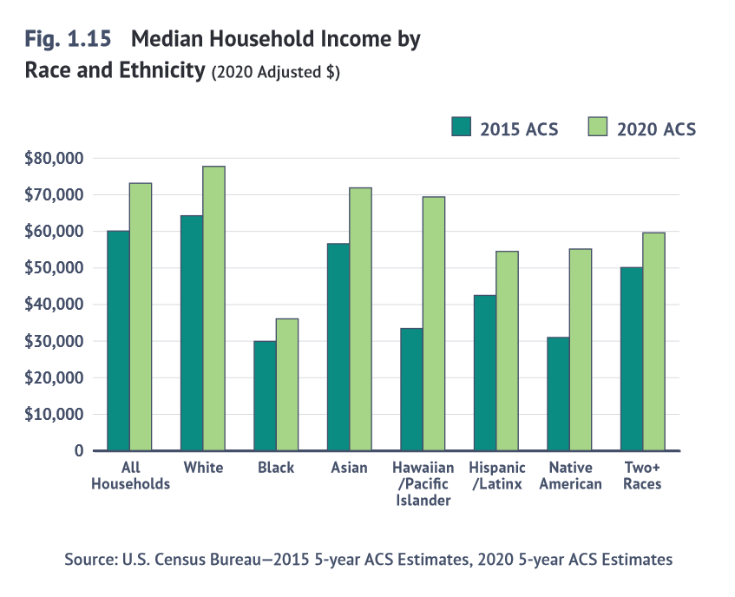
White Portlanders earn nearly 220% more than Black Portlanders.

Slide 5
Hattie Redmond Apartments

Slide 6
The Fair Housing Act and Fair Housing Month are for celebration and proclamation, and a reminder we have more work to do and must take action to address a debt owed and promises made.

Slide 7
Fair Housing Council of Oregon
Allan Lazo
Executive Director

Slide 8
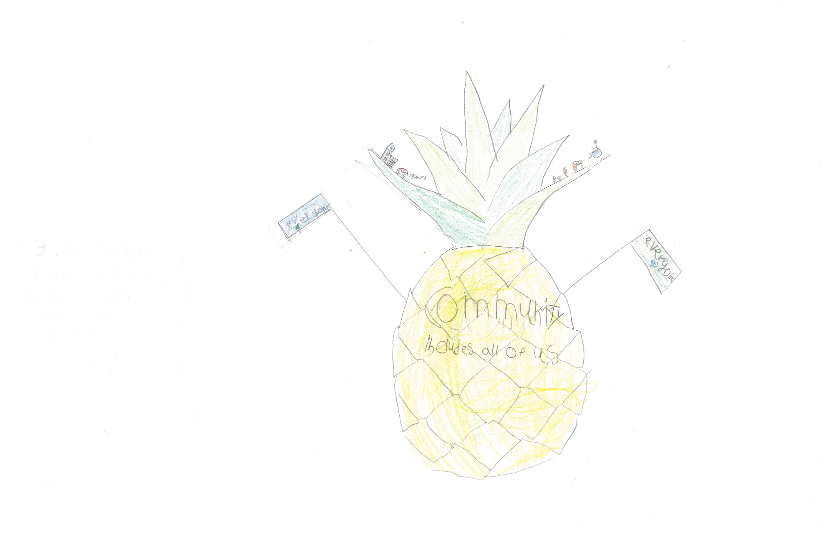
Hajjar Abidar
2nd Place
Grades 1-3 Category
Muslim Educational Trust

Slide 9
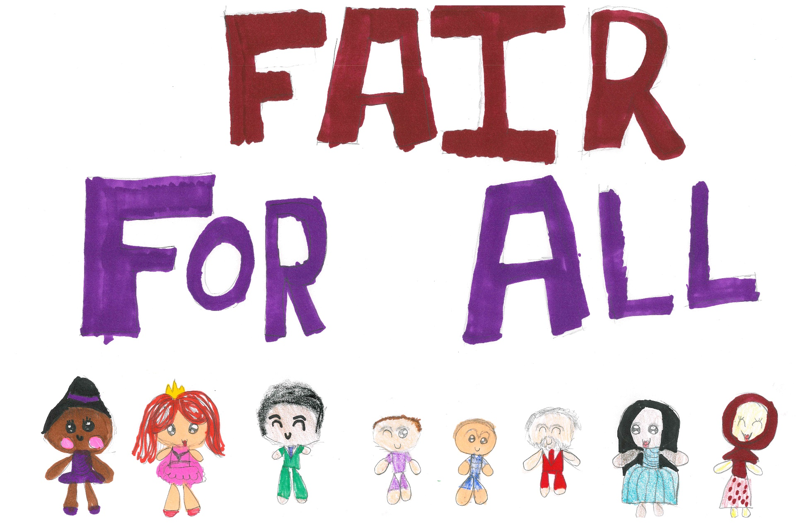
Rania Ahmed
1st Place
Grades 1-3 Category
Muslim Educational Trust

Slide 10
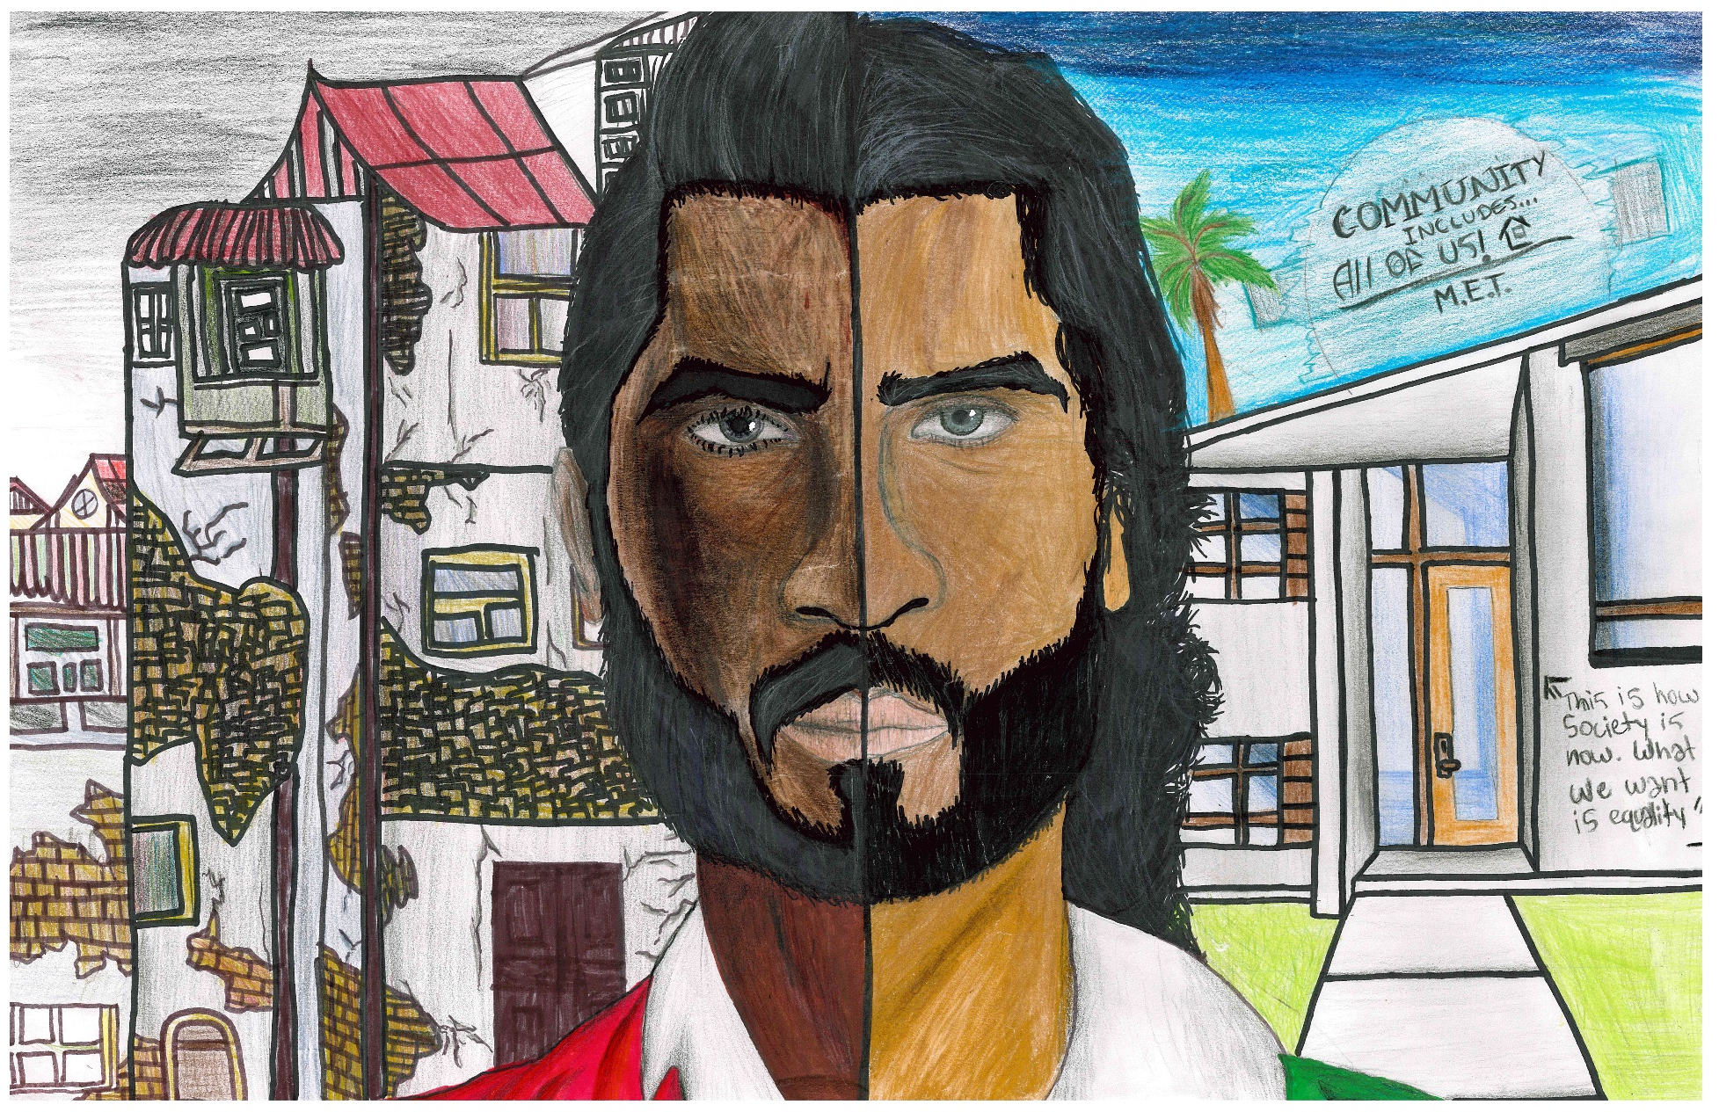
Haroon Jamal
2nd Place
Grades 4-5 Category
Muslim Educational Trust

Slide 11
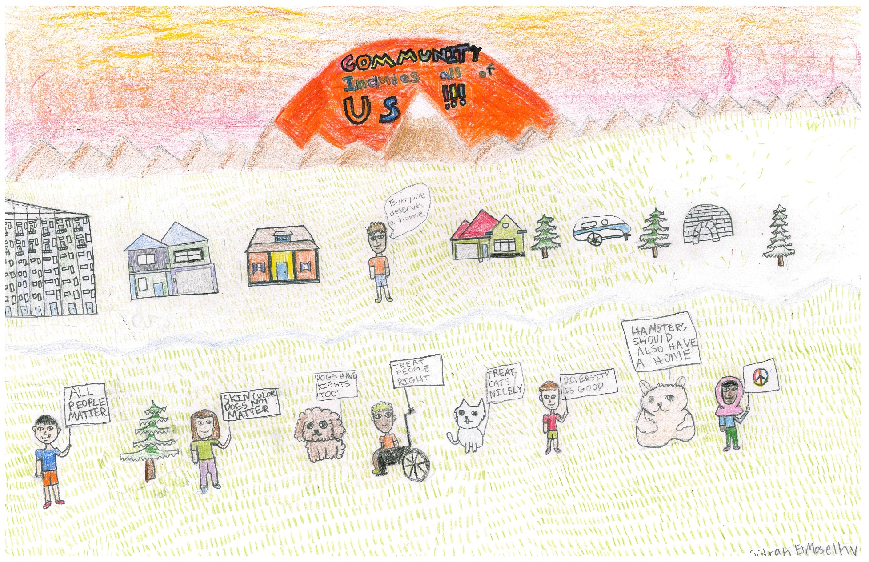
Sidrah ElMoselhy
1st Place
Grades 4-5 Category
Muslim Educational Trust

Slide 12
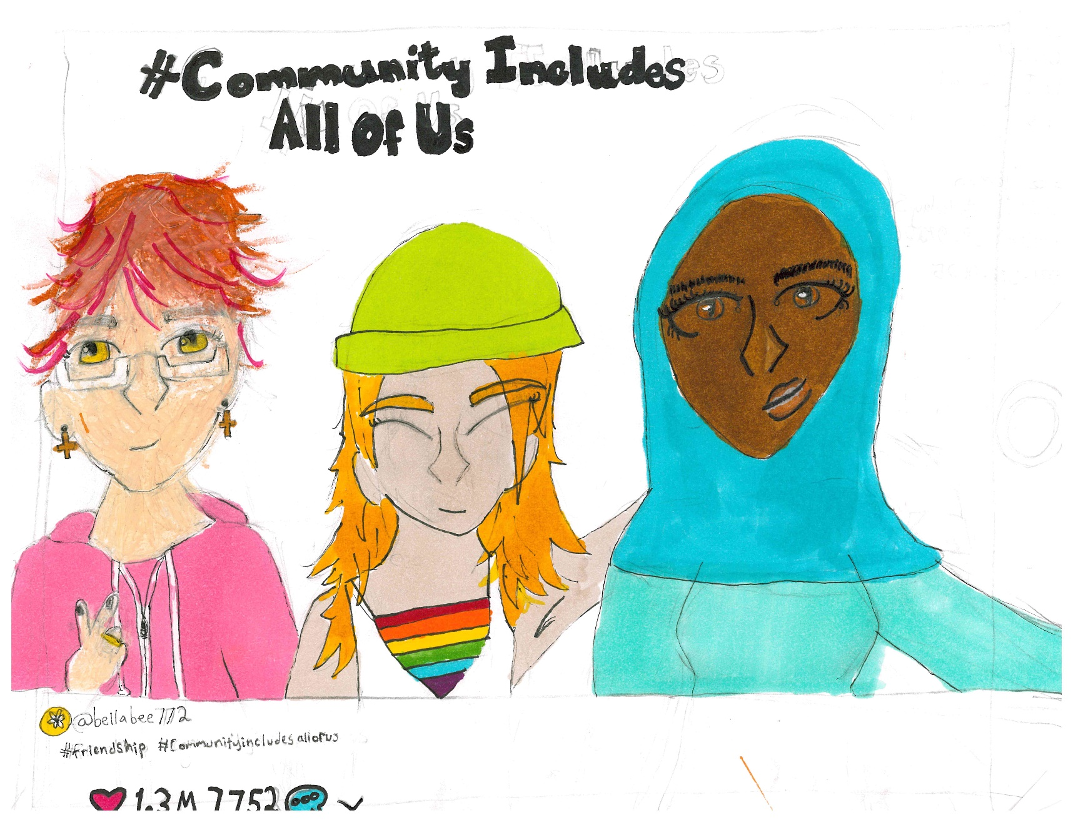
June Afeman
3rd Place
Grades 6-8 Category
The Ivy School

Slide 13
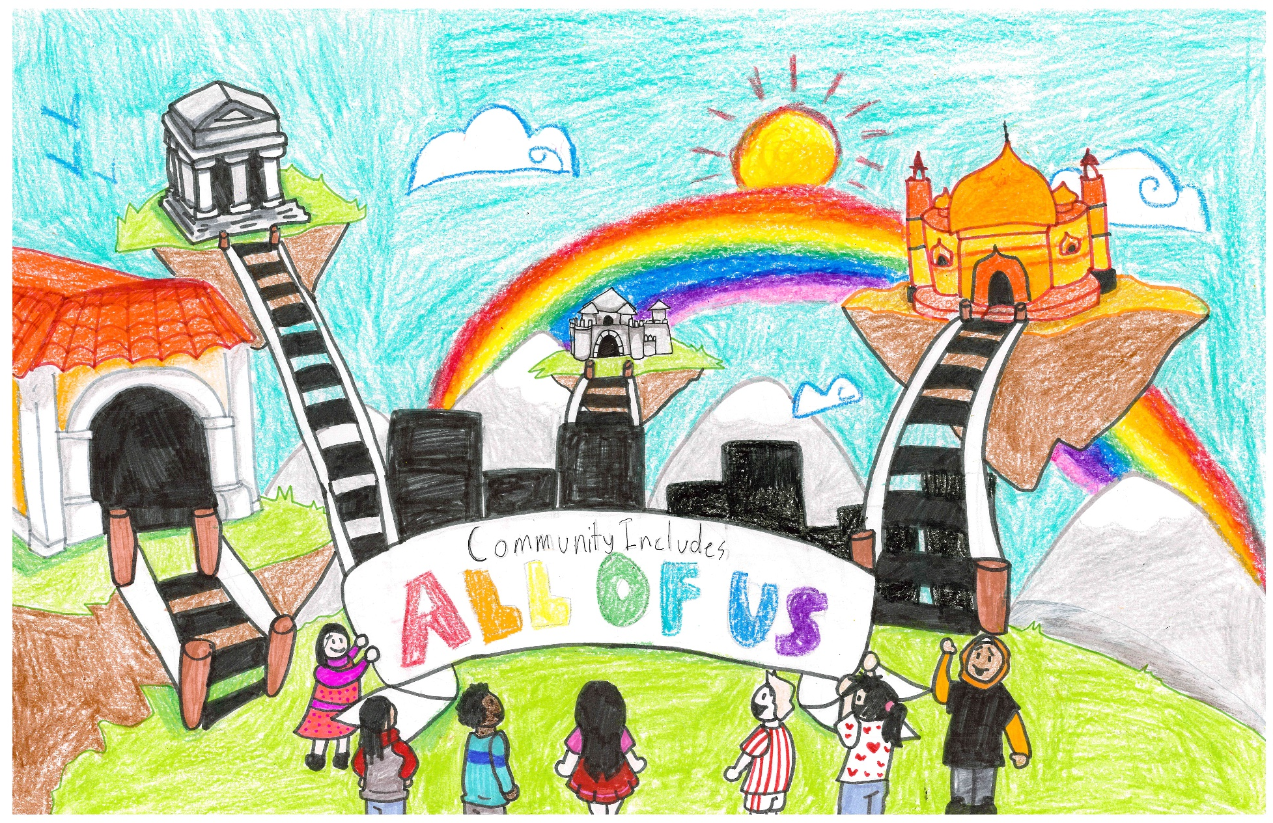
Huda Ibrahim
1st Place
Grades 6-8 Category
Muslim Educational Trust

Slide 14
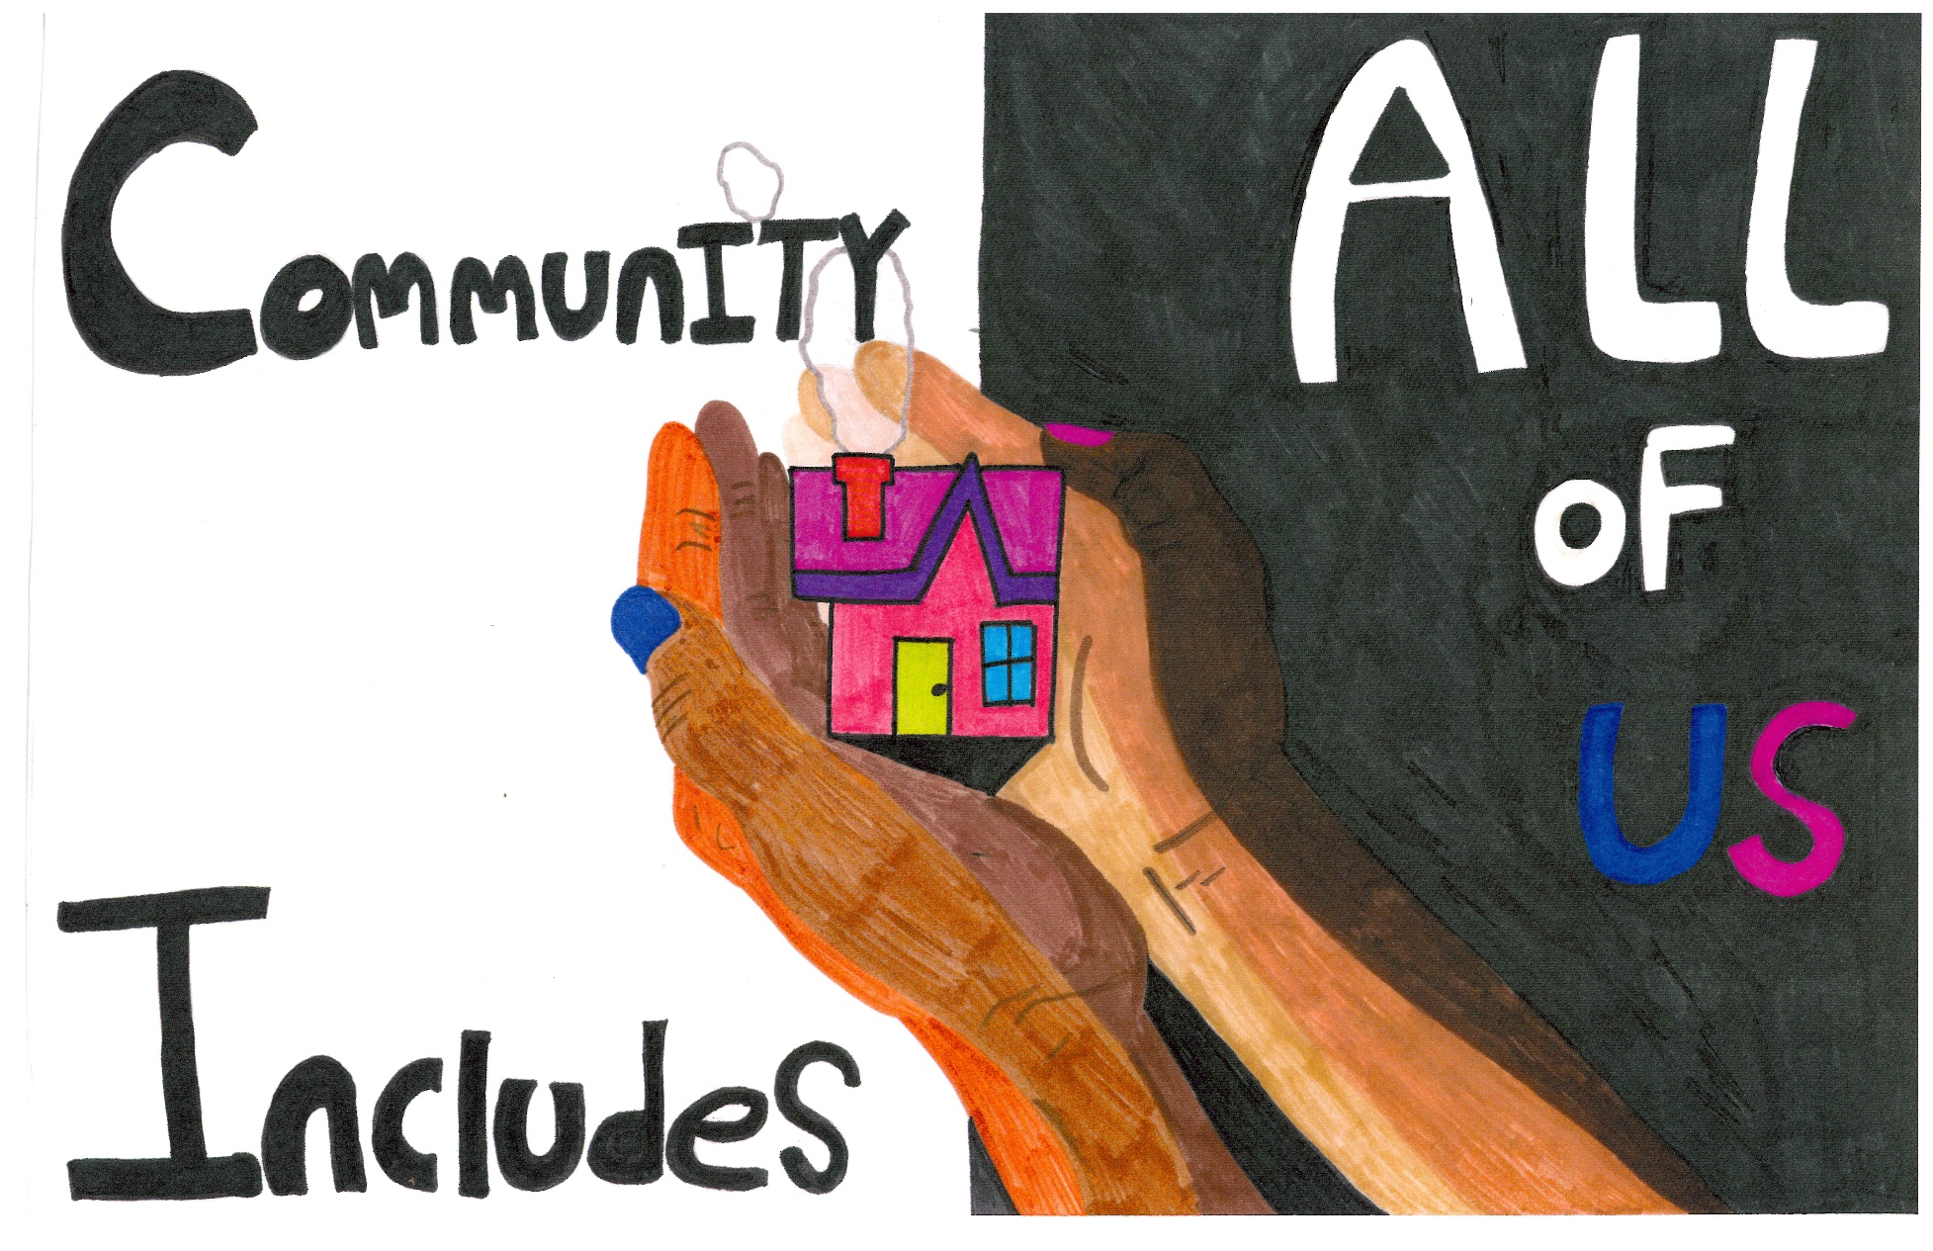
Halima Asad
GRAND PRIZE WINNER
Muslim Educational Trust

