Slide 1
Appointment of the Salary Commission
March 8, 2023
Notes:
[Jamey] Good morning, Mayor Wheeler, Commissioners Mapps, Rubio, Gonzalez and Ryan.
I’m honored to be here today. My name is Jamey Duhamel, and I am a staff with the charter transition team, housed in the Office of Management and Finance. It is my privilege to work closely with the Bureau of Human Resources to help stand up the Salary Commission and I will continue to work in partnership with them as the Commission does it’s work for the next five months.
Before we begin, I want to thank the many people who, in addition to the Bureau of Human Resources of course helped to bring the recommended commission appointees to you today. This process would not have been possible without assistance from the Office of Civic Life, city council staff, particularly Hayley Blonsley of the Mayor’s office, and my co-workers on the transition team. Thank you all for your collaboration.

Slide 2
Salary Commission
Commission Background
Commission made up of 5 Portland residents (and 2 alternates)
Tasked with setting salaries for all elected officials including city councilors, mayor, and auditor.
Deadline of August 1, 2023, and every 2 years thereafter
Notes:
[Jamey] In November 2022, registered voters supported a broad range of charter reforms by approving Ballot Measure 26-228. Among these reforms was the appointment of a Salary Commission that will set salaries for elected officials. The Salary Commission will include five commissioners and two alternates, who will be seated no later than March 15, 2023, and complete their work by August 1, 2023. The process this morning ensures we meet the required March 15th deadline. Moving forward, the Bureau of Human Resources will need to reconvene a Salary Commission every two years to evaluate the methods and salaries and make adjustments as needed.

Slide 3
Salary Adoption
Salary Commission
1
If 3 or more commissioners approve, the salary proposal is adopted
2
If fewer than 3 approve, the most recent proposal is sent to Council for consideration
Notes:
[Jamey] According to the charter amendments, if at least three Salary Commissioners agree on a salary proposal, then those salaries will take effect starting with the newly elected body on January 1, 2025
However, if after two votes, the Salary Commission is unable to reach that four-member majority, the most recent version of the proposal is forwarded to City Council for consideration and adoption.
And now I would like to turn it over to the Chief Human Resource Officer Cathy Bless to describe the selection process and to introduce the selected commissioners.

Slide 4
What was the selection process?
Salary Commission
18 applications were received/14 met residency requirements and other qualifications.
Applications were scored on 5 criteria:
Qualified HR professional
Experience setting pay
Experience working in or with mission-based, non-profit, public, and/or volunteer organizations
Experience with community engagement or involvement
Experience engaging with diversity, equity, and inclusion principles and practices
Council offices selected final list
Notes:
[Cathy] Introduce self
Good Morning Mayor Wheeler and Commissioners. I am Cathy Bless, Chief Human Resource Officer. I appreciate the opportunity to present this morning and I also want to thank the Chief Administrative Office, Barb Siples, the Interim Classification and Compensation Manager, you Office Mayor, and all others who have also helped get us to this point. The Bureau of Human Resources (BHR) partnered with the Office of Civic Life (OCL) and the Chief Administrator’s Office (CAO) to develop a job posting to attract qualified commissioners. Applicants responded to questions relating to their background as human resources professionals, their experience setting pay, their engagement with the principals and practices of equity and inclusion, and their involvement with their respective communities.
As part of the recruitment plan, BHR and CAO began outreach to community stakeholders, personal and professional networks, private industry, and compensation professionals, as well as public organizations, non-profits, trade organizations, and utilities……..several paid advertisements were also posted in local trade organizations.
Applicant Selection
The Salary Commission job posting was open for nine weeks and closed with 18 applications—of those, 14 applicants met the Portland residency requirement. These 14 also met the requirement of human resources and compensation experience.
Applications were reviewed and ranked by BHR and CAO staff. Scoring criteria included:
Qualified HR professional
Experience setting pay
Experience working in or with mission-based, non-profit, public, and/or volunteer organizations
Experience with community engagement or involvement
Experience engaging with diversity, equity, and inclusion principles and practices
The process resulted in a recommendation to seat the highest scoring seven applicants, which includes two alternates. Applicant information was provided to the Mayor’s Office in February 2023 for his selection.

Slide 5
Short Timeline – Work must be completed by August 1, 2023
Why include alternates?
1
2
Additional Connections – increased ability to engage Portlanders
Notes:
[Cathy] You may be wondering why we are asking for appointment of 5 members PLUS 2 alternates instead of just the five as required.
There are two simple reasons for this:
First, the commission is working under a very short timeline – the newly amended Charter requires that their work be completed no later than August 1st of this year. This gives the Commission roughly 5 months in which to complete research, public input, and discussions. By having alternates already appointed who can quickly step in to fill a vacancy, this ensures that the work of the commission will not be delayed.
Second, the plan that the Salary Commission approves affects ALL Portlanders. Having extra voices seated around the table with lived experiences and connections to Portland’s communities is incredibly useful, even if they are not voting members.

Slide 6
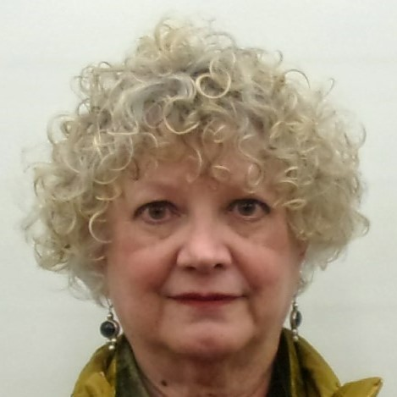
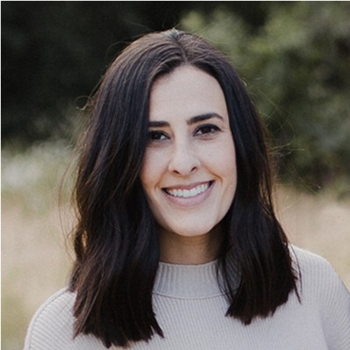
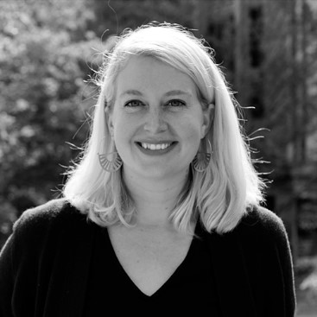
Salary Commission
Commission Member Nominees
Joni Marie Johnson
“Serving on this committee will provide an opportunity to help create a strong, rational compensation structure as the city develops its new positions. Having a transparent process that allows elected and appointed officials to understand the compensation process will both attract strong candidates and inform the public.”
Laura Sampson
“I am excited about being part of the team that is serving as the first salary commission, much like I did at Washington County. I am interested in learning more about the City structure and taking part in this important new body of work.”
Abby Engers
“I believe we all have a duty to give back to our communities, and I think my skills align with the City's needs here. I am also a very curious and resourceful person, happy to challenge my own beliefs and take on other perspectives.”
Notes:
[Cathy] We are pleased to be able to briefly introduce the nominees for the Salary Commission. Apologies that we will be going through them rather quickly, but their biographies were attached to this council item and we will also have them posted on the Salary Commission website later today.
Joni Marie Johnson
Retired now but worked for Oregon Historical Society
Served on PP&R’s Vision 2020 Plan and City Arts Advocates Committee
Laura Sampson
Currently works for Multnomah County
Served on Washington County’s first salary commission
Abby Engers
Currently works for Boly: Welch with a variety of local business and nonprofits to address HR issues and opportunities
Creator of two hiring-themed zines and a workshop series focused on job search

Slide 7
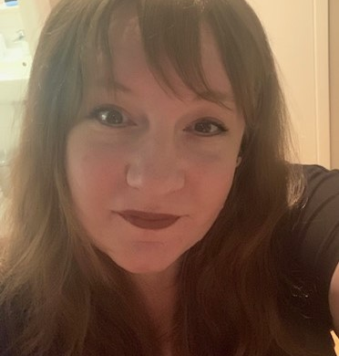
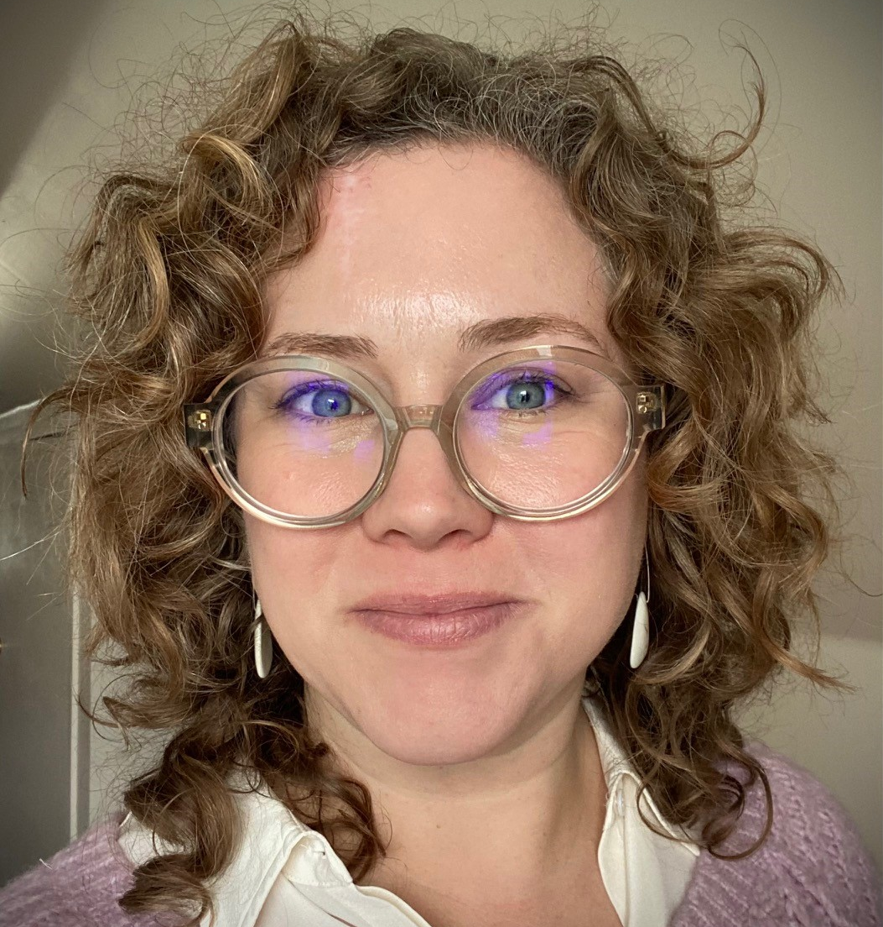
Salary Commission
Commission Member Nominees
Rosanna Gill
“I'm excited to use my HR skills in a civic manner. My current position is all about listening, synthesizing, and taking into consideration all perspectives in terms of the applicant and employee experience.”
Maura Cooney
“The opportunity to work with a diverse group of professionals to determine fair salaries for city officials sounds exciting to me. One of our missions at OHSU is service, and I would welcome the opportunity to give back to Portland by contributing my time.”
Notes:
Rosanna Gill
Current career focus in HR Technology
Projects include talent enablement, recruiting technology and compensation
Maura Cooney
Currently and over the last 20 years works for OHSU
Drawn to service

Slide 8
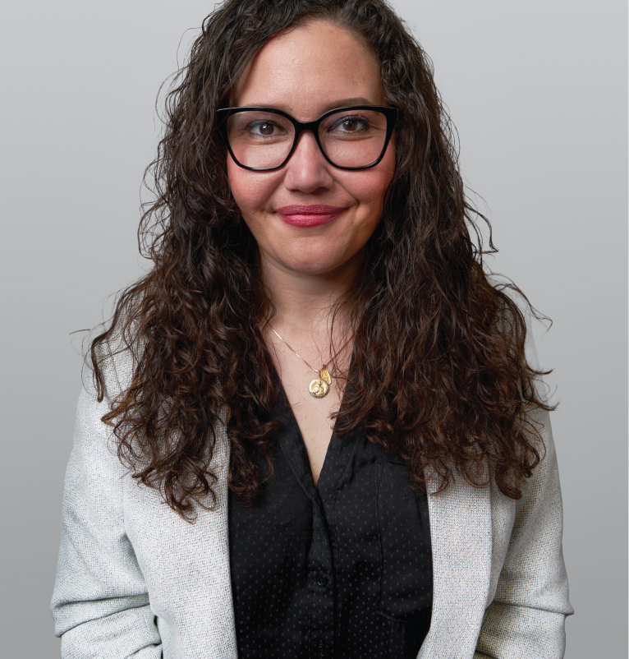
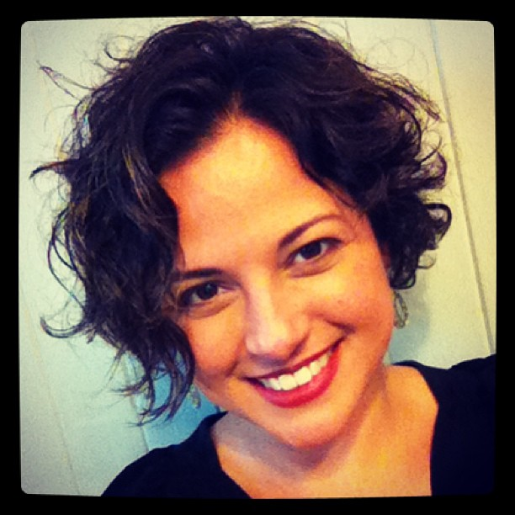
Salary Commission
Alternate Member Nominees
Moya Wong
“The opportunity to serve on the Salary Commission Advisory Body is incredibly interesting to me. As an HR Professional who specializes in integrating DEIA tenants into my work, serving on this advisory body would allow me to share my professional and lived experience to help the City further its goals for anti-racism, transparency, and pay equity.”
Rut Martinez-Alicea
“As a member of the Portland community, I'm interested in contributing towards a healthy, thriving and inclusive local democracy where our elected officials are fairly compensated with competitive salaries that compensate their labor while also fostering responsible stewardship of public funding.”
Notes:
Moya Wong
Currently consulting with a widely diverse array of organizations
Dedicated to infusing diversity, equity, and inclusion into HR solutions
Rut Martinez-Alicea
Currently at Oregon Food Bank
Designed and implemented Linea UNICA – the statewide 24/7 bilingual hotline for survivors of domestic and sexual violence

Slide 9
Public meetings – starting March 28th
Next Steps
Website
Portland.gov/transition/DistrictCommission
Salary Commission
Notes:
[Cathy]
BHR is ready to welcome the appointed commissioners for our first meeting on March 28th and provide a framework to support their work for the next 5 months. We are pleased to engage in this historic process that will provide transparency, opportunities for community to engage with the process, and help ensure that pay for the City of Portland’s elected officials is neither a barrier nor the primary incentive for seeking office.

Slide 10
Questions?
Salary Commission
Notes:
Thank you for your time, Mayor and Commissioners. We look forward to partnering with your offices on the work of the commission and hope to find many ways to engage you and your constituents in this process.
We welcome any questions about either the nominees or the upcoming work of the Commission.

