Slide 1
Bull Run Treatment Program
Property Acquisition
Jodie Inman, P.E.
Chief Engineer

Slide 2
Bull Run Filtration Projects
Keeping our water safe and abundant for the next century and beyond
Notes:
The Portland Water Bureau is building a water filtration facility, and new pipelines to help the bureau comply with federal Safe Drinking Water Act regulations and be completed by 2027. City Council chose filtration because of the many benefits it offers to further protect our health, support our economy, and prepare us for the future — keeping our water safe and abundant for generations to come

Slide 3
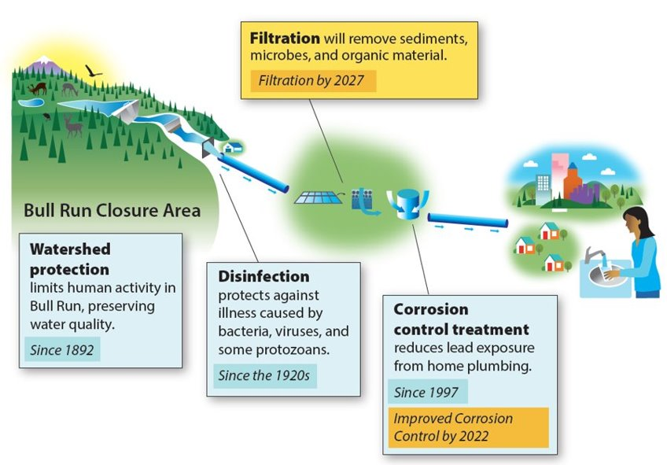
Why we’re doing these projects
Improvements to our system are required to meet federal drinking water standards.

Slide 4
Program Status
Filtration design submitted to Oregon Health Authority in October to meet our second compliance milestone.

Slide 5
Easement Acquisition Guidelines
Prioritized using public rights of way where possible
Where easements are needed:
Minimize the number and size of permanent easements
Use temporary construction easements
Work with property owners to minimize impacts, such as easements over farm roads instead of crops
Restore property to preconstruction conditions
Federal and State acquisition rules will be followed
Property Owner outreach:
Met with each owner multiple times to discuss easement and mitigations

Slide 6
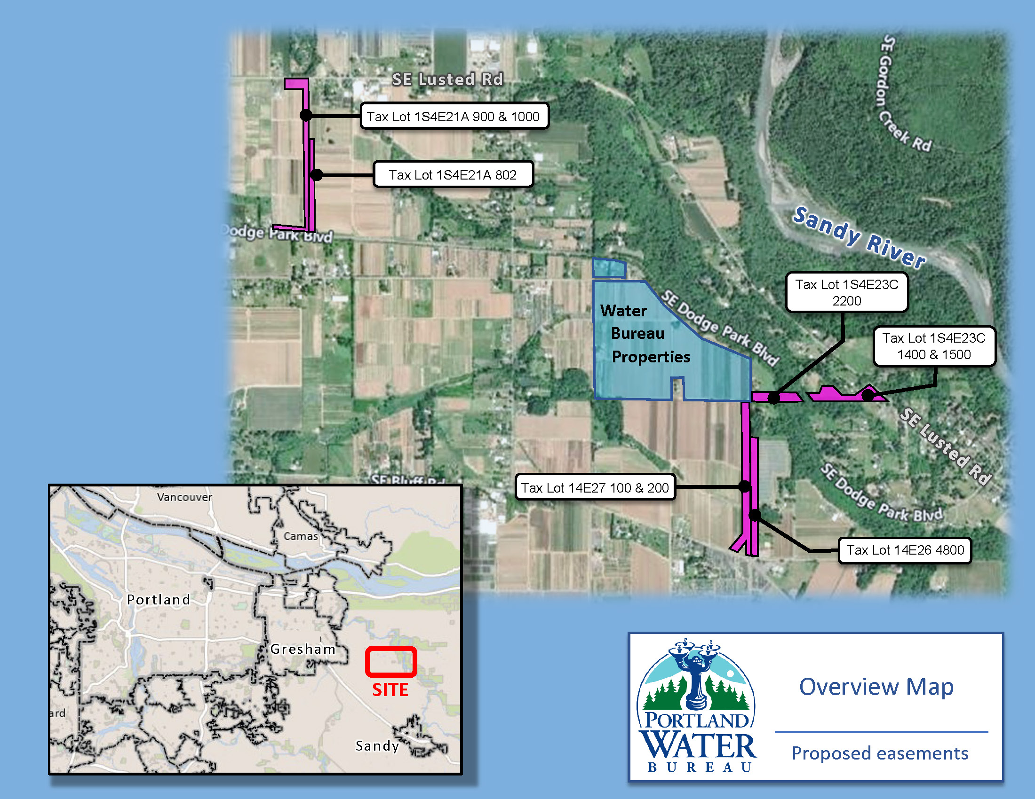
Easements
Working with 6 property owners.
9 Permanent Easements, 12.2 Acres
Pipeline
Pipeline Tunnel
Water Facility (Intertie)
Access
8 Temporary Construction Easements, 7.8 Acres

Slide 7
Request
Authorize the City of Portland, on behalf of the Portland Water Bureau, to acquire certain permanent and temporary property rights necessary for construction of the Bull Run Filtration Projects through negotiation or the exercise of the City’s eminent domain authority, as needed.
Notes:
Will not put out to bid until all easements and property issues are addressed.
As needed is the important element. We are bringing this ordinance to you so that we can start the process of negotiating.

Slide 8
Permanent Pipeline & Access Easement
Emergency access road to Filtration site
Water line to support fire hydrants
Fiber-optic cable
Temporary Construction Easement (Five Years)
Temporary construction access to Filtration site
Temporary overhead electric power to Filtration site
30 Nov 2022
Notes:
Surface Nursery Property

Slide 9
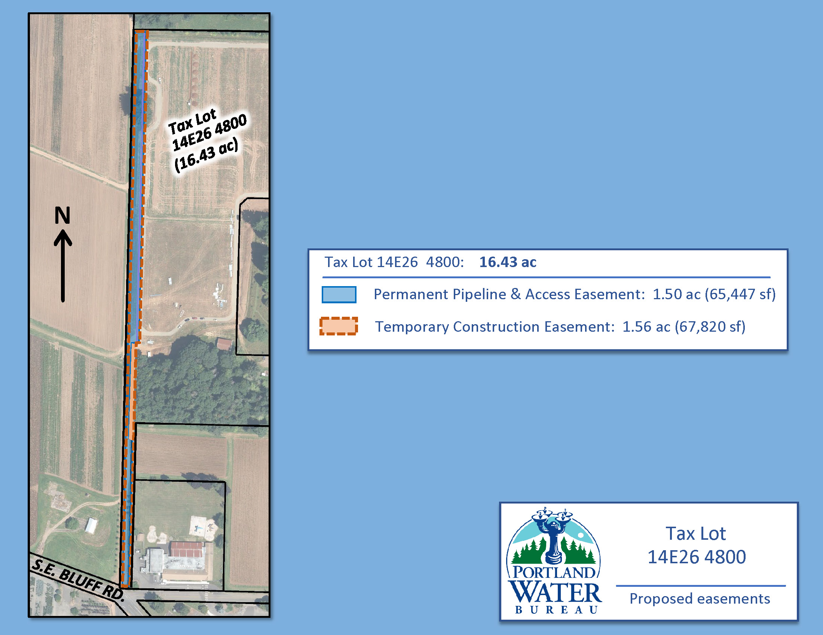
Permanent Pipeline & Access Easement
Emergency access road to Filtration site
Water line to support fire hydrants
Fiber-optic communication line
Appurtenances: including hydrants and vaults
Temporary Construction Easement
(Five Years)
Temporary construction access to Filtration site
Temporary electric over-head power to Filtration site
30 Nov 2022
Notes:
Burkholder Property (Solar facility owner)

Slide 10
Permanent Pipeline & Access Easement
Water pipelines
Appurtenances: including access vaults, water release valve, air release valve
Fiber-optic communication line
Electric power line and facilities
Access road to appurtenances
Temporary Construction Easement
(Five Years)
Work areas
30 Nov 2022
Notes:
Bissel Properties

Slide 11
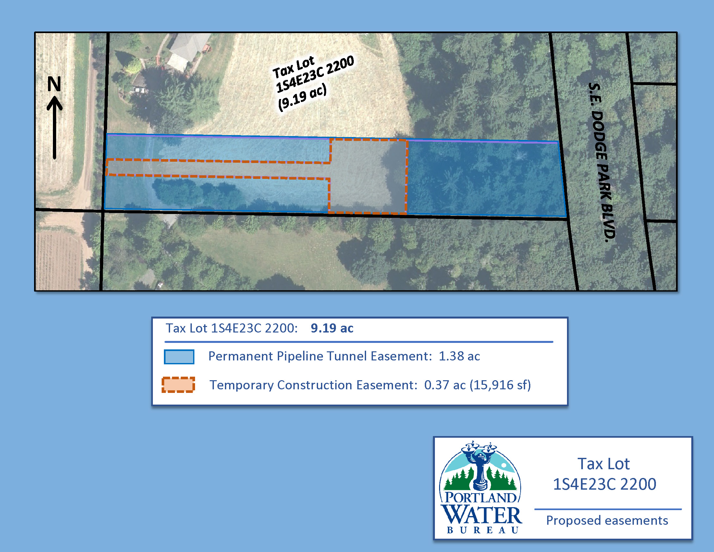
Permanent Pipeline Tunnel Easement
Water pipelines, approx. 150 feet underground
Temporary Construction Easement (Four Years)
Access to piezometer (well monitoring device)
30 Nov 2022
Notes:
Walters’ Property

Slide 12
Temporary Construction Easement
(Three Years)
Work area
30 Nov 2022
Notes:
Schoepper Property

Slide 13
TAX LOT 900
Permanent Facility Easement
Pipeline intertie facility
Small building
Paved parking
Fenced perimeter
Pipelines
Electric power facilities
Fiber-optic facilities
Permanent Pipeline and Access Easement
Pipelines
Appurtenances: including air release valves, water release valves, access vaults
Access road to pipelines and intertie facility
Temporary Construction Easement
(Five Years)
Work area
TAX LOT 1000
Temporary Construction Easement
(Five Years)
Work area
30 Nov 2022
Notes:
Ekstrom Property – North Half

Slide 14
TAX LOT 900
Permanent Pipeline and Access Easement
Pipelines
Appurtenances: including air release valves, water release valves, access vaults
Access road to pipelines and intertie facility
Temporary Construction Easement
(Five Years)
Work area
30 Nov 2022
Notes:
Ekstrom Property – South Half

Slide 15
Questions?
Bonita Oswald
503 823-6039
Portland.gov/water/bullruntreatment/filtration/
PortlandWater
PortlandWaterBureau
PortlandWaterBureau
E-News: eepurl.com/gcWEjj

Slide 16
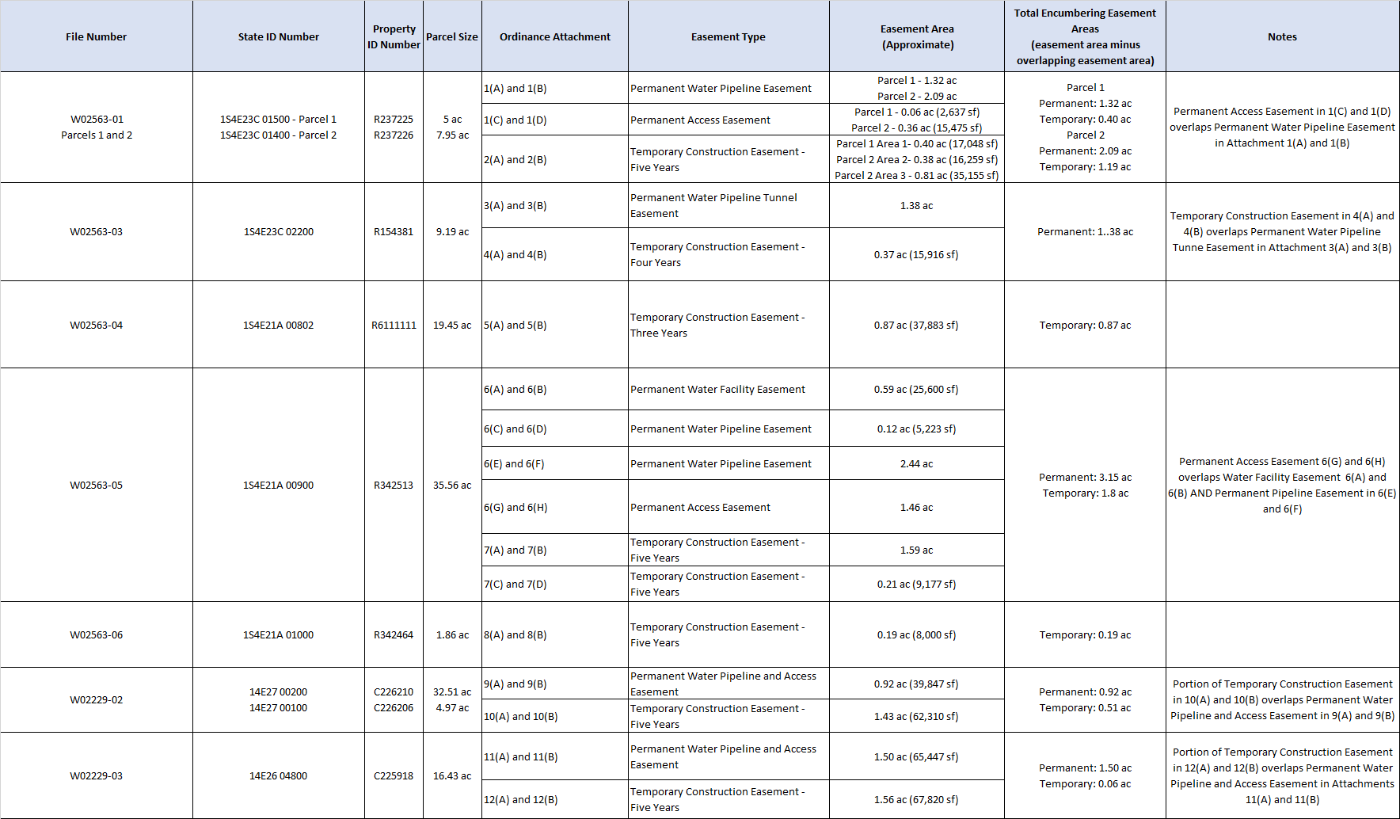
30 Nov 2022
Notes:
Ekstrom Property – South Half

