Slide 1
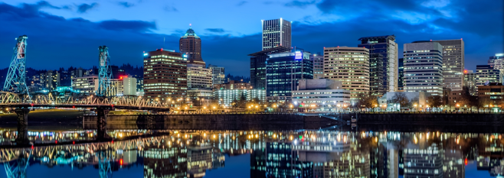
English as a Second Language Driver Program November 30, 2022
A/Cmdr. David Abrahamson

Slide 2
SCOPE
This grant will provide funding for the Portland Police Bureau to provide driving instruction and traffic safety training to Portlanders who speak English as a second language (ESL) or have limited English proficiency (LEP). The primary objective is for PPB police and partners to educate, train, and empower IRNPs with classroom and hands-on driver’s education training so they are confident and safe on our roadways.

Slide 3
HISTORICAL CONTEXT
In 2013, Portland Police recognized it was responding to a large volume of crashes involving immigrants/refugees/New Portlanders' (IRNPs) who have been self-taught drivers, and not familiar with local laws.
Driver education manuals and education were/are available in English or Spanish.
Meetings were sought with IRNP organizations to hear how we can provide support. Through their input, content was created with government partners and funding was sought to create a program that would meet unserved needs.

Slide 4
HISTORICAL CONTEXT
In 2015-2019 private and City grants were obtained for the program.
Nearly 800 New Portlanders have attended previous courses.
In 2018, the Oregon Driver Manual was translated into Russian through the assistance of Portland State University’s Russian Flagship Program.
PPB will utilize partners such as Oregon Impact, Portland Bureau of Transportation, Oregon Driver Education Center (ODEC), and Oregon Department of Transportation Safety Team to assist with education components.

Slide 5
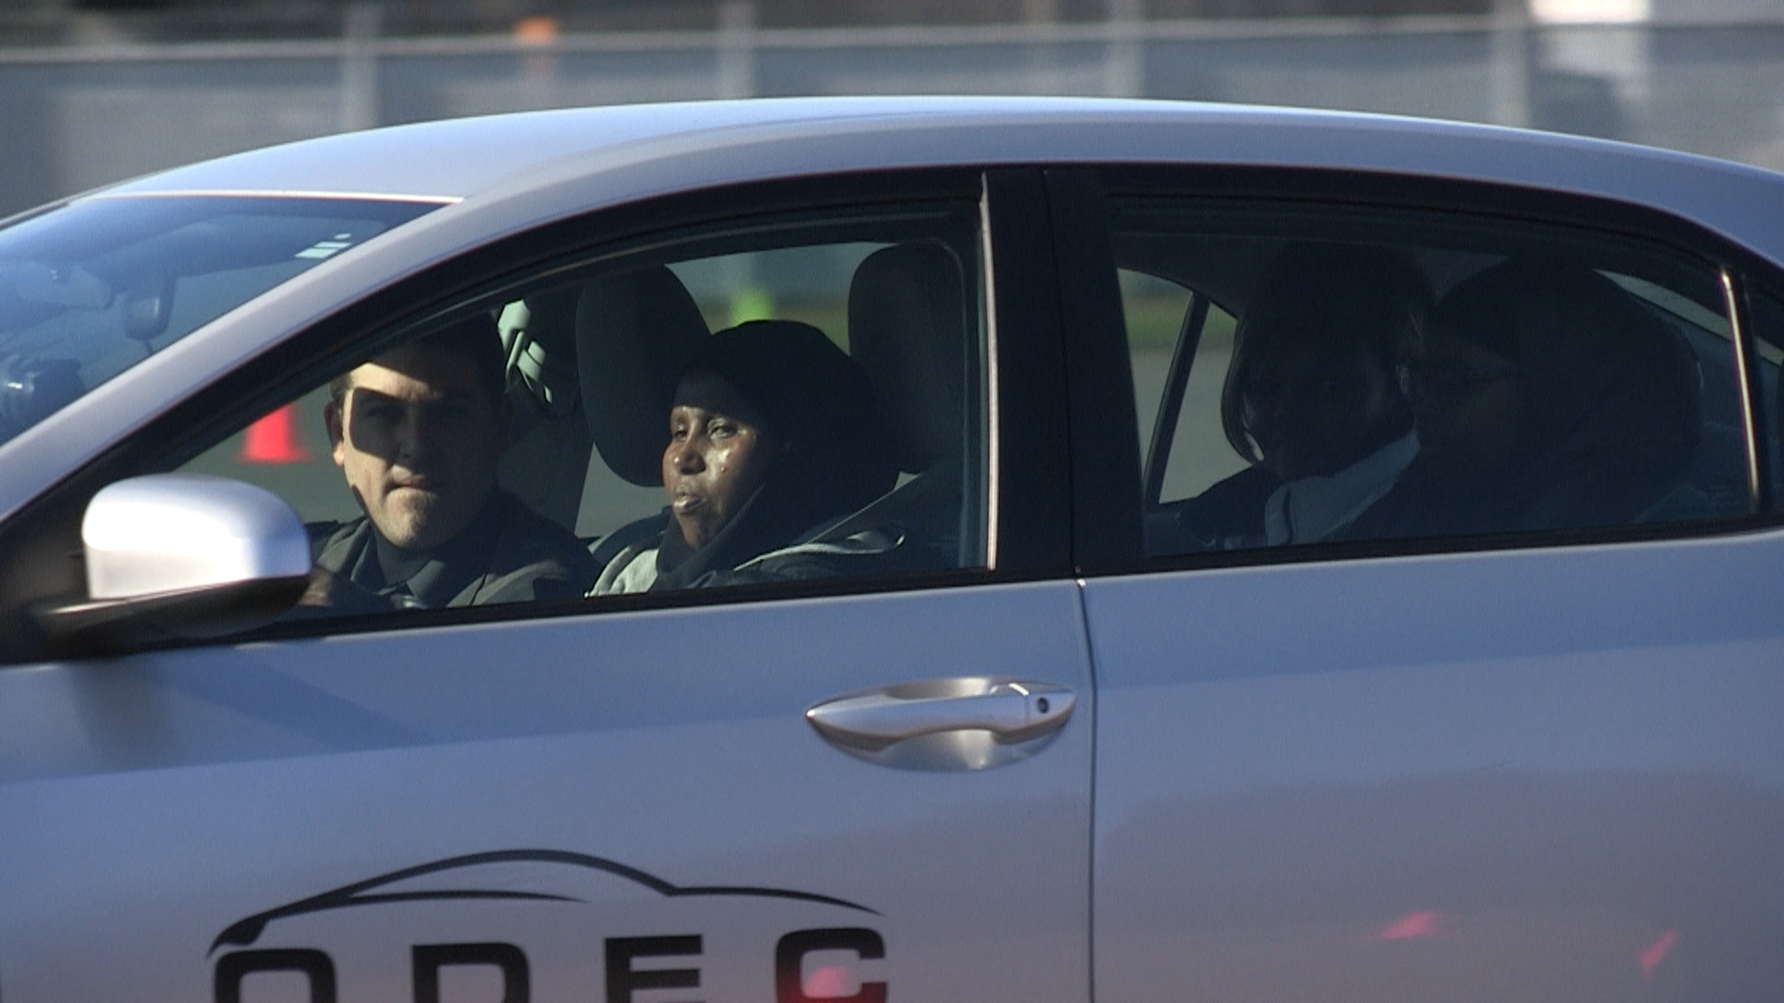
PERSPECTIVE

Slide 6
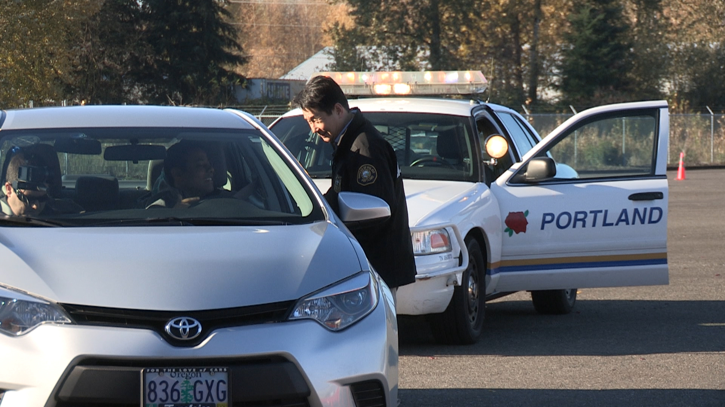
PERSPECTIVE

Slide 7
PERSPECTIVE

Slide 8
These courses have been a catalyst for understanding and relationship with our diverse communities, breaking down fear of police, and providing greater understanding for PPB members.
A/Commander David Abrahamson David.Abrahamson@police.portlandoregon.gov
503 793-3837

