Slide 1
City of Portland Action Plan FY 2022-23
Molly Rogers, Interim Director, PHB
Dr. Uma Krishnan, Action Plan Lead
August 3, 2022
Action Plan City Council Hearing| 08/3/2022 | Portland Housing Bureau

Slide 2
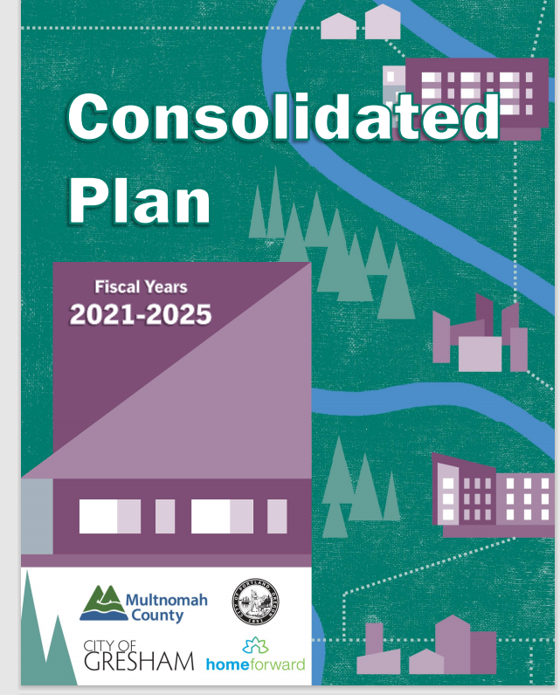
Consolidated Plan Basics
What is the “Con Plan”? How is it connected to annual Action Plans?
Who are the Portland Consortium Partners?
Which are the HUD Program Funds that the Portland Consortium receives?
Action Plan City Council Hearing| 08/3/2022| Portland Housing Bureau
2

Slide 3
What is the Consolidated Plan?
Through the Consolidated Plan (often called the “Con Plan”) agencies receiving funds from the federal Dept. of Housing and Urban Development (HUD) assess community needs and make strategic investment decisions
The Plan period can be 3 to 5 years
The Plan “consolidates” four formula block grant programs
HUD provides specific guidance on contents of the plan through sections and questions.
3

Slide 4
What is an Annual Action Plan?
Action Plan (“AP”) is a yearly document that needs to be submitted to HUD. Since the Con Plan cover a 5-year period, there will be 5 associated APs.
It details:
How the allocated resources will be spent on various projects. Each of the projects are associated with specified Con Plan Goals
Projects comprise of various “Activities”
HUD upon review and approval of the AP release the grant agreement
Con Plan Strategic Goals Implemented through Action Plan Projects
AP
FY 21-22
AP
FY 22-23
AP
FY 23-24
AP
FY 24-25
AP
FY 25-26
4

Slide 5
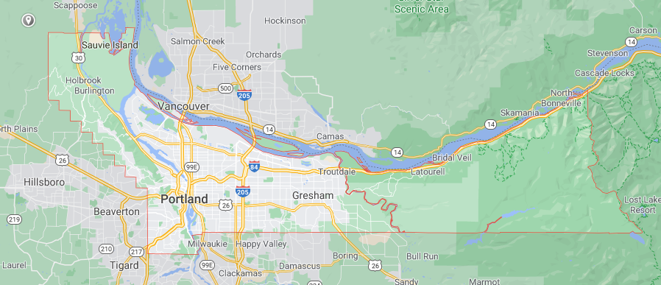
Who are the Consortium Partners?
City of Portland (Consortium Lead)
City of Gresham
Multnomah County (representing the unincorporated portions and smaller cities (Maywood Park, Troutdale, Fairview, Wood Village, Corbett) within its boundaries
5

Slide 6
What Federal Funds does the Consortium receive? Consortium
CDBG: Community Development Block Grant Program
HOME: HOME Investment Partnerships Program
ESG: Emergency Solutions Grants Program
HOPWA: Housing Opportunities for Persons with AIDS Program
6

Slide 7
Consolidated Plan: Priority Needs and Goals
1. Affordable Housing Choice | Increase and preserve affordable housing choice in ways that promote racial equity
2. Basic Services & Homeless Prevention/Interventions | Reduce and prevent homelessness in ways that can mitigate overrepresentation of BIPOC communities
3. Community and Economic Development | Improve livability through Infrastructure, employment, and anti-poverty strategies
Action Plan City Council Hearing| 08/3/2022 | Portland Housing Bureau
7

Slide 8
HUD Funding Received for FY 2022-23
Consortium Member | CDBG Allocation | HOME Allocation | ESG Allocation | HOPWA Allocation
Gresham | $1,020,99 | - | - | -
Multnomah County | $298,610 | - | - | -
Portland | $8,284,513 | $3,923,762 | $729,011 | $1,891,284
City of Gresham and Multnomah County submit separate and individual annual Action Plans for their CDBG Entitlement Programs
25% of CDBG Allocation is passed on to Prosper Portland for Community Economic Development Activities & the remaining is allocated to projects that further other Con Plan Goals
HOME allocation is shared on a formula basis with Consortium partners Gresham and Multnomah County
ESG & HOPWA Allocations are passed on to the Joint Office of Homeless Services
Action Plan City Council Hearing| 08/3/2022| Portland Housing Bureau
8

Slide 9
City of Portland Project List: FY 2022-23
# | Project Title | Goal | Grant | Adopted FY22-23
1 | FY21-22 Program Administration - CDBG | 1 | CDBG | $ 1,173,190.00
2 | FY21-22 Program Delivery - CDBG | 1 | CDBG | $ 470,415.00
3 | FY21-22 Program Administration - HOME | 1 | HOME | $ 450,007.00
4 | FY21-22 ESG Subcontracts | 2 | ESG | $ 729,011.00
5 | FY21-22 Program Administration - HOPWA | 2 | HOPWA | $ 56,738.52
6 | FY21-22 Fair Housing Admin - CDBG | 1 | CDBG | $ 45,385.00
7 | FY21-22 Section 108 Repayment | 1 | CDBG | $ 779,513.00
8 | FY21-22 Economic Opportunity Initiative - Microenterprise | 3 | CDBG | $ 599,602.00
9 | FY21-22 Economic Opportunity Initiative - Adult Workforce | 3 | CDBG | $ 866,646.00
10 | FY21-22 Economic Opportunity Initiative - Youth Workforce | 3 | CDBG | $ 866,646.00
11 | FY21-22 Housing Development Center | 1 | CDBG | $ 12,000.00
12 | FY21-22 New Affordable Housing | 1 | CDBG | $ 2,517,353.00
 | FY21-22 New Affordable Housing | 1 | HOME | $ 3,970,059.00
13 | FY21-22 HOME Consortium - Gresham | 1 | HOME | $ 785,366.00
14 | FY21-22 HOME Consortium - Multnomah Co | 1 | HOME | $ 153,252.00
15 | FY21-22 Single Family Fin Assist | 1 | CDBG | $ 1,044,000.00
16 | FY21-22 Single Family Home Repair | 1 | CDBG | $ 1,159,421.00
17 | FY21-22 HOME CHDO Operating Contracts | 1 | HOME | $ 196,188.00
18 | FY21-22 HOPWA Subcontracts | 2 | HOPWA | $ 1,834,545.48
Action Plan City Council Hearing| 08/3/2022| Portland Housing Bureau
9

Slide 10
Requested Council Action & Recommendation
Review the 2022-2023 annual Action Plan for the City of Portland
Staff recommends Council move to approve this Ordinance to adopt and authorize the submission of the FY 2022-2023 Portland Action Plan Application for the CDBG, ESG, HOME, and HOPWA entitlement funds.

