Slide 1





Diversity Civic Leadership Program

Slide 2
Partner Organization | FY 2022/23 Amount
Immigrant and Refugee Community Organization (IRCO) | $147,334
Latino Network | $147,334
Native American Youth Alliance (NAYA) | $147,334
Urban League of Portland | $147,334
Unite Oregon | $147,334
Total | $736,670
Partner Org
anizations

Slide 3



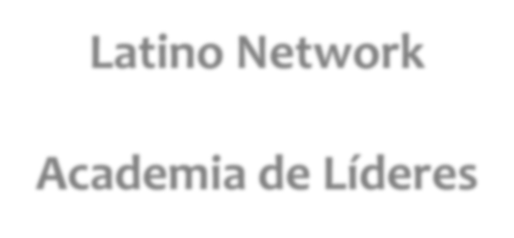

Latino Network
Academia de Líderes
Ana Muñoz
Director, Community Engagement & Leadership Development

Slide 4



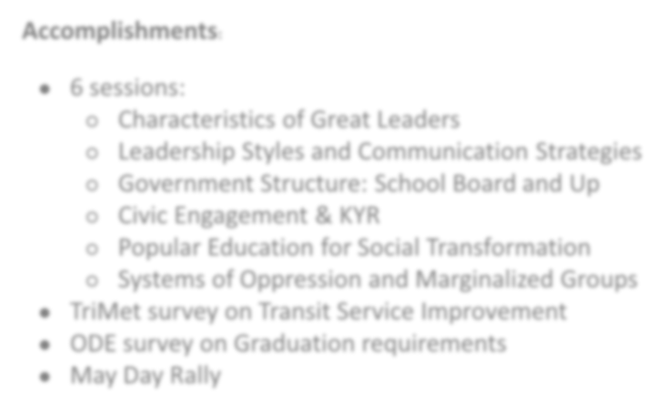


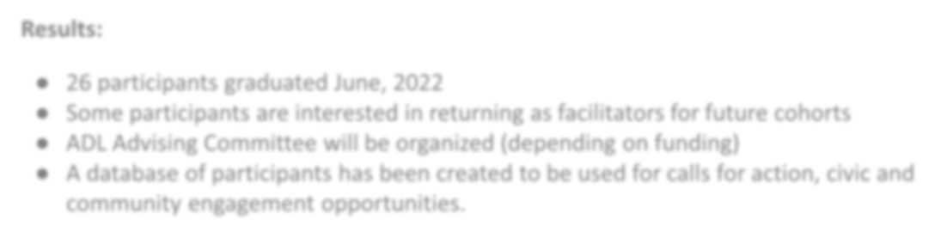
Impact:
Academia de Lideres has been around for more than 12 year.
Graduate between 15-20 leaders each year.
Opportunity to cross collaborate with other culturally specific CBOs in Multnomah County
  Verde
Accomplishments:
6 sessions:
  Characteristics of Great Leaders
  Leadership Styles and Communication Strategies
  Government Structure: School Board and Up
  Civic Engagement & KYR
  Popular Education for Social Transformation
  Systems of Oppression and Marginalized Groups
TriMet survey on Transit Service Improvement
ODE survey on Graduation requirements
May Day Rally
El Programa Hispano
Hacienda CDC
Others
Join forces to support efforts to create healthy and thriving communities
Results:
26 participants graduated June, 2022
Some participants are interested in returning as facilitators for future cohorts
ADL Advising Committee will be organized (depending on funding)
A database of participants has been created to be used for calls for action, civic and community engagement opportunities.

Slide 5



Testimony:
Paola Rodrigues
Testimony: Francisco Aguirre

Slide 6
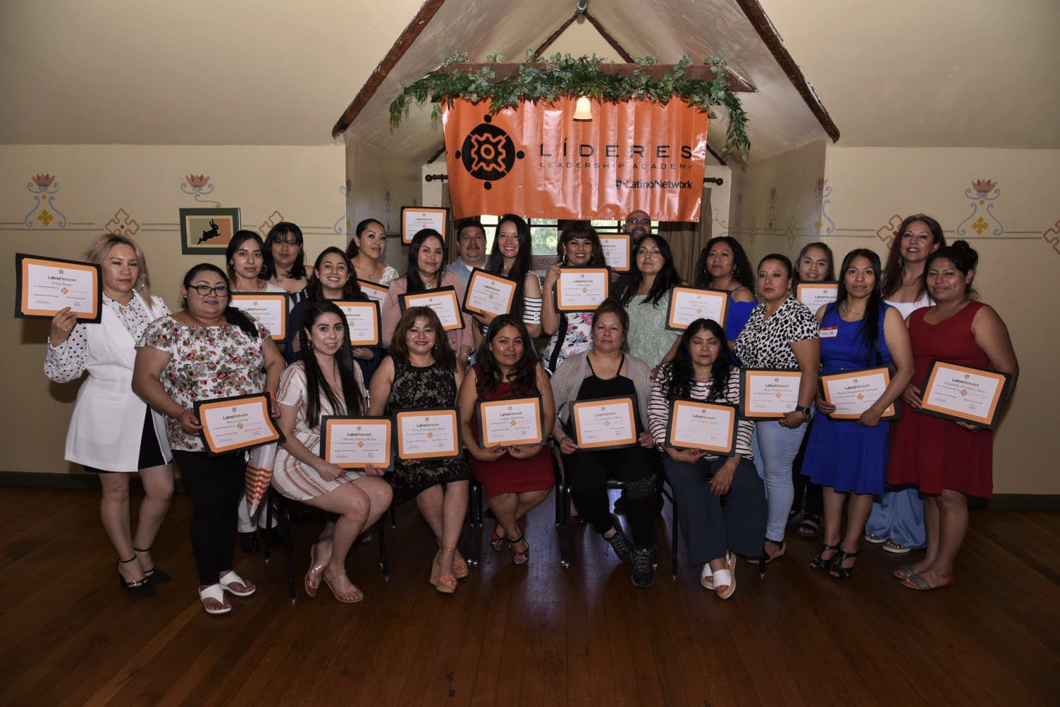
Thank you!

Slide 7
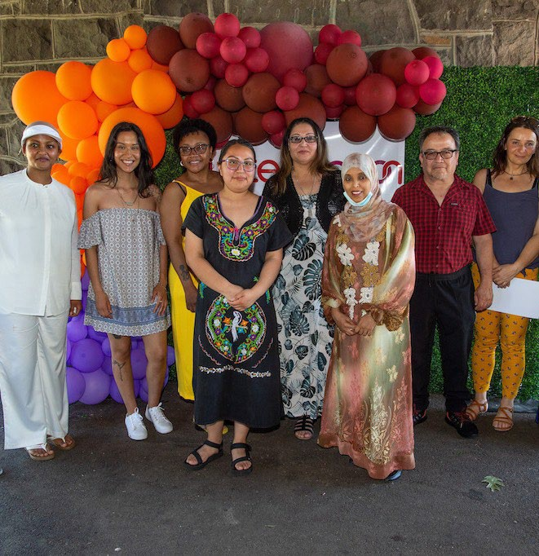





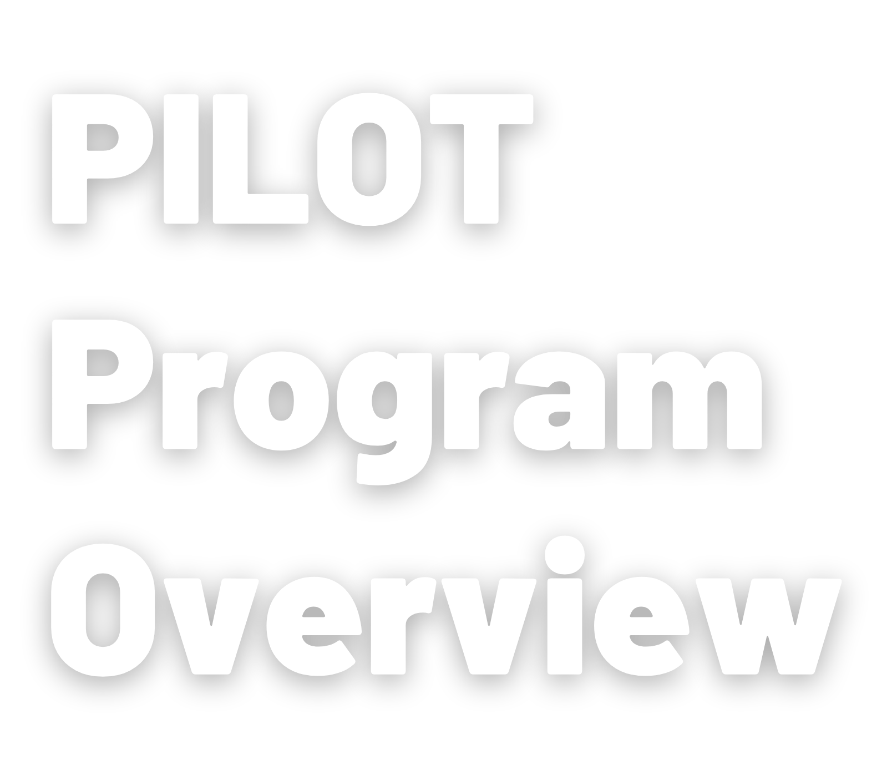
Portland City Council Hearing July 13, 2022
VANIA LUCIO
Multnomah Co.Lead Organizer.

Slide 8

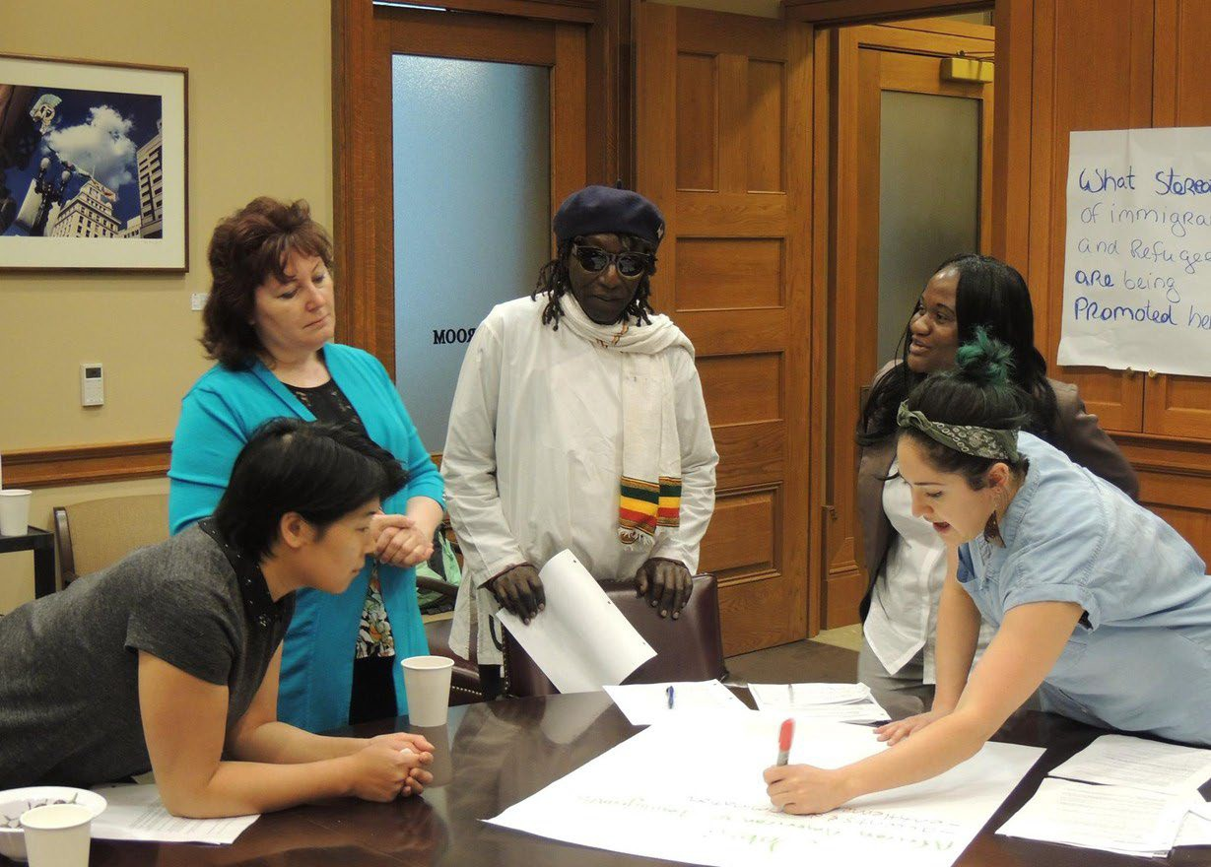
In order to build power in this environment we have found that creating and growing multiracial organizing spaces like PILOT are necessary to continue our fight for racial justice.
01
After 15 years, we have graduated about 300
leaders in cohorts of 15-30/year, from about 71 countries of origin/ethnicities.
02
Through our partnership with the national refugee
advocacy coalition We Are All America, we' ve helped implement the P I LOT model in other states.
03
P I LOT wa s highlighted in Unbound Philanthropy’s report
F r o m R esett lement t o Belong ing: O pportunit ies for
R ef u g e e Leader s hip an d C iv ic Part icipation highlighting refugee civic engagement and leadership development programs.
PILOTmembers at Portland City Hall in 2016.

Slide 9

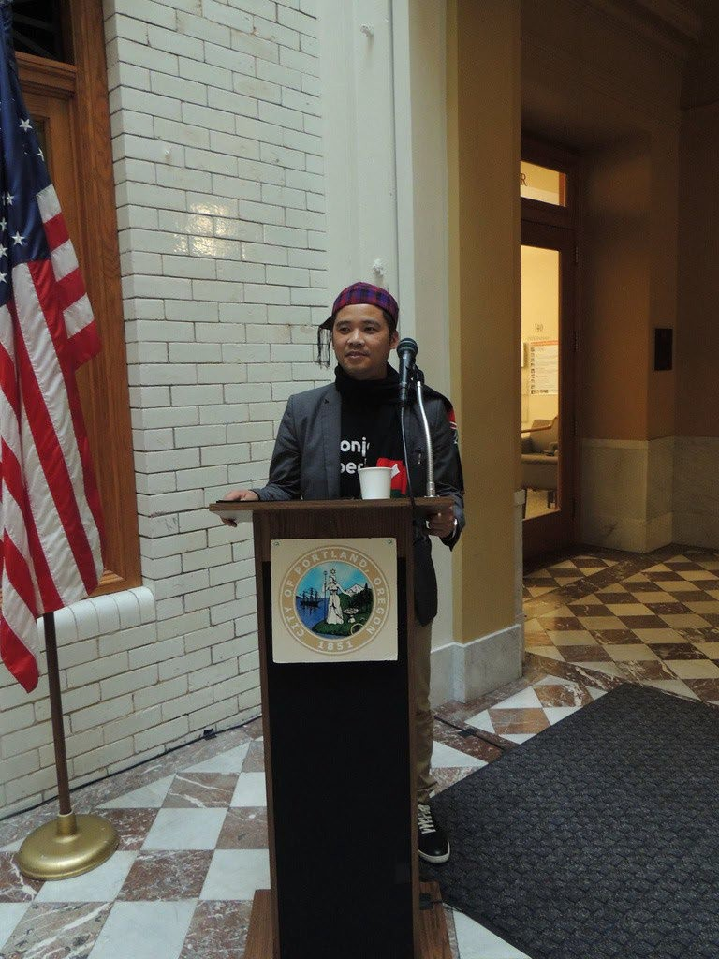
2010-2011:Created the Somali Youth of Oregon
P I LOT grad Kamar Haji-Mohamed organized 5 0 Somali youth to create Somali Youth of Oregon, a sp ace for dialogue about
challenges and barriers that Somali youth are facing.
2015-2016: Helped pass HB 2002, the End Profiling Act
Our P I LOT cohort collected 34 petitions to the Attorney General from students and helped organize two listening sessions on law enforcement profiling.
2018-2019: Campaigned to end the City's cooperation with the FBI’s Joint Terroism Task Force
In January 2019, one of our P I LOT participants testified passionately in front of the Portland City Commission, telling the story of how the Joint Terrorism Task Force had severely impacted her family, arresting her father and temporarily detaining her and her siblings. City
Commissioners later voted to withdraw from the JTT F.
PILOTgraduate at the 2016 graduation at Portland City Hall.

Slide 10

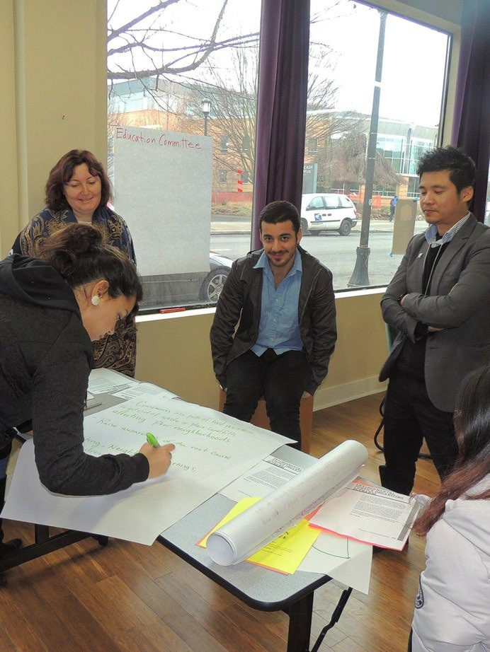
2019-2020: #WeCountOregon
Unite Oregon was one of 13 partner organizations working together as part of #We Count Oregon in coalition to get out the word about the importance of the 2020 Census for our “hard to count” communities. PILOT participants turned out 27 African community members to the Black census event, and helped to
register 134 people for the Muslim Summit event. These activities led to a successful census count of our communities that led to
an additional Congressional seat.
2020-2021: BPS Partnership
3 cohort members then designed and organized workshops for East Portland’s Arab and Kurdish
communities, Ethiopian and Eritrean communities, and
youth. These workshops were attended by 33 Arab and Kurdish community members, 67 youth, and 64 Eritrean and Ethiopian community members. These workshops paved a path to expand the discussion towards other
sustainability practices such as gardening and traditional food growing.
PILOTRetreat in 2016.

Slide 11
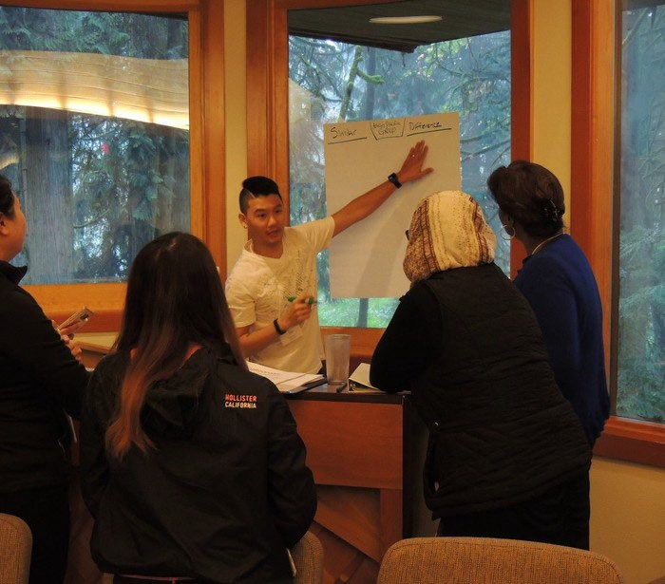
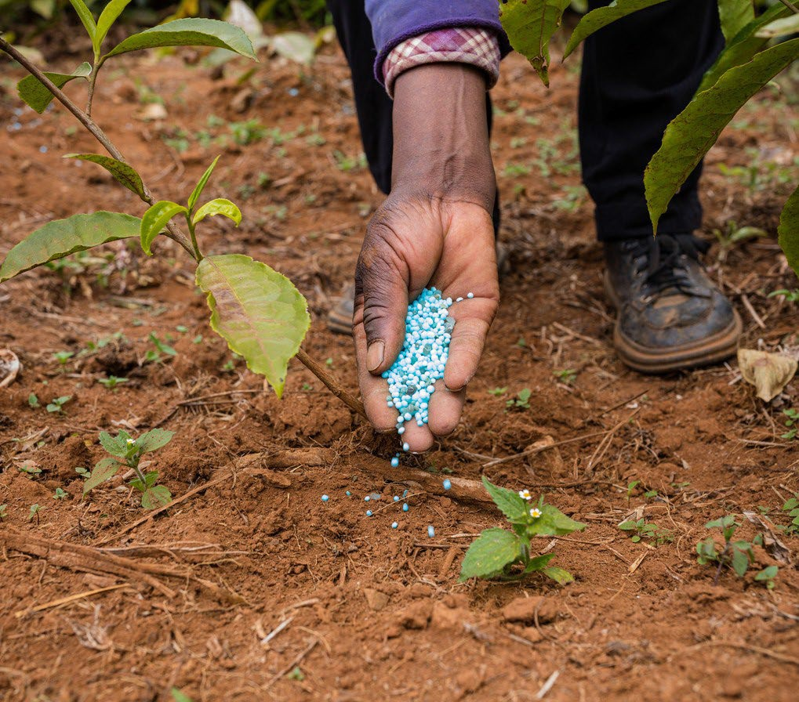

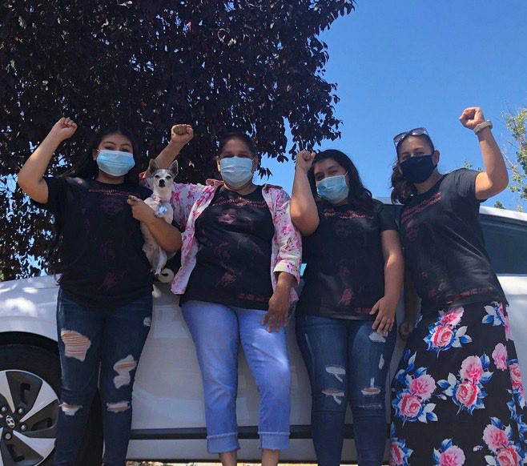
Future Goals
Streamlined Process
Community Garden
We’ve secured resources for a
Economic Prosperity
We have been organizing in East Portland to build wealth and equitable investments
Service to Organizing Model
Our direct service program connects people that we provide direct service to organizing and other opportunities so the people that are most impacted are the directly informing the policies that we are trying to change.
Streamline connect leadership
our process to graduates to councils, board
community garden in East
with
and so
Portland in partnership
and commissions, and provide training (budgeting,
the Portland Parks Recreation Department
participants can access
for our communities and are hearing directly from the
community that they need the training and resources to explore and implement
entrepreneurial activities.
policy, etc) so they can fully participate in those
food
and practice entrepreneurship by selling the traditional food they grow.
decision making processes

Slide 12
Testimony:
Maria Zavala

Slide 13
THANK YOU
Visit uniteoregon. org to learn more about the PILOT program.

