Slide 1

Intergovernmental Agreement with Multnomah County Vector Control
Jeremiah Hess, P.E. | Engineering Supervisor | Bureau of Environmental Services
6/29/2022
MINGUS MAPPS, COMMISSIONER
DAWN UCHIYAMA, INTERIM DIRECTOR

Slide 2
Vector Control Services Required
Rats living in the sewers leave the pipes from street inlets and service branches
BES owns over 180 stormwater quality sites requiring mosquito treatment and monitoring

Slide 3
Program Goals
JOINT CITY/COUNTY PURPOSES AND GOALS FOR THIS AGREEMENT
Protect Public and Environmental Health, and Neighborhood Livability
Provide Cost Effective and Efficient Services
Monitor and Control the Vector Population in BES Facilities

Slide 4
Vector Control Service Provider
Multnomah County has been providing health services to City since 1968 through multi-year Intergovernmental Agreements.
Scope
  Rodent Control and Surveillance program
  Mosquito Control and Surveillance program
  Vector control education and public outreach
  Community driven complaint response and investigation

Slide 5
Project Budget and Schedule
BES agrees to pay Multnomah County Vector Control a total not to exceed $1,710,000.
The annual not to exceed amount shall be $342,000.
The IGA is for 5-years
  Effective immediately

Slide 6
Revised 5-year Intergovernmental Agreement
Reimbursement based on actual services performed (fully-burdened hourly rate)
Billing rates will be adjusted annually for inflation
Costs tied to assets for Asset Management tracking purposes
Reporting of data and metrics spatially

Slide 7
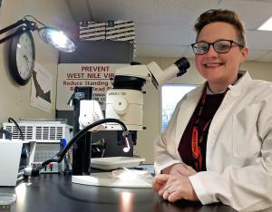
Questions?
Thank you

