Slide 1
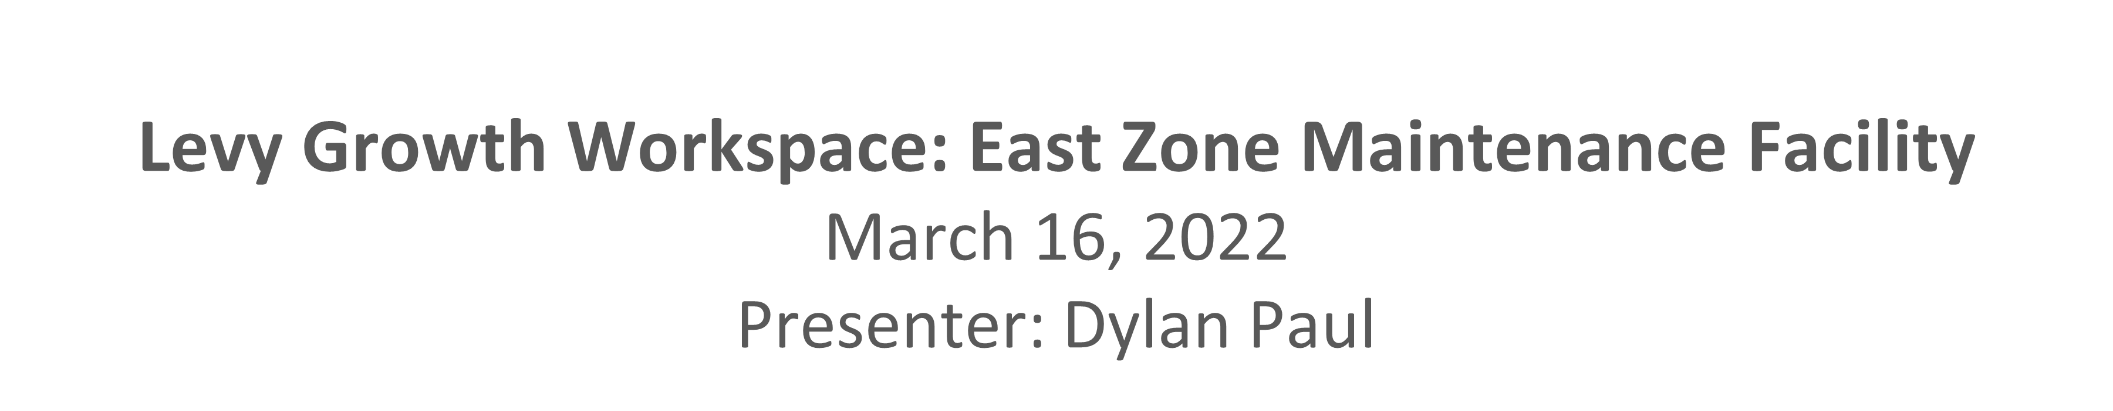
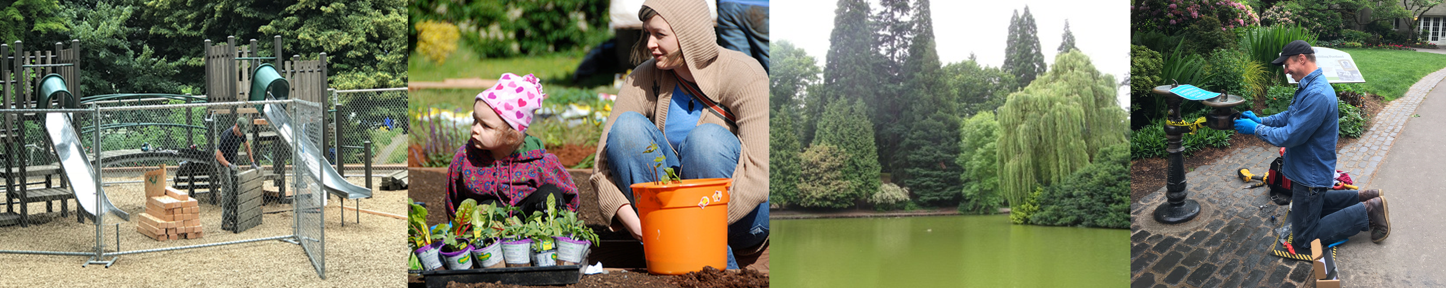

Slide 2
New Levy Funded Maintenance and Operation Space
Must Accommodate Levy Growth timeline
Must be located in NE Portland
Must accommodate 50 FTE, 60 Seasonal staff with vehicles and equipment
Yard and operation space focus, office space is auxiliary.
Must be mostly turnkey/ready to use
Must be leased space
Notes:
CHRIS: will talk about how we did our best to keep workgroups in-place, wasn’t always possible (in-fact we have instances of violating all criteria except accommodating growth)
- Explain or discuss the tension between efficiency of geographic location near work locations and efficiency gains of collaboration and efficiency gains of common area spaces, 30% maintenance facilities common areas, restrooms, lactation rooms, etc???

Slide 3
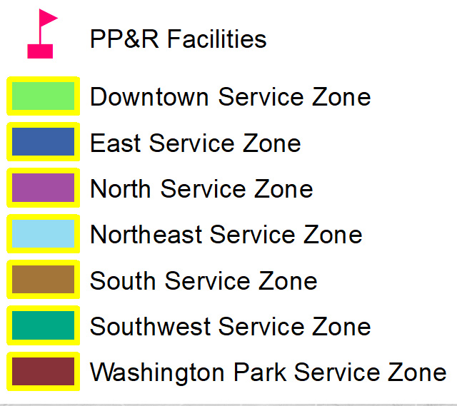
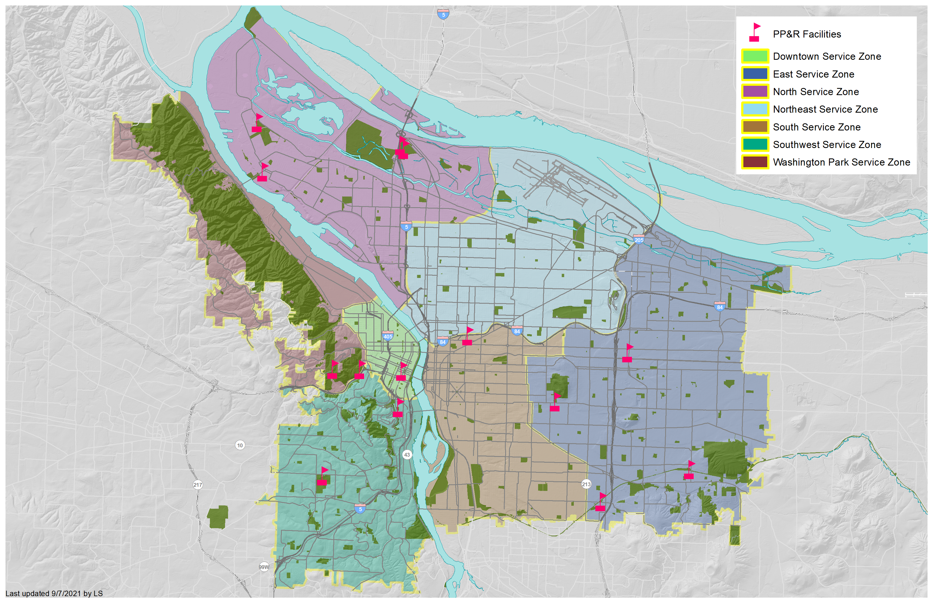
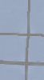
★
Potential Future PP&R Facility
Facility Location
NORTH ZONE / CHIMNEY PARK
URBAN FORESTRY
ATHLETIC FIELDS
MAINTENANCE
ST. JOHNS
NORTHEAST ZONE
?
POTENTIAL EAST ZONE MAINTENANCE FACILITY
★
WASHINGTON PARK / DOWNTOWN ZONE
HOYT ARBORETUM /
WASHINGTON PARK
THE PORTLAND BUILDING
CARNEGIE ANNEX /
LAIR HILL PARK
SOUTHWEST ZONE /
GABRIEL PARK
FLAVEL – CNE/SE ZONE
MT TABOR
EAST SERVICE ZONE
Notes:
After an in-depth search the location marked with a star in this map was been identified as the preferred location for the facility. This site is at NE Mason and NE Airport Way.
This exact location has not been previously shared widely as we have been engaging in negotiations and doing due diligence about land use.
CAMILA (or Chris)
Make a note that this hasn’t been shared as we have been in negotiations and doing due diligence about land use.

Slide 5
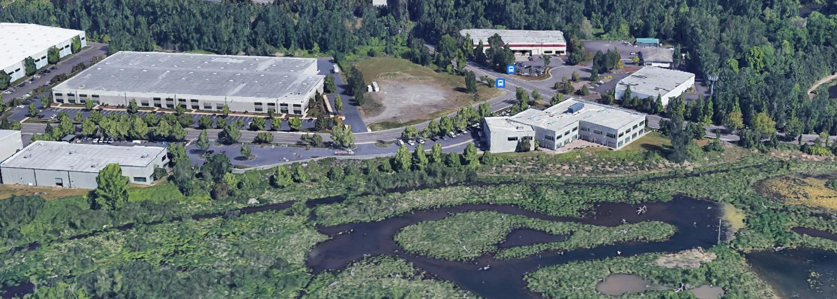
Facility Details
Maintenance Shop
with existing fencing
Personal
Vehicle Parking
Over 1.2ac. Usable Yard
For Fleet and Storage
Bus
Stop
Warehouse &
Storage
Multi-tenant office
LEED Gold - 2009
NE Airport Way
Big Four Corners
Natural Area
NE Mason St
Big Four Corners
Natural Area
Notes:
CAMILA
This site located directly adjacent to the Big Four Corners Natural Area. The site is made up of a multi-tenant office with an attached storage warehouse. It is nearby a bus stop, and we’ll be working to secure sufficient fleet and personal vehicle parking as well as bicycle parking spaces. Additionally, there is a large maintenance shop building with large overhead doors and fenced parking.
Now that we have found a site that meets the teams’ basic requirements; we along with the property team and will continue to work on additional due-diligence, approvals
Simultaneously we will be more deeply engaging and setting up meetings with building users to progress space planning
Once we get to this phase I will be the main point of contact for space planning and will be advocating for all of our groups’ needs as we prepare to work with the owner’s architect on permit drawings for construction and improvements.
During this phase I will also work with these teams to understand key areas where customization can be achieved and provide the most value to our teams. An example of a key customization that will be pursued is fencing all parking areas and adding a washer and dryer.

Slide 6
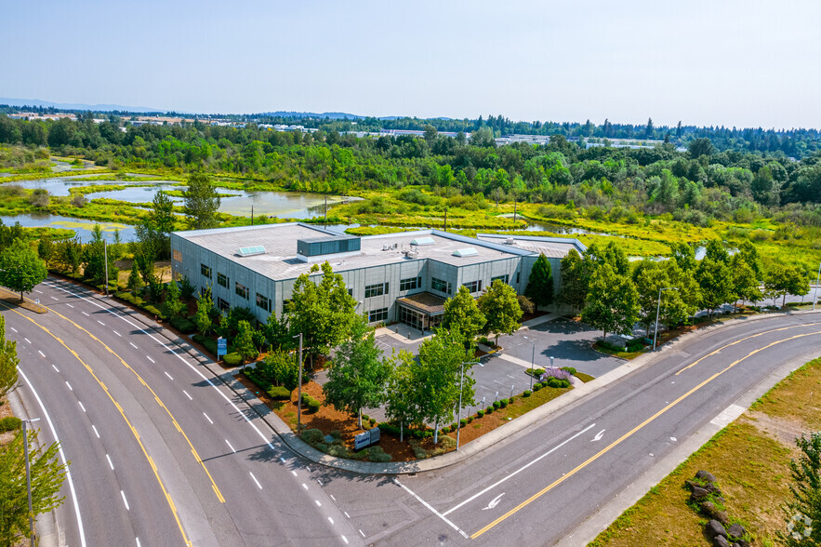
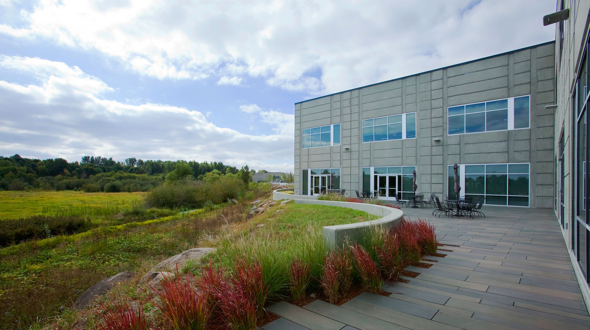
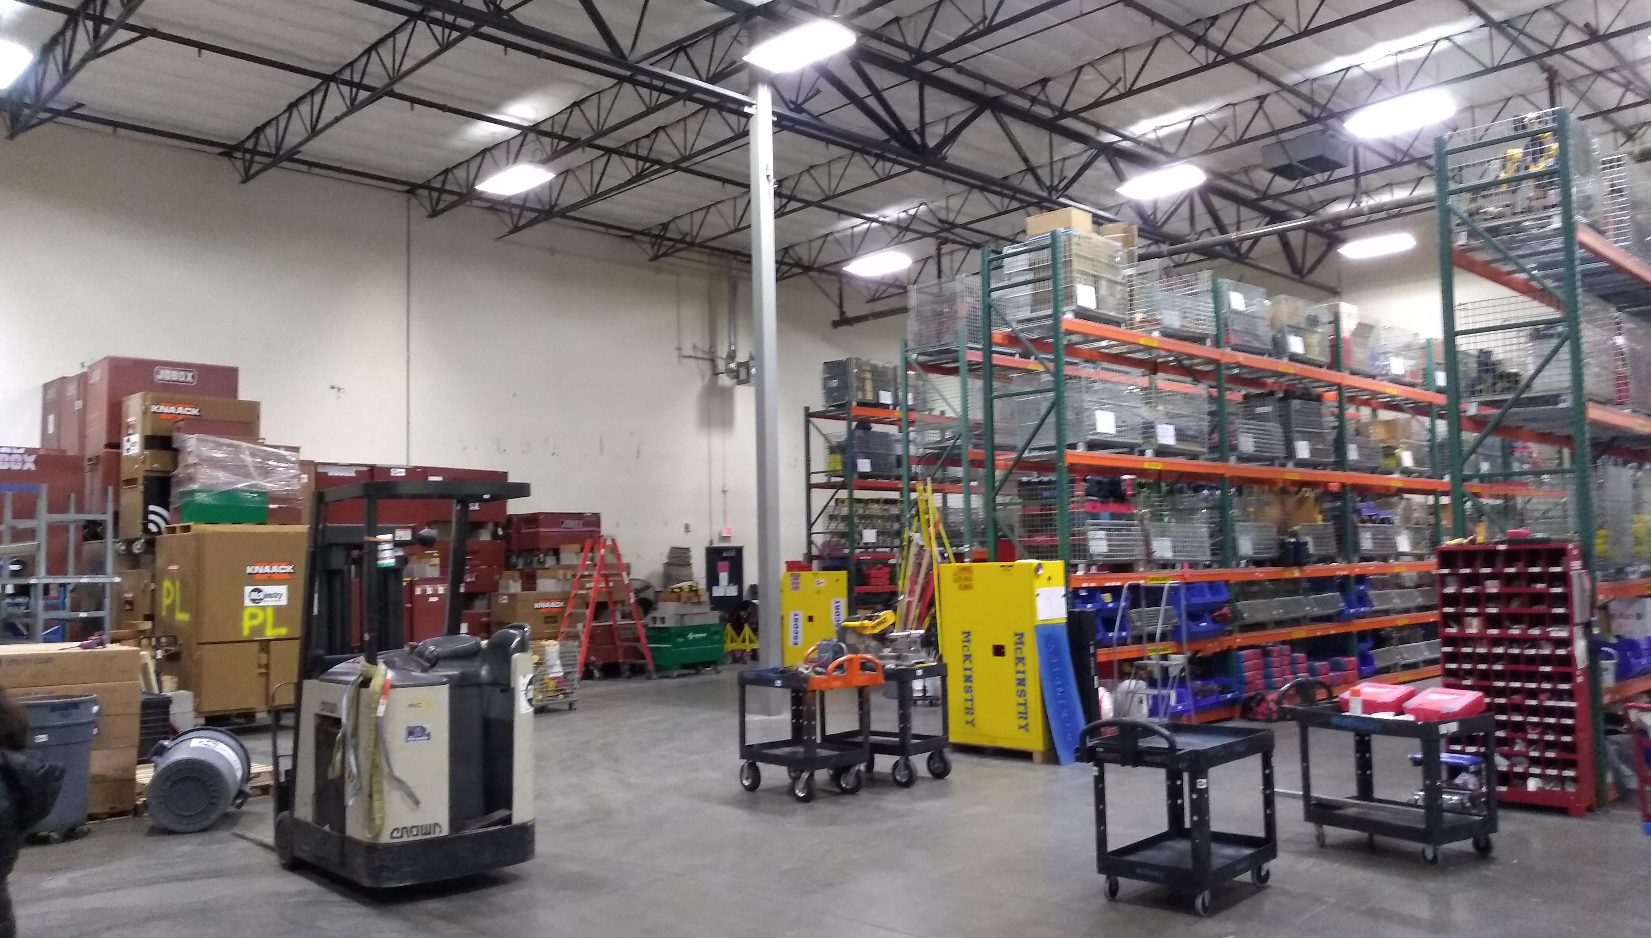
Facility Details
Maintenance Shop
with existing fencing
Multi-tenant office
LEED Gold - Built in 2009
Over 1.2ac. Usable Yard
For Fleet and Storage
Warehouse & Storage
Big Four Corners
Natural Area
NE Airport Way
NE Mason St
Notes:
CAMILA
As we move forward towards occupancy, I will also work with internal teams, vendors and possibly OMF on move-in logistics including phasing options as needed

Slide 7
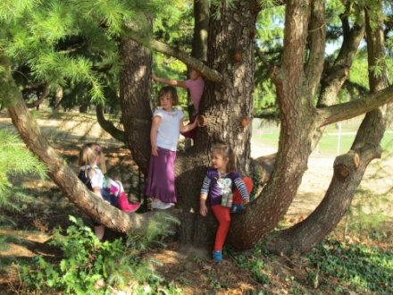

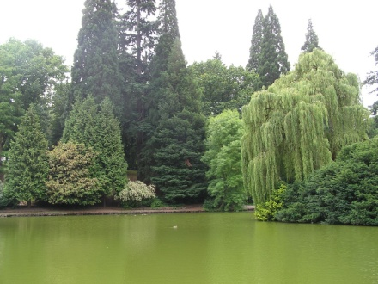
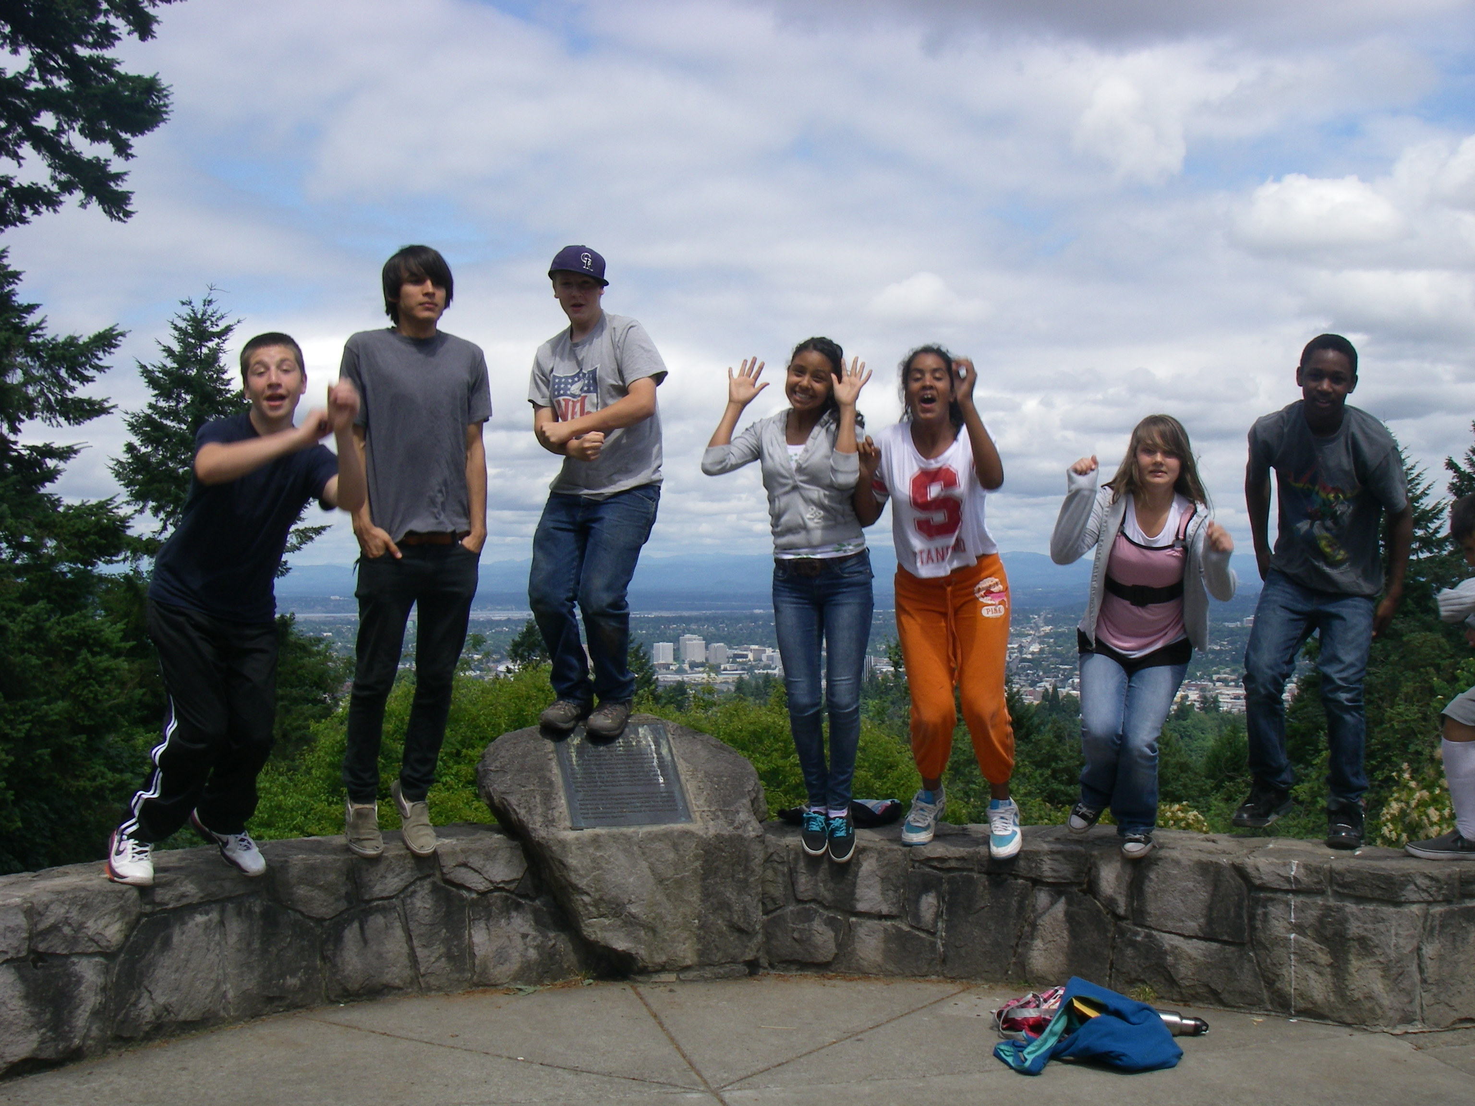
Questions?

