Slide 1
Total budget: $239,959
City of Portland:
General Fund (spring BMP), $100,000
City Arts Program, $20,000
Office of Community and Civic Life, $20,000
Emergency Coordination Center, $10,000
Oregon Community Foundation, $25,000
James F. & Marion L. Miller Foundation, $25,000
City Arts Program redeployment of PDX CARES money, $39,959

Slide 2
Total served
16 artists
33 nonprofit organizations
5,000 Portlanders (estimate)

Slide 3
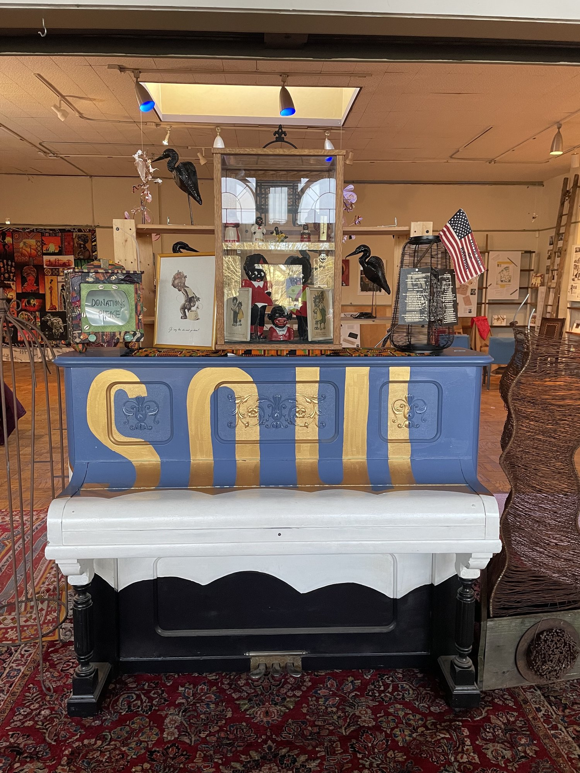
Soul Restoration Project
Darrell Grant

Slide 4
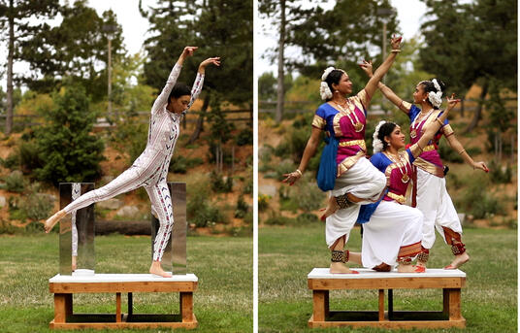
Ten Tiny Dances
featuring Adrian Lobo

Slide 5
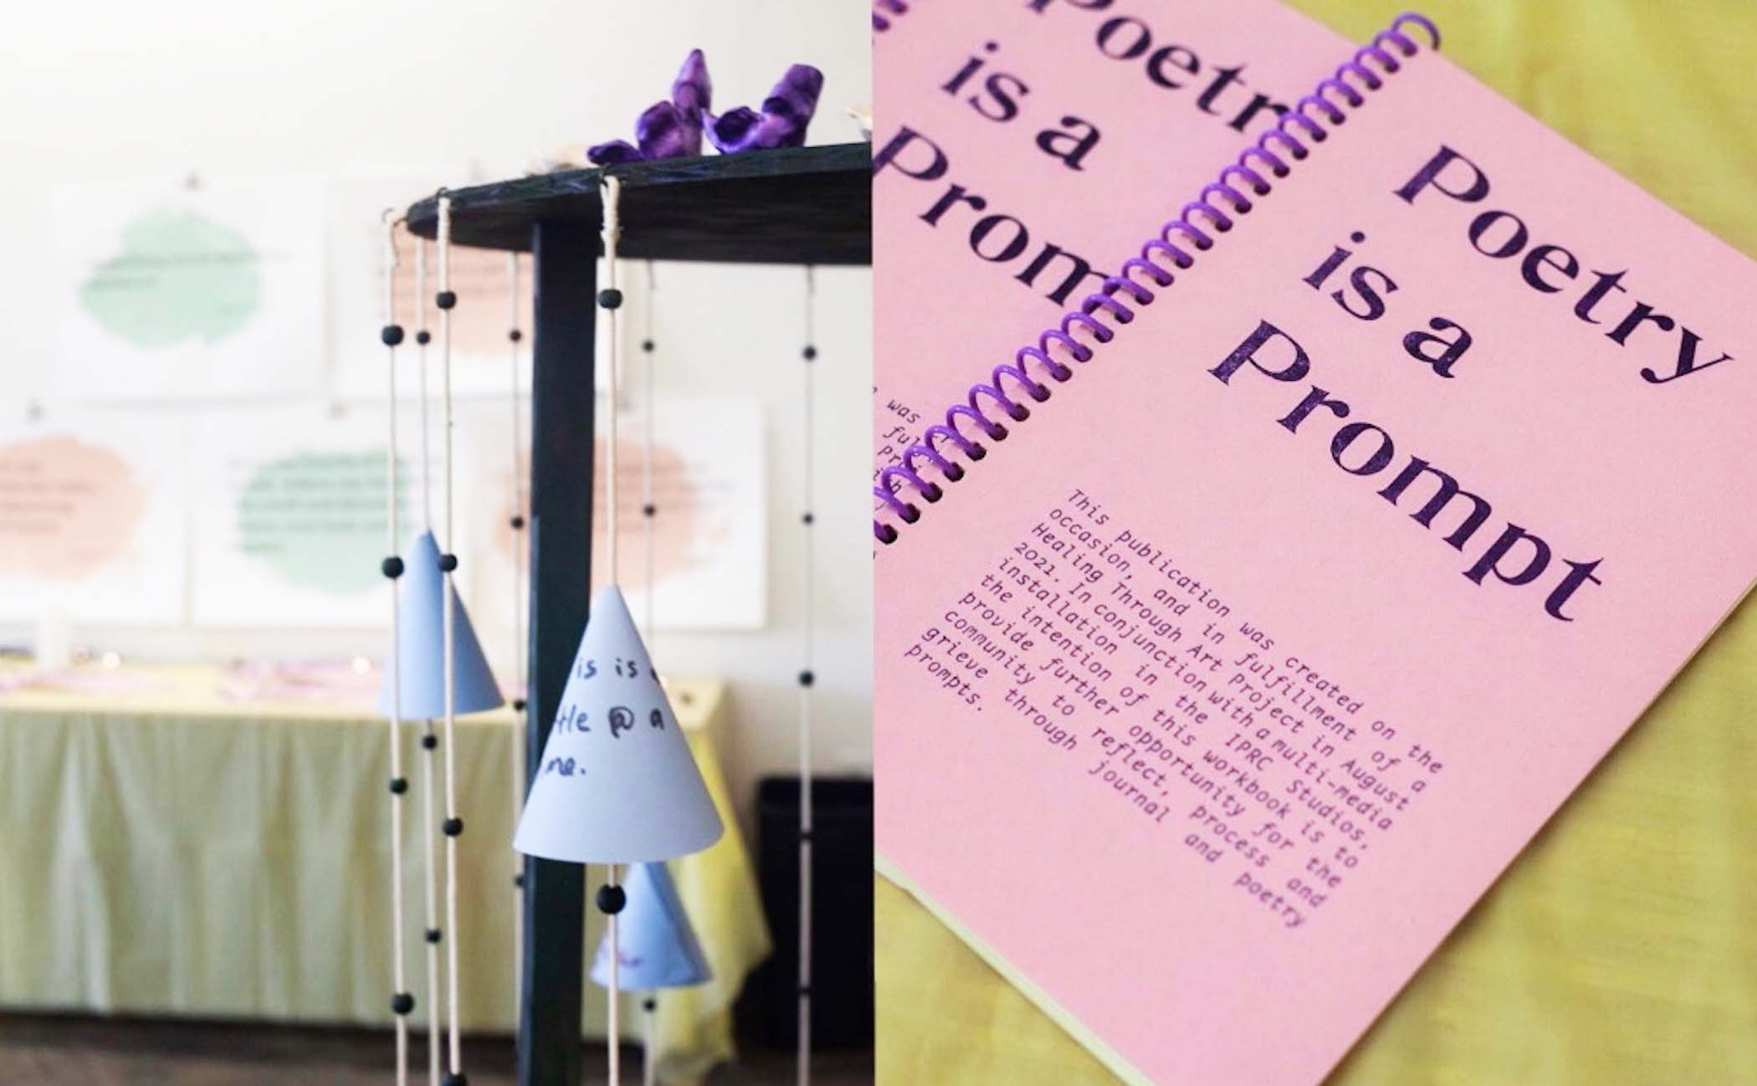
Poetry is a Prompt
IPRC

Slide 6
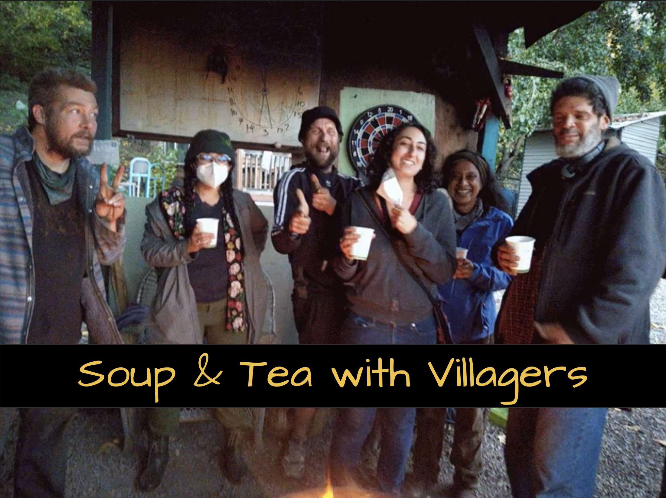
Soup and Tea
Celesté Macias,
Sia Hanna &
Ridhi D'Cruz

Slide 7
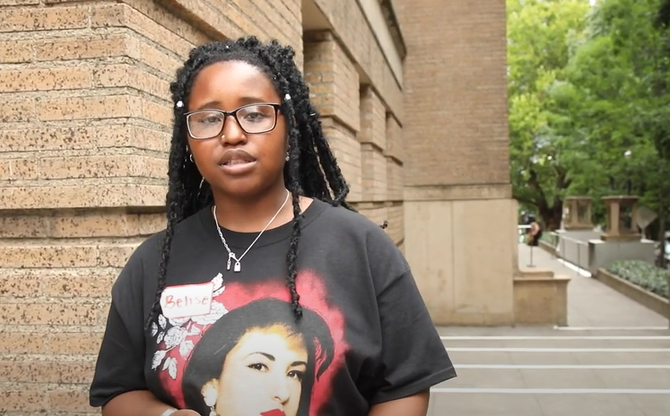
“Black Clouds”
Belise Nishimwe
https://www.youtube.com/watch?v=7rN3SCmaeoI

Slide 9
Demographics
5% American Indian or Alaska Native
23% Asian
27% Black or African American
9% Latinx or Hispanic
5% Middle Eastern or North African
9% White
22% Multiracial or other
41% LGBTQIA
36% Living with a disability
27% Immigrant or refugee

Slide 10
Still to come:
APANO presents HUG (Heal * Unite * Gather)
Morpheus Youth Project presents a new mural in the Cully Neighborhood
Black Sun Collective presents Black Arts Summer Showcase
Uwu Collective presents UwUnoco Flo
East Portland Collective presents Graves into Gardens
Joe Kye presents KIMJANG! Nourish Your Soul
YGB Portland presents BIPOC Ritual Time Capsule
Ariel Hernandez presents Black Feast

Slide 11
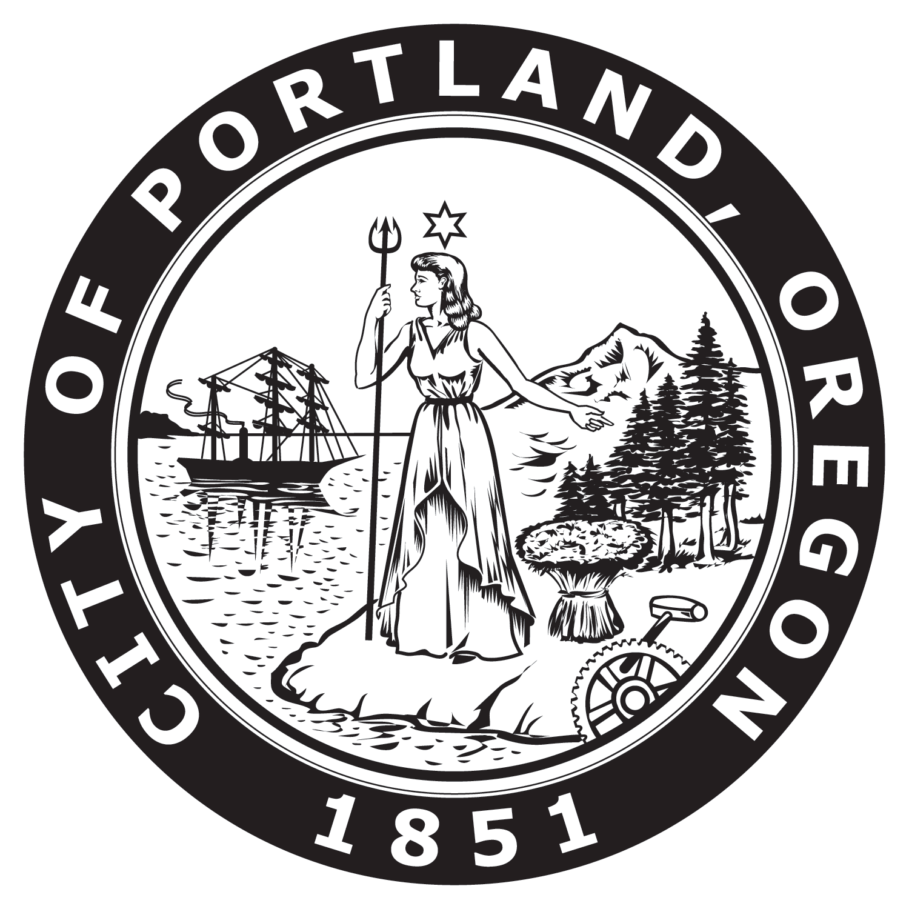
AMERICAN RESCUE PLAN
Relief and Recovery for Artists of Color
$2M to be deployed by the City Arts Program in 2022-2024
Activating the IFCC ($500,000)
Providing free space and residency grants to artists to present public programs at the Interstate Firehouse Cultural Center, which is emerging as a Center for Black Arts and Culture.
Indigenous Public Art ($500,000)
Procuring and installing artworks that celebrate Indigenous culture in the Cully neighborhood.
Resiliency Grants for Cultural Organizations ($500,000)
Grants to community-based cultural nonprofit organizations that are led by and serving Black, Indigenous, other People of Color and/or other historically under-served and under-represented communities. This also includes, but is not limited to, organizations led by and serving LGBTQIA+ communities and with people with disabilities. These grants are designed to reinvigorate artistic programming in these communities.
Support for Artists in Under-represented Communities ($500,000)
Grants for under-represented Black, Indigenous, other People of Color (BIPOC) artists and/or other historically under-served and under-represented artists. This also includes, but is not limited to, LGBTQIA+ artists and artist with disabilities. These grants are designed to support underrepresented BIPOC artists most negatively impacted due to Covid impacts.

Slide 12
Coming this summer!
A new cultural planning process to:
assess the state of arts and culture in the Portland metro region,
identify opportunities,
address inequities, and
develop a clear vision, goals and strategies for arts and culture.
CREATING
OUR FUTURE:
A new cultural plan for the Portland metro region

