Slide 1
2020 CARES Act: tech kit partners
A MIRacle Foundation, Inc African Refugee Immigrant Organization Asian Pacific American Network of Oregon Black Education Achievement Movement Black Mental Health Oregon Bradley Angle Brown Hope Ethiopian and Eritrean Cultural and Resources Center Hacienda Community Development Corporation Immigrant and Refugee Community Organization KairosPDX Latino Network Native American Youth and Family Center | North by Northeast Community Health Center Portland Indigenous Marketplace Portland Opportunities Industrialization Center, Inc. Self Enhancement, Inc. Somali American Council of Oregon The Arc of Multnomah-Clackamas Counties The Islamic Center of Portland, Masjed As-Saber The National Association for Black Veterans, Inc. Portland Chapter #0032 The Rosewood Initiative Urban League of Portland Verde

Slide 2
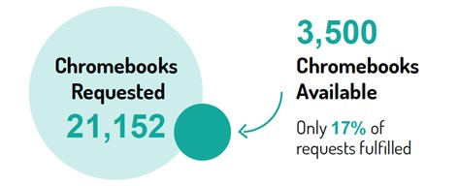
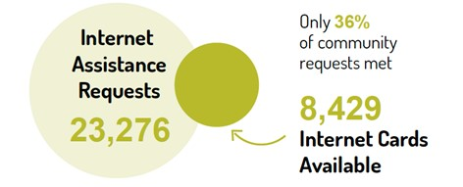
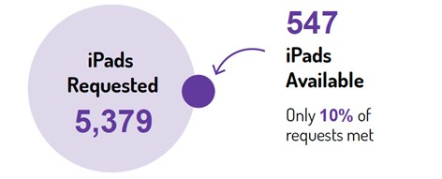
2020 CARES Act: unmet needs

Slide 3
2021 phone and online surveys
Hacienda CDC Coalition of Black Men Black Educational Achievement Movement De Rose Community Bridge and Holistic Wellness POIC Urban League of Portland Togo Community Organization of Oregon The Rosewood Initiative Portland Indigenous Marketplace HAKI Community Organization Black Community of Portland Youth Organized and United to Help African Refugee Immigrant Organization Slavic Community Center of NW Latino Network Circles Willamette Valley NAYA CAT Constructing Hope | Southwest Somali Community Somali American Council of Oregon Ethiopian and Eritrean Cultural and Resource Center APANO Camp Elso Risen Community Verde Equitable Giving Circle North by Northeast Community Health Center Unite Oregon The Islamic Center of Portland, Masjed As-Saber YWCA of Greater Portland IRCO The Arc Portland Metro Bradley Angle Leaders Become Legends Historic Parkrose NAMI Multnomah Open Signal

Slide 4
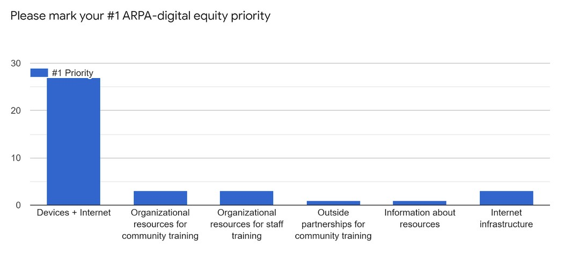
survey results: priorities

