Slide 1
E10735 Portsmouth Force Main Valve Vault Monitoring Project Acquiring Permanent Property Right Council Item #582 Portland City Council | July 21st, 2021
Joe Dvorak, P.E.
Engineering Manager
Lisa Moscinski
Project Manager
Kevin Balak
PBOT Right of Way Agent
MINGUS MAPPS, COMMISSIONER
MICHAEL JORDAN, DIRECTOR

Slide 2
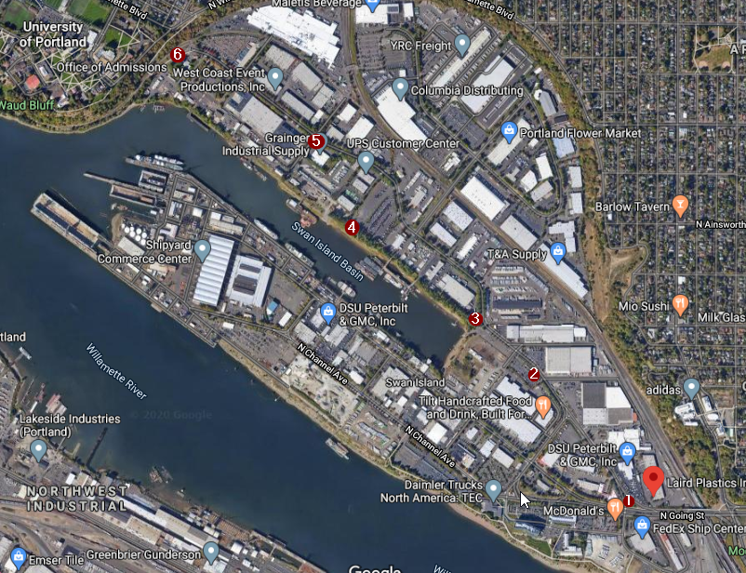
Project Overview
Project objective
Install leak detection monitoring to reduce the likelihood of Combined Sewer Overflow events
Monitors will alert maintenance staff of potential issues so they can take correction action.
Project scope
Install monitors at six locations along pressurized pipeline.
Notes:
The air pressure relief vaults continually release air during force main operation to protect against unwanted sewage and stormwater surges and control odors. A problem inside the vaults could cause a sewage overflow to the Willamette River. And has on a couple occasions leading to fines from DEQ.
This project provides early leak detection and alarm notification to enable City maintenance crews to quickly respond to stop the leaks and clear jammed valves along the Portsmouth Force Main between N. Going Street and the end of N. Basin Avenue.

Slide 3
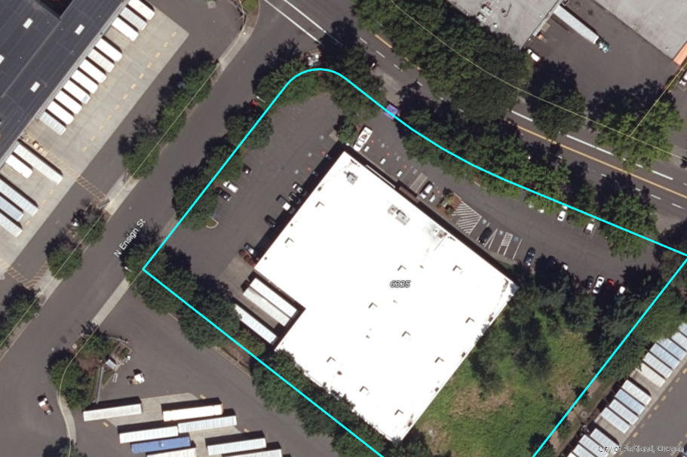
Construction in Private Property
New alarm panel in private property
New sewer easement at 6335 N. Basin Ave.
Construction Method
Construction of concrete pad and panel installation.
Public Outreach
Direct communication with property owner.
Continued outreach during construction.
Approx. easement area
Notes:
5 of the 6 sites are able to be constructed in the ROW or existing easements. One site where we don’t have room in the ROW is at 6335 N Basin Ave-W.W. Grainger Inc. The existing vault is in the ROW and there isn’t room to install the additional concrete pad and panel in the ROW so we need a permanent easement.
Kevin Balak-PBOT ROW Agent met with Grainger site manager on 7/8 to go over the easement and proposed work and the meeting went well. They know the ordinance is on the City Council agenda for 7/21 and are invited to join if they are interested.

Slide 4
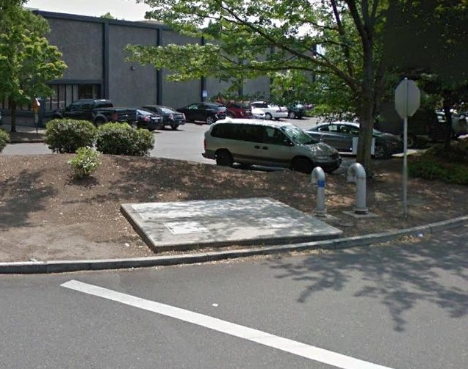
Sewer Easement
Easement
Permanent sewer easement approx. 20 ft wide and 23 ft in length.
Market value determined by an administrative determination of just compensation appraisal.
Schedule
Anticipated Construction NTP: Spring 2022.
Acquire possession of this property interest by December 1st, 2021.
Notes:
Concrete pad and panel will be installed in landscaped area adjacent to existing vault. We will be installing screening plants as required by Bureau of Development Services.

Slide 5
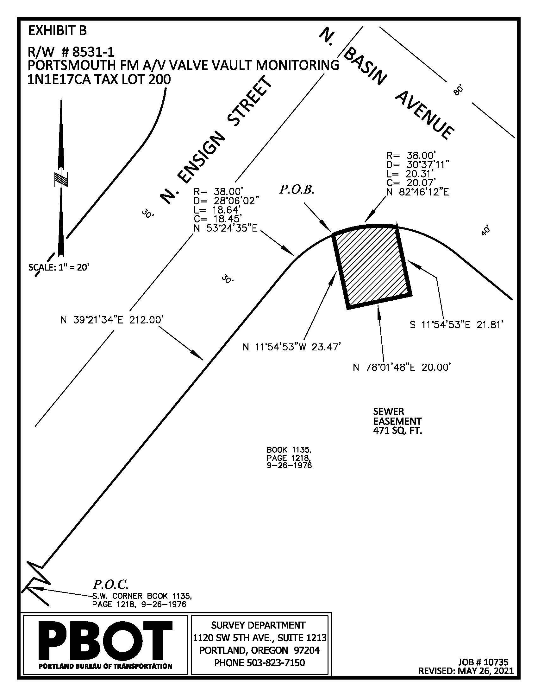
Questions
Q & A

