Slide 1
Paving the Pathway from Streets to Stability
June 30, 2021

Slide 2

PRE-PANDEMIC 2019 POINT IN TIME COUNT OF AT LEAST
4,015 Houseless Individuals

Slide 3
Problem at Hand
Neighbors experiencing houselessness are residing in parks, natural areas, and the right of way, all posing serious risks from the perspective of public health and safety.
While the City of Portland works with our government, non-profit and business partners to solve the houselessness crisis, the City needs to identify a new comprehensive solution to camping in urban settings.

Slide 4


Slide 5
Office of Mayor
Ted Wheeler
Office of Commissioner
Jo Ann Hardesty
Office of Commissioner
Mingus Mapps
Alignment on Creating Safe Rest Villages
Office of Commissioner
Carmen Rubio
OMF​
State of Oregon​
Stop the Sweeps​
Street Roots
Office of Commissioner
Dan Ryan

Slide 6
Community Inclusion
Neighbors experiencing houselessness
Joint Office of Homeless Services
A Home for Everyone
Multnomah County
Oregon Metro
State legislators
Community Town Hall meetings
Oregon Law Center
Street Roots
Neighborhood Associations
Northeast Neighborhood Coalition
Business for a Better Portland
Portland Business Alliance
HereTogether
Portland, Neighbors Welcome

Slide 7
Action
This ordinance creates clear standards by which Portlanders experiencing houselessness can expect to rest safely without fear of intervention by City entities;
It explains the criteria used in determining which camps are high-or-low impact and establishes zones that are de-prioritized for intervention by the Impact Reduction Program
It ensures the Impact Reduction Program assists houseless Portlanders in accessing Safe Rest Villages should they voluntarily choose to do so; and
It clarifies the Impact Reduction Program is the responsibility of the entirety of Council, not simply the Mayor or whichever Commissioner overseeing the land-owning bureau on which a high-impact encampment exists.
The ordinance does not criminalize houselessness, and it does not feed into the false binary of—"to sweep, or not to sweep."
It does provide a humanitarian response to meet our houseless residents where they are.

Slide 8

Example: Eugene, OR

Slide 9
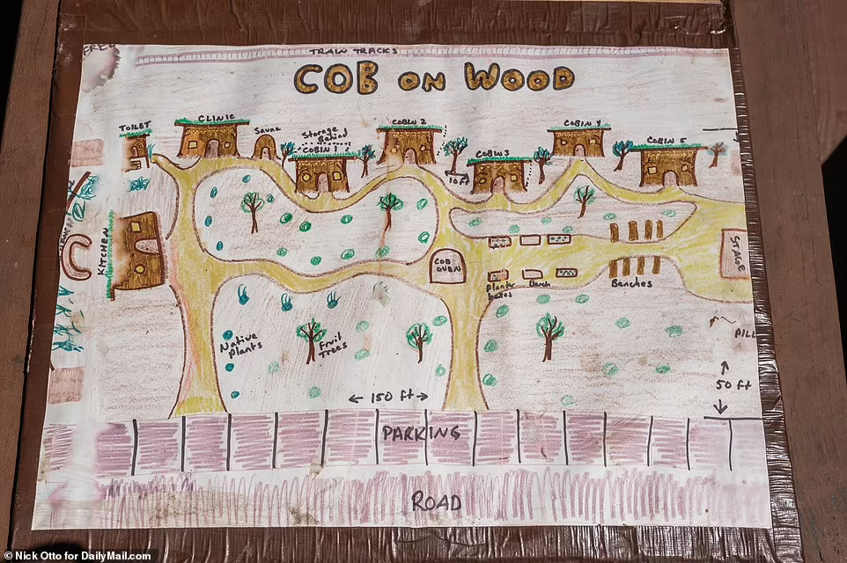
Example: Oakland, CA

Slide 10
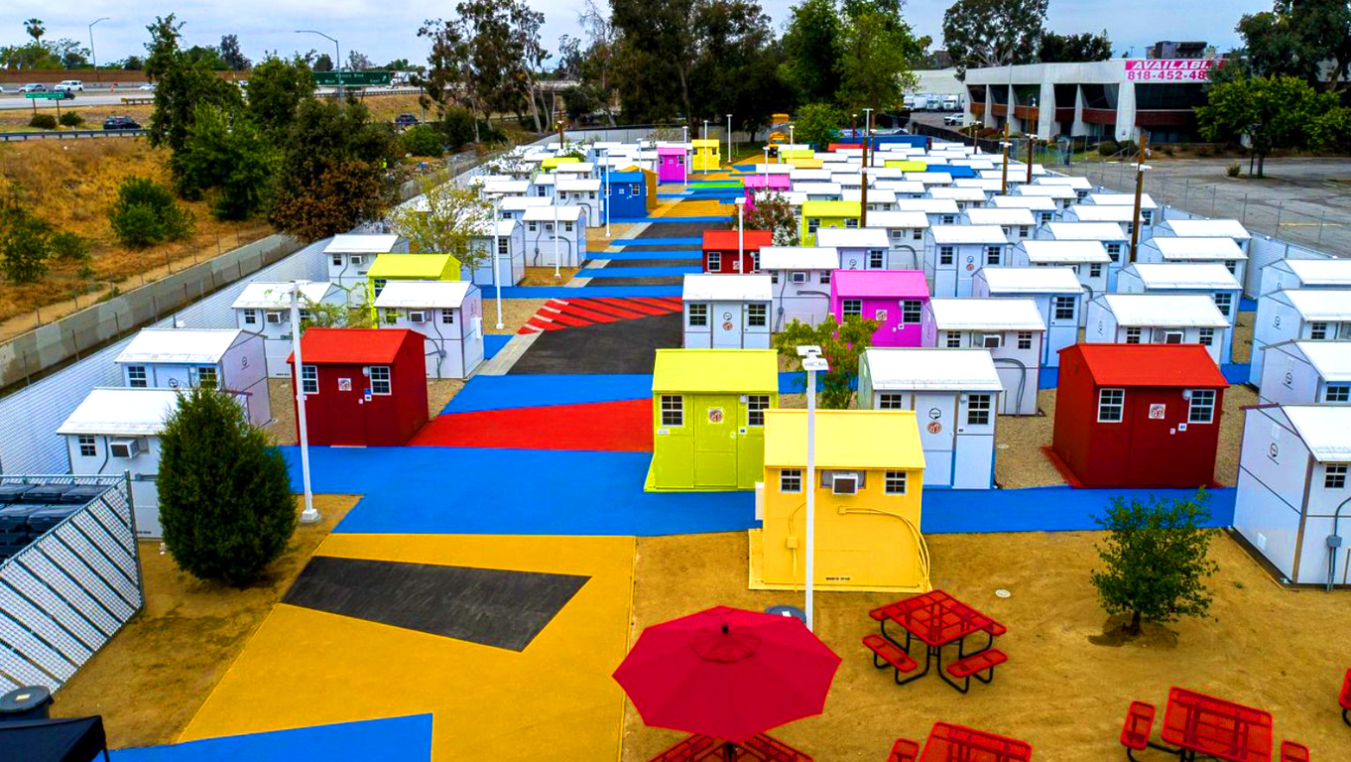
Example: Los Angeles, CA
Chandler Boulevard Bridge Home Village

Slide 11

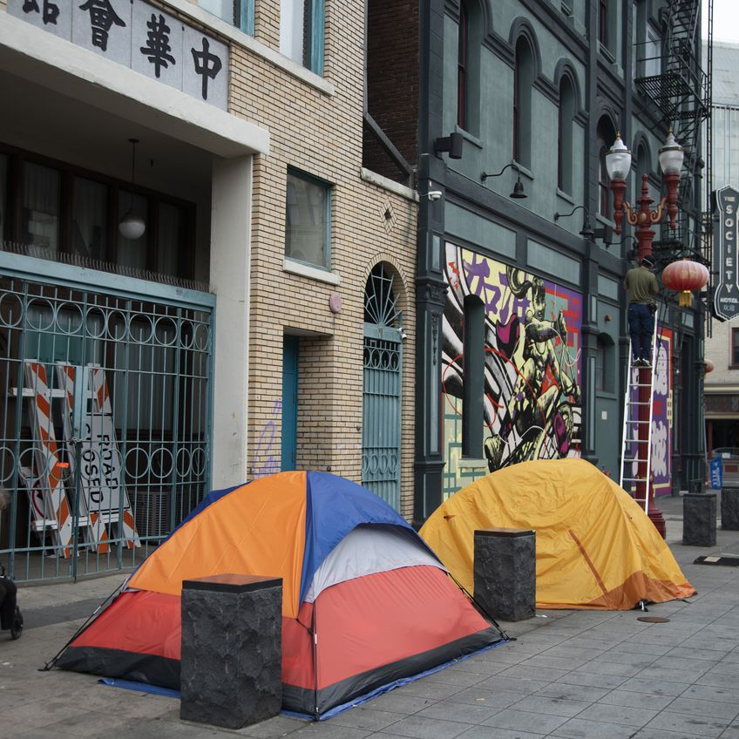
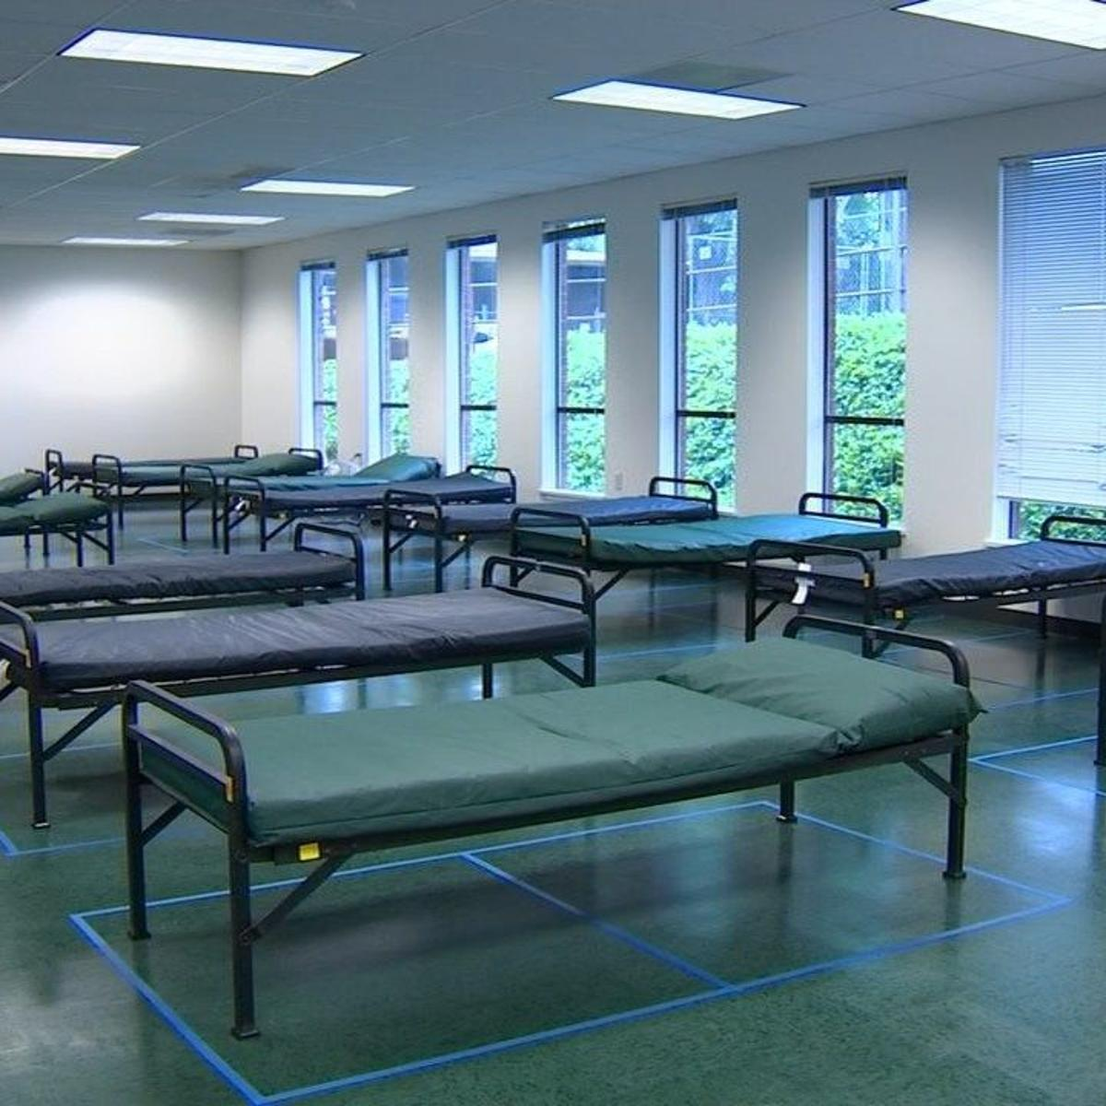
Improved Point of Entry

Slide 12
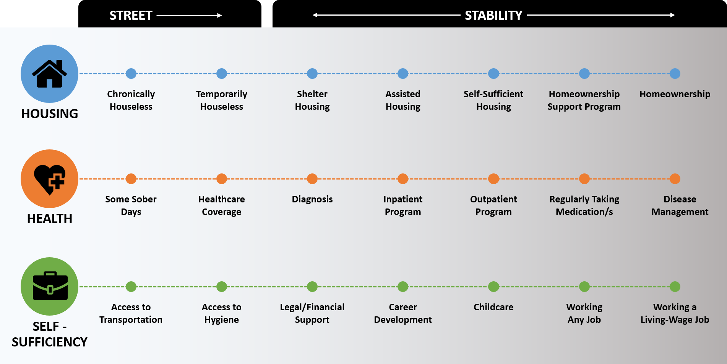

Slide 13
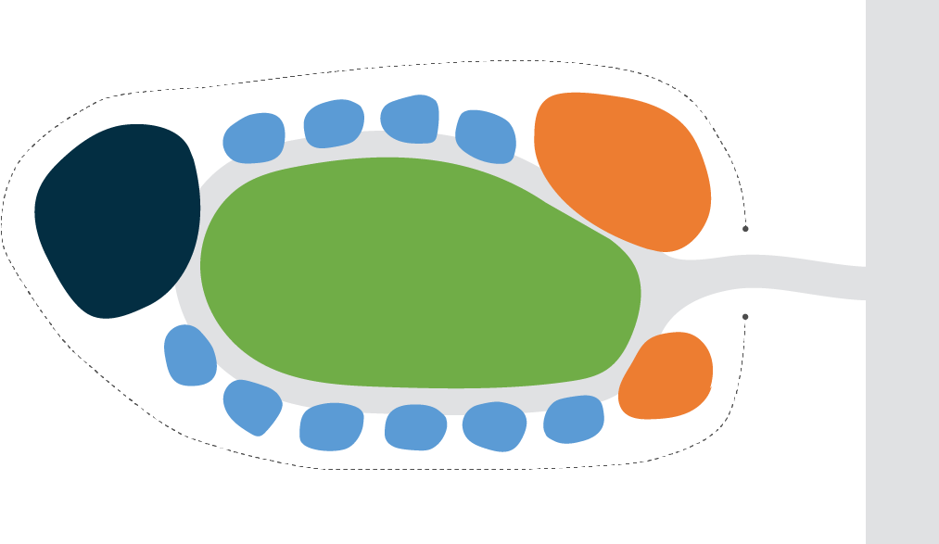
Individual Shelters
Hygiene:
Laundry
Showers
Garbage
Recycling
Community Space:
Food prep
Electricity
Clean water
Wi-Fi
HVAC
Sense of Dignity
Art
Plants
Access to Public Transportation
Sense of Safety
Access
to Social Services
Individual Shelters
Example: Portland, OR
Conceptual use of space diagram

Slide 14





Safe Rest Villages – Service Priorities
Values:
Dignity
Safety
Community
Compassion
Housing:
Private Space
Shared Space
Infrastructure:
Electricity
Clean Water
Wi-Fi
HVAC
Food Preparation
Fire Safety
Public Transportation
Hygiene:
Laundry
Showers
Flush Toilets
Garbage
Recycling
Access to Services:
Case Management
Mental Health Supports
Substance Abuse Services
Housing Supports
Community Advocates
First Aid & Medical Care

Slide 15


Safe Rest Villages – Next Steps
April - S2HC
May - Budget $$
June/July – ARPA
July – Hire project manager
Aug/Sept - Community engagement team
Aug/Sept - Site Selection
Sept/Dec - Construction

Slide 16


Slide 17
Testimony & Dialogue
June 30, 2021

