Slide 1



Errol Heights
Street Improvement Project
Presentation to Portland City Council – February 3, 2021
65 Declare intent to initiate local improvement district formation proceedings to construct street, sidewalk, and stormwater improvements in the Errol Heights Local Improvement District (Resolution; C-10064)
*66 Authorize the Bureau of Transportation to acquire certain temporary rights necessary for construction of the Errol Heights Street and Local Improvement District through the exercise of the City’s Eminent Domain Authority (Ordinance introduced by Commissioner Hardesty; C-10064)

Slide 2
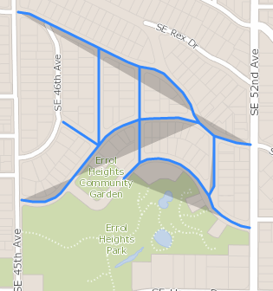
Project Area

Slide 3
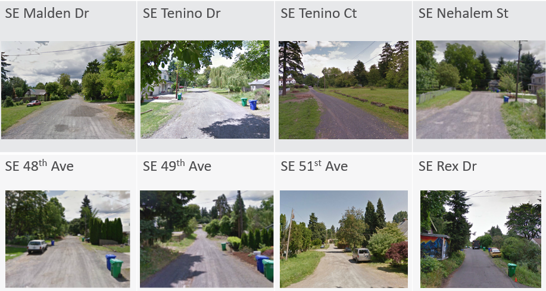
Existing Conditions

Slide 4
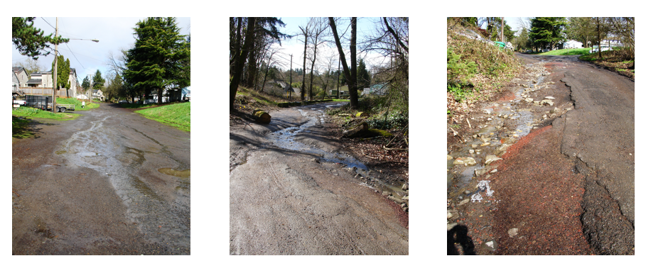
Existing Conditions

Slide 5
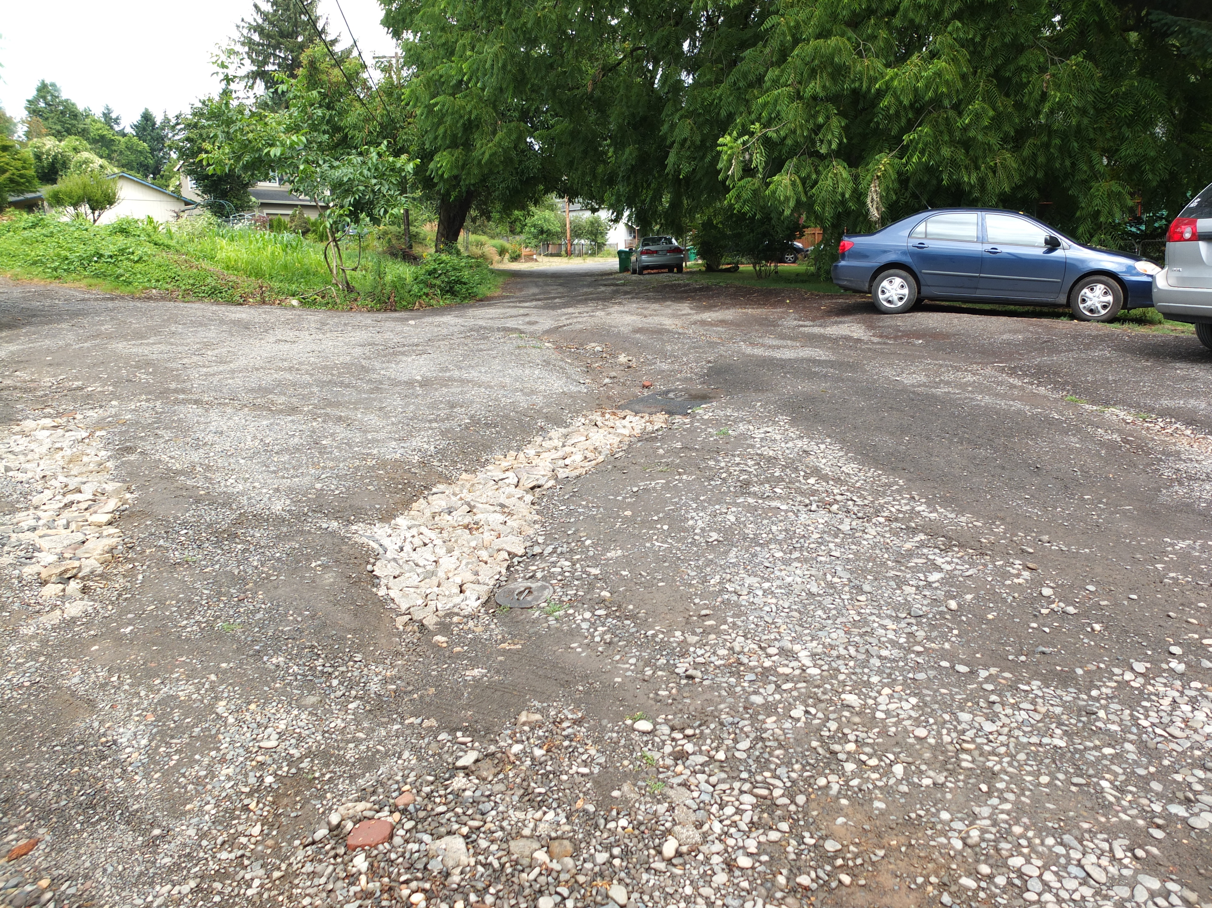
Existing Conditions

Slide 6
Project History
Year | Status
2008 | Local Improvement District (LID) discussion begins but does not move forward because of high project costs.
2013 | Neighbors learn about the City’s Street by Street program and ask for lower-cost street improvements in Errol Heights.
2014 | PBOT and BES draft a design concept for a second effort at creating an LID. The design is generally well received but the price tag (assuming project is 100% funded by property owners) is too high.
2015 | Project team reexamines the design and funding to address community concerns. City Council allocates funding to help with project financing (allocation from the “Up Out of the Mud” program)
2016 | The project design continues, looking at the area’s soils, slope and hydrology. Street design options are studied, and the project team coordinates with PP&R regarding development of Errol Heights Park. BES commits to pay for stormwater facilities to reduce costs for LID participants.
2017 | Design concepts are developed and studied for pedestrian safety. Two street design options are developed, and the overall project design reaches 30% completion. PBOT agrees to full deferral of any LID payments until a property is sold
2018-2020 | PBOT advances design engineering plans. PBOT petitions property owners to determine LID support (65% petition support for LID) City Council fully funds development of Errol Heights Park. PP&R develops design. Construction of park will overlap with street project. PBOT and BES complete design for Errol Heights Street Improvement Project and prepare project for construction

Slide 7
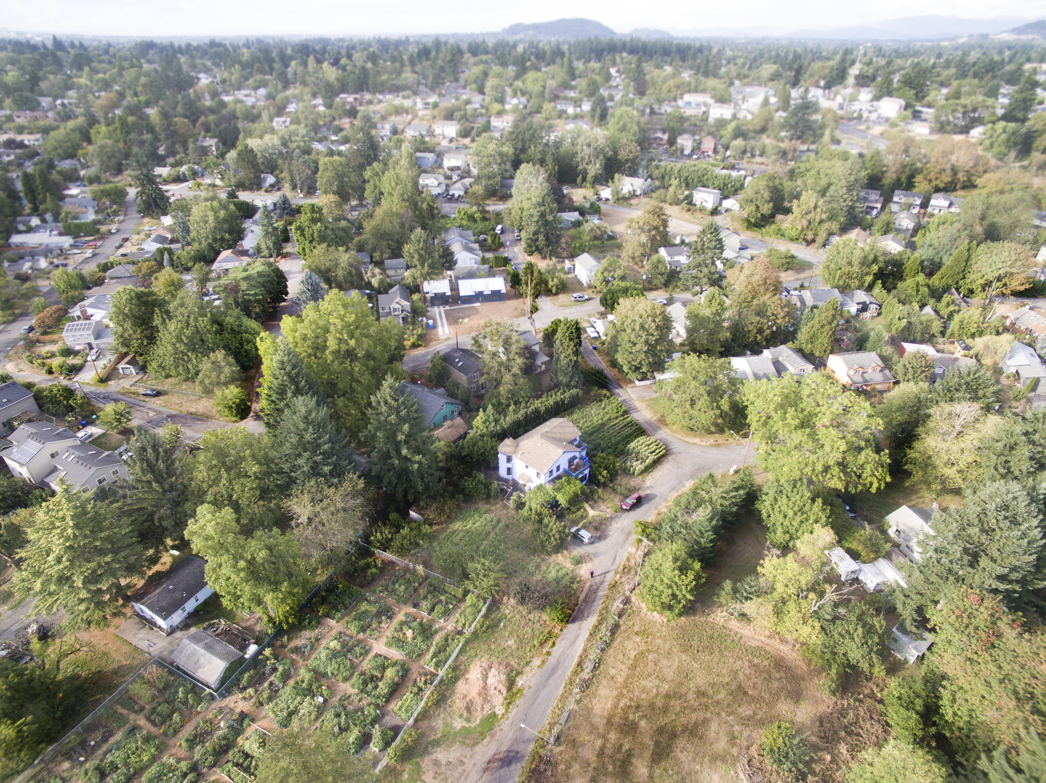
Project Goals and Objectives
Improve:
  Access for pedestrians, bicycles, cars, and emergency vehicles
  Access to schools, parks, and community centers
  Safety and livability
  Stormwater conveyance and water quality
Maintain:
  Low traffic volumes and speeds
  Character of the neighborhood
Provide:
  Lower-cost shared street and stormwater improvements
Pursue:
  Grant or other capital funding to help offset costs of property-owner Local Improvement District (LID). Note: PBOT and BES successfully identified funds that could be used to reduce LID cost

Slide 8
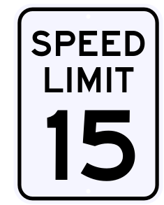
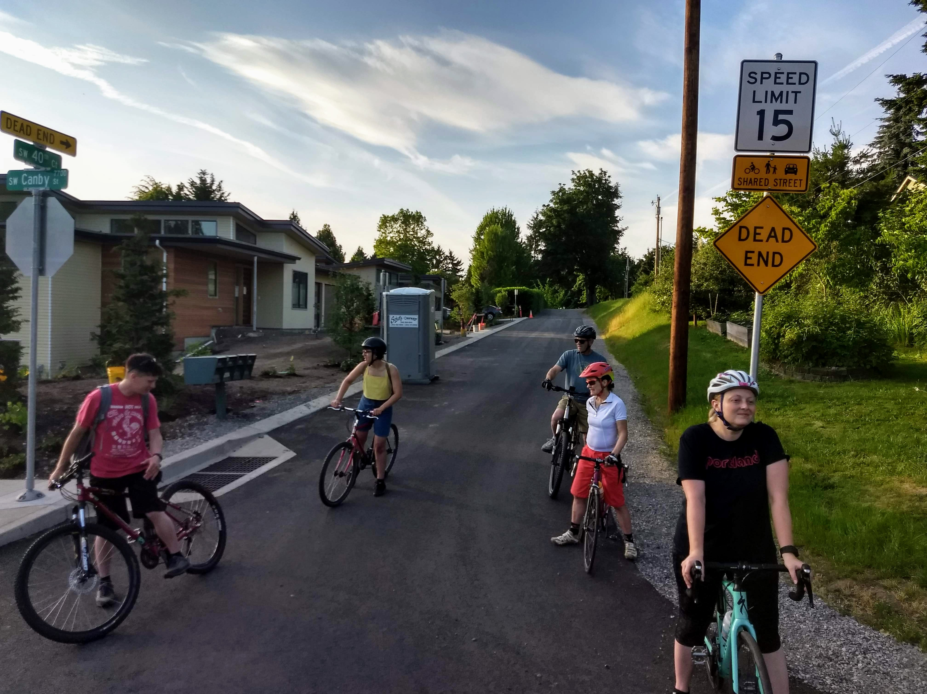
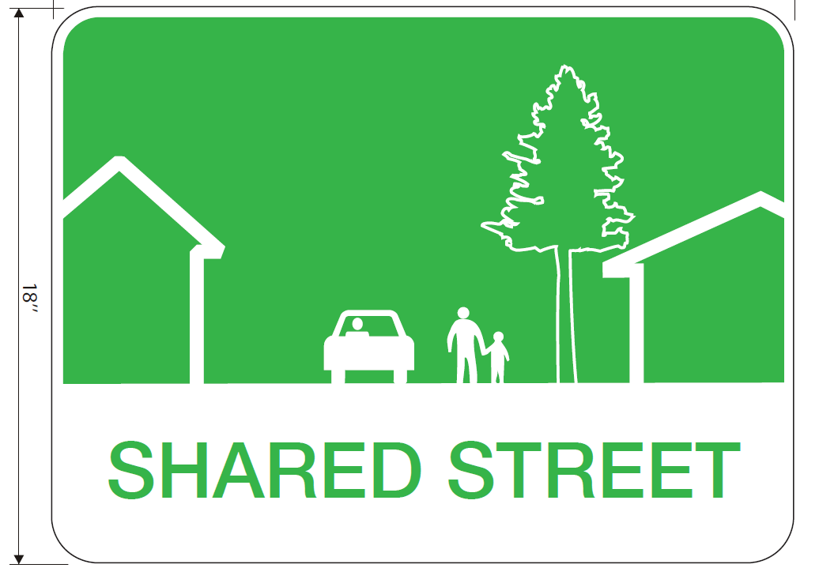
Errol Street Design - Shared Streets
Design Criteria:
Residential streets only
Less than 500 vehicles per day
Speed limit must be lowered to 15 MPH
“Shared Street” signage at all neighborhood entrances

Slide 9
Shared Street Design: SE 48th, SE 49th, SE 51st, SE Nehalem

Slide 10
Separated Street Design: SE Malden and SE Tenino Drive/Court

Slide 11
Errol Heights Stormwater Design
Original Concept
Surface infiltration with conveyance ditches, vegetated planters and green streets
Geotech and Stormwater Assessment
Steep slopes and soil type limits surface infiltration
Deep infiltration with sumps is feasible
Current Design: Hybrid Approach
Conveyance ditches
Sedimentation manholes and sumps
Two large vegetated stormwater facilities
Maintenance
System will be maintained by the city
Property owners are encouraged to help care for the stormwater conveyance ditches by removing trash and weeds

Slide 12
Errol Heights Stormwater Flows to Johnson Creek

Slide 13
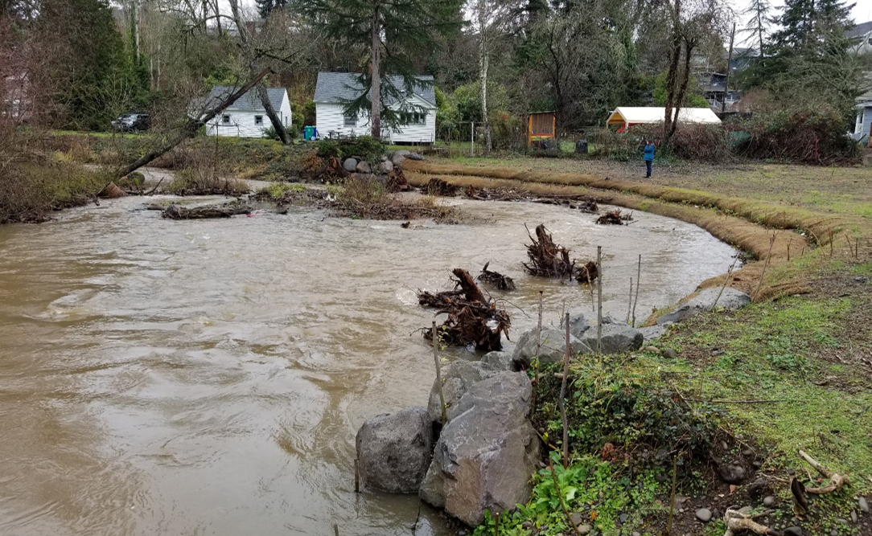
BES Johnson Creek Oxbow Enhancement Project
Water quality and habitat restoration project
Will improve habitat for endangered salmon and other native species
Errol Heights LID will eliminate a source of pollution to Johnson Creek within the Oxbow project area
In combination with Errol Heights Park, project will improve community access to natural areas

Slide 14
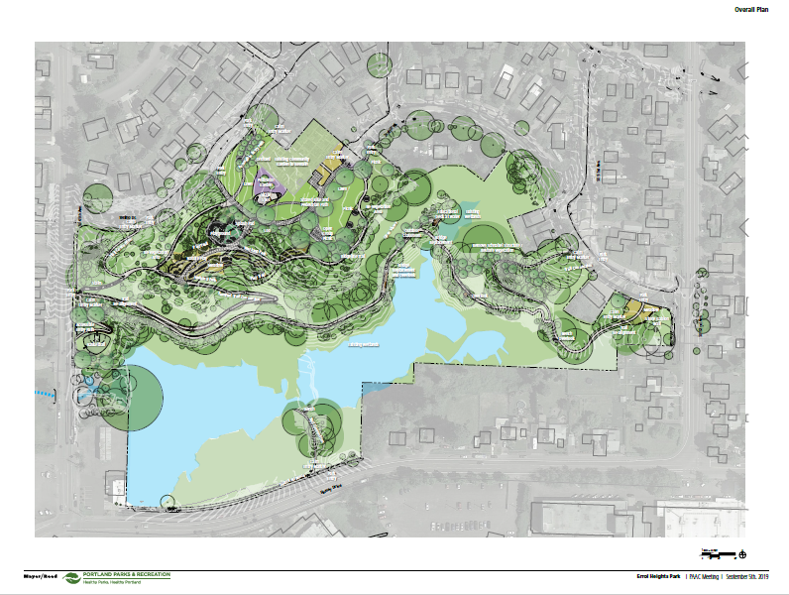
The Errol Heights Park project will protect and restore the lower natural wetland and riparian areas, improve and expand existing trails for ADA access, and develop the upper plateau for play, picnics and gardening.
Current Project Schedule:
Building Permits: Jan – March 2021
Ad/Bid/Award Contract: April – June 2021
Park Construction: July 2021 - Fall 2022
Errol Heights Park Project

Slide 15
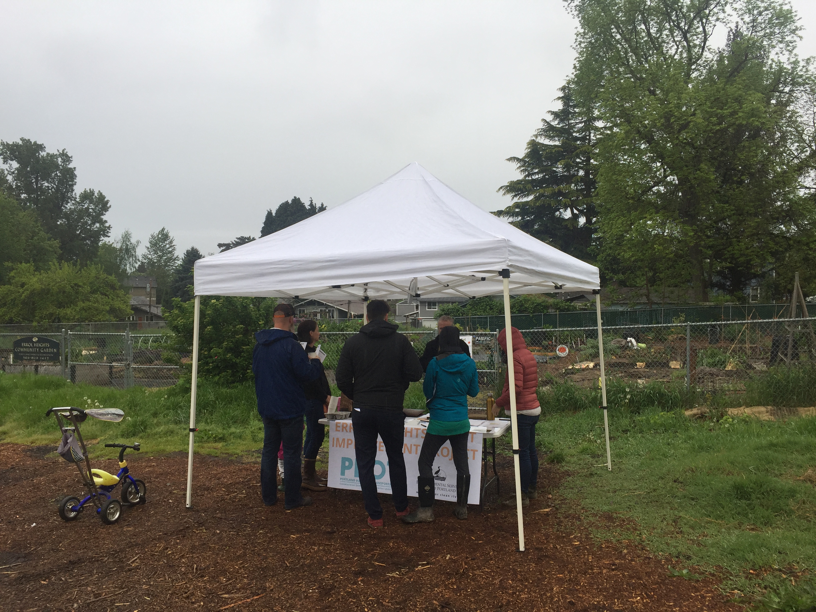
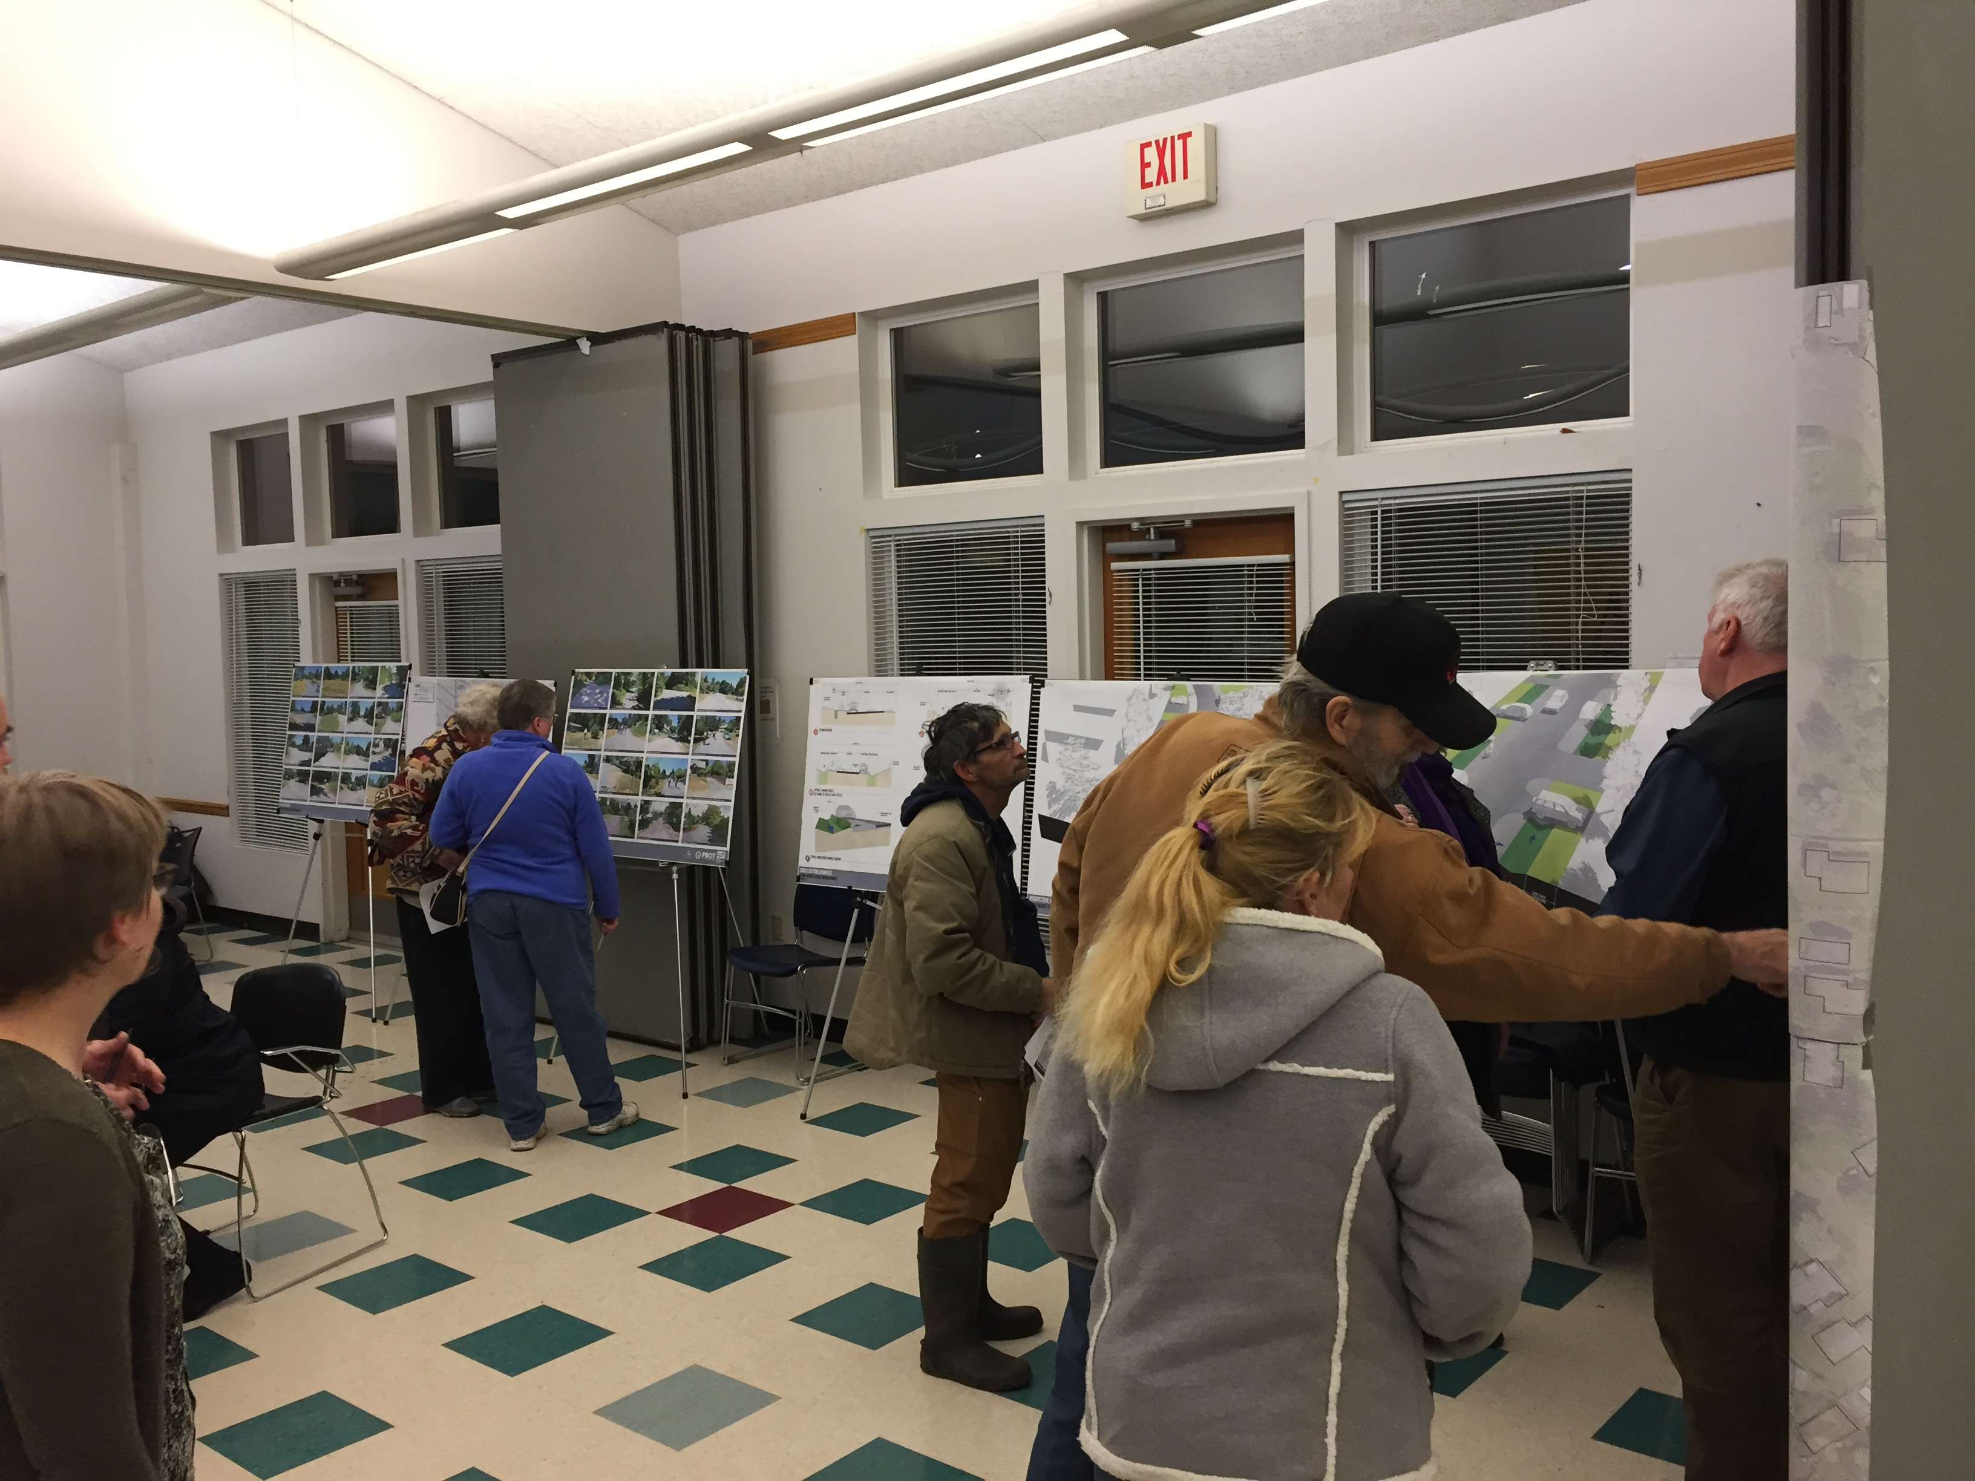
Public Involvement Summary
Public Open Houses
Design Workshop
Drop-in Design “Office Hours”
Individual Property Owner Meetings
Neighborhood Association Briefings
Mailers / Newsletters
Email Updates
Posters placed throughout neighborhood

Slide 16
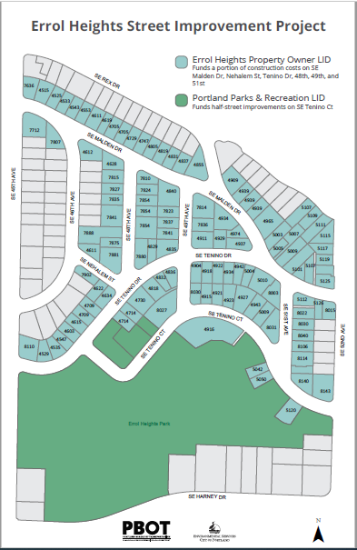
Errol Local Improvement District (LID)
Fixed Assessment Rate per Property
116 properties
$2.55 per square foot ($12,750 for 5000 sf)
Average assessment in Errol: $14,137.58
LID Financing
Individual LID assessment deferred until property is sold
The LID assessment will be a lien against the property until paid
City of Portland (PBOT) will pay for the LID upfront with Transportation SDC funds.
PBOT will collect the assessment when properties are sold.

Slide 17
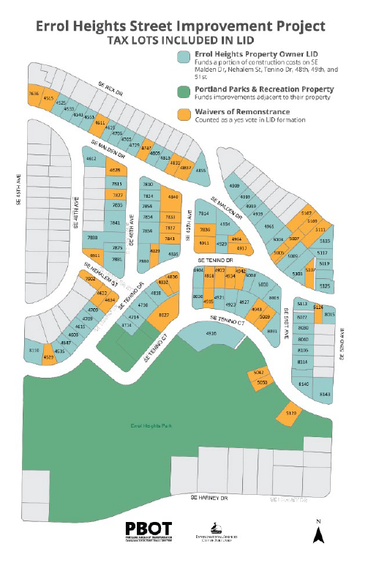
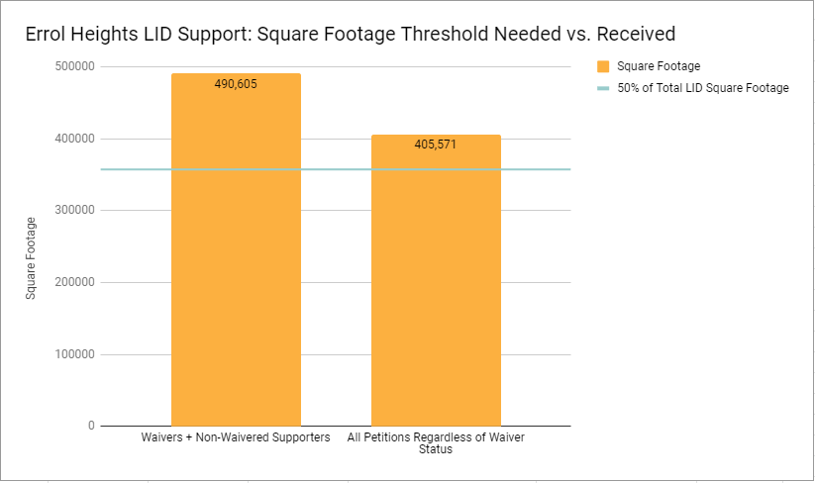
Errol Heights LID Petition Process
City Council Requirement:
Greater than 50% required before Council will consider LID
Project Goal:
To receive over 50% support independent of waivers
Actual:
56.79% support independent of waiver status
67.58% support with waivers

Slide 18
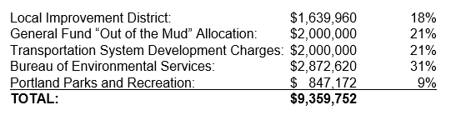
Cost Estimates and Funding Breakdown
Total value inclusive of all phases (planning, design, right-of-way, construction)
Errol Heights LID will be leveraged by public funds at an approximate 4:1 ratio
Public funds are broad-based across multiple bureaus and funding sources

Slide 19
Right of Way
Agenda Item 66 gives PBOT authority to compensate affected property owners for needed temporary easements and if necessary, to condemn for these property rights associated with the Errol Heights LID project.
Permanent ROW is not necessary, only temporary rights will be needed from 4 properties to support construction of project improvements.
These temporary easements will allow construction support of certain ADA and sidewalk facilities being placed within existing ROW.
All affected property owners have been informed of the project need for these temporary property rights and were invited to attend this reading.

Slide 20
Schedule and next steps
Item | Date
City Council Session: Resolution: Intent to form LID | February 3, 2021
Public Notification for LID Formation Hearing | February 3-March 3, 2021
City Council Session: LID Formation Ordinance | March 2021 (Dates TBD)
Permitting | January – March 2021
Advertise Project | April 2021
Begin Construction | July 2021

Slide 21
Acknowledgements and Invited Testimony
Thank You:
Past and Present Leadership and Staff from BES, PBOT and PP&R
Brentwood-Darlington Neighborhood Association
Errol Heights Community
Invited Testimony:
Molly Stiles
Paul Tourville
Roshan Bellavara

Slide 22
Thank you!
Elizabeth Tillstrom, PBOT Project Manager
Elizabeth.Tillstrom@portlandoregon.gov
503-823-0396
Sean Bistoff, BES Project Manager
Sean.Bistoff@portlandoregon.gov
503-823-7125

