Slide 1
Cathedral Village funded by the Portland Housing Bond
Shannon Callahan,
Director, Portland Housing Bureau
January 13, 2021

Slide 2
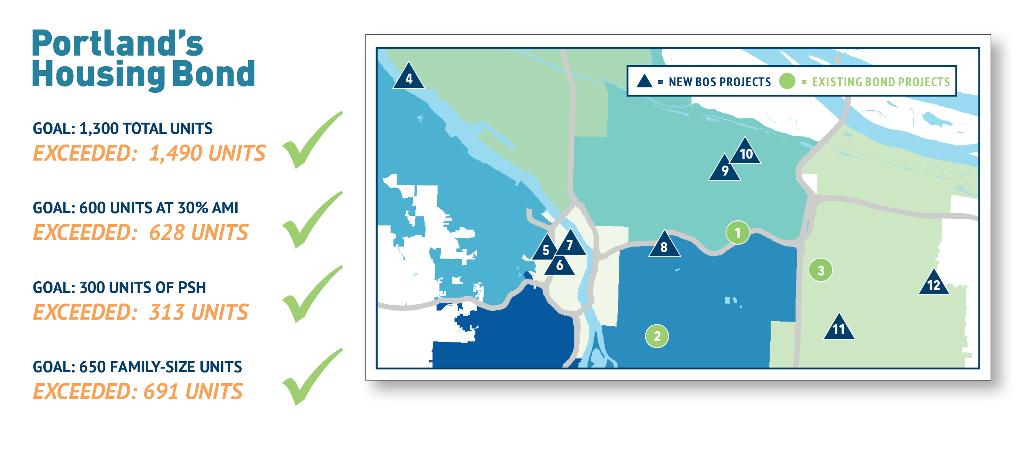

Slide 3
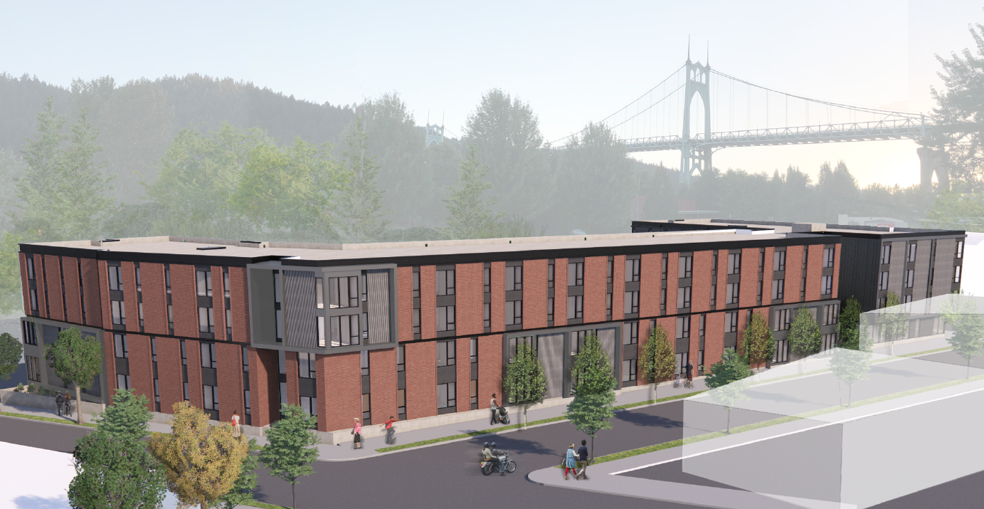
Cathedral Village
Shannon Callahan
Director, Portland Housing Bureau
January 13, 2021

Slide 4
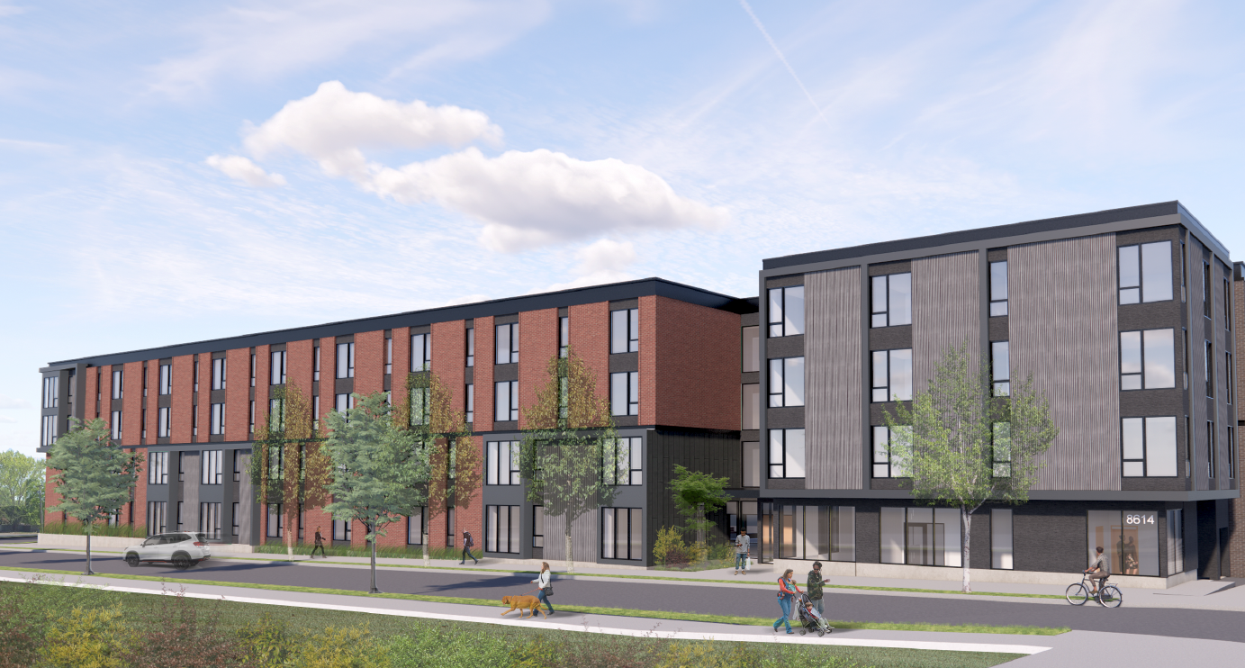
Project Highlights
St. Johns Neighborhood, amenity rich location
Targeted to families (~51% of units), immigrant and refugee households, and people exiting homelessness
110 affordable units for an estimated 263 people
8 units for Permanent Supportive Housing
37 units at 30% AMI and 73 units at 60% AMI
Cathedral Village Portland Housing Bureau

Slide 5
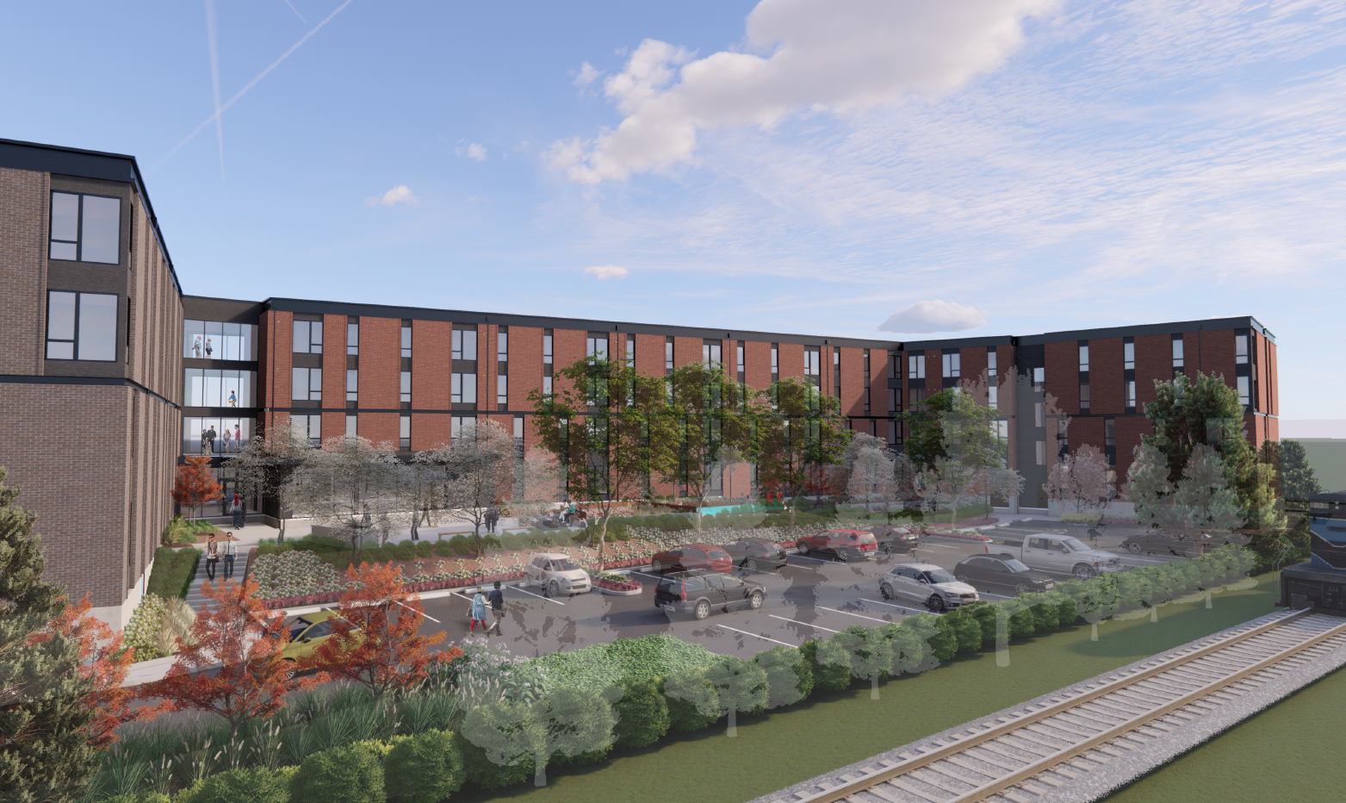
110 units
11 3BR
45 2BR
37 1BR
17 Studio
Rents range from $431 (Studios 30% AMI) to $1,338 (3BR 60% AMI)
Regulated 99 years
Earth Advantage Gold
Construction Jan. 2021
Completion Aug. 2022
Unit Mix
Cathedral Village Portland Housing Bureau
Notes:
No manager’s unit

Slide 6
Project Services
Joint Office of Homeless Services providing $10,000/unit in services for 8 Permanent Supportive Housing (PSH) units
Catholic Charities providing resident services and PSH services
On-site youth music program
Cathedral Village Portland Housing Bureau
115th and Division Portland Housing Bureau 4
Notes:
PSH services:
Housing First model with case management and peer support, focused on housing stability and retention
Services related to mental health, income support, wellness, social connection
Resident services:
Move-In 101 and Housing 101 curriculum
Catholic Charities’ financial empowerment, parenting, immigration/legal and counseling services
On-site music classes for children and teens (provided by Vibe of Portland)

Slide 7
Project Funding Sources
SOURCES
Portland Housing Bond | $17,454,910
4% Low Income Housing Tax Credit (LIHTC) Equity | $8,505,278
OHCS Weatherization & Foundation Grants | $221,000
Umpqua Bank Loan | $7,225,000
SDC Exemptions | $1,867,968
Deferred Developer Fee | $2,829,869
TOTAL SOURCES | $38,104,025
PHB funds leveraged approximately $20.6 million of other funding
Cathedral Village Portland Housing Bureau
115th and Division Portland Housing Bureau 4

Slide 8
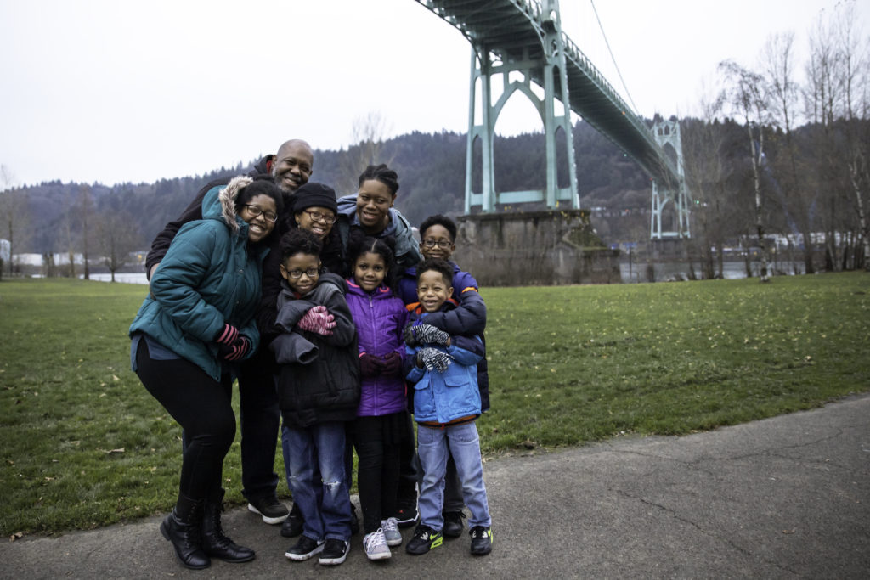
Summary
Authorize:
Funding in an amount not to exceed $17,454,910 to Cathedral Village Partners Limited Partnership or a Related Northwest / Catholic Charities affiliate
Director of PHB to execute all documentation needed for this project
8
Cathedral Village Portland Housing Bureau
Division Street Apartments 04/22/2020 Portland Housing Bureau 5

