Slide 1
Action Plan Portland Consortium | Action Plans FY 2020-2021
Kim McCarty, Rental Services Manager June 3, 2020

Slide 2
Consortium Action Plan Hearing: 3 Actions
2020 Action Plan Goals, Strategies and Actions
Citizen Participation Plan Amendment
2019 Action Plan Substantial Amendment to receive CARES Act federal formula grants
Notes:
Fall community based hearings about housing and community economic development needs.
Share community feedback to inform federal funding planning.
Spring hearings to share the goals, strategies and actions with community prior to adoption.
Apply for the federal formula grants.
Certify that the jurisdiction federal grant recipient is compliant with federal fair housing law.

Slide 3
2020 federal formula grant resources
Community Development Block Grants (CDBG)
$8,736,686 new+$4,153,348 (carryover)
Emergency Solutions Grant
$ 747,743 new
Housing for Persons with AIDS (HOPWA)
$ 1,717,254 new
HOME
$4,005,944 new+$7,582,284 (carryover)
$ 28,636,563 (new + carryover)

Slide 4
Consolidated Plan - 3 Goals
Increase and preserve affordable housing choice.
$24 Mill.
Safe, and quality housing
Home repair
Down payment assistance
New and affordable housing development
Rental housing development
Permanent supportive housing
Reduce and prevent homelessness.
$2.3 Mill.
Supportive services
Transitional housing
Housing First model
Fair Housing enforcement
Culturally appropriate program delivery
Activities to increase self-sufficiency
Improve employment and household economic stability
$2.3 Mill.
Employment training
Referral, self sufficiency and economic enhancement programs
Micro-enterprises and business development
Public facilities, parks and transportation improvements

Slide 5
Increase and Preserve Housing Choice
Goal 1: Rental Housing
Multi family Activity | Source | Proposed Amount
FY20-21 Program Administration - CDBG | CDBG | $ 1,156,052
FY20-21 Program Delivery - CDBG | CDBG | $ 496,115
FY20-21 Program Administration - HOME | HOME | $ 445,507
FY20-21 Fair Housing Admin - CDBG | CDBG | $ 715,000
FY20-21 Section 108 Repayment | CDBG | $ 767,000
FY20-21 Housing Development Center | CDBG | $ 12,000
FY20-21 New Affordable Housing | CDBG | $ 2,057,405
FY20-21 New Affordable Housing | HOME | $ 3,815,000
FY20-21 HOME CHDO Operating Contracts | HOME | $ 200,297
Recommendation Total |  | $20,661,343
Rental Development
Rental Preservation
Fair Housing
Rental Services

Slide 6
Increase and Preserve Housing Choice
Goal 1: Homeownership
Homeownership Activity | Source | Proposed Amount
FY20-21 HOME Consortium - Gresham | HOME | 1147369
FY20-21 HOME Consortium - Multnomah Co | HOME | 147787
FY20-21 Single Family Fin Assist | CDBG | 744000
FY20-21 Single Family Home Repair | CDBG | 1122000
Recommendation Total |  | $3,161,156
Homeownership
Rehab and Repair
Home Retention
Multnomah County

Slide 7
Reduce Homelessness, Increase Stability
Goal 2: Homelessness Prevention Services
Housing Stability Activity | Source | Proposed Amount
Emergency Shelter, rapid rehousing | ESG | $747,743
FY19-20 Program Administration - | HOPWA | $51,517.62
FY19-20 HOPWA Subcontracts | HOPWA | $1,665,736.38
Recommendation Total |  | $2,464,997
Emergency Shelter
Fair Housing
Housing for Persons with AIDS

Slide 8
Infrastructure, Facilities, Economic Opportunities
Goal 3: Economic Development
Activity | Source | Proposed Amount
FY19-20 Economic Opportunity Initiative – Microenterprise | CDBG | $615,775
FY19-20 Economic Opportunity Initiative - Adult Workforce | CDBG | $866,646
FY 19-20 Economic Opportunity Initiative - Youth Workforce | CDBG | $866,646
Recommendation Total |  | $2,349,067
Lending to small businesses
Youth job training
Adult job training
Infrastructure projects

Slide 9
Citizen Participation Plan Amendment
Citizen participation plans in declared emergencies:
Reduce comment period to 5-days
Allow virtual hearings
Reduced notification time and outreach
Hard copies are not required to be made available.
As allowed by federal rule waivers the Citizen Participation Plan was amended to give the Consortium Members outreach and notification flexibility in a declared public emergency. Specifically the public comment period can be reduced to 5-days, and hearings can be held virtually provided that there reasonable notification, closed captioning, and reasonable opportunities for accommodation.

Slide 10
2019 Action Plan Amendment for CARES Act and HOME TBRA Funds
HOME & CARES ACT FUNDS ALLOCATION FOR PY2019 AMENDMENT
# | Project Title | Activity | Grant | Adopted FY20-21
1 | CV - FY19-20 Economic Opportunity Initiative - | TBD | CDBG | $ 1,284,820
2 | CV - ESG19-20 | TBD | HESG | $ 2,578,424
3 | CV - FY19-20 HOPWA Subcontracts | TBD | HOPWA | $ 249,909
4 | CV - FY19-20 CDBG Rent Assistance | TBD | CDBG | $ 3,854,461
5 | FY 19-20 Tenant Based Rent Assistance | TBD | HOME | $ 4,500,000
Funds to assist low-income households and/or businesses impacted by COVID-19.

Slide 11
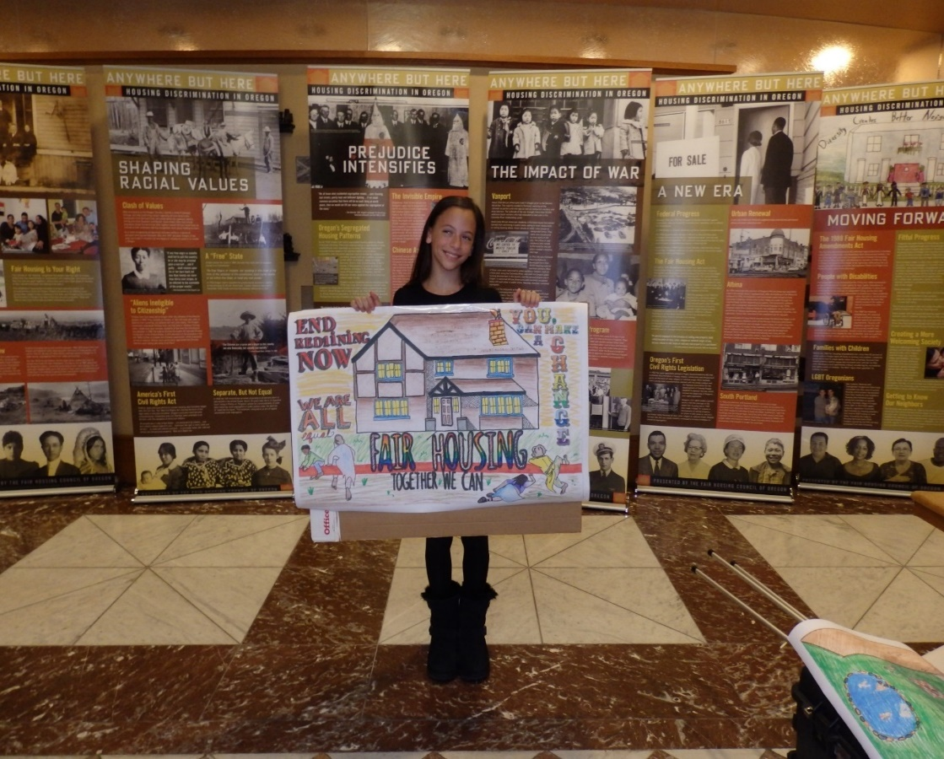
Public Comments are invited!
Portland Consortium Action Plan Hearing
Due to the public health crisis, this hearing will be held remotely.
Date: June 11, 2020
Time: 06:00 p.m.
Web Access: https://us02web.zoom.us/meeting/register/tZYrde-opj4uG9DmjQRmGhU1aa46YYN_VP7j
Comment period: Action Plan Substantial Amendment public comment ends June 12, 2020. Consortium 2020 Action Plan public comment ends July 7, 2020.
Contact us!
By email, mail, calls, online, or at public meetings. Contact Kim McCarty at Kim.McCarty@PortlandOregon.gov For translations, interpretation, or other accommodations please call 503-823-5312. :For more information about related Gresham and Multnomah County hearings visit: https://www.portlandoregon.gov/phb/74382.

