Slide 1

Welcome! Online Meeting Protocols and Tips
1. Be patient and respectful. This is a new experience for all of us!
2. Check speakers and microphone work properly.
3. Mute your microphone/phone when not speaking.
4. Introduce yourself before speaking.
5. The chat will be open at the end for Public Testimony.*
*This public meeting will be recorded, including the chat.
Notes:
Let’s learn from each other and make this a respectful, productive space. For many, online teleconferencing will be a brand new experience. Let’s dive in with humility and understanding as we all learn to navigate this new space.
Give yourself extra time to get set up. Check your headset, microphone, volume level, and if needed, any software that you may need to install.
Mute yourself when not speaking. This prevents feedback and noise disruptions.
Introduce yourself before speaking. This helps the audience connect the voice to the speaker.
Keep the chat respectful and on topic. Please be aware that some public meetings are recorded, including the chat.

Slide 2

North/Northeast Neighborhood Housing Strategy Oversight Committee
5-year summary
Thursday May 14, 2020

Slide 3
Funds committed but not spent in Goals 2 and 3: $28,353,854.00
PHB has non-committed funds remaining in Goal 1: Preventing Displacement. $9,620,999.00.
Notes:
Add information about remaining funds.

Slide 4

2019 Accomplishments
One multi-family building, the Magnolia II was completed in 2019, leasing began in September 2019
Three multi-family projects were under construction: Songbird, renaissance commons and king+parks
PCRI’s first home ownership development under the preference policy was completed and sold to 4 preference policy families.
Preference Policy Home Buyers increased from 7 in 2018 to 33 in 2019

Slide 5
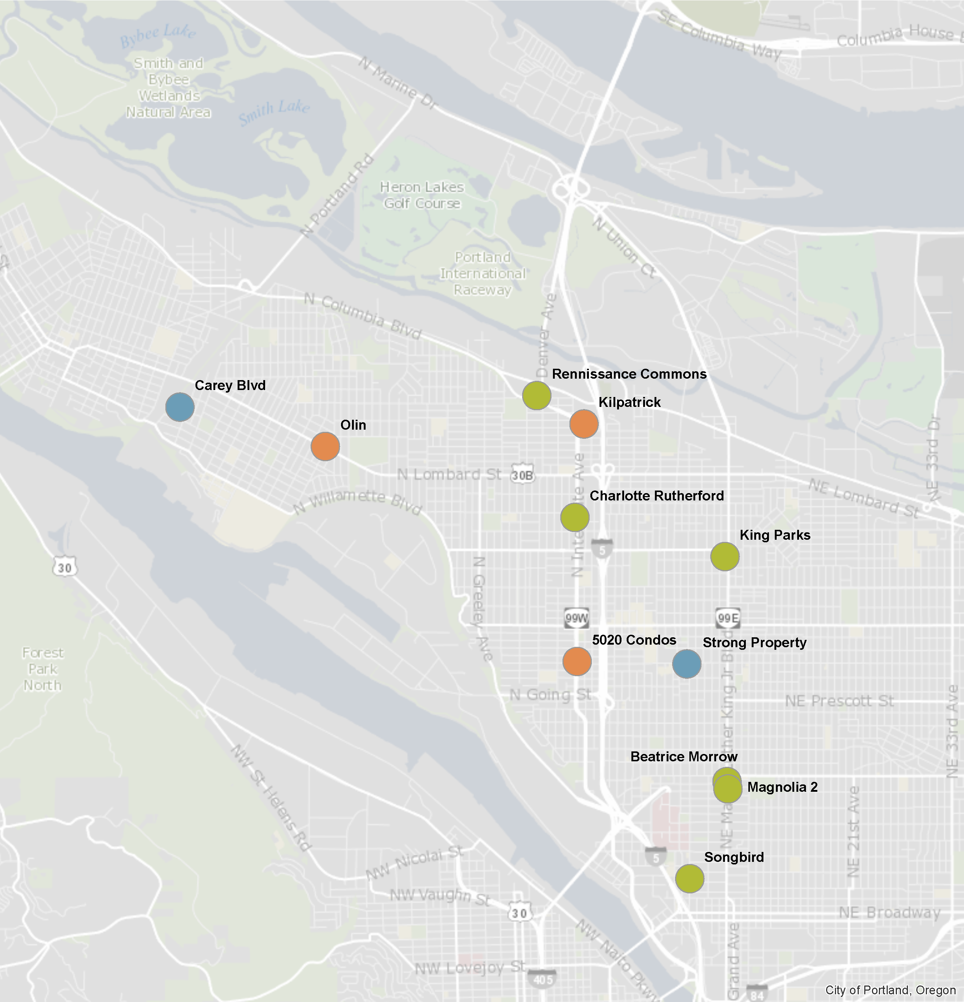
PHB N/NE
Investments

Slide 6
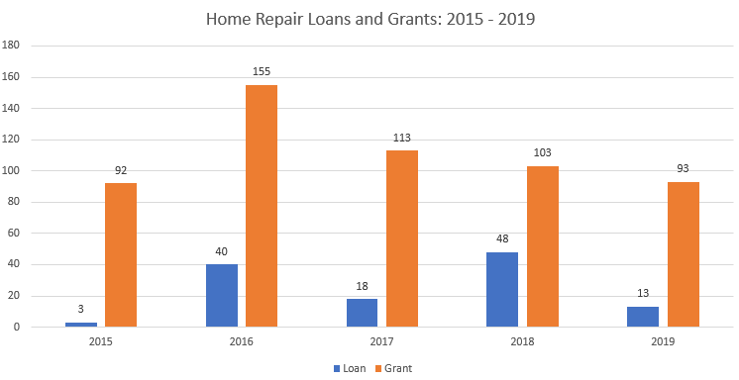
Strategy 1: Preventing Displacement
Total Home Repair Loans: 122
Total Home Repair Grants: 558

Slide 7
Strategy 1: Preventing Displacement

Slide 8
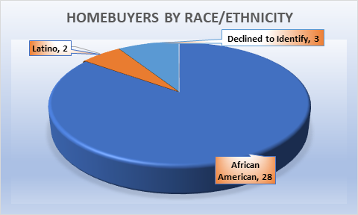
Strategy 2: Creating New Homeowners
Notes:
The 17 N/NE DPAL Home Buyers count towards PHB’s goal of 110 by 2022
An additional 6 new homeowners purchased as of February 12, 2020
An additional 10 households are in contract, anticipating closing by end of March 2020

Slide 9
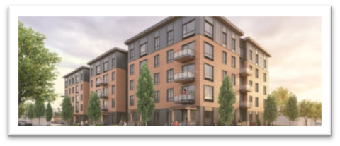
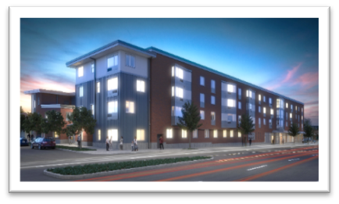
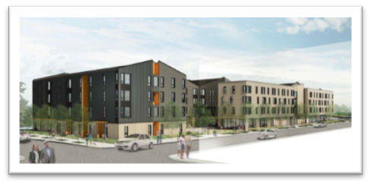
Strategy 3: Creating Rental Homes
IHI/Magnolia II – 24 families moved in, 6 scheduled to move in as of February 7th
PCRI/King+Parks – Expected completion of construction and occupancy in June 2020
Bridge/Songbird – Expected completion of construction and occupancy in June 2020
Reach/Renaissance Commons – Expected completion of construction and occupancy in June 2020

Slide 10
Strategy 3: Creating Rental Homes
PHB has exceeded the goal of 380 rental units, with a total of 501 units between 6 buildings.
A 52% of the units are family sized with 2+ bedrooms
We will be able to serve very low income families through a combination of Project Based Section 8 vouchers and PSH.
Approximately 1254 people will be housed in these units

Slide 11
Strategy 4: Land Banking
PHB completed negotiations the Strong family to purchase property within the district.
PHB purchased the Carey blvd property from the Water bureau for future home ownership development, at it’s April meeting Prosper Portland’s Board voted to include the property in the Interstate TIF district

Slide 12
Policy Goal: DMWESB Participation Home Repair

Slide 13
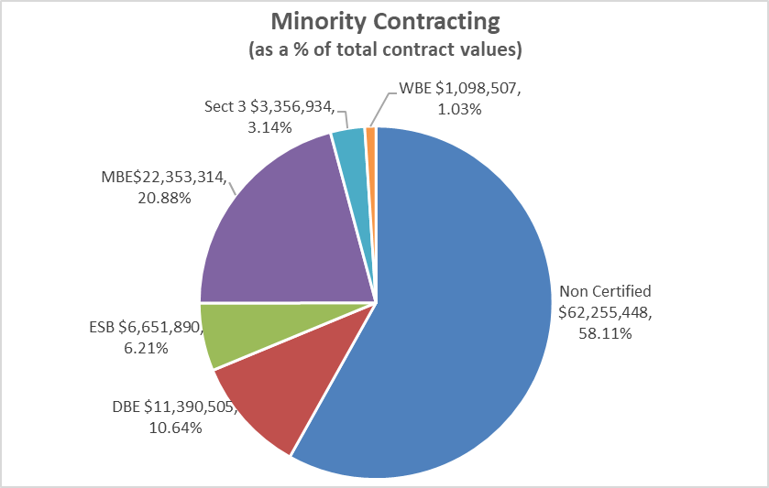
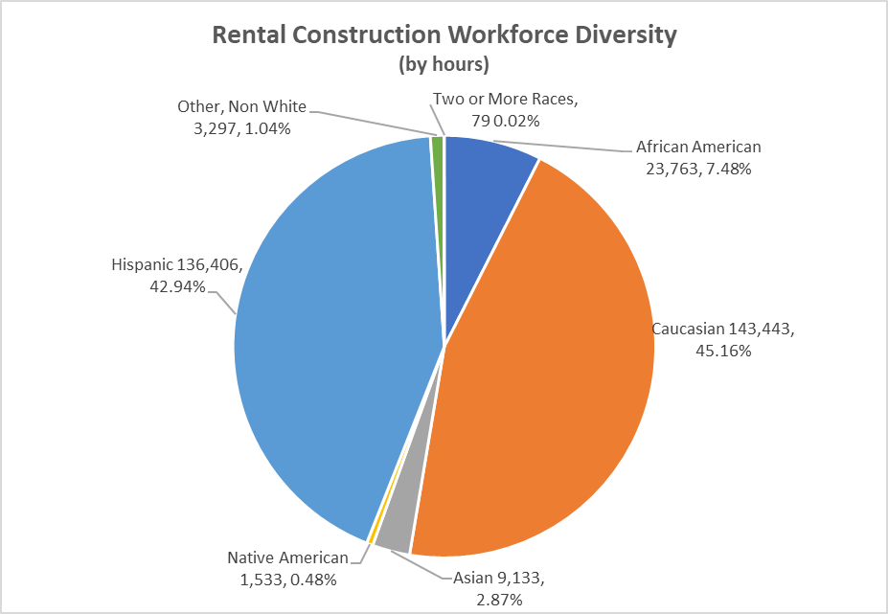
Policy Goal: DMWESB Participation Rental Construction

