Slide 1
Mobility Hub
Staff presentation to The City Council
November 20, 2019

Slide 2


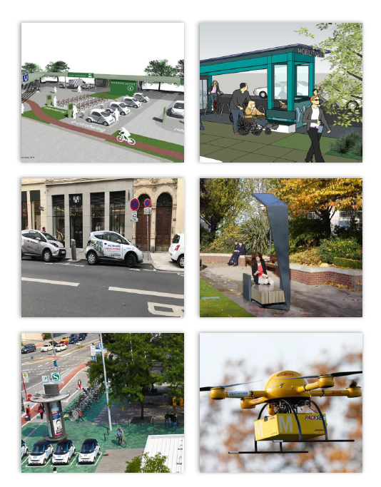


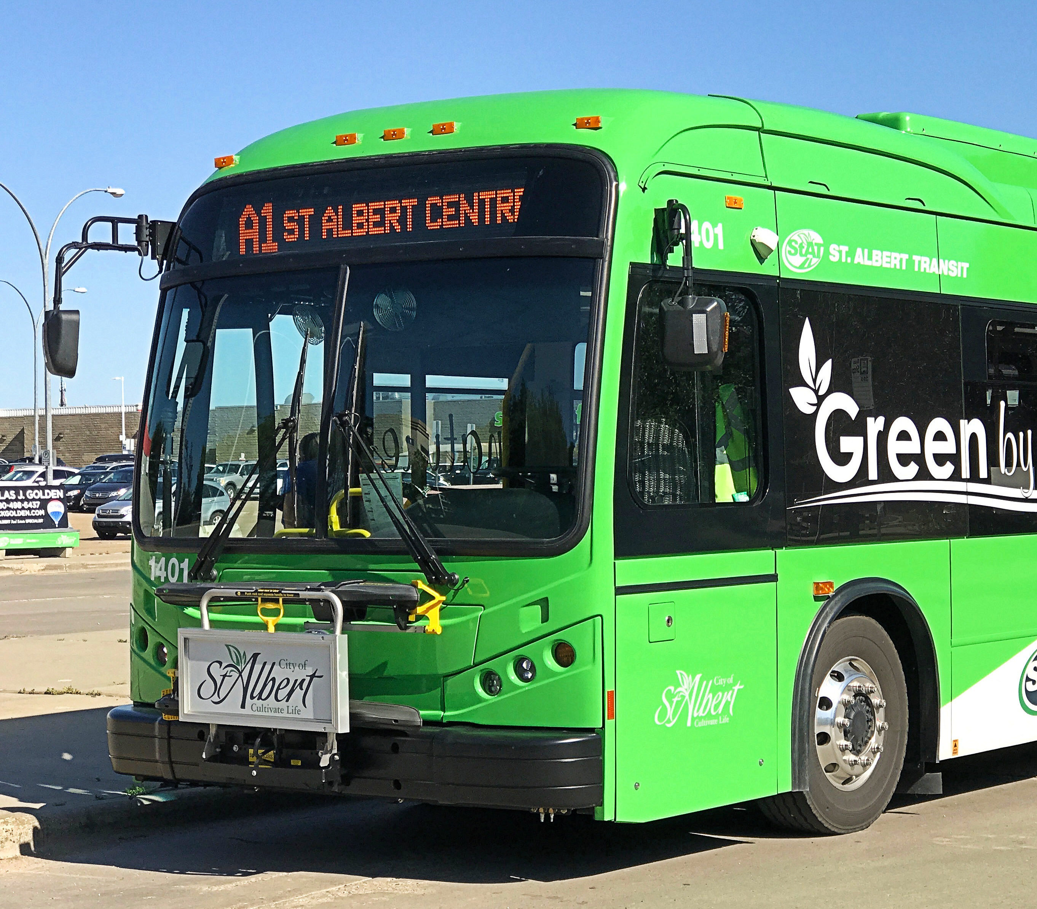

PGE Mobility Hub Concept:
Integrate different modes of transportation, multi-modal supportive infrastructure, and place-making strategies to create activity centers and maximize first/last mile connectivity.

Slide 3
Mobility Hub Components
Mobility proposal includes:
Electrified micro-mobility;
EV smart car-share;
Public transit;
Bike parking/valet; and
Electric wheelchair charging

Slide 4
Mobility Hub Components
Placemaking proposal:
Smart furniture;
Public WiFi;
Ballot drop box;
Attended restroom;
Job training on charging infrastructure maintenance; and
Food carts

Slide 5
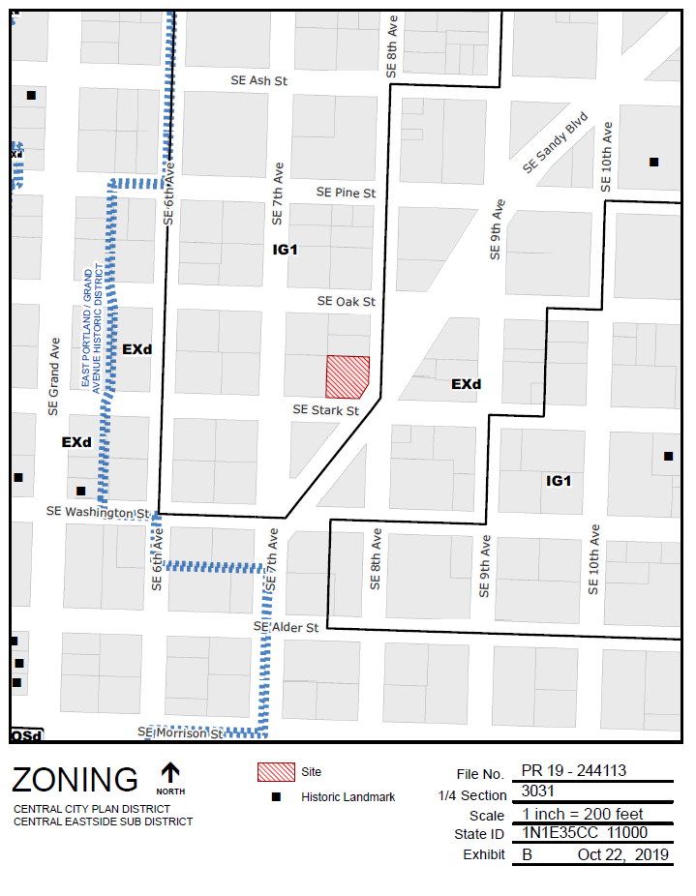
Site: SE 8th Avenue and SE Stark Street
Zoning: IG1 (General Industrial 1) in Central City Plan District/Central Eastside Subdistrict

Slide 6
Zoning Issues
Use is categorized as Retail Sales and Service;
Retail uses are limited to 5,000 square feet of building or exterior activity area in the Central Eastside;
Temporary uses are limited to 2 weeks; and
Permanent site changes would be required.

Slide 7
Ordinance
Extend temporary activity allowance from 2 weeks to until June 30, 2021 (but only for a mobility hub);
Waive prohibition on new permanent development to allow 10,000 square feet of Retail Sales and Service;
Waive screening requirement for mechanical equipment and garbage/recycling; and
Request BPS scope future effort to update City Code including Title 33 to address changing mobility needs.

Slide 8
Mobility Hub
Staff presentation to The City Council
November 20, 2019

