Slide 1
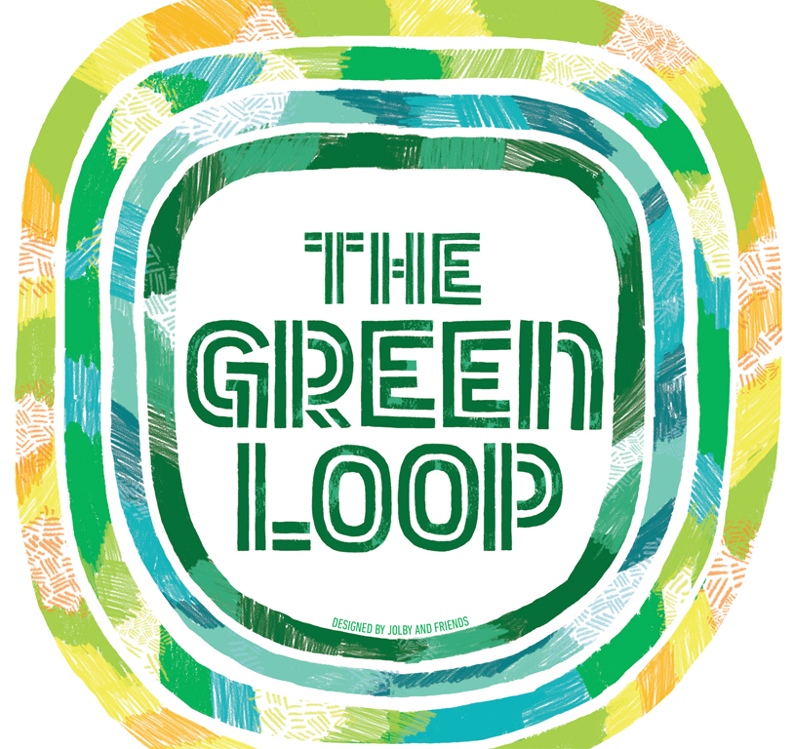
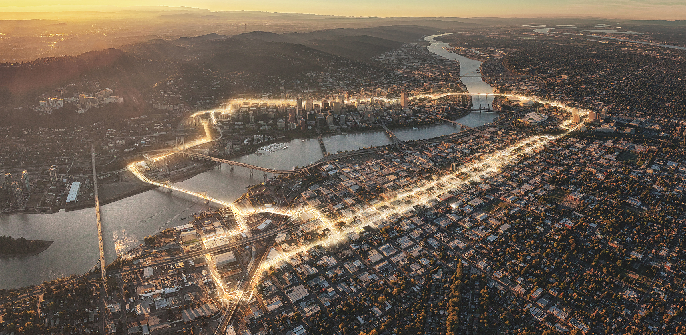
The Green Loop: A 21st Century Public Works Project
Credit: Untitled Studios

Slide 2
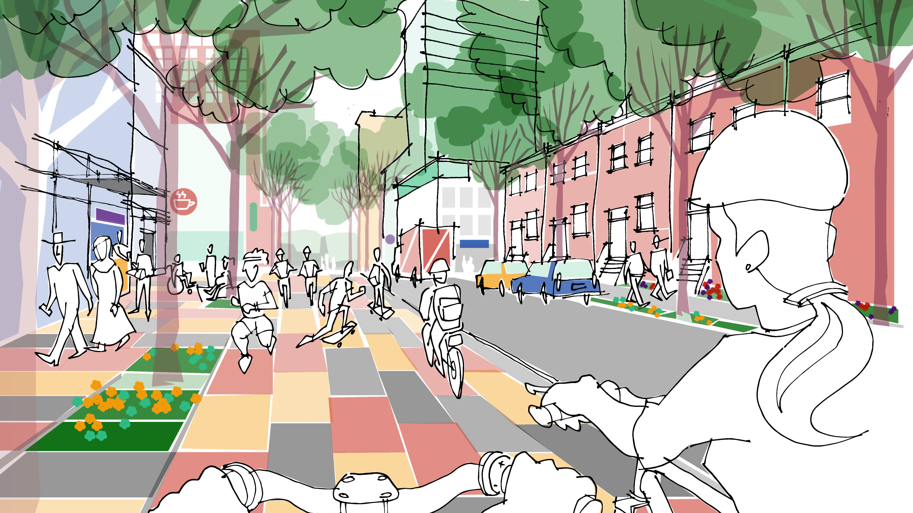
Adopted with Central City 2035 Plan

Slide 3
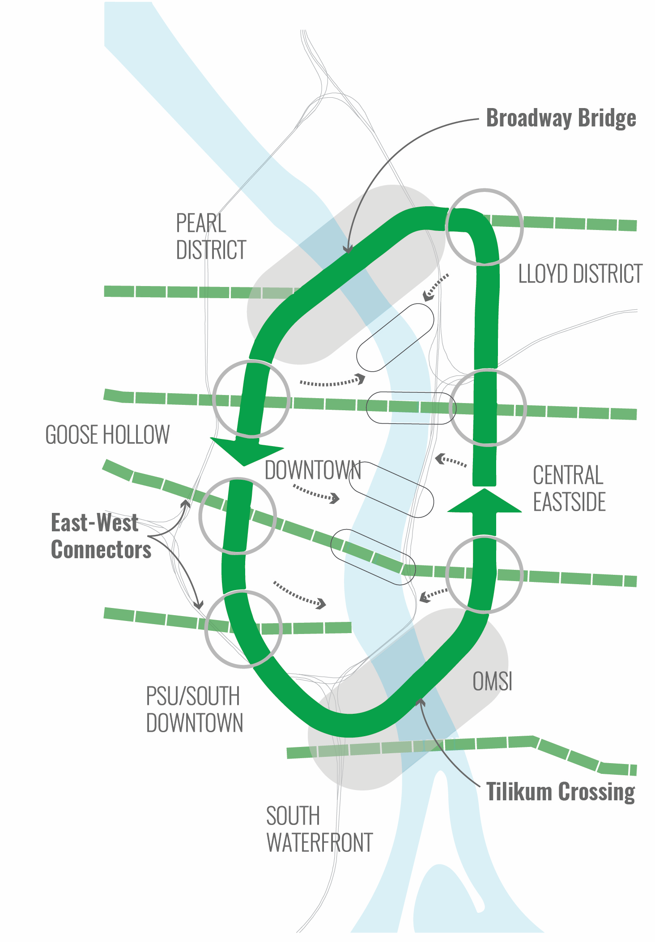
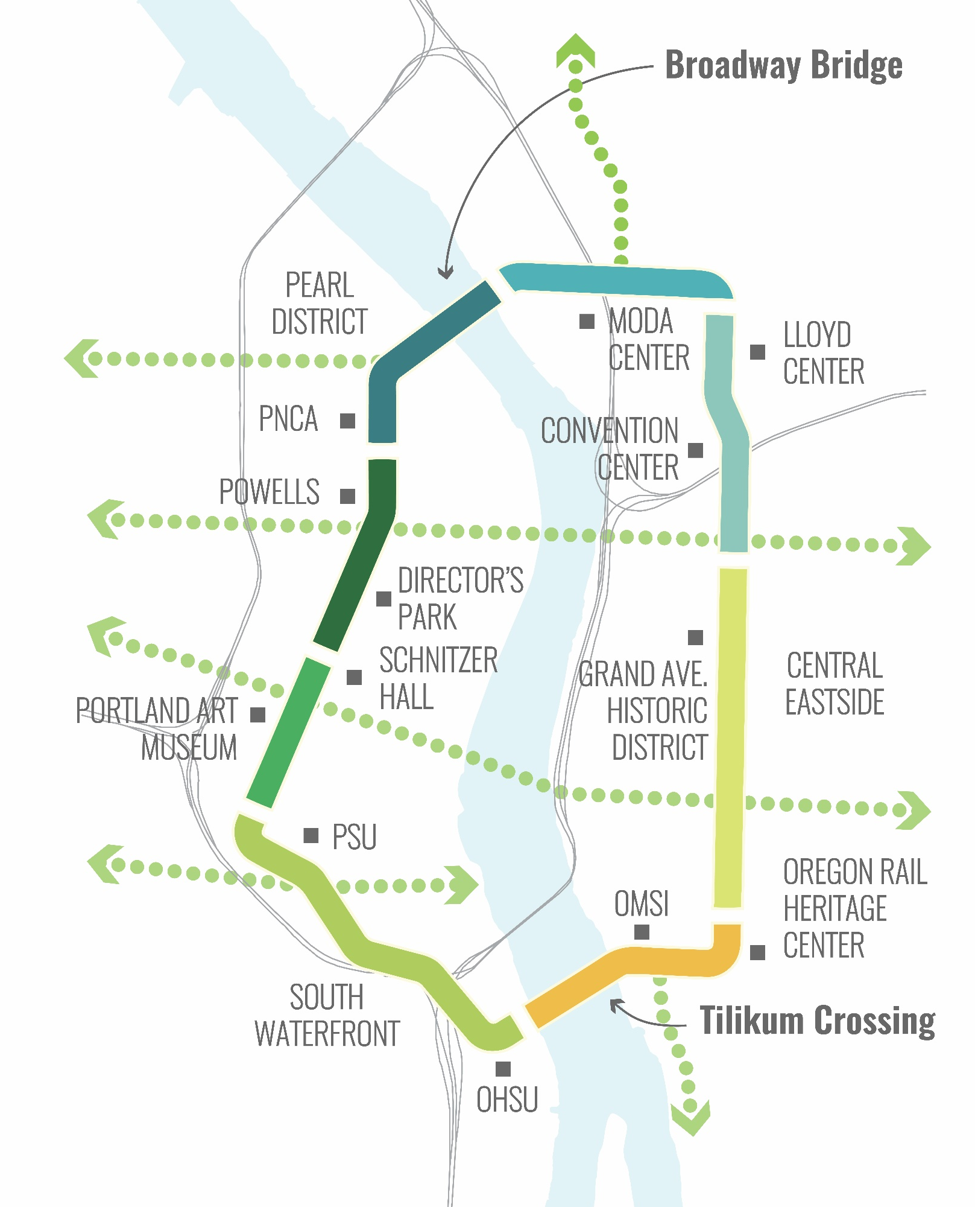
The Green Loop is a six-mile linear park that invites residents, employees and visitors to experience Portland’s Central City in an entirely new way.
Notes:
At its core, the Green Loop is a 6-mile walking and biking linear park. The concept connects the Broadway Bridge on the northern end to the Tilikum Crossing Bridge at the southern end. Both of these locations have tremendous redevelopment potential that can bring people closer to the Willamette River. A series of clear east-west connections link surrounding neighborhoods and districts to the loop and on through to the river. The Green Loop is an example of being more intentional with the Central City’s street network, prioritizing some routes for some functions and others for others, ala the Transit Mall.

Slide 4
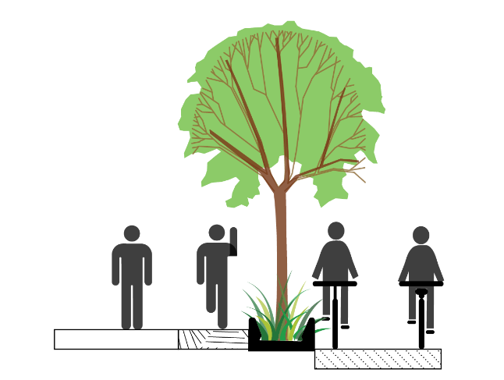
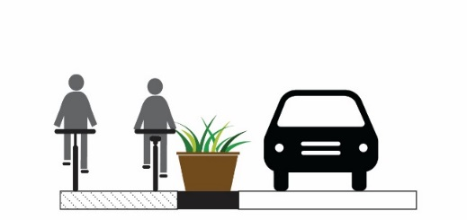
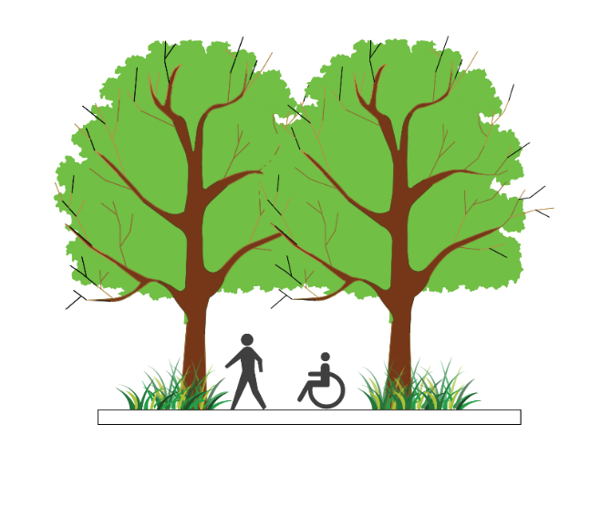
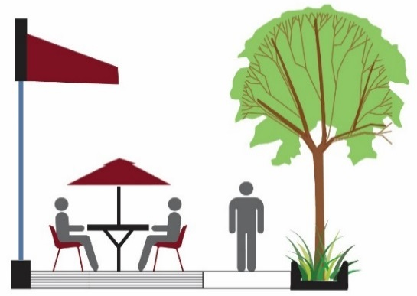
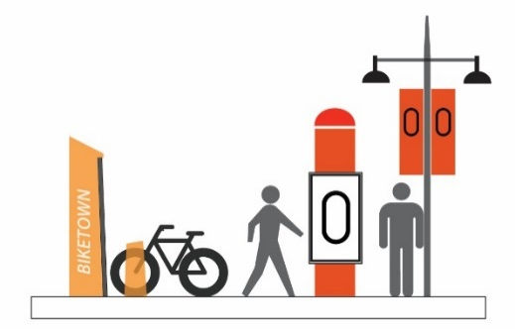
DESIGN PRINCIPLES
THE GREEN LOOP
PHYSICAL SEPARATION
WALKING, JOGGING,
BIKING
CONNECTED CANOPY
BUILDING ORIENTATION
BRANDING/IDENTITY
CREATIVE FURNISHING DESIGN
Notes:
The Green Loop aims to follow four key design principles:
It will incorporate a multi-use path that is intended to accommodate but separate pedestrians and joggers from cyclists.
Though it will be located within many of Central City’s existing street network, the Green Loop will be physically separated from cars.
Where possible, the Green Loop will include a connected tree canopy as well as pedestrian and bicycle-related amenities such as seating, bike racks, lighting, wayfinding, and water fountains.

Slide 5
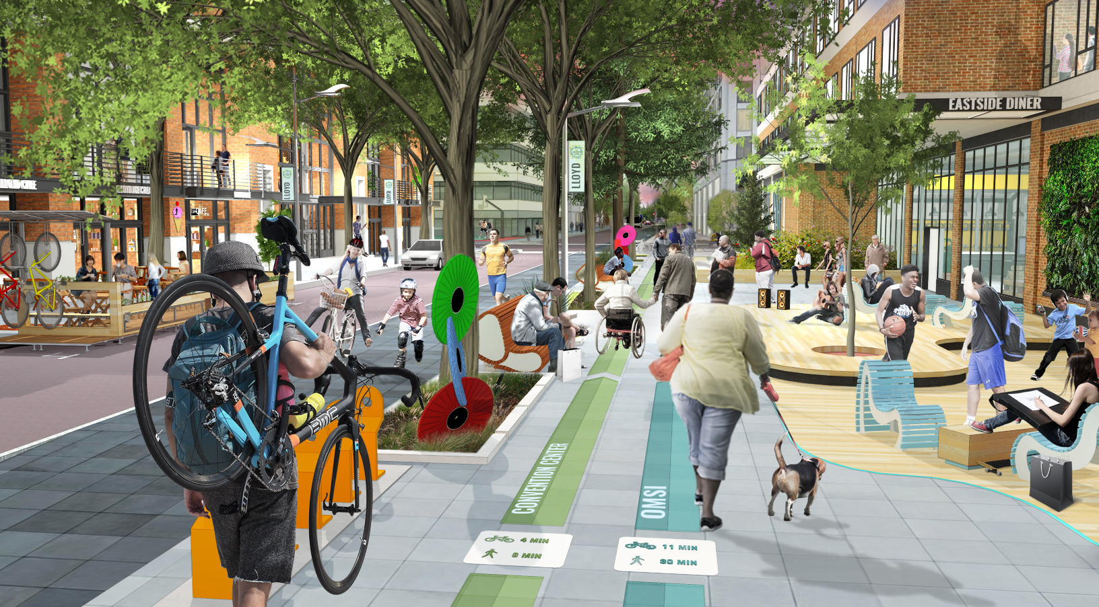
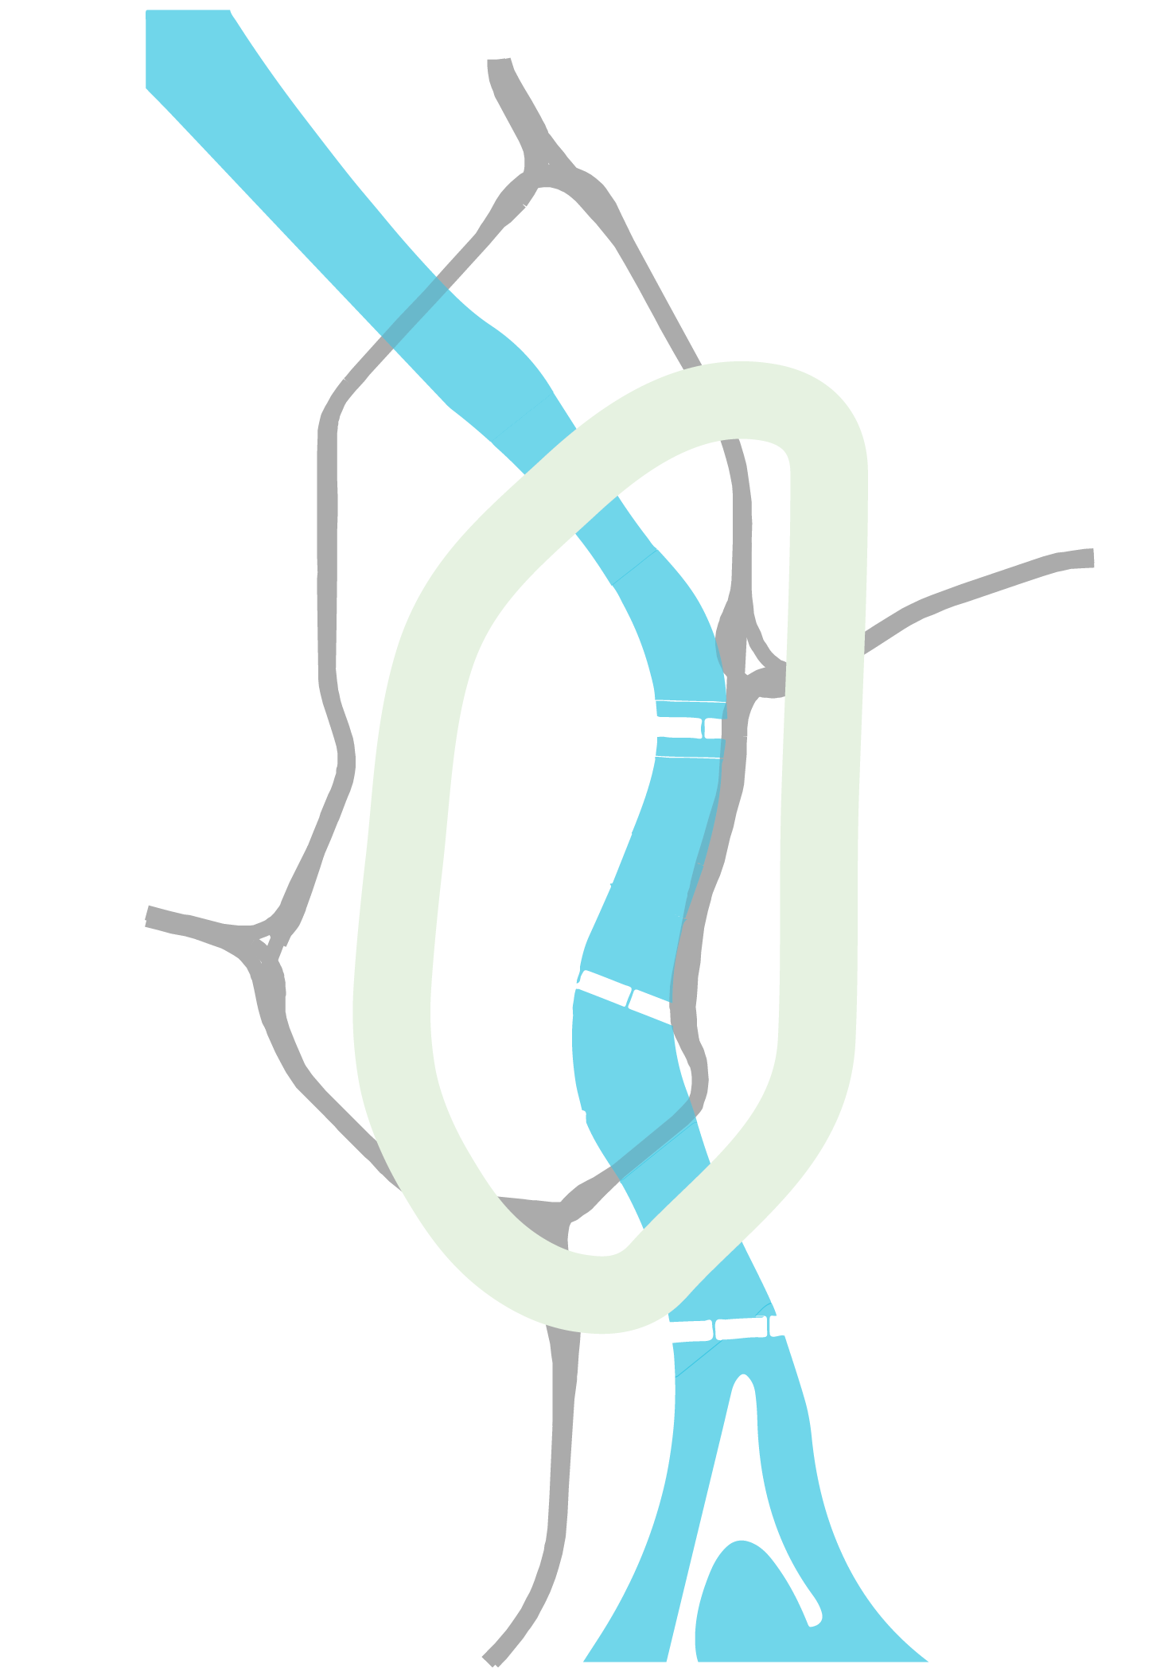
Lloyd District

Slide 6
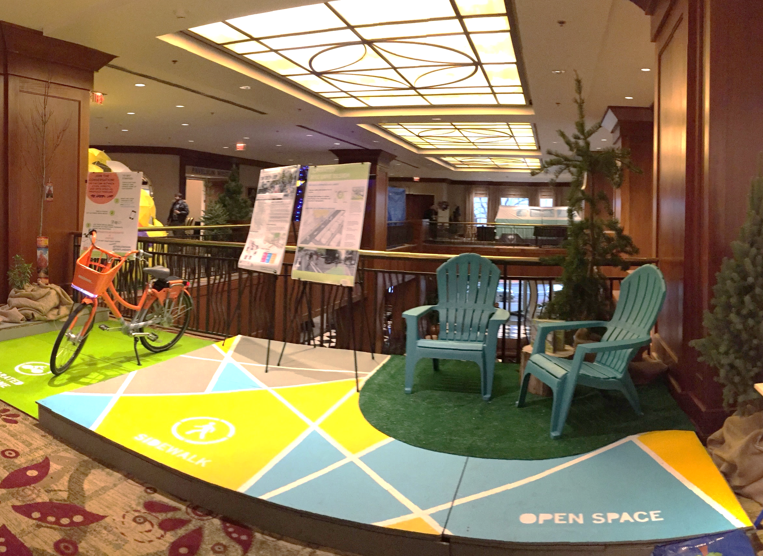
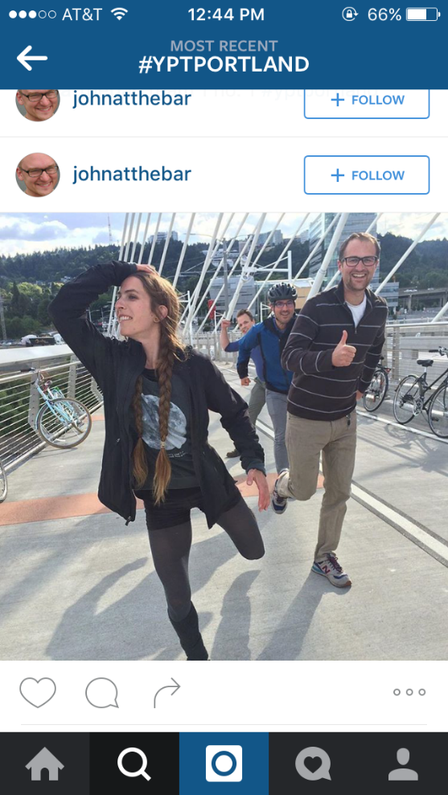
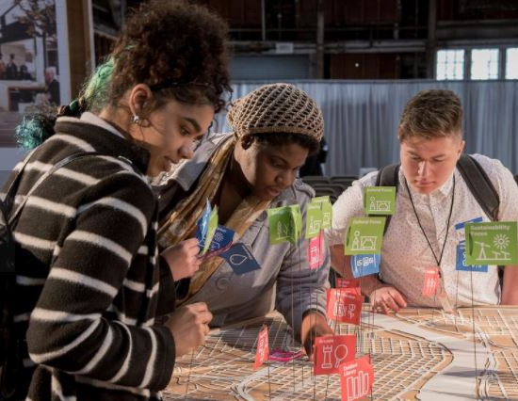
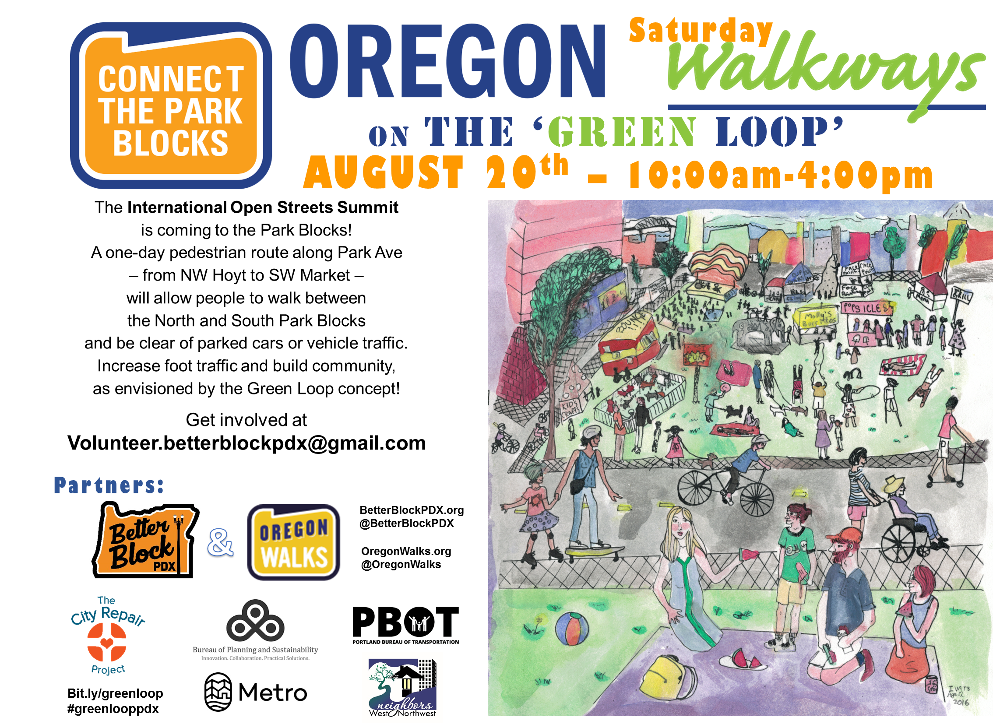
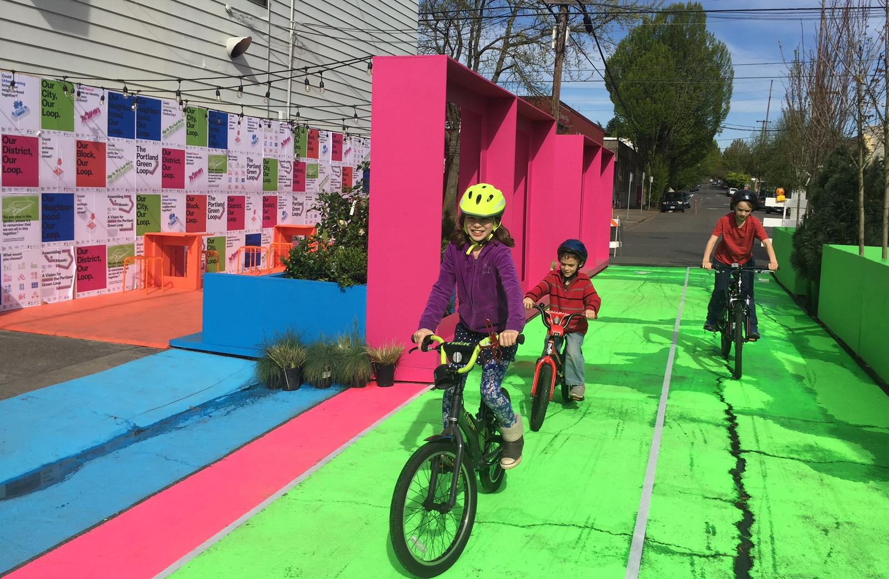
Community Involvement
The Green Loop
Oregon Walkways 2016
YPT Scavenger Hunt 2016
Design Week Portland 2016

Slide 7
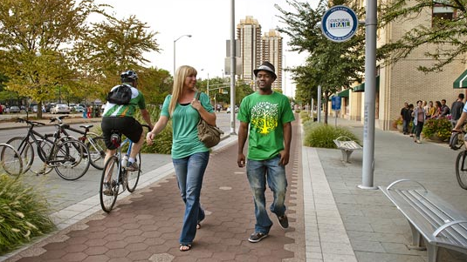
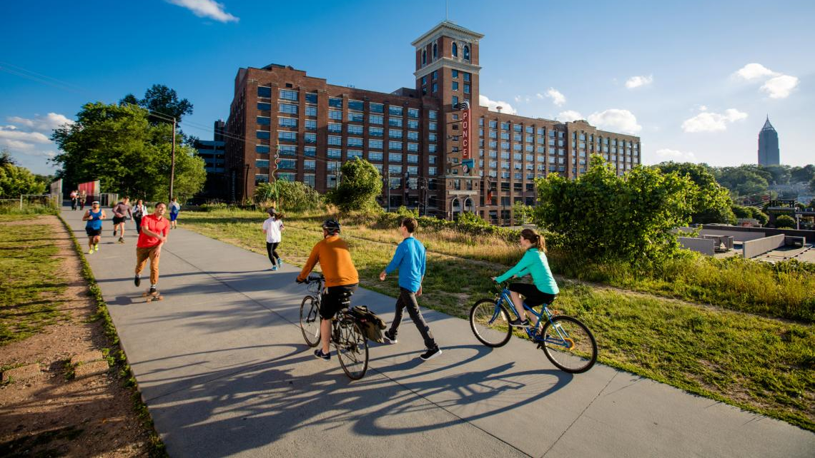
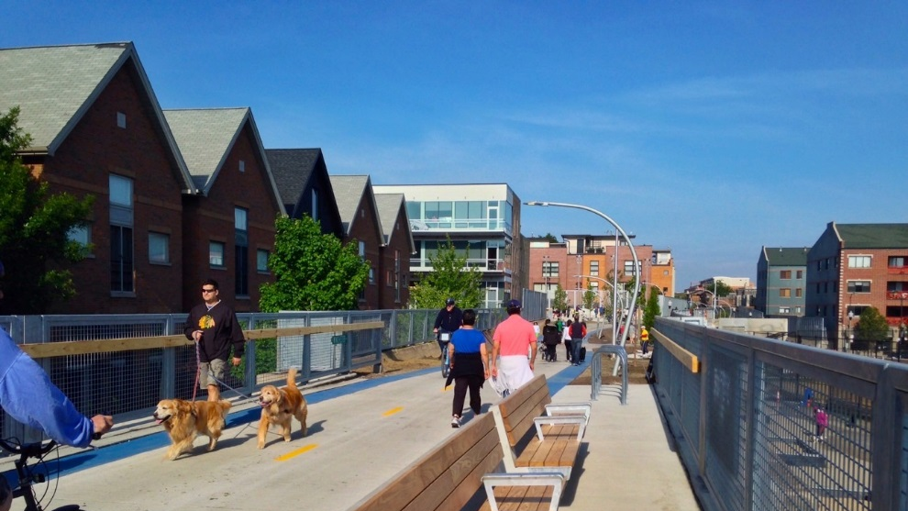
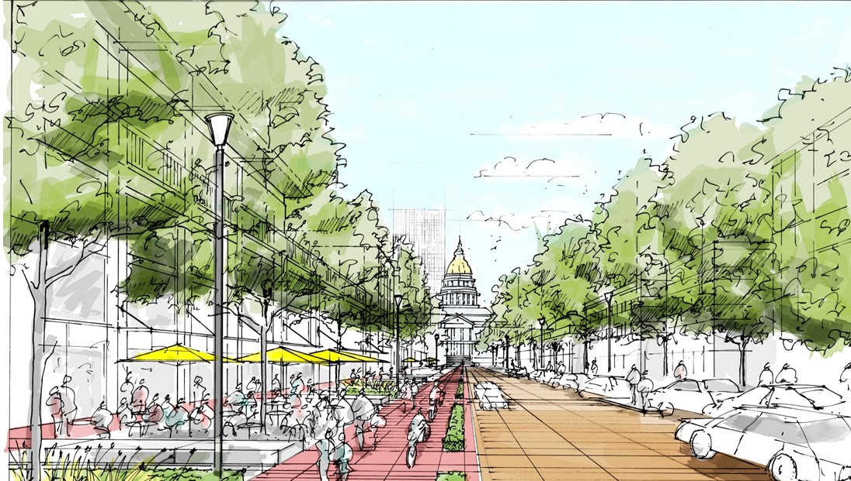
Precedents
The Green Loop
The Indianapolis Cultural Trail
The Atlanta Beltline
The Chicago Bloomingdale Trail – “The 606”
The Denver 5280 Loop
Notes:
Many other cities are investing in low-stress, placemaking strategies that incorporate active transportation through the centers of their downtowns.
The example from Vancouver shows a lower cost, perhaps initial-phase approaches to consider.
New York and Indianapolis show more permanent solutions that have had measureable impacts for walking and biking for each city. The Indiana Cultural Trail connects several institutions along an 8 mile trail. Though it is a high level of design throughout the length of the trail, over half of it was funded by federal transportation funding, and most of the remainder was funded privately.
The example in Chicago is the 606 – a new highly visible elevated linear park and trail system – is a separated bicycle, jogging and pedestrian connection across six neighborhoods, which will provide three miles of green space, connecting six neighborhood parks at ground level, a wheel-friendly event plaza, an observatory, art installations, educational programming, and other amenities.

Slide 8
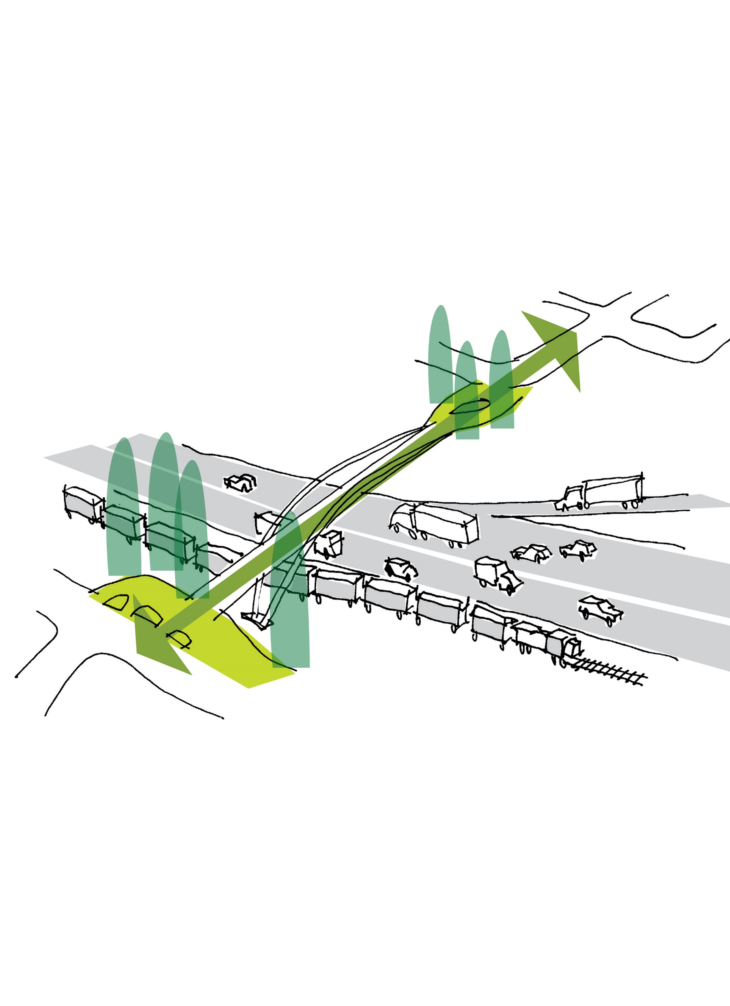
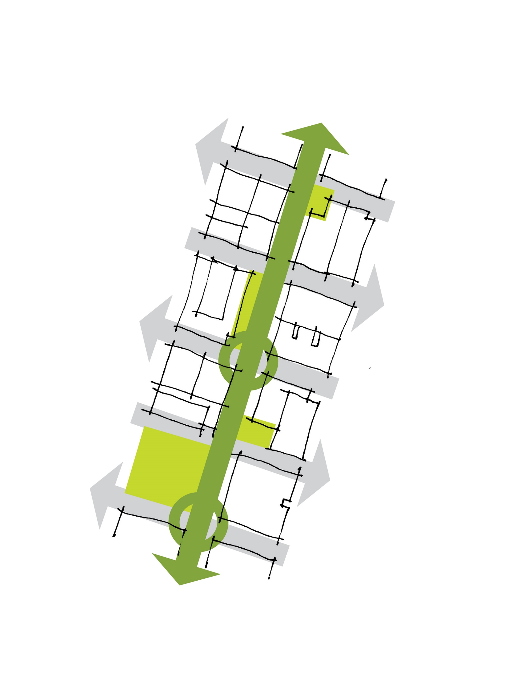
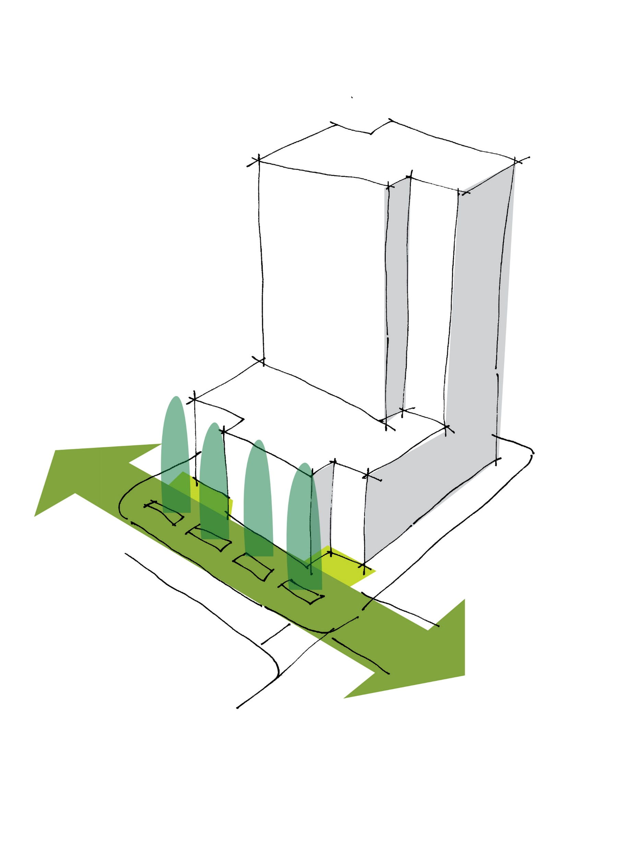
Public Infrastructure
Loop Implementation
Development Regulations
Capital Improvements

Slide 9
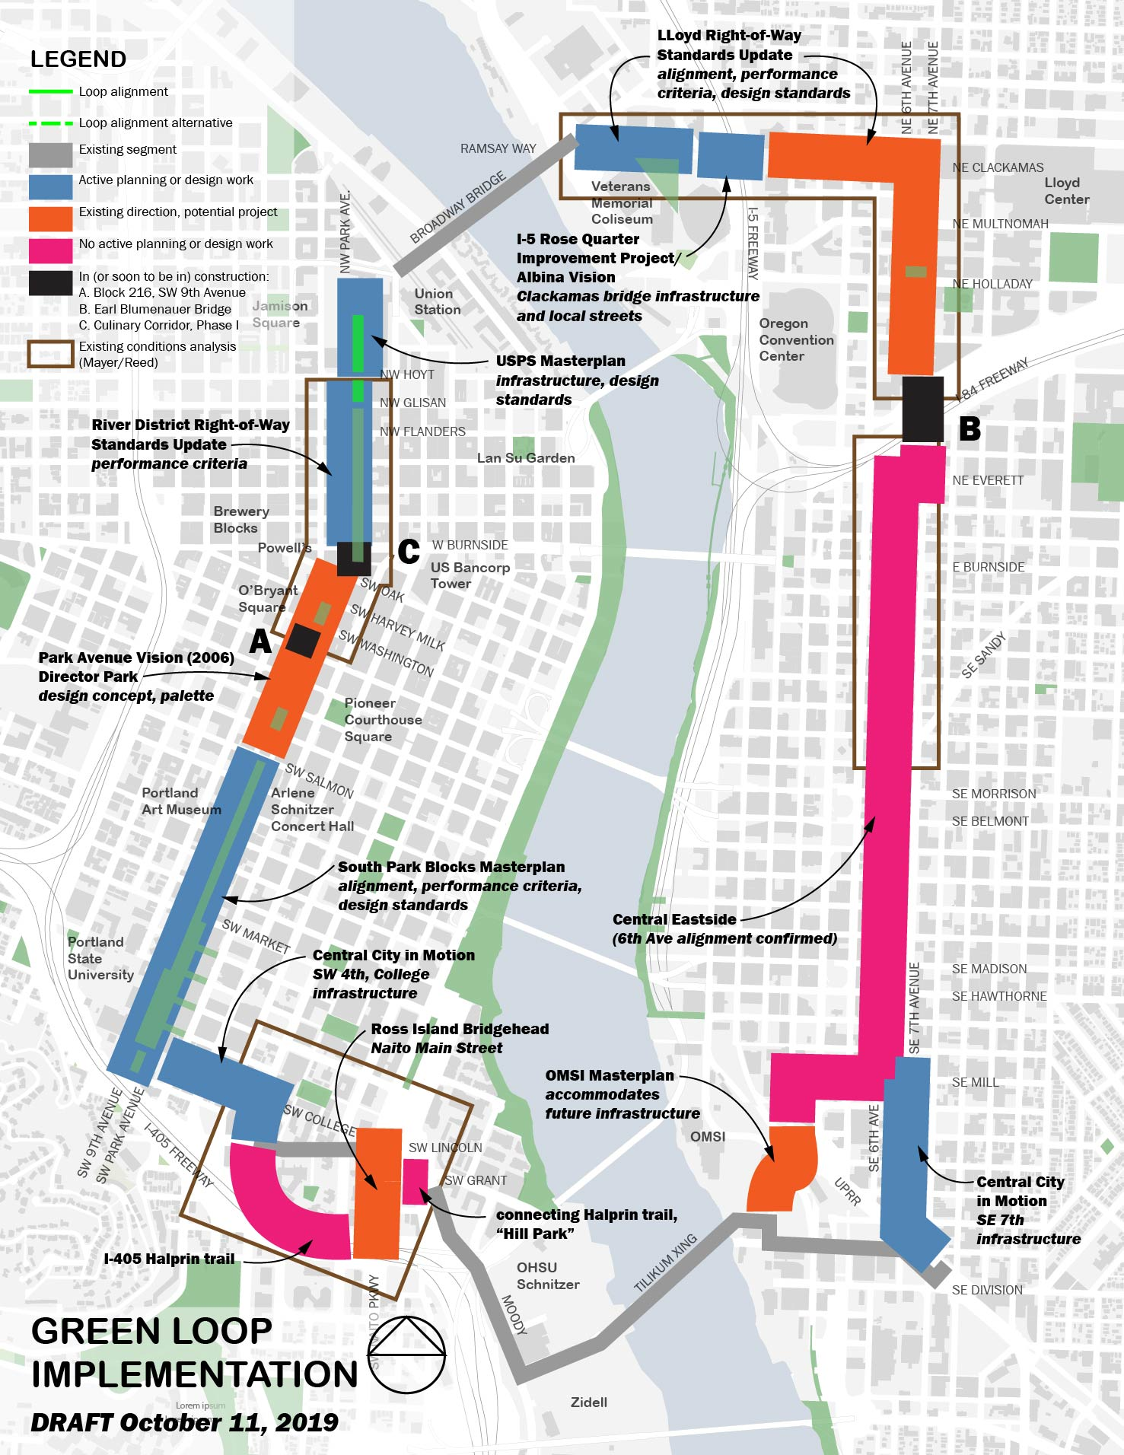
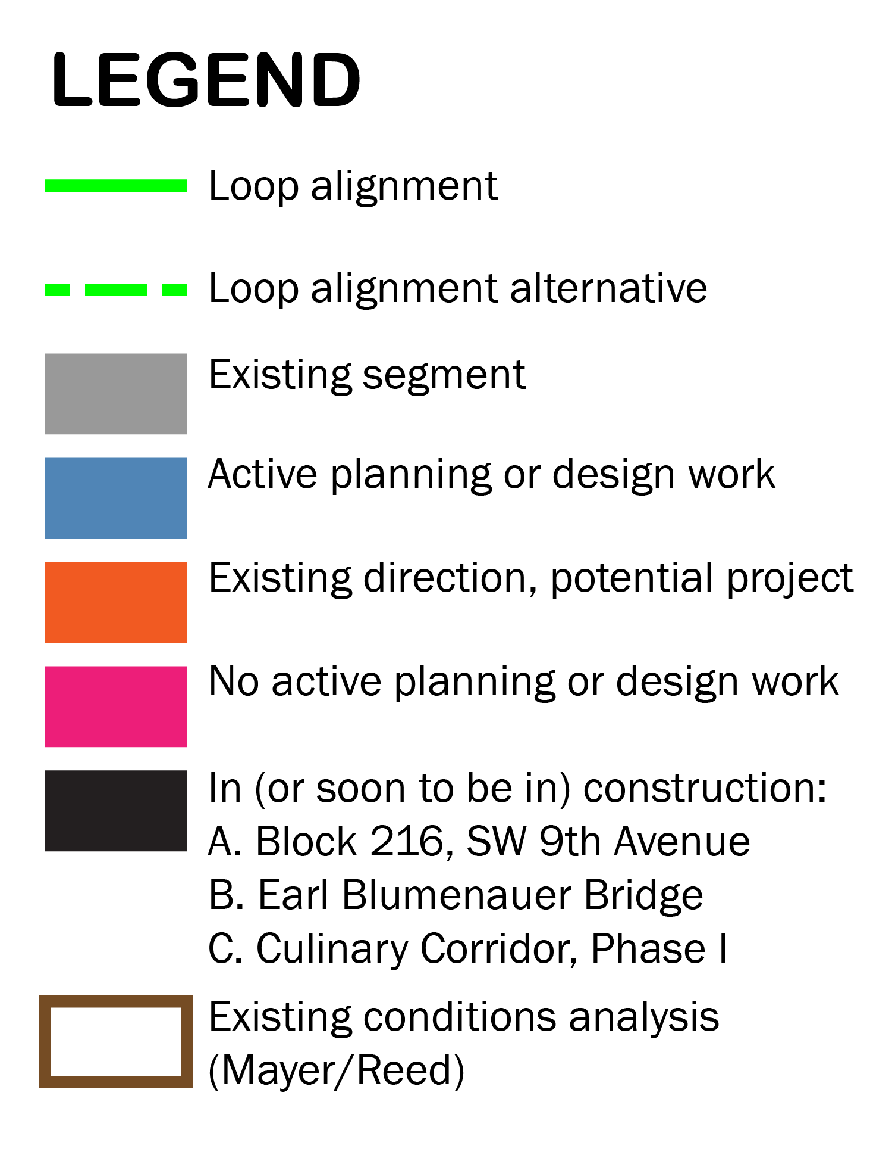
Loop in Progress

Slide 10
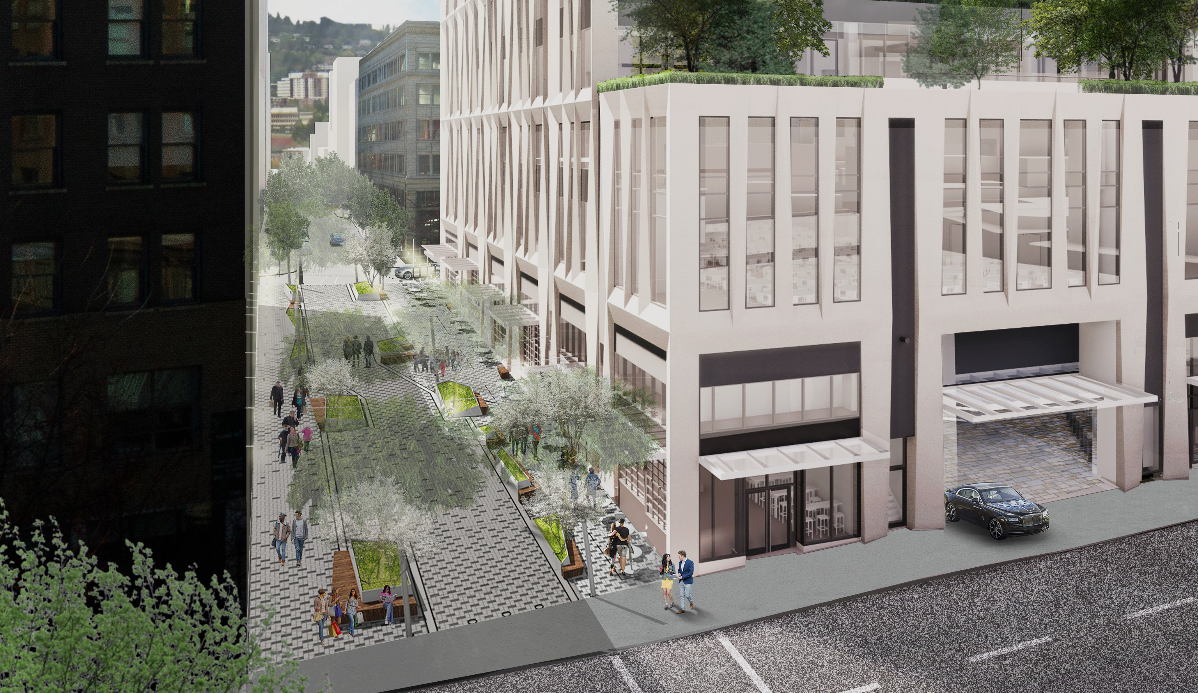

Slide 12
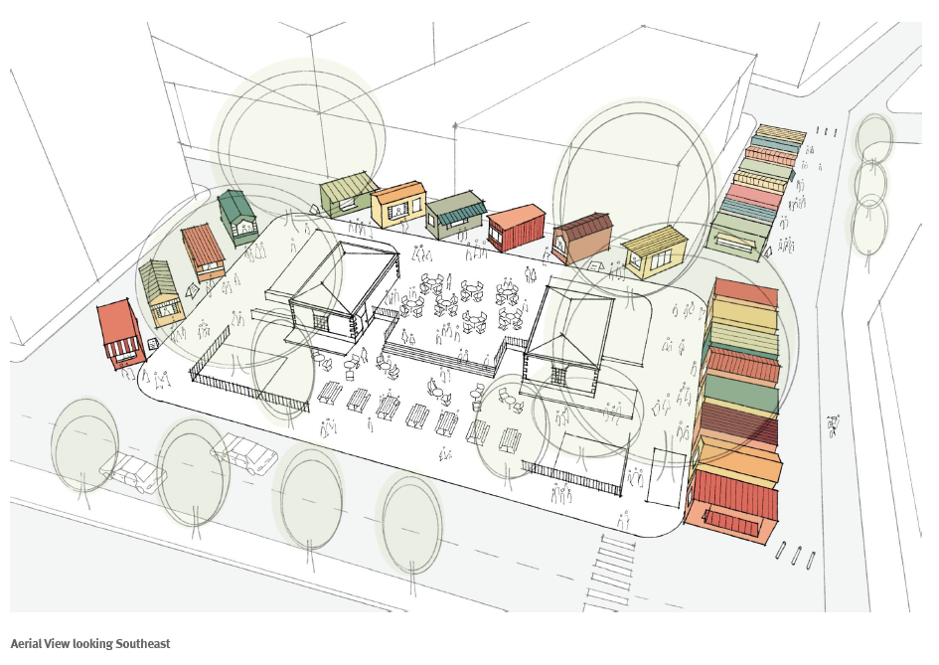
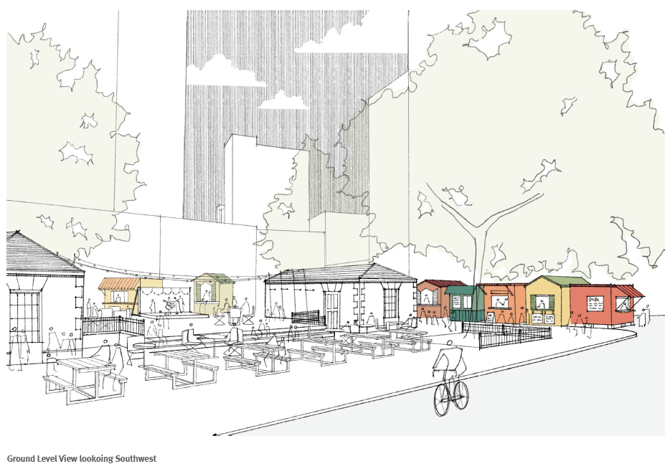

Slide 13
Loop in Progress

Slide 14
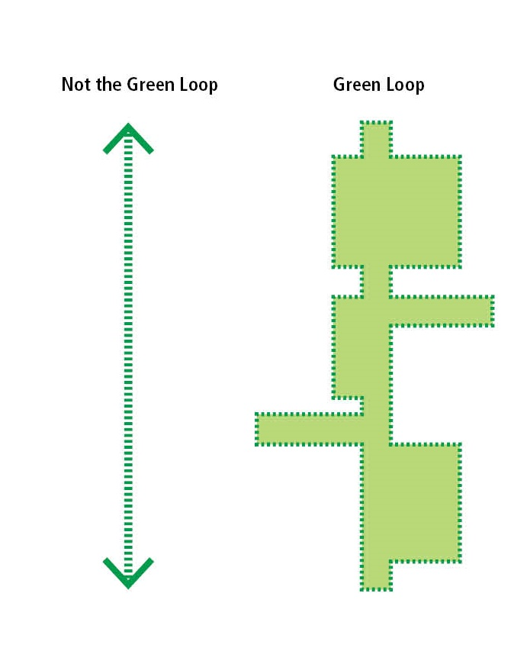
Lloyd District
North Park Blocks
South
Downtown
Central
Eastside

Slide 15
Central Eastside Study Area
I-84
NE Glisan St
E Burnside St
6th Ave
7th Ave
SE Washington St

Slide 16
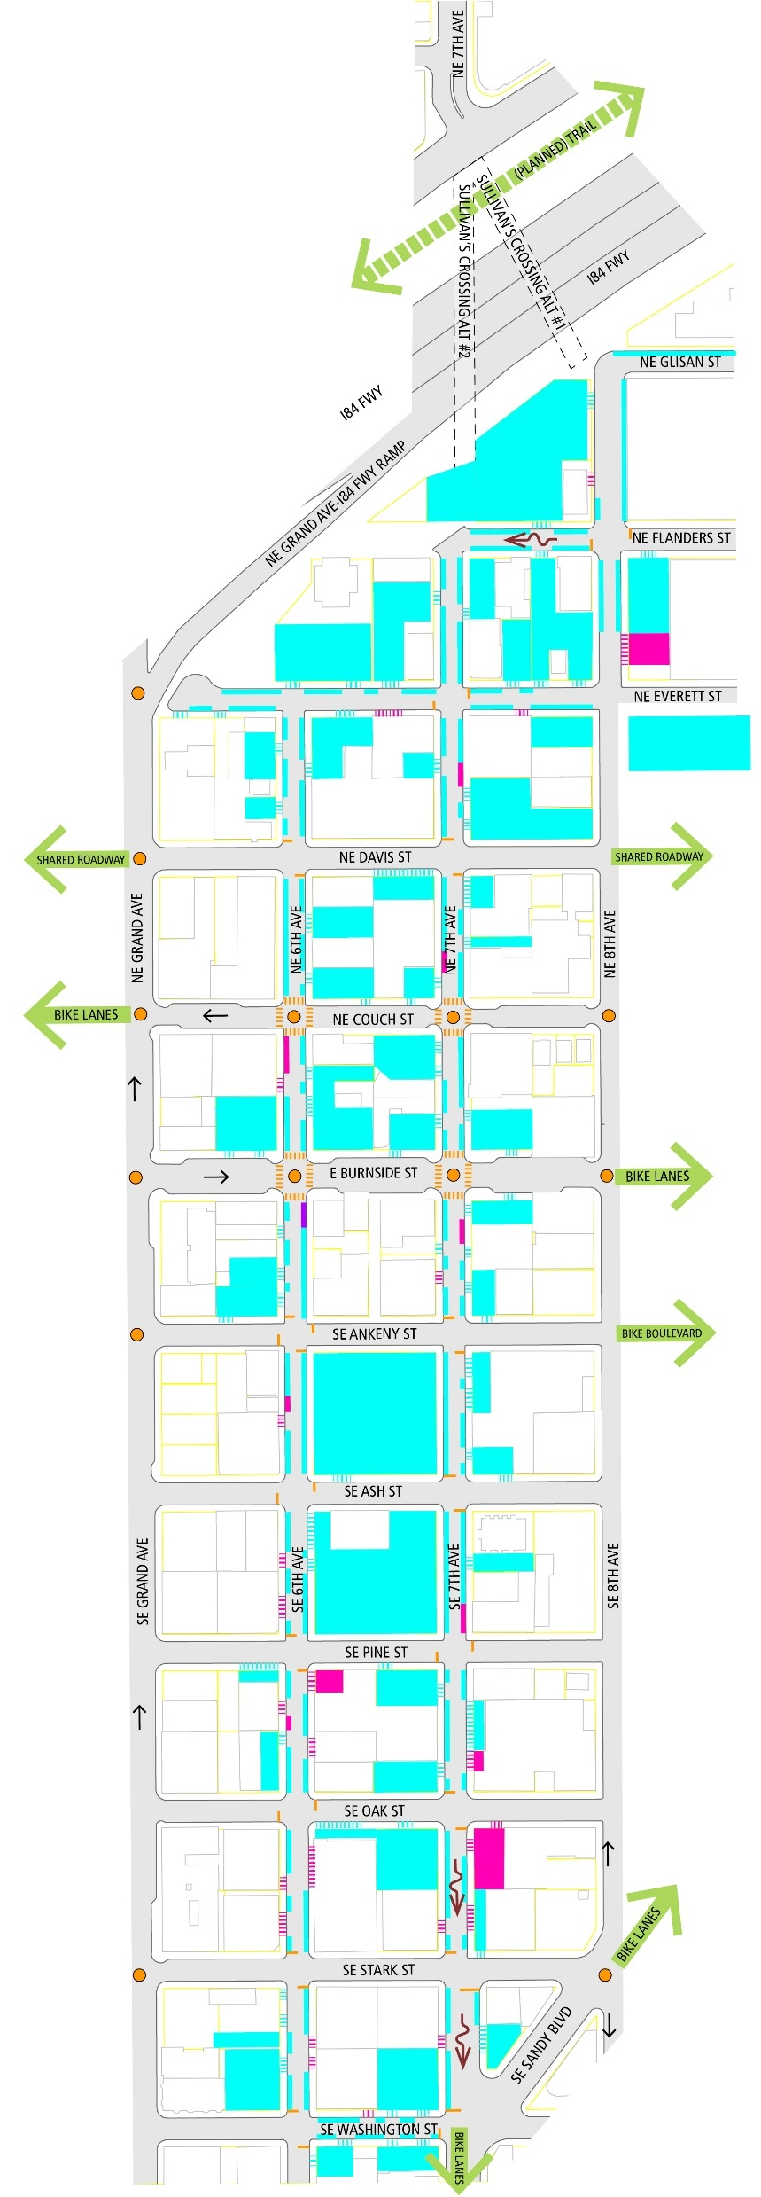
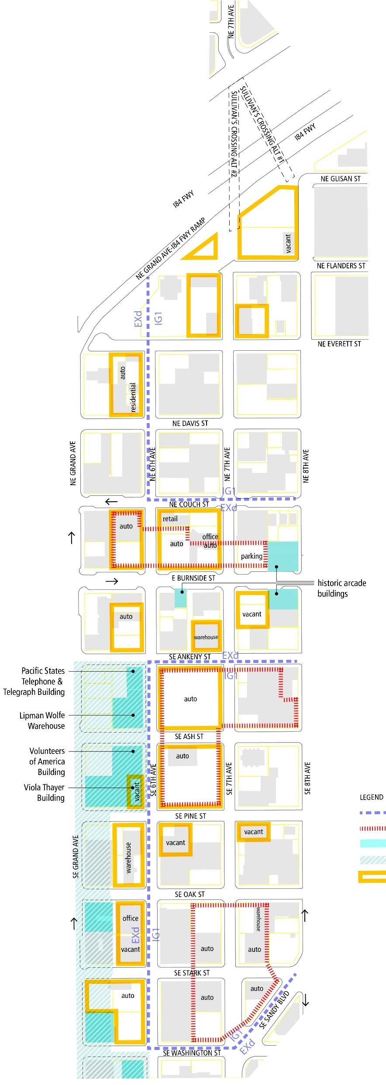
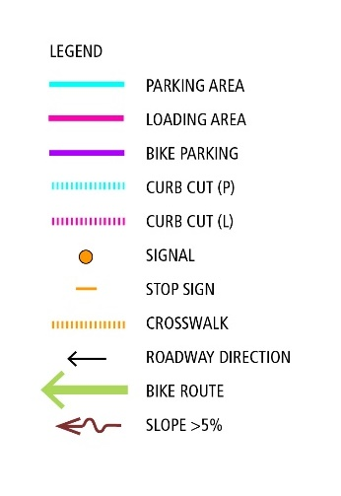
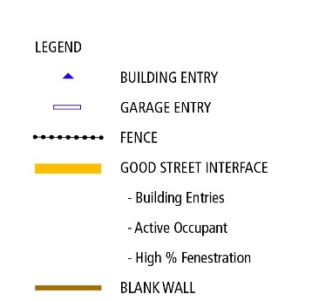
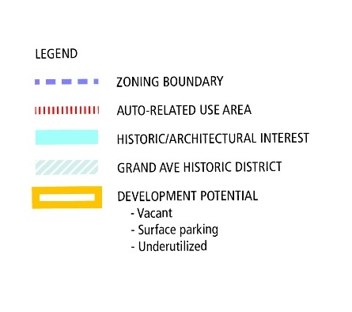
Central Eastside Existing Conditions
Street Condition
Building Condition
Land Use & Zoning

Slide 17
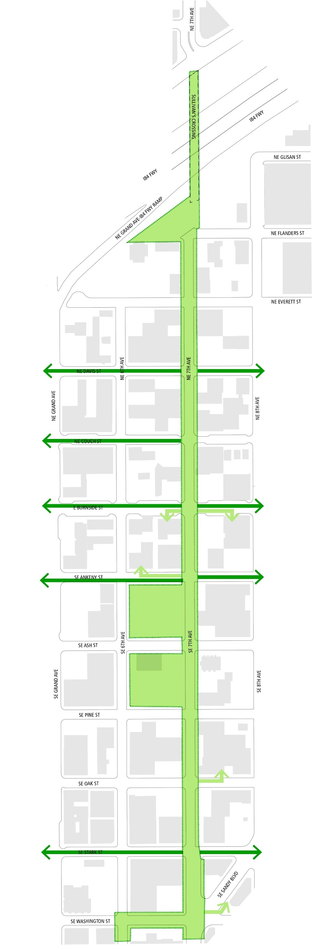
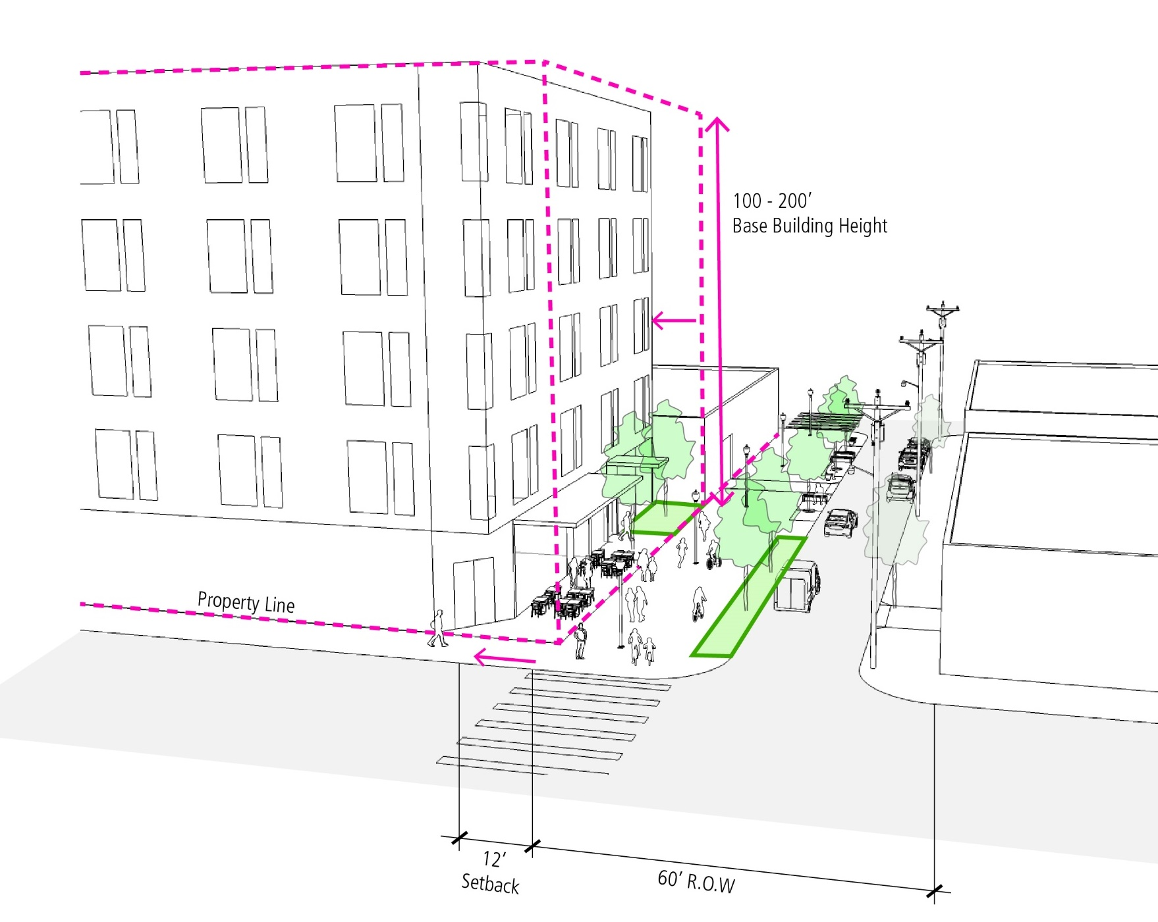
Central Eastside Open Space Opportunities Analysis
6th Ave
7th Ave
Potential Setback in EX Zone

Slide 18
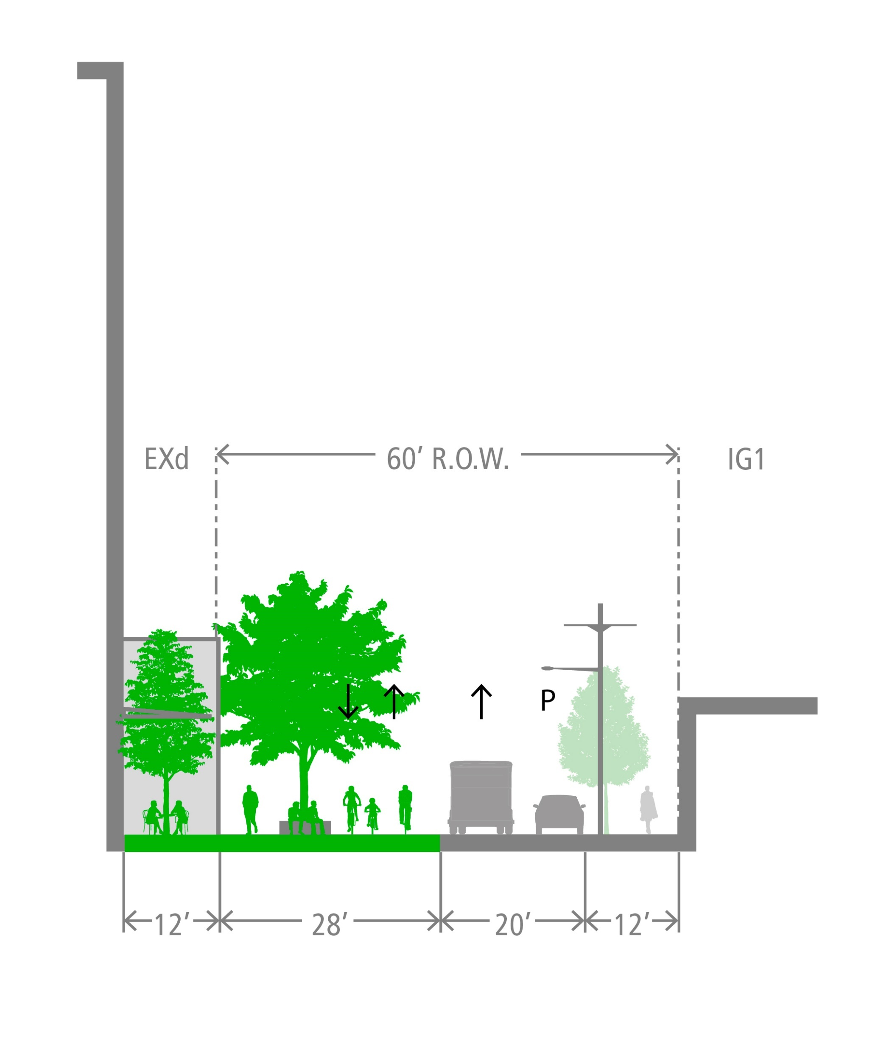
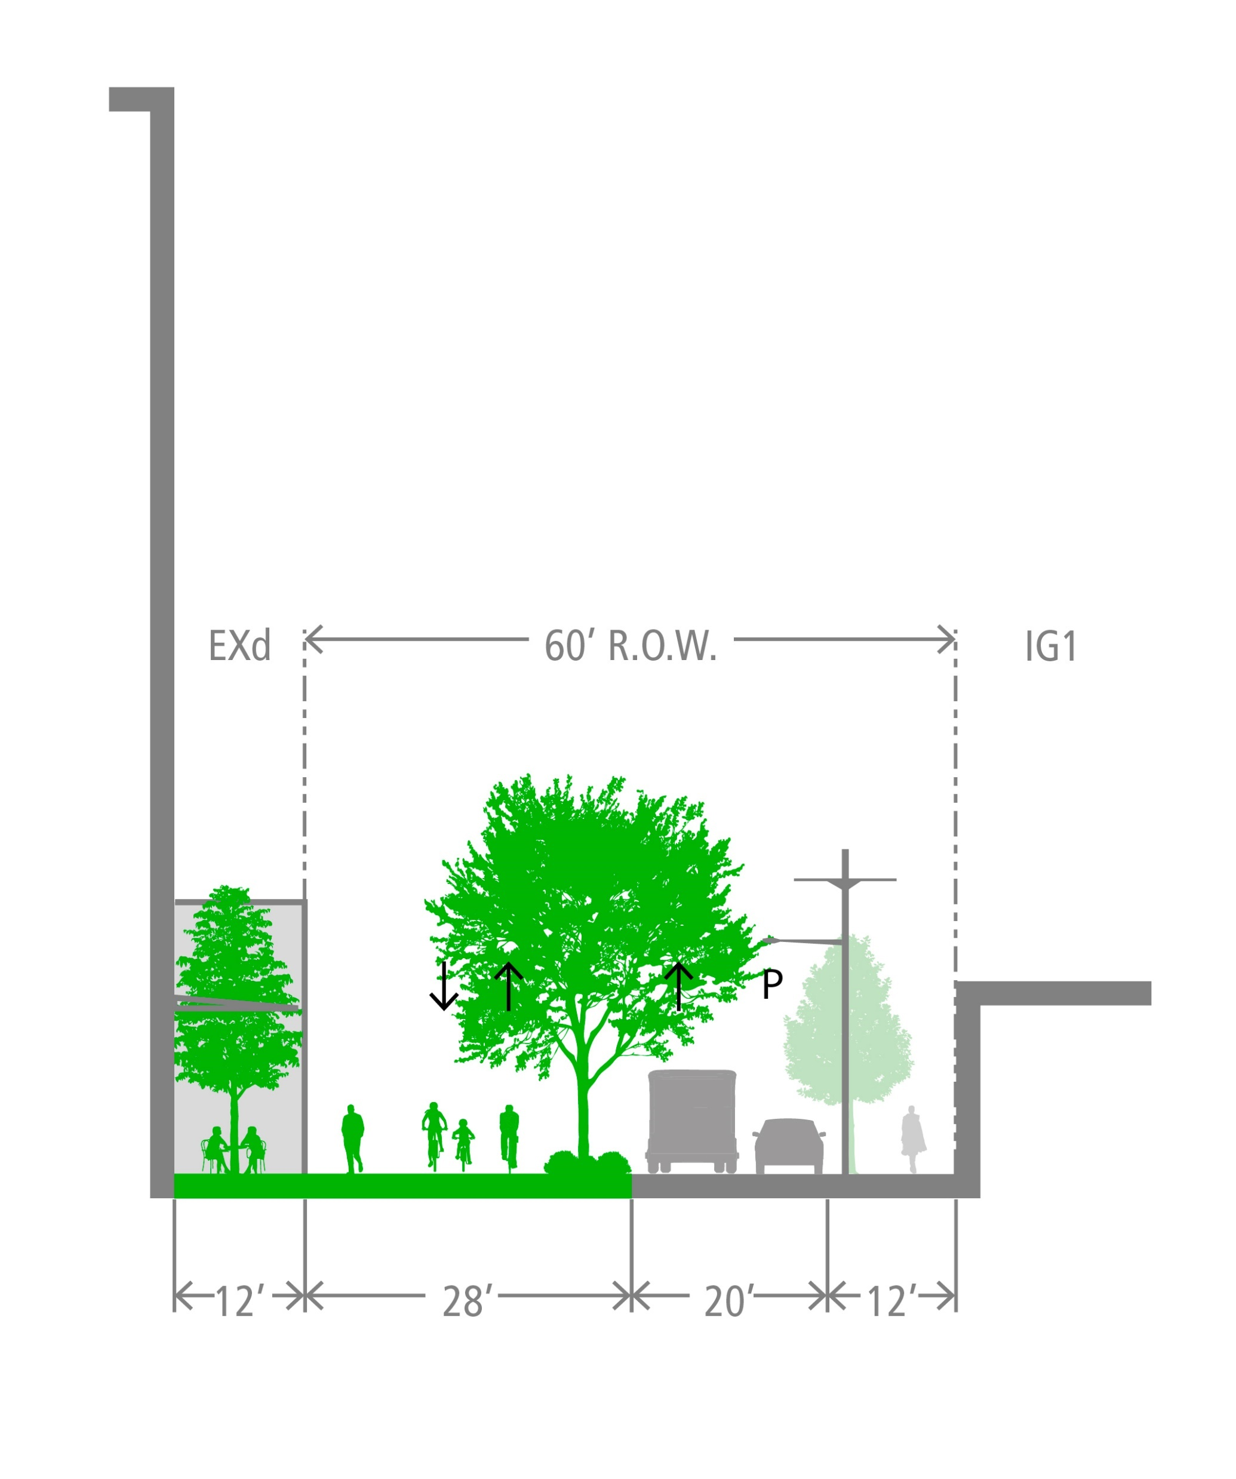
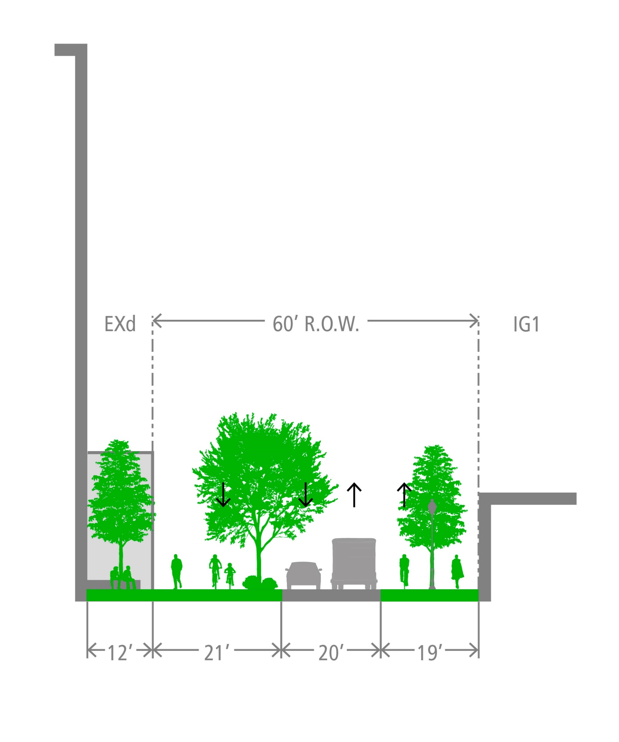
Concept Design – Arrangement of Elements
Concept A
Concept B
Concept C

Slide 19
Concept Design – Narrow & Wide Variations

Slide 20
Lloyd District Study Area
NE Broadway
NE Clackamas St
NE Multnomah St
6th Ave
7th Ave
NE Holladay St
I-84

Slide 21
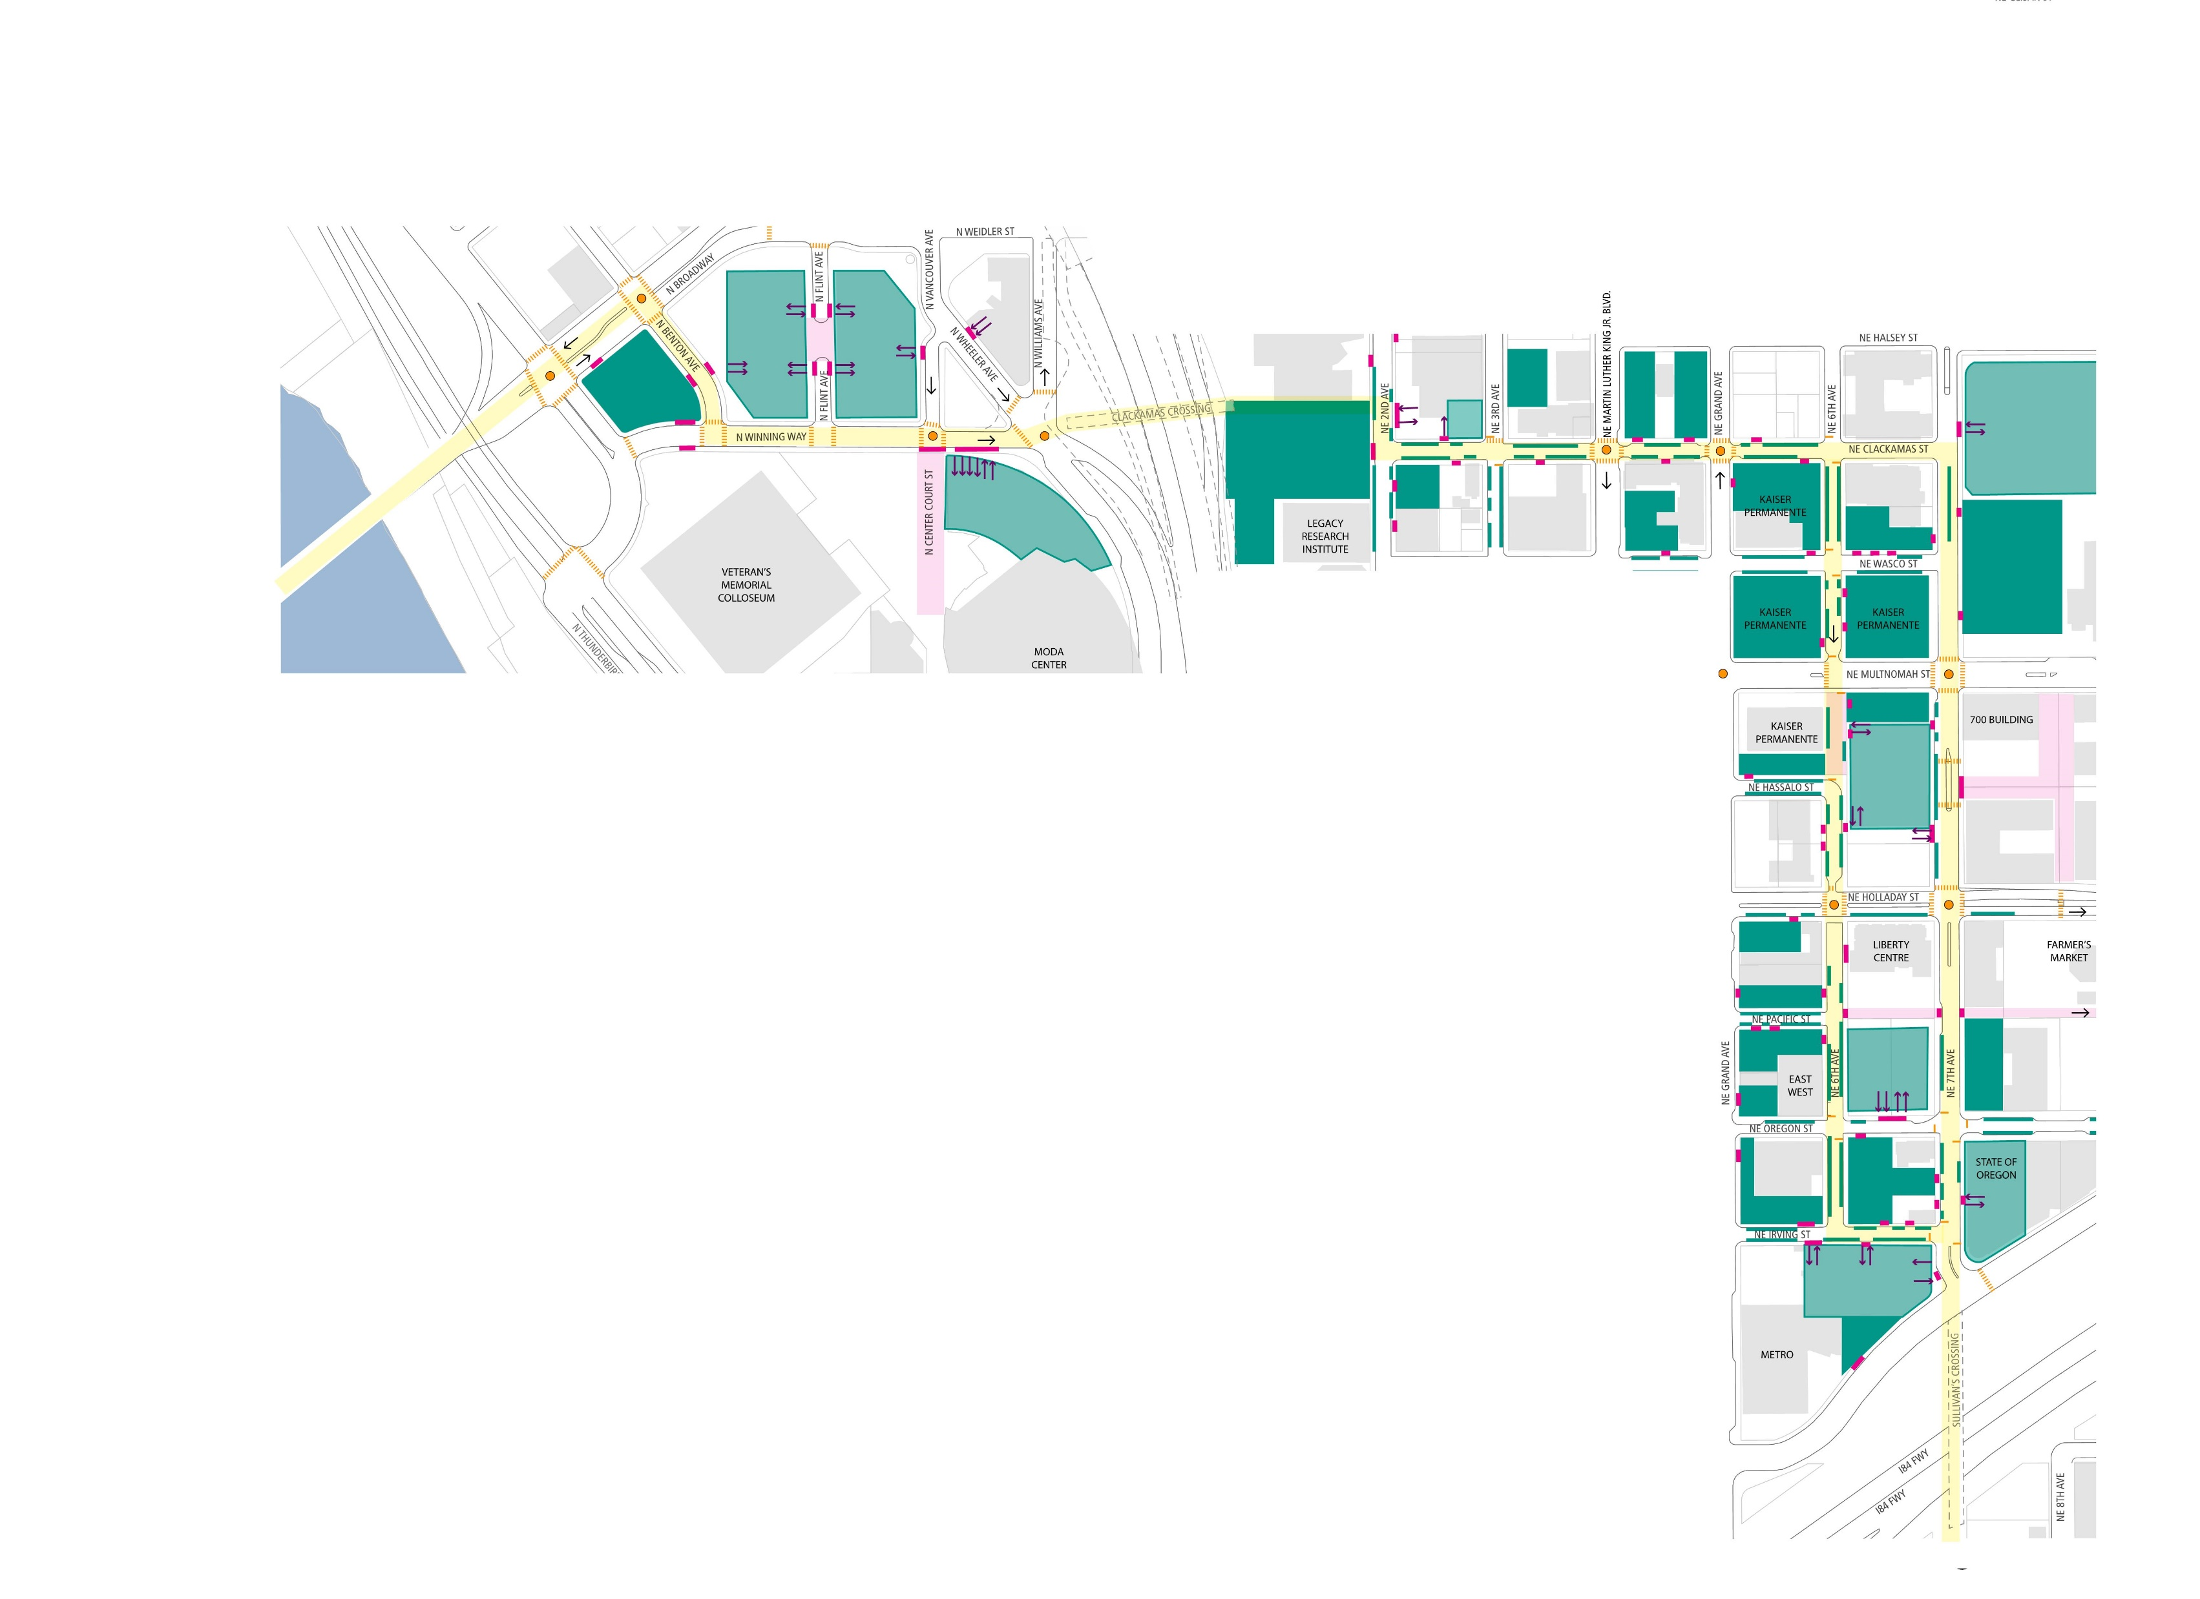
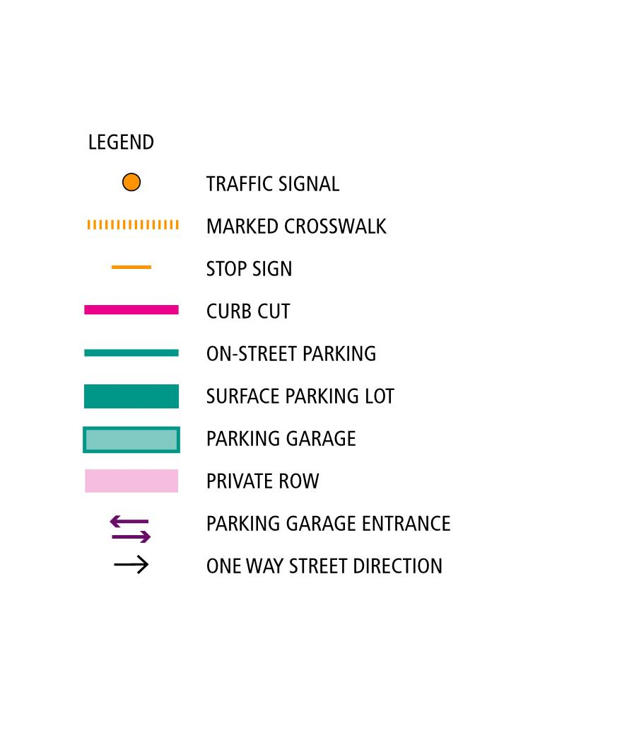
Lloyd Existing Conditions
Street Condition

Slide 22
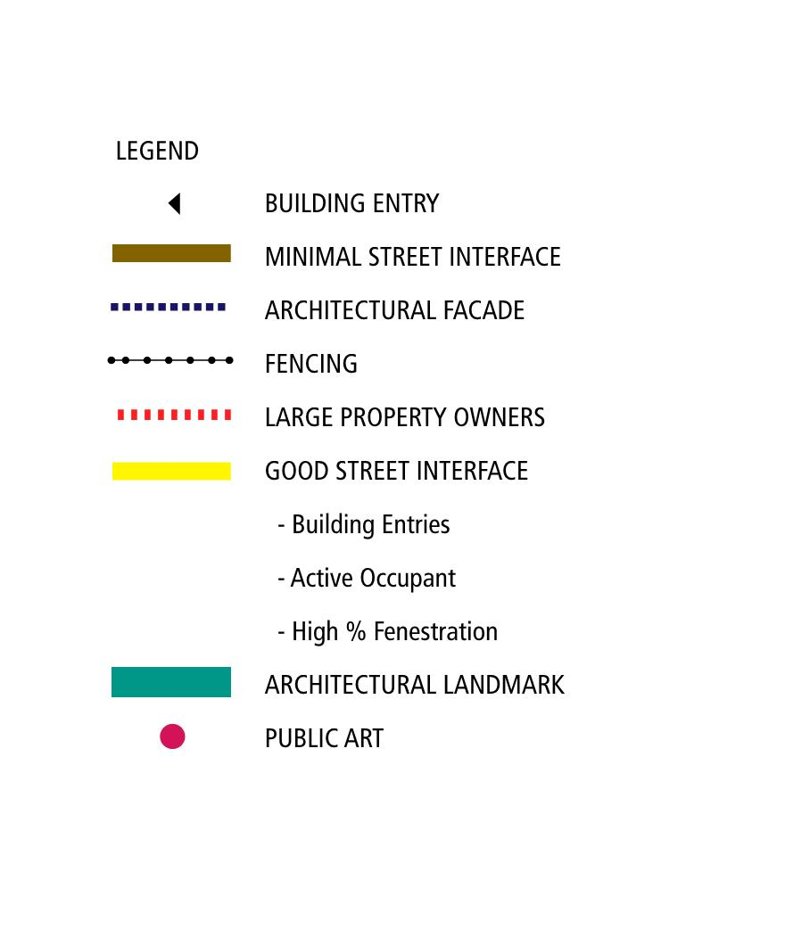
Lloyd Existing Conditions
Building Condition

Slide 23
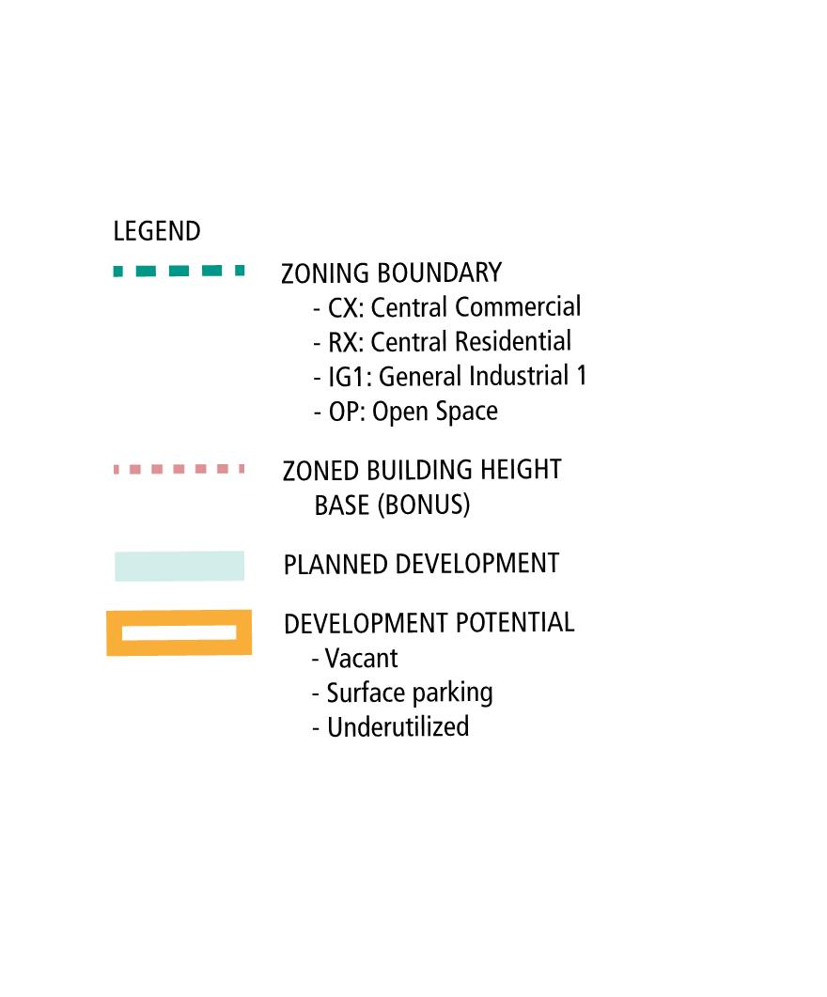
Lloyd Existing Conditions
Land Use & Zoning

Slide 24
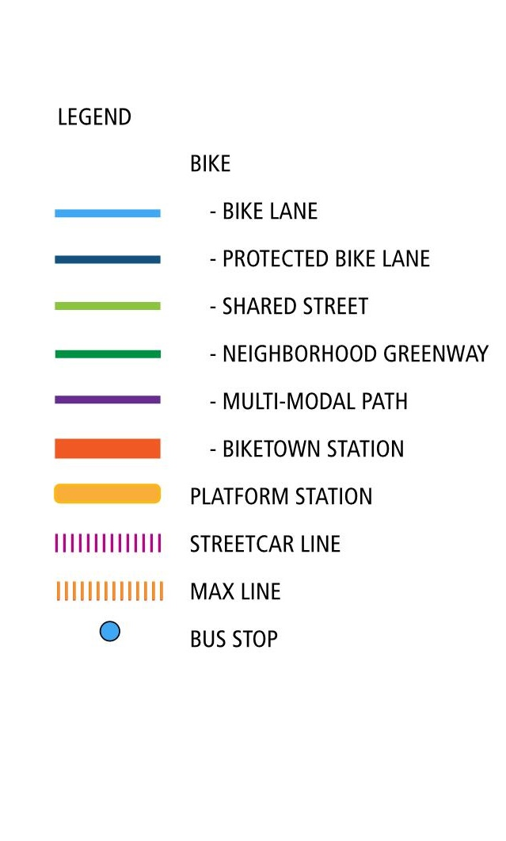
Lloyd Existing Conditions
Transportation

Slide 25
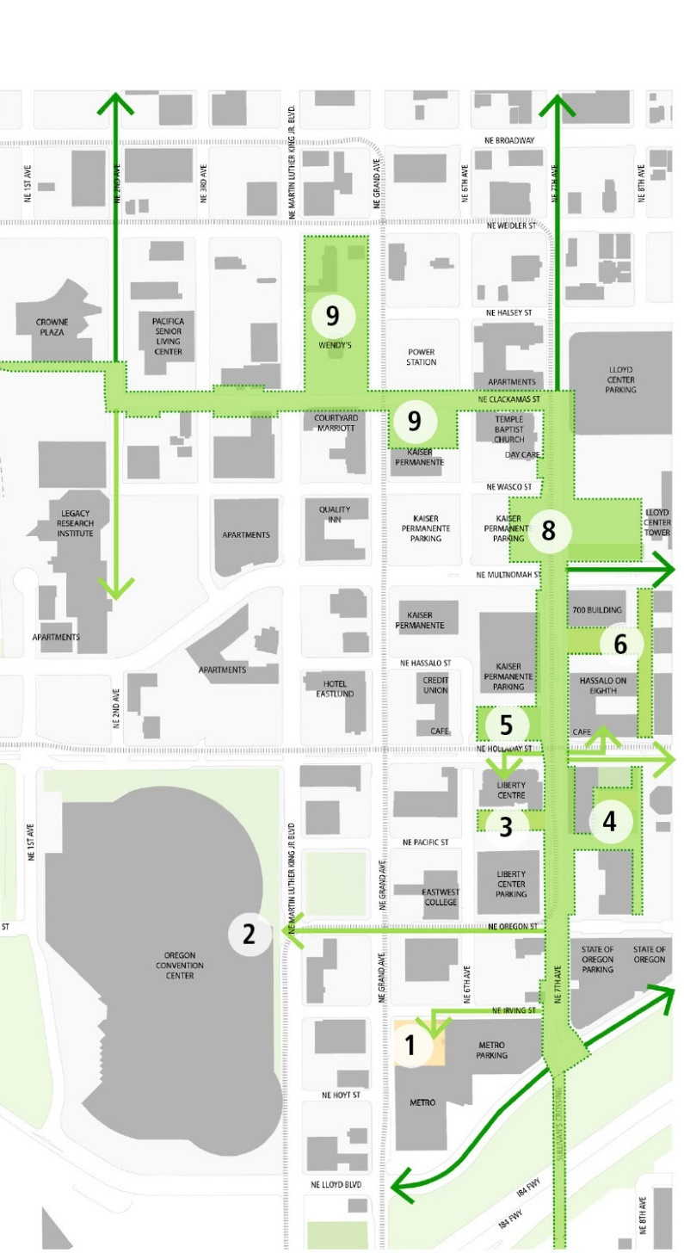
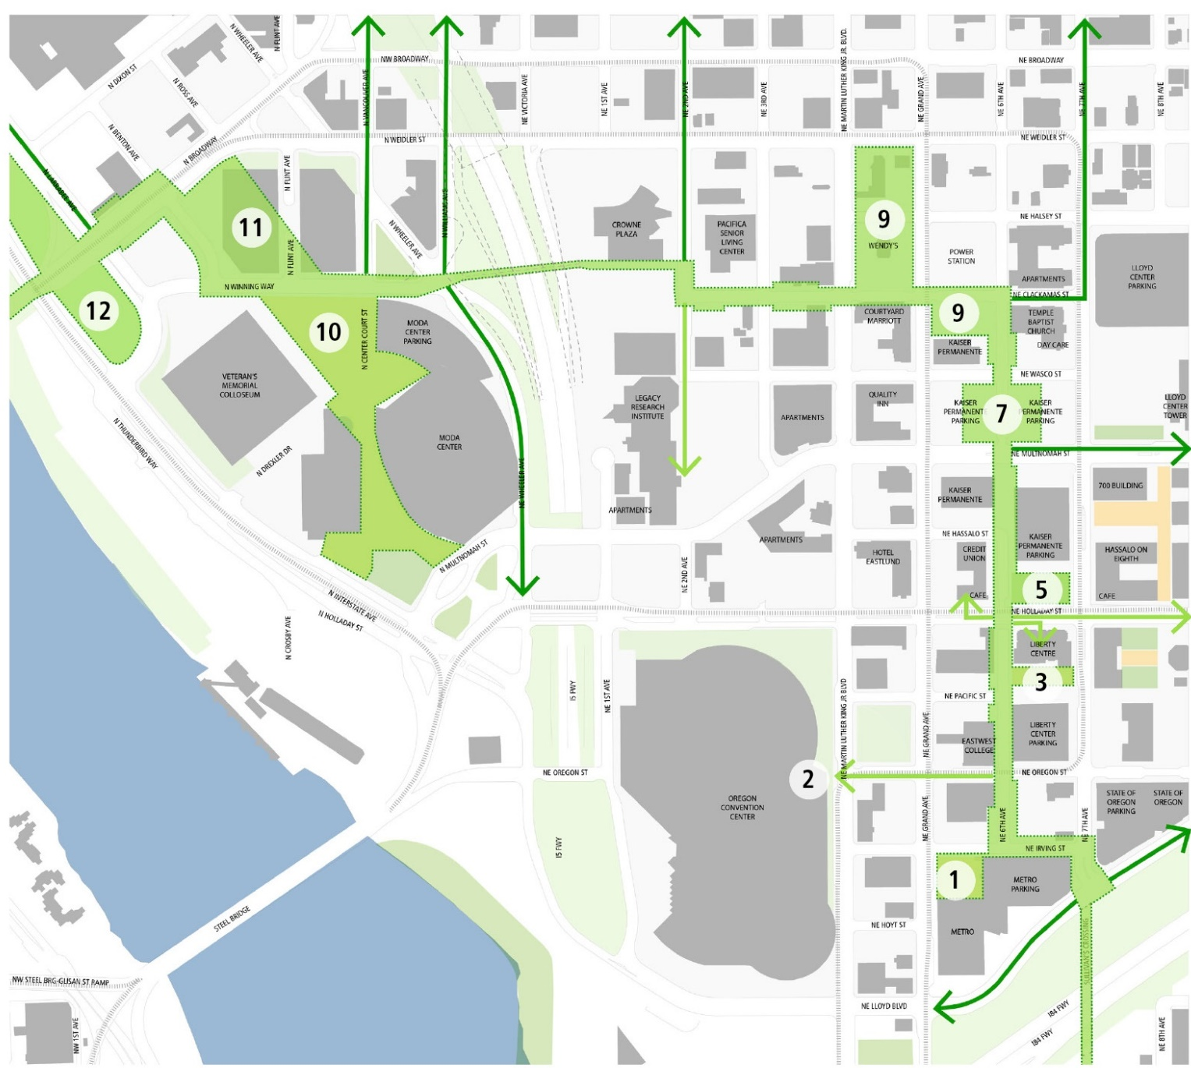
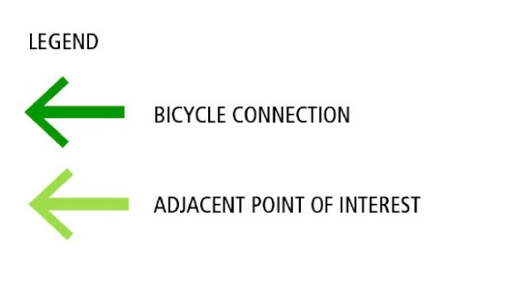
Lloyd Open Space Opportunities Analysis
6th Ave
7th Ave
TBD, current Albina Vision and Rose Quarter planning in progress

Slide 26
Concept Sections – 7th Ave

Slide 27
Concept Design – Streetscape Character

