Slide 1
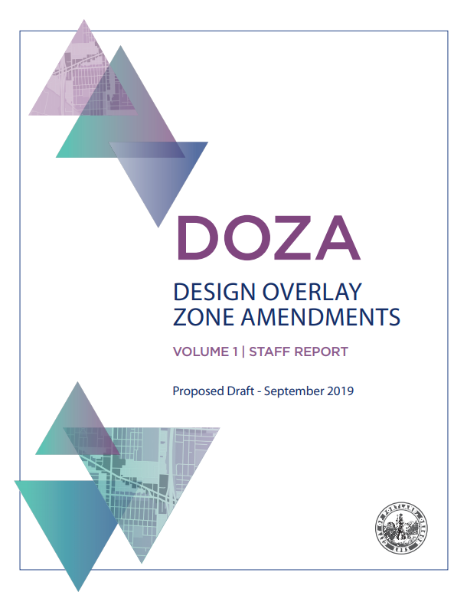
Portland Historic Landmarks Commission Briefing Bureau of Planning and Sustainability September 30, 2019

Slide 2
DOZA Proposals

Slide 3
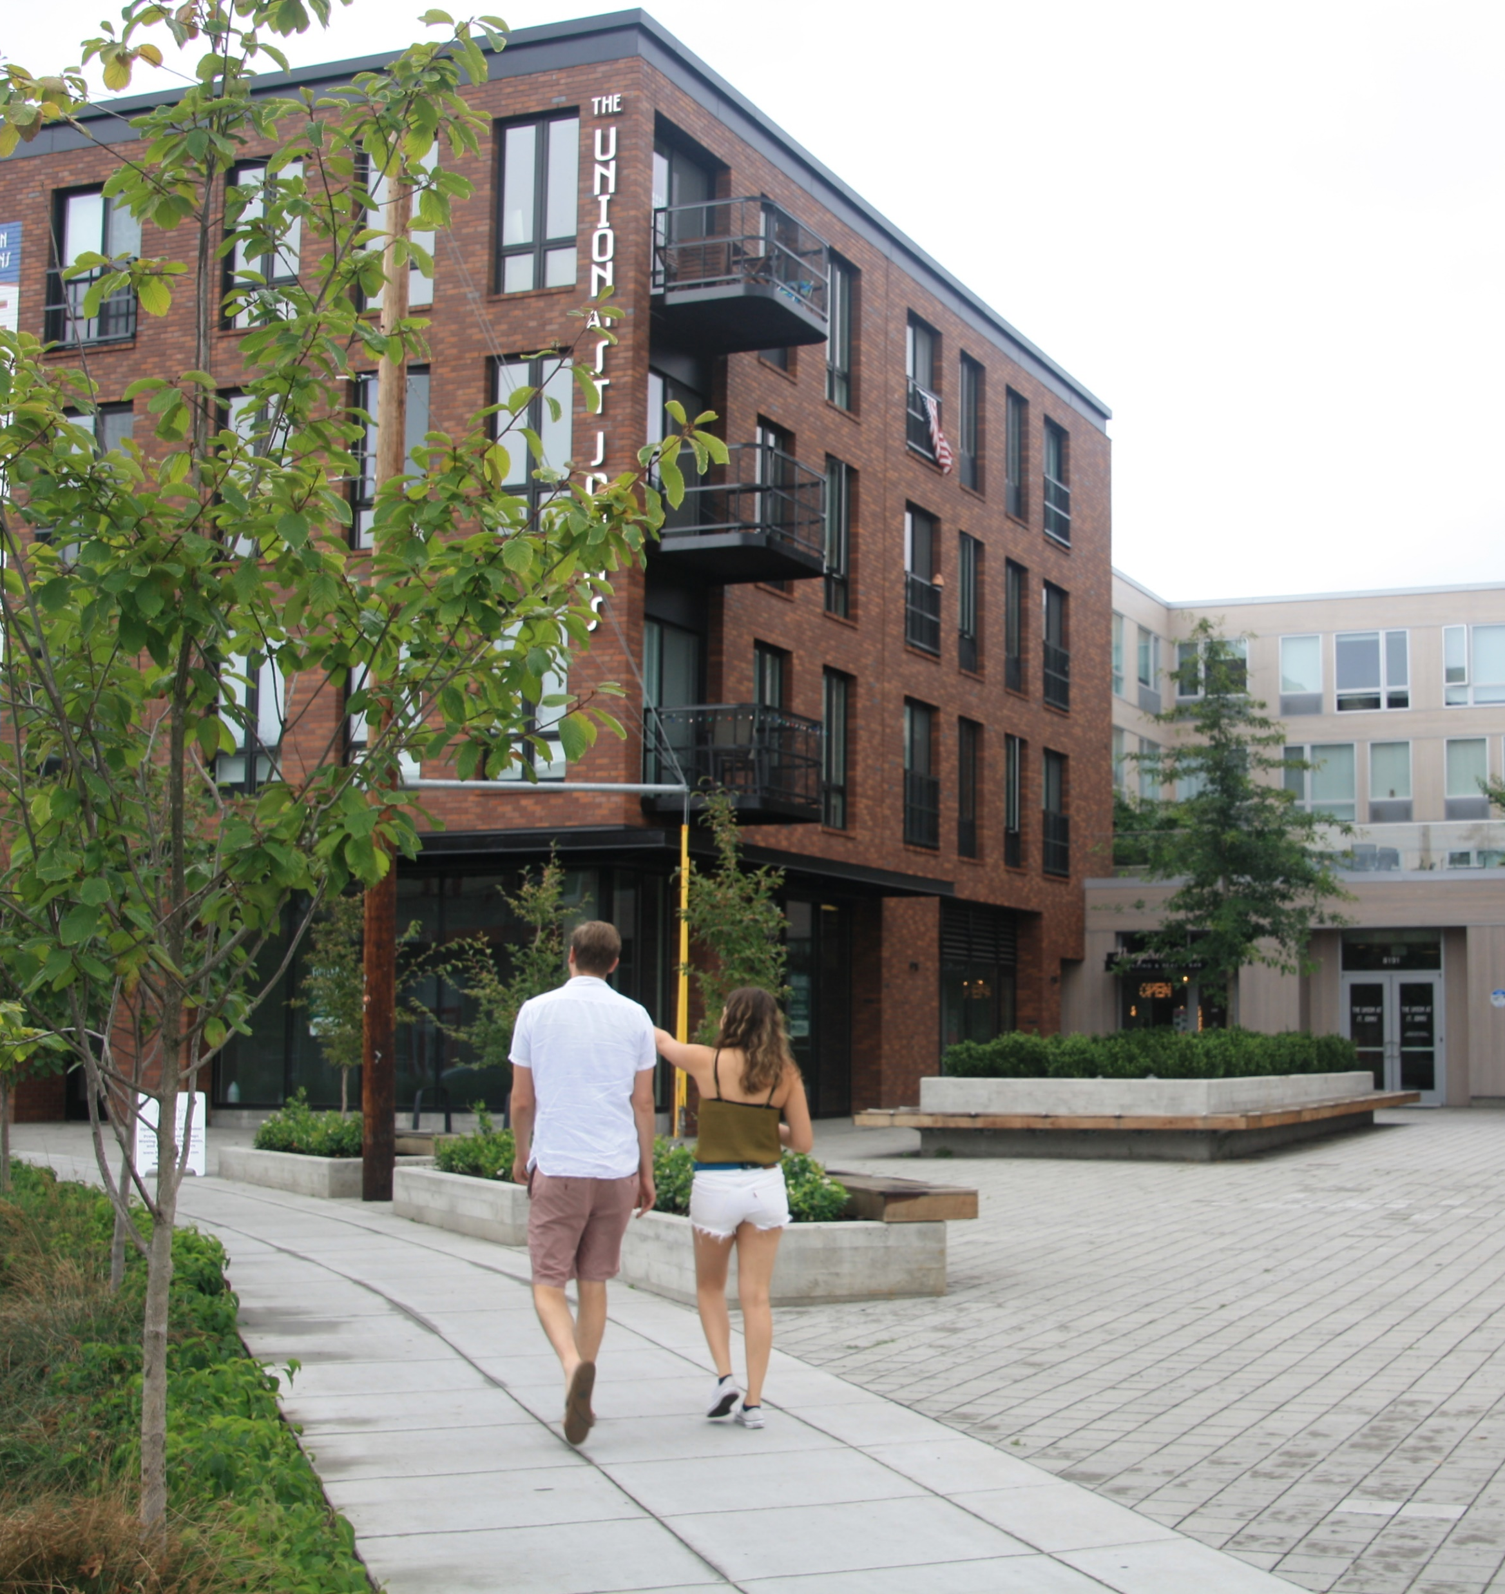
What’s in the DOZA Proposed Draft?
Volume 1: Staff Report
Volume 2: Code and Map Amendments
Volume 3: Portland Citywide Design Guidelines
Volume 4: Appendices (portlandoregon.gov/bps/doza)
Appendix A: BDS Administrative Improvements
Appendix B: Housing Affordability Memo (February 6, 2017)
Appendix C: What We Heard Report
Appendix D: Consultant Testing of Draft Standards and Guidelines

Slide 4
DOZA Proposals
PURPOSE of the Design overlay zone
MAP of where the Design overlay zone applies
THRESHOLDS for reviewing projects
PROCESS for design review
TOOLS for evaluating projects
Portland Citywide Design Guidelines
Design Standards

Slide 5
1. PURPOSE of the Design overlay zone
33.420.010 Purpose
The Design overlay zone ensures that Portland is a city designed for people.
The Design overlay zone supports the city’s evolution within current and emerging centers of civic life. The overlay promotes design excellence in the built environment through the application of additional design guidelines and standards that:
Build on context by enhancing the distinctive physical, natural, historic and cultural qualities of the location while accommodating growth and change;
Contribute to a public realm that encourages social interaction and fosters inclusivity in people’s daily experience; and
Promotes quality and long-term resilience in the face of changing demographics, climate and economy.

Slide 6
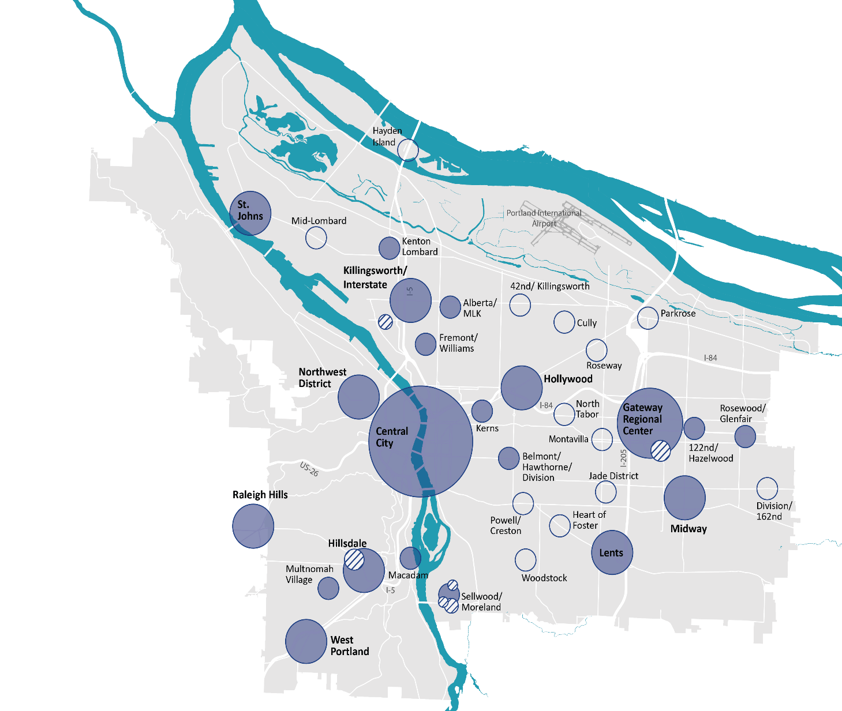
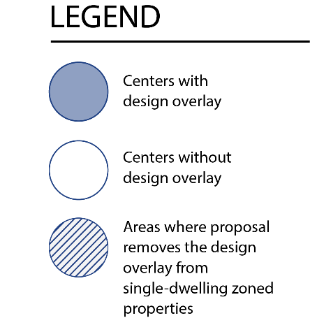
2. Map of where the Design overlay zone applies
Remove the Design overlay zone from single-dwelling-zoned properties outside of the Terwilliger Design District

Slide 7
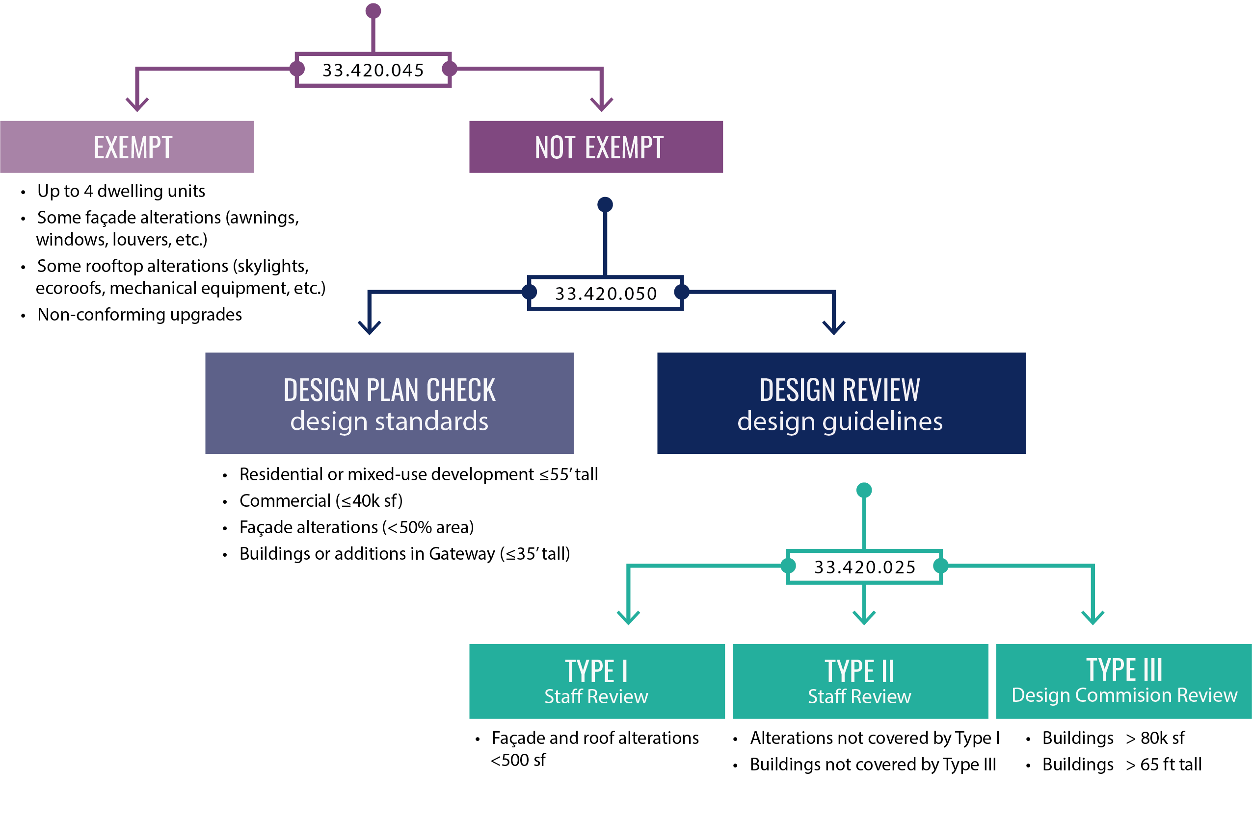
3. THRESHOLDS for reviewing projects
Design overlay zone ‘d’ outside the Central City
a. Establish review
thresholds based on size and scale
c. Allow Gateway to use Design Plan Check
09/30/19

Slide 8
3. THRESHOLDS for reviewing projects
Design overlay zone ‘d’ in the Central City
Fewer façade alterations (awnings, louvers…)
Some rooftop alterations (skylights, ecoroofs, mechanical equipment…)
Non-conforming upgrades
Buildings > 25k sf
Buildings > 45 ft tall
Alteration > 50% façade or 200 linear ft ground floor
09/30/19

Slide 9
4. PROCESS for design review
Update the Design Commission membership rules:
Landscape architects, urban planners
Public-at-large member
Align Type III process with applicant’s process (DAR)
Make administrative improvements for transparency and efficiency of design review process
Clarify that design review cannot require a reduction of proposed FAR (except in limited cases in the Central City)
Clarify that mitigation may be required to lessen cumulative impacts of modifications

Slide 10
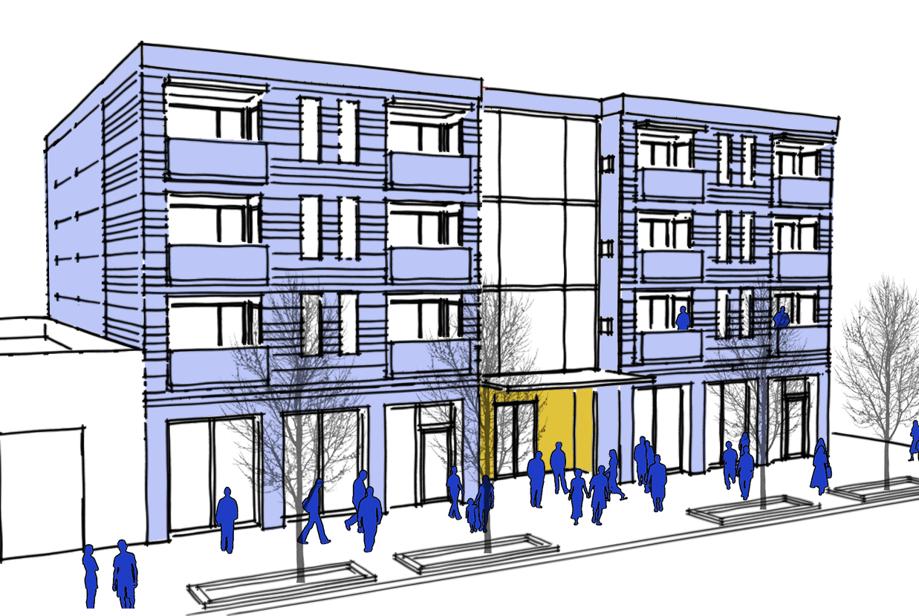
4. Process for design review (DAR)
b. Align the Type III design and historic review processes with applicant design process
Allow optional DAR except where code already requires it
Limit DAR meeting to one except for multiple buildings
Require DARs to be held w/in 56 days of submittal
Require posting and noticing of DAR
Continue administrative improvements to further clarify process and purpose of the DAR and to encourage timely and relevant submittals

Slide 11
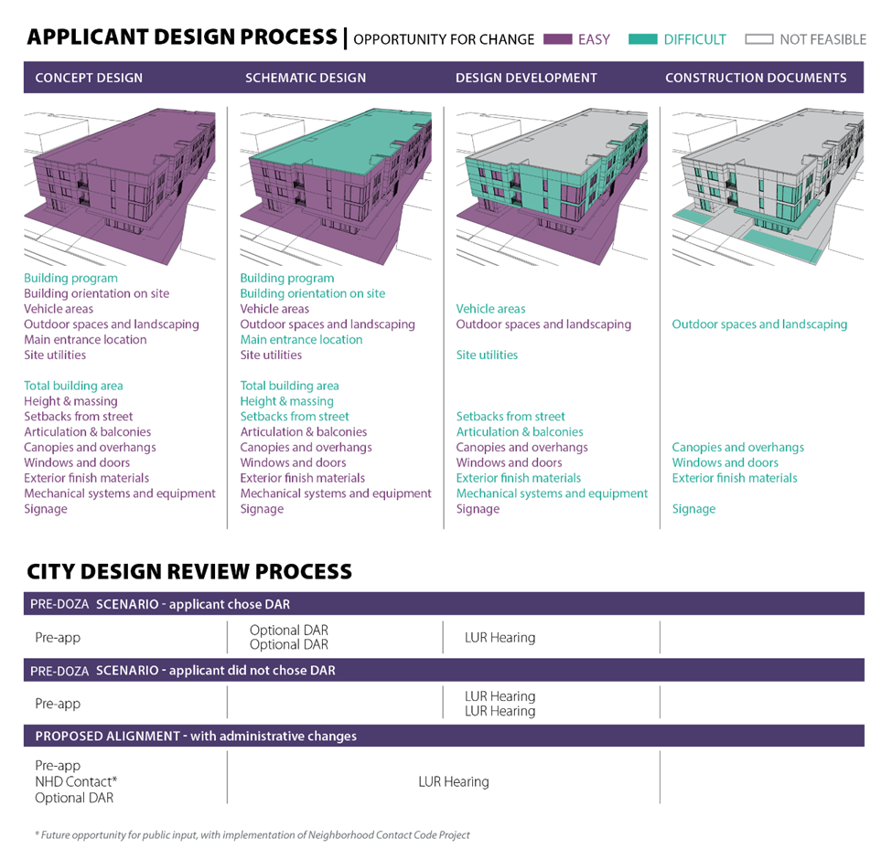
4. Process for reviewing projects
b. Align the Type III design and historic review processes with applicant design process

Slide 12
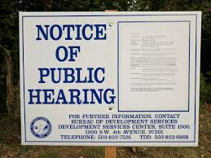
4. Process for reviewing projects
c. Make administrative improvement to the efficiency and transparency of the design review process
Inclusion of renters in mailing
Update meeting agendas, time limits, provision of comments
Update DAR/LU process, handouts and staff templates
Update submittal requirements and encourage timely applications
Continue administrative improvements to further clarify process and purpose of the DAR and to encourage timely and relevant submittals
Equity training related to Commission role & responsibilities

Slide 13
5. Tools for reviewing projects

Slide 14
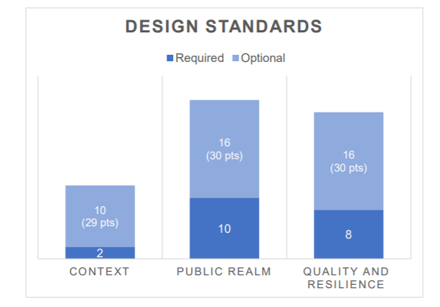
5. Tools for reviewing projects
Optional points:
1 point per every 1000 sf of site area up to maximum of 20 points
Sites greater than 20K sf: at least 1 point from each category
Major remodels must meet 1 point for every 1000 sf of site area up to maximum of 5 points

Slide 15
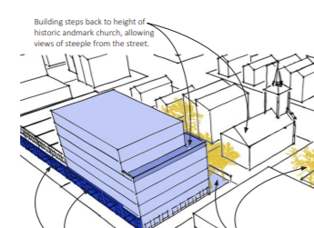
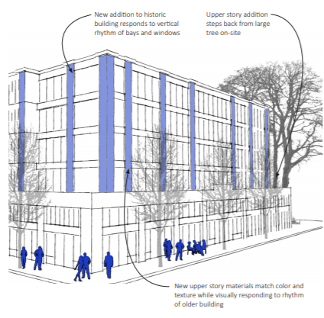
5. Tools for reviewing projects
How the Tools treat historic resources:
Portland Citywide Design Guidelines
02: identify designated historic resources
04 and 10: support preservation and adaptive reuse
03: encourage relating to adjacent historic resources
Design Standards
Required points for relating to adjacent historic landmark
Preservation is considered alteration or addition
Optional points for preservation of façade
Greater flexibility for using existing materials

Slide 16
Next Steps
Joint Briefing:
Tuesday, October 8, 2019 at 12:30 p.m.
Testify at Joint Public Hearing:
Tuesday, October 22, 2019, at 5 p.m.
Public Testimony closes on November 15.
www.portlandoregon.gov/bps/mapapp

