Slide 1
Portland
Residential Infill Project
September 2019
Bureau of Planning and Sustainability
Notes:
Last HLC briefing 4/8/2019

Slide 2
Overview
Context
Concerns
Proposals
- Reduce scale of structures
- Allow more housing types
- Allow them everywhere
Displacement Risk Analysis
Residential Infill Project| 2

Slide 3
CONTEXT

Slide 4
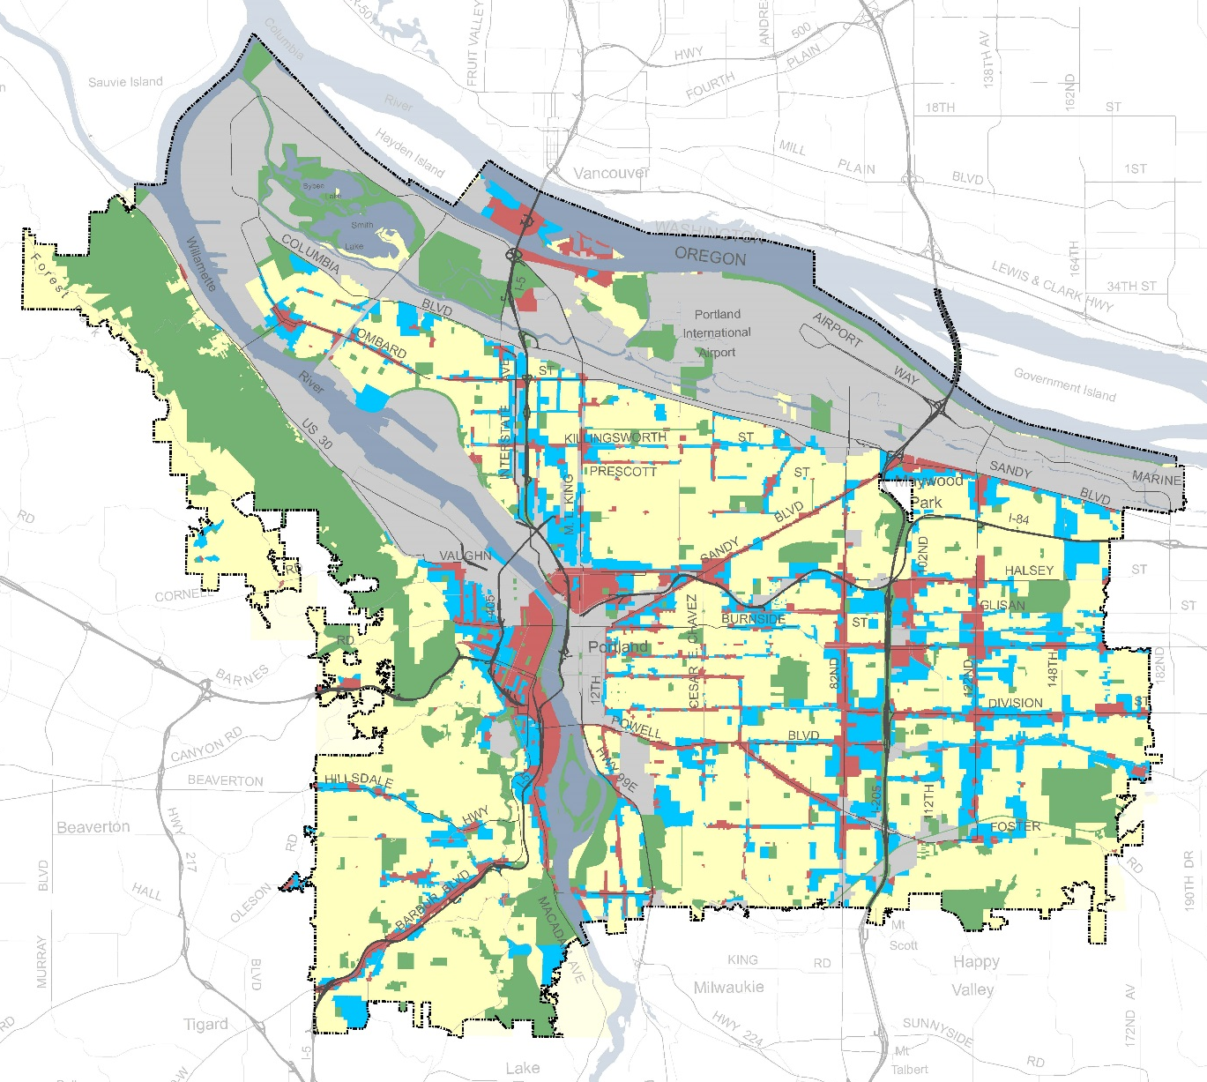
Generalized Zoning Map
Single-Dwelling 43%
Industrial/Empl
21%
Open Space
21%
Mixed Use
8%
Multi-Dwelling
7%
Residential Infill Project| 4
Notes:
This growth strategy translates to a zoning map that that looks like this.
80% of our growth allocated to the red and blue on the map.
20% allocated to the yellow areas.
A lot of growth dedicated to a little bit of land. Not surprising or different from other US cities.

Slide 5
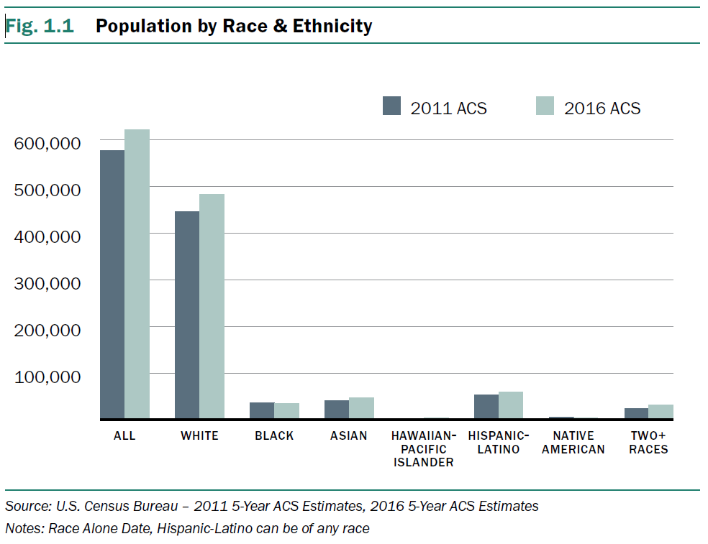
Changing Needs
260,000 more people expected in 123,000 new households
Smaller household sizes
Smaller percentage of households with children
Greater racial diversity
Aging population wanting to age in place
Notes:
The city is growing, but the household needs are also changing (and have been for some time)
The average size of the household continues to decline from around 2.5 just over 2 persons per household
Fewer of these new households will have children [do we have a stat?] (but there will still be a net increase in children overall)
We’ve become more racially diverse, though this is leveled off in the last couple of years.
And the average age of the total population will get older.

Slide 6
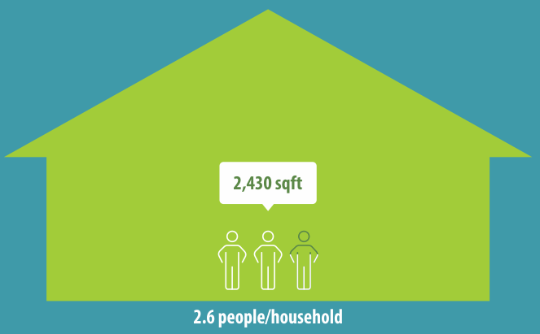
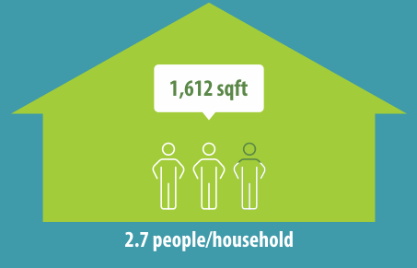
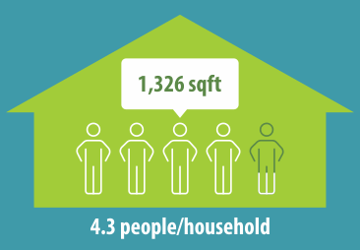
1920
Household and House Size
1980
2010
Notes:
So, one would expect that with household sizes getting smaller, that houses would be getting smaller.
In fact, the exact opposite is true.
This is a fun graphic that shows US national averages. It shows an average of 4.5 persons/household in 1920 in a smaller house compared to 2.6 people/household in a much larger house in 2010.

Slide 7
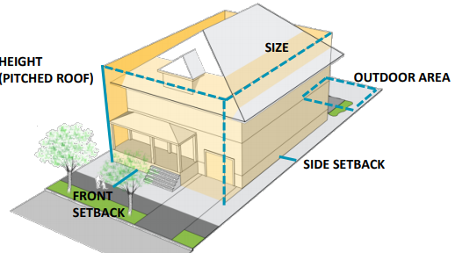
Current approach to infill
Height
Building Coverage
Setbacks
Outdoor Yard Area
Relation to street – main entrance,
windows, garages
Residential Infill Project| 7
Notes:
There are a number of zoning standards that address the basic building form (setbacks height, base zone design standards, etc).
These are the basic standards that regulate the scale and look of houses.

Slide 8
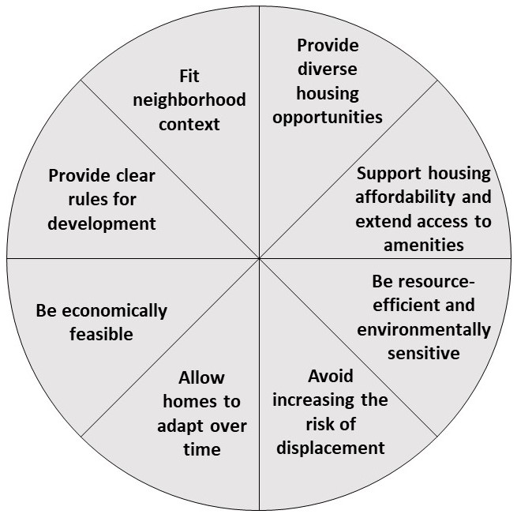
Balancing Multiple Goals

Slide 9
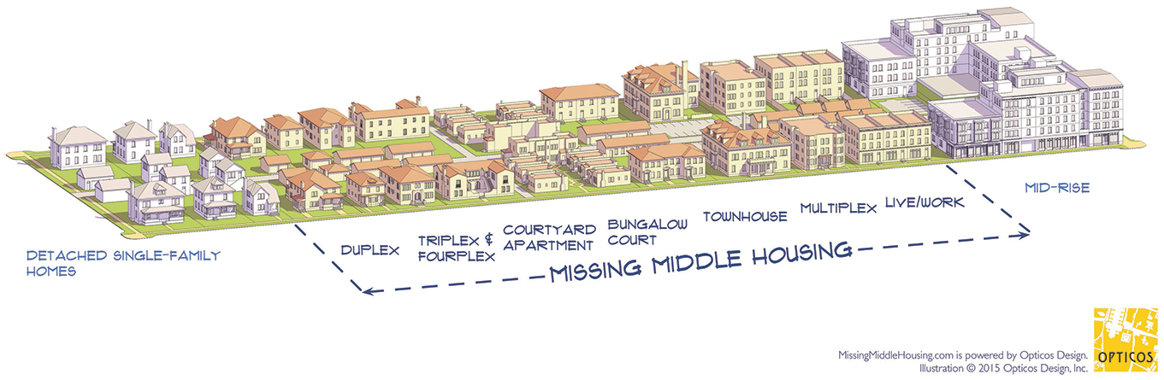
Rewriting the Code
Residential Infill Project
Single-Dwelling Zones
Better Housing by Design
Multi-Dwelling Zones
Mixed Use Zones Project
Commercial/Mixed Use Zones
Residential Infill Project| 9

Slide 10
CONCERNS

Slide 11
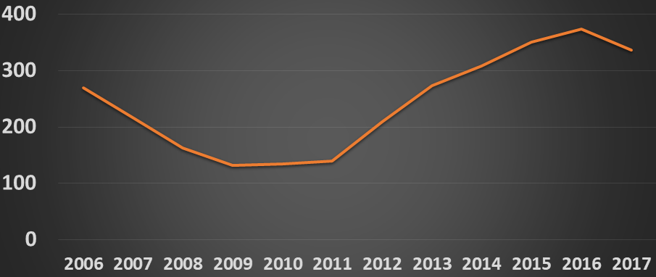
Concerns –
House Demolitions
Residential Infill Project| 11
Notes:
Concern over the increase in demolitions…
Median sales price increased from the bottom of the recession to 2018 from $250k to $450k.

Slide 12
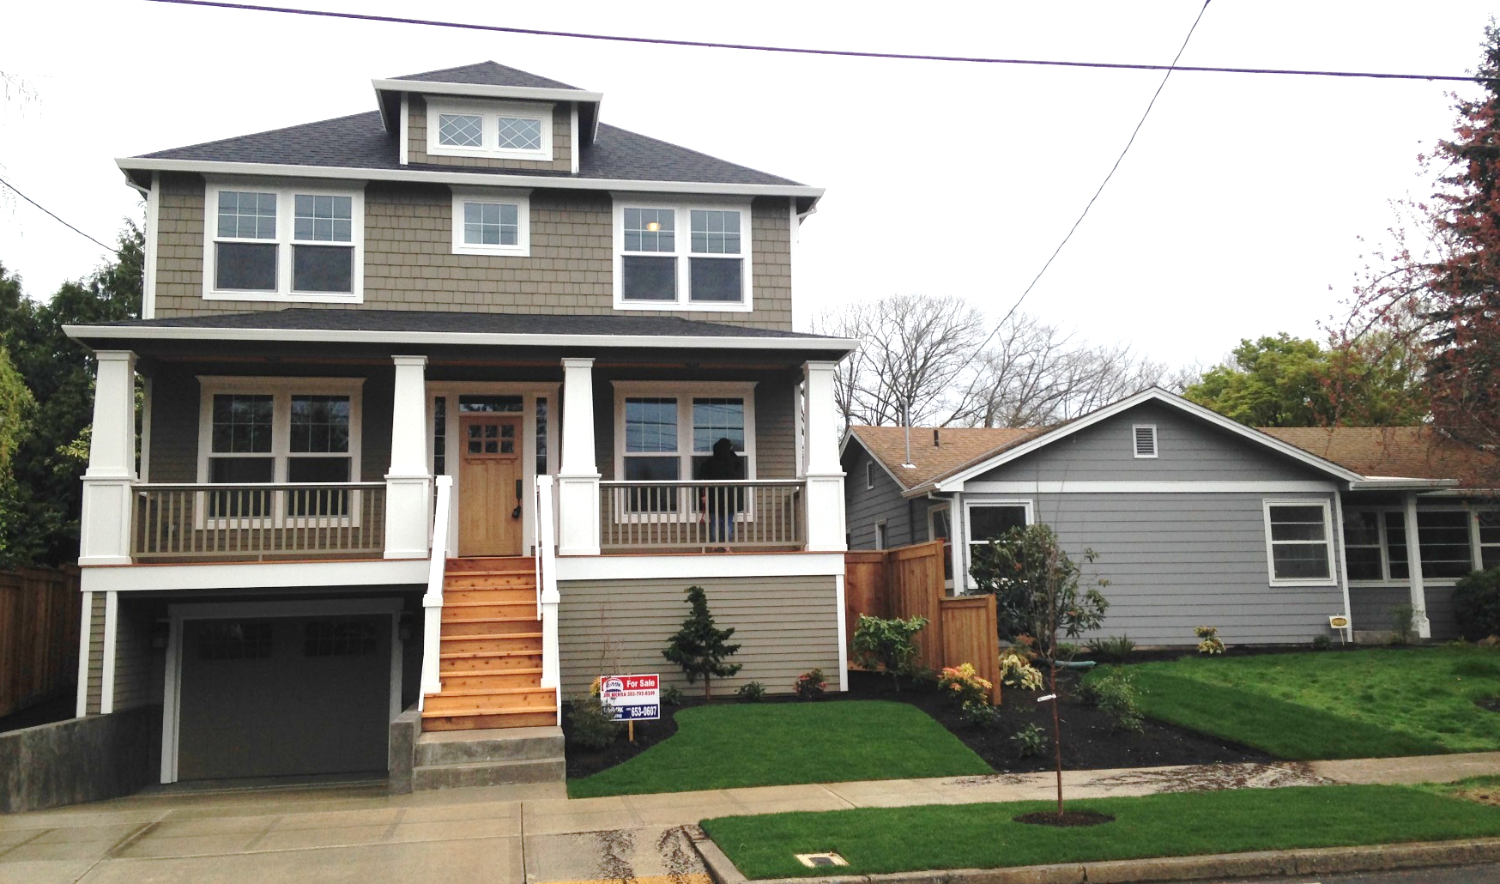
Concerns –
Scale of New Houses
Notes:
Another concern was about the size of new houses, especially compared to the size of older homes.
And often, people were disappointed to see small, old homes to demolished to make way for big new ones, partly because of the embodied energy lost in the demolition of the old home.

Slide 13
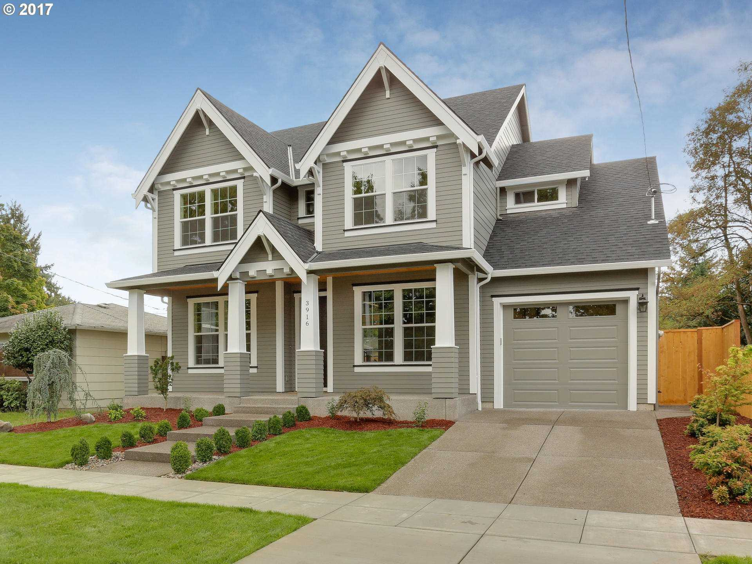
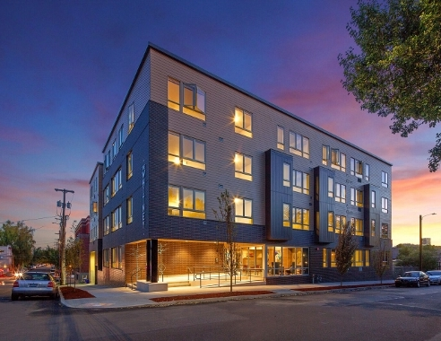
Concerns –
Lack of Housing Diversity
56%
40%
Residential Infill Project| 13
Notes:
Our growth strategy also translates to two types of housing: Single-family detached houses and apartments.
56% of our housing stock is detached houses, while nearly 40% is in apartments.
That means that <4% of housing in duplexes, ADU’s, and smaller attached houses.
And we continue to build this way.
In 2015, (7800 units built)
15% of new units were single-family
77% were apartments
8% were the other housing types (4% for ADU’s, 3% attached houses, and 1% duplexes)

Slide 14
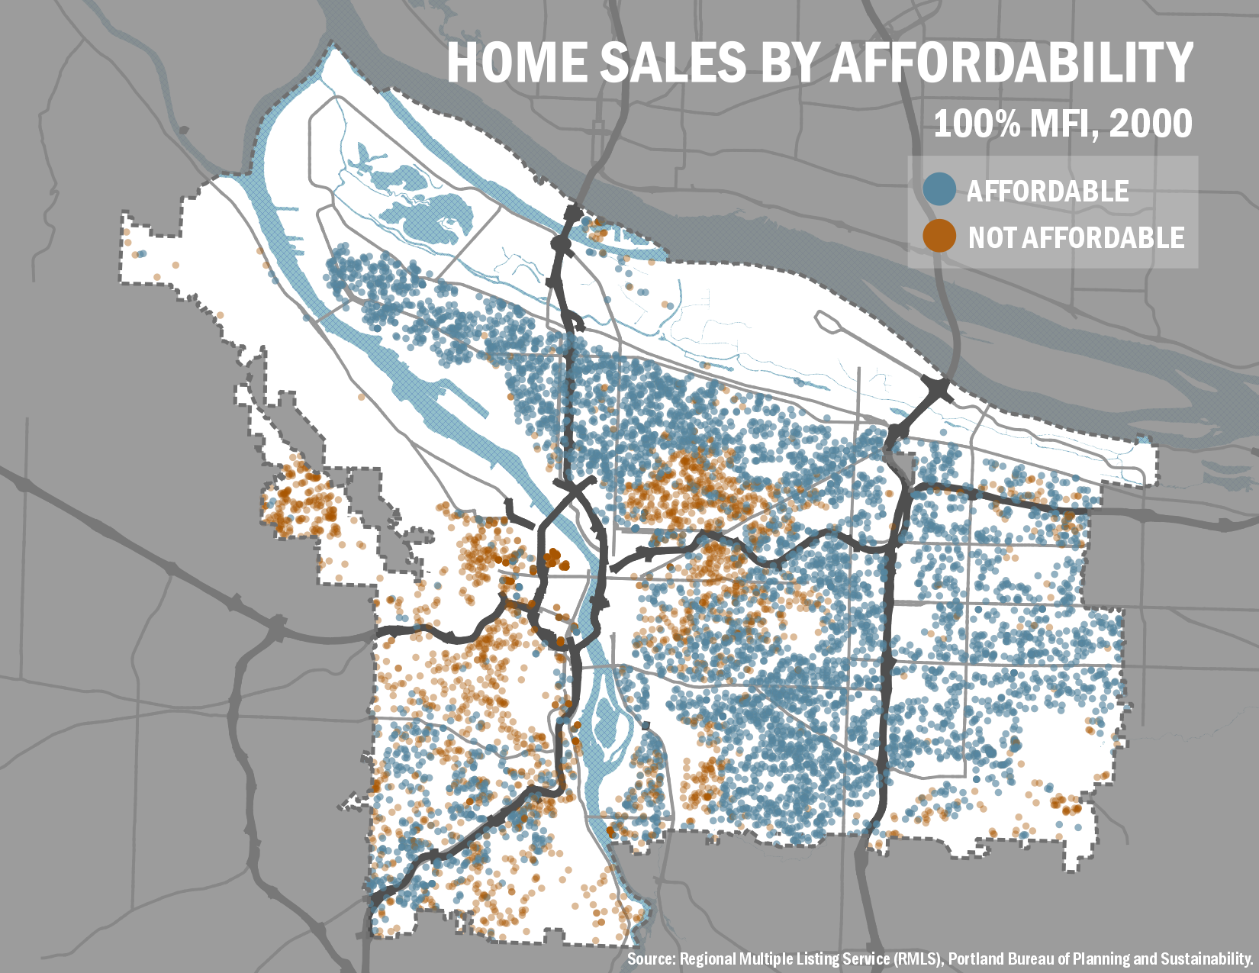
Concerns –
Affordability
Notes:
And, of course, Portland is becoming less affordable.
This map shows the home sales that occurred in 2010. The blue dots represent the houses that were affordable to those earning 100% MFI and the brown dots show sales not affordable to those earning 100% MFI.

Slide 15
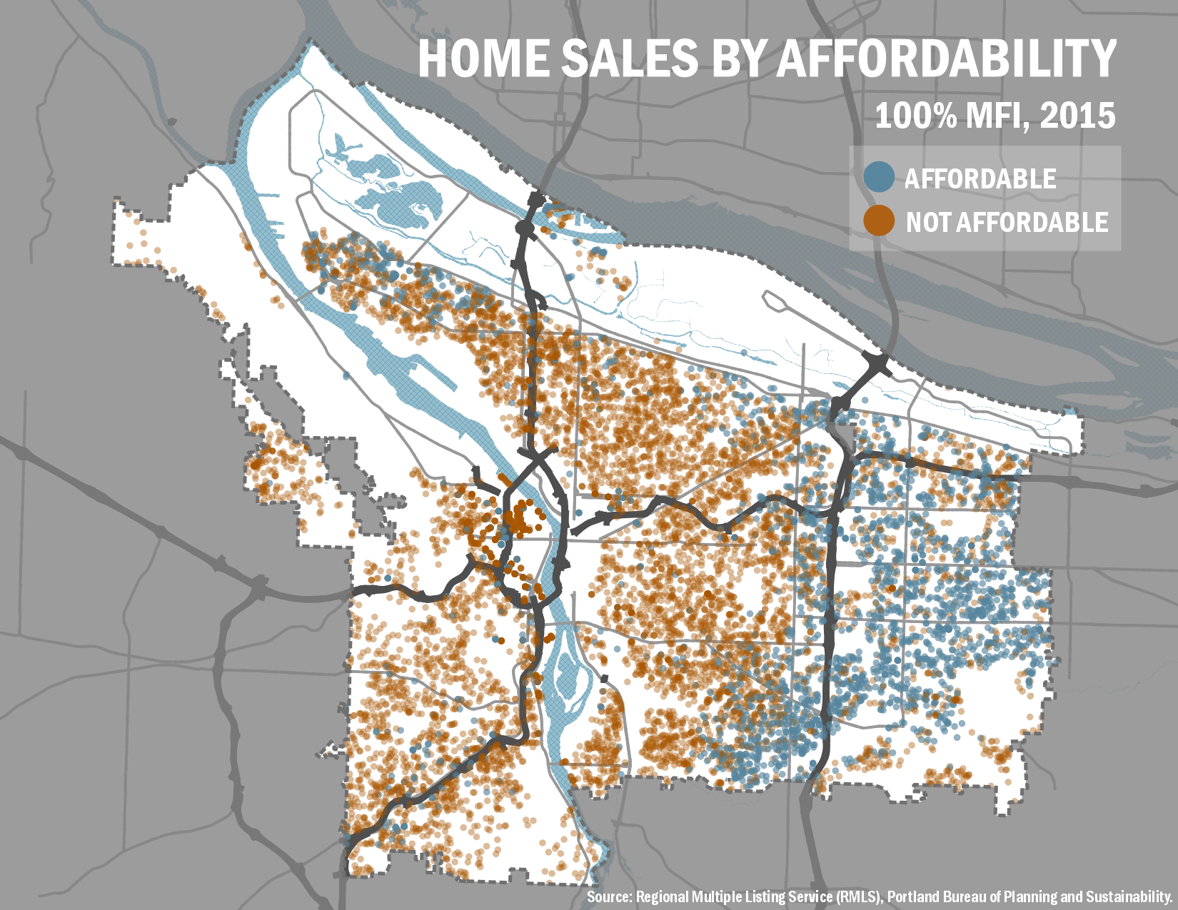
Concerns –
Affordability
Notes:
2015 (when we began this project)

Slide 16
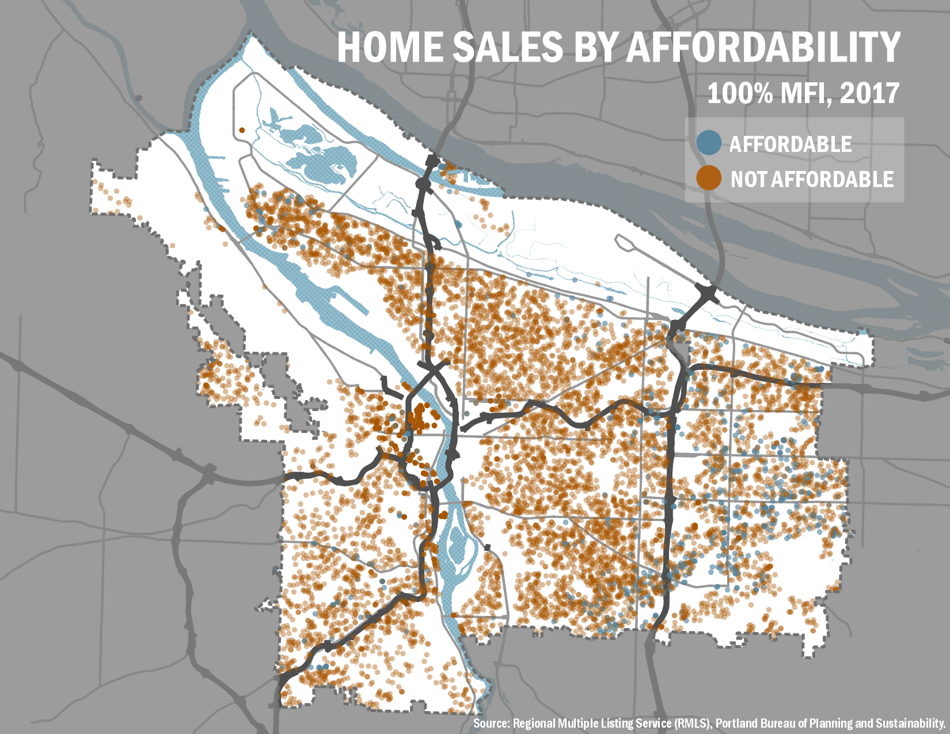
Concerns –
Affordability
–
Notes:
This is 2 years later. Nearly all the blue dots have disappeared.
This means that there were few homes available for a family of four earning $86,000 or a family of two earning $67,000 in Portland anymore.
The series of maps is even worse for POC.

Slide 17
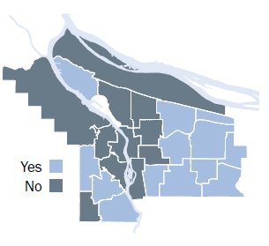
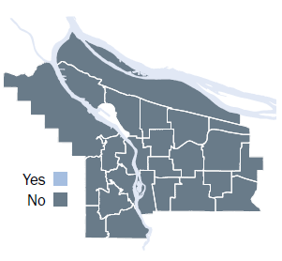
Concerns –
Displacement
Average Portland Household
Average Black Household
Residential Infill Project | 17
Notes:
As this map shows. The light blue is affordable and the dark blue is not.
Based on average rent by area for 2-bedroom unit. Average Portland household can afford $1461/mo; average black household can afford $667/mo
As you can see, there is no place in Portland where the average black household can afford.
Increasingly, many Portlanders wouldn’t be able to afford the very homes we live in.
In addition, this is displacing lower-income households to the fringes of the city, if they can afford to live in Portland at all.
This is a key equity and livability issue.
This comparison of neighborhood affordability is from the 2016 state of housing report
In the year between 2015 and 2016,
Four more neighborhoods fell out of reach for the average 3-person Portland household
Only 6 neighborhoods are considered affordable to low income households
For seniors, there is only one attainable neighborhood
And for black households, there is no place that is affordable within the city

Slide 18

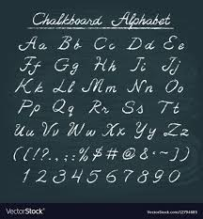
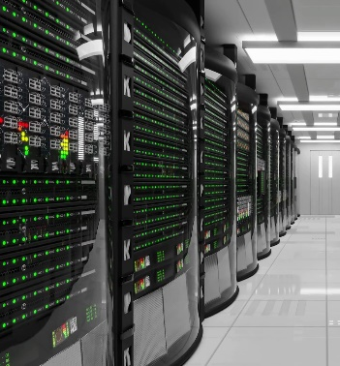
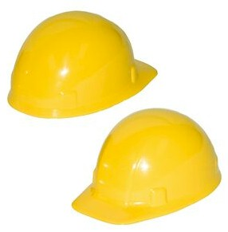

What does MFI mean?
60%
80%
100%
120%
$39K
$26K +
$26K
$57K
$49K +
$49K
Notes:
If the $57K wage earner had 3 kids, then he would be at 70% MFI (four person household)

Slide 19
What rent can families afford*?
2 person
2 person
1 person
4 person
60% $975/mo
80% $1,300
100% $1,425
120% $2,450
$39K
$26K +
$26K
$57K
$49K +
$49K
* Determined by 30% of gross wages
Notes:
If the $57K wage earner had 3 kids, then he would be at 70% MFI (four person household)

Slide 20
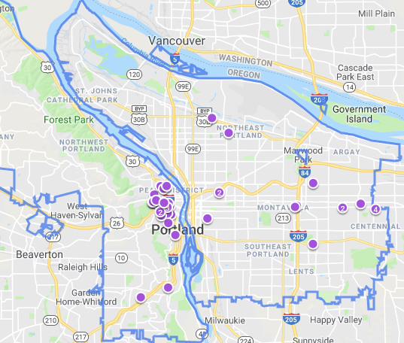

$975/mo
60% MFI
0+ BR
Available units per Zillow on 9/10/2019

Slide 21
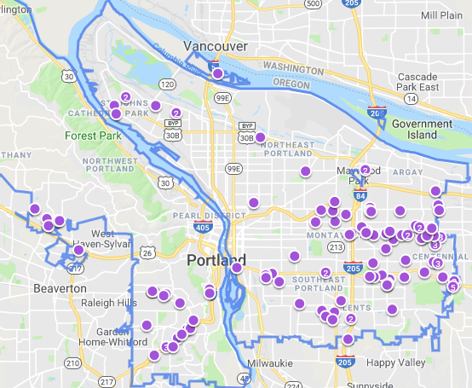
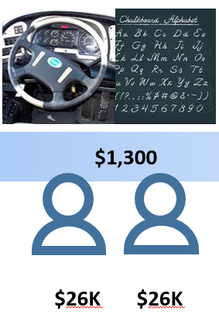
$1,300/mo
80% MFI
2+ BR
+
Available units per Zillow on 9/10/2019

Slide 22
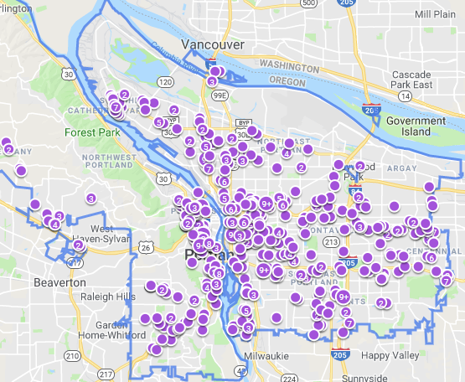
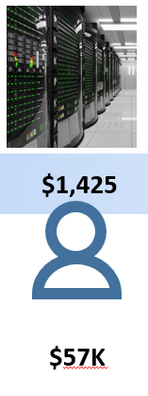
$1,425/mo
100% MFI
1+ BR
Available units per Zillow on 9/10/2019

Slide 23
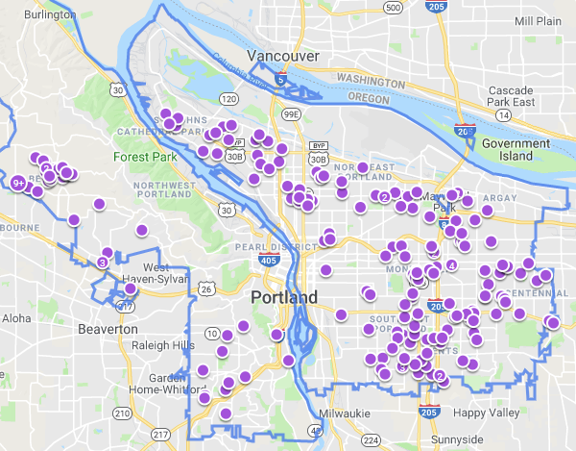
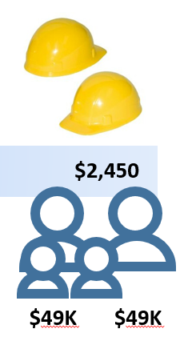
$2,425/mo
120% MFI
3+ BR
+
Available units per Zillow on 9/10/2019

Slide 24
PSC’s
RECOMMENDATION
Residential Infill Project | 24

Slide 25
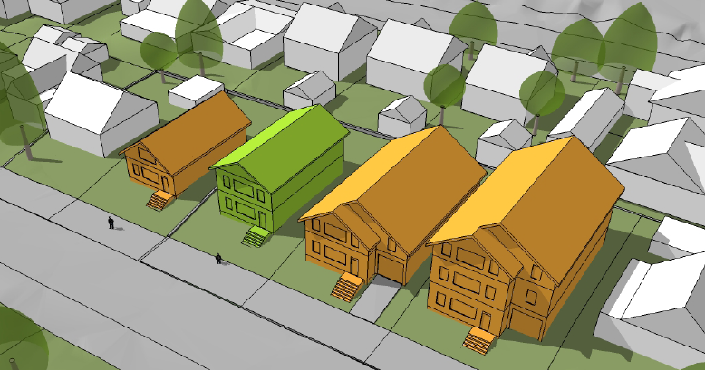
1. Reduce the scale of houses
1,500
SQUARE FEET
2,500
SQUARE FEET
4,400
SQUARE FEET
6,750
SQUARE FEET
Notes:
Our first proposal is to reduce the scale of houses.
This slide shows a range of house sizes on 5,000 s.f. lots:
On the left is a typical older Portland home
On the far right is the largest house one can build under today’s code
The largest house built in 2013 was just over 4,400 s.f.
We are proposing a maximum size of 2500 sq. (the green house)

Slide 26
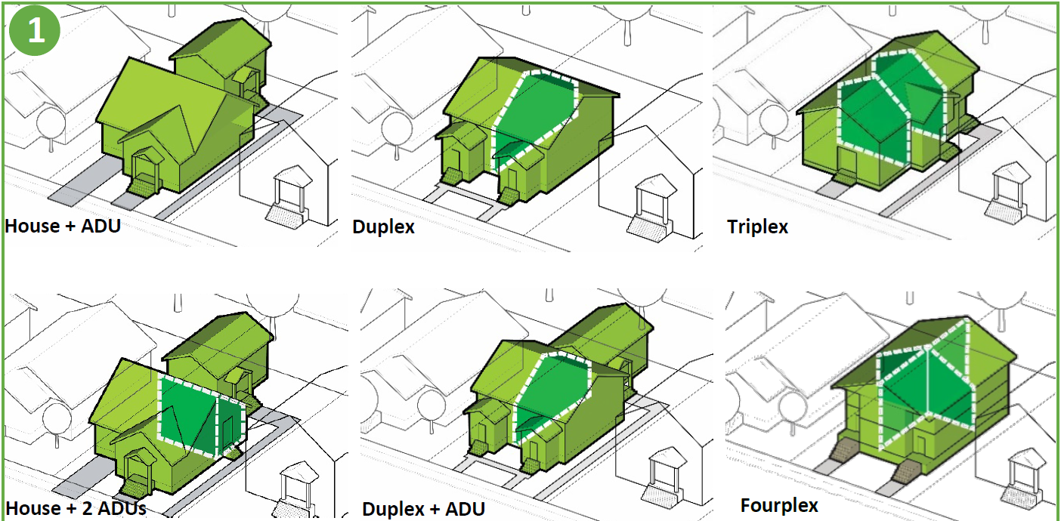
2. Allow more housing types
PSC Recommendation
Notes:
The second part of the proposal is an increase in the range of housing types allowed in single-dwelling zones.
This would allow several combinations of units up to four. So, a house with an ADU, a duplex, a triplex, etc.

Slide 27
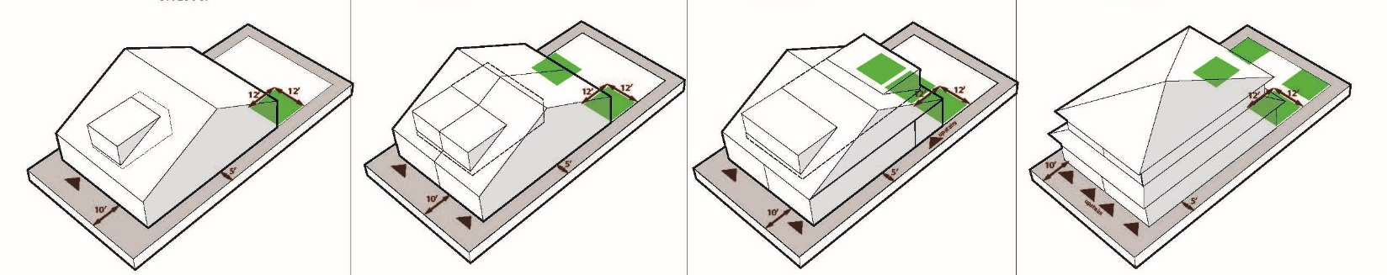
3. Revisit size of structures
Use floor-to-area ratio (FAR)
Vary FAR by number of units
Bonus FAR for affordability or preserving house
2,500 sf
3,000 sf
3,500 sf
House
House +ADU
Duplex
House +2 ADUs
Duplex +1 ADU
Triplex
Fourplex
Bonus
3,500 sf
4,000 sf
Residential Infill Project| 27
Notes:
Because we’re allowing more units and reducing the scale of development, we decided to use FAR to measure size.
Structures are allowed more square footage (a .1 FAR) for each additional unit.
Still, the overall size of building that’s allowed– even with 4 units – is less than what’s allowed today for one big house.
The proposal includes a FAR bonus (again of .1) if one of the units is affordable or if the existing house is being preserved.
You’re probably wondering what value an FAR bonus would have for an existing house, but it can be used for an addition or for a detached accessory structure.

Slide 28
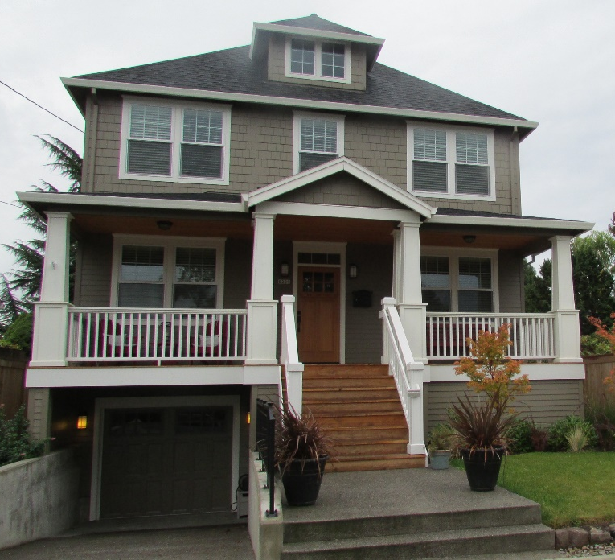
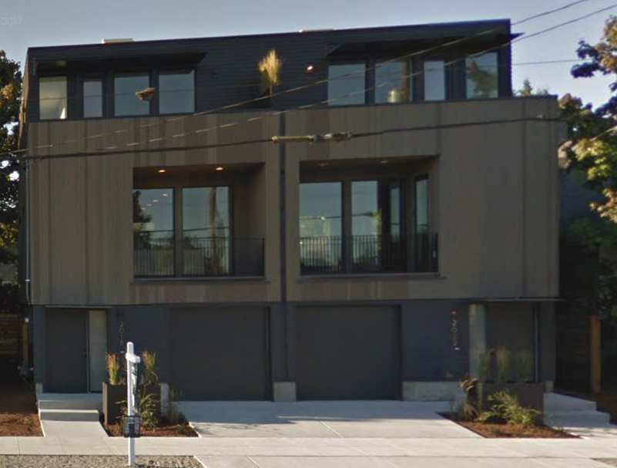
How do unit size and cost relate?
Single Family
Duplex
170% MFI
110% MFI
Average Size | 2,500 Square Feet (4 BR) | 1,500 Square Feet (3 BR)
Average Sale Price | $772,500 | $463,500
Average Price per SF | $309/SF | $309/SF
Average Rent | $5,400/month | $3,255/month
Average Rent per SF | $2.17/SF | $2.17/SF
Residential Infill Project| 28
Notes:
This combination of proposals – reducing the scale and allowing more units everywhere, will likely significantly reduce the cost of housing for the additional housing types allowed in single-dwelling zones.
This is a function of the smaller unit sizes as well as the ability to defray land costs across two, three, or four housing units as opposed to one unit.

Slide 29
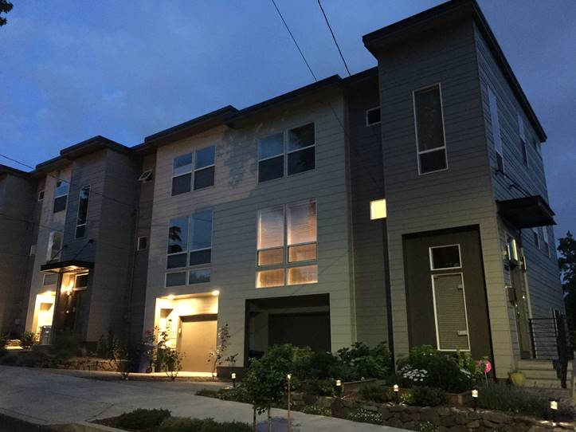
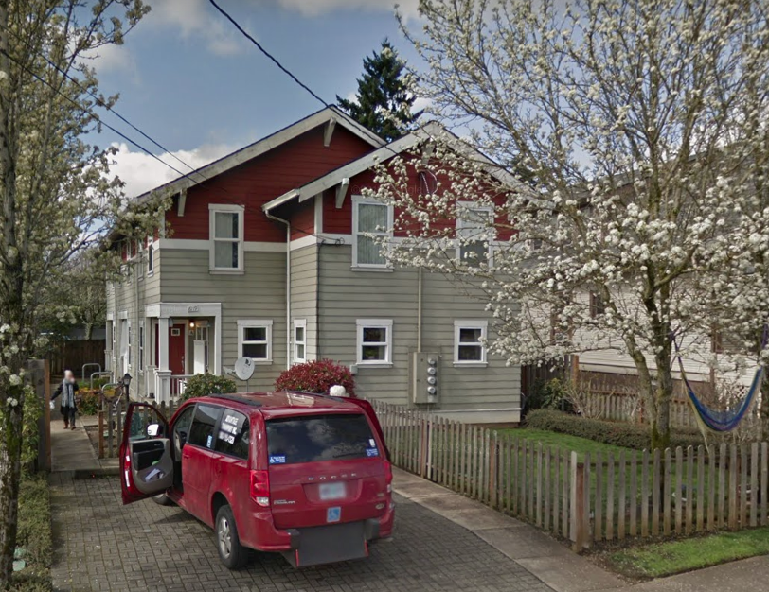
How do unit size and cost relate?
Triplex
Fourplex
90% MFI
80% MFI
Average Size | 1,166 Square Feet (2-3 BR) | 875 Square Feet (1-2 BR)
Average Sale Price | $360,500 | $270,375
Average Price per SF | $309/SF | $309/SF
Average Rent | $2,500/month | $1,900/month
Average Rent per SF | $2.17/sf | $2.17/SF
120% MFI
100% MFI
Residential Infill Project| 29

Slide 30
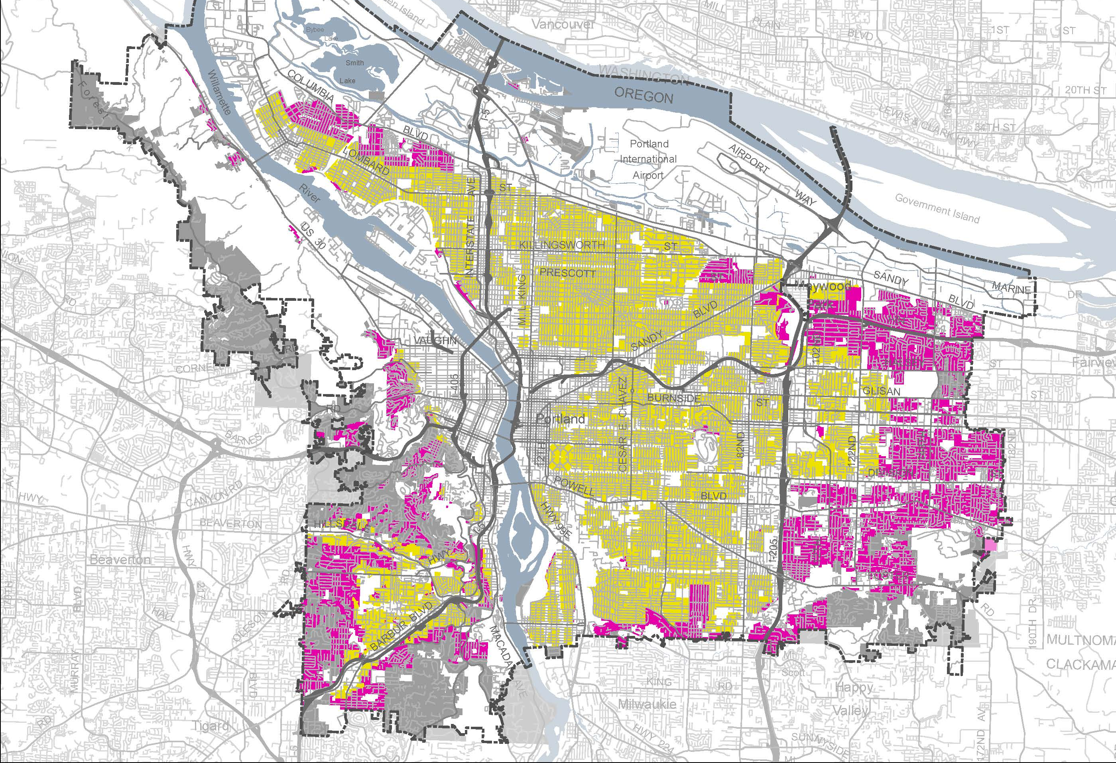
4a. Allow in limited area (Staff Proposal)
Additional housing
types allowed
(‘a’ overlay)
Additional housing types not allowed
Residential Infill Project| 30
Notes:
Once we had the size of the structure and the number of units set, we needed to decide where these infill options would be allowed.
I’m sharing two versions of this map because this is the most hotly-debated part of the proposal.
This map shows staff’s original proposal.
The yellow areas are where the infill options would be allowed and the gray and pink areas are where they wouldn’t be. Staff excluded areas:
in low density SFR zones (gray) and other natural hazard constraints
in a school district that was over capacity
far from transit
Areas with high percentage vulnerable populations (which I’ll explain more deeply later). Our fear was that by providing the opportunity for more development, low-income renters of SFR houses would be displaced.

Slide 31
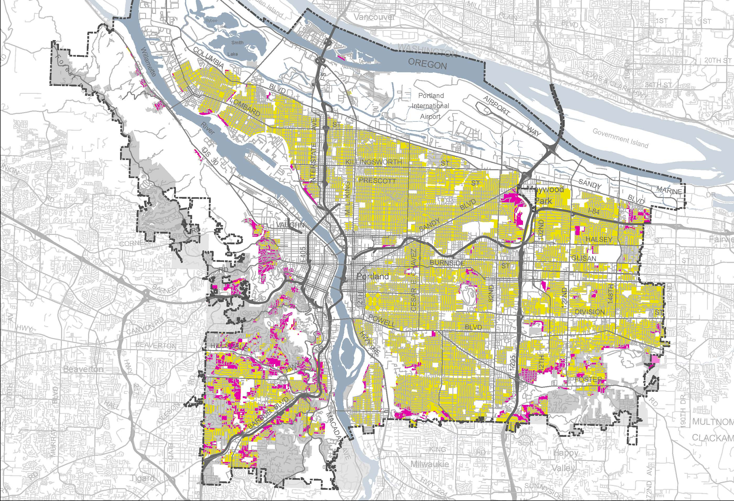
4. Allow “everywhere” (PSC recommendation)
Additional housing
types allowed
Additional housing types not allowed (‘z’ overlay)
Additional housing types not allowed (RF/R20/R10)
Residential Infill Project| 31
Notes:
The Planning Commission disagreed. They felt that our proposal didn’t go far enough and expanded the map to almost everywhere. In particular, they wanted to give low-income homeowners the opportunity to use these new provisions to build wealth. They only excluded:
- 100-year floodplain
- Areas identified in the natural resource inventory (NRI)
- Landslide hazard areas
- Unpaved streets

Slide 32
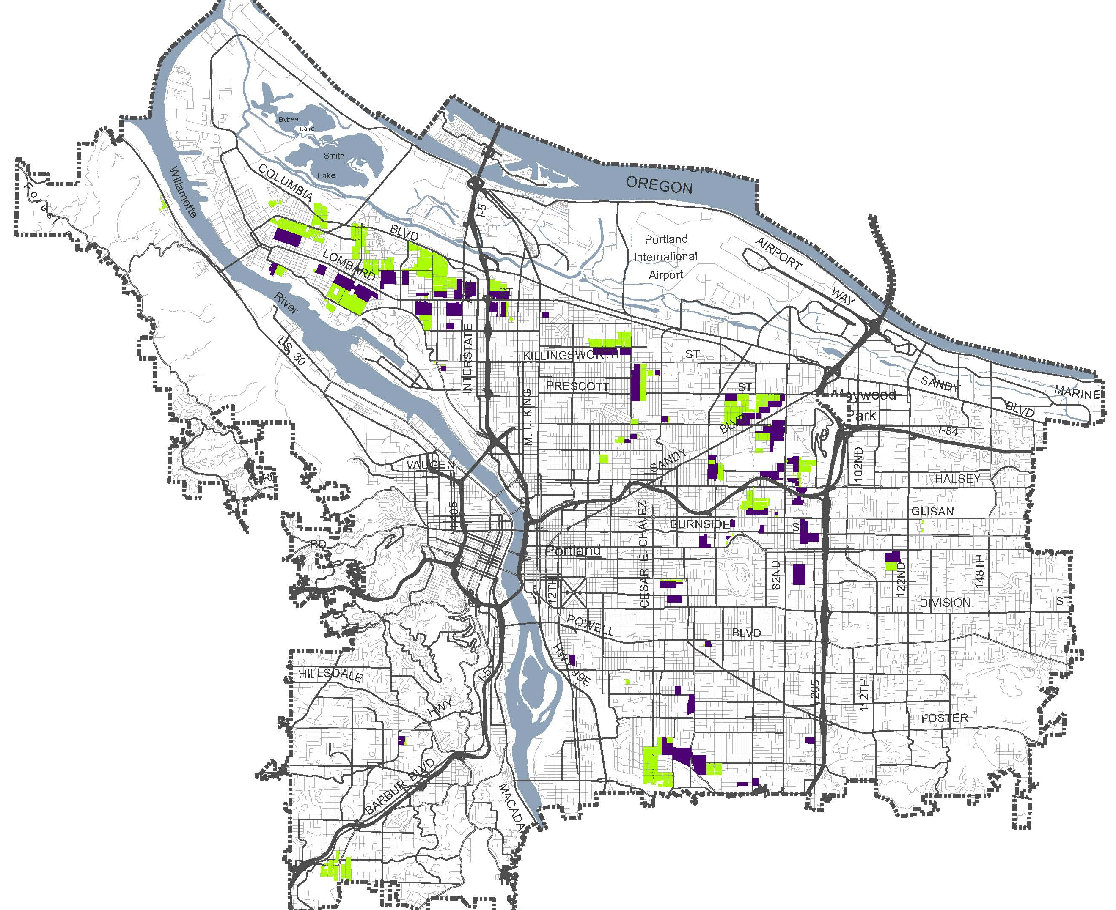
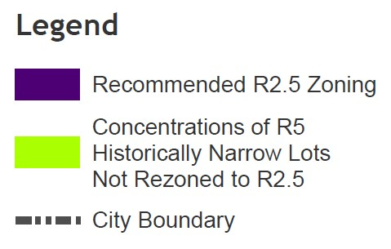
5. Rezone Historically Narrow Lots
Residential Infill Project| 32
Notes:
The Planning Commission disagreed. They felt that our proposal didn’t go far enough and expanded the map to almost everywhere. In particular, they wanted to give low-income homeowners the opportunity to use these new provisions to build wealth. They only excluded:
- 100-year floodplain
- Areas identified in the natural resource inventory (NRI)
- Landslide hazard areas
- Unpaved streets

Slide 33
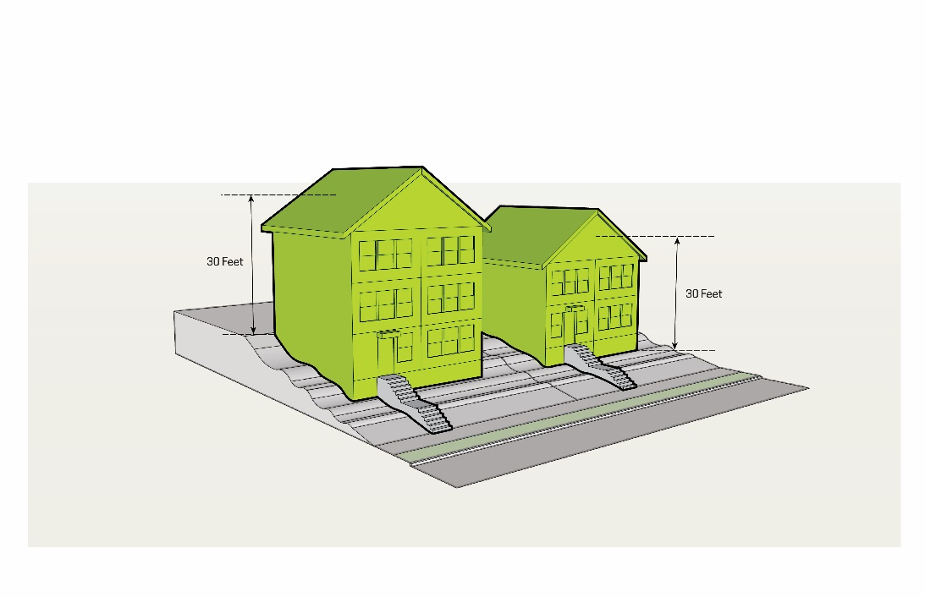
6. Improve building design
a. Measure height from the low point
b. Exclude dormers from height measurement
c. Continue to allow 2 ½ stories
d. Allow 2’ eave projections
30’
30’
Current height measurement
Proposed height measurement
Residential Infill Project| 33

Slide 34
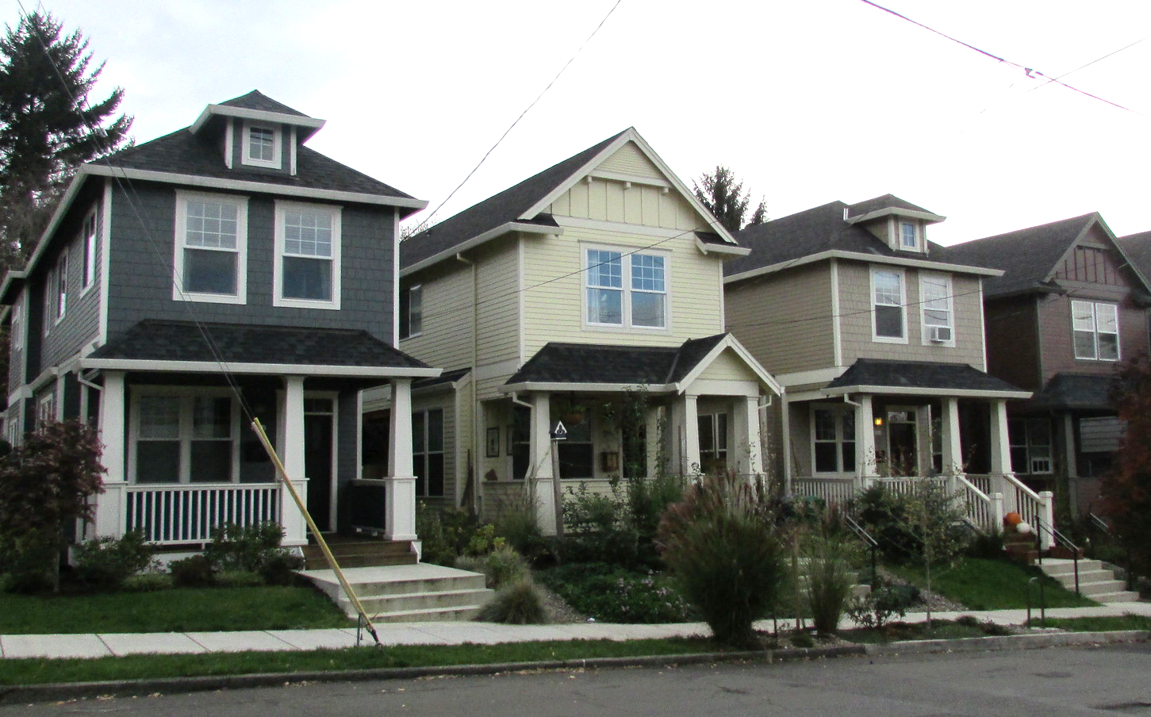
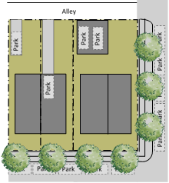
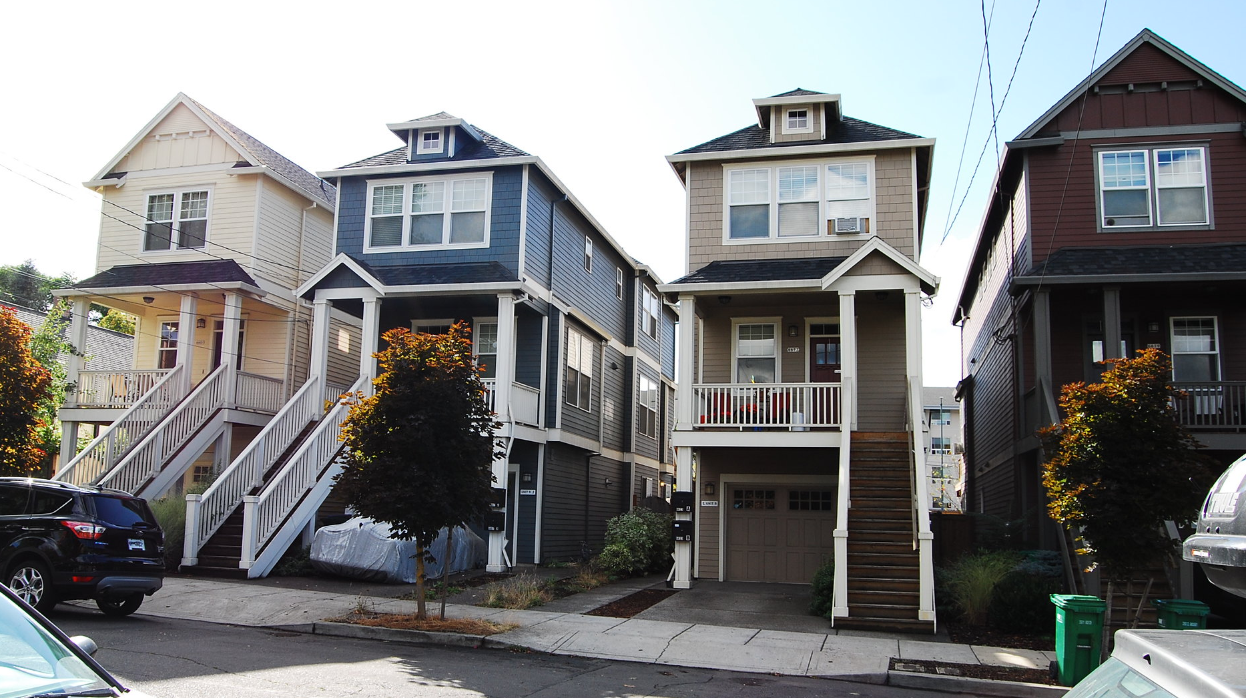
7. Improve public realm (parking)
a. Eliminate minimum parking requirement
b. Require alley access
c. Limit garages
Residential Infill Project| 34

Slide 35
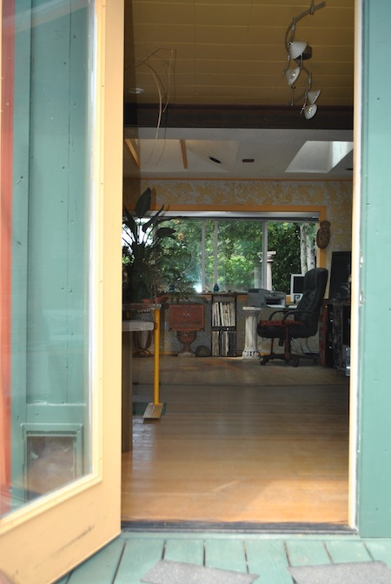
8. Increase accessible units
One of 3 or 4 units must have:
No-step entry
Wider doorways
Ground floor bathroom
Ground floor living space
Residential Infill Project| 35

Slide 36
Reducing demolitions
FAR caps reduce feasibility for demo/replace
Existing house retention incentives
  Bonus FAR for adding units to an existing house
  Basement ADUs not capped at 800 sf/75% dwelling size
  250 sf additions allowed every 5 years
  PLAs to create flag lots on historically narrow lots
  No parking required – easier to add units/convert garages
  Exemption for visitability requirement
  HB2001: directs building code changes to facilitate internal conversions
Historic review still applies to exterior alterations/demolition

Slide 37
DISPLACEMENT RISK ANALYSIS
Residential Infill Project | 37
Notes:
Shifting gears…
After we figured out what our proposal was, we conducted a displacement risk analysis. It evaluates whether the proposal increases the likelihood of displacement or decreases it.
To be honest, we hadn’t actually measured how much displacement was occurring in Portland. So, we were at a great disadvantage for understanding how the proposal affected outcomes.

Slide 38
Comp Plan Displacement Policies
Policy 5.15 – Gentrification/displacement risk
Evaluate plans and investments...for the potential to increase housing costs for, or cause displacement of communities of color, low- and moderate-income households, and renters. Identify and implement strategies to mitigate the anticipated impacts.
Policy 5.16 – Involuntary displacement
When plans and investments are expected to create neighborhood change, limit the involuntary displacement of those who are under-served and under-represented. Use public investments and programs, and coordinate with nonprofit housing organizations (such as land trusts and housing providers) to create permanently-affordable housing and to mitigate the impacts of market pressures that cause involuntary displacement.
Residential Infill Project | 38
Notes:
But, we did have clear policy directives to evaluate proposals for their impacts on displacement and to limit displacement from occurring in the first place.

Slide 39
Types of Displacement
Direct displacement - When government acquires property through eminent domain and a property owner is forced to sell their home
Indirect Displacement - When policy changes create measurable impacts on market dynamics, such as an increase in rates of redevelopment
Induced Displacement - When market conditions respond to new development and changes in neighborhood character and impact existing housing units in terms of increasing rents or prices
Residential Infill Project| 39
Notes:
Displacement can be classified into three categories.
READ
Because the Residential Infill Project is a policy amendment that changes the market dynamics, we measured INDIRECT DISPLACEMENT with this analysis.
…And was defined as a home being torn down and replaced with one or more new units as a result of new development standards.

Slide 40
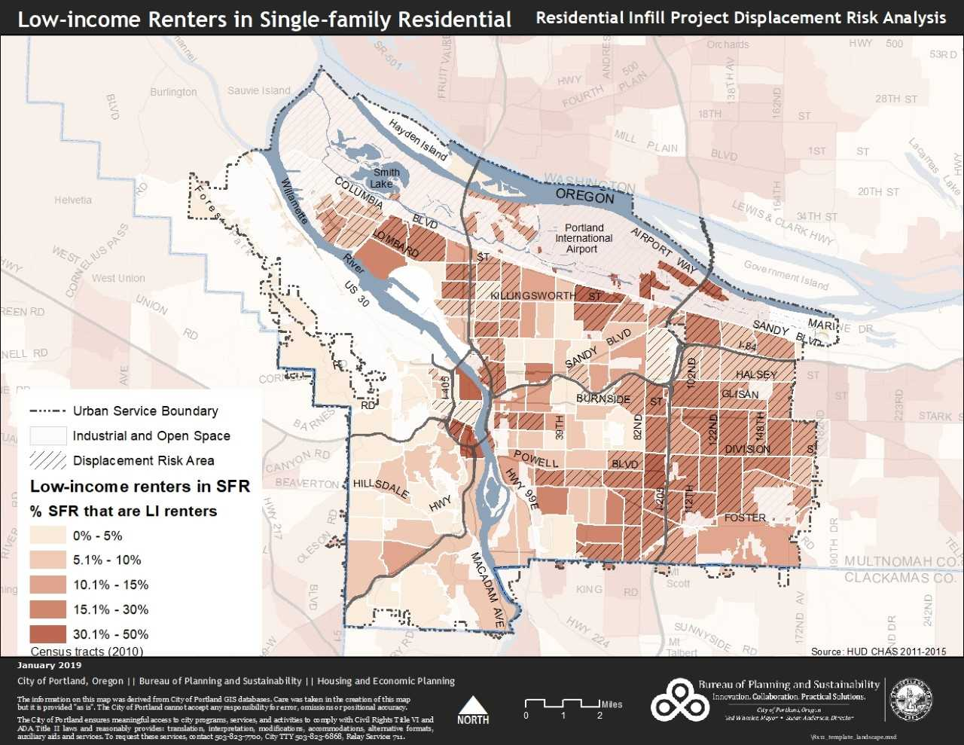
Low-Income Renters in Single-Family Houses
Notes:
For the purposes of this project, the most vulnerable people are low-income renters (<80%) in single family structures. They have the least control over their housing situation in that they can get evicted, and if they do get evicted, they don’t have a lot of choice in housing based on affordability.
153,000 SFRs citywide. Of those, 14,000 are rented to low-income households. They are located in the areas with the darkest colors.

Slide 41
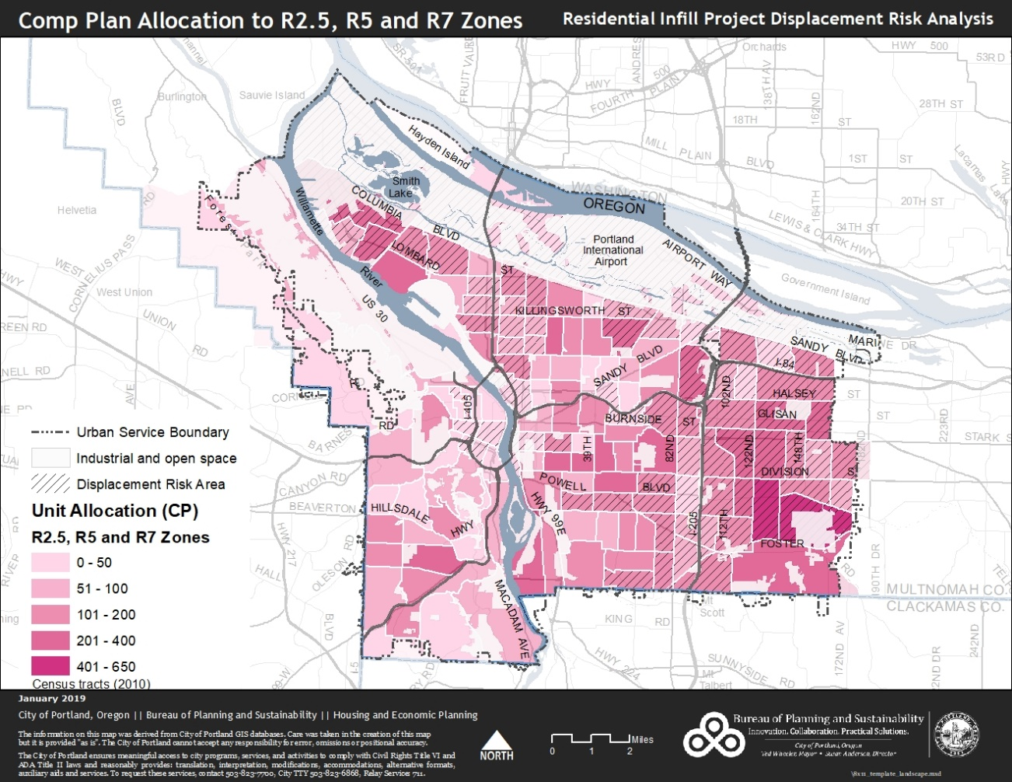
Comp Plan Growth Allocation
Baseline Scenario

Slide 42
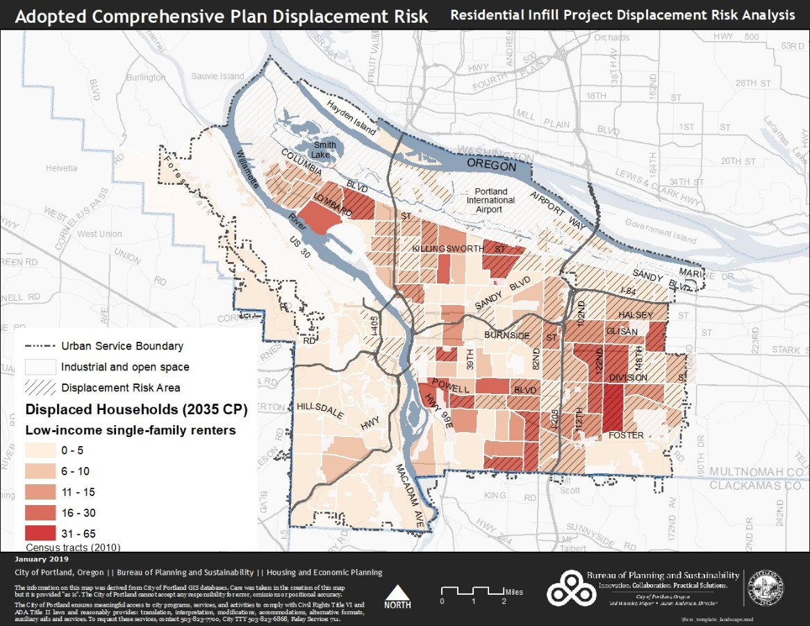
Comp Plan
Displacement Risk
Baseline Scenario

Slide 43
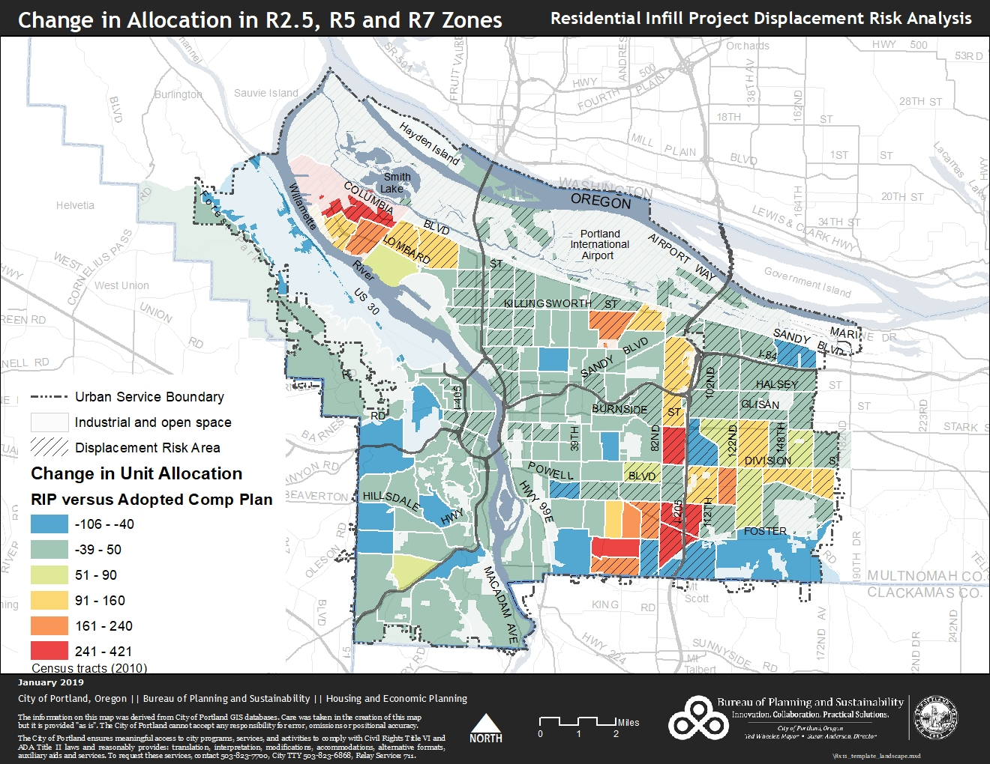
Growth Allocation Change
Change - baseline to RIP

Slide 44
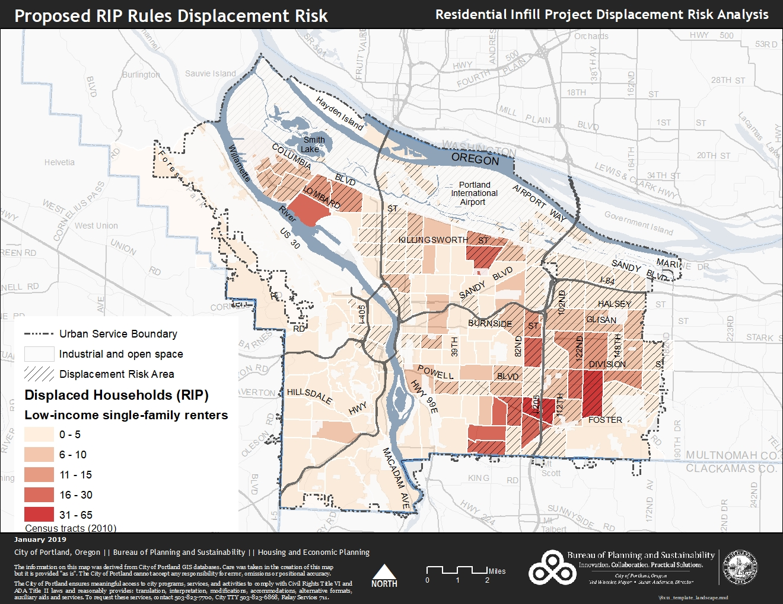
RIP Displacement
Risk
RIP Scenario

Slide 45
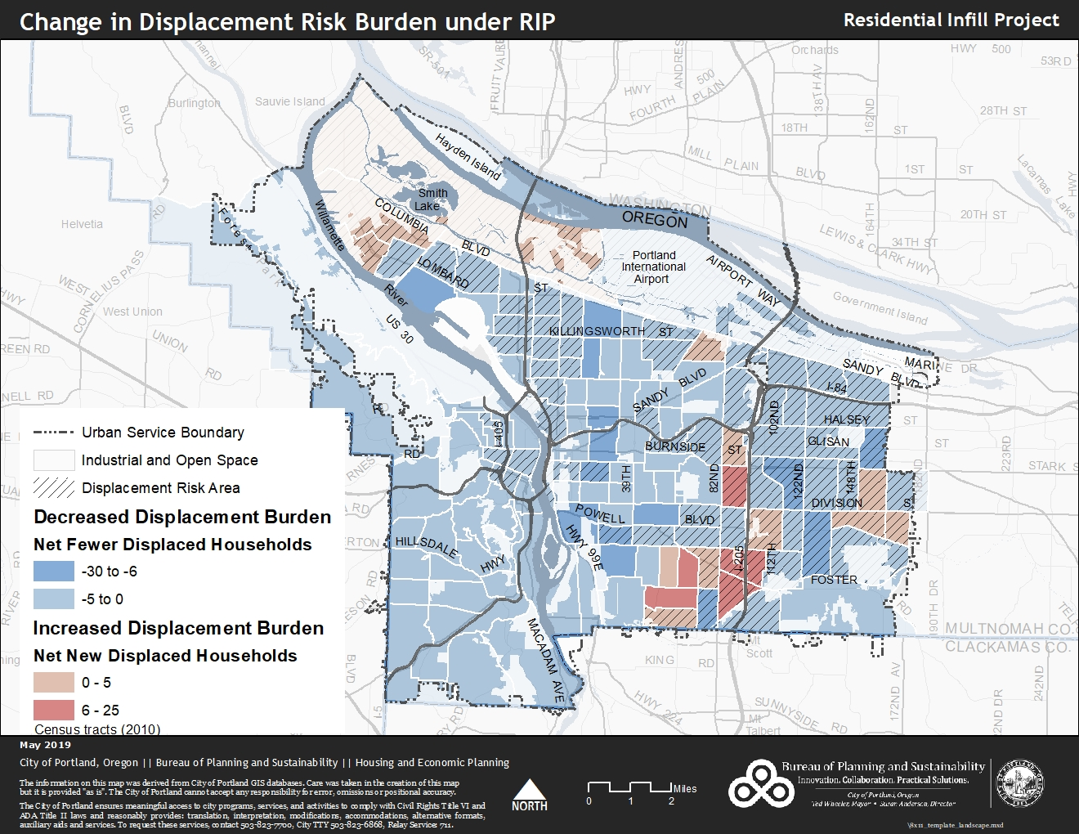
Displacement Impacts
RIP vs. Comp Plan
Notes:
This map compares the risk of displacement between the current zoning and the proposal scenario to the 14,000 low-income households who rent single-family homes in single-family zones.
When we compare the two maps, we found that displacement decreases for all the areas in blue -- to the tune of 28%.
In other words, we estimate that 28% fewer households will be at risk of displacement over the next 20 years if these zoning code amendments go into effect. That’s the good news.
That’s because allowing more units to be built on one lot means that fewer lots will be redeveloped across the city.
The bad news is that displacement increases in a few census tracts, most notably in three areas shown in red.

Slide 46
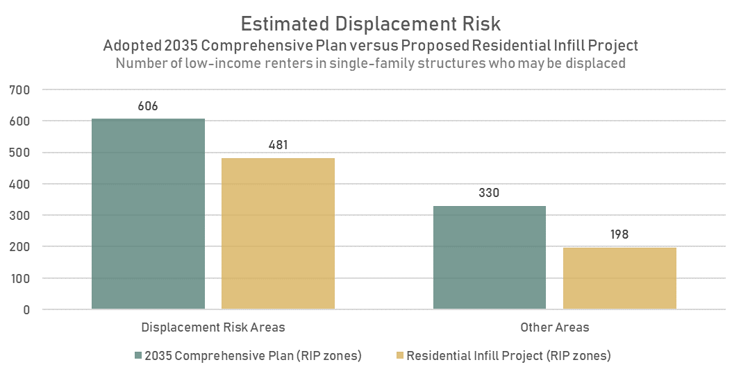

Slide 47



Lower priced houses, 3 potential futures…
❶
❷
Built 1955 – 2BR, 780 sf unit
$430,000
Built 2018 – 2BR, 1000 sf units
$380,000
Built 2019 – 4BR, 3,200 sf unit
$1,100,000
$380,000 6plex unit built 2018 Next door, 1955 2BD/1BA 783 sq ft listed at $430,000. The only new (2010-2019) SFR house for sale in the neighborhood
Built 2019 4BD/3BA 3,210 sq ft $1,100,000 (2380 N Humboldt St)

Slide 48



It’s not just about redevelopment.
❸
2005
$284,000
2011
$350,000
2019
$600,000
Notes:
5018 NE 10th street
Year built 1915
3BR/3BA
2,300 sf (incl 1,400sf addition)

Slide 49
Summary
More housing types
+ smaller size, scaled by number of units
+ allowed everywhere
=
More units
smaller units
less-expensive units
and less displacement overall
Residential Infill Project | 49

Slide 50
Related Efforts
Housing Opportunities Initiative:
  Residential Infill Project
  Better Housing by Design
  Citywide Anti-Displacement Action Plan
HB2001 Allow duplexes everywhere and 3-plex and 4-plex somewhere
SB534 Allow development on all historically platted lots
Residential Infill Project | 50

Slide 51
Next Steps
October 2, 3PM Better Housing by Design (BHD) at City Council
Fall 2019 RIP City Council Hearings
Early 2020 RIP City Council vote
Spring 2020 RIP/BHD Effective
Residential Infill Project | 51

