Slide 1
Item 641 – BIKETOWN Ordinance
Extend operator contract through April 2020
Increase contract value (no budget impact)
June 26, 2019

Slide 2
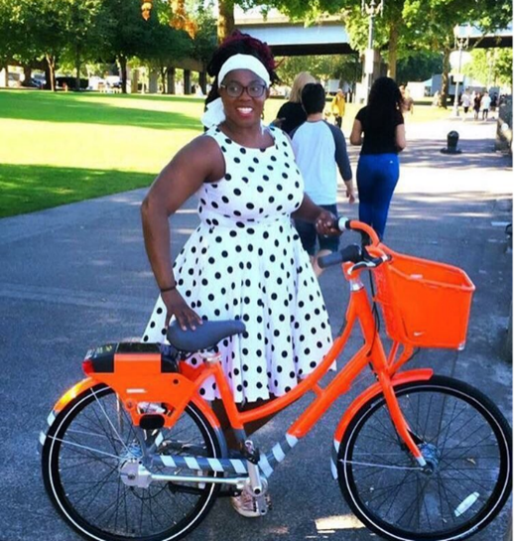
BIKETOWN
City-owned program
Launched in July 2016
1,002 bikes, 147 stations
~1,000,000 rides
Major sponsors: Nike and Kaiser Permanente
Contractor operations paid by sponsorship and user revenues
RFP for expanded system and e-bikes to be released summer 2019
BIKETOWNpdx.com

Slide 3
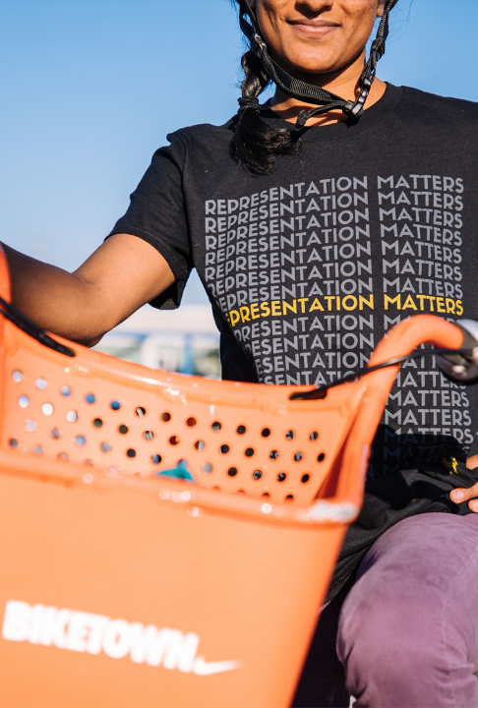
Request of Council
Extend term of Motivate International contract to April 30, 2020
(Current term ends August 1, 2019)
Extension allows bike share service to continue during new RFP and during transition.
BIKETOWNpdx.com

Slide 4
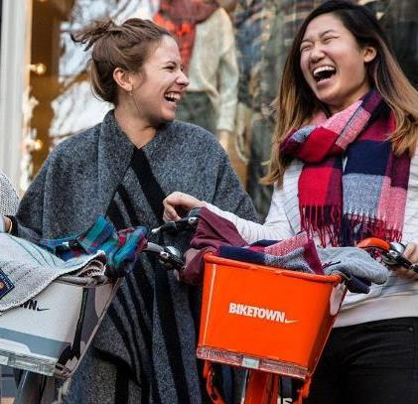
Request of Council
Increase contract value by $3M to $14.7M for the term of the agreement
No impact to City budget
Funds paid to Motivate for operation and capital come solely from BIKETOWN sponsorships and user revenues
.
BIKETOWNpdx.com

Slide 5
Payment to Motivate Limited to Bike Share Revenues
Revenue from memberships AND User fees
PRIVATE SPONSORSHIP
(Nike, KAISER PERMANENTE)
Bike share revenue account
(sole source of payment to motivate for bike share operations)
BIKETOWNpdx.com

