Slide 1
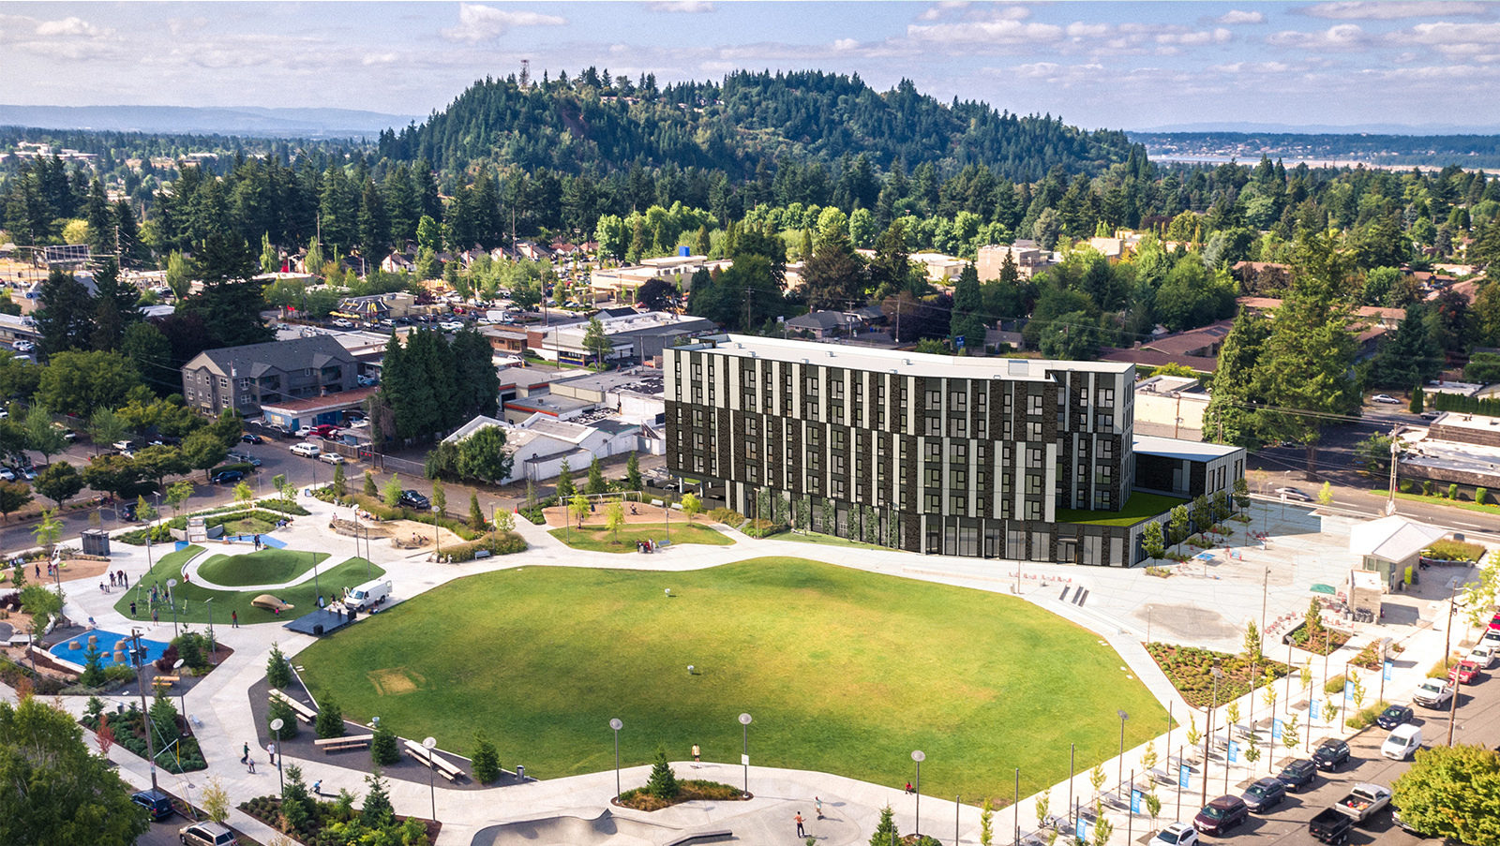
HALSEY106
Shannon Callahan,
Director, Portland Housing Bureau
Kimberly Branam,
Executive Director, Prosper Portland
July 10, 2019

Slide 2
Ordinances for N/NE Properties
Kilpatrick Phase I & II
N. Williams & N. Alberta
Shannon Callahan, Director
July 10, 2019

Slide 3
HALSEY 106
75 units blending middle-income and affordable rental housing
52 affordable units
7 deeply affordable units
Affordable commercial space
106Halsey/Gateway Park l 07/10/2019 l Portland Housing Bureau

Slide 4
PARTNERSHIPS
Affordable Commercial
Office
Mixed-income housing units
From the Plaza Perspective
Showing proximity to Discovery Park
106Halsey/Gateway Park l 07/10/2019 l Portland Housing Bureau

Slide 5
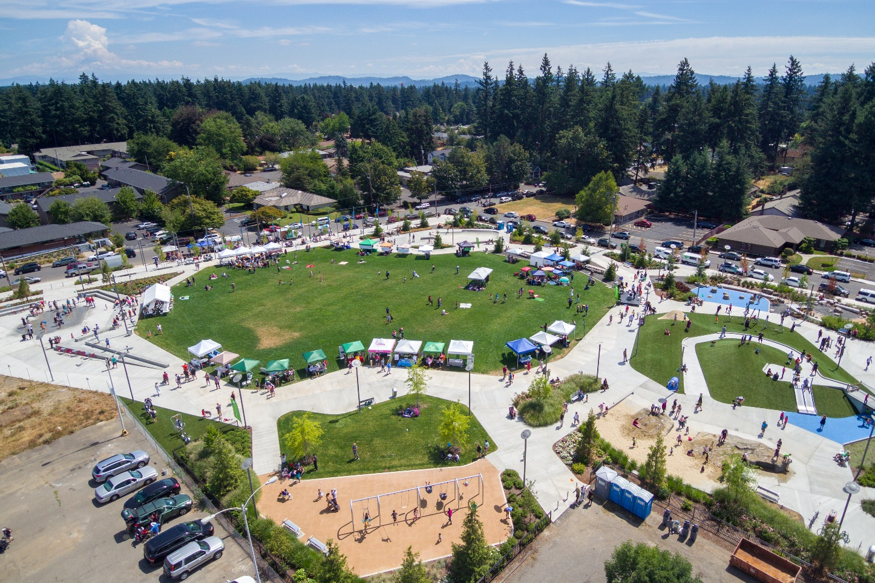
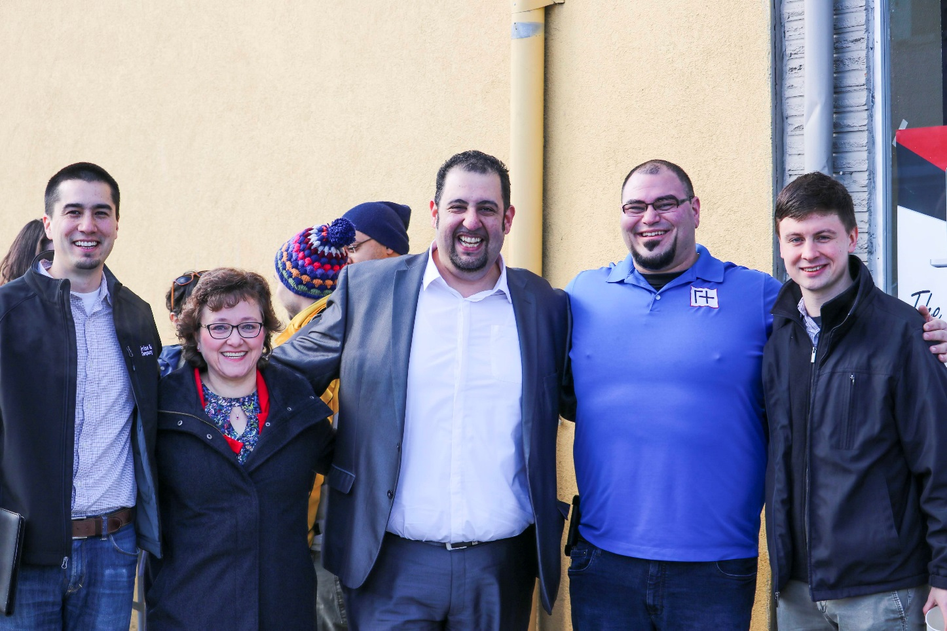
COMMUNITY COMMITMENT
106Halsey/Gateway Park l 07/10/2019 l Portland Housing Bureau
106Halsey/Gateway Park l 07/10/2019 l Portland Housing Bureau 5

Slide 6
PARTNERSHIPS
 | Market Rate Housing | Affordable Housing | Retail | Office | TOTAL
Portland Housing Bureau |  | $7.4M |  |  | $7.4M
Prosper Portland | $5.9M |  | $3.5M |  | $9.4M
Tax Credits (LIHTC, NMTC) |  | $6.2M |  | $2.9M | $9.1M
Debt |  | $2.65M |  | $2.2M | $4.85
Other | $0.2M | $1.35M |  | $0.5M | $2.05M
TOTAL | $6.1M | $17.5M | $3.5M | $5.6M | $32.7
106Halsey/Gateway Park l 07/10/2019 l Portland Housing Bureau

