Slide 1
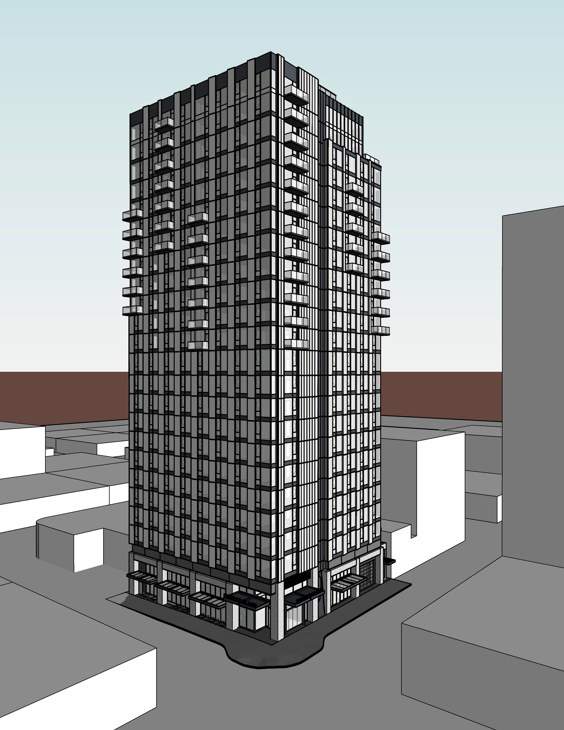

City of Portland
Design Commission
Type III Land Use Review
LU 19-145295 DZM
Hyatt Place at 350 NW 12th Ave.
July 18, 2019
Staff Presentation

Slide 2
Staff Presentation
Applicant Presentation
Staff Recommendation
Public Testimony
Applicant Response to Public Testimony
Commission Discussion

Slide 3
Proposal Summary

Slide 4
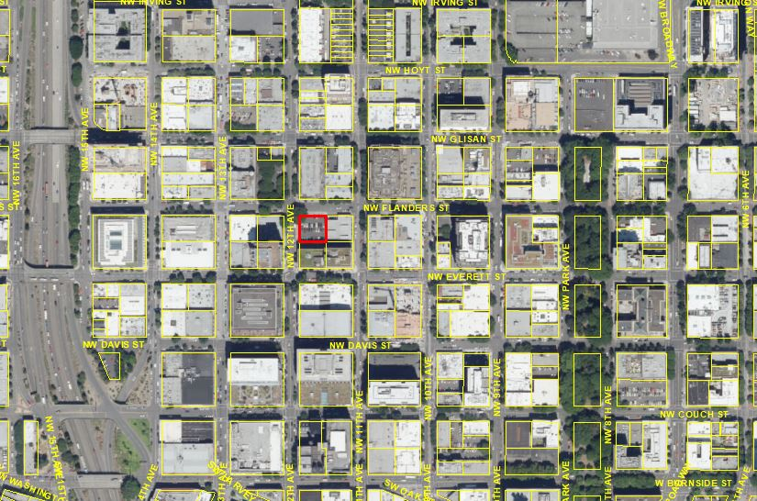
Location
Central City Plan District
Pearl Subdistrict

Slide 5
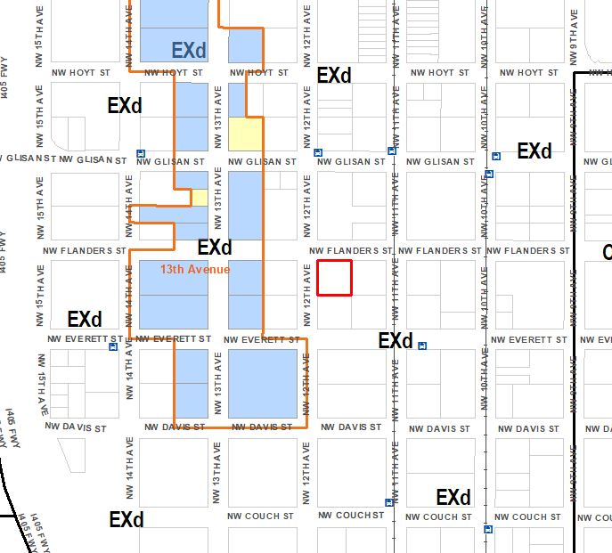
Zoning
Base Zone:
EX – Central Employment
Overlay:
d - Design Overlay
Floor Area Ratio:
6:1 base, 3:1 bonus possible and unlimited FAR transfers
(approx. 18.7:1 proposed)
Height:
100’ base. 250’ bonus
(250’ proposed)
Northwest Triangle Pedestrian District
Site Concerns:
Future Flanders Greenway

Slide 6
Approval Criteria
Central City Fundamental Design Guidelines
River District Design Guidelines
PZC 33.825.040: Modifications That Will Better Meet Design Review Requirements

Slide 7
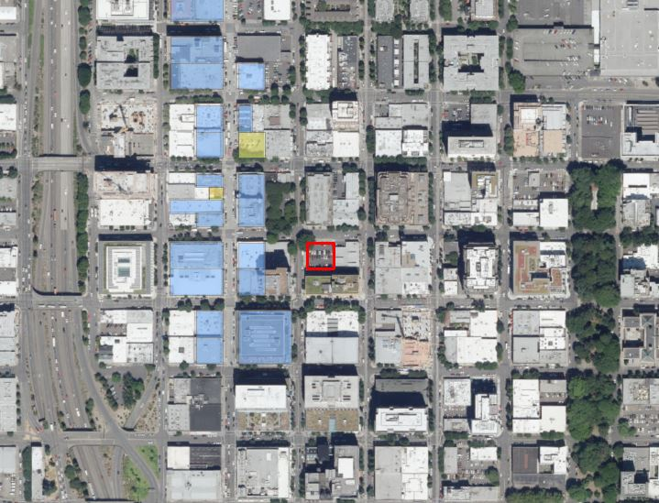
Context
The Pearl District
13th Avenue Historic District
North Park Blocks
Proposed Flanders Greenway

Slide 8
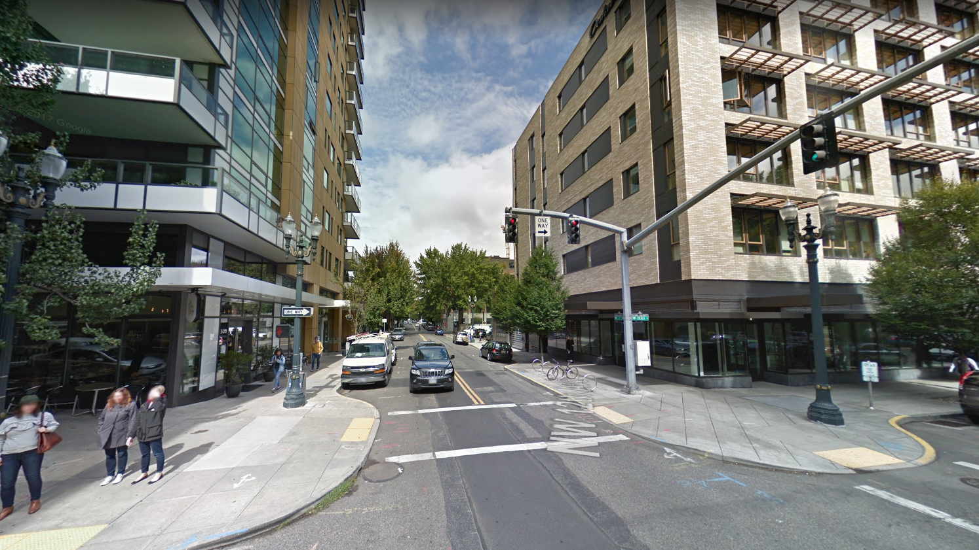
Context
Looking North on NW 12th Ave.

Slide 9
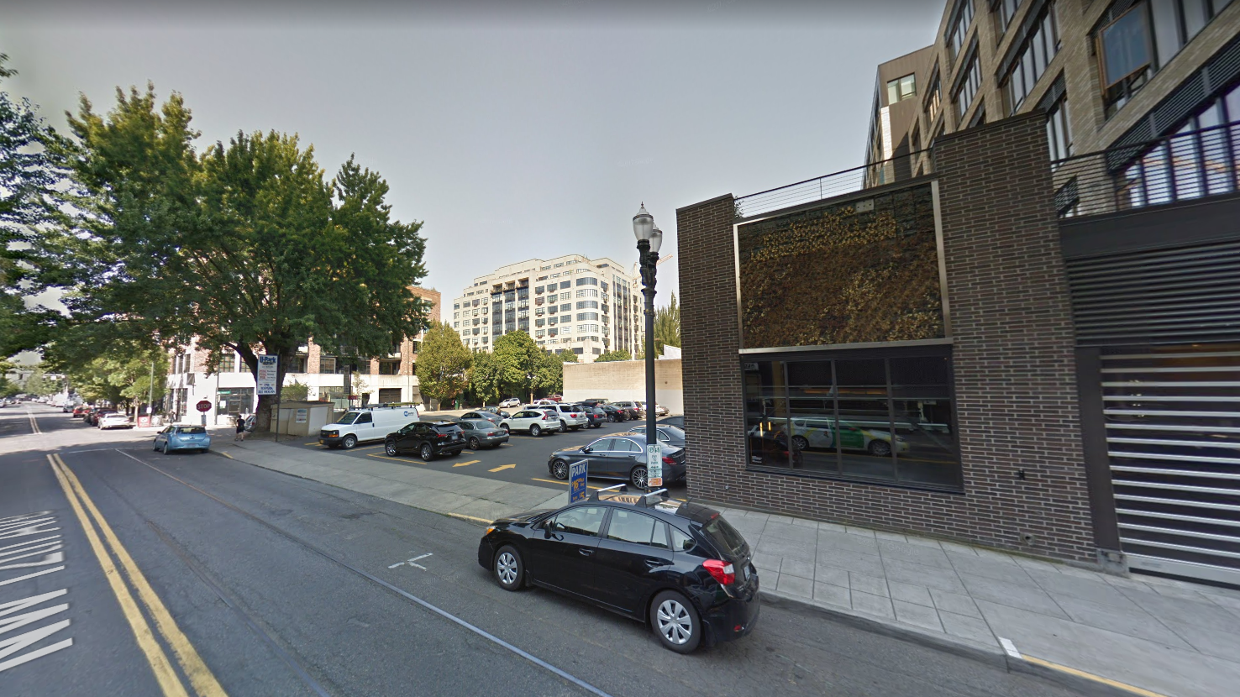
Context
View of the site from NW 12th Ave.

Slide 10
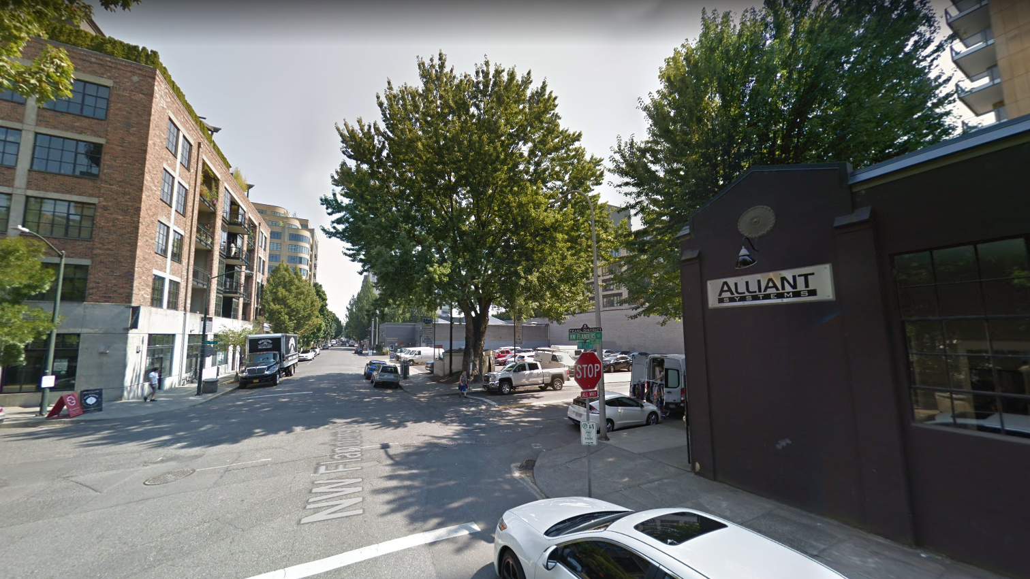
Context
Looking east on NW Flanders

Slide 11
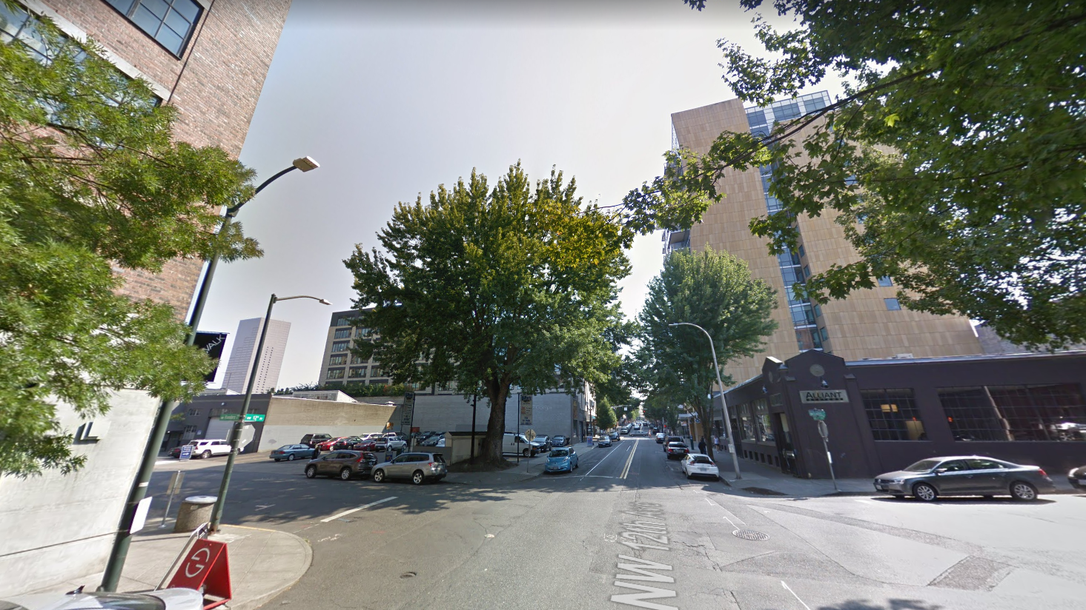
Context
Looking south on NW 12th Ave.

Slide 12
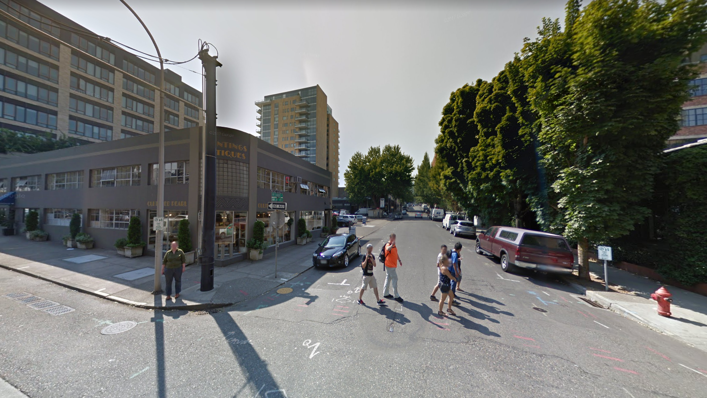
Context
Looking west on NW Flanders

Slide 13
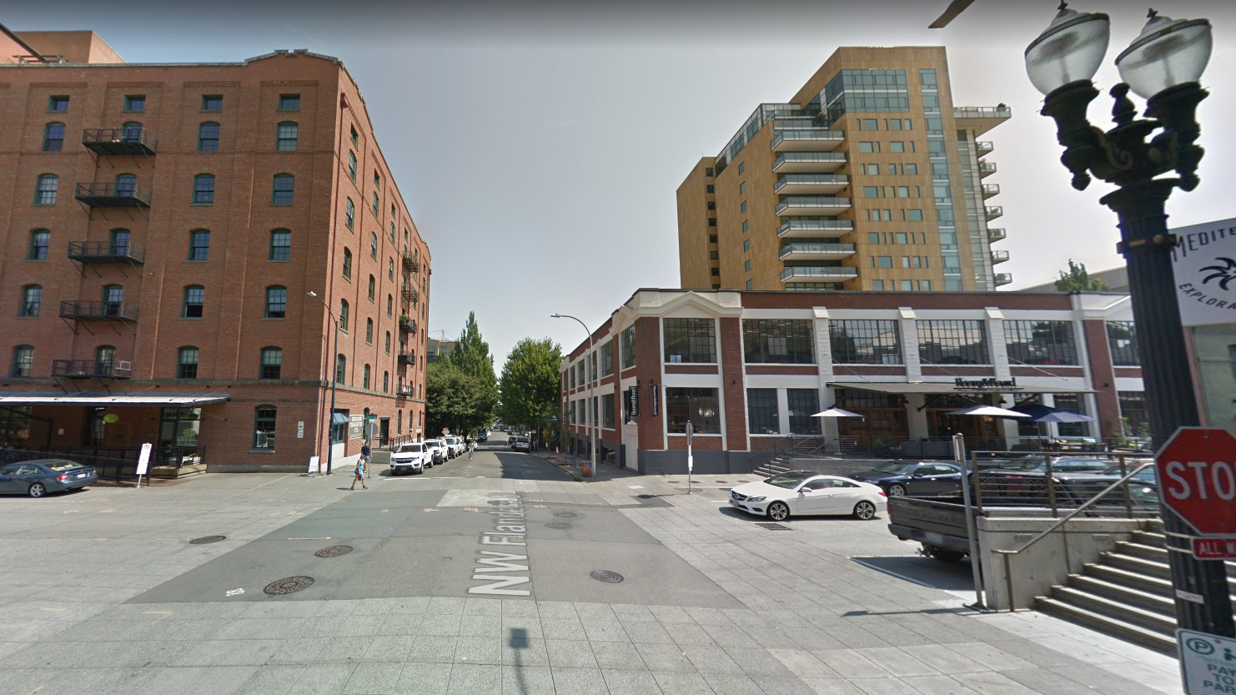
Context
View from 13th Ave Historic District

Slide 14
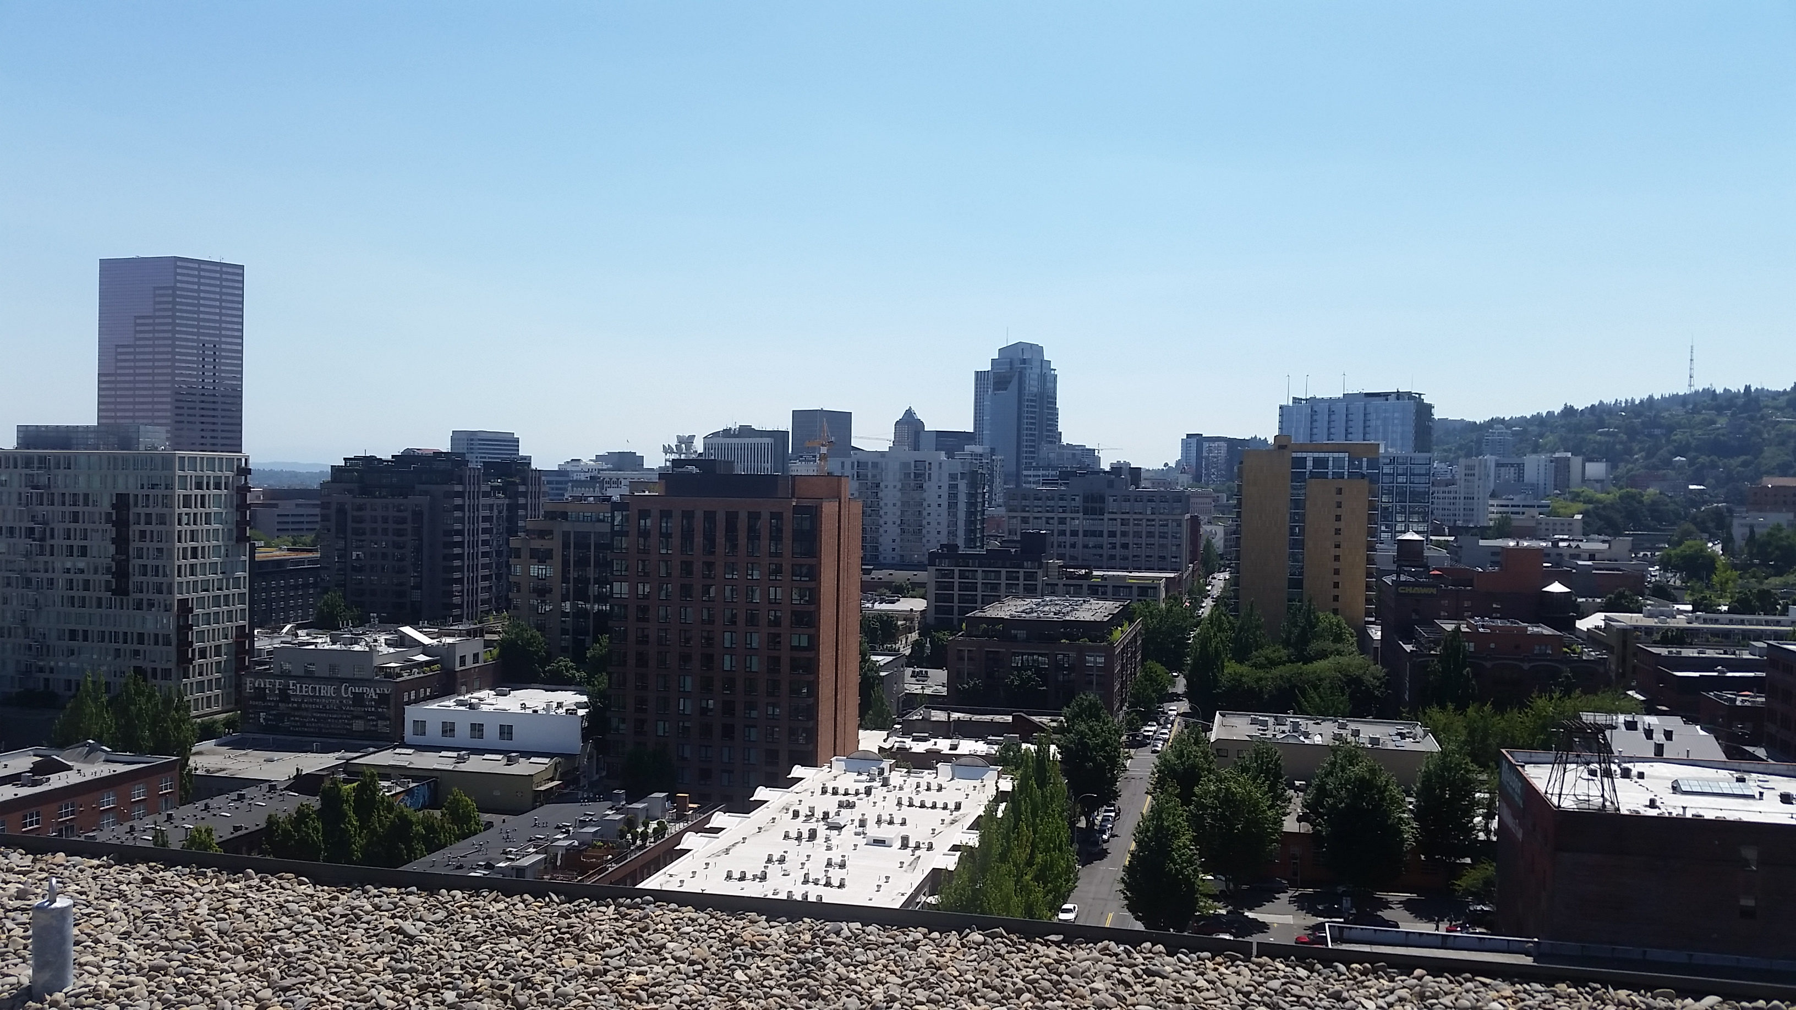
Context
Aerial view of site

Slide 15
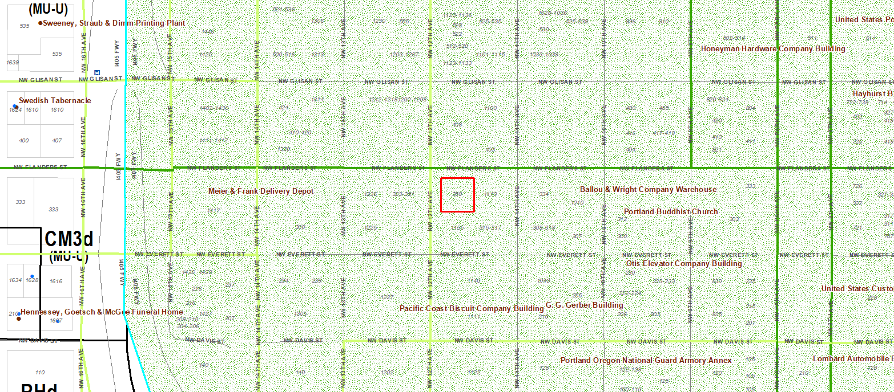
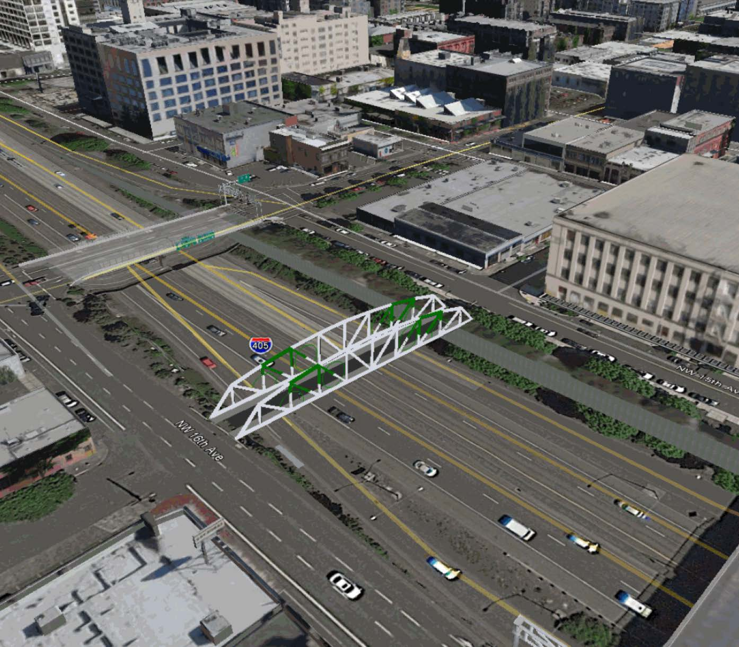
Context
Flanders Greenway

Slide 16
Program Overview
23-story, 250’ tall (including rooftop elements) mixed-use building on a quarter block
Ground floor hotel and residential entry, hotel lobby and café/lounge area
Levels 2-11: 170 hotel rooms and support spaces.
Levels 12-23: 110 one-bedroom and studio units with balconies.
Level 22: Shared amenity spaces.

Slide 17
Program Overview
Two standard A loading spaces are accessed from NW 12th Ave
Metal ACM panel, window wall systems, cast-in-place concrete, aluminum storefront systems.
Modification: To long-term bicycle parking, reducing the width from 24” to 18”. (supported)

Slide 18
Program Overview
Two standard A loading spaces are accessed from NW 12th Ave
Metal ACM panel, window wall systems, cast-in-place concrete, aluminum storefront systems.
Modification: To long-term bicycle parking, reducing the width from 24” to 18”. (supported)

Slide 19
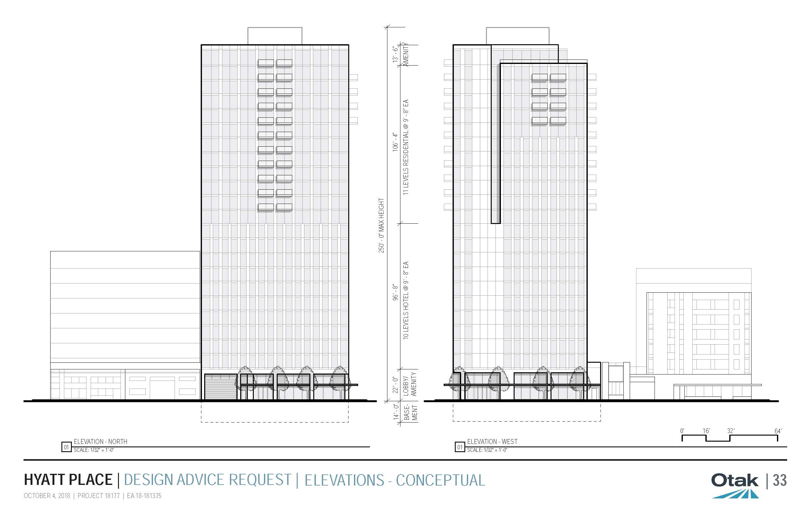
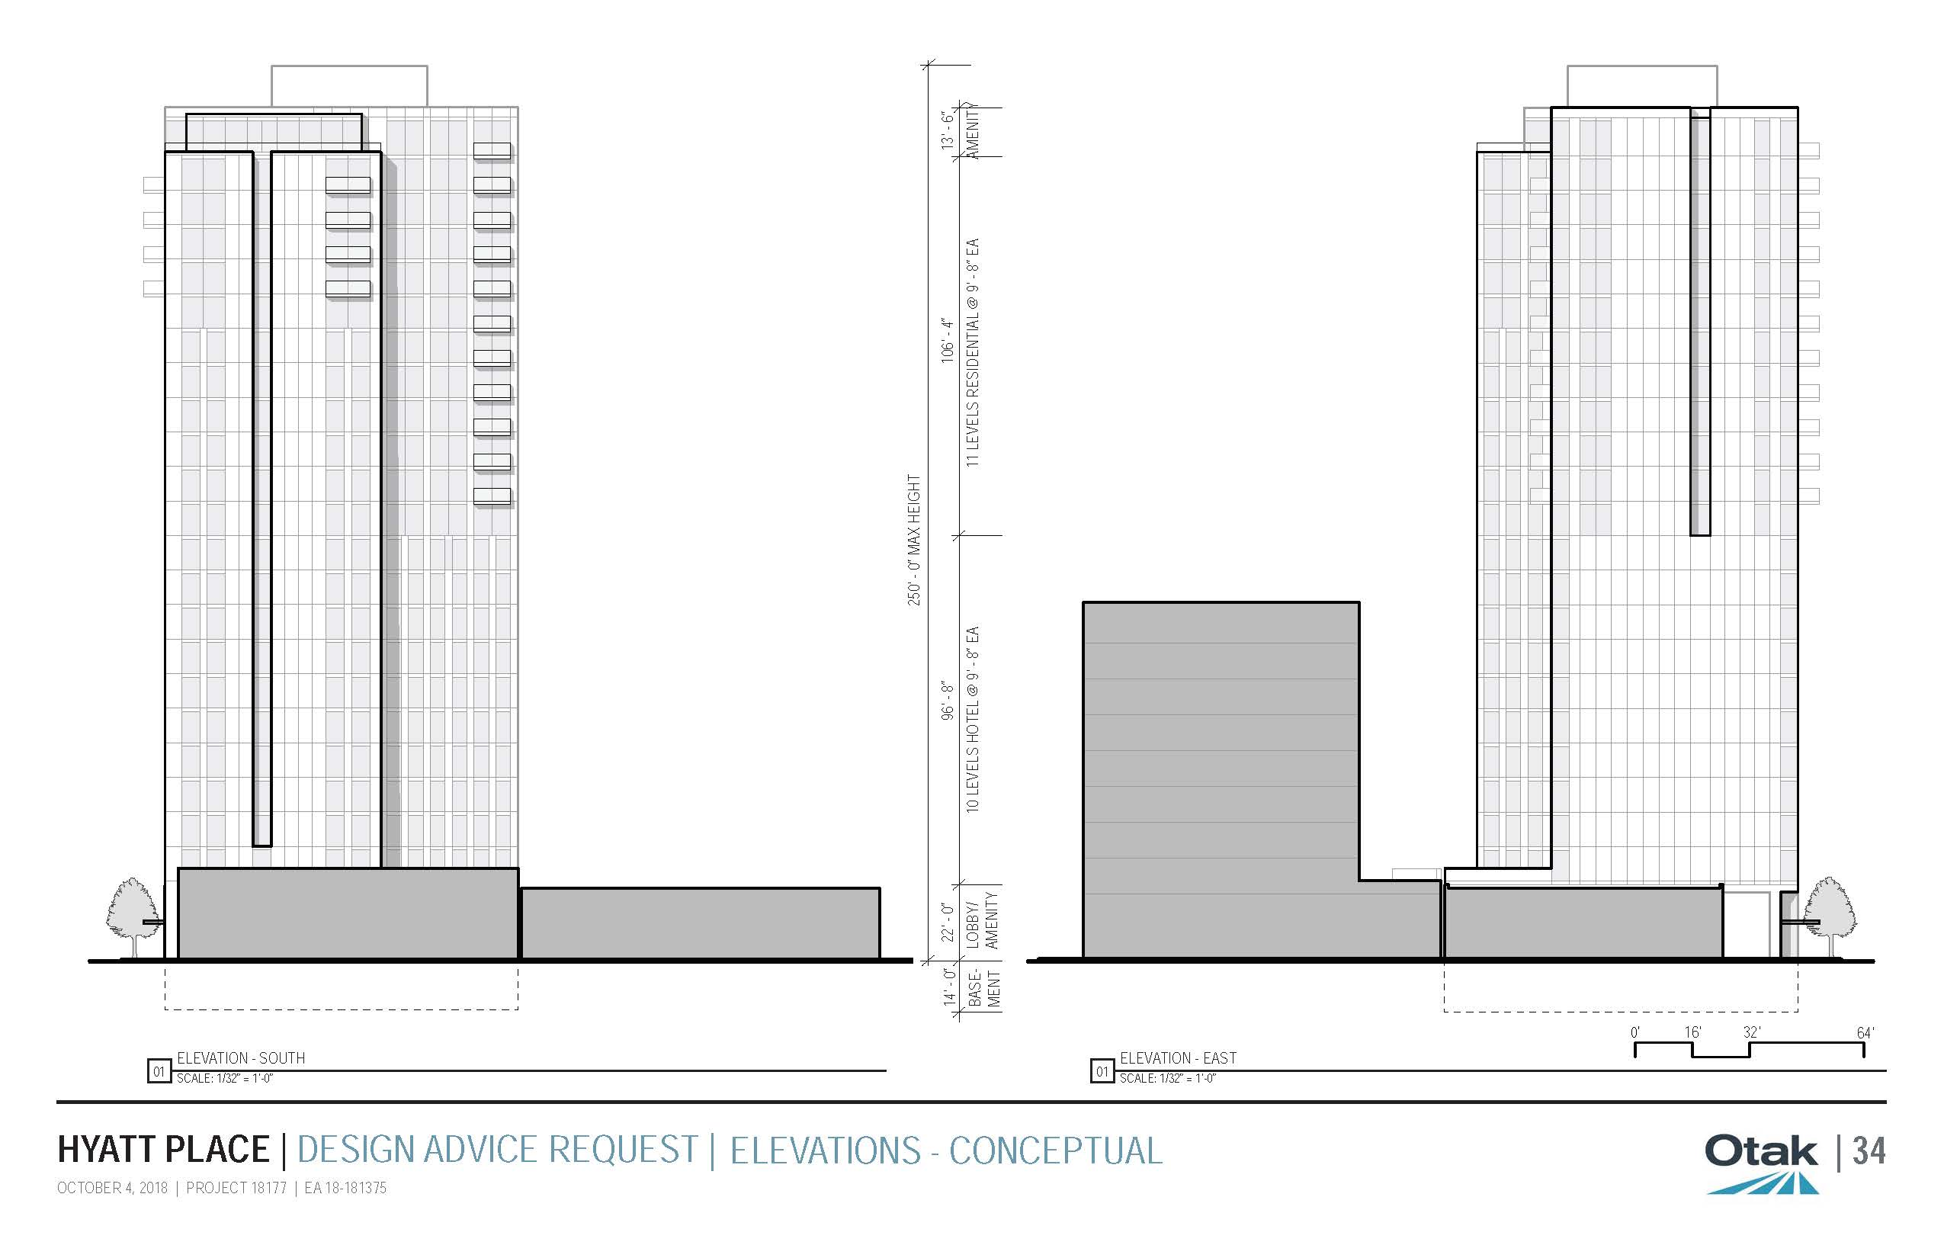
Project History
Pre-App
2 DARs
DAR #1
West
North
South
East

Slide 20
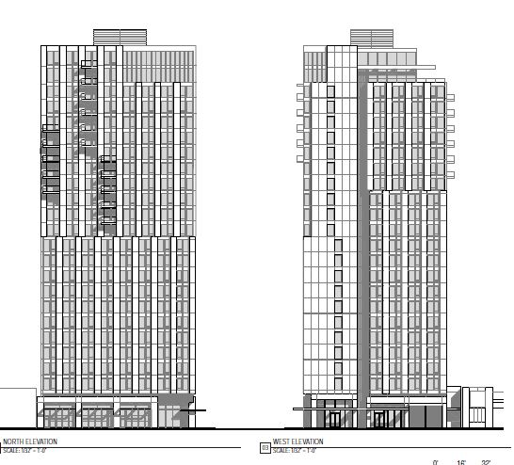
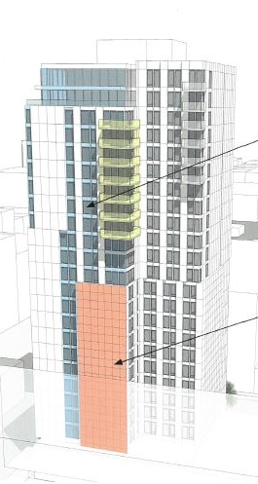
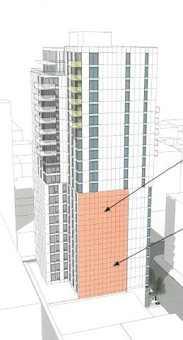
Project History
Pre-App
2 DARs
DAR #2
West
North
South
East

Slide 21
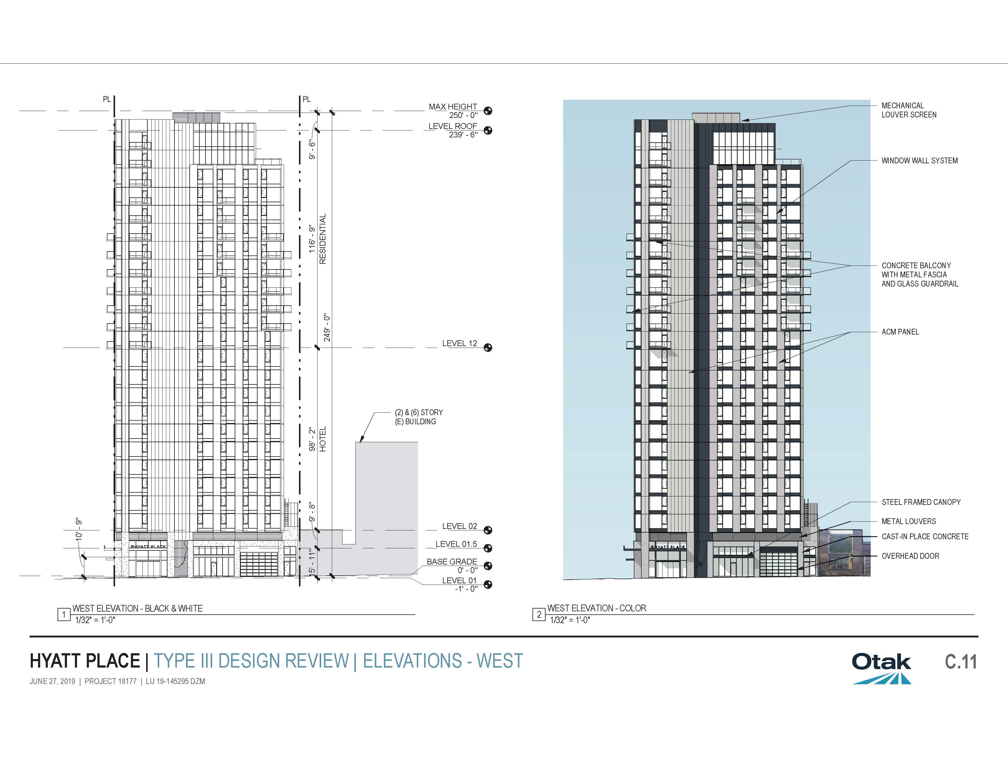
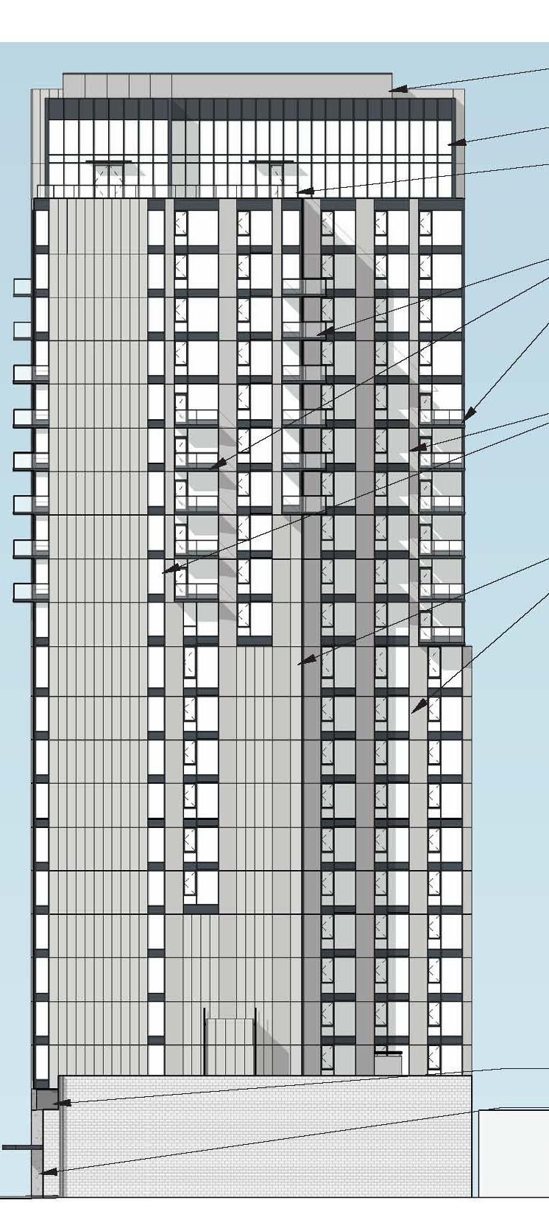
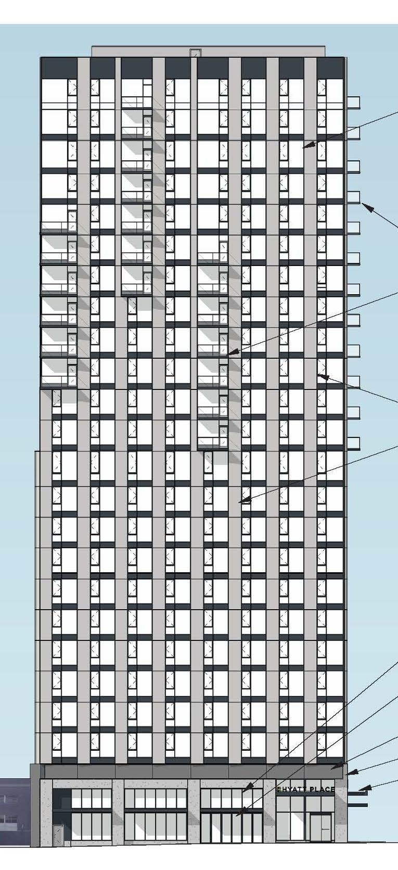
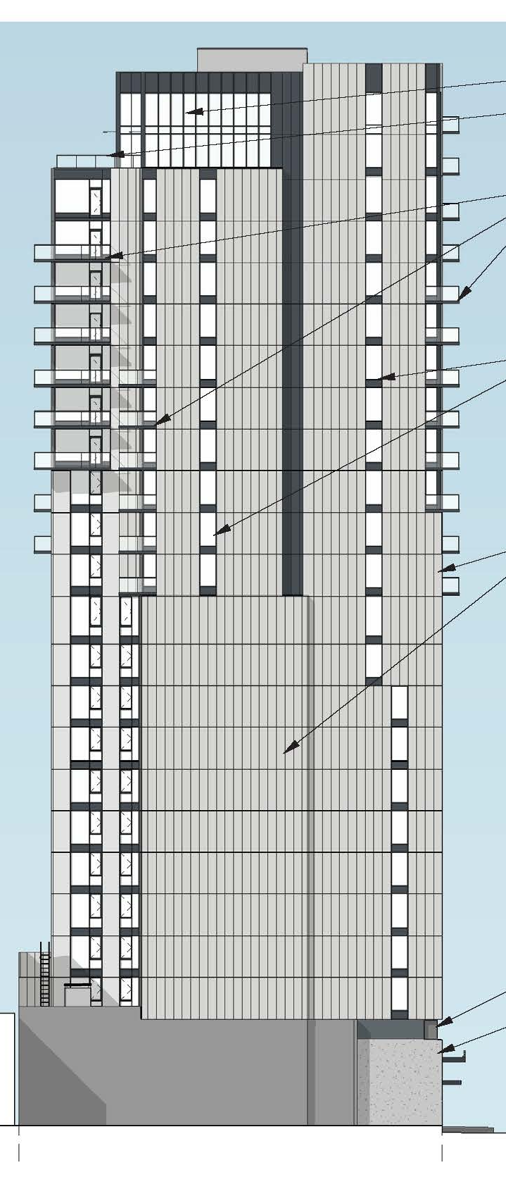
Project History
Pre-App
2 DARs
Today
West
North
South
East

Slide 22
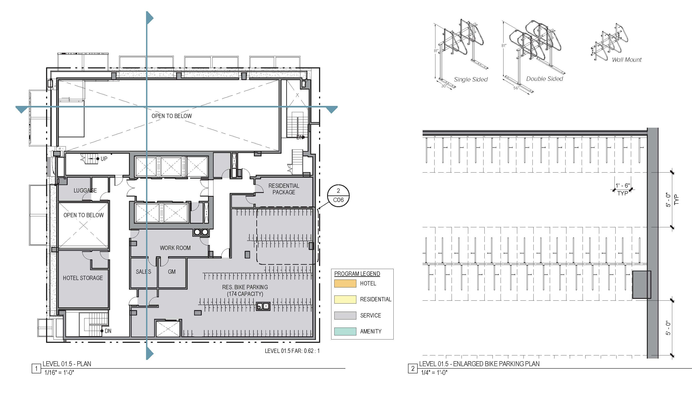
Modification: Standards for Bicycle Racks
The Standard: A space 2 feet by 6 feet must be provided for each required bicycle parking space…
The Purpose: Ensure that bikes may be securely locked without undue inconvenience and will be safeguarded from damage.
The Proposal: Provide 1’-6” x 6’ vertically-mounted spaces.

Slide 23
Site

Slide 24
Proposed Development Site
FLEXIBLE
These streets, pathways and trails are part of a pedestrian and bicycle oriented network that offers quieter, low-stress walking, jogging, rolling or bicycling experiences. Due to their “flexible” character of these connections, the ground floor responses of adjacent buildings varies considerably.

Slide 25
Site

Slide 26
Site

Slide 27
Staff Presentation
Applicant Presentation
Staff Recommendation
Public Testimony
Applicant Response to Public Testimony
Commission Discussion

Slide 28
Staff Presentation
Applicant Presentation
Staff Recommendations
Public Testimony
Applicant Response to Public Testimony
Commission Discussion

Slide 29
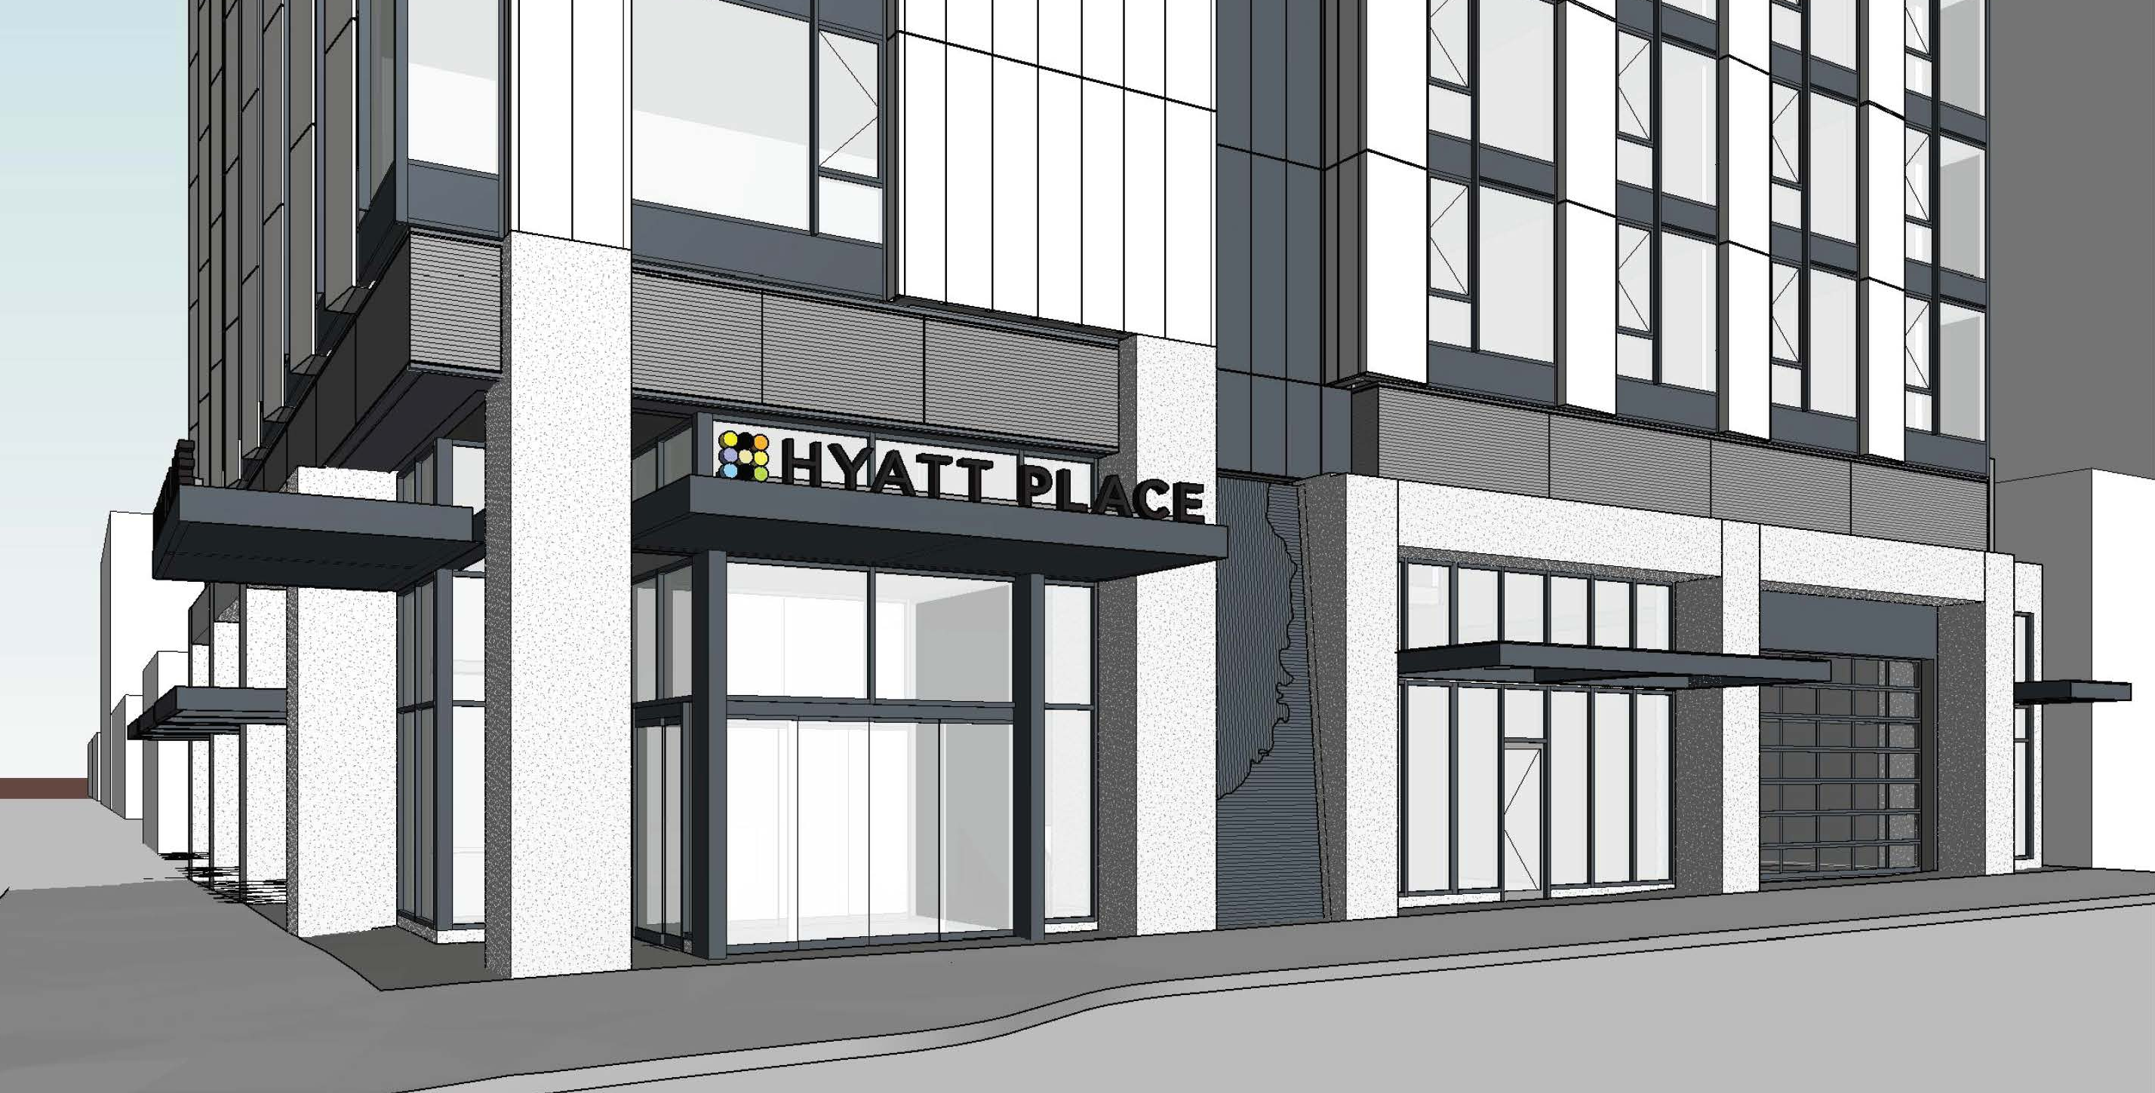
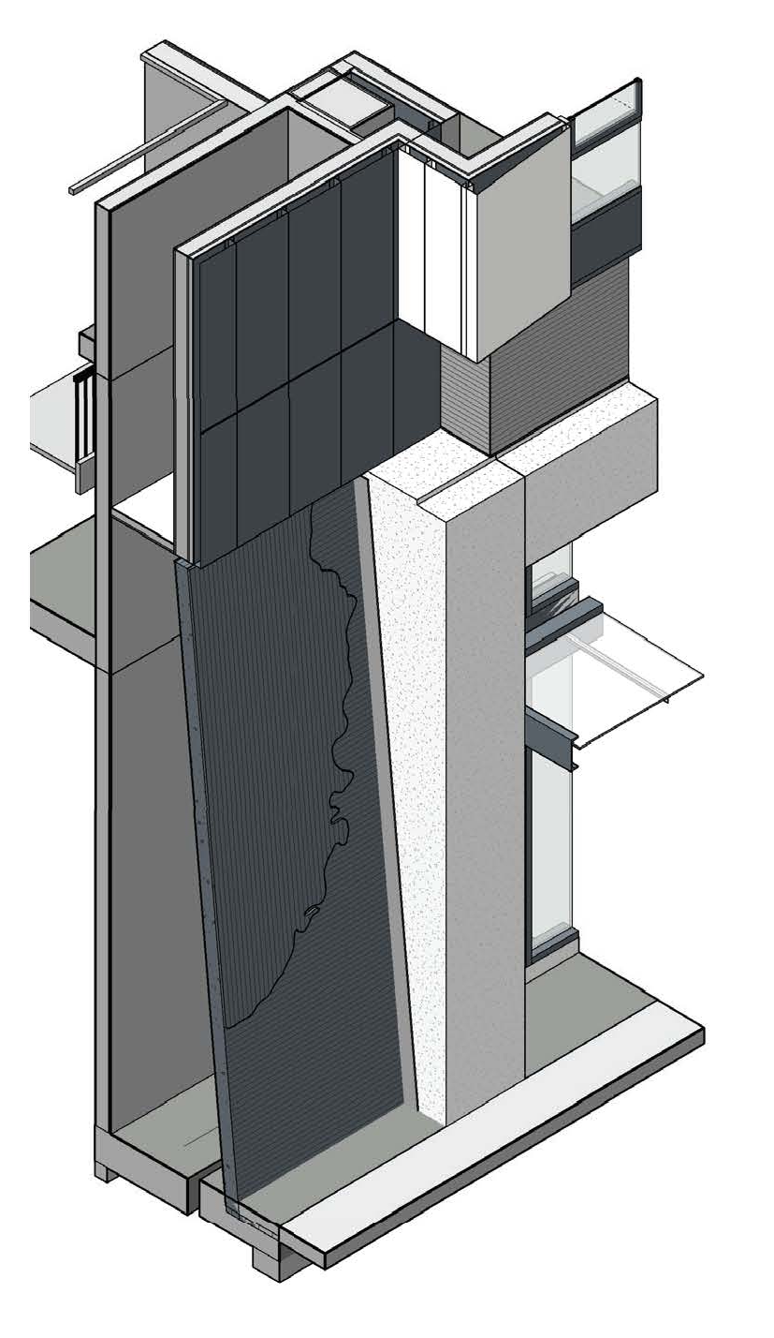
1. Guidelines A2, A5-3 and A5-4
2. Guideline C8, C9 and C9-1
3. Guideline C2, C4 and C5
4. Guideline C12
A2 - Emphasize Portland Themes, A5-3 Incorporate Water Features, A5-4 Integrate Works of Art
Feature intends to be meet multiple Guidelines yet lacks cohesiveness in integration with the building.
Location and size of feature is unresolved.

Slide 30
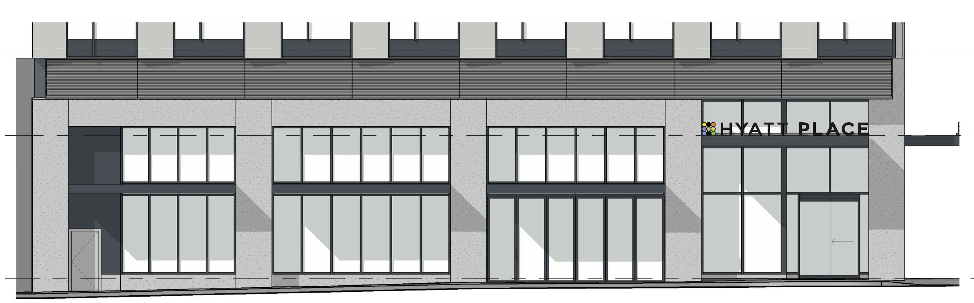
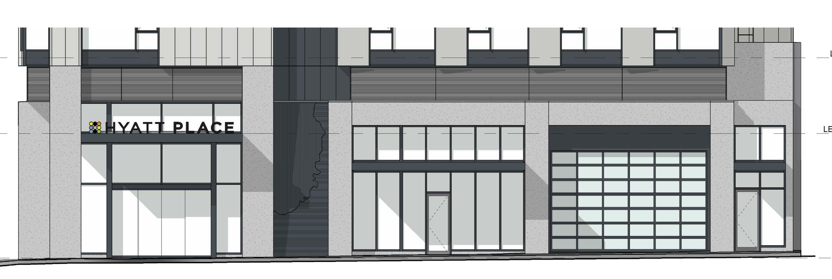
Context
1. Guidelines A2, A5-3 and A5-4
2. Guideline C8, C9 and C9-1
3. Guideline C2, C4 and C5
4. Guideline C12
North
West
C8 - Differentiate the Sidewalk Level of Buildings, C9 - Develop Flexible Sidewalk Level Spaces, C9-1 - Reduce the Impact of Residential Unit Garages on Pedestrians
Base of the tower lacks coherency with the body of the tower.
The north and west elevations (street facing) lack coherency and continuity regarding canopies, storefront systems, bay widths, material hierarchy

Slide 31
Context
1. Guidelines A2, A5-3 and A5-4
2. Guideline C8, C9 and C9-1
3. Guideline C2, C4 and C5
4. Guideline C12
West
North
South
East
C2 - Promote Permanence & Quality in Design, C4 - Complement the Context of Existing Buildings, C5 - Design for Coherency
The concept is not entirely coherent regarding the base, middle and top of the tower.
The proposed base was to be drawing from the district but needs further refinement to meet this guideline.

Slide 32
Context
1. Guidelines A2, A5-3 and A5-4
2. Guideline C8, C9 and C9-1
3. Guideline C2, C4 and C5
4. Guideline C12
C12 - Integrate Exterior Lighting
The lighting scheme is not completely identified.

Slide 33
Staff Recommendations
Staff recommends denial
Denial of Design review
Approval of Modification

Slide 34
Staff Presentation
Applicant Presentation
Staff Recommendations
Public Testimony
Applicant Response to Public Testimony
Commission Discussion

Slide 35
Staff Presentation
Applicant Presentation
Staff Recommendations
Public Testimony
Applicant Response to Public Testimony
Commission Discussion

Slide 36
Next steps
Design Commission Options
Accept staff report and deny the proposal;
Reject staff report and ask staff to return with a report recommending approval; or,
Request the applicant to return with revisions.

Slide 37
Questions

