Slide 1

Portland City Council
Type III Land Use Appeal
Staff Presentation of the
Hearings Officer Decision
Land Use Review LU 18-190331 CU
Everett House Conditional Use

Slide 2
Summary of the Proposal
Everett House Community Healing Center (Everett House) sought to eliminate 1982 condition of approval to provide off-street parking;
Staff recommended conditional approval, with clean-up of unenforceable and vague language from CU 26-82, as discussed with the applicant at the Pre-Application Conference;
Extensive testimony and evidence provided to the Hearings Officer at and following the public hearing led to denial of the application due to the intensity and type of uses occurring at the site, and lack of evidence in the record for uses and transportation impacts; and
Applicant has appealed to City Council to reconsider.

Slide 3
Zoning
R5 base zone
(Single-Family Residential 5,000)
Conditional Uses
(allow institutional uses that maintain and don’t conflict with “residential appearance and function of the area”, ensure availability of public services, conformance with adopted zoning and area plans)
Approval Criteria
33.815.105.A-E, Institutional and Other Uses in R Zones
Statewide Planning Goals
“Residential area” for this review outlined in purple

Slide 4
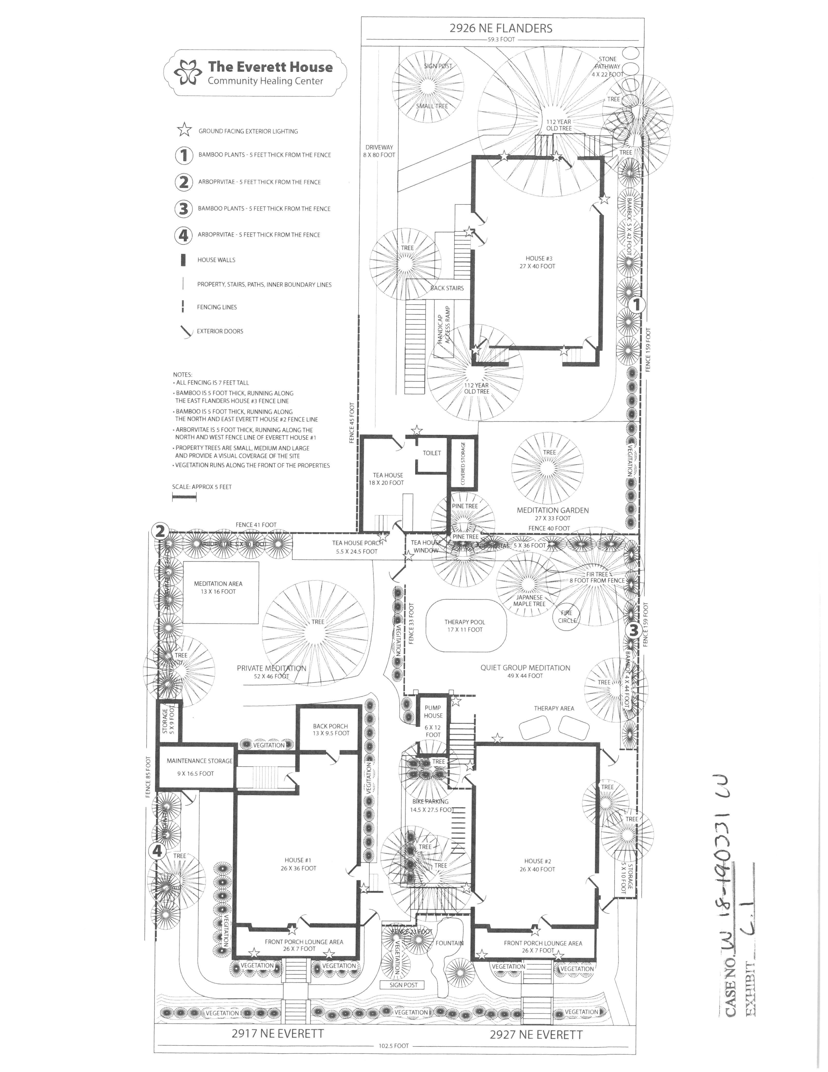
Exhibit C.1, Site Plan

Slide 5
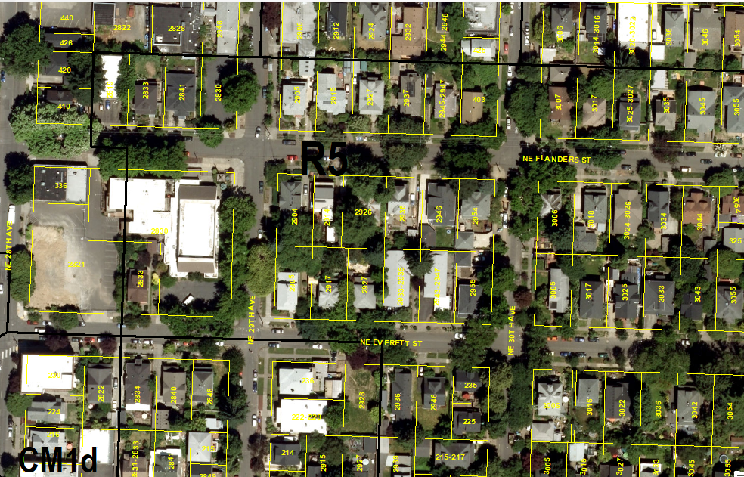
Aerial Photo

Slide 6
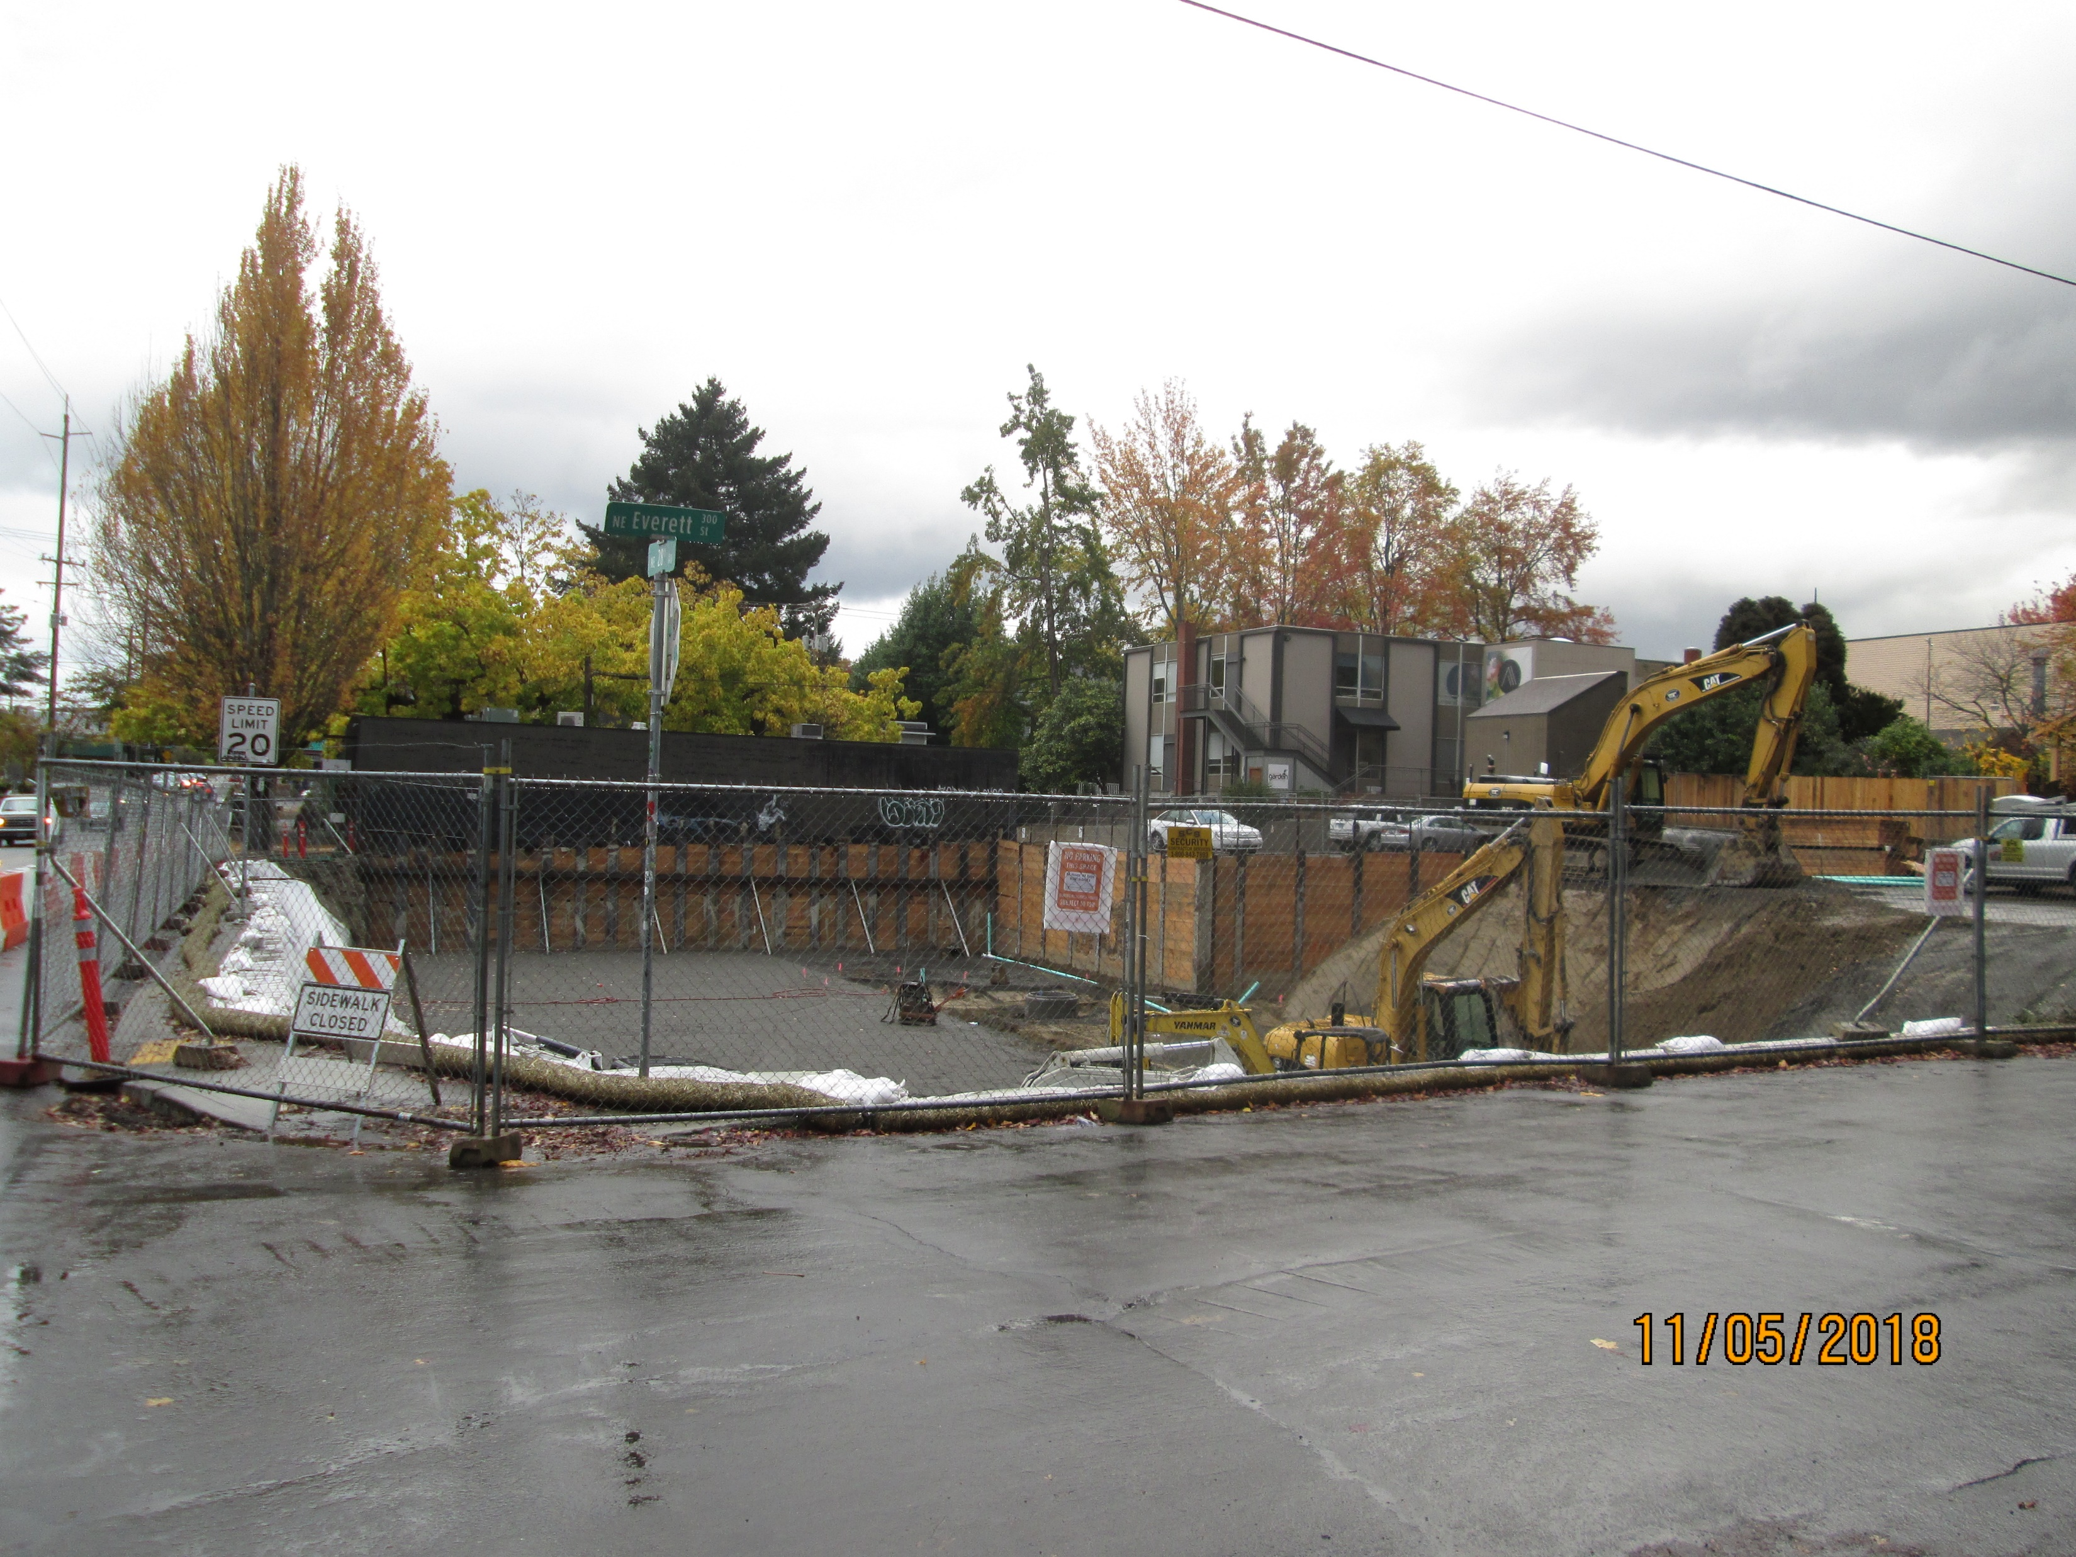

Slide 7
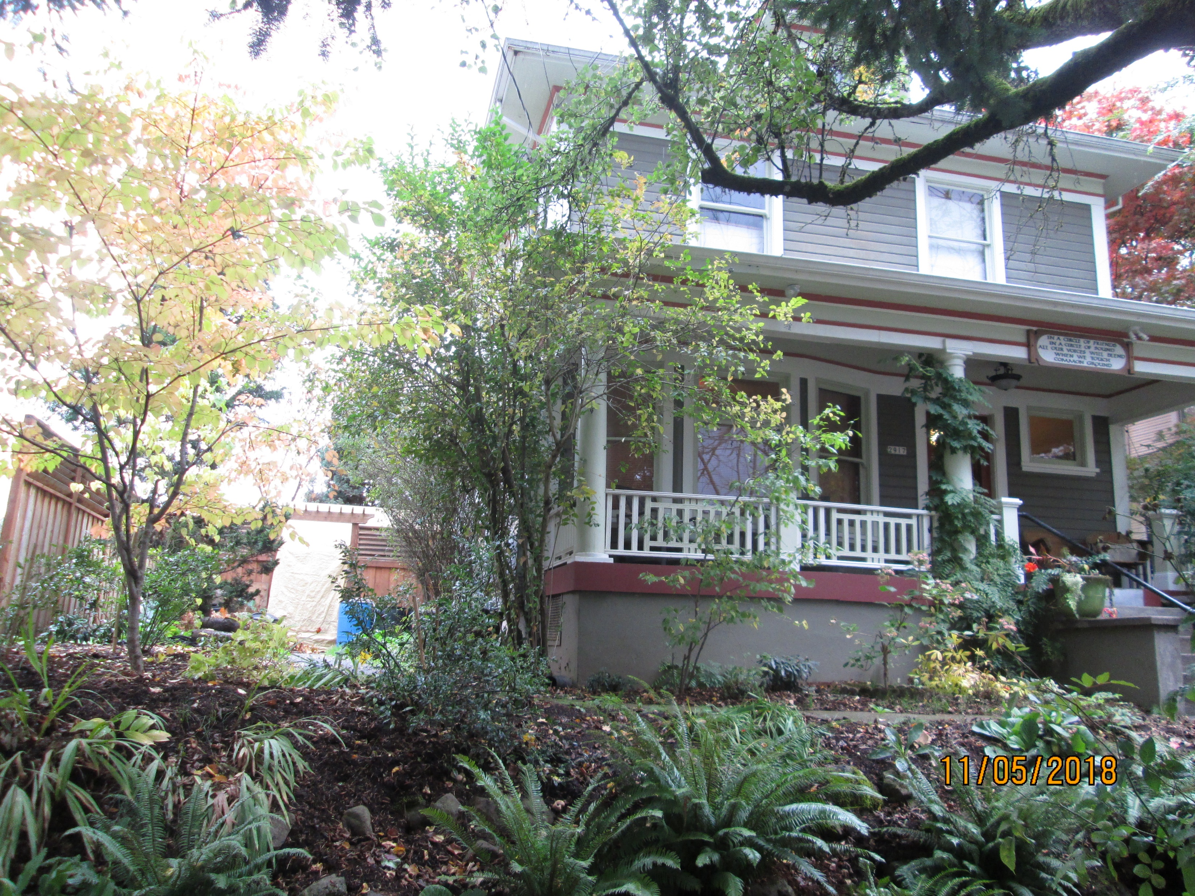

Slide 8
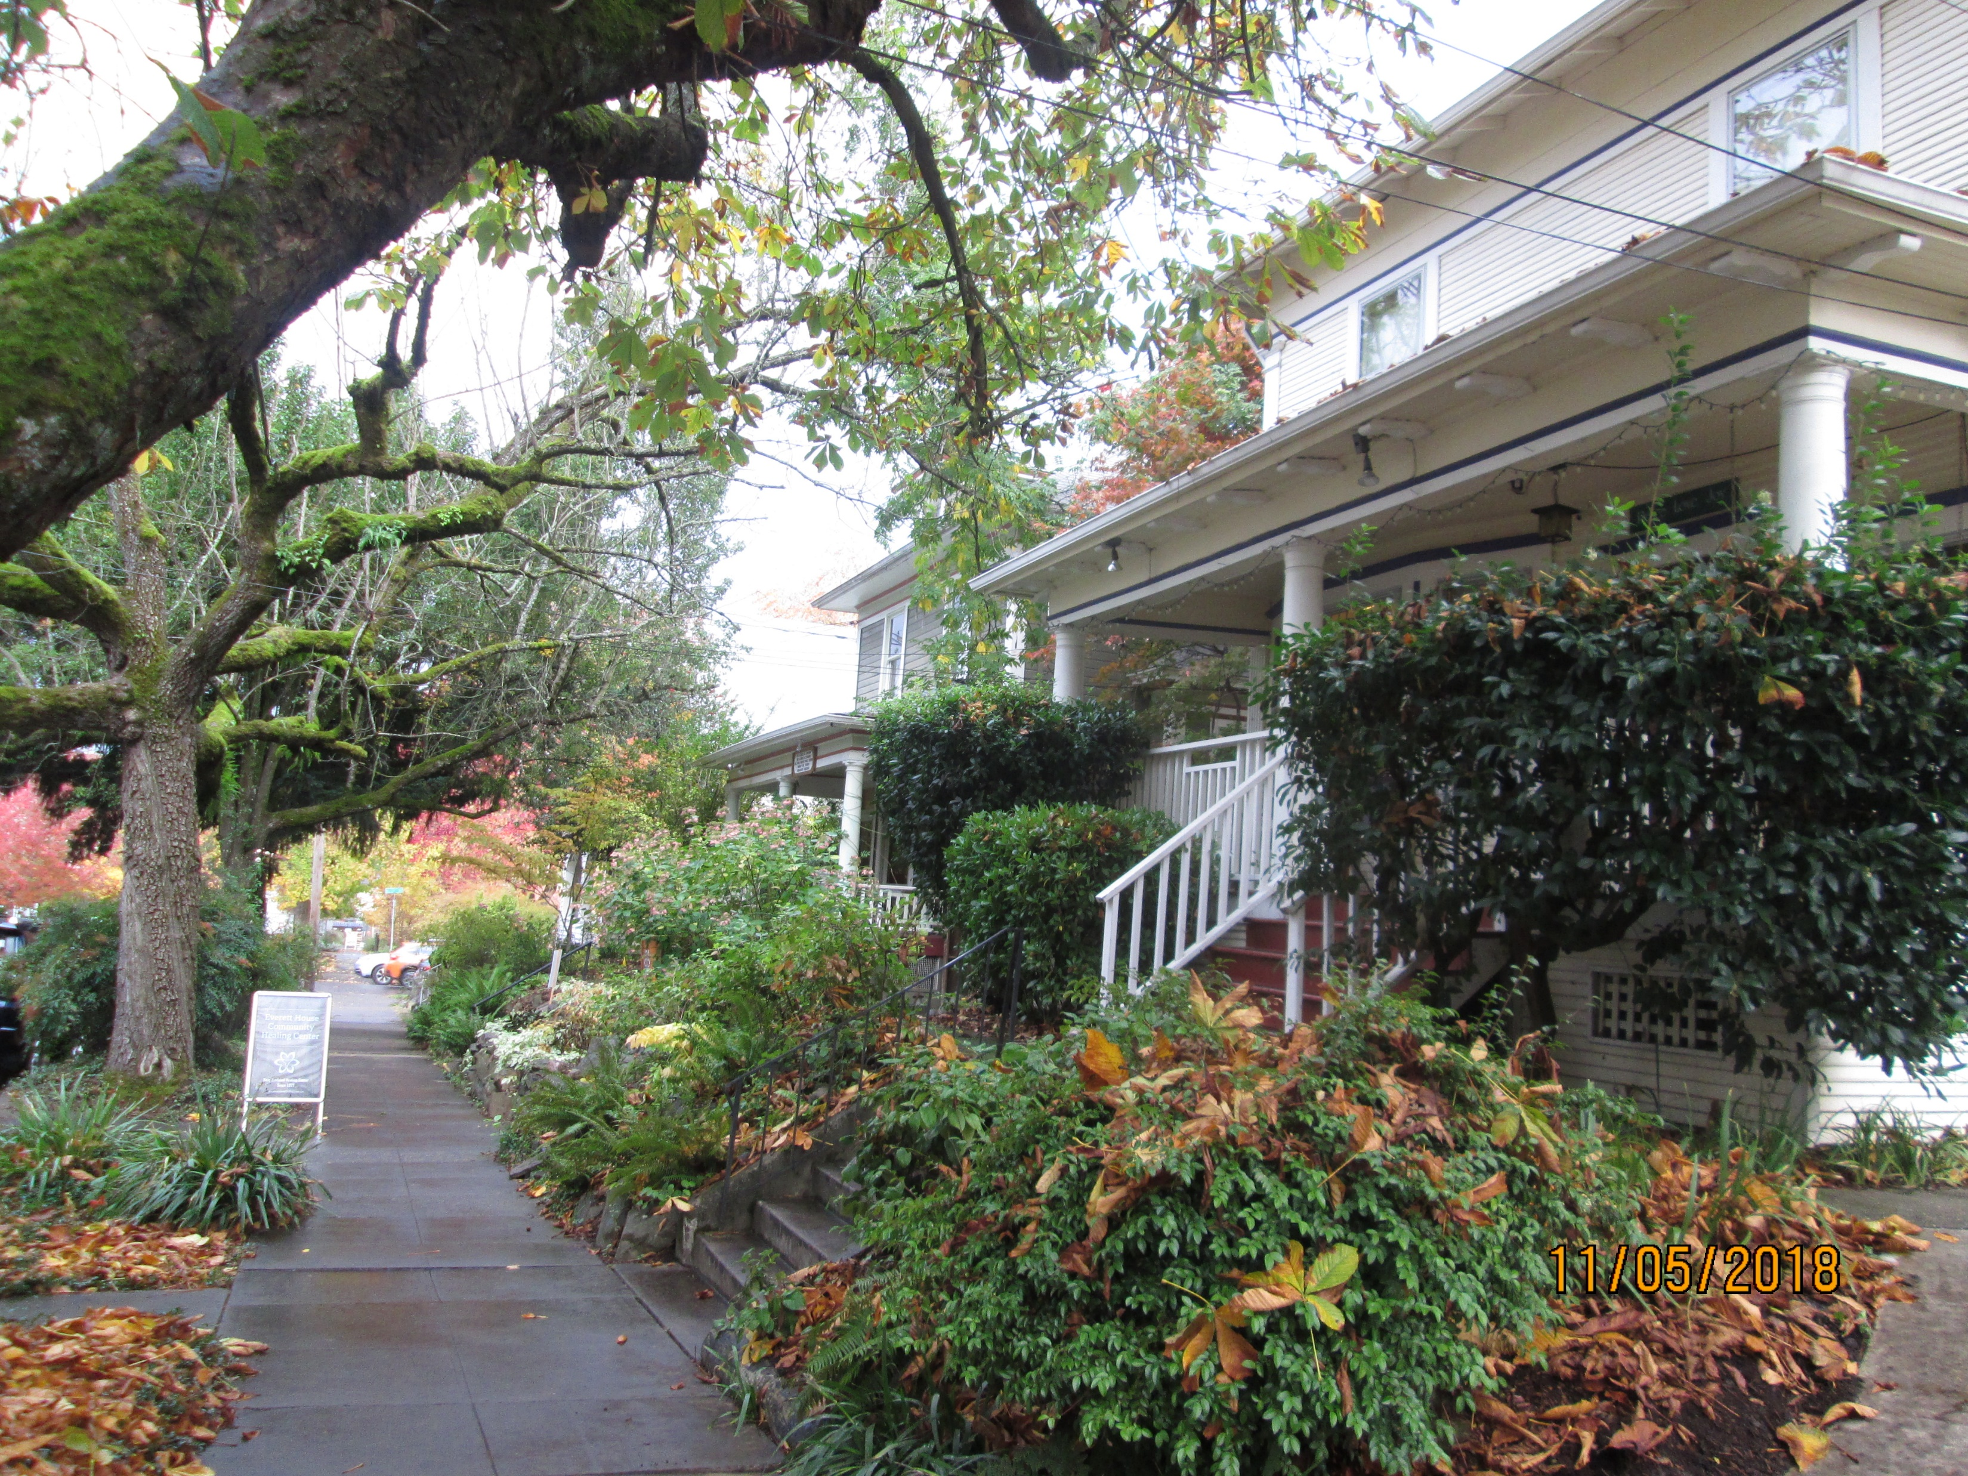

Slide 9
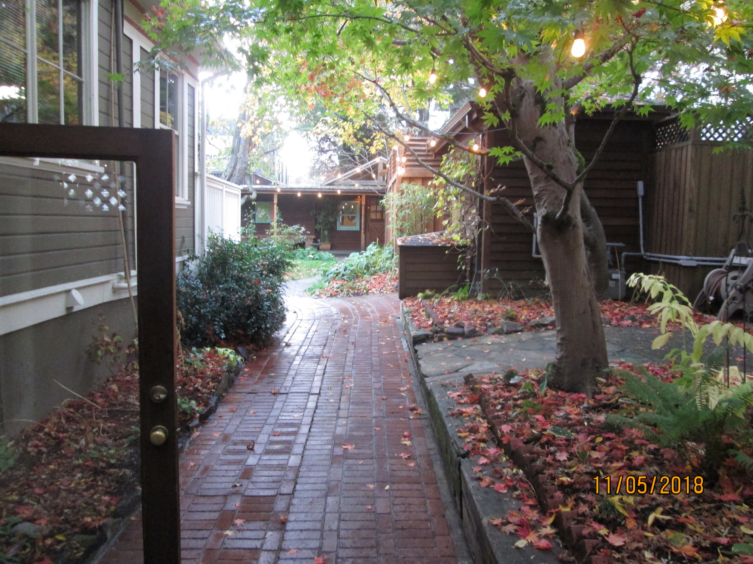

Slide 10
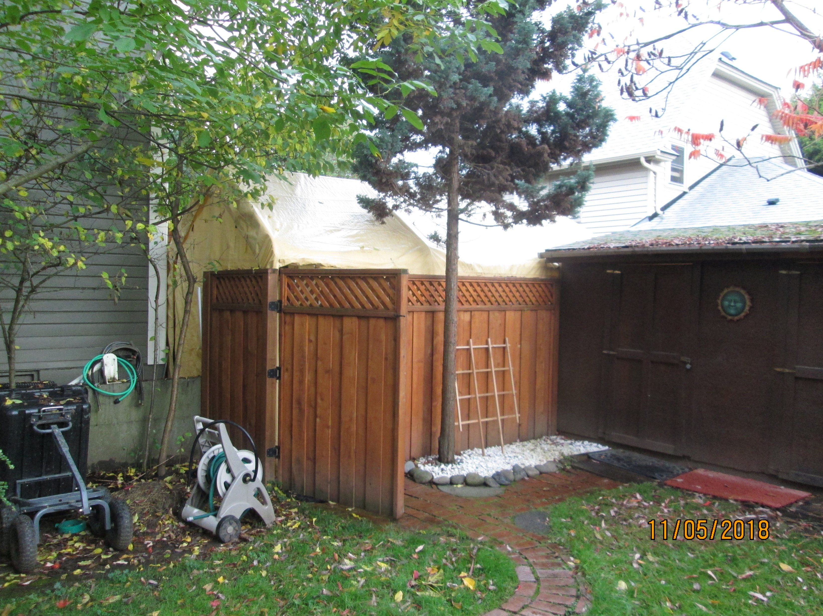

Slide 11
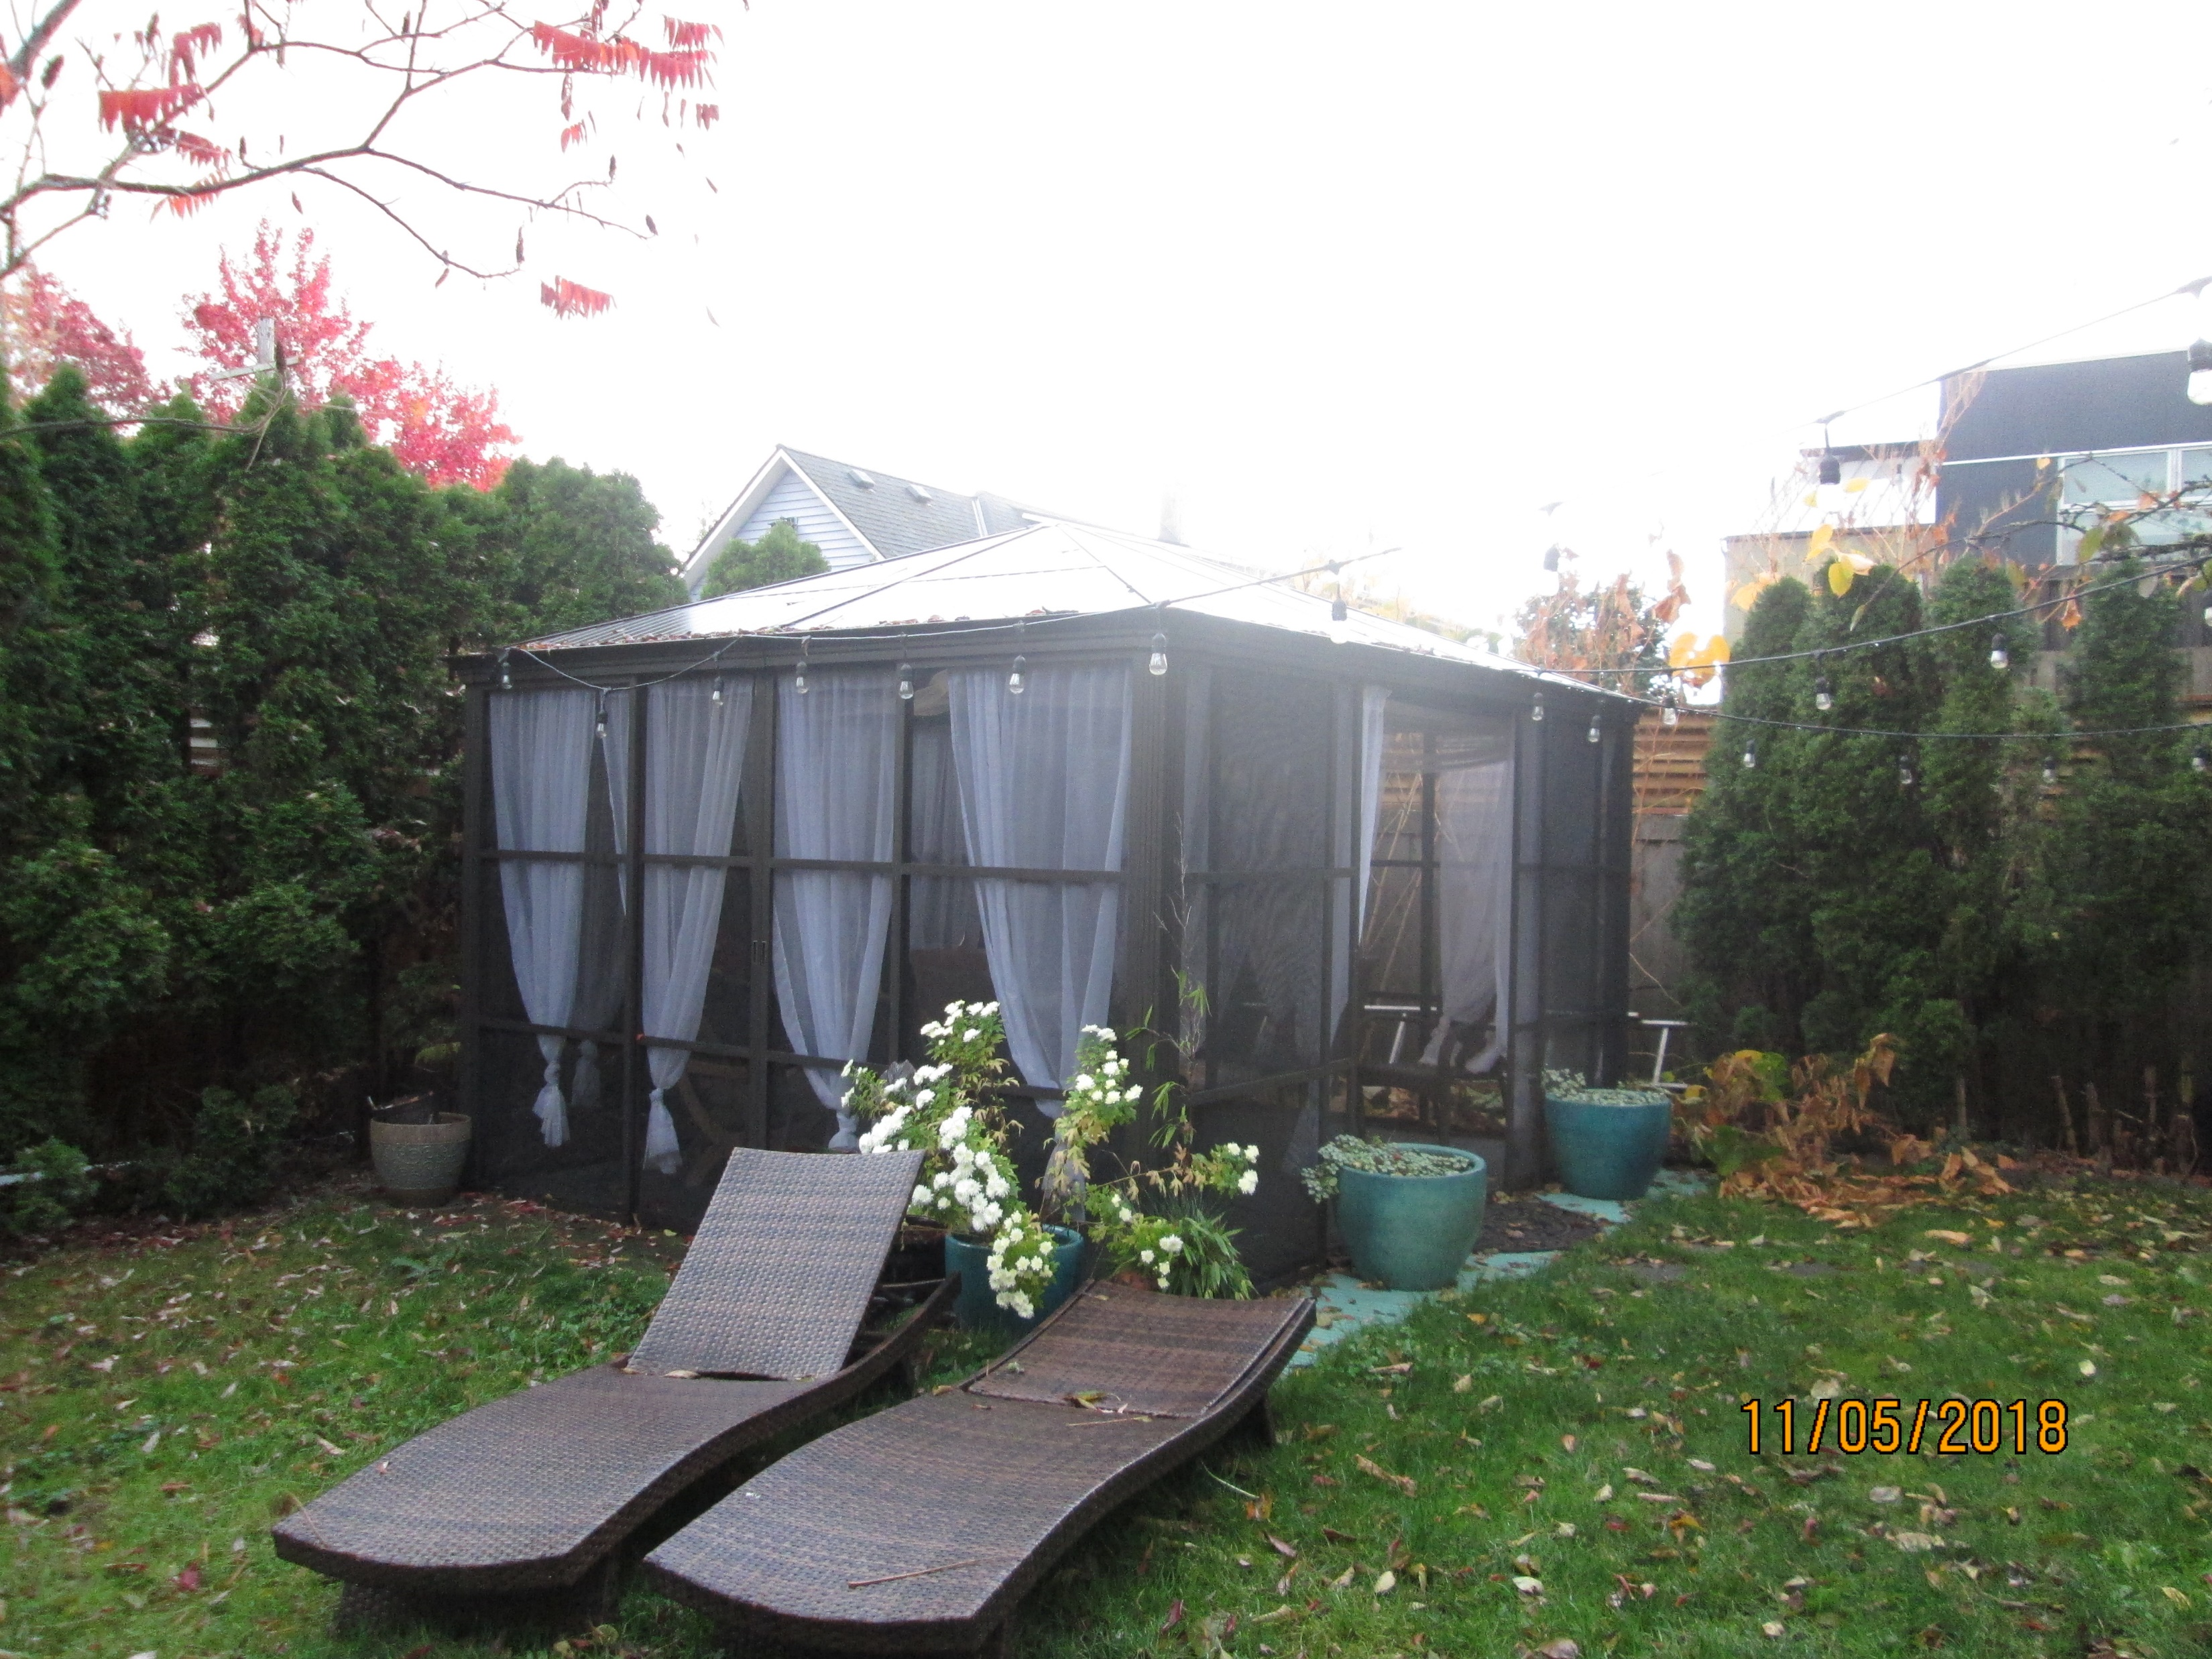

Slide 12
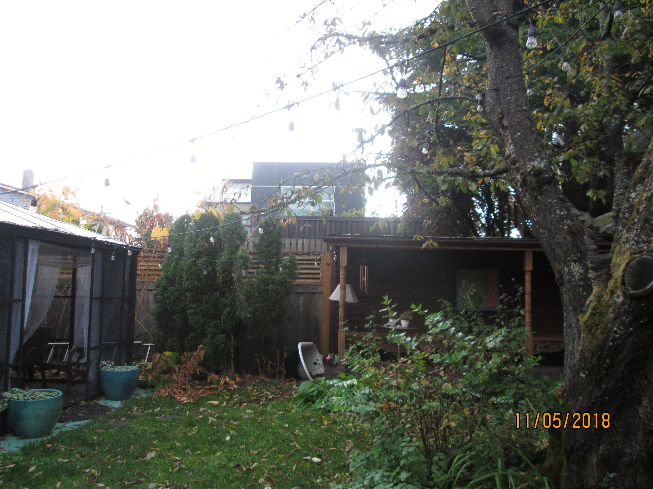

Slide 13
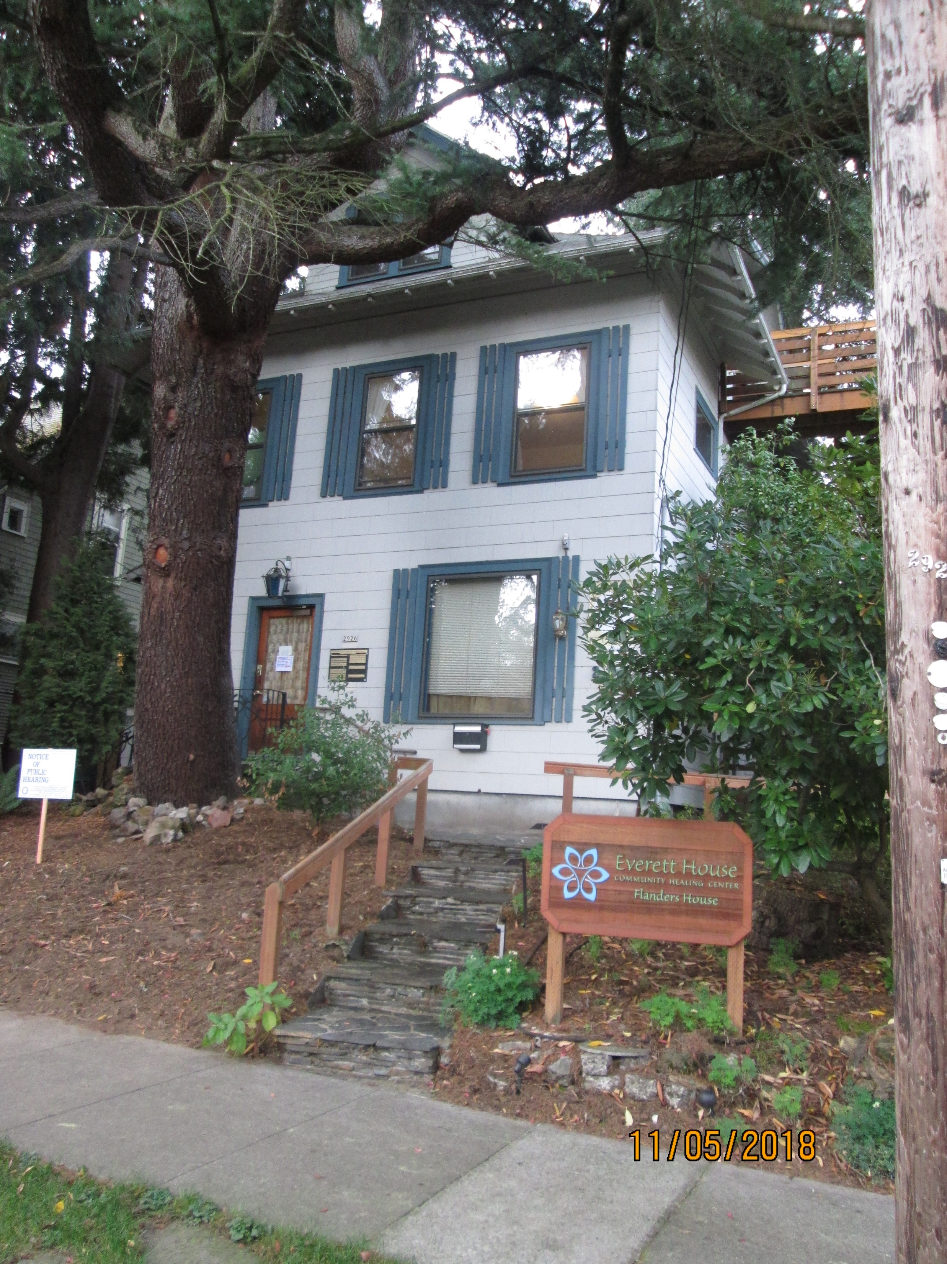

Slide 14
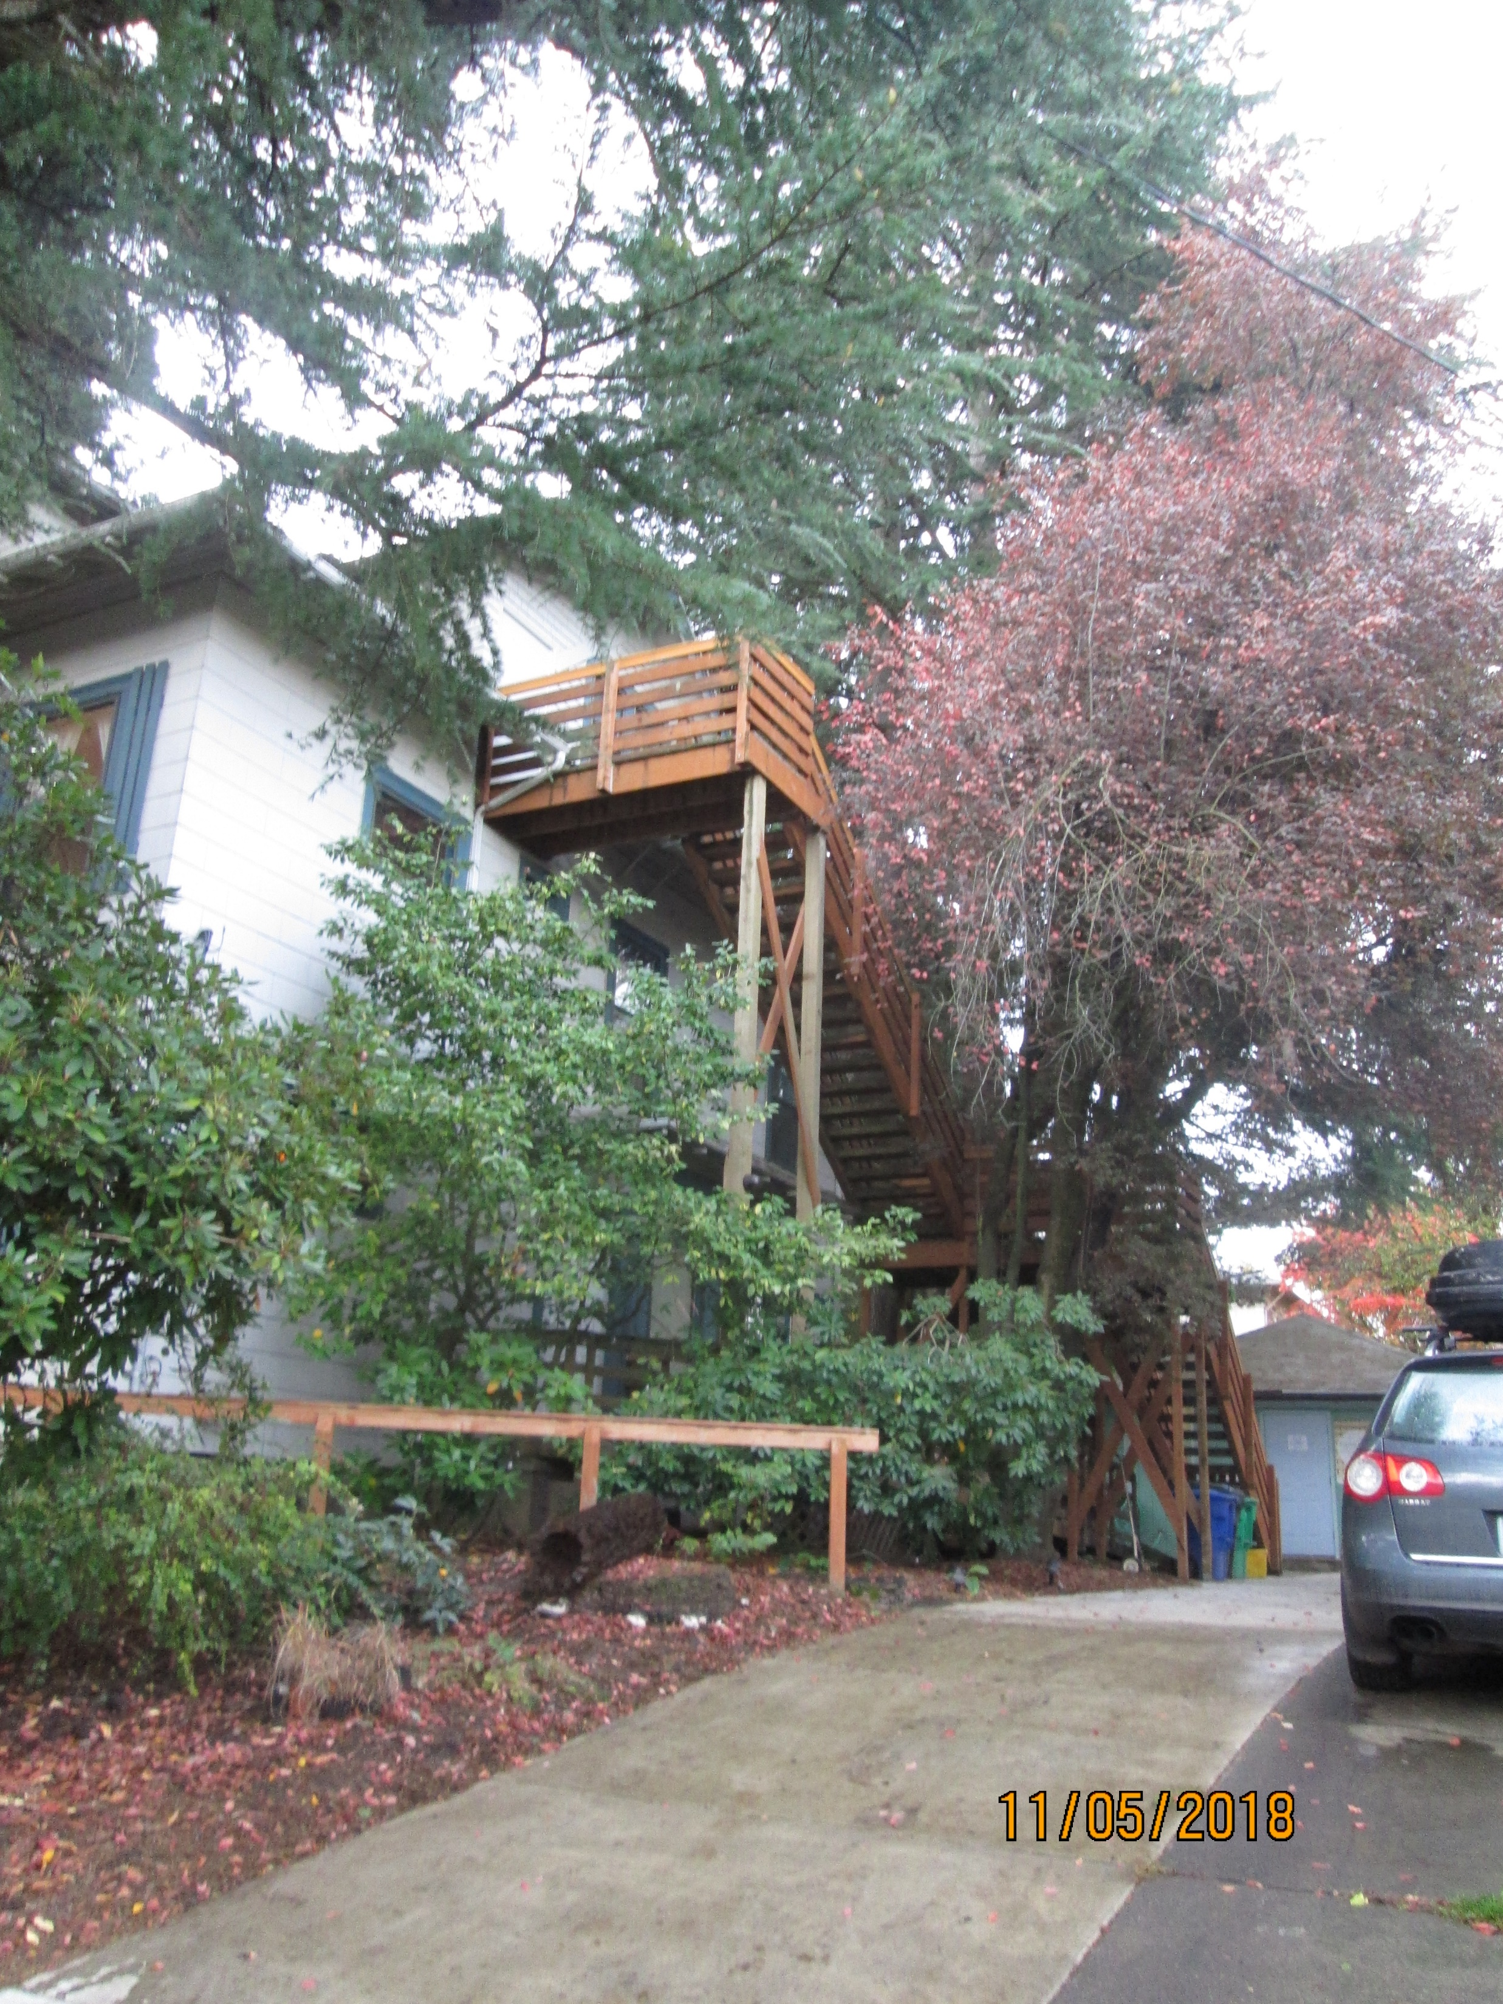

Slide 15
Brief Use History
(1980) David Slawson home occupation permit for massage and hot tub use;
(1981) Increased clientele and staff leads to first conditional use case CU 32-81, approved with conditions limiting use to 15 guests, requiring 20 off-street parking spaces, 10 bike spaces, adherence to Noise Ordinance, subsidized transit passes for employees, and “no new construction shall take place”;
(1982) Renewal of conditional use request via CU 26-82 for “permanent conditional use approval to continue sauna, hot-tub and massage therapy services” and also “relaxation and health counseling and a ‘tea house’ food service”, and including a request that “limitations to the number of people servable per hour be omitted”.

Slide 16
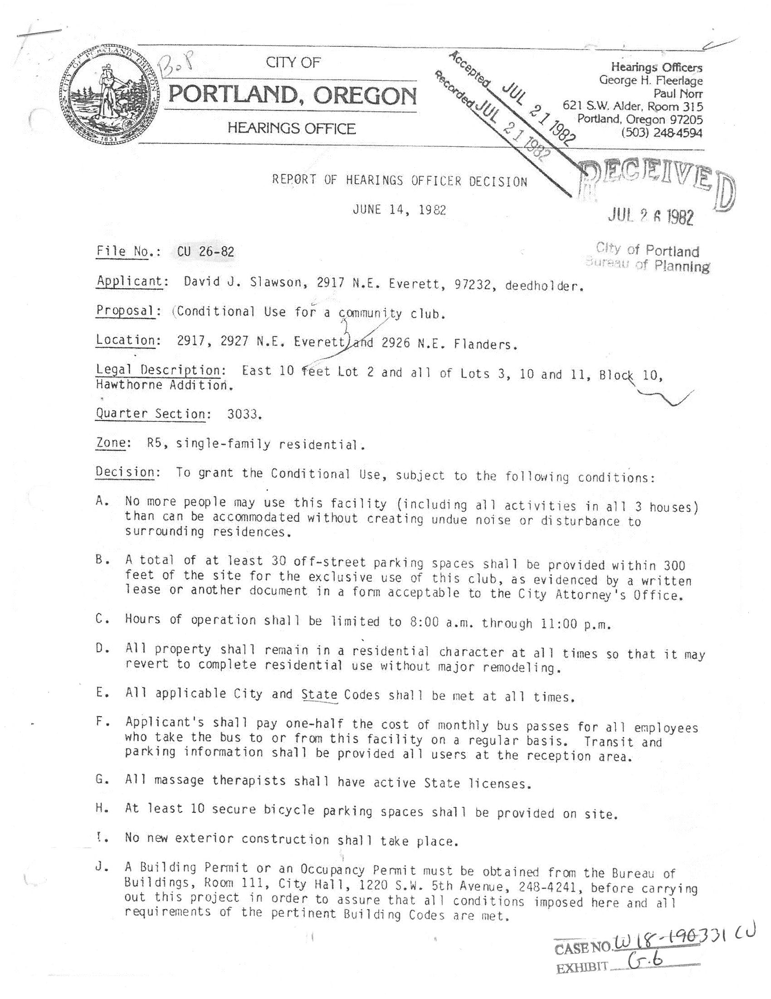
Brief Use History, cont’d.
(1982) CU 26-82 Hearings Officer approved the request and included conditions A through J. For limitations on the intensity of the use, the following conditions were imposed:
  A. “No more people may use this facility (including all activities in all 3 houses) than can be accommodated without creating undue noise or disturbance to surrounding residences”;
  C. “Hours of operation shall be limited to 8:00am to 11:00pm”; and
  I. “No new exterior construction shall take place”.

Slide 17
Staff Report/Recommendation
Proposal as reviewed was for no changes to the use, but only to remove parking. Only letters of support prior to hearing.
Staff recommended conditional approval, with no analysis done of any increase or changes to the intensity of activity at the site over time. Conditions of approval included the following:
Standard case number listing on future permits;
Temporary “maintenance/storage” and “meditation area” structures must be removed. “Storage 5 x 9 foot” structure may remain;
Maintenance and repair of existing structures allowed, except removal of two under condition B. Expansions in the future trigger a Type II (≤10% increase) or Type III (>10% increase) conditional use review;
Title 18 noise impacts, code references, and complaint protocol for neighborhood noise concerns;
Clarification of deleted and continuing conditions from CU 26-82.
Out-dated conditions (massage licensure, city and state codes, 1982 occupancy permit issuance) were deleted.

Slide 18
Public Hearing (11/26/18)
Staff and three representatives from the applicant testified.
21 supporters testified. 6 in opposition testified. Record held open for new information and rebuttal after hearing.
SUPPORTERS of the proposal – Summary of Comments:
Use provides valuable health services, classes, seminars, etc.;
Noise controlled with quiet hours and staff patrols;
Many clients walk, bike or take transit;
Discounts offered for not arriving by car;
Space hosts organizations and groups who could not find a home elsewhere, often for free, very welcome/opening;
Parking lot was rarely used, on-street parking is available;
Facility should not be punished for business growth on 28th/Burnside, or apartments built by-right with no parking; and
Facility has deep community ties, provides a peaceful oasis in town.

Slide 19
Public Hearing, cont’d.
OPPONENTS of the proposal – Summary of Comments:
Use has expanded over the years, has a commercial character;
Noise and late hours detract from the residential character of the area, and evening hours should be reduced/eliminated;
Parking availability and traffic safety concerns;
Activity exceeds that of a community center, and functions more like a medical office, which is prohibited in R zones;
Original conditions of approval preventing new construction ignored;
Parking study did not evaluate all the uses operating at the site;
Facility lost their non-profit status in the past, corrected after Code Compliance action in 2007 led to renewed non-profit status; and
Don’t want to “close it down”, but scale of activity should be reduced.

Slide 20
Hearings Officer Record
Extensive information provided during open record period:
Additional letters of support and concern;
Evidence about the variety, intensity and scope of activities at the site from internet sources, Groupon activity, and other information;
Information documenting the various code complaints and enforcement activity at the site over the years (new hot tub, structures and fencing built, loss of non-profit status, noise);
Supplemental traffic analysis and data from the applicant’s traffic engineer, Mike Ard;
Prior 1987 and 1997 City of Portland staff memos about the use;
Supplemental use information with intensity/occupancy numbers from the applicant; and
Clarifying memos from BDS and Portland Transportation staff.

Slide 21
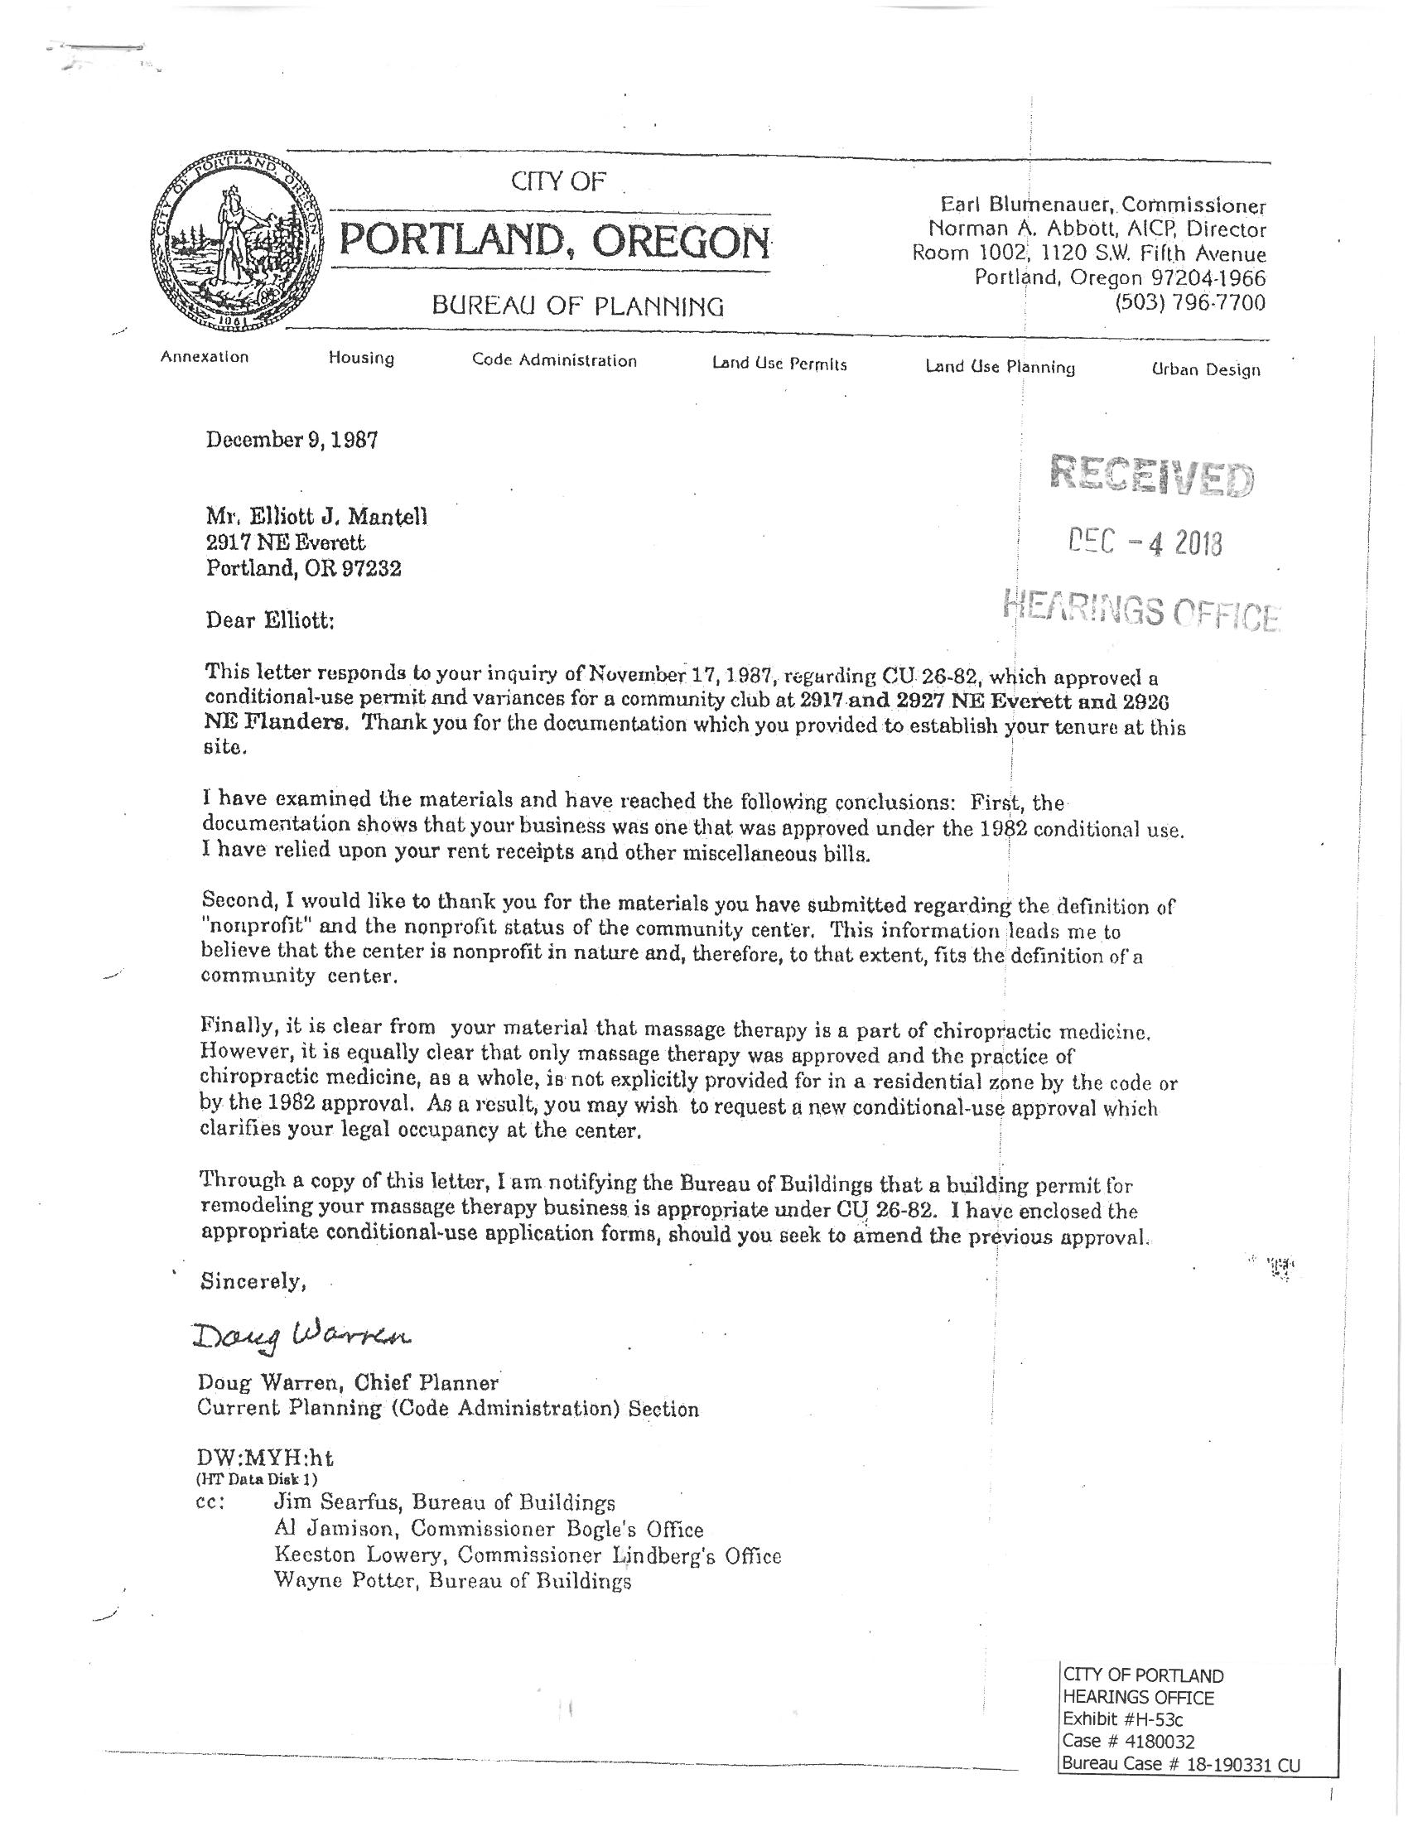
1987 Planner Memo
1987 Memo from BOP Planner Doug Warren to Elliott Mantell
Response to request to evaluate information and classify use, in order to obtain remodeling permit
“Finally, it is clear from your material that massage therapy is part of chiropractic medicine. However, it is equally clear that only massage therapy was approved and the practice of chiropractic medicine, as a whole, is not explicitly provided for in a residential zone by the code or by the 1982 approval”.

Slide 22
Hearings Officer Findings
33.815.105.A.2 Overall residential appearance/scale of the area, “based on the intensity and scale of the proposed use and of existing Household Living uses and other uses”
Clear and detailed description of all uses is required to evaluate the proposal;
CU 26-82 establishes the allowed scope of uses, still applies and includes sauna, hot tub and massage therapy services, relaxation and health counseling for individuals and small groups, ‘tea house’ food service);
No evidence or specific detail was provided by the applicant to regarding how expanded activities at the site since 1982 would impact the overall residential character (12 Special events, chiropractic services/office use, acupuncture services, yoga offerings, hydrotherapy services, flotation tank services, classes/seminars/workshops for 15-18 persons not related to relaxation and health counseling services);

Slide 23
Hearings Officer Findings, cont’d.
33.815.105.A.2 - intensity and scale, cont’d.
Applicant’s proposed occupancy of 65 persons is over 4 times as many people as allowed under CU 32-81 (15 persons);
Special Events for 95 persons is over 6 times as many as were allowed under CU 32-81 (15 persons);
1982 approval eliminated numerical limits, but important for context;
If uses were unaltered from 1982, request could have been approved;
No substantial evidence in the record describing increased uses, scale of uses, intensity of uses and impacts on surrounding R-zoned area;
Because neighborhood impact evidence not provided for expanded uses, this criterion is not met.
33.815.105.D.2 – Transportation System Capacity & SWPG Goal 12
Traffic study covered both original and “expanded uses”, but 12 annual Special Events for up to 95 people are on the “expanded” list and were not addressed; and
Lack of evidence regarding proposed Special Events = criterion not met.

Slide 24
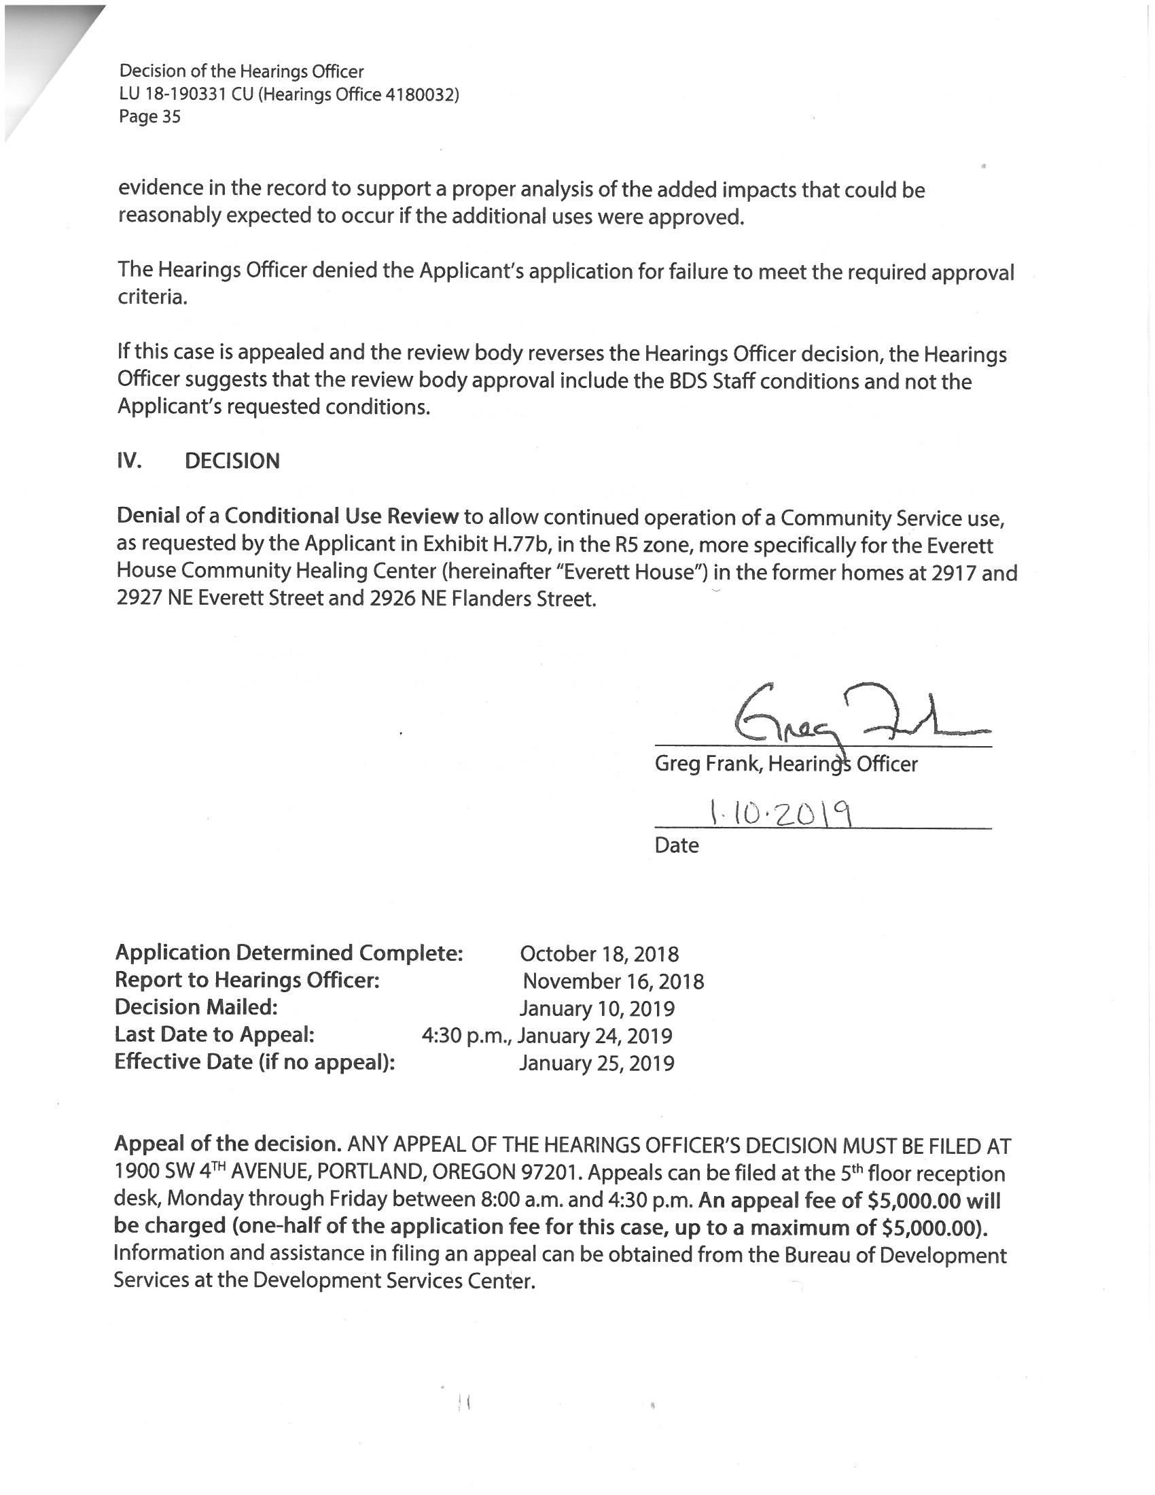
Hearings Officer Decision
Insufficient evidence in the record to assess whether chiropractic, acupuncture, yoga, hydrotherapy, flotation tanks, Special Events, and classes/seminars/workshops for 15-18 persons not related to relaxation and health counseling would lessen the overall residential appearance and function of the area;
Impacts of expanded list of uses are not in the record;
Because the intensity/scale and transportation-related criteria are not met, the request must be denied; and
If appeal reverses this decision, Hearings Officer suggests that Council include the staff-recommended conditions (remove two buildings, future CU triggers, Noise complaint process, etc.) and not those requested by the applicant.

Slide 25
Council Appeal Issues
On-the-Record Appeal (no new information or issues allowed)
120-day expires October 17, 2019.
Uses Allowed
H.O. Yes allowed – sauna, hot tub, massage therapy, relaxation and health counseling for individuals and small groups, and ‘tea house’ food service; and
H.O. Not allowed - 12 Special events/year for 95 persons, chiropractic services, acupuncture services, yoga offerings, hydrotherapy services, flotation tank services, classes/seminars/workshops for 15-18 persons not related to relaxation and health counseling services.
Waiving parking, in light of uses being approved (H.O. – no Special Events)
Keeping two temporary buildings (H.O. – demo buildings per staff condition B).

Slide 26
Council Alternatives
(Deny Appeal) Accept the Hearings Officer’s recommendation, with no changes. This would deny the application, requiring the applicant to provide 30 off-street parking spaces and/or return through a subsequent land use review; OR
(Grant Appeal) Overturn the Hearings Officer’s recommendation, and grant approval of the more limited spectrum of previously-approved uses from CU 26-82 (sauna, hot tub, massage therapy, relaxation and health counseling, tea house food service), and removing the requirement for off-street parking spaces. This would allow ongoing operation with fewer allowed activities (e.g. no chiropractic, etc.); OR
(Grant Appeal, modify findings) Overturn the Hearings Officer’s recommendation, and grant approval of a modified spectrum of previously-approved uses from CU 26-82, removing the off-street parking condition and with other changes to findings or conditions of approval (e.g. allowing retention of the two buildings).

Slide 27
end

Slide 28
Exhibit C.1, Site Plan

Slide 29
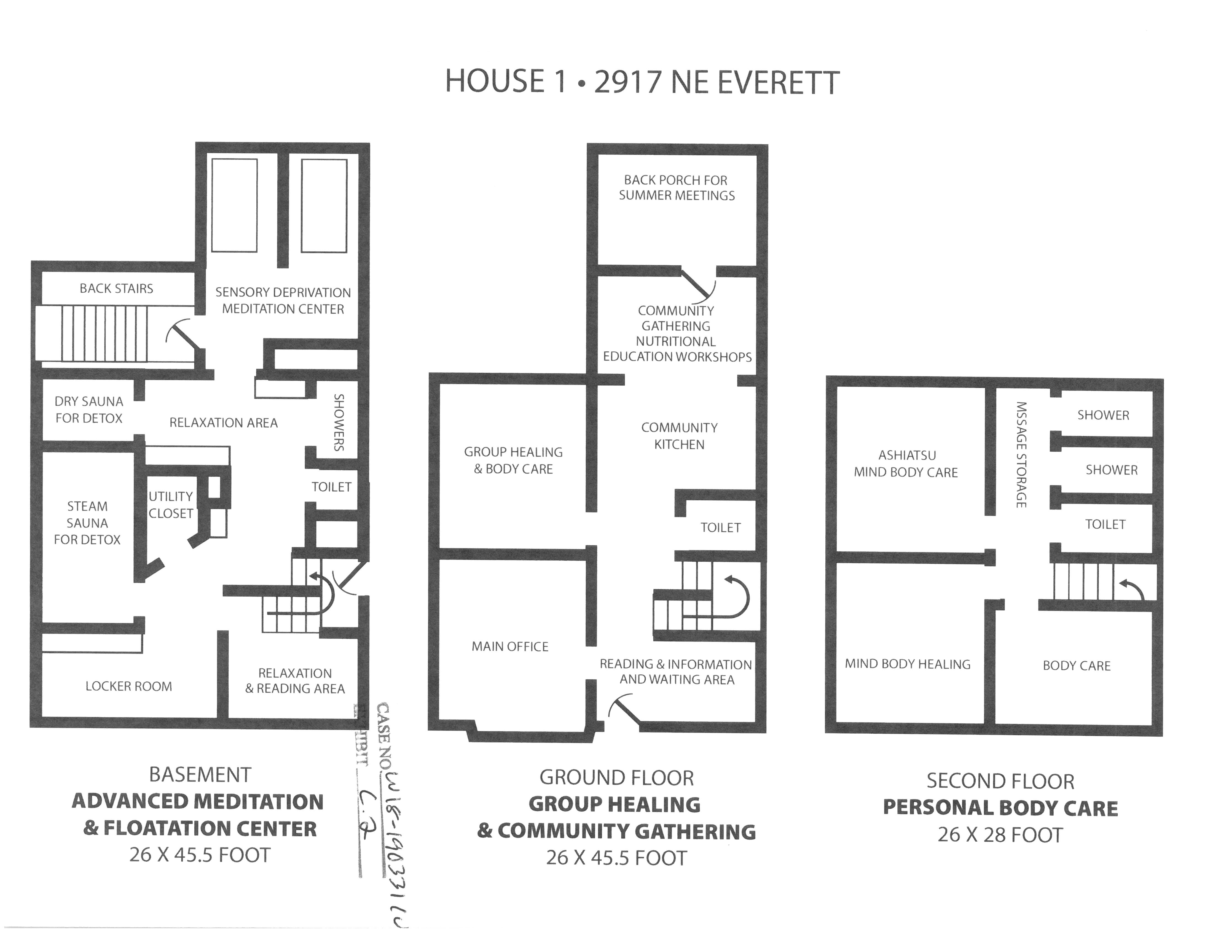
Exhibit C.2, 2917 NE Everett Floor Plans

Slide 30
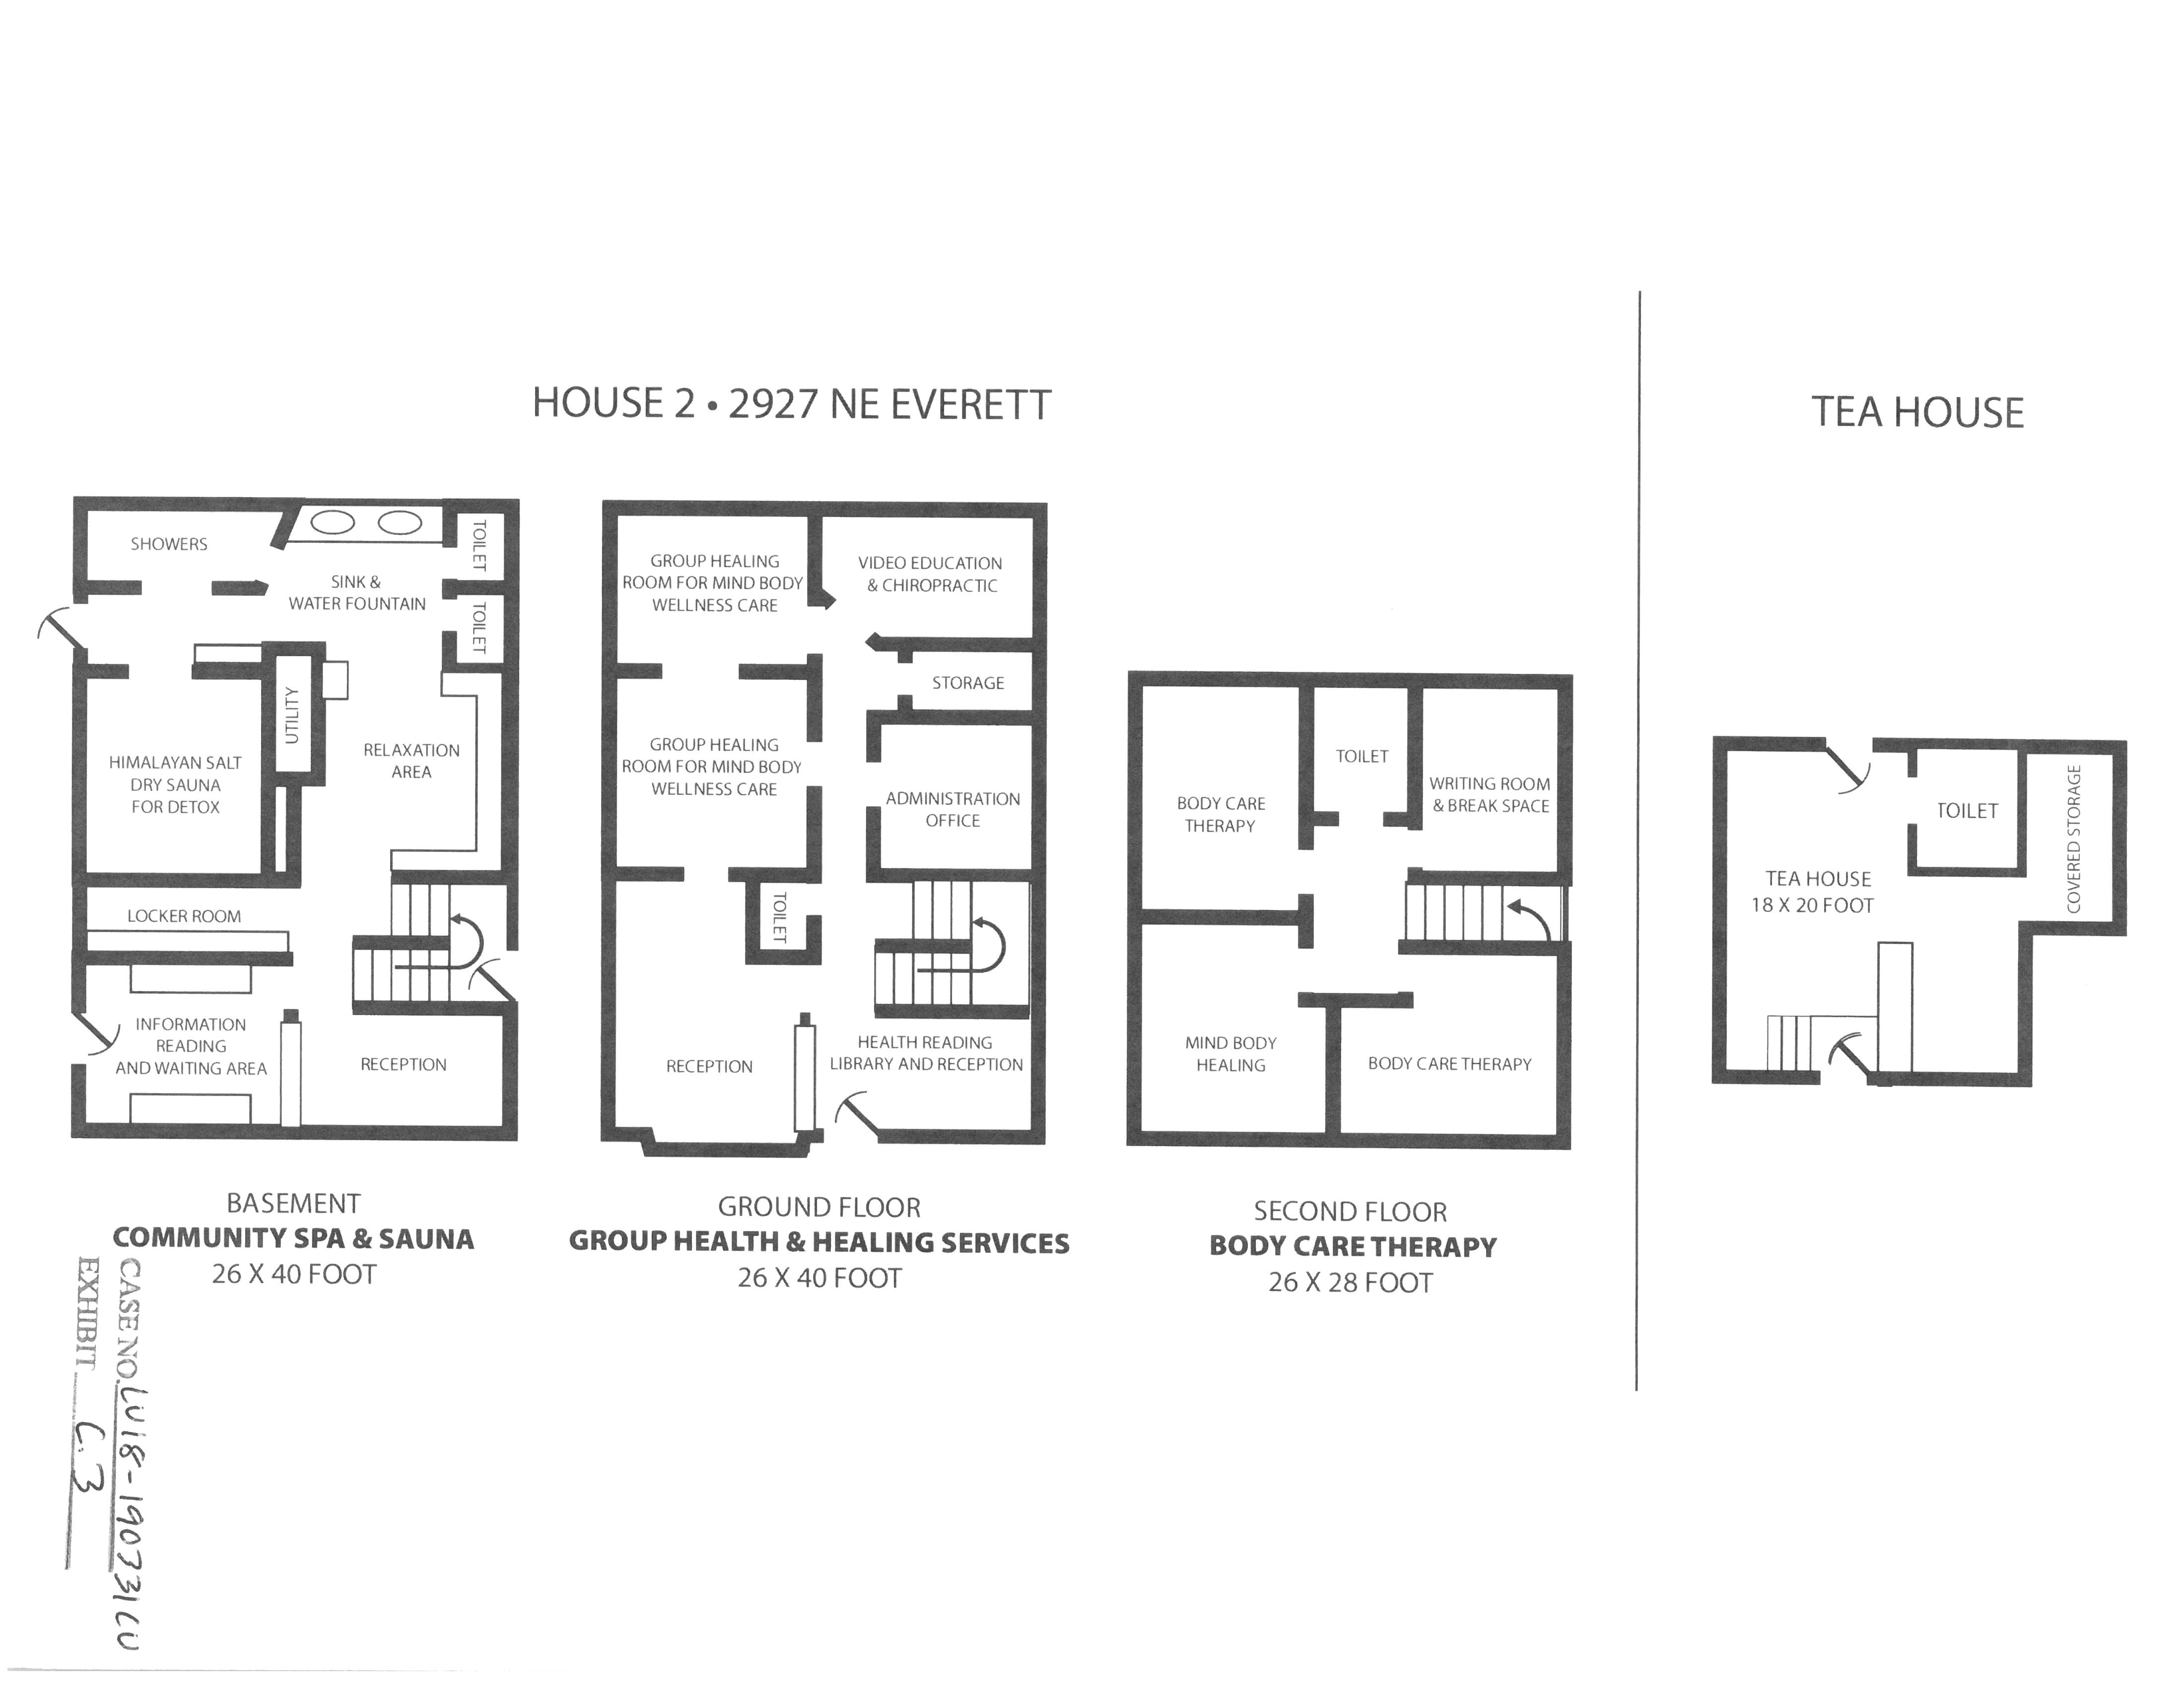
Exhibit C.3, 2927 NE Everett Floor Plans

Slide 31
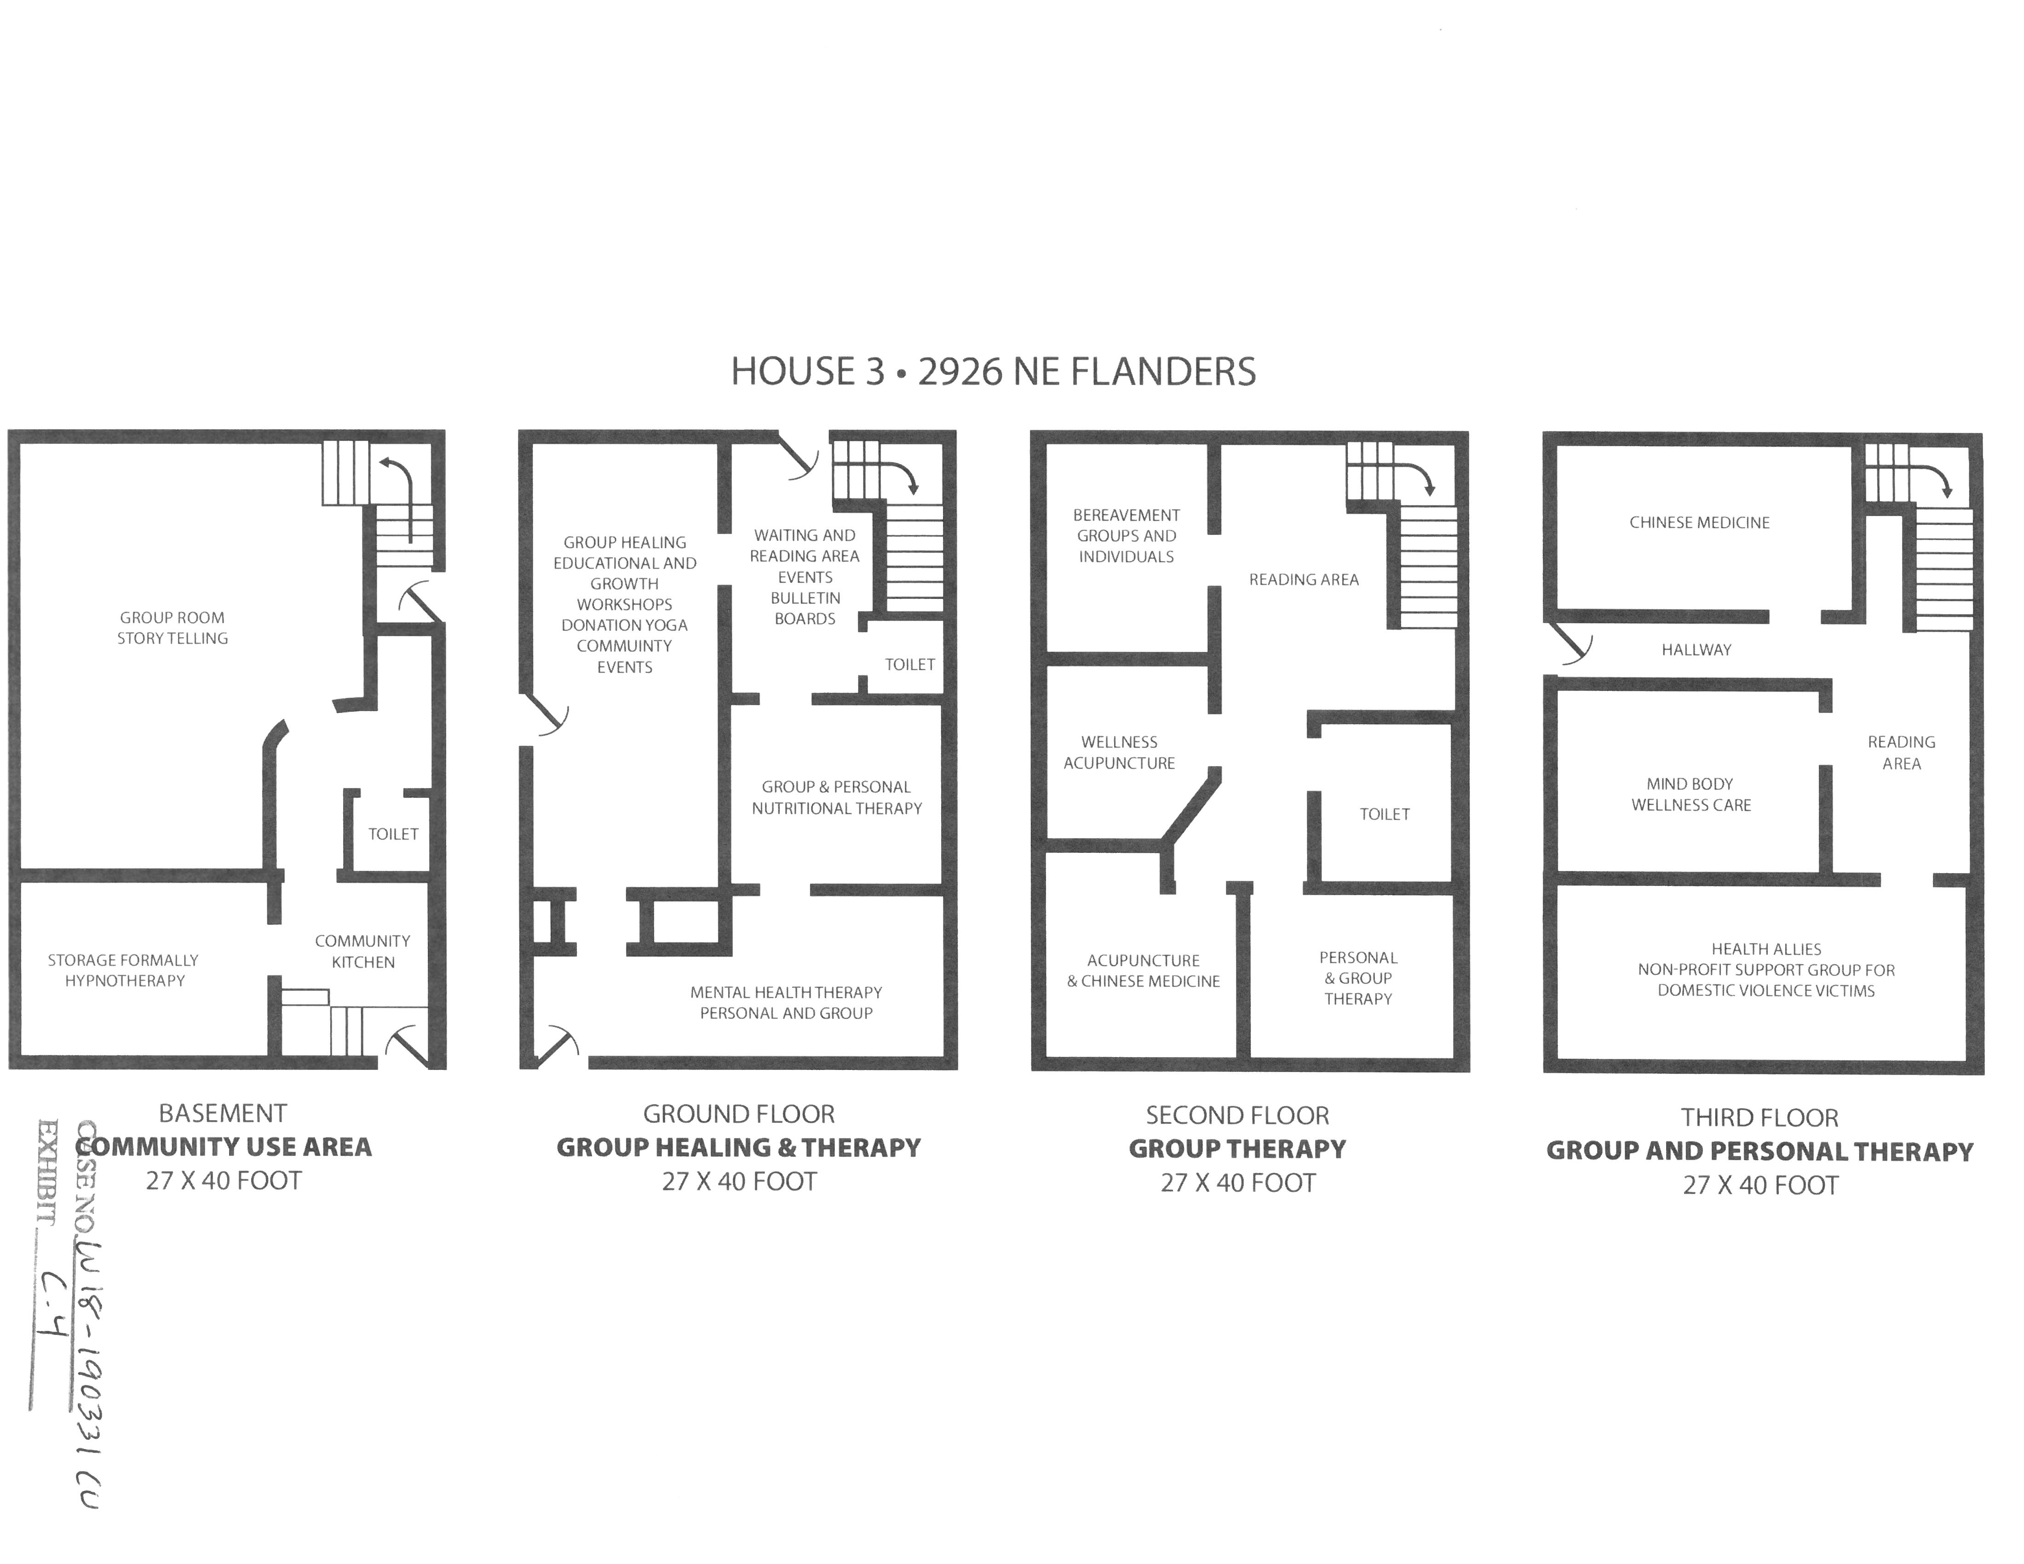
Exhibit C.4, 2926 NE Flanders Floor Plans

