Slide 1
*Accept a $6,719,840.85 grant from Oregon Department of Transportation and authorize Intergovernmental Agreement for the City of Portland Safety Projects (Ordinance)
Notes:
Thank you Mayor, Commissioners
My name is Geren Shankar
I am a project manager at the Portland Bureau of Transportation
I am hear to request authorization for an IGA with ODOT for $6,719,840.85 to construct a series of transportation safety improvements funded via the ARTS program

Slide 2
ODOT’s ARTS PROGRAM (All Roads Transportation Safety)
50% of Oregon’s Fatal and Serious Injury crashes occur on local agency roads
Notes:
The ARTS program was created…

Slide 3
ODOT’s ARTS PROGRAM GOALS
Select the best projects to reduce fatalities and serious injuries across the state
Address safety on all roads
Data-driven, regardless of road ownership

Slide 4
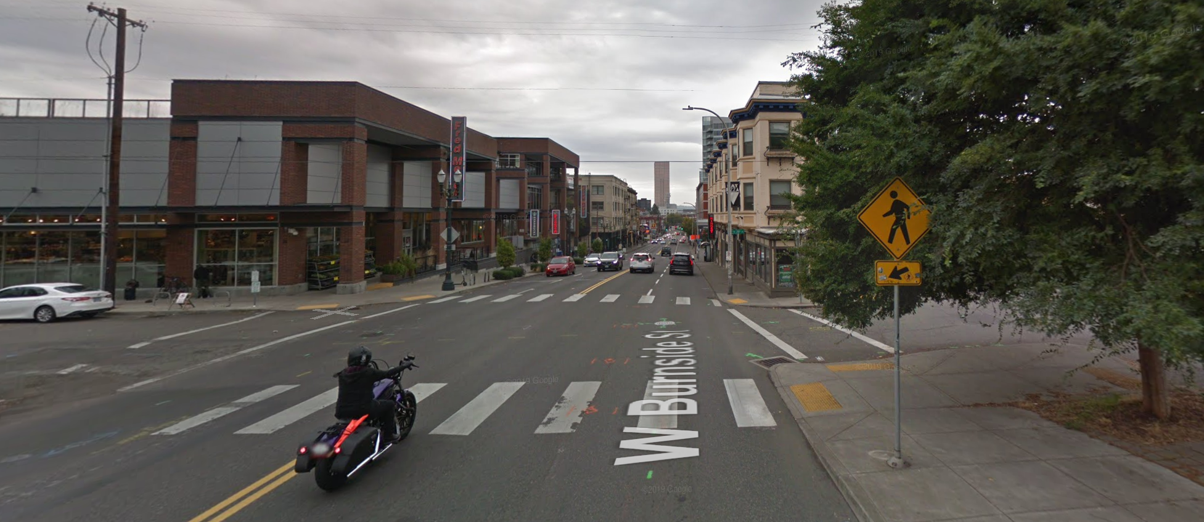
PROJECT HIGHLIGHTS
W BURNSIDE AND 20TH PLACE – Install new traffic signal

Slide 5
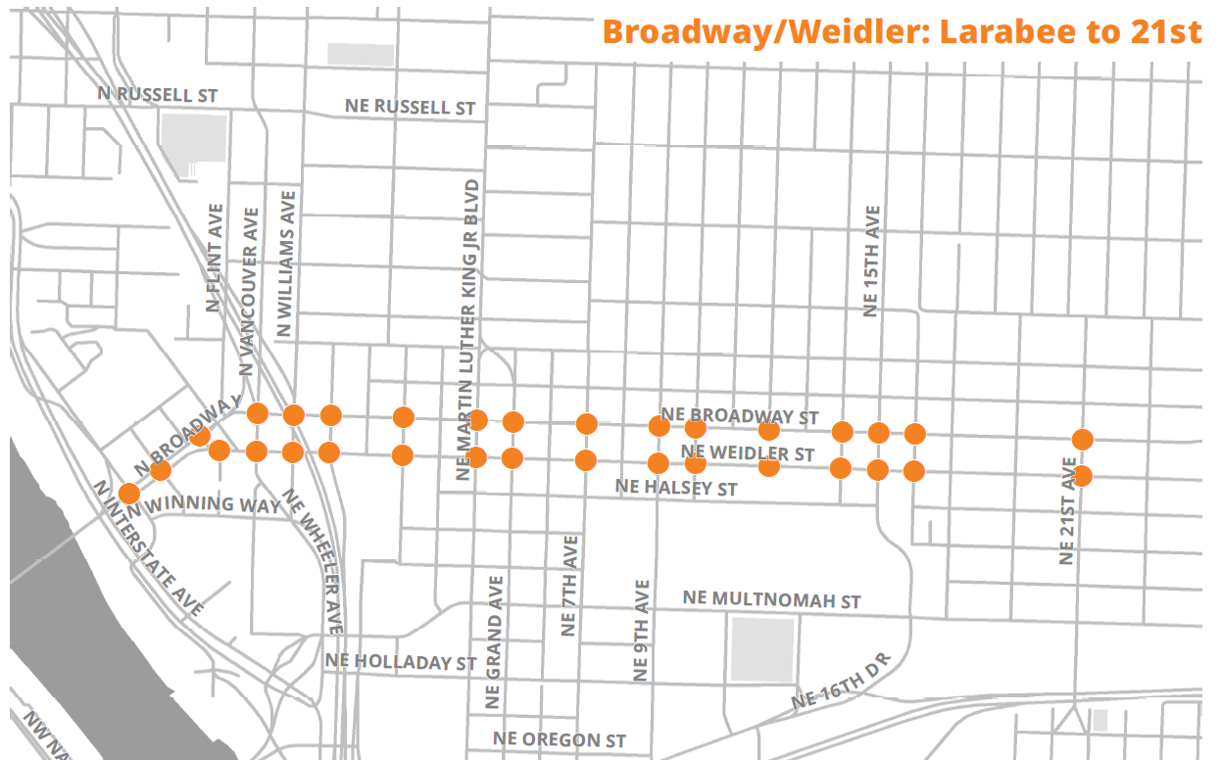
PROJECT HIGHLIGHTS
BROADWAY / WEIDLER: Install adaptive signal timing

Slide 6
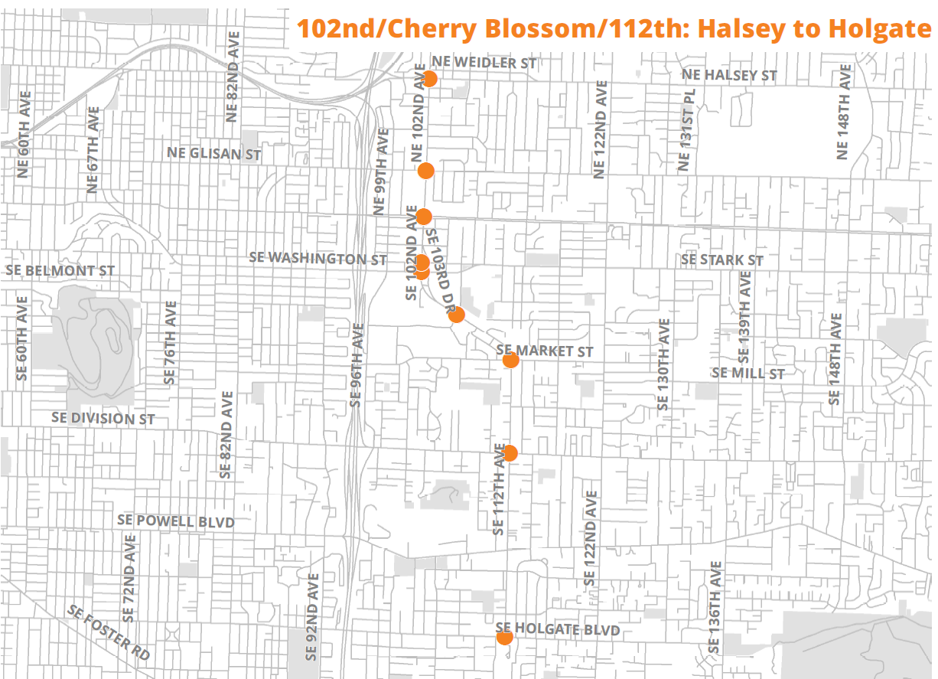
PROJECT HIGHLIGHTS
102ND, CHERRY BLOSSOM, 112TH: Install adaptative signal timing and dilemma zone protection

Slide 7
Thank you

