Slide 1
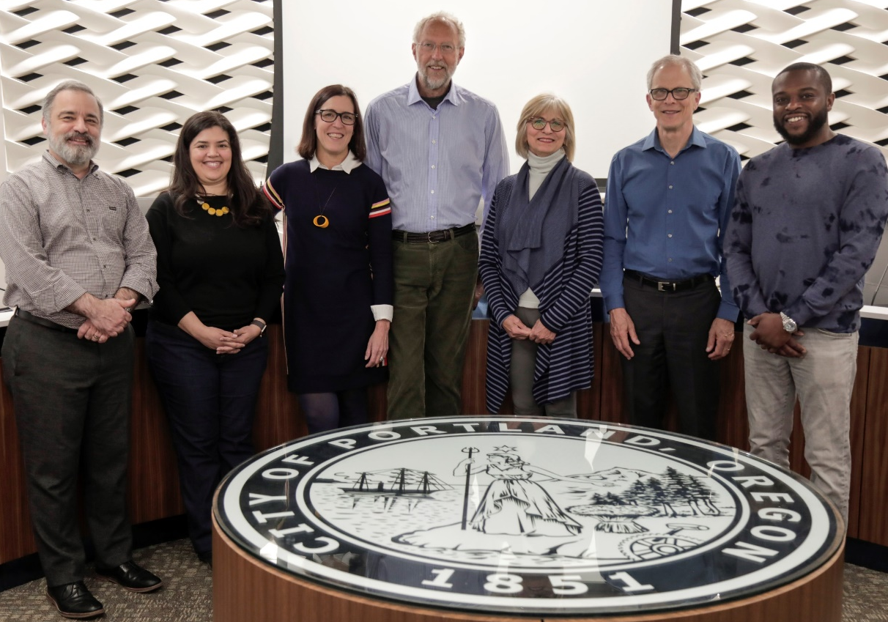
ANNUAL REPORT TO CITY COUNCIL
Sam Rodriguez, vice chair
Jessica Molinar
Julie Livingston, chair
Don Vallaster
Zari Santner
Brian McCarter
Andrew Clarke
PORTLAND DESIGN COMMISSION
MAY 1, 2019
Notes:
Good afternoon Mayor Wheeler and Commissioners Eudaly, Fritz, Hardesty, and Fish. My name is Julie Livingston and I’m the current chair of the Portland Design Commission, thank you for giving Commission the opportunity to share some of the highlights of 2018 with you today. I’m joined by Commissioners Sam Rodriguez, Jessica Molinar, Don Vallaster, Brian McCarter, and Andrew Clarke. Zari Santner is out of town but sends her regards. Also with us are Rebecca Esau, Kara Fioravanti, and Tim Heron of the Bureau of Development Services.

Slide 2
ANNUAL REPORT TO CITY COUNCIL
1. Purpose of design review
2. DOZA administrative improvements
3. Caseload data
4. 2018 overview of projects
5. 2018 Design Excellence Award
6. Testimony
PORTLAND DESIGN COMMISSION
MAY 1, 2019
Notes:
This is today’s agenda, and it looks almost identical to the agenda of our October 2018 presentation, and that’s because today is really just an end-of-year update and we’ve tried not to duplicate anything you saw in October.
So this is a modest presentation, I plan to keep my presentation to 20 minutes or fewer. We’ll then have testimony from several fantastic people that represent the broad range of professionals that interact with the design review process. The Commission’s hope is that this format will give you a solid understanding of the work we do in the hearings room.
The hard copy of the report you have has a little more detail.
So here we go, please stop me if you have questions or if there’s a topic you’d like to drill into. And Commissioner Hardesty, I know you weren’t here in October, so please call me out if I make references or use acronyms that seem like nonsense.

Slide 3
PURPOSE OF DESIGN REVIEW
33.420.010 PURPOSE (PROPOSED REVISION)
The Design overlay zone strengthens Portland as a city designed for people and supports the city’s evolution within current and emerging centers of civic life. It promotes design excellence in the built environment through the application of additional design guidelines and standards that:
Build on context by enhancing the distinctive physical, natural, historic and cultural qualities of the location while accommodating growth and change;
Contribute to a public realm that encourages social interaction and fosters inclusivity in people’s daily experience; and
Promote quality and long-term resilience in the face of changing demographics, climate and economy.
(emphasis added)
PORTLAND DESIGN COMMISSION
MAY 1, 2019
Notes:
The purpose of design review is to promote design excellence. The City of Portland has been engaged in design review for about 35 years, and it is the reason our neighborhoods have character, our streets are walkable, and our central city filled with buildings that stand the tests of time.
This purpose statement is fairly new. In April 2017, Mark Hinshaw of Walker Macy, the Bureau of Planning & Sustainability’s Design Overlay Zoning Assessment (also known as DOZA) consultant, recommended Design Commission adopt a charter and clarify its scope. As part of that work, we re-worked the design review purpose statement and made some tweaks to better align it with the goals of the 2035 plan.
The refreshed language also addresses one of Mark Hinshaw’s PRIORITY recommendations—to use the 3 tenets of design—CONTEXT, PUBLIC REALM, and QUALITY—as an organizational structure to simplify, consolidate and revise the community design standards and design guidelines.
Your hard copy includes a 1-pager that describes the business of the commission in greater detail.

Slide 4
DOZA ADMINISTRATIVE IMPROVEMENTS BY BDS
Align review process with the design process
Improved public outreach tools
@PortlandDCChair
Hearing efficiencies
Improved agendas
Renters included in mailed notifications
Neighborhood Association trainings
Design Advice Request (DAR) re-branding
Courtesy DARs for 100% affordable housing cases
Increased staffing & professional development
Commission trainings & regular retreats
Design Commission bylaws
PORTLAND DESIGN COMMISSION
MAY 1, 2019
Notes:
Updating standards and guidelines—the TOOLS of the design review process—is underway within the Bureau of Planning & Sustainability.
The PROCESS improvements recommended by DOZA are the responsibility of the Bureau of Development Services. The administrative improvements listed here have been accomplished over the last two years and have had a very positive impact on the work that rolls out in the hearings room. We’ve been very focused on the three aspects of the process that applicants told us were most important to them: EFFICIENT HEARINGS, TIMLENESS, and PREDICTABILITY.
Early Design Advice Requests are proving to be critical to streamlining the process. Early advice gives applicants the opportunity to test proforma ideas before financial commitments are made and allows them to integrate feedback from the commission very early in the design process.
Your hard copy includes a DOZA Administrative Improvements report that goes into much more detail about the work done to date.

Slide 5
CASELOAD DATA | WORKLOAD
2018
24
18
24
0
0
124
3
34
193
2017
25
23
37
1
3
142
4
42
277
Briefings, retreats, work sessions
Design advice requests
Type III approvals
Type III denials
Type III appeals to Council
Type II approvals
Type II appeals to Commission
Thursdays
Total items
PORTLAND DESIGN COMMISSION
MAY 1, 2019
Notes:
OK, caseload data.
2015, 2016, and 2017 were all record years, and 2017 was particularly busy due largely to the number of housing proposals that were vested just prior to the adoption of Inclusionary Housing.
Interesting to note here is that Type III cases, which are the cases Design Commission reviews, decreased by about a third between 2017 and 2018, and Type IIs, which are reviewed by staff, have only decreased by about 12%.
Thursdays, by the way, the last line item here, Thursdays are the day we host briefings, Design Advice Requests and Type III hearings. So even though work has slowed, the Commission is still meet two out of every three weeks.

Slide 6
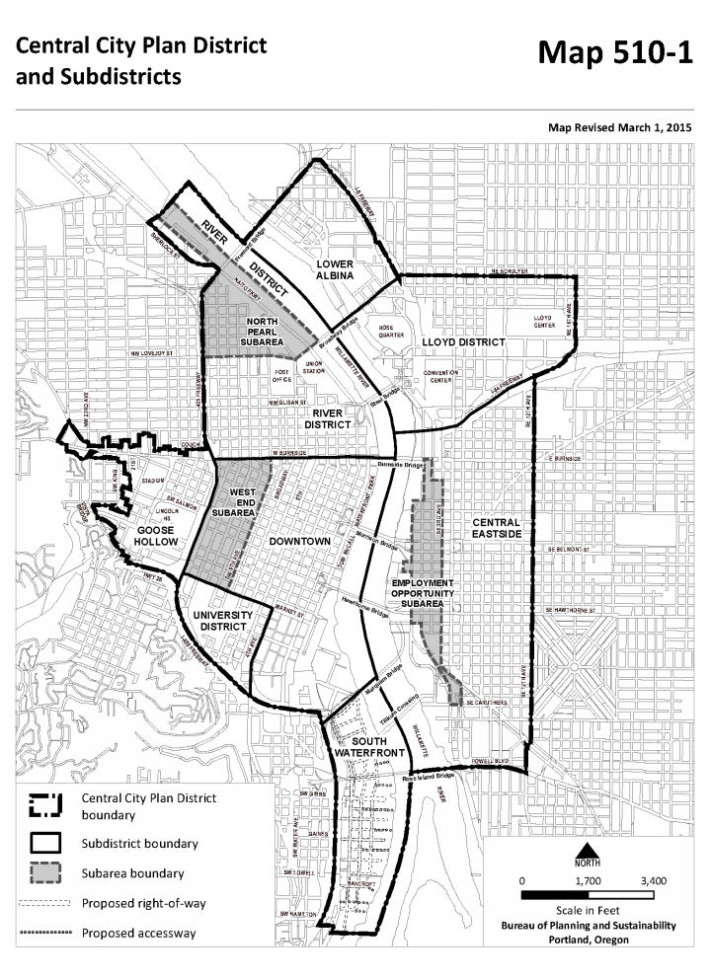
CASELOAD DATA
BUILDINGS APPROVED
0
1
Downtown
Goose Hollow
River District
Lloyd
Central Eastside
South Waterfront
Southwest
Northwest
Northeast
Gateway
Total buildings
4
6
5
2
2018
7
2
3
5
2
2
1
4
0
1
27
2017
9
7
4
2
6
5
1
6
1
1
42
GATEWAY
1
1
3
4
2
7
7
9
2
6
1
1
2
5
PORTLAND DESIGN COMMISSION
MAY 1, 2019
Notes:
I think this is an interesting slice through data: the number and location of the buildings, NOT CASES, approved through the type III process in both 2017 and 2018. If every one of these buildings were under construction simultaneously, we’d have 69 cranes in the sky. But that’s not the case, and if you read last week’s DJC, you know that many of the housing developments that were vested pre-Inclusionary Housing have yet to pull their permits.
Nonetheless, all of the central city neighborhoods are gaining a number of new, large buildings that will impact and change neighborhood character, and the design commission has to be able to understand and interpret many different contexts, and consider both present and future circumstances.

Slide 7
HOUSING SNAPSHOT | TYPE III CASES, ANNUAL
PORTLAND DESIGN COMMISSION
MAY 1, 2019
Notes:
So… we all spend a lot of time thinking about housing. Here’s a high level look at how housing has been playing out in the hearings room over the course of the past few years.
This slide represents Type III housing approvals between 2010 and 2017. The blue bars are housing cases, the green bars are all other cases, so you can see housing as a percentage of all cases. Some of these cases represent more than one building.
This just Type IIIs that are reviewed by Commission, Type II staff level approvals aren’t included here.
2018 = 13, 8 of these were subject to IH
2017 = 19
2016 = 6
2015 = 10
2014 = 4
2013 = 1
2012 = 5
2011 = 5
2010 = 2

Slide 8
HOUSING SNAPSHOT | ALL CASES, QUARTERLY
PORTLAND DESIGN COMMISSION
MAY 1, 2019
Notes:
This is another snapshot of housing cases only, this time it’s every quarter since the last quarter of 2016, about the time the rush to beat Inclusionary Housing began.
This slide shows all Type III approvals in green and Type II approvals in blue—for housing developments, and again, not all of these are out of the ground. There is still a significant backlog of work from pre-IH.
16Q4 = 13, 6
17Q1 = 9, 4
17Q2 = 0, 3
17Q3 = 1, 0
17Q4 = 0, 2
18Q1 = 0, 1
18Q2 = 6, 10
18Q3 = 5, 2
18Q4 = 2, 0
The next slide…

Slide 9
HOUSING SNAPSHOT | PRE-IH VESTED UNITS
*submitted prior to 2/1/2017
PORTLAND DESIGN COMMISSION
MAY 1, 2019
Notes:
…Shows how many of the pre-IH vested units aren’t yet out of the ground. Type IIs are on the left, Type IIIs are on the right, green hasn’t yet begun construction, blue has.
Some are permitted, some are in permit review, and given nervousness around current market conditions, some are up for sale.
TYPE II = 669 not started, 529 under construction—that’s about 44% of the total.
TYPE III = 4469 not started, 808 under construction—that’s about 15% of the total.

Slide 10
HOUSING SNAPSHOT | POST-IH PIPELINE UNITS
data through December 2018
PORTLAND DESIGN COMMISSION
MAY 1, 2019
Notes:
OK, this is out last slide before we move to the overview of projects, and it’s a look at the housing proposals that have entered the design review process since February 2017—the projects that aren’t vested and have an obligation to provide affordable housing units.
The type II bar on the left is a stand alone, but Pre-App Conference, DAR, and type III bars are cumulative—these three bars represent all of the projects currently somewhere in the Type III pipeline.
TYPE II = 416, this number is unchanged since October
PRE-APP = 2948, this was 110 when we were here in October
DAR = 2824, this was 969 when we were here in October
TYPE III = 3668, this was 1961 when we were here in October
TOTAL = 9440, and it was 3040 when we were here in October

Slide 11
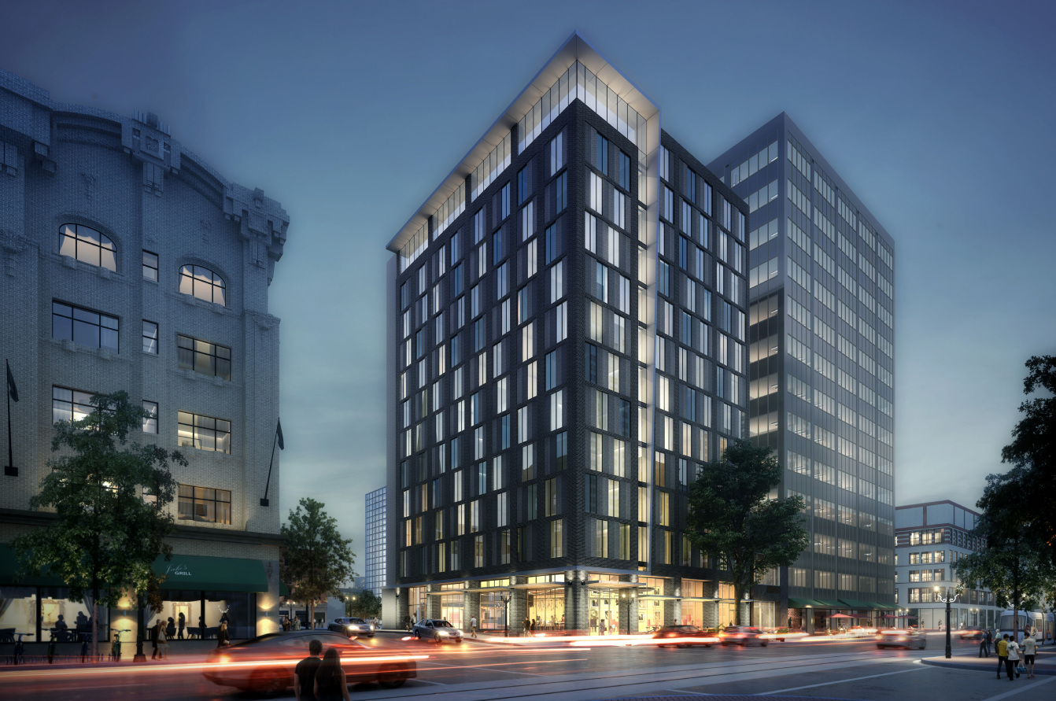
DOWNTOWN
MOXY HOTEL, DLR GROUP
PORTLAND DESIGN COMMISSION
MAY 1, 2019
Notes:
Here’s the show & tell. This is the real the reason the City of Portland values the design review process.
We are going to share images of 11 recent projects that raised the bar on DESIGN EXCELLENCE. There have been many more, but these 11 all address the three tenets well.
MOXY HOTEL – DLR GROUP – PUBLIC REALM
This is the hotel currently under construction across SE Alder from the Sentinel Hotel. It’s one of many very small developments that are on a quarter block or less that Design Commission has seen recently—there’s a significant uptick in buildings with very small footprints. This building does a particularly good job with public realm guidelines, and goes so far to integrate the possibility of food carts into an otherwise under-utilized loading dock.
A8 Contribute to a vibrant streetscape (public realm)
B1 Reinforce and enhance the pedestrian system (public realm)

Slide 12
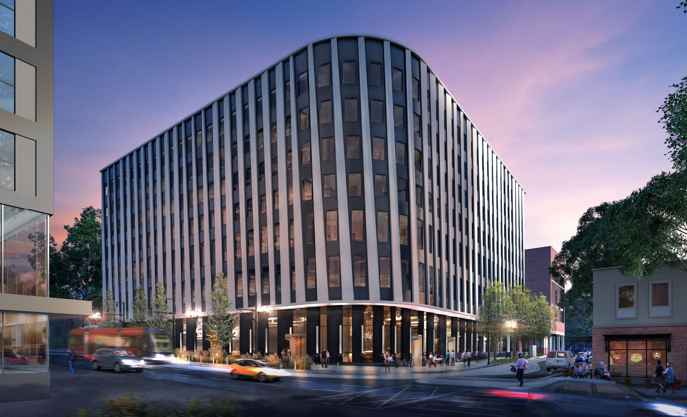
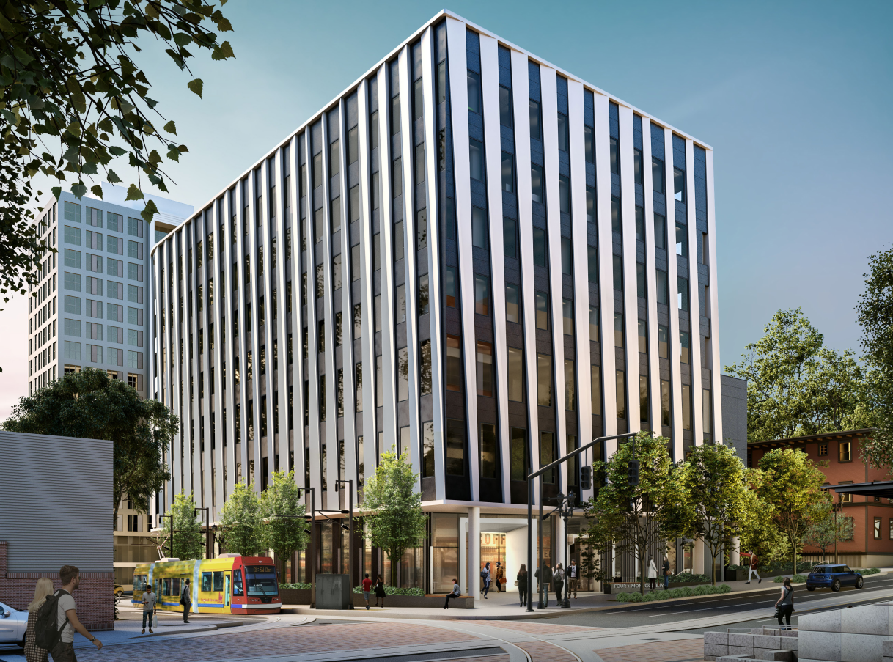
DOWNTOWN
FOURTH & MONTGOMERY, SRG PARTNERSHIP
PORTLAND DESIGN COMMISSION
MAY 1, 2019
Notes:
FOURTH & MONTGOMERY BUILDING AT PSU – SRG PARTNERSHIP – CONTEXT & PUBLIC REALM
Dan Zalkow from PSU is here to testify today and he may give you a little more information about this building. This building merited a lot of discussion in the hearings room—it’s on the PSU campus, but it’s an office building that will be occupied by PSU, PCC, OHSU and the City of Portland. So, how do you drop an office building into the middle of an urban campus? SRG first responded to site conditions--the site is adjacent to the streetcar and PSU’s urban plaza and shares the block with an historic apartment building—and followed up with a façade that curves at the proud corner and is skinned in a manner that connotes movement.
C4 Complement the context of existing buildings (context)
C7 Design corners that build active intersections (public realm)

Slide 13
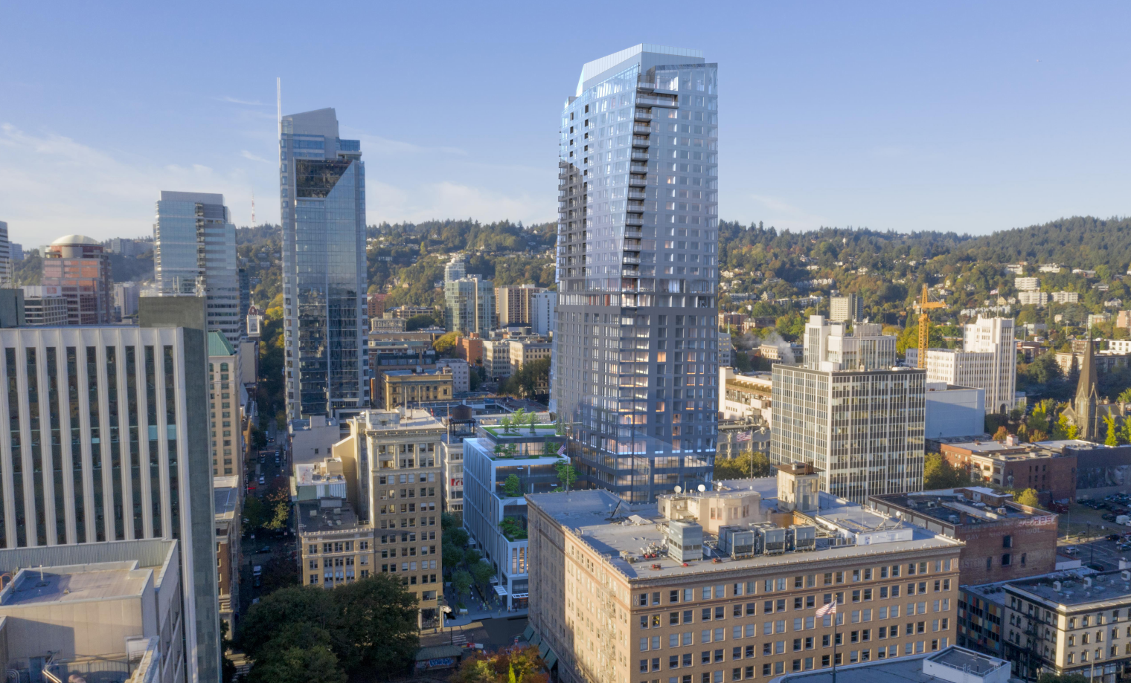
DOWNTOWN
BLOCK 216, GBD ARCHITECTS
PORTLAND DESIGN COMMISSION
MAY 1, 2019
Notes:
BLOCK 216 – GBD ARCHITECTS – PUBLIC REALM
There are a couple of tall shiny buildings in this slide, the one that’s more-or-less in the center is Block 216, the full block development that will sit between the Pittock Building and the Galleria. As proposed, this full block development is 460 feet tall, 35 stories, and has a mixed-use program of ground floor commercial activity, office space, 250 hotel rooms, and housing. The development team went the distance on public realm guidelines with a well programmed ground floor, and they also made a strong proposal for the first block of Green Loop development, which you can just see here in this image.
B5 Make plazas, parks, and open spaces successful (public realm)
C9 Develop flexible level sidewalk spaces (public realm)

Slide 14
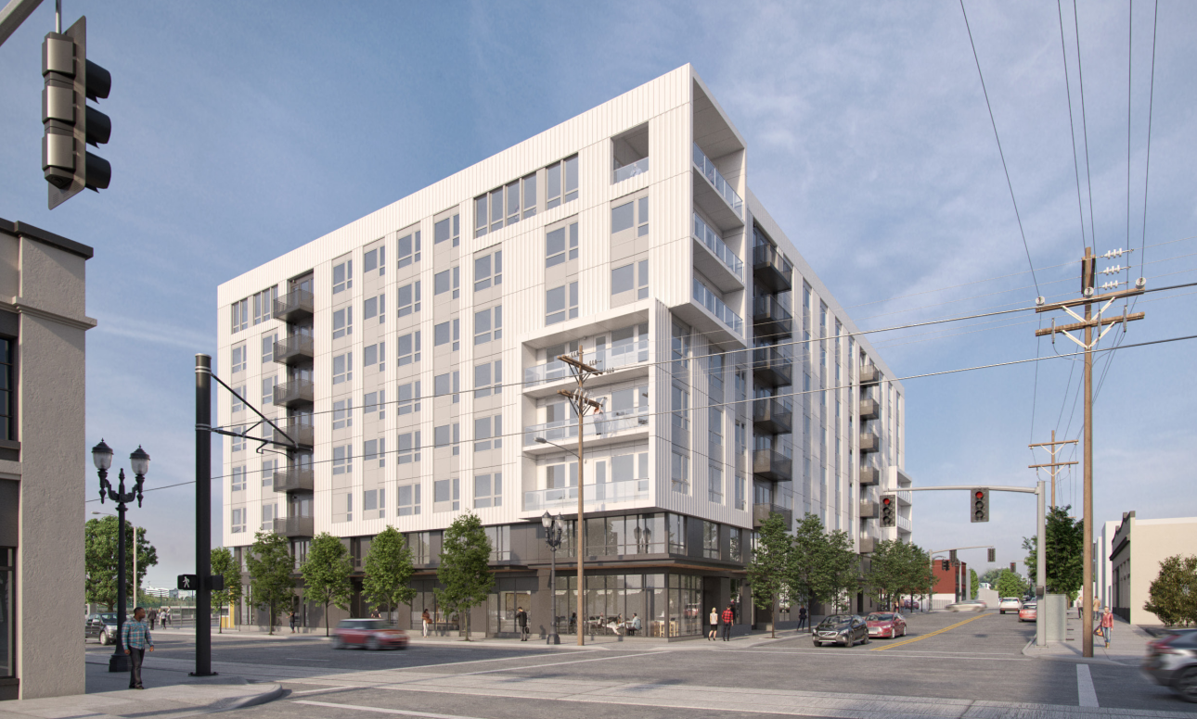
CENTRAL EASTSIDE
GRAND AVE BUILDING, ANKROM MOISAN ARCHITECTS
PORTLAND DESIGN COMMISSION
MAY 1, 2019
Notes:
GRAND AVENUE BUILDING – ANKROM MOISAN ARCHITECTS – ON BALANCE
This is an apartment building with ground floor commercial space at NE Grand and Davis, just north of the Burnside Bridgehead.
Like many buildings the Commission sees, the site, program, and construction methods created many design challenges, building makes a fair response to all three tenets. Here , I’d call out
C5 Design for coherency, (quality), because the design team really pushed themselves throughout the design advice request and Type III processes to deliver a thoughtful, cohesive architectural expression.

Slide 15
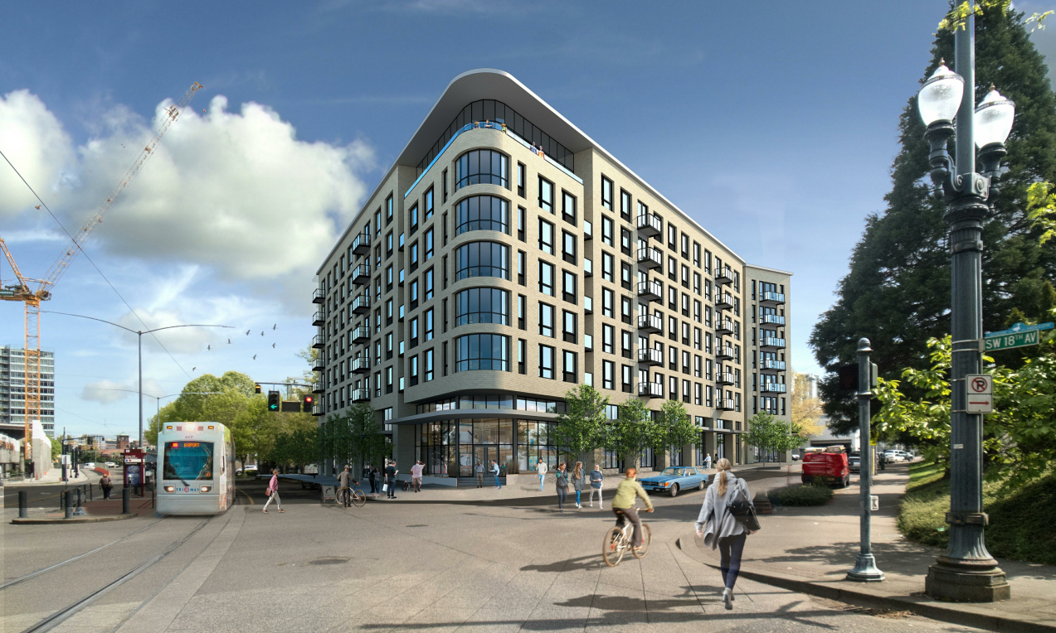
GOOSE HOLLOW
SALMON ST BUILDING, SERA ARCHITECTS
PORTLAND DESIGN COMMISSION
MAY 1, 2019
Notes:
SALMON ST BUILDING – SERA ARCHITECTS – ON BALANCE
Kurt Schultz from SERA Architects is also here to testify today. This is one of several projects Kurt presented to Design Commission in 2018. The site is in Goose Hollow, immediately north of Lincoln High School. This is an unusual block because it’s not the standard 200 x 200. In fact, the corner we’re looking at in this image is a gently flatiron point, and the design team exploited this feature well to make an elegant residential building that fits well in the Goose Hollow context.
A3 – Respect the Portland block structure (public realm)
A7 – Establish and maintain a sense of urban enclosure (public realm)
C4 – Complement the context of existing buildings (context)

Slide 16
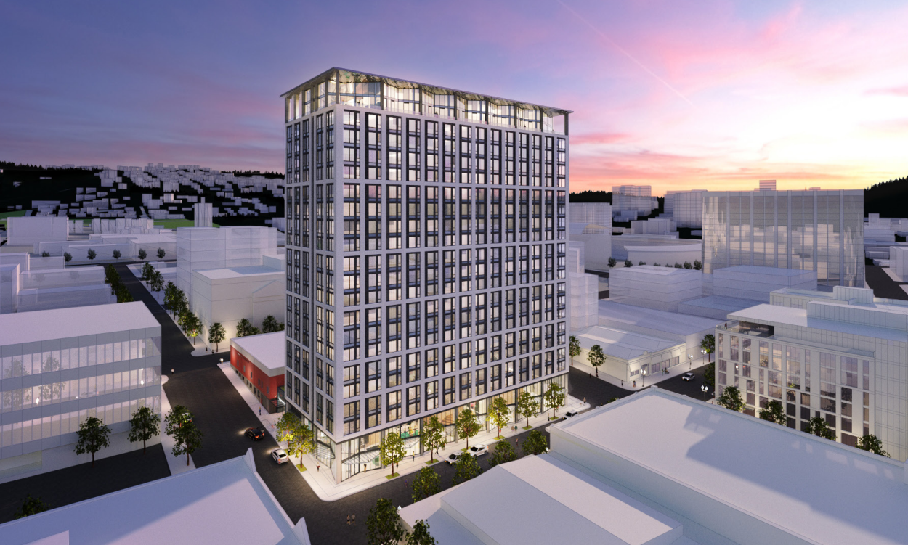
GOOSE HOLLOW
ART TOWER, ANKROM MOISAN ARCHITECTS
PORTLAND DESIGN COMMISSION
MAY 1, 2019
Notes:
ART TOWER – ANKROM MOISAN – A CLOSE 2ND FOR THE DESIGN EXCELLENCE AWARD
Paul Jeffreys and his team at Ankrom Moisan just knocked this one out of the park. This is the new residential tower that will be built on the Artist’s Rep site in Goose Hollow. It’s a complicated program because of underground connections to the existing Scottish Rite Temple. This building responds extraordinarily well to the three tenets, but it’s response to the guidelines about QUALITY is particularly strong:
A4 Use unifying elements (quality)
C2 Promote permanence and quality in design (quality)
C5 Design for coherency (quality)
C11 Integrate roofs and use rooftops (quality)
And a special call out for
B6 Develop weather protection (public realm) because the team carried the design parti all the way through to the canopies at the ground floor

Slide 17
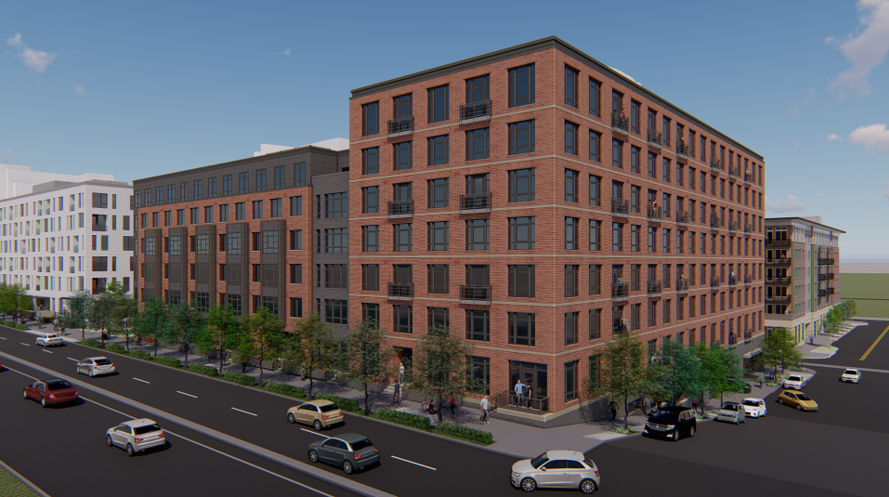
SOUTH WATERFRONT
BLOCK 40, HENSLEY LAMKIN RACHEL ARCHITECTS
PORTLAND DESIGN COMMISSION
MAY 1, 2019
Notes:
BLOCK 40 – HENSLEY LAMKIN RACHEL ARCHITECTS – SOUTH WATERFRONT GUIDELINES
Block 40 is an unusually large site adjacent to Macadam in South Waterfront, there are two buildings visible in this image. The developer, Alamo Manhattan, and the architect are both home based in Texas. Matt Segrest, founder of Alamo Manhattan, wasn’t able to join us today but provided some written testimony. This team is currently engaged in Design Advice Requests for four more buildings and more than 1000 housing units in South Waterfront.
These buildings changed greatly as they moved through the design process and this team was very responsive to comments received from commission. This is a site with many challenges--a major grade change, fast moving traffic on Macadam, the adjacent streetcar, the obligation to develop a block of SW Lane street as a public accessway… the first of two buildings is now under construction. The response to the South Waterfront guidelines is strong, especially
B1-2 Enhance accessway transitions (public realm)
C4-1 Develop complementary structured parking (context)
B4, Provide Stopping and viewing places

Slide 18
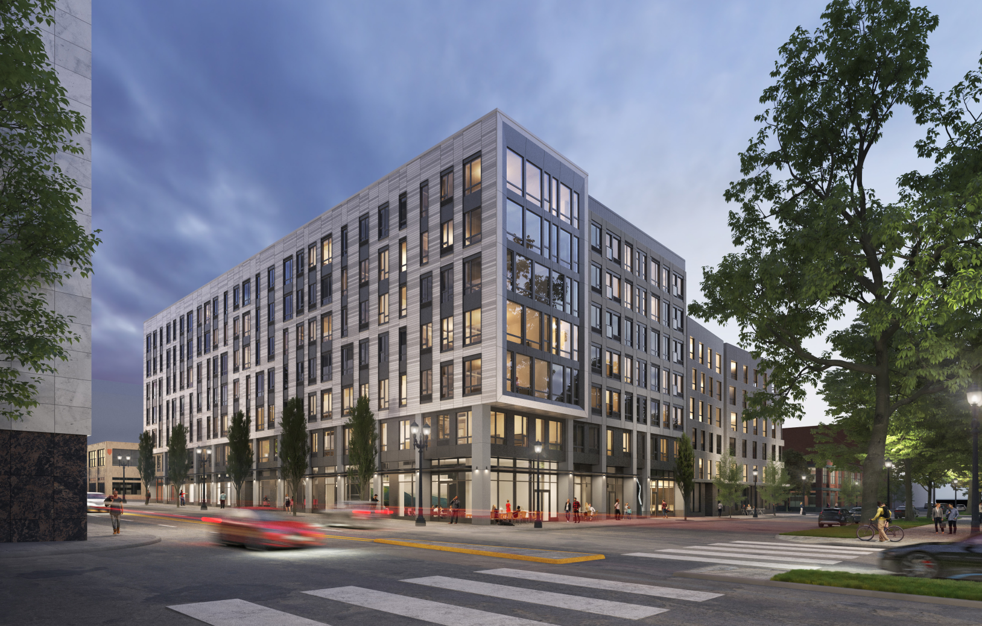
RIVER DISTRICT
815 W BURNSIDE, ANKROM MOISAN ARCHITECTS
PORTLAND DESIGN COMMISSION
MAY 1, 2019
Notes:
815 WEST BURNSIDE – ANKROM MOISAN ARCHITECTS - CONTEXT
If you’ve been to the North Park Block recently, you may have seen that the Firestone site at SW Park & Burnside—right next to Art House—is vacant and fenced. This neat building, a foil to the terse façade of the AT&T building directly across the site, was the first building that came through a Type III review that was subject to Inclusionary Housing.
A5 Enhance, embellish and identify areas (context)
C8 Differentiate the sidewalk level of buildings (public realm)
And specific to the River District,
A5-1-2 Reinforce the identity of the north park blocks area (context)

Slide 19
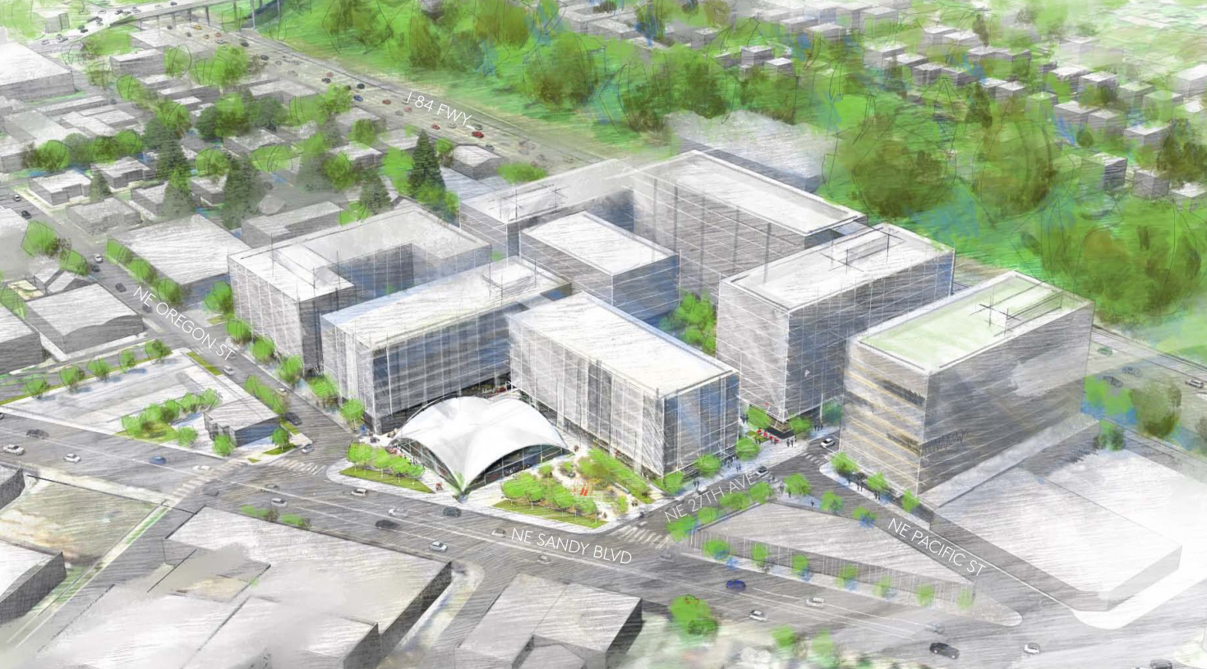
PLANNED DEVELOPMENT, KERNS
PEPSI BLOCKS, MITHŪN
PORTLAND DESIGN COMMISSION
MAY 1, 2019
Notes:
PEPSI BLOCKS – MITHUN – PLANNED DEVELOPMENT
This was the first planned development under the new code that’s been in front of commission. Dorothy Faris of Mithun is here to testify today and will likely speak more to the process. The first Type III review associated with the Pepsi Blocks is on our agenda this month.
The planned development is a master planning mechanism that allows for greater flexibility on large sites if the development includes features that provide public benefit. The goals of a successful master plan are:
High quality design that’s integrated into the broader urban fabric
Pedestrian oriented development, with a strong orientation towards multimodal transportation alternatives
Access to light and air
Protection of public view corridors
A vibrant public realm
Open space areas for gathering and passive and active recreation opportunities
Affordable housing
Energy efficient development

Slide 20
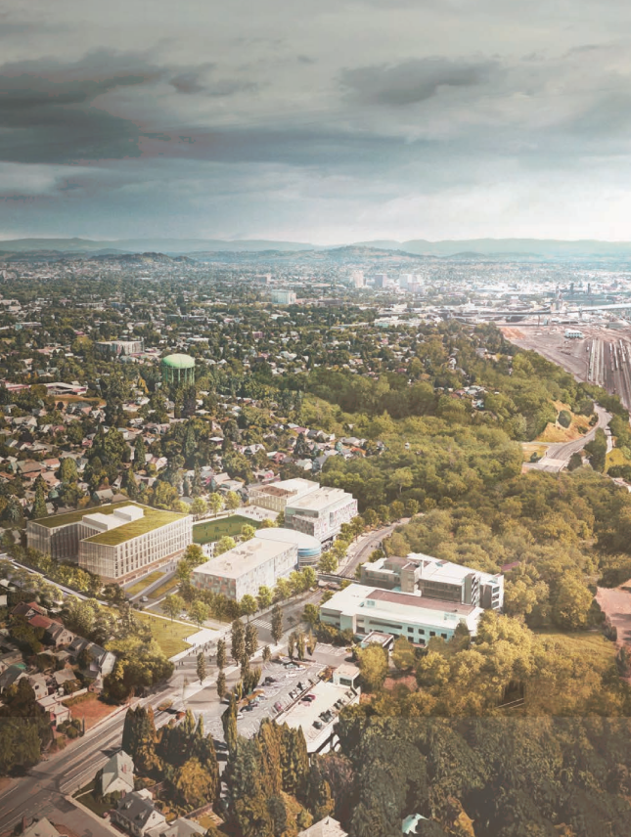
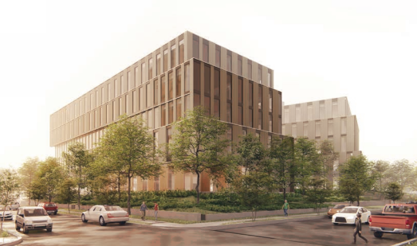
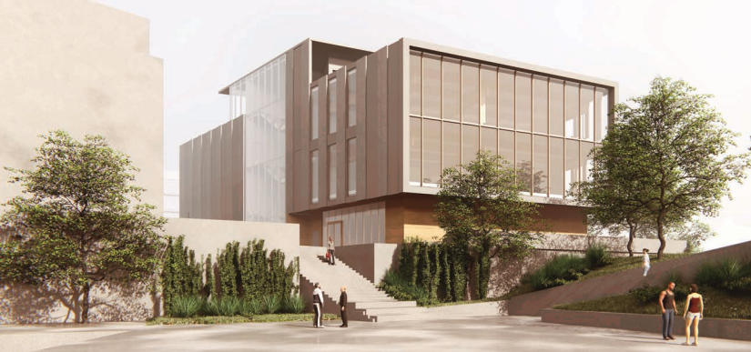
TYPE II REVIEW, OVERLOOK
ADIDAS VILLAGE EXPANSION, LEVER ARCHITECTURE
PORTLAND DESIGN COMMISSION
MAY 1, 2019
Notes:
ADIDAS VILLAGE EXPANSION – LEVER ARCHITECTURE
The development team elected to participate in a Design Advice Request with commission. The Design Advice Request is available to all Type II and Type III applicants, and Type II applicants sometimes take advantage for any one of a number of reasons—including the fact that it creates a good structure for public involvement.
Chris Trejbol, Chair of the Overlook Neighborhood Association, is here today to provide some testimony about the Type II process.
THAT’S IT! All that remains is the reveal of the winner of the 2018 Design Excellence Award. This is the 3rd year Design Commission has made this award.

Slide 21
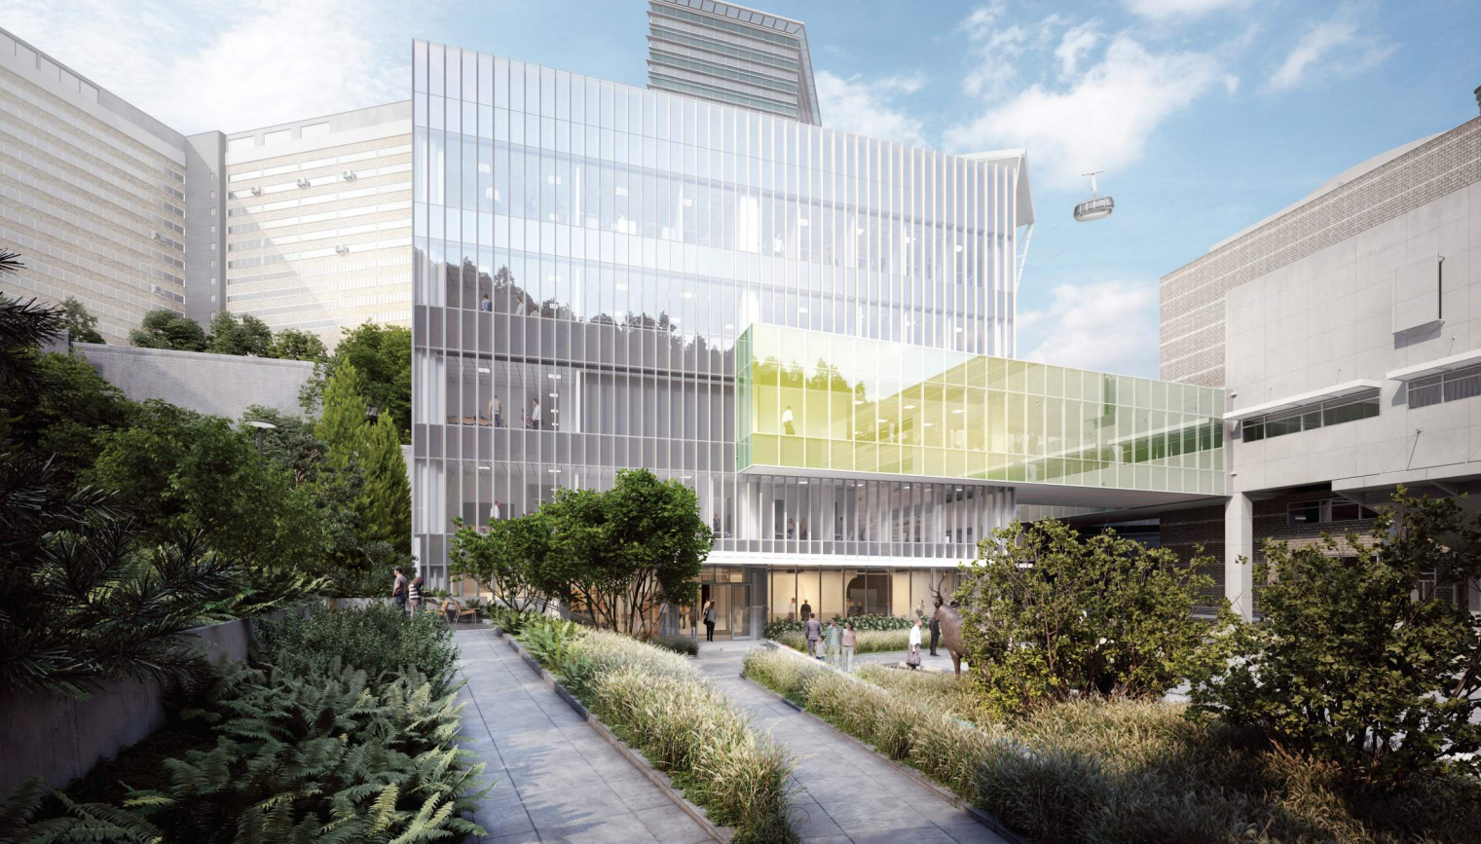
2018 DESIGN EXCELLENCE AWARD
2018 DESIGN EXCELLENCE AWARD
ELKS CHILDREN’S EYE CLINIC, NBBJ & MAYER/REED
PORTLAND DESIGN COMMISSION
MAY 1, 2019
Notes:
You saw this building in October—it’s the Elks Children’s Eye Clinic on OHSU’s Marquam Hill Campus. The architect is NBBJ’s Seattle Office and the landscape architect is the Portland firm Mayer/Reed.
This proposal arrived in the hearings room fully-resolved and beautifully expressed. The building and landscape work together to create a place of healing and are elegant in their simplicity. The site plan organizes and make sense of competing uses in a manner that improves the pedestrian environment and equally benefits both the new building and existing Casey Eye Institute. And the one big architectural move—a skybridge skinned with dichroic glass that connects to the neighboring structures—is absolutely contrary to every idea about how to create a strong public realm that exists in guidelines, but in this context it works very well.
OHSU is to be commended for taking their role as an URBAN medical campus seriously and consistently delivering projects both on the hill and at the Schnitzer campus that accomplish the three tenets.
B2 Protect the pedestrian (public realm)
B3 Bridge pedestrian obstacles(public realm)
Thank you very much! If you don’t have questions for me, Carol Mayer-Reed is here today to accept the Design Excellence award and begin our public testimony. She’ll be followed by Kurt Schultz of SERA architects, Chris Trejbol of the Overlook Neighborhood Association, Dan Zalkow from PSU, and Dorothy Faris from Mithun.

Slide 22
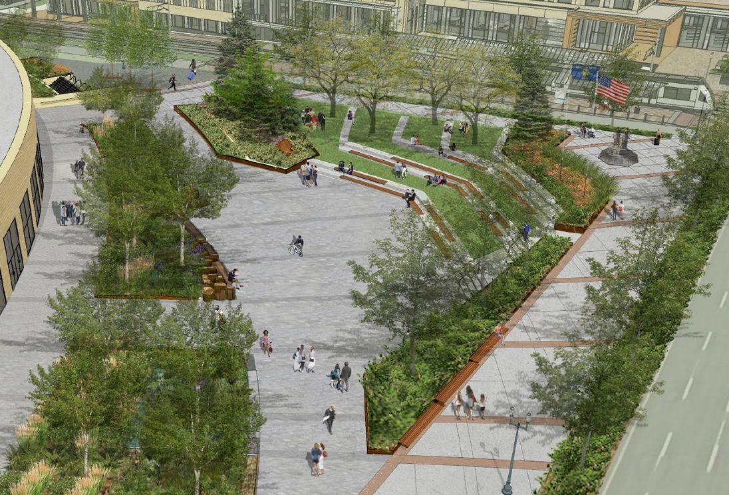
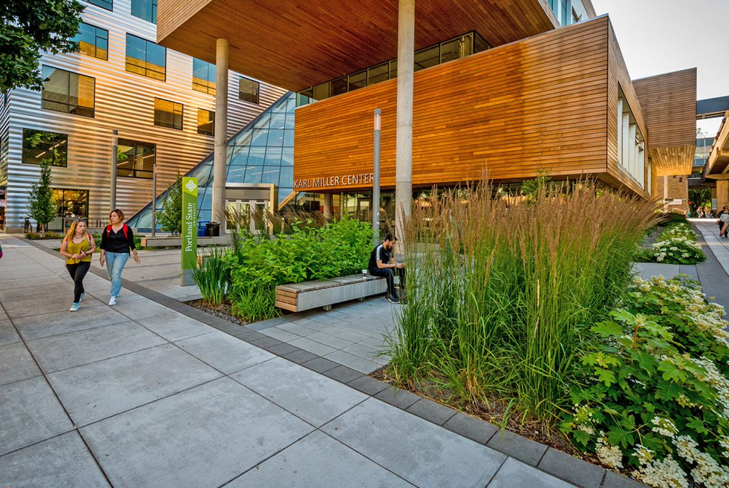
CAROL MAYER-REED, MAYER/REED
PORTLAND DESIGN COMMISSION
MAY 1, 2019

Slide 23
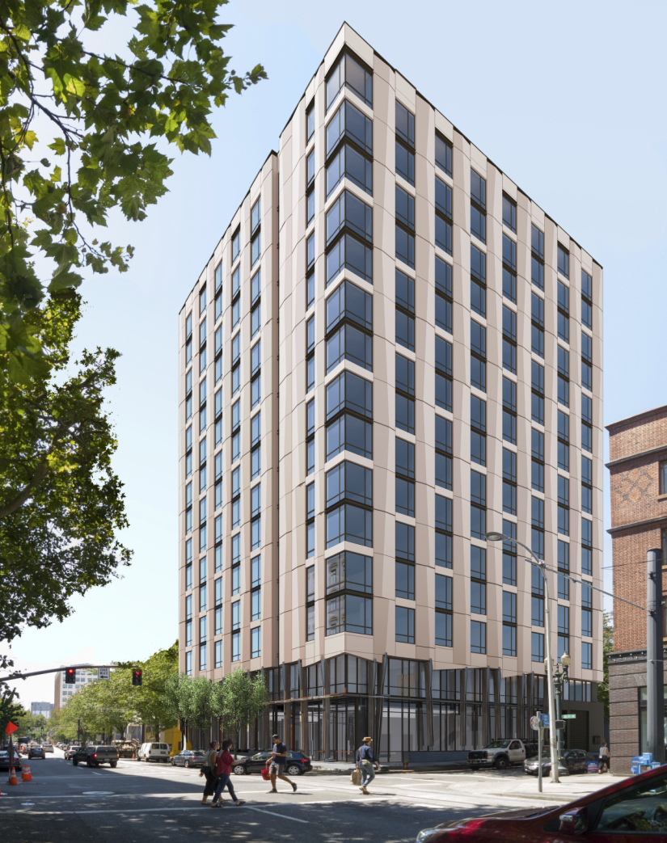
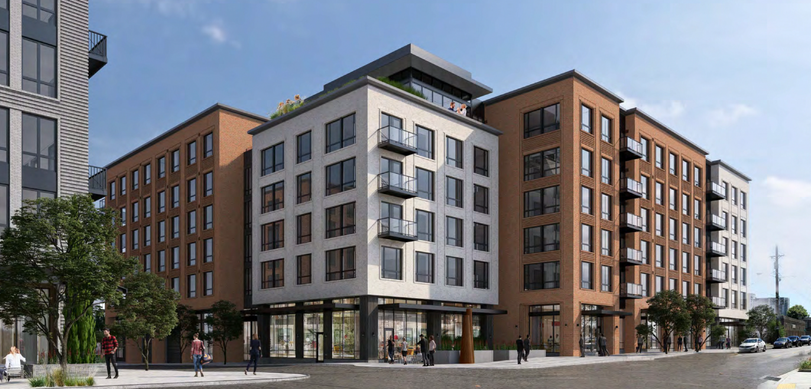
KURT SCHULTZ, SERA ARCHITECTS
PORTLAND DESIGN COMMISSION
MAY 1, 2019

Slide 24
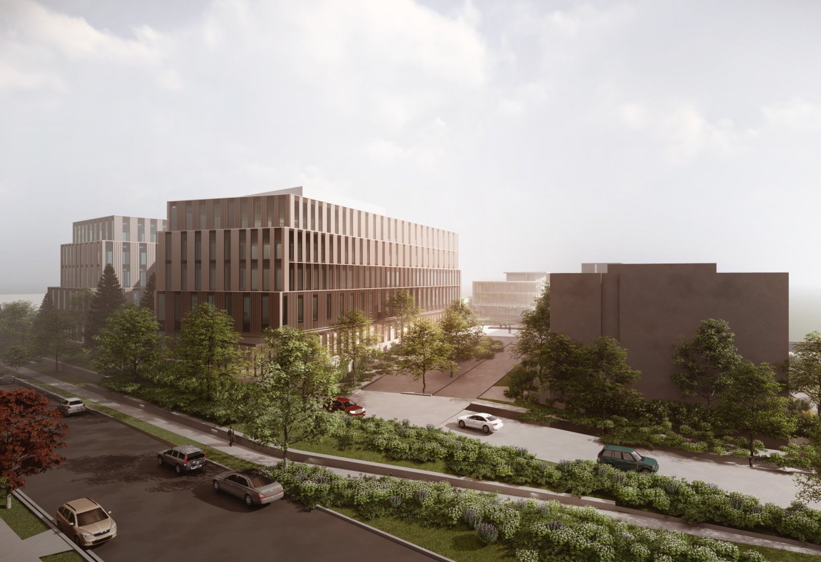
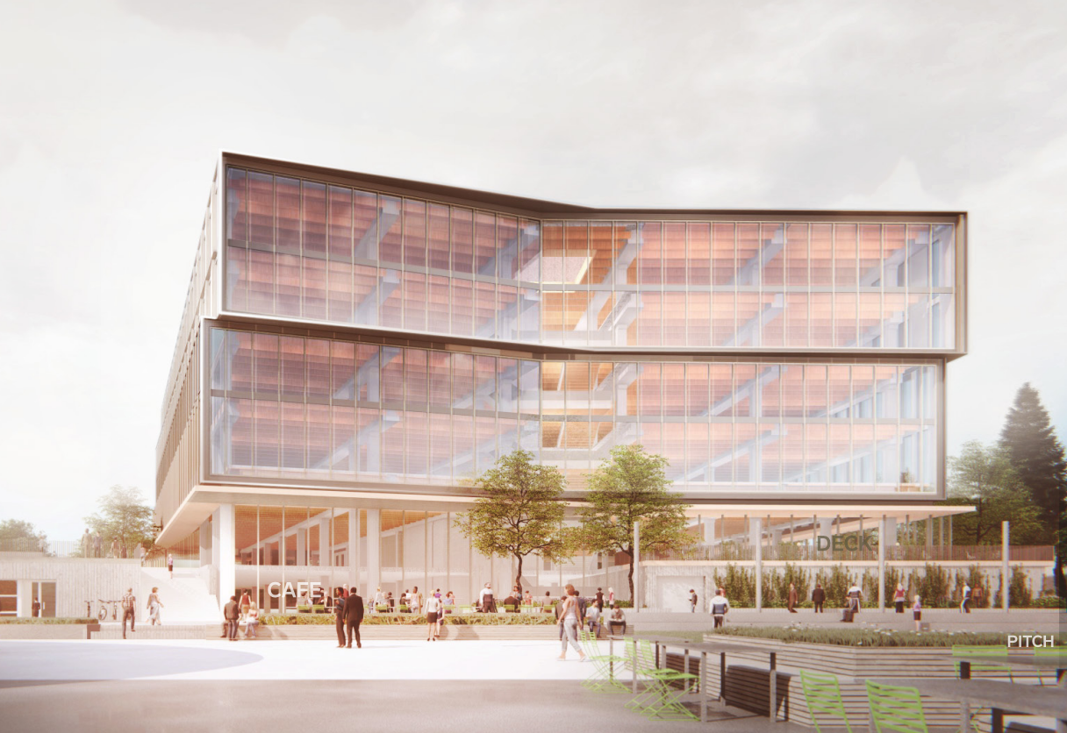
CHRIS TREJBOL, OVERLOOK NEIGHBORHOOD ASSOCIATION
PORTLAND DESIGN COMMISSION
MAY 1, 2019

Slide 25
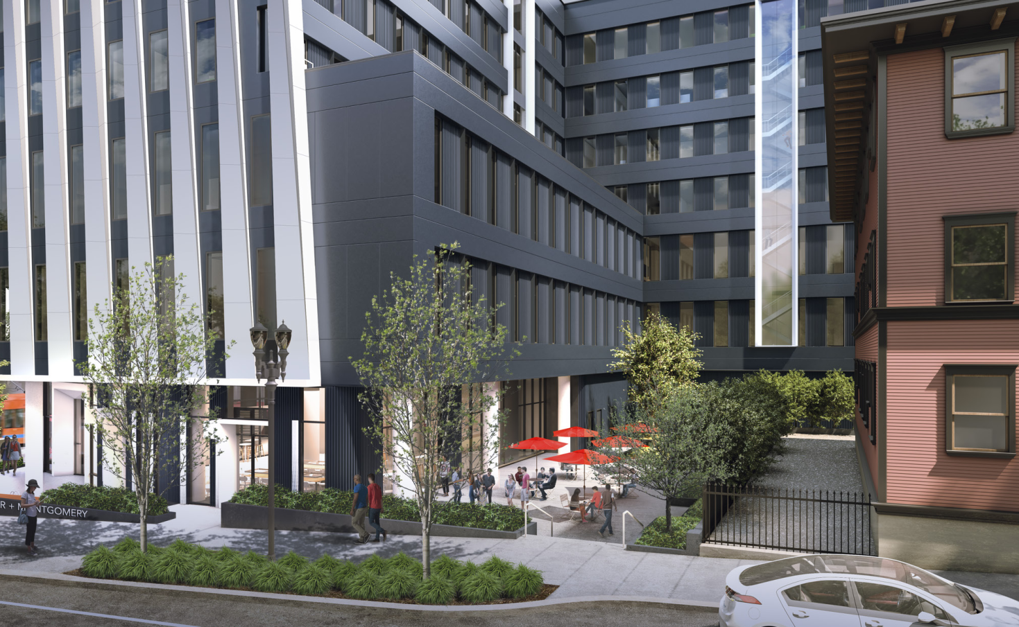
DAN ZALKOW, PORTLAND STATE UNIVERSITY
PORTLAND DESIGN COMMISSION
MAY 1, 2019

Slide 26
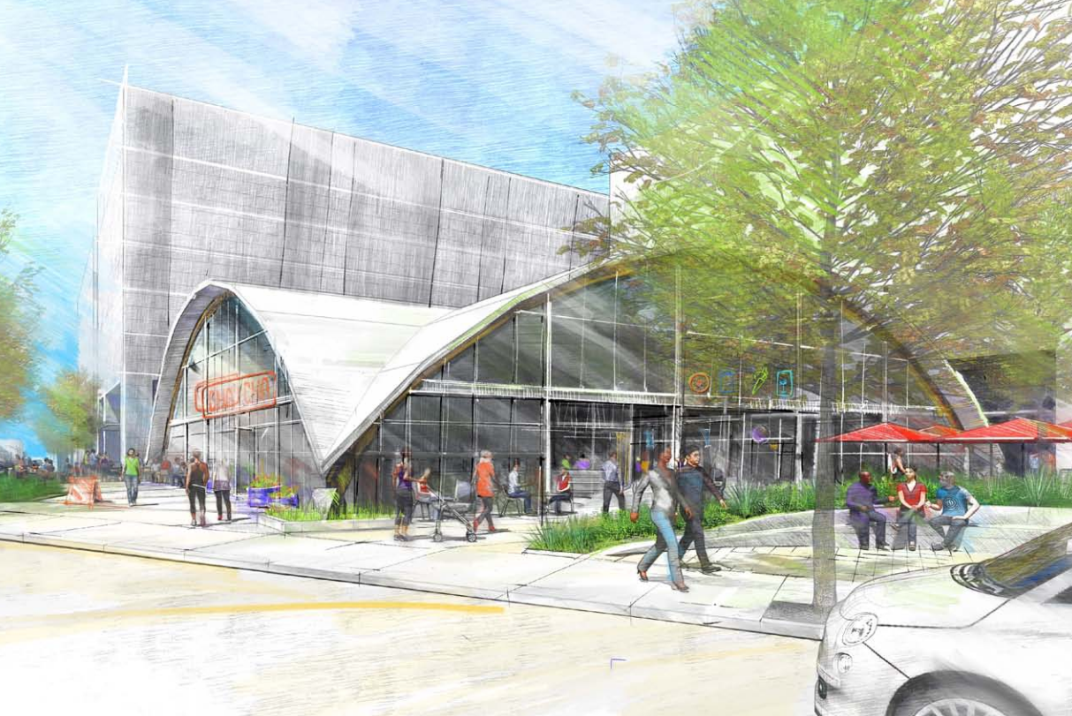
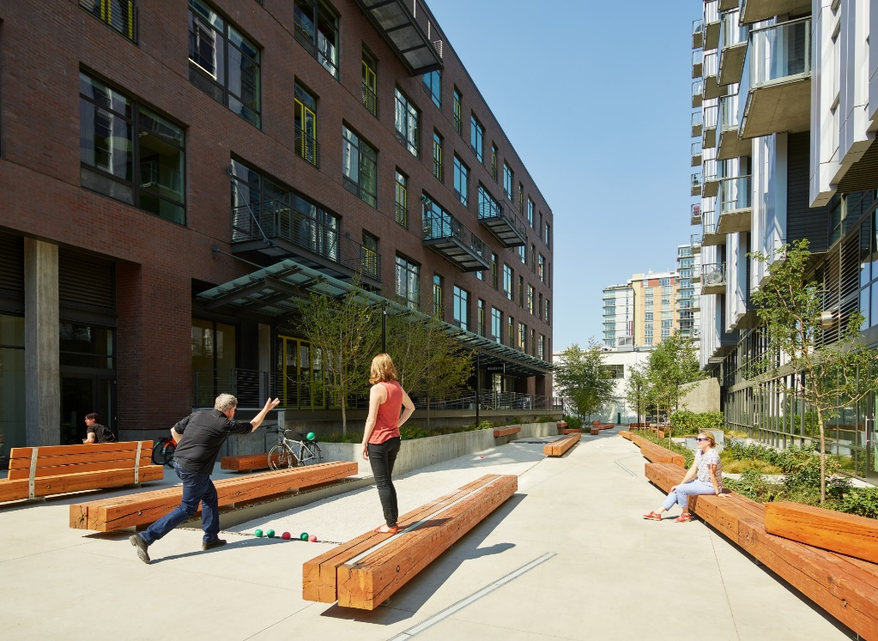
DOROTHY FARIS, MITHŪN
PORTLAND DESIGN COMMISSION
MAY 1, 2019

Slide 27
@PortlandDCChair

