Slide 1



Agenda Item *288
*Amend Ordinance to modify a condition of approval for the vacation of a portion of SE Claybourne St east of SE 122nd Ave subject to certain conditions and reservations

Slide 2
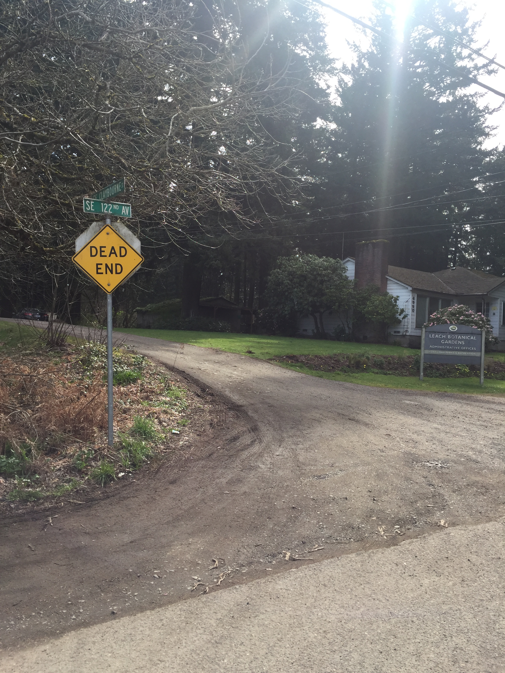
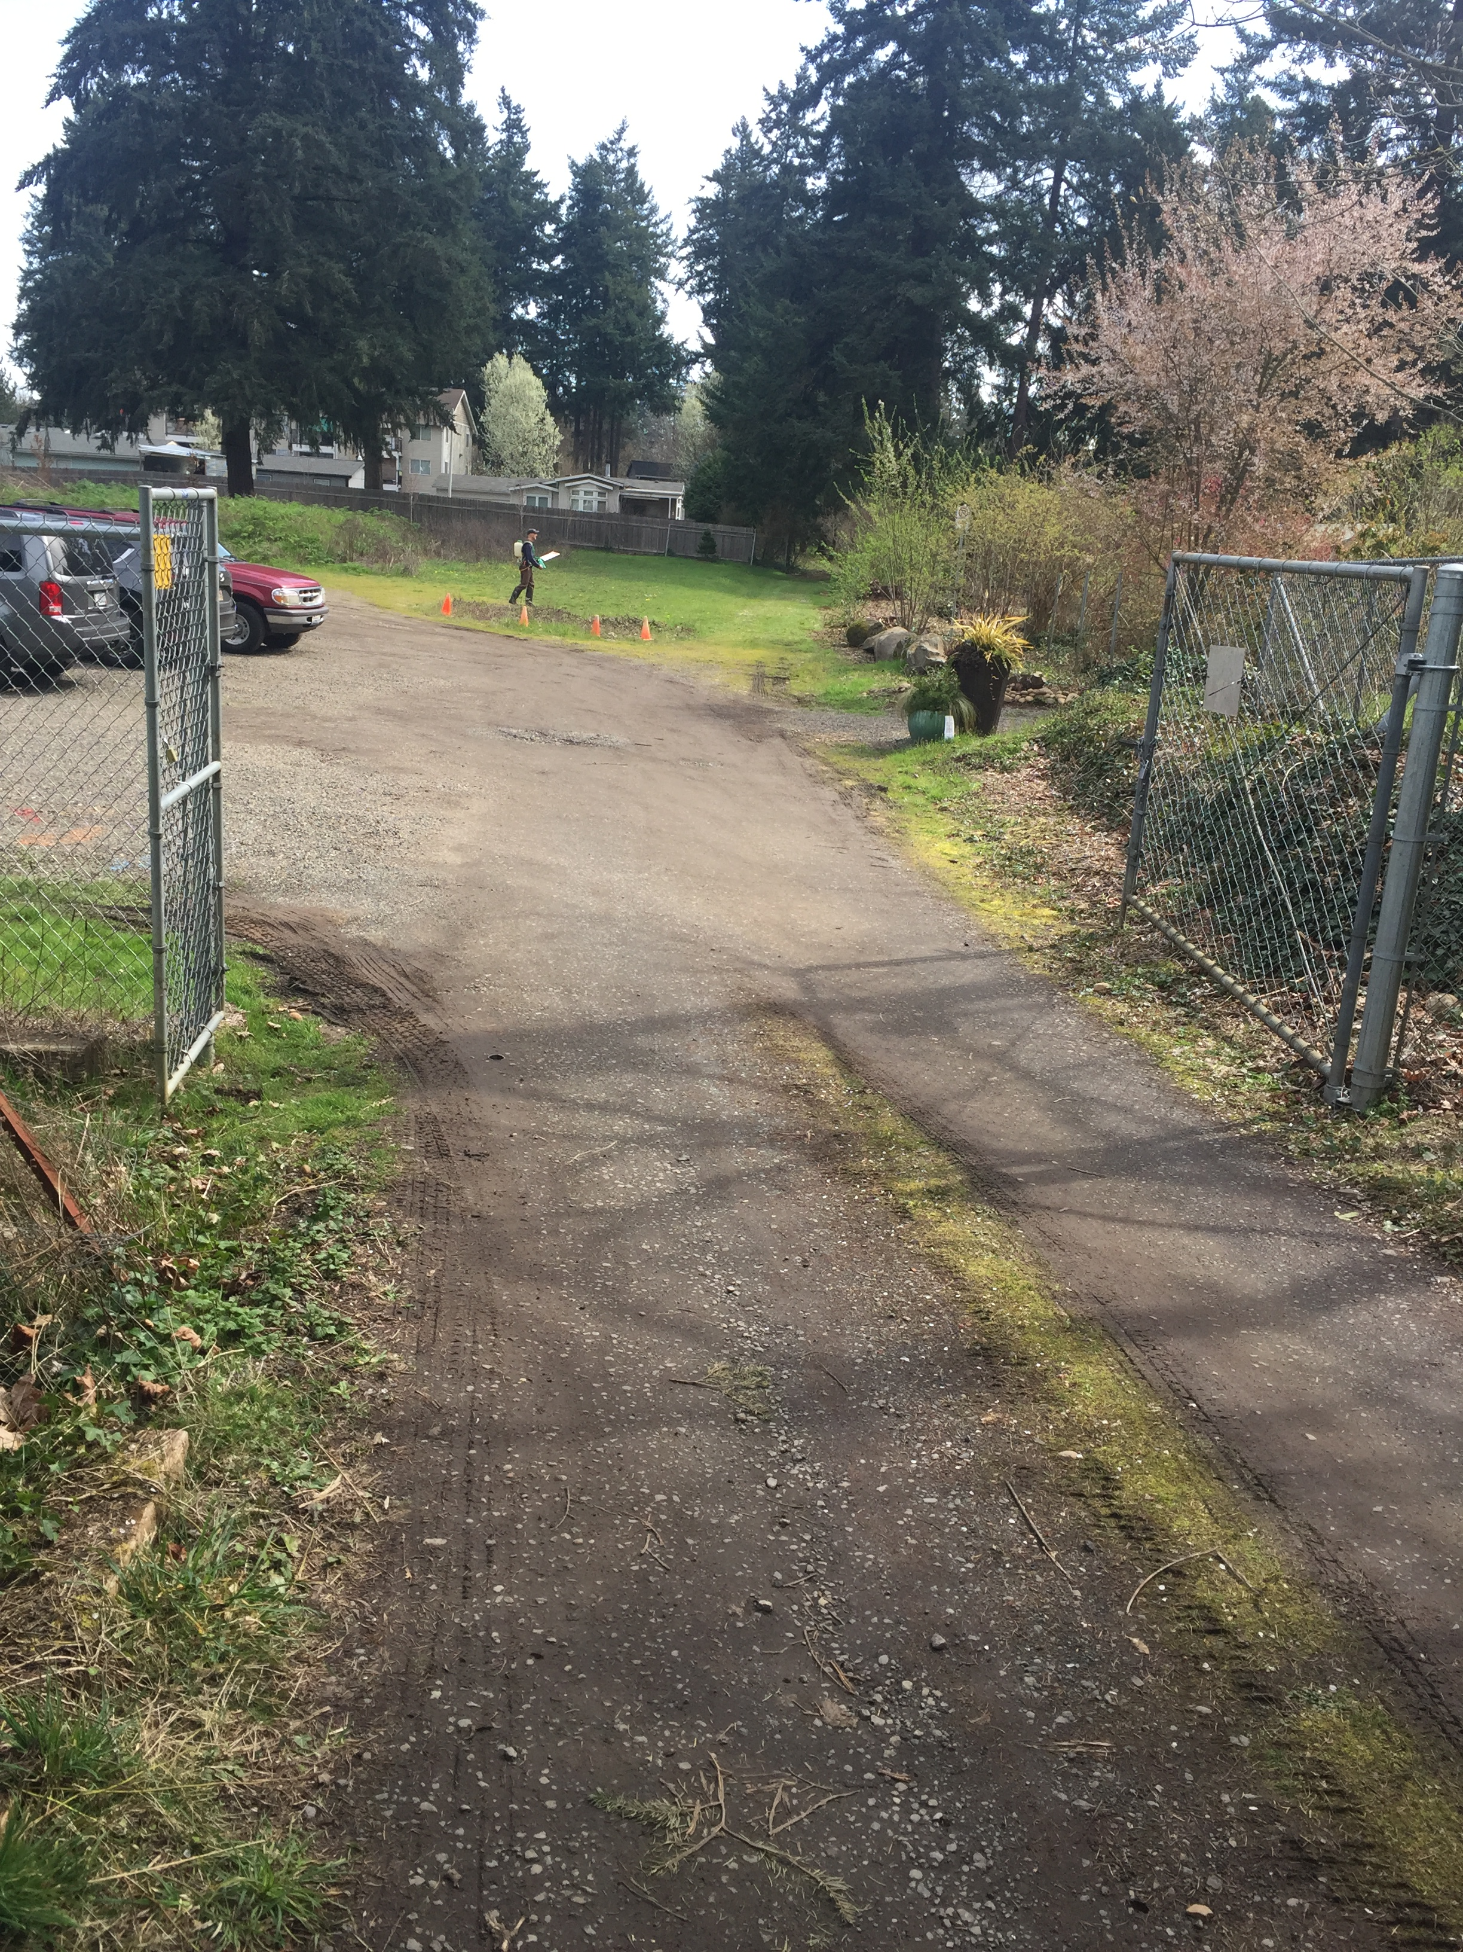
SE Claybourne Street
Current Conditions
SE Claybourne Street east of SE 122nd Ave
(Portion to Remain as Public Right-of-Way)
SE Claybourne Street looking east.
(Portion to be Vacated)

Slide 3
Leach Botanical Garden Master Plan
Street Vacation Area

Slide 4
SE Claybourne Street
May 9, 2018 – City Council approved Ord. No. 188928 vacating a portion of SE Claybourne St.
January 14, 2019 – Bureau of Development Services (“BDS”) revised its response to the street vacation.

Slide 5
SE Claybourne Street
BDS Condition of Approval No Longer Needed.
Split Zoning No Longer Exists – All parcels owned by Portland Parks & Recreation now zoned as Open Space (“OS”) per recent update to Comprehensive Plan.
Parcels Zoned OS Not Required to Have Public Street Frontage – BDS recently determined that City Code does not require Open Space parcels to front public right-of-way.

