Slide 1
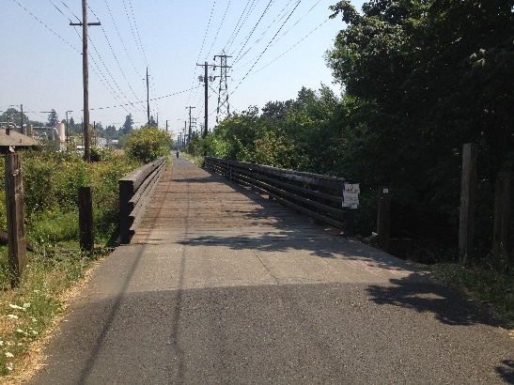
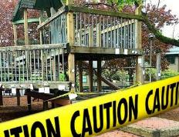
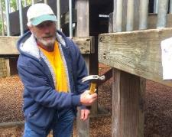
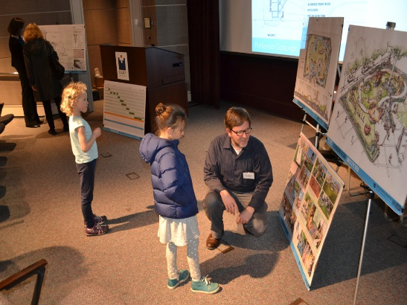
PARKS
REPLACEMENT
BOND
Springwater Corridor Bridge #48 Replacement CITY COUNCIL - Wednesday March 27, 2019
Commissioner Nick Fish | Director Adena Long
Notes:
Hello Mayor Wheeler and members of Council. My name is Robin Laughlin, I am the Bond Program Manager with Portland Parks & Recreation.
With me today is Marlo Medellin, Capital Project Manager with Portland Parks & Recreation. Marlo will be giving a brief presentation on the Springwater Corridor Bridge #48 Replacement Project.
We are here today to request Council to accept the bid from Just Bucket Excavating for the Springwater Corridor Bridge #48 Replacement Project for the amount of $1,169,668.67.

Slide 2
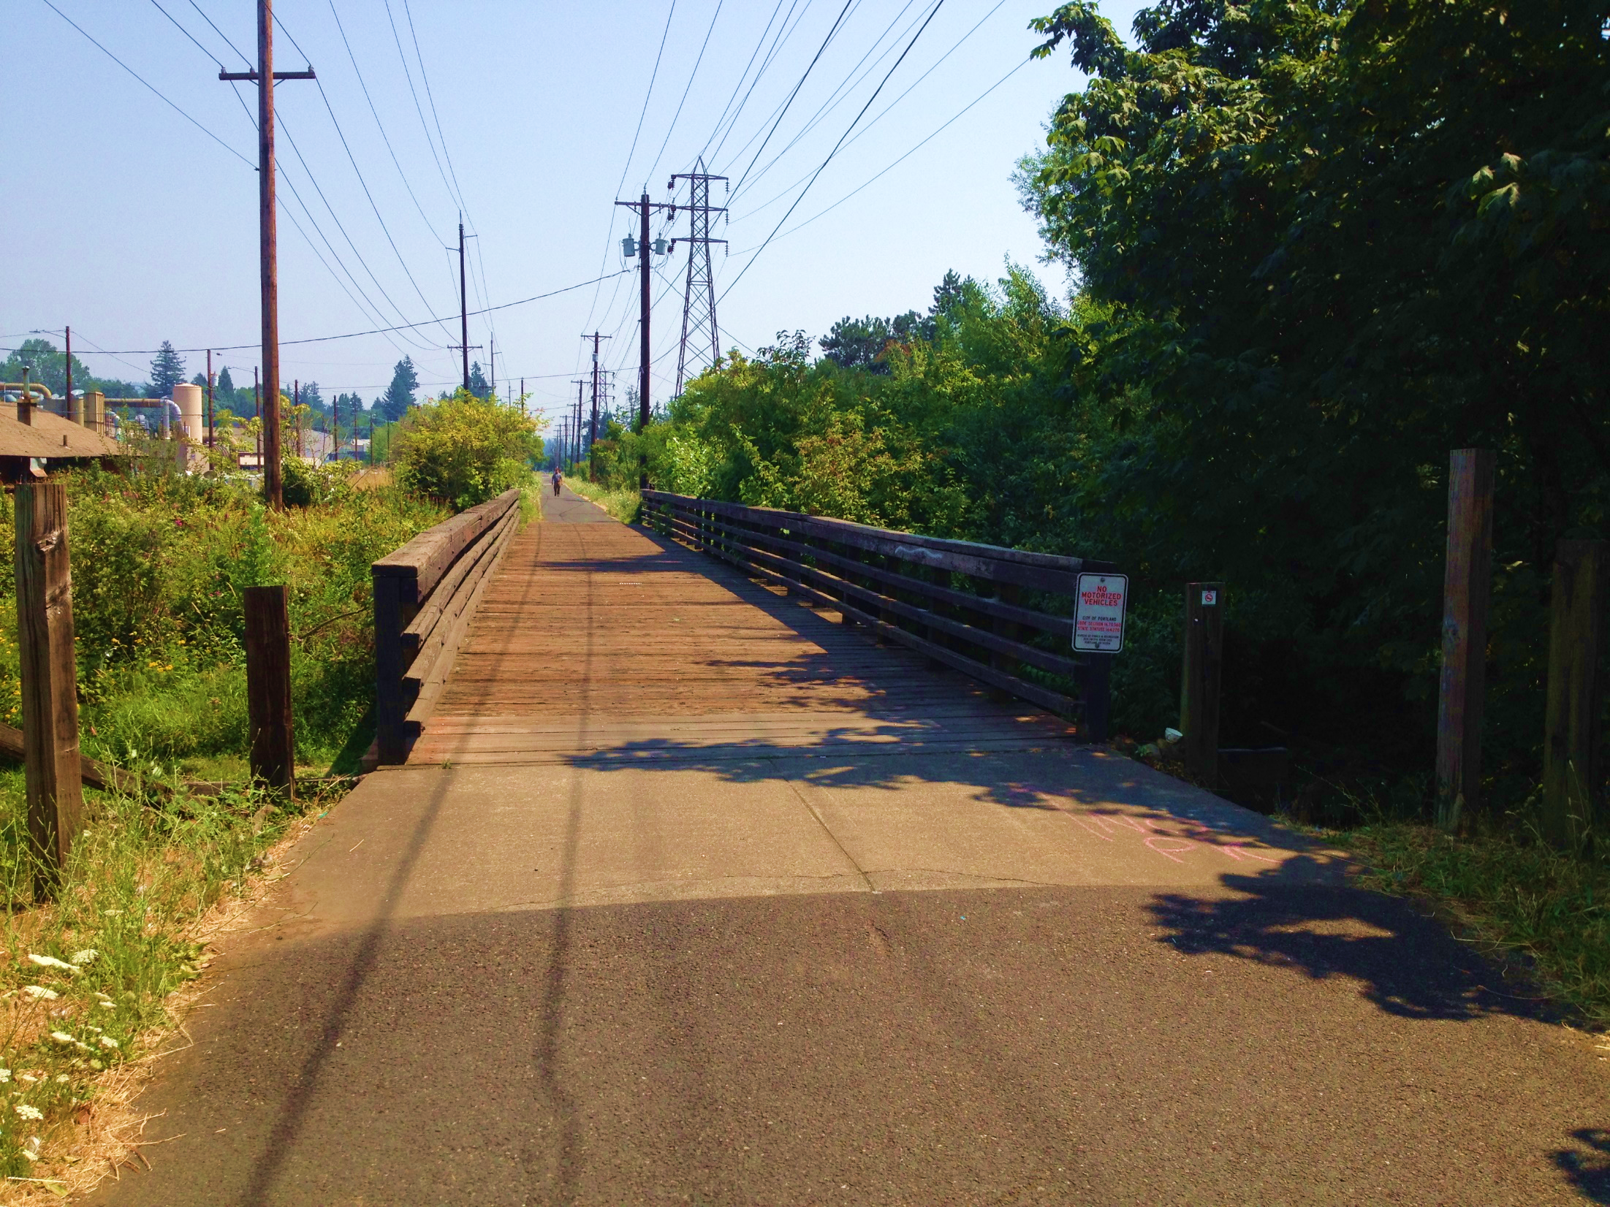
FOCUS
TRAILS & BRIDGES
Repair trails and bridges, preserving access to natural areas and open spaces
Notes:
The Springwater Corridor Bridge #48 Replacement Project is part of the 2014 Parks Replacement Bond that was generously passed by voters who approved the $68 million Bond Measure to address critical park needs without increasing tax rates.
As you know, the Bond funding goes towards Park’s most urgent needs in seven priority areas.
Playgrounds
Trails and Bridges
Pools
Accessibility
Protecting Workers
Pioneer Courthouse Square
Restrooms and Other Facilities
This project fits into the Trails and Bridges focus area and is the third Replacement Bond BRIDGE project to go into construction.
The Project funding comes totally from 2014 Parks Replacement Bond.

Slide 3
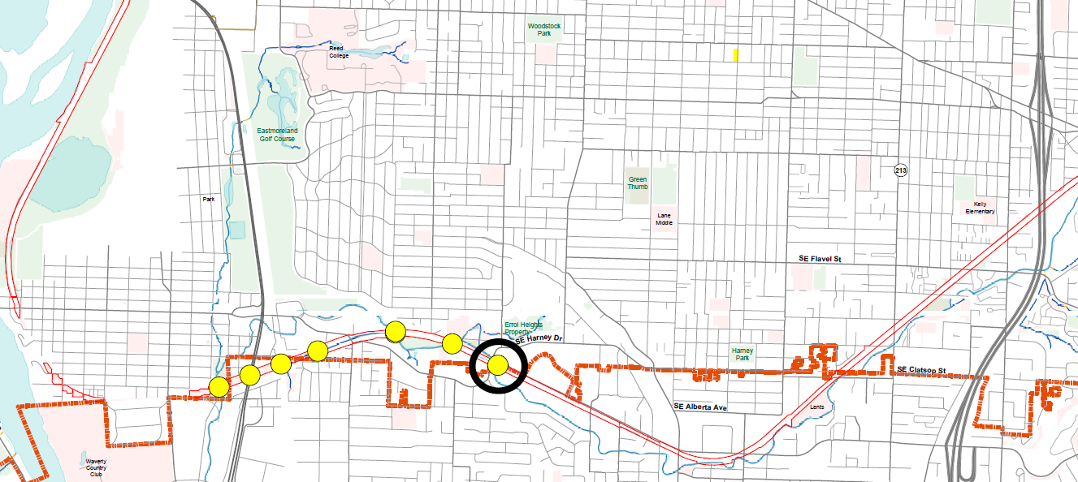
PROJECT SITE
SPRINGWATER CORRIDOR
Springwater Corridor
Bridge #48
Notes:
(Marlo)
The Springwater Corridor Bridge #48, as its name suggests, is located along the Springwater Corridor. The Springwater Corridor represents the major southeast segment of the 40-Mile Loop, which was inspired by the 1903 Olmstead Plan of a parkway to connect park sites throughout the city.

Slide 4
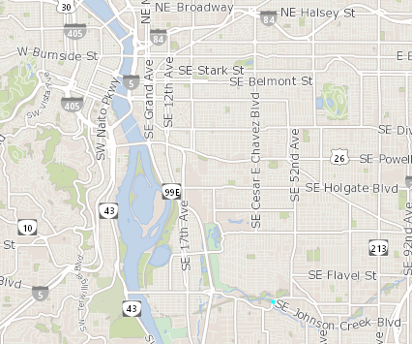
PROJECT SITE
SPRINGWATER CORRIDOR
City of Portland
City of Milwaukie
Notes:
(Marlo)
The bridge itself is located in the City of Milwaukie, at the edge of SE Portland City limits. The City of Portland owns and maintains the Springwater Corridor up to the City of Gresham.
This image shows the Project Area at the intersection of SE Johnson Creek Boulevard and SE 45th Avenue:
The trail leading to the western end of the bridge is within Portland city limits, necessitating permits both from City of Milwaukie and City of Portland.
The Project will replace an aging 8-span wood trestle bridge width.
The new 2-span steel bridge will provide unobstructed passage of Johnson Creek.
This Project will enhance the safety and enjoyment of Springwater Trail users for years to come.

Slide 5
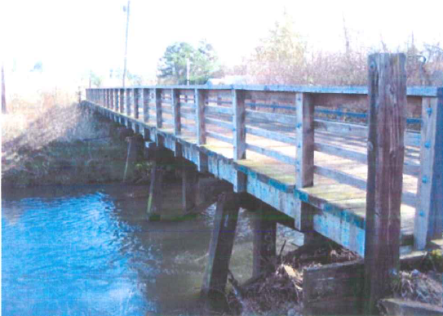
PROJECT DETAILS
Bridge #48
Failing piles & decking
Obstructing piles
Heavy cyclist use
Notes:
Johnson Creek and the Springwater Corridor are intertwined, with at least 10 trail bridges over the creek. The creek was once host to abundant native fish populations, including threatened salmon species.
The existing Bridge #48 currently has three sets of pile supports resting in the creek bed. Piles create obstructions where debris can lodge, creating log jams and putting additional stress on the structure. In 2013, in fact, the bank armoring failed and had to be repaired under emergency response.
The section of trail that this bridge supports is also heavily used by cyclists.
The current bridge design is problematic. You can see here the pilings reach into the stream bed. This causes:
Debris collection, which ultimately creates pressure on the structure; and
Which constrains fish passage.

Slide 6
PROJECT DESIGN
Structural integrity
Accessibility
Unobstructed creek flow
Notes:
The Project will:
Remove the current failing bridge and replace it with a brand new bridge (shown here).
The new bridge will:
Be constructed of durable Corten steel construction, with wood top railings and concrete decking, thereby reducing maintenance costs;
Provide an accessible smooth bridge surface - replacing an uneven aging timber deck; and
Create enhanced stream-viewing opportunities.

Slide 7
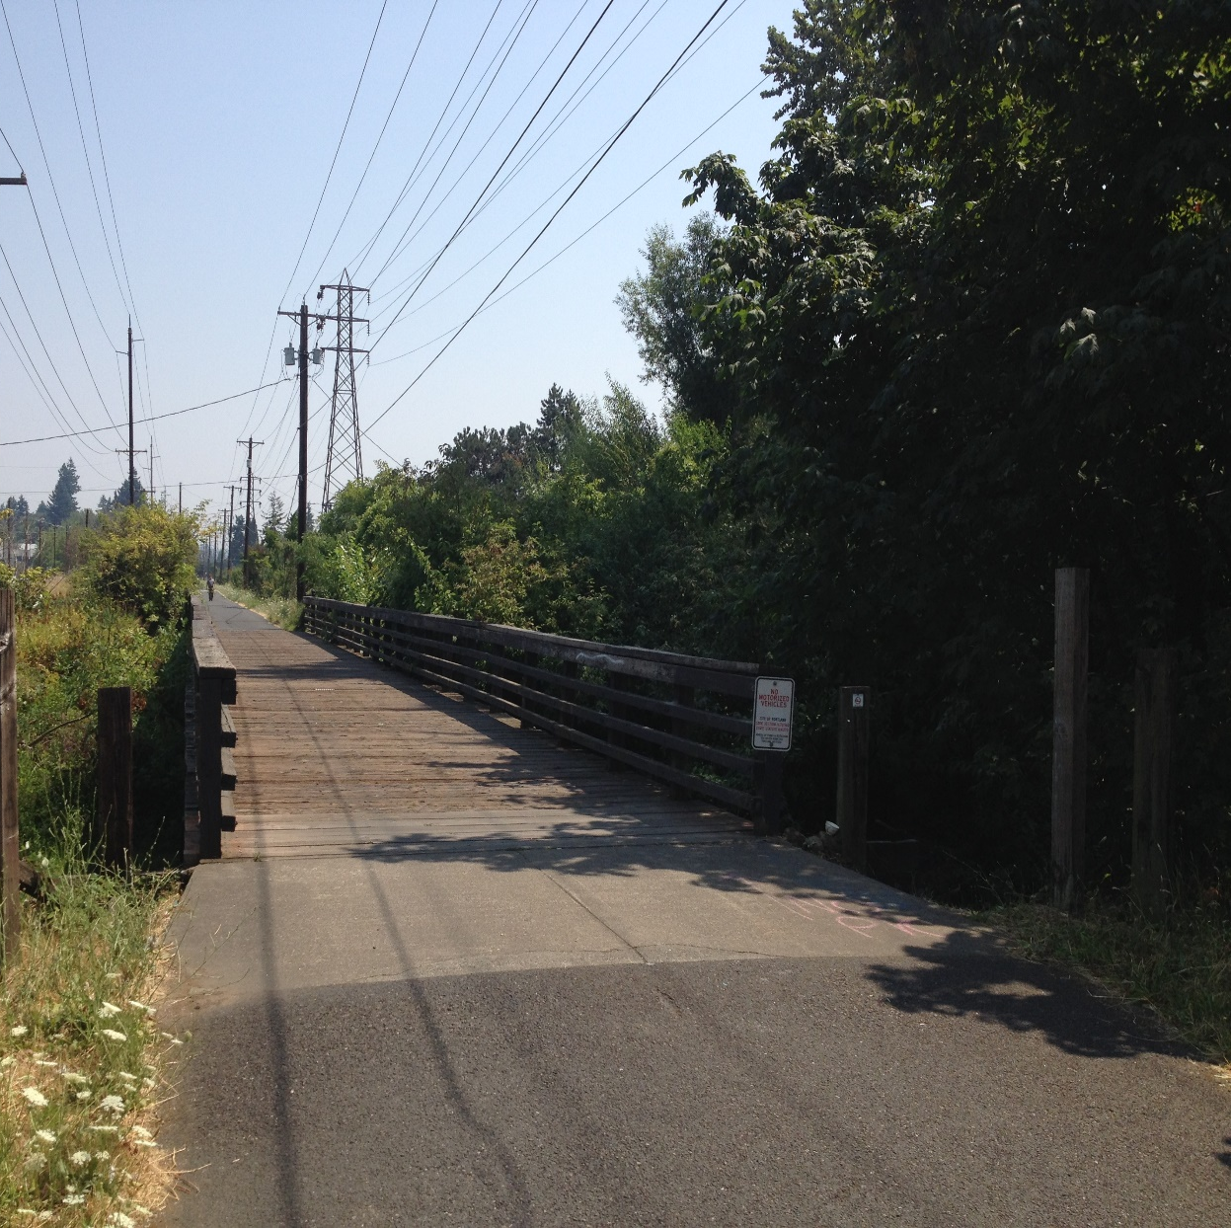
Springwater Trail Bridge Replacement
PUBLIC PROCESS
Informational Outreach:
Ardenwald –Johnson Creek Neighborhood
Southeast Uplift Neighborhood Coalition
Bike Portland
Trail Signage
Flyers
Notes:
The Project serves Southeast Portland, especially the Ardenwald-Johnson Creek Neighborhood, which is part of the Southeast Uplift Neighborhood Coalition.
Public involvement for this project is at the informational level, as the bridge replacement project is largely technical and for safety reasons.
Still, the Bond Project to replace this bridge included outreach to neighboring businesses and the community.
Outreach also included email announcements to contact lists, including Bikeportland.org, flyers to neighborhood residents and signage along trail.
Prior to construction, information again will be shared using the same mediums to provide information about impacts and detour.

Slide 8
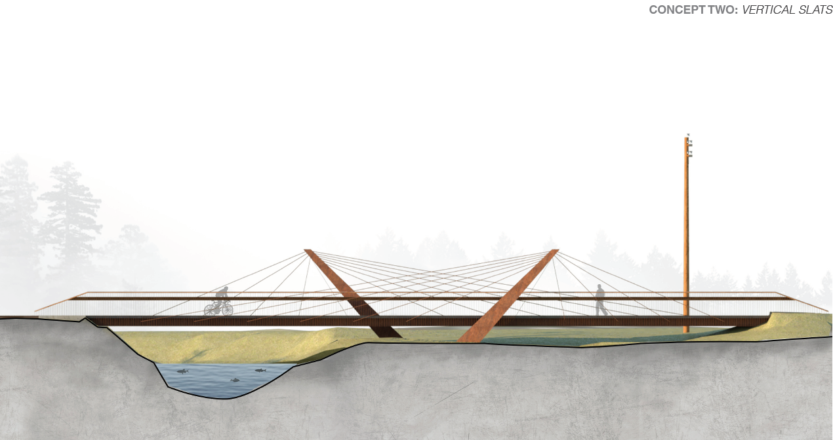
WHY ARE WE HERE?
Authorize contract with Just Bucket Excavating, Inc.
for Springwater Corridor Bridge #48 Replacement for $1,169,668.67 (Ordinance - Bid No. 00001123)
Notes:
We anticipate construction to start in mid-May 2019, with construction through early fall 2019.
We are here today to request acceptance of the bid from Just Bucket Excavating, Inc. for the Springwater Corridor Bridge #48 Replacement Project in the amount of $1,169,668.67.
Now, Larry Pelatt will provide an overview of the Procurement-related Bid Process related to the acceptance of the bid from Just Bucket Excavating for the Springwater Corridor Bridge Replacement Project in the amount of $1,169,668.67. After that overview, we will be happy to answer any questions.

