Slide 1
Our Mission
Go Lloyd connects people and places by creating partnerships and transportation solutions to make Lloyd extraordinary

Slide 2
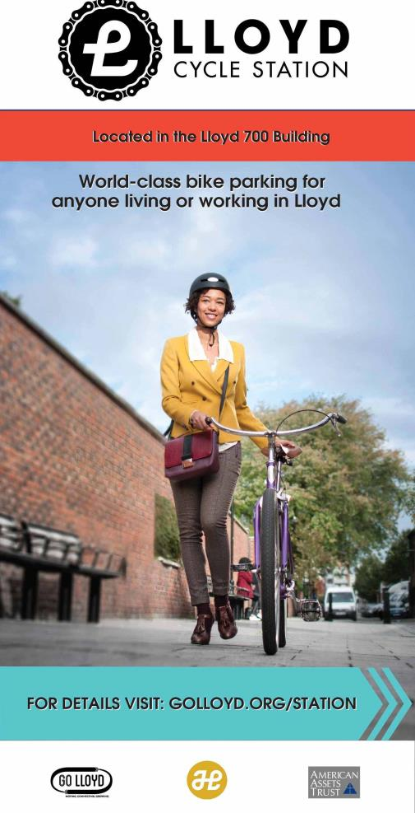
Go Lloyd Profile
Founded 1994 – initiated programs in 1997
Providing services to employers for 21 years
6 staff – 1-2 summer interns
165 Member businesses
Representing over 10,000 employees & residents
Public partners:
Portland Bureau of Transportation
TriMet
Prosper Portland
Portland Streetcar
Metro

Slide 3
Current Conditions

Slide 4
First 12 cans
Phase One:
21 cans on MLK and Grand
Phase Two:
East Lloyd, Broadway & Weidler

Slide 5
Art Sponsorships
PORTLAND Street Art Alliance
Alex Chui
Maryanna Hoggatt
Ben Patterson
Sponsoring Businesses
Hotel Eastlund
INN at the Convention Center
Lloyd Community Association
Spirit of ‘77
Oregon’s Finest
City Center Parking

Slide 6
Art Examples

Slide 7
Art Examples

Slide 8
Art Examples

Slide 9
Art Examples

Slide 10
Thank You
Portland City Council
Mayor Wheeler and Staff
Kevin Veaudry Casaus – BPS
PSAA and Artists
Lloyd Businesses Providing art sponsorships

