Slide 1
Amend Contract With Brown & Caldwell for the Columbia Boulevard Wastewater Treatment Plant Waste Gas Burner Replacement BES Project No. E10649
James Brown, Supervising Engineer
Aaron Lawler, Engineer
February 13, 2019

Slide 2
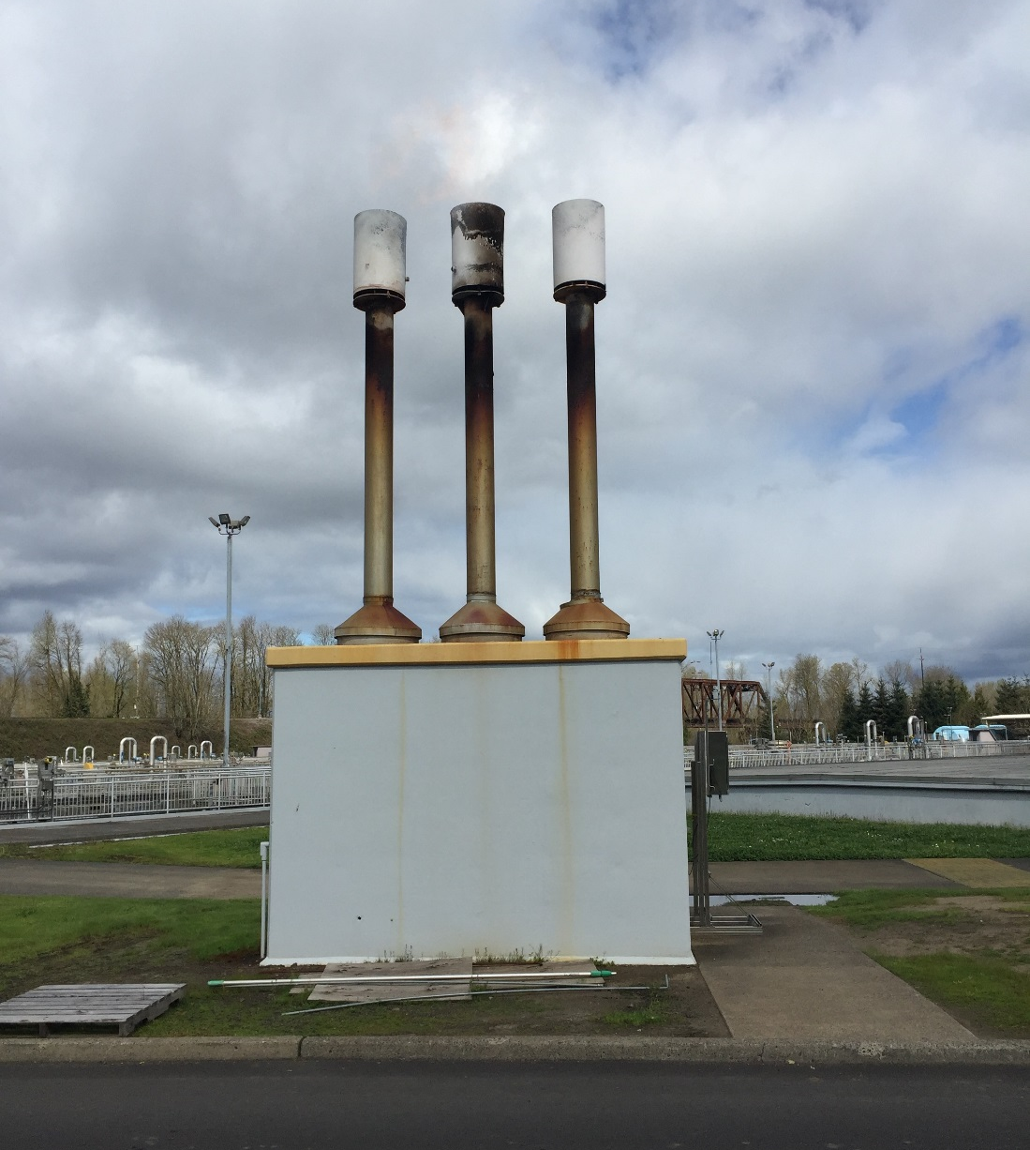
Project Location
Existing Waste Gas Burners (WGBs) Located at CBWTP
EXISTINGWGB LOCATION
PROPOSED WGB LOCATION

Slide 3
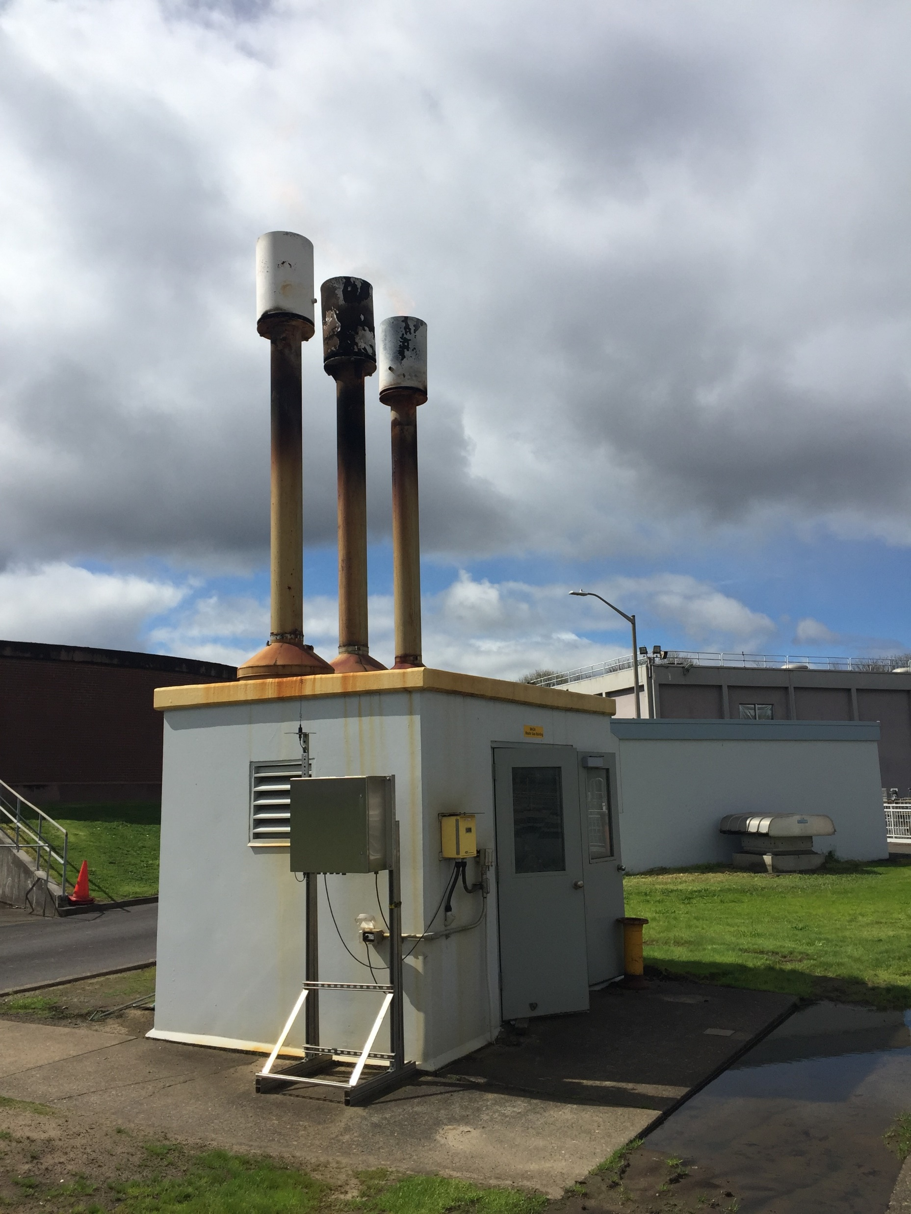
Council Presentations
Initial Council Presentation – May 24, 2017
- ORD No. 188379 Approved
Future Council Presentation
Ordinance Authorizing Construction Contract
(approx. February 2020)

Slide 4
Project Objectives
Problem Statement:
The WGBs are over 36 years old and have exceeded their useful life, are demonstrating signs of significant wear and corrosion, and do not appear to be structurally and seismically secured, creating operational and safety issues
Project Objectives:
Install new WGB system, near Digester 9 and 10, and increase system safety, capacity, and reliability.

Slide 5
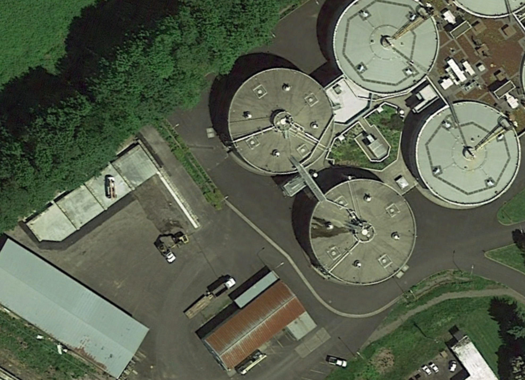
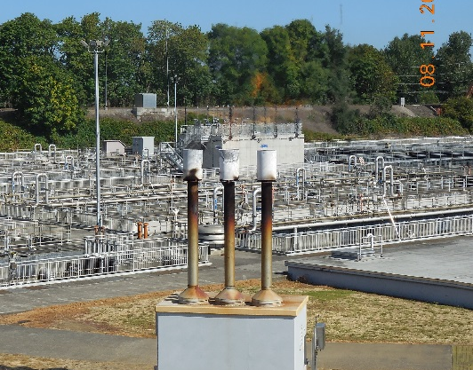
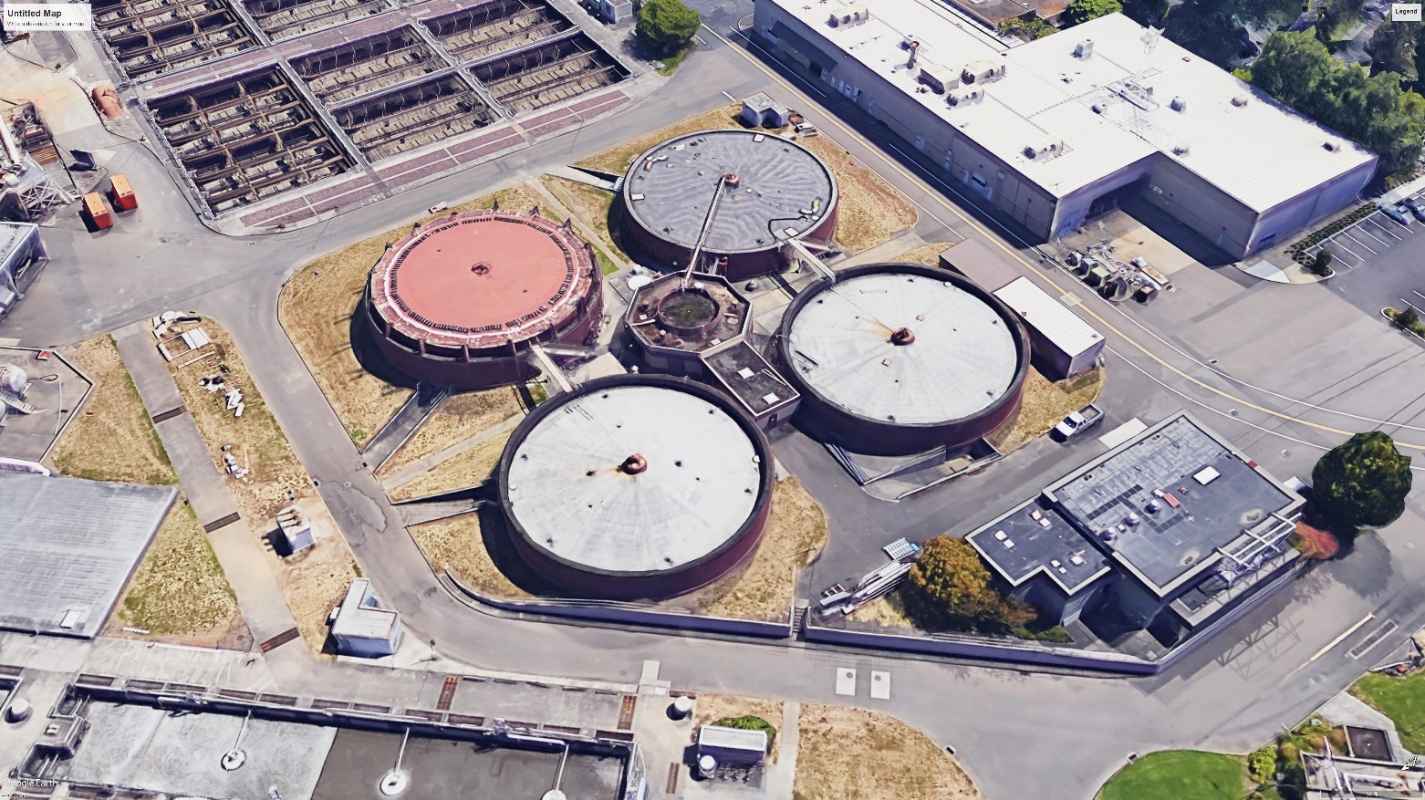
Project Overview
Install new WGBs at new location

Slide 6
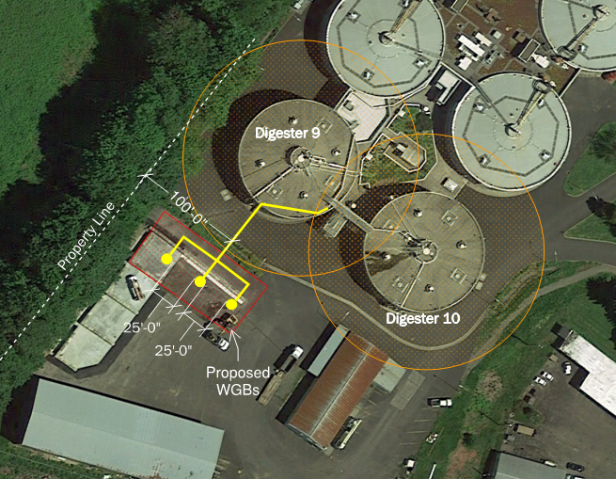
Project Benefits
Reduced Green House Gas Emissions
Increased Reliability
Improved Safety
Increased Capacity/Permit Compliance

Slide 7
Project Budget and Schedule
The current budget and estimated total project cost is $3,448,793
The level of confidence associated with this estimate is Low
The current construction contract estimate is $1,700,000
Current Proposed Schedule:
DESIGN
Adv
CONSTRUCTION
FINAL COMP
2019
2020
2021
April July Oct Jan April July Oct Jan April July

Slide 8
Project Budget
Project Phase | Estimated Project Cost | PTE Support Contract
Predesign Phase | $221,170 | $134,329
Design Phase | $637,418 | $366,984
Advertise-NTP | $16,001 | $5,839
Construction Phase | $2,449,044 | $125,722
Startup/Closeout Phase | $125,160
Estimated Total Project Cost | $3,448,793 | $632,874

Slide 9
Original Contract
Project work was advertised for competitive selection
4 proposals received
Brown & Caldwell were selected in accordance with City Code 5.68
Negotiated fee is $293,939
M/W/ESB Subcontracts participation is at 31.3% of total contract NTE limit, or $92,002.

Slide 10
Amendment 1
Amendment to original PTE contract required due to scope changes:
Relocate flares instead of replace at current location
Additional gas production modeling
Additional complexities to design of new facility
Amendment 1 scope and fee developed and negotiated with B&C
Total Amendment: $338,935
Optional Tasks: $156,500
D/M/W/ESB: $106,013
Amended D/M/W/ESB Participation: 31.28%
Updated Contract NTE: $632,874

Slide 11
Amendment 1 (cont’d)
Original PTE Contract Not-To-Exceed: 293,939
Amendment 1 Not-To-Exceed: $338,935
- 10% of Overall Project Cost
Revised PTE Contract Not-To-Exceed: $632,874
Overall Project Budget: $3,448,793

Slide 12
Recommendation
Authorize the execution of a PTE Amendment with Brown & Caldwell with a contract not-to-exceed limit of $338,935.

Slide 13
Questions
Thank you

