Slide 1
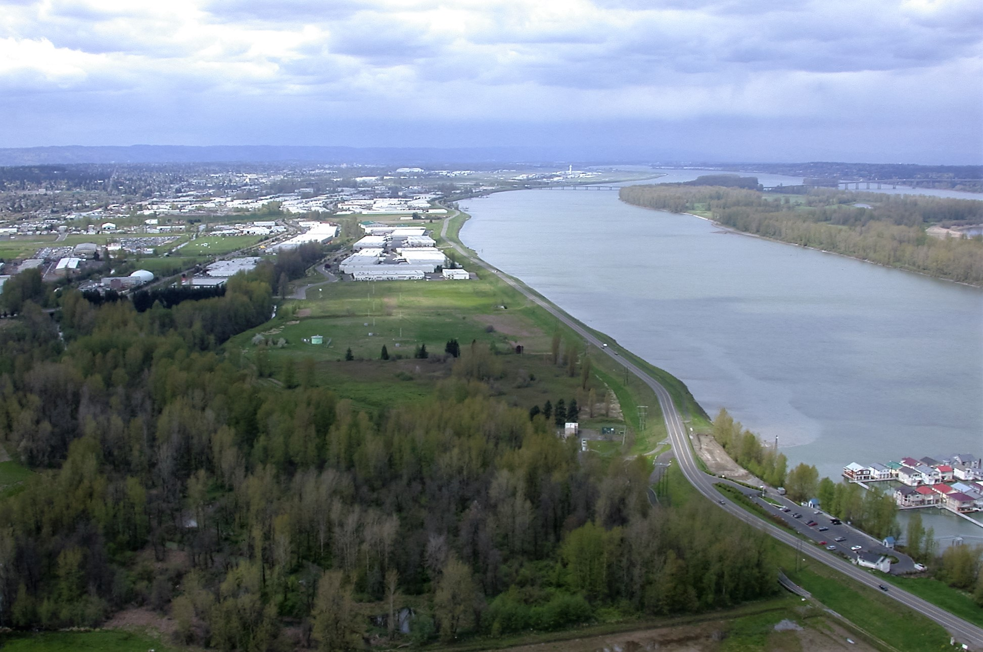
Levee Ready Columbia 2019 Update
Presentation to Portland City Council
Notes:
Mike
Introduction to the City’s role and participation in Levee Ready Columbia
--Introduce Project
--Introduce speakers
--note this is an Oregon Solution Project

Slide 2
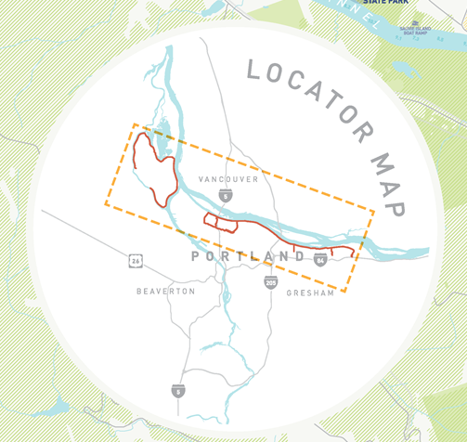
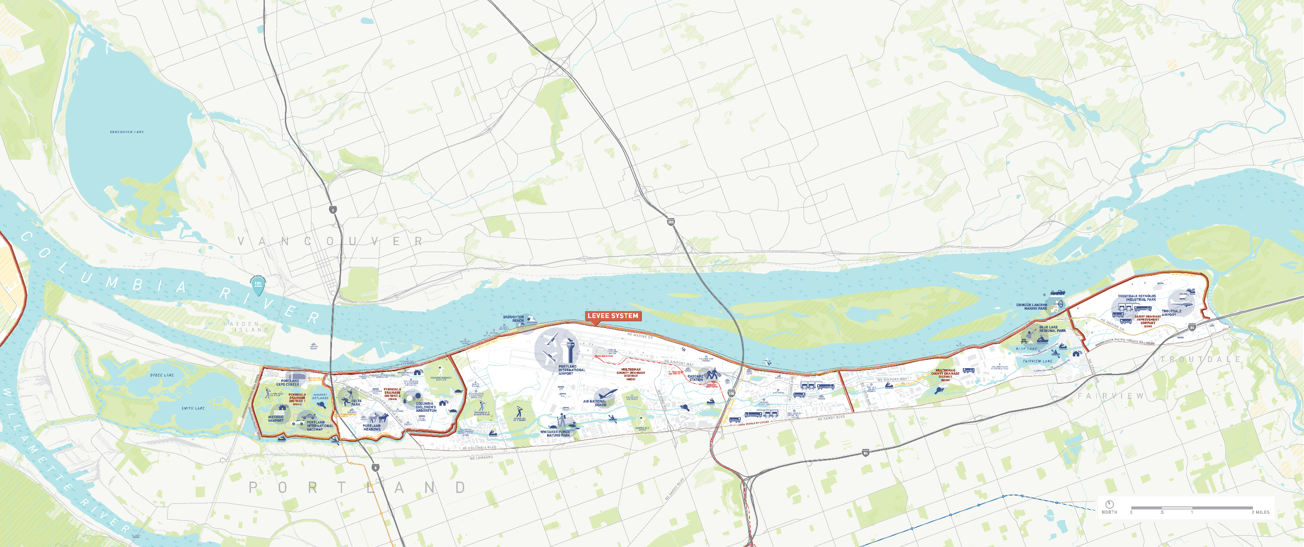
Our Managed Floodplain
27 miles of Federally Authorized Levees
12 pump stations
+13,000 acres of land
Levee Ready Columbia 2019 Update
Notes:
Colin
--Very brief overview of what the system looks like

Slide 3
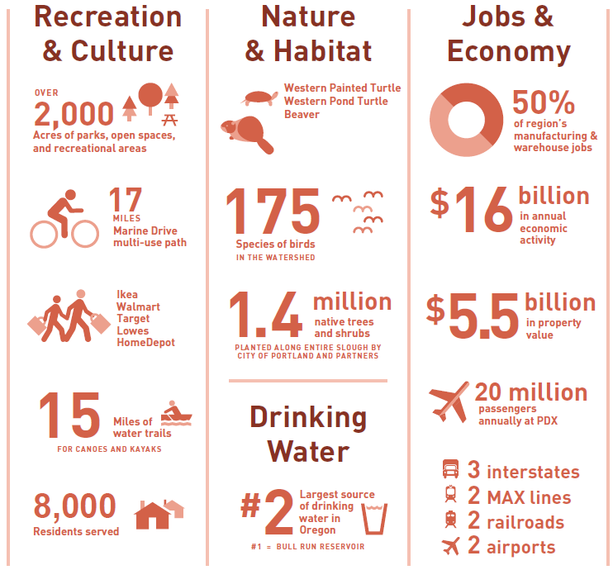
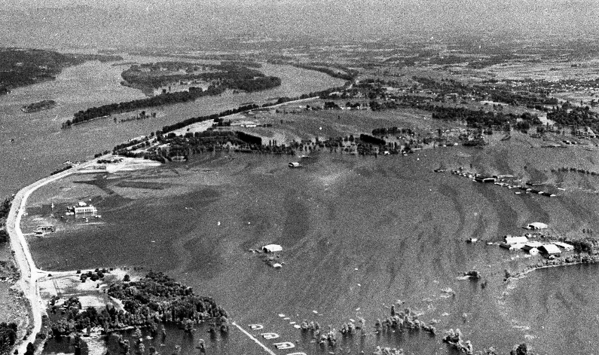
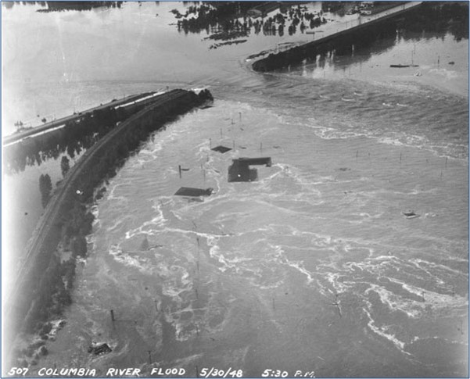
Flood Risk
Levee Ready Columbia 2019 Update
Notes:
Colin
Our history of flooding
--We know the disastrous impacts of flooding firsthand
- Vanport Mosaic FESTIVAL – Memorial Day weekend 71st anni
8,000 residents
+59,000 jobs
Regional transportation nexus
Our industrial core
Parks, open space, and quiet places
--PROBLEM Statement
-Changes in floodplain management and regulation
-Changes in land use mean there is shared responsibility
-Collaborative instead of doing it on our own
-Identified need for

Slide 4
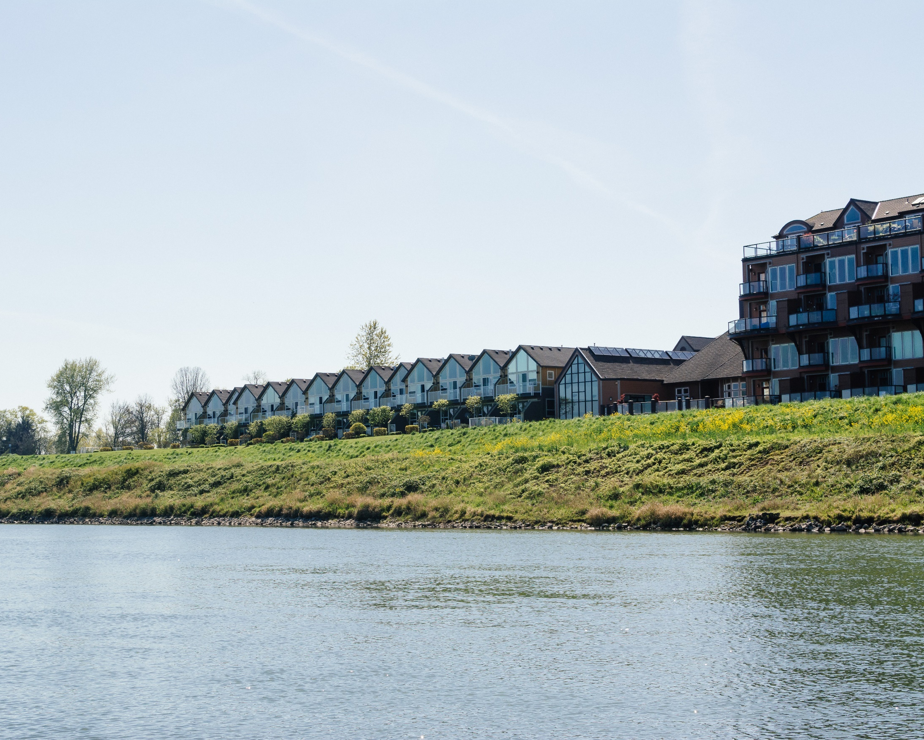
Levee Ready Columbia Project Partners
City of Portland
City of Gresham
City of Fairview
City of Troutdale
Metro
Multnomah County
Port of Portland
Peninsula Drainage District #1
Peninsula Drainage District #2
Multnomah County Drainage District
Sandy Drainage Improvement Company
State of Oregon
Representatives from neighborhood associations, business, environmental, and public interest non-profits
Levee Ready Columbia 2019 Update
Notes:
Stephanie
Overview of Oregon Solutions
--Housed at PSU’s College of Urban and Public Affairs
--Community based problem solving and collaborative governance
--Portland Community Gardens with Commissioner Fish
--Projects are designated by the Governor
--LRC has been a project for 5 years – designated by two Governors
--Hales and Bailey original co-conveners; Bailey now convenes and I facilitate
--Participants shown on slide
Goals of the project:
--to modernize levee and flood control system to meet and retain federal standards
--to continue to protect resources described in previous slide from flooding
Strategies:
--increase public awareness of the importance of the levees and what they protect, e.g. Marine Drive is a levee
--ensure that the process includes diverse interests and perspectives
--develop a long-term governance and financing model to pay for capital improvements and operations and maintenance
--work closely with the federal government to maximize opportunities for federal funding – Colin talk about Feasibility Study
--solicit and maintain support from the Governor and the legislature
(Segue to next slide – what has been accomplished)

Slide 5
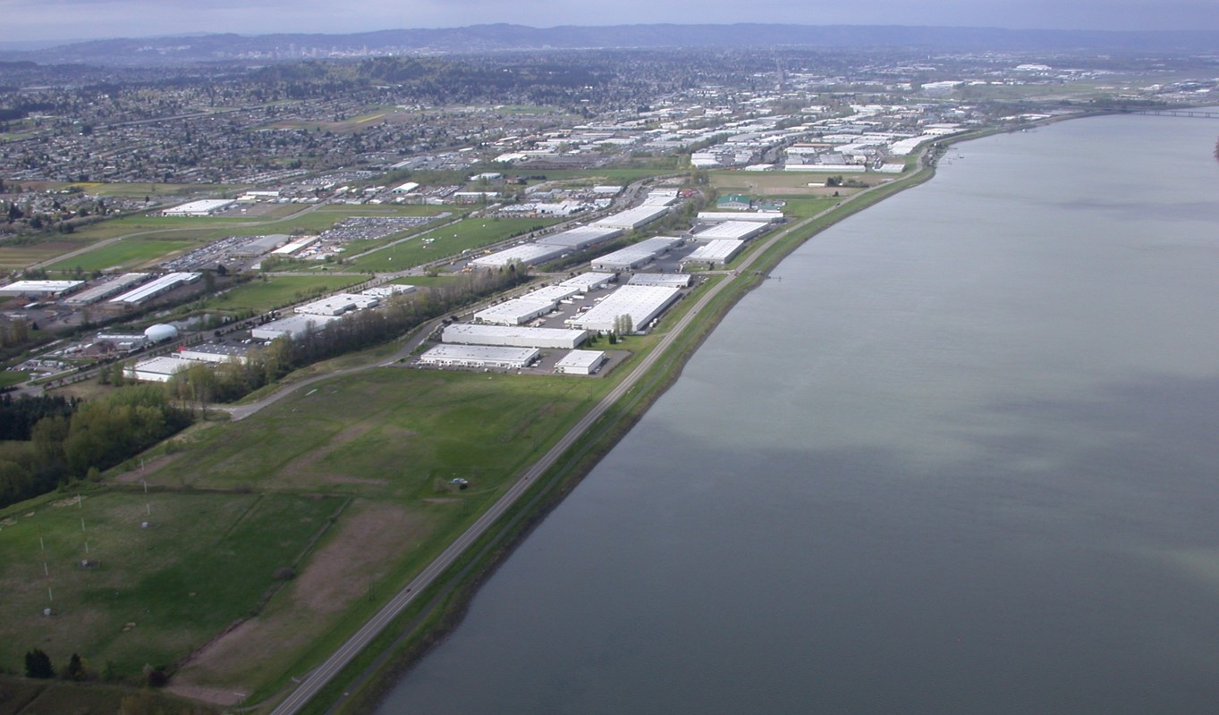
Levee Ready Columbia Accomplishments
Completed first-ever geotechnical evaluations
Advocated for–and landed –the $3M Feasibility Study
Completed a series of investigations necessary to understand flood risk, environmental, economic, and social functions of the area
Introduced legislation to address long-term challenges
…and Continued Conversations
Legislative concept
Feasibility study and certification project costs
Levee modernization that meets our local needs
Levee Ready Columbia 2019 Update
Notes:
Stephanie
Since inception of the project, Levee Ready Partners have received $4.9 million in state Infrastructure Finance Authority loans from Business Oregon and contributed $6.6 million in cash towards federal certification and accreditation of the levee and flood control system.
These dollars have:
--provided technical and engineering data to identify specific projects and costs required to upgrade and maintain the system
--funded completion of investigations to define resources protected by the system and risks to those resources
--helped acquire federal investment in the USACE Feasibility Study
--defined a path toward modernization and stable funding through a new governance and financing structure by creating a new district
(Segue to next slide – why a new special district)

Slide 6
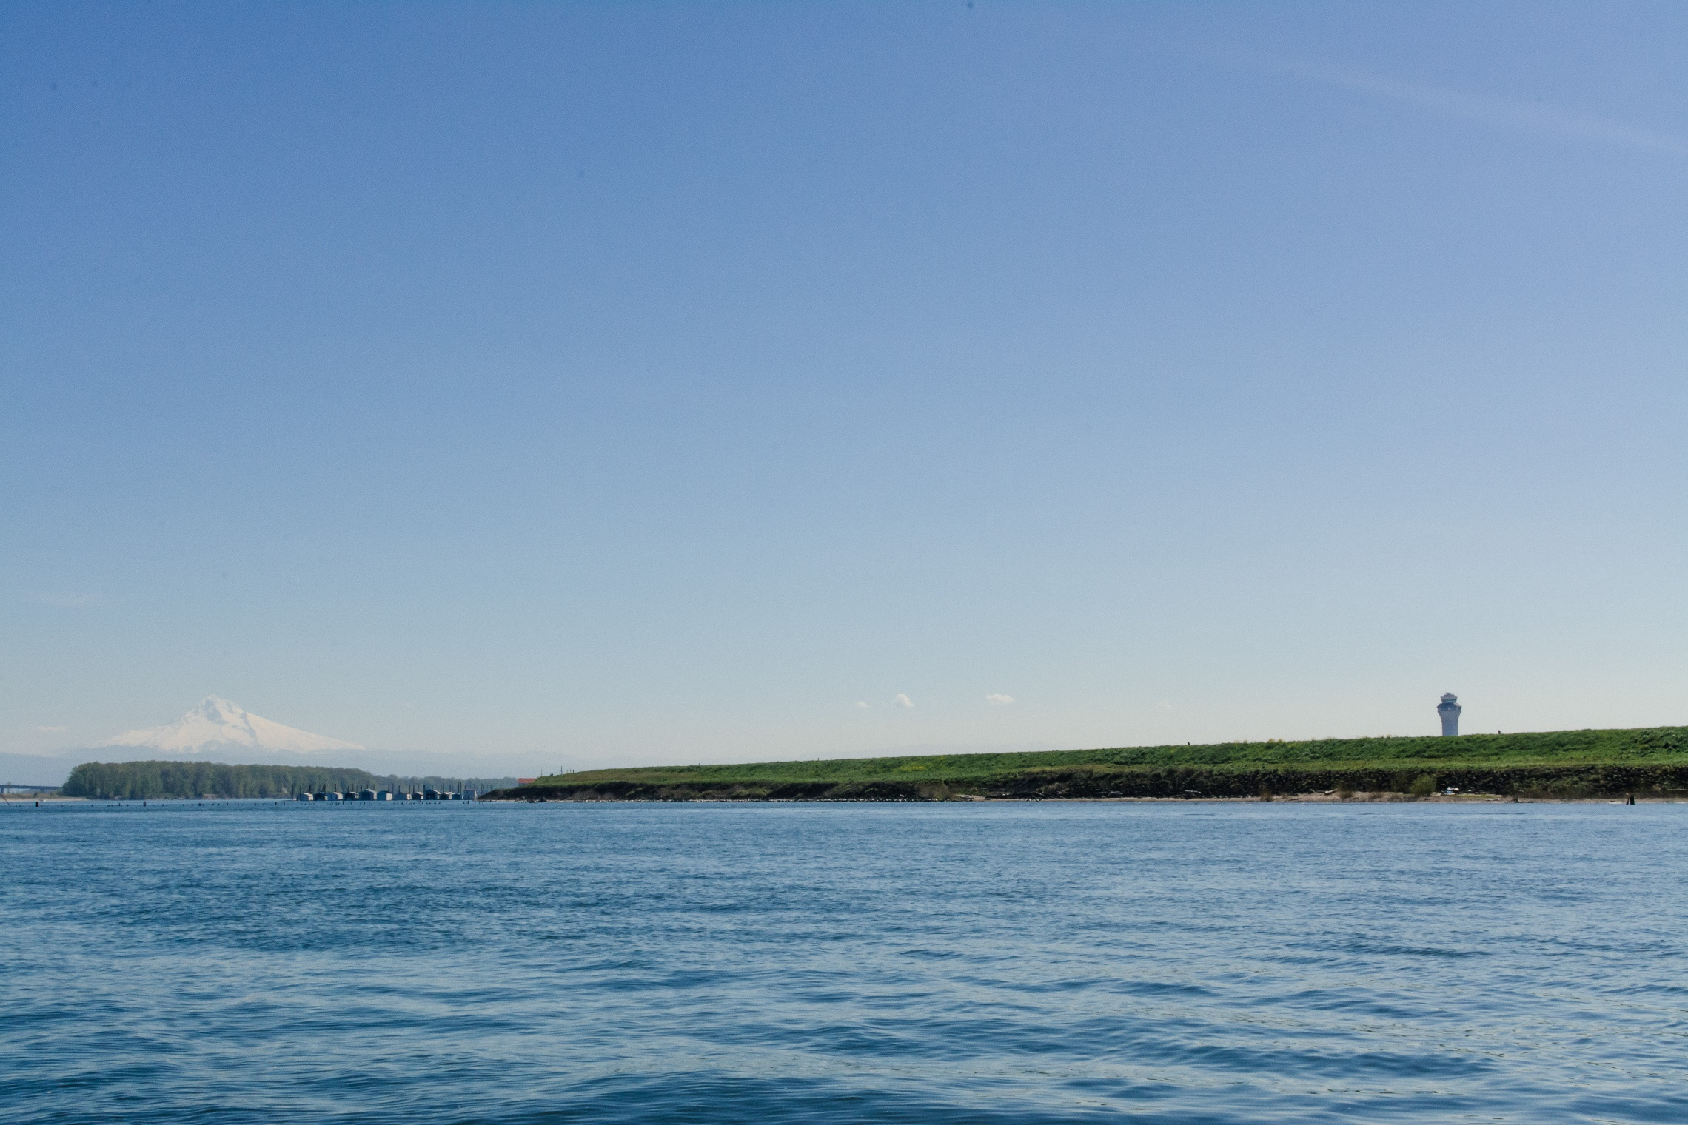
The need for a new District
Benefits and burdens: The status quo does not equitably allocate costs of flood risk management in the Columbia Corridor to the many beneficiaries of the system.
Fragmented responsibility: Responsibility and authority for vital functions are fragmented across several jurisdictions. No single entity is responsible for reducing flood risks.
Insufficient revenue: The existing four drainage districts assessments are limited. Revenues will need to approximately triple to support the system.
Levee Ready Columbia 2019 Update
Notes:
Stephanie – Why a new district?
With the assistance of consultant experts, the partners worked through multiple options for governance and financing structures to address the problems associated with creating and maintaining a long-term levee and flood control system
--currently, all costs of protecting resources within the managed floodplain are borne by those living and working in the managed floodplain
--those outside the managed floodplain who receive benefits from those resources do not share in the cost
--responsibility for protecting the resources is fragmented among 4 drainage districts, 4 cities, the County, Metro, the Port
--current revenue structure based on property tax assessments is not sustainable - costs would have to triple under current system and distribution is inherently inequitable due to compression
To address these concerns, the partners agreed to ask the 2019 legislature to create a new special district with a utility based fee structure and bonding authority that would address these concerns.
The Intergovernmental Agreement that is before you today serves as a bridge to implementation of that special district.
(Segue to next slide)

Slide 7
2019-2024 Levee Ready Columbia IGA’s Purpose
Continues LRC Partners’ work toward recertification
Establishes temporary decision-making and staffing structure
Continues public outreach and public information efforts
Funds coordination of the US Army Corps of Engineers’ New Start Feasibility Study
Development of Locally Preferred Plan and Alternatives
Project management and coordination; communication and public outreach related to the Feasibility Study
Continues long-term governance work
Levee Ready Columbia 2019 Update
Notes:
Colin
Does NOT Overrule any jurisdiction’s existing authorities
Does NOT commit any partner to funding LRC for more than one year at a time
Does NOT Guarantee any specific outcome(s) or favor any party
Provides the table for conversation
Through 2024 with annual appropriation; no more 5% increase with consensus decision

Slide 8
Anticipated Capital Projects to Meet Certification
and Major Capital Investment Needs*
February 2019
LEGEND
Location of pump stations requiring investments
Project required to meet certification minimum
*Some costs do not include contingency
Estimated sum for Certification in all districts: $43M
Estimated sum for other major projects in all districts: $72M
Total estimated sum for Certification & Major Projects: $115M
Clubhouse Low Spot
$500k - $1M
Railroad Embankment
$15M - $20M
Levee Embankment Remediation
$500K - $1M
Marine Drive Off-ramp Low spot
$1M - $3M
Peninsula Canal Levee
$2M - $5M
“Gatetower” Closure Structure
$1.5M - $3M
MCDD Columbia Slough Levee
$1M - $2M
PEN 1 Accreditation Costs:
$16M - $23M
PEN 1 Major Project Costs:
$15M
Est. total: $38M
PEN 2 Accreditation Costs:
$2.5M - $6M
PEN 2 Major Project Costs: $14.8M
Est. total: $20.8M
MCDD Accreditation Costs:
$5M - $11M
MCDD Major Project Costs: $32.7M
Est. total: $43.7M
SDIC Accreditation Costs:
$1.5M - $3M
SDIC Major Project Costs:
$9.1M
Est. total: $12.1M
Levee Ready Columbia 2019 Update
Notes:
Colin

Slide 9
Local representation on the US Army Corps Feasibility Study
Purpose of the project is to answer:
Is there Federal interest in reinvesting in our levee system?
What projects would reduce threats to life, property, and internal systems?
October 2018: Study Began
December 2018: First round of Public Meetings and Open Houses
January 2019: Initial Scoping completed
October 2019: Preliminary Plans for public review
USACE working to develop the final objectives, measures, and strategies
Levee Ready Columbia is facilitating the local review of these plans, coordinating local outreach
Partnership and community will need to determine if projects meet local needs.
Levee Ready Columbia 2019 Update
Notes:
Colin

Slide 10
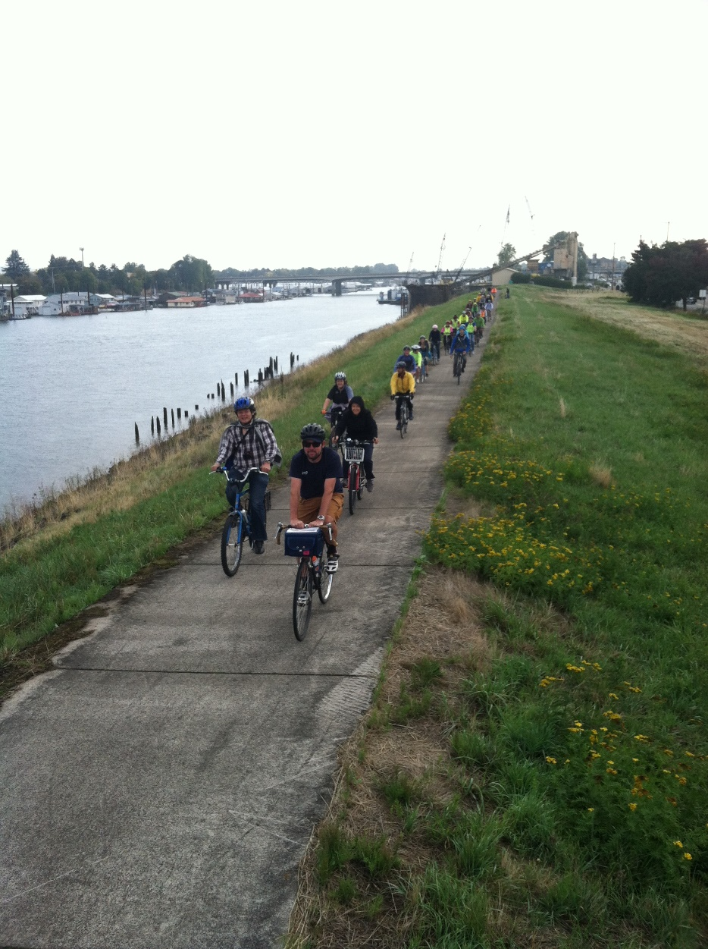
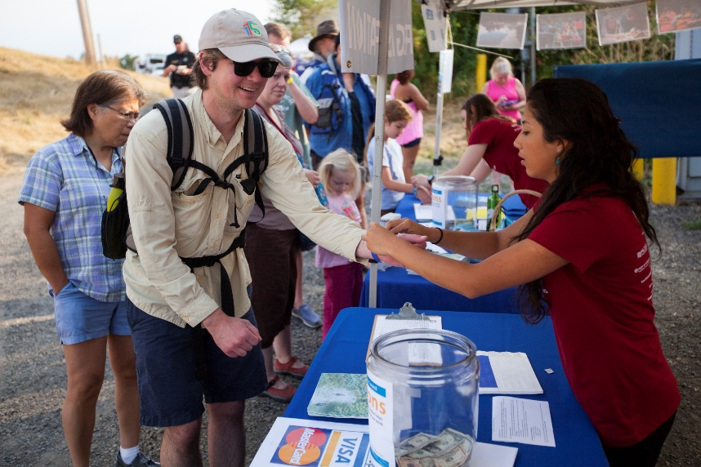
Levee Ready Columbia Next Steps
Parties to sign IGA to continue program
Facilitation
Communications
Completing technical projects
New governance conversation continues
Three bills in the legislature
Continue representing local interests for the USACE New Start Feasibility Study
Levee Ready Columbia 2019 Update
Notes:
Colin
What’s next!?

Slide 11
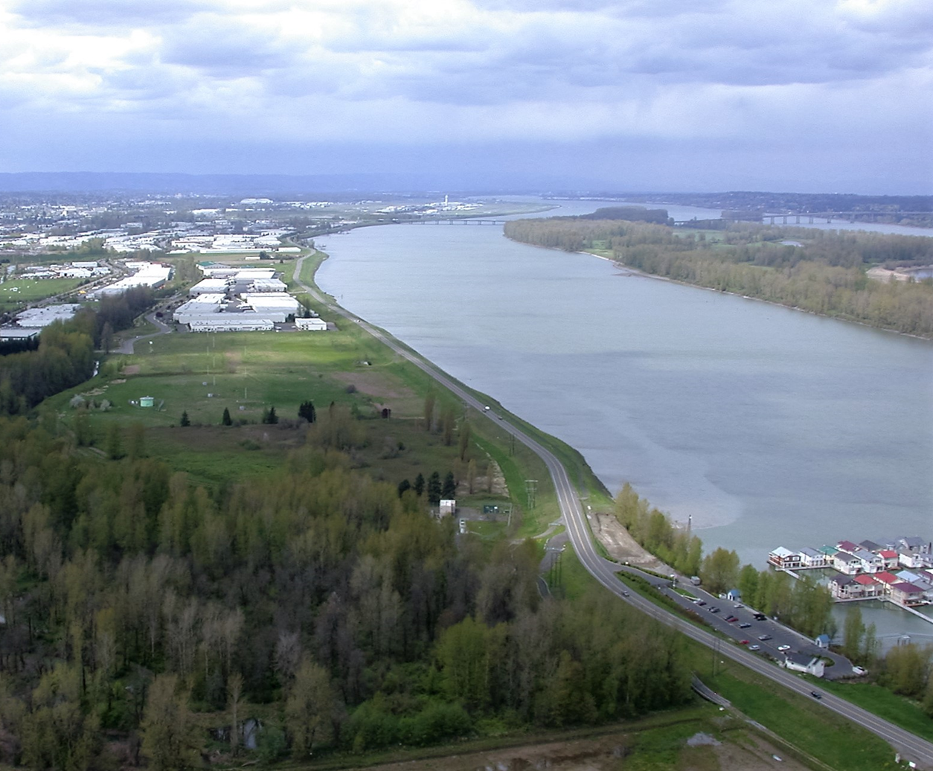
Today’s Council Action:
Authorize cost-sharing Intergovernmental Agreement for Levee Ready Columbia Interim Governance for $233,590 (FY19/20)

