Slide 1
Private Investment, Public Benefit

Slide 2
Brad Malsin, President
Central Eastside Industrial Council and
ESD Steering Committee

Slide 3
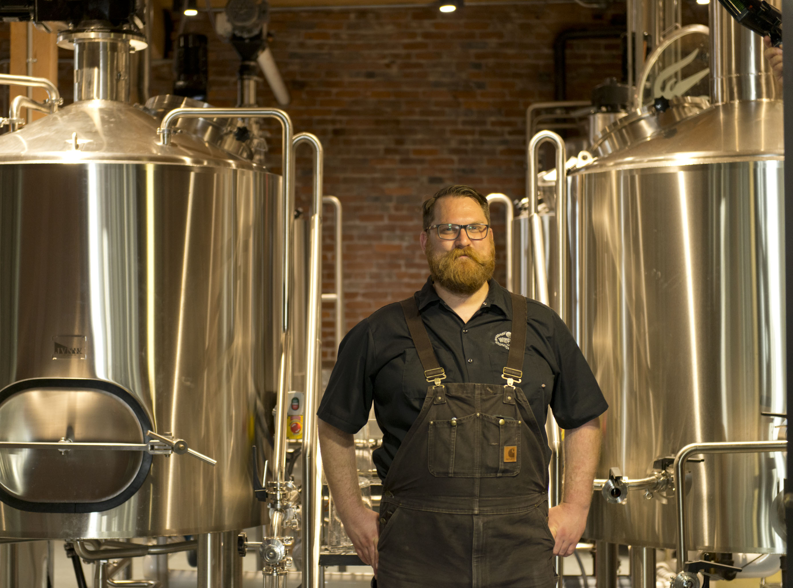
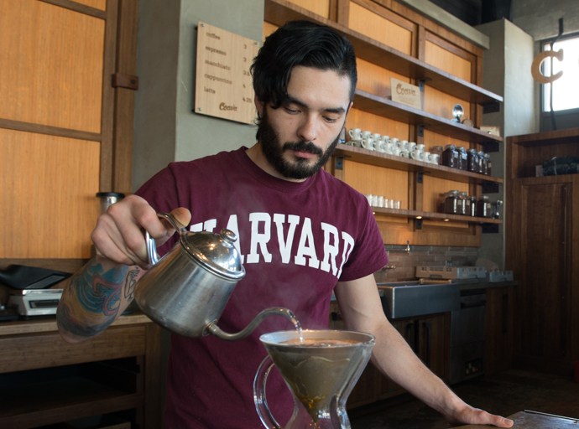
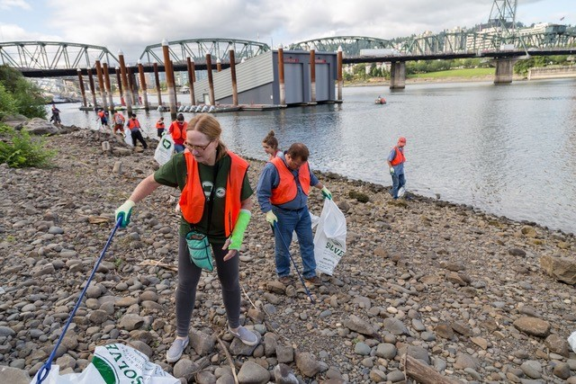
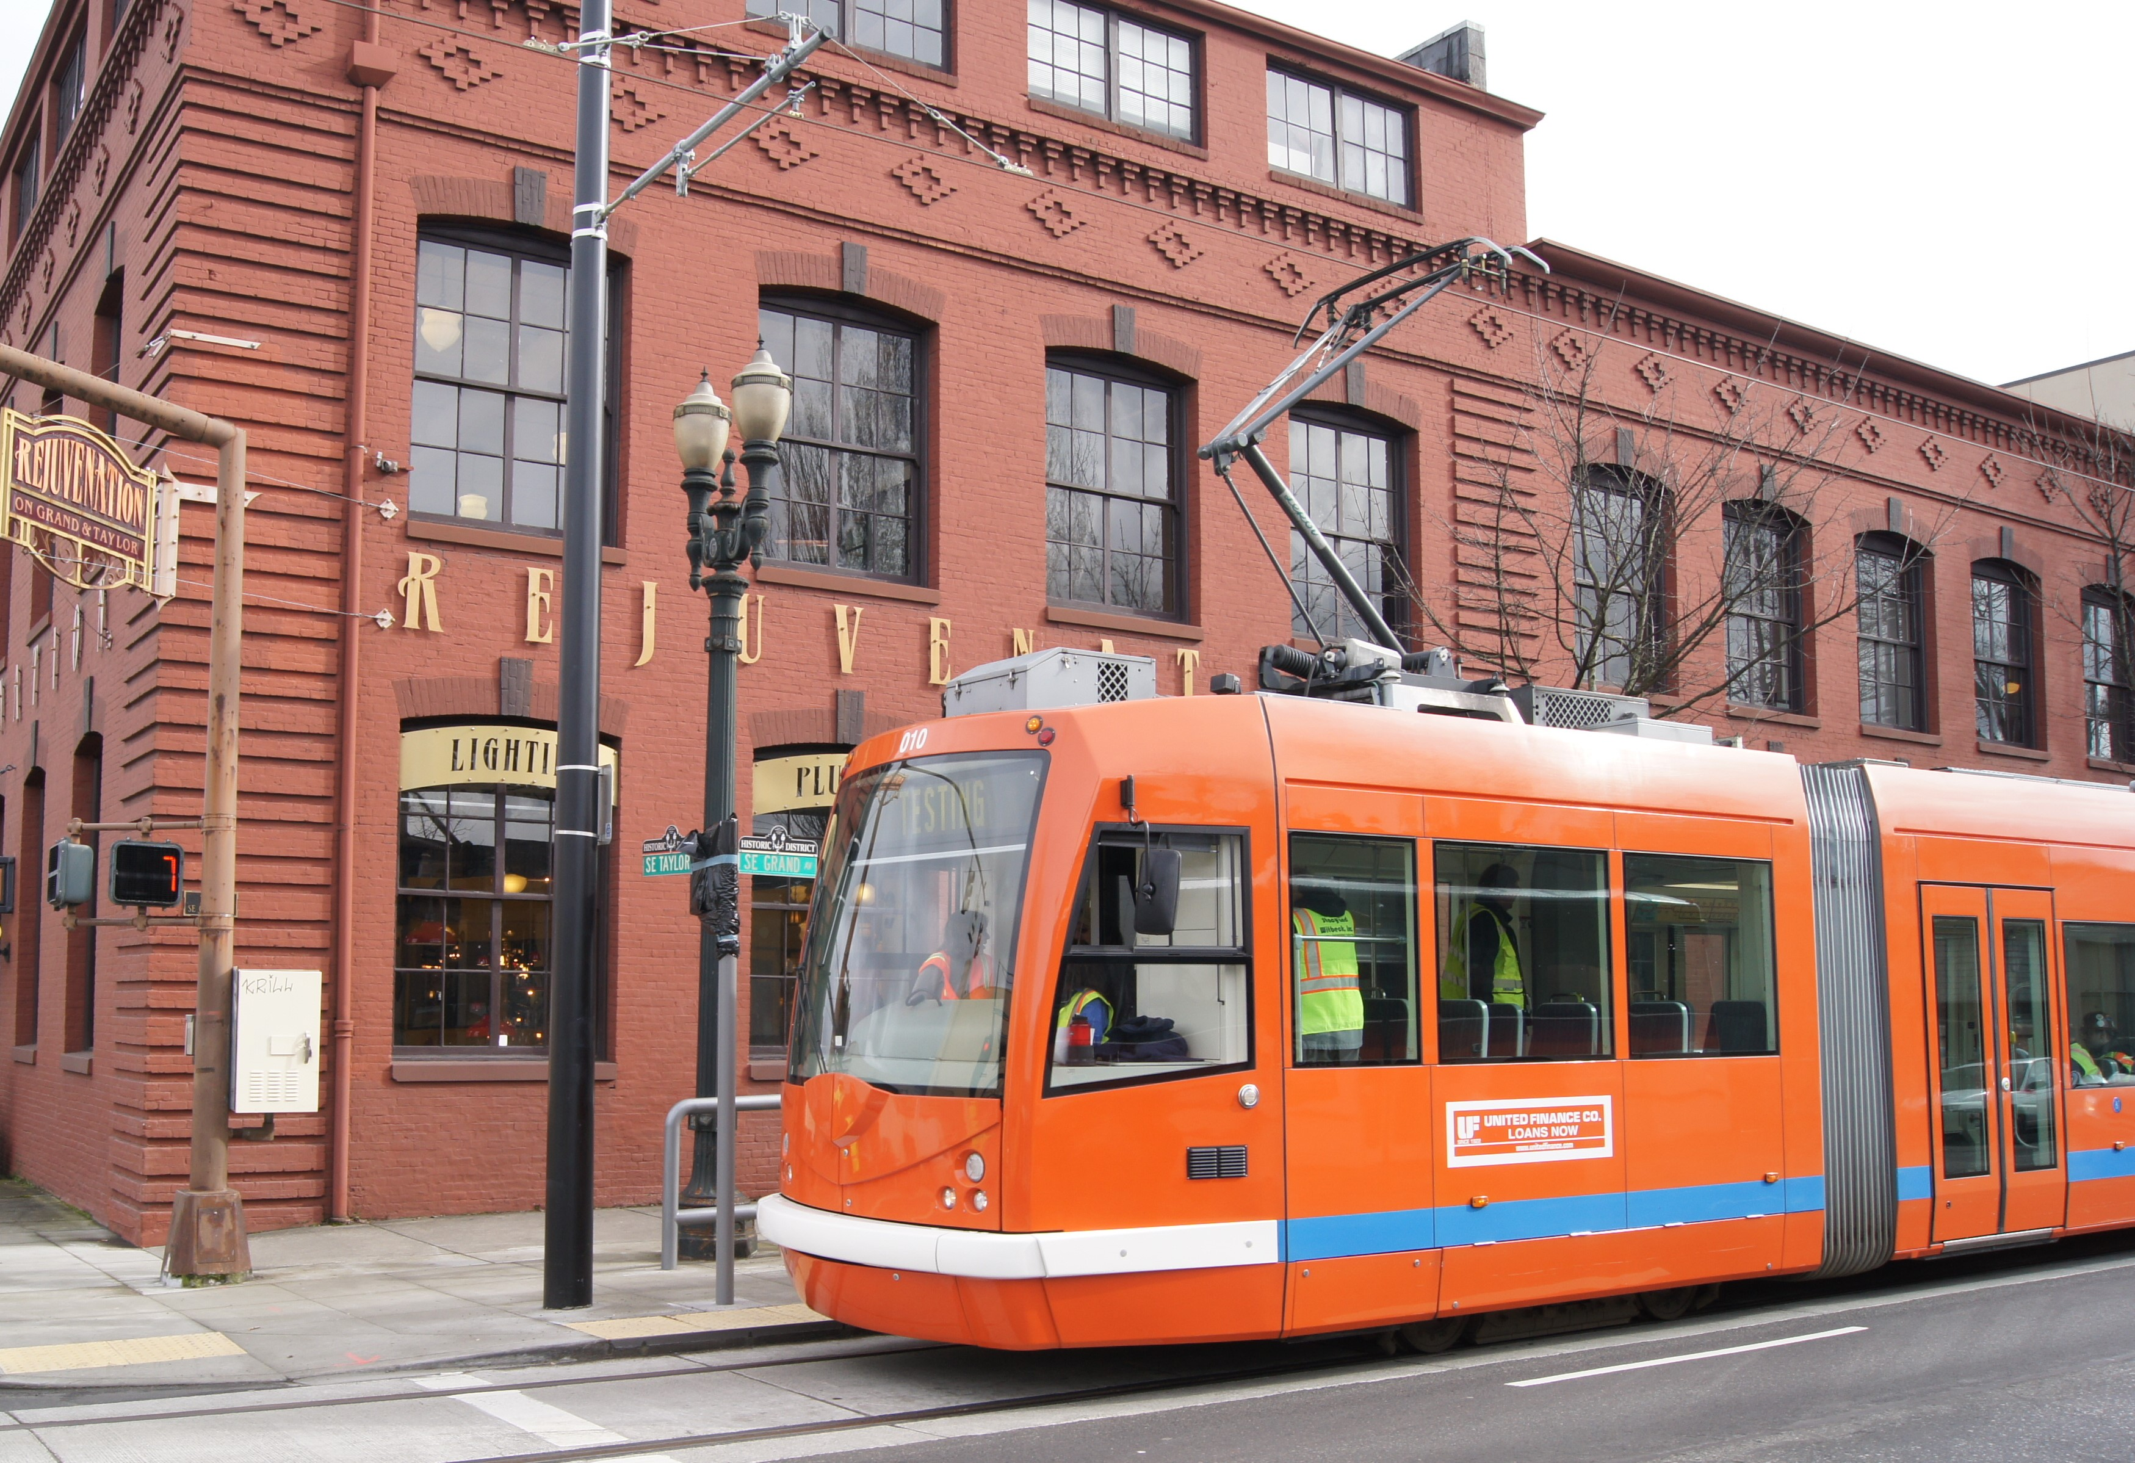
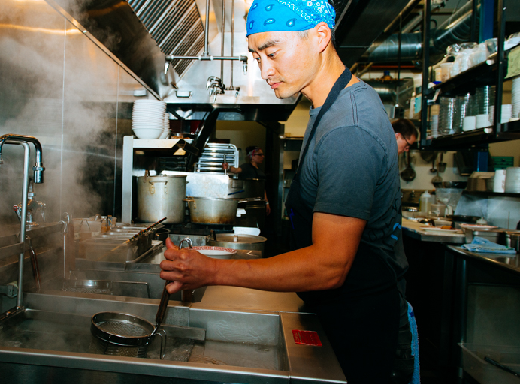
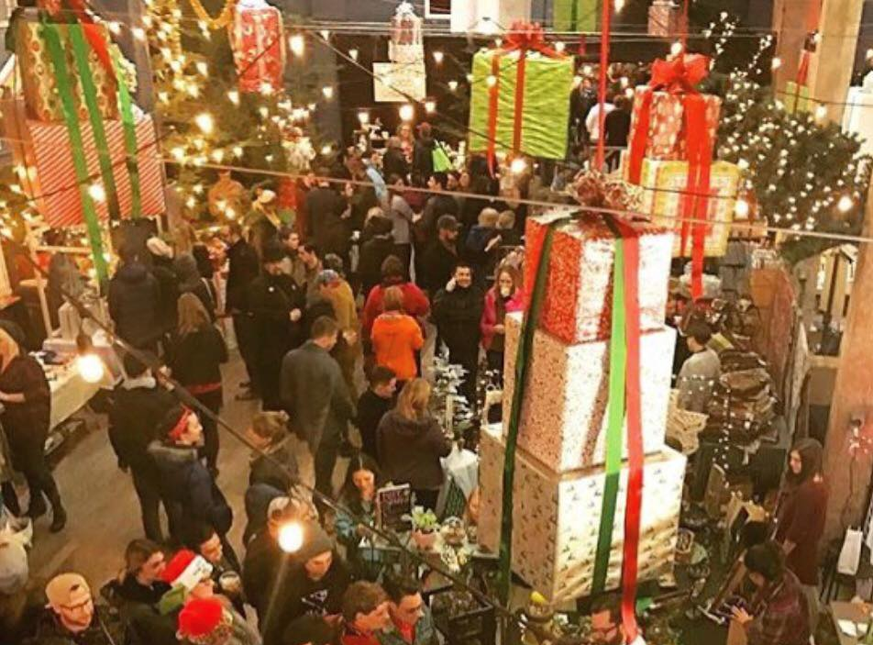
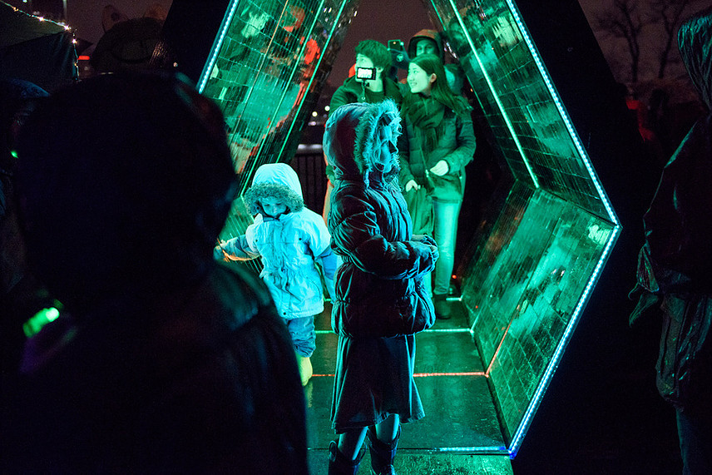
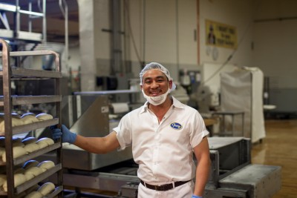
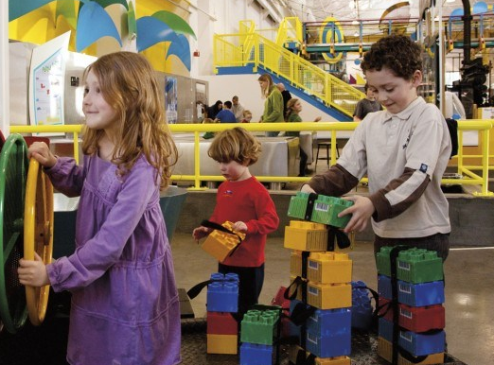
Central Eastside Industrial District
Central Eastside Industrial District is the national model for a thriving urban industrial district. Central Eastside’s diverse mix of businesses, industries, makers, manufacturers, creatives, residents and advocates contributes to an innovative environment that generates quality jobs, promotes a vibrant pedestrian experience and ensures a resilient, welcoming and connected community.

Slide 4
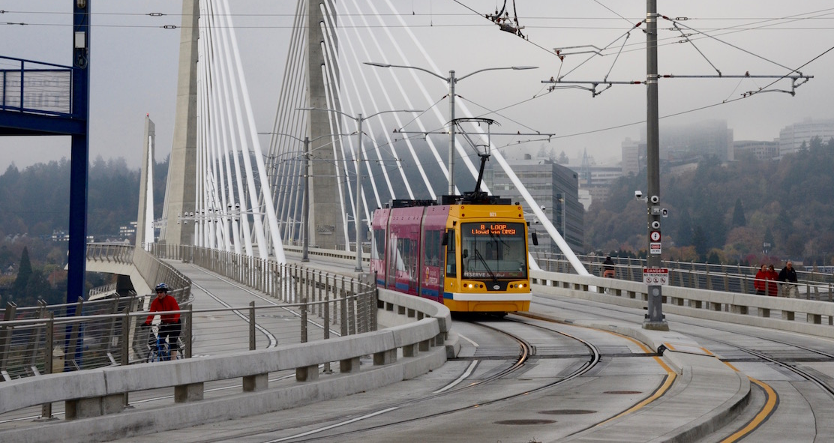
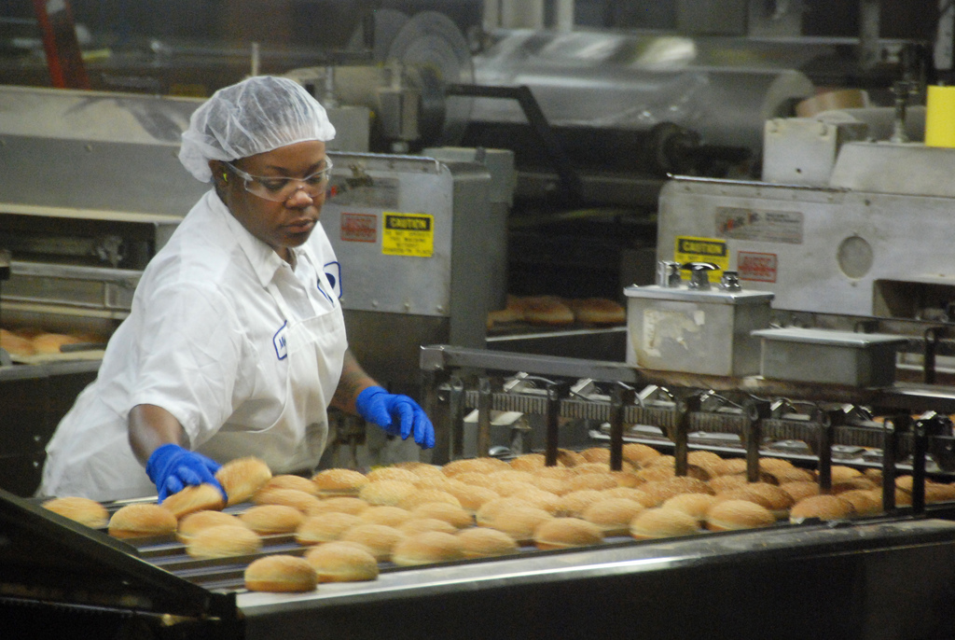
Central Eastside Industrial District
By The Numbers
20,200 Jobs (30% increase since 2010)
1,370 Businesses (21% increase since 2010)
2,000 Residents
681-acre Industrial Sanctuary
5 Bridgeheads (Burnside, Hawthorne, Morrison, Tilikum, Ross Island)
2 New Transportation Lines (Max, Streetcar)

Slide 5
The Only Constant is Change
Central Eastside is Changing.
A Lot.
New Development
Restored/Restoring Historic Buildings
New Max and Streetcar lines
New Tool to Support Changing District
An Enhanced Services District (ESD) is Portland’s name for a tool that business and property owners in a defined commercial area like the Central Eastside can use to fund improvements that go above and beyond normal City services.

Slide 6
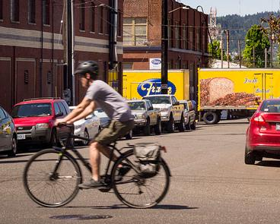
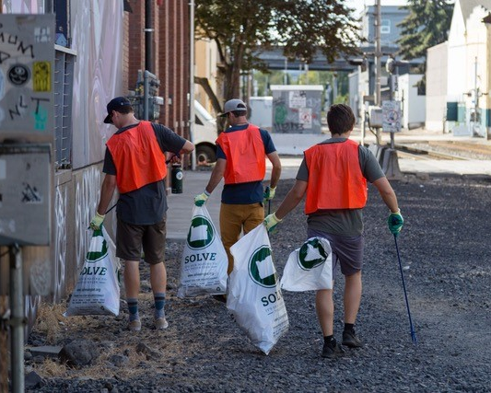
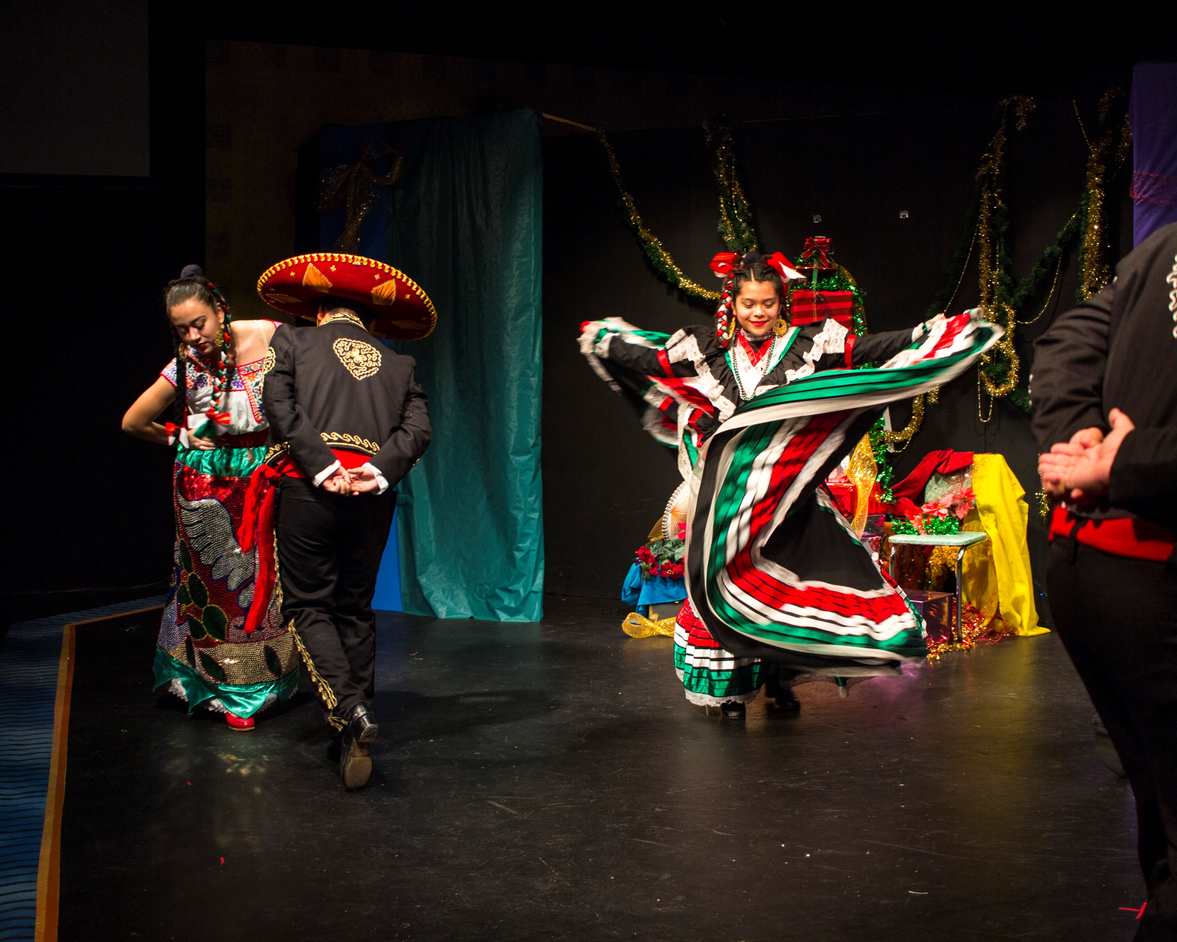
A New Kind of ESD
Central Eastside’s Enhanced Services District will foster a safer community, enhance the pedestrian experience, reinforce economic viability and promote Central Eastside’s unique identity through innovative and highly-responsive programs.

Slide 7
GOALS
Increase cleanliness throughout Central Eastside;
Improve safety for all in Central Eastside;
Manage parking and transportation demand / improve wayfinding;
Brand Central Eastside to increase business, customers, visitors;
Support innovation in all forms including strengthening Central Eastside as an employment center;
Increase economic viability of Central Eastside and promote prosperity for all; and
Ensure Central Eastside is an ideal place to create, innovate, work, live and visit.

Slide 8
Kate Merrill, Executive Director
Central Eastside Industrial Council
Jay McIntyre, Central City Concern

Slide 9
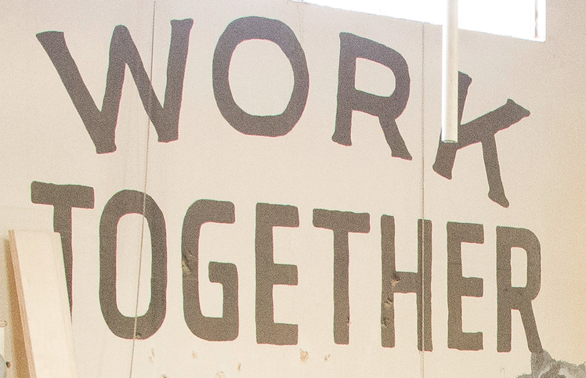
Central Eastside Industrial District
Core Values
Collaboration
Innovation
Responsiveness
Transparency
Equity

Slide 10
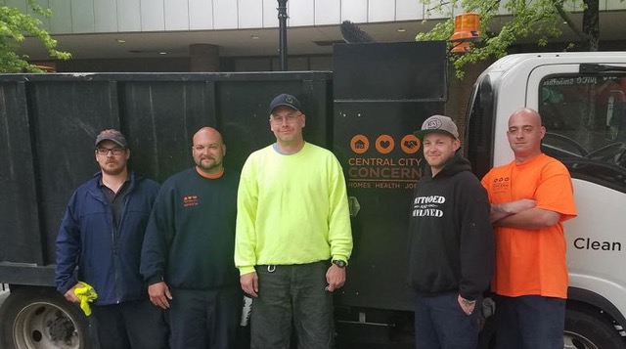
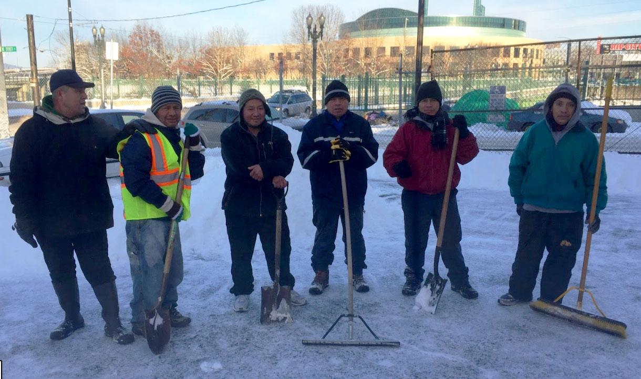
Community Investment
Helped Create and/or Support
Community Policing Committee (1990-2015)
Central City Concern Clean Start Program
Jean’s Place (permanent 60-bed women’s shelter)
Shleifer Building (temporary 100-bed shelter)
The Clark Center (permanent 90-bed shelter)
Portland Night Market (innovative tri-annual showcase of Portland creatives and makers)
Portland Street Art Alliance $50k “Mural Corridors” Grant (graffiti deterrent under Hawthorne and Morrison Bridges)
VOZ MLK Jr. Worker Center (permanent site)
Clean Start Program
The Clark Center
VOZ MLK Jr. Worker Center

Slide 11
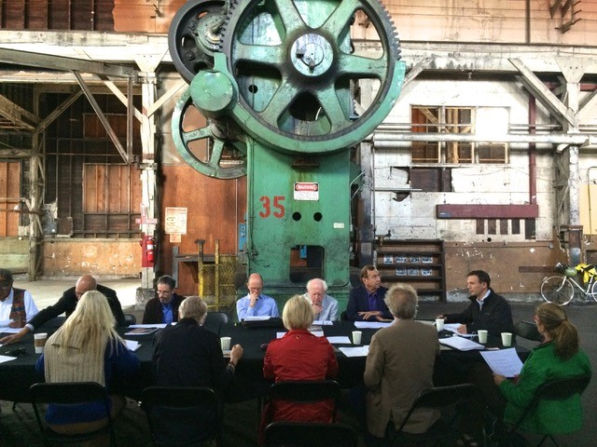
Community Engagement (2017-2019)
Communicated with 1,500 Businesses, Residents and Supporters
Mailed Service Plan to 100% Property Owners 2 Times (570 individual owners)
Facilitated 25 Community Outreach Meetings
Convened 25 ESD Steering Committee Meetings
Secured $10,000 ESD Formation Grant
Discussed Assessments with 240 Individual Property Owners
Met with Non-Commercial Property Stakeholder Groups
Businesses
Merchants and Makers
Nonprofits and Service Providers
Residents
Vulnerable Population Advocates

Slide 12
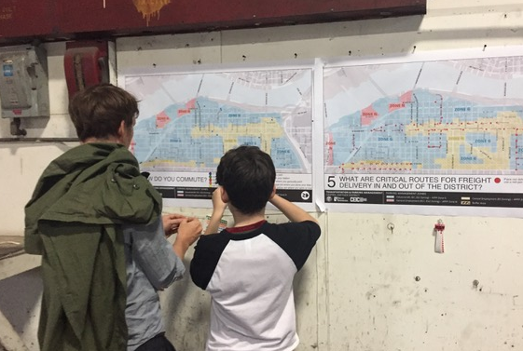
Community Engagement (2017-2019)
Met with 31 nonprofits, service providers and houseless advocacy groups 28 times
Met with Mayor, City Commissioners and City Staff 20 times
Updated website with Pilot Project Results, Revised Service Plan, FAQ and Budget
Secured Support from
City Commissioners
Multnomah County
PBOT
Prosper Portland
Revenue Bureau

Slide 13
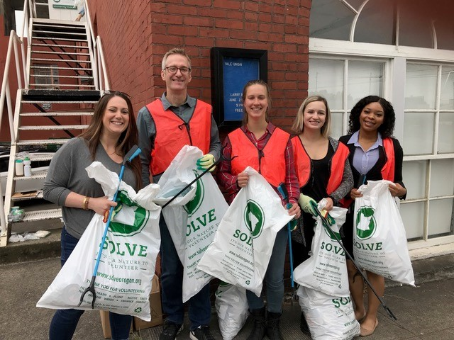
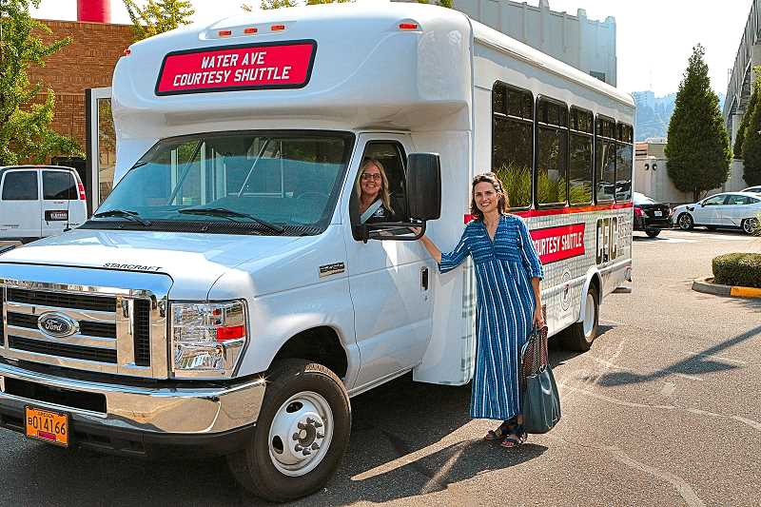
Pilot Projects: Real-time District Data
Launched 3 Pilot Projects (2018)
Real-time Data Gathering
Impact Assessment
Visible Benefit

Slide 14
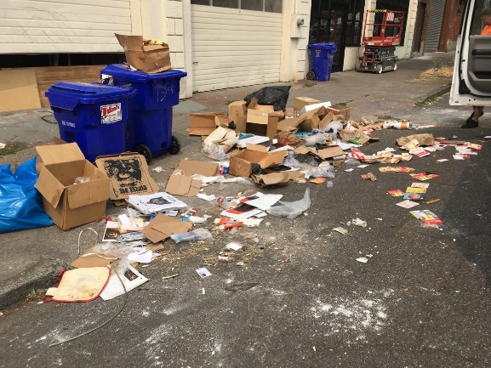
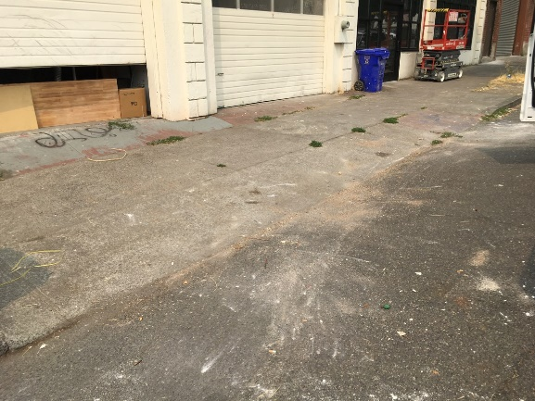
Pilot Projects: Cleaning/Graffiti Removal
Clean Start: District-Wide Cleaning and Job Skills
Partnered with Central City Concern to keep the district free of trash and other biohazards. Innovative Clean Start Program is peer-based, mentored, six-month job skills program that provides work experience for individuals impacted by houselessness.
Monday-Friday, 8am-4:30pm
RESULTS
Collection/Removal of 80 Tons of Trash (8,048 bags in 2018)
300 Individuals Contributed 900 Volunteer Hours during 3 Community Clean-ups
Made Referral Contacts During 468 Sidewalk Interactions
To report trash near you contact cleanstartceid@ccconcern.org.
MID-YEAR REVISION (November 2018)
Added Graffiti Removal Services

Slide 15
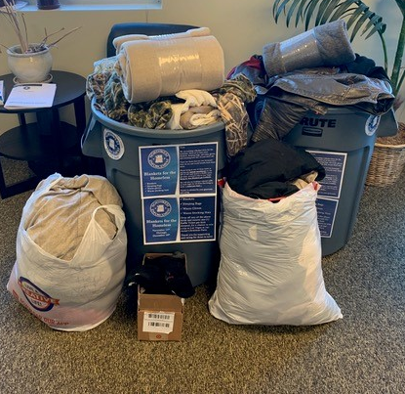
Pilot Project: Safety for All
Safety for All
Unarmed professionals provide safety services in the northeast part of district (West Buckman).
Monday-Saturday, 5pm-3am (West Buckman)
RESULTS
Documented 1,136 incidents of graffiti, trash and vandalism
Convened 6 Safety for All Pilot Oversight Committee Meetings Donated 100+ Winter Coats/Blankets, 200+ Handwarmers and 100+ First-aid Kits; initiated 4 Public ‘Winter Warm Drive’ Drop-off sites; replaced R2DToo Shower (Lloyd location)
MID-YEAR REVISION (January 2019)
Earlier Hours // Business Outreach // Safety Escorts (3-7pm)
Transit Route and Vandalism Hot Spot patrols

Slide 16
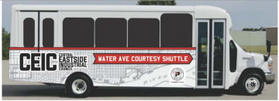
Pilot Project: Transportation Access
Water Avenue Shuttle
Launched first-ever district shuttle to connect employees, residents and visitors to district destinations and additional transit and parking options. By expanding active transportation options, the shuttle makes freight movement more efficient.
Monday-Friday, 6:30-9:30am // 4-7pm
RESULTS
Doubled Ridership Between August-December
Added 2 New Stops for a Total of 8
Dairy Building (2705 SE 8th Ave)
Oregon Rail Heritage Foundation (2250 SE Water Ave)
OMSI Northern parking lot (1945 SE Water Ave)
ODOT Blocks (Water Avenue between Taylor and Salmon)
Smith Teamaker (110 SE Washington St)
Subaru of Portland (400 E Burnside St)
Eastside Exchange Building lot (123 NE 3rd Ave)
Oregon Convention Center (most northern bus stop area)
Created Online Shuttle Tracking System

Slide 17
Lessons Learned
Harder Than We Thought
ESDs are complicated. So is Central Eastside. So is Portland.
Details Matter
So do our values and approach.
Transparency – and building trust – is critical
Teamwork makes the dream work (and so does compromise)
An equitable district requires having diverse voices/perspectives at table
Best practices are good but so is creating a new kind of ESD
The Only Constant is Change
Responsive programming requires consistent iteration.
Innovation is exciting/necessary – and messy/uncomfortable
Visible impact (value/benefit) is important
Central Eastside is Deeply Committed to Positive Change

Slide 18
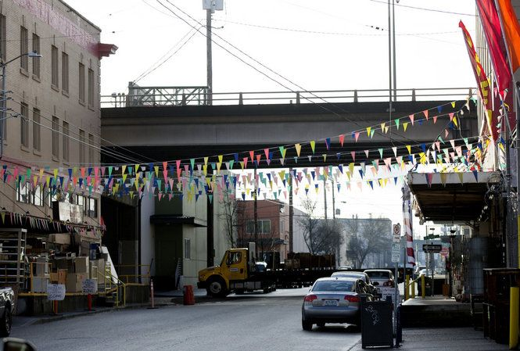
A Complicated District
Central Eastside’s commercial landscape is made up of primarily small, locally owned businesses.
1,131 Parcels
8 Parcels (1% of total) represent 1% or more of total assessed value
243 Parcels (21%) represent .1% or more of total assessed value
888 Parcels (78% of total) represent less than .1% of total assessed value
Contrast
Lloyd – 125 parcels
Downtown – 602 parcels

Slide 20
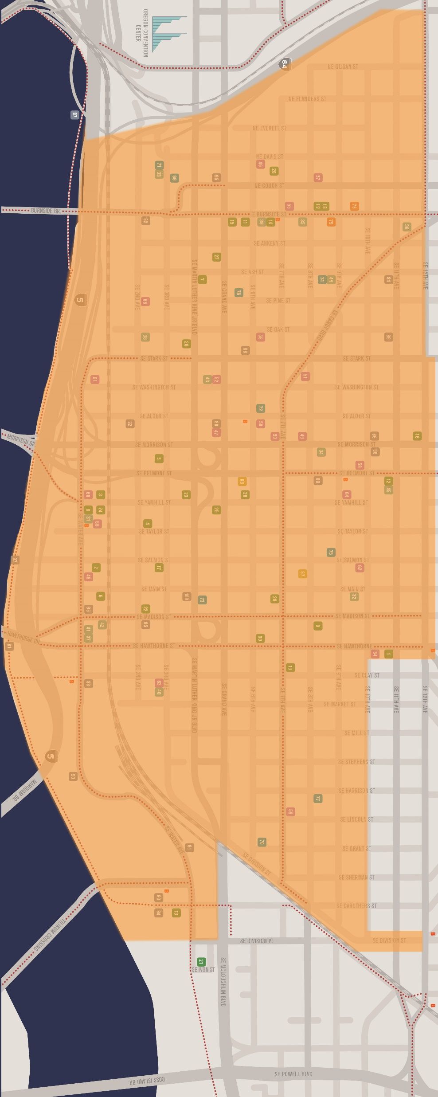
Proposed Boundaries
North: I-84 (south side between Willamette River and east side of 12th Avenue)
South: SE Division Place (north side between I-99/McLoughlin Blvd and River); SE Division Street (south side between Grand and 10th Avenues; both sides between 10th and 12th Avenues); and SE Hawthorne (both sides between 10th and 12th Avenues)
East: SE 10th Avenue (west side between Hawthorne Blvd and Division Street); SE 12th Avenue (west side between I-84 and Stark Street; east side between Stark Street and Hawthorne Blvd)
West: Willamette River (between I-84 and north side of Division Place)

Slide 21
Proposed Service Plan
Central Eastside ESD
Sidewalk Operations
Parking and Transportation
Streetscape Improvement
Innovation Fund
Advocacy and Administration
Contingency/
Reserve

Slide 22
Proposed Service Plan
Sidewalk Operations: Cleaning and Safety
Unarmed, highly-trained, peer-based Cleaners, Safety Ambassadors and Crisis Worker document/address district graffiti, trash and safety needs
Enhanced trash removal and as needed sidewalk power washing
Safe routes to transportation and parking including improved lighting
Connect those in need to transit, social/supportive services; enhance pedestrian experience
Low-barrier uniforms
Significant Training (trauma-informed; provided by housed/houseless trainers)
‘Central Eastside Cleaning Certification’ – 2+ hours training upon hire and every 6 months
‘Central Eastside Safety Certification’ – 12 hours training upon hire and every 6 months plus 4 hours/month ongoing professional development
‘Central Eastside Situational Protocol’ – best practices around involving law enforcement
All services contracted through RFI Process
Safety for All Oversight Committee

Slide 23
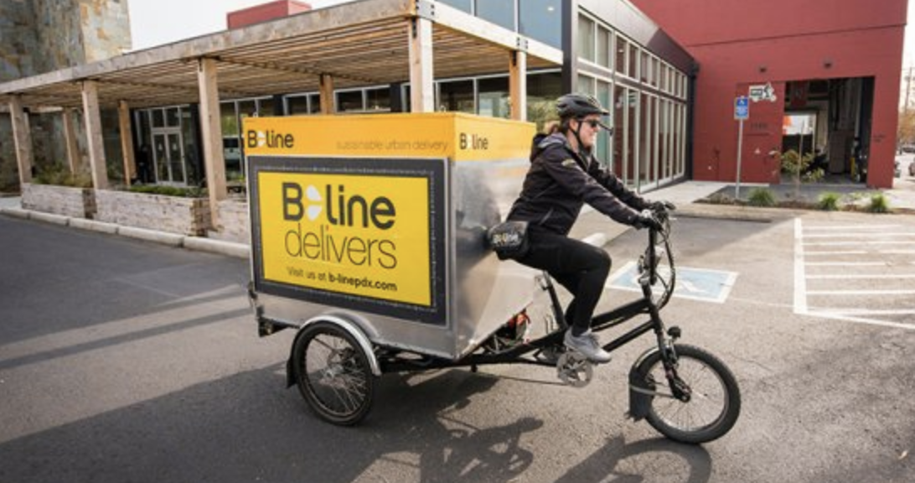
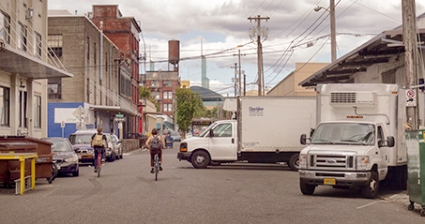
Proposed Service Plan
Parking and Transportation
Discounted transit passes for Central Eastside employees (Bus, Max, Streetcar)
Parking demand management including permits
Transportation demand management including Water Avenue Shuttle and road safety improvements (flashing beacon at OMSI)
Safety Ambassador Escorts to transportation
Efficient movement of freight

Slide 24
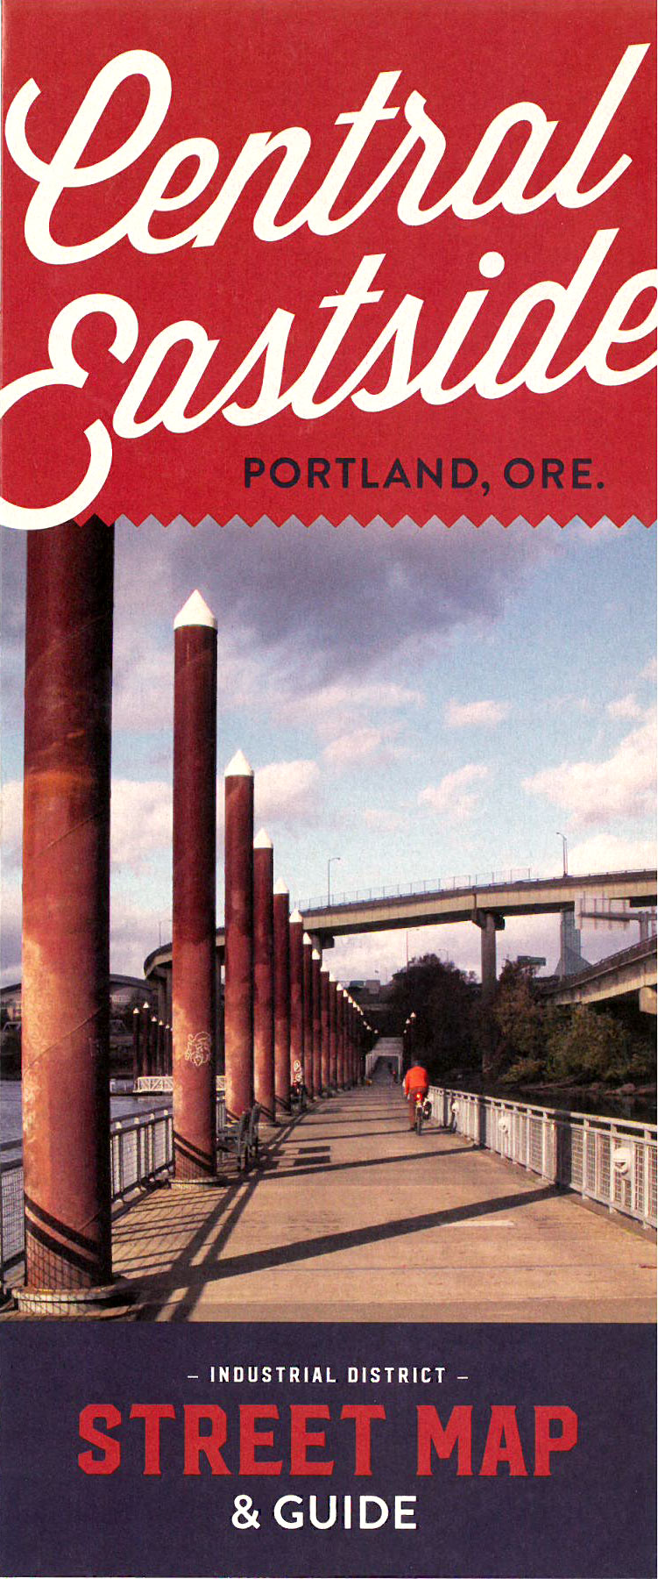
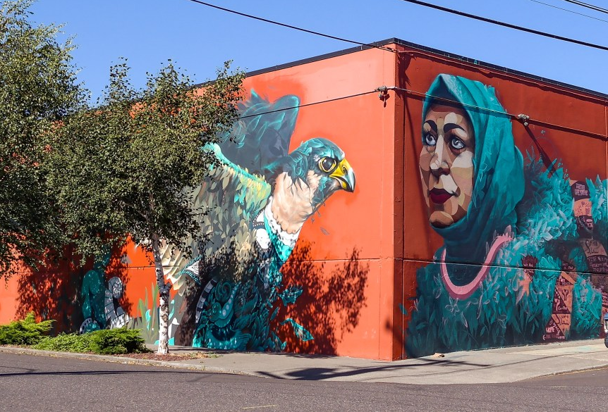
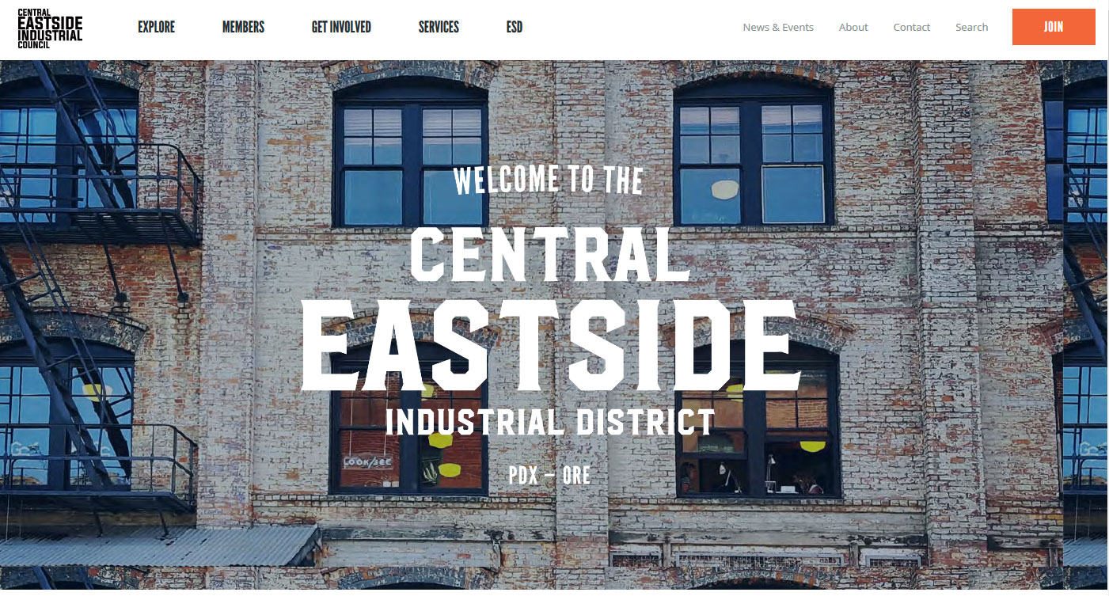
Proposed Service Plan
Streetscape Improvement and District Identity
District brand/identity; website, newsletter and communications; marketing/promotions
Wayfinding including map, banners and signage
Public amenities including murals and trash cans

Slide 25
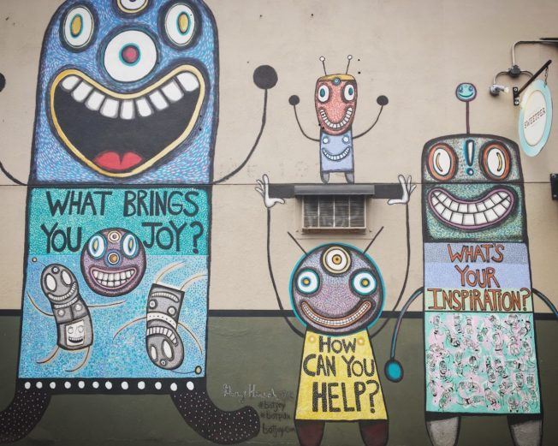
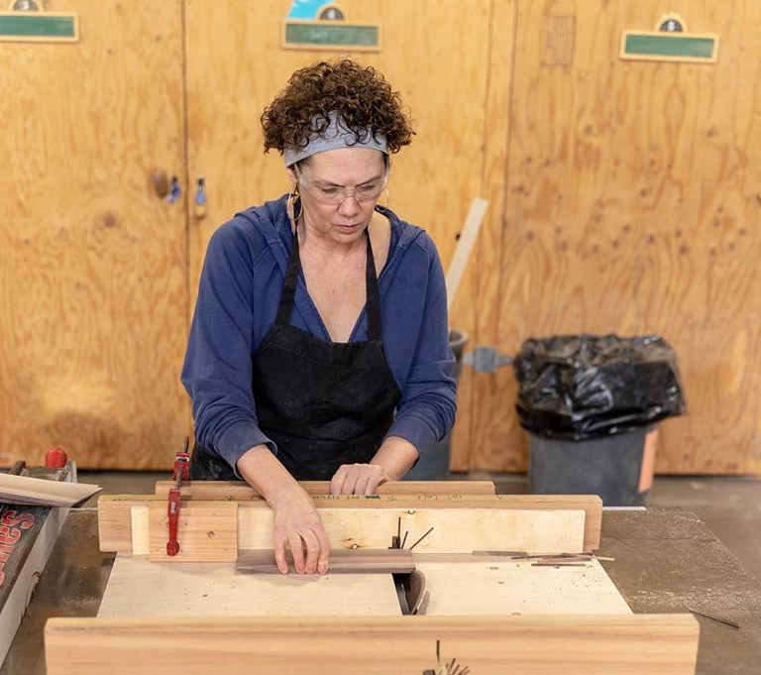
Proposed Service Plan
Community and Workforce Innovation Fund
Small annual grants to:
Businesses in district implementing innovative workforce development strategies (job training, apprenticeship to work, houseless to employment, etc)
Community organizations providing services in district that support ESD goals (peer-based waste collection, safe storage, or hygiene projects; public art, etc)

Slide 26
Proposed Service Plan
Advocacy and Administration
501(c)3 Management Corporation
Personnel // Office // Insurance // PR
Relations with City
Robust Internal Controls and transparent financials
Annual External Audit and published Annual Report
Bi-Annual Property Owner and District Stakeholder Meetings
RFI/RFP required for all service contracts
Contingency/Reserve
Ensures financial stability; funds long-term capital projects

Slide 27
Proposed Governance
20%
Business
(up to 4)
Diverse, Volunteer Board of Directors (10-20 members)
3-Year Terms; maximum 2 consecutive terms
Formal Nominating Committee and Board Recruitment process
Up to 3 Directors will represent vulnerable populations (have lived experience of housing insecurity/houselessness)
Business
20%
(Up to 4)
Vulnerable Populations
15-20%
(Up to 3)
Community Organization
15-20%
(Up to 3)
Board of Directors
20%
Property Owner
(up to 4)
Property Owner
20%
(Up to 4)
Government
10%
(Up to 2)
Residential
20%
(Up to 4)
20%
Residential
(up to 4)

Slide 28
Property Management License Fee: 2019-2021
Proposed Formula
Properties in the ESD will be assessed annually using the following formula:
Improved Value – $0.45 per $1,000 of improved value
Building Square Footage – $3.50 per 290 sq ft of improvements less parking
Land Square Footage – $0.020 per sq ft of land owned
Annual Escalator – 2.3% annually starting in the 2020 License year. Note: figure is equal to the 10-year average of Portland’s consumer price index (CPI -W1).
This formula is expected to generate $1,200,000 in Year 1 and $4,100,000 over the proposed 3-year life of the ESD (2019-2021). Note: private funds will be matched with $1,400,000/year in parking demand management (permit and meter) revenue or $4,200,000 over the proposed 3-year life of the ESD.

Slide 29
Proposed Budget
Budget: Year 1
Sidewalk Operations | 1,250,000 | 48%
Parking/Transportation | 800,000 | 30%
Streetscape/District Identity | 175,000 | 7%
Innovation Fund | 50,000 | 2%
Advocacy/ Administration | 275,000 | 11%
Contingency/Reserve | 50,000 | 2%
TOTAL | $2,600,000*
*$1,200,000 – ESD Assessments (Restricted to Service Plan Activities)
*$1,400,000 – Public Matching Funds (Restricted to Parking/Transportation)

Slide 30
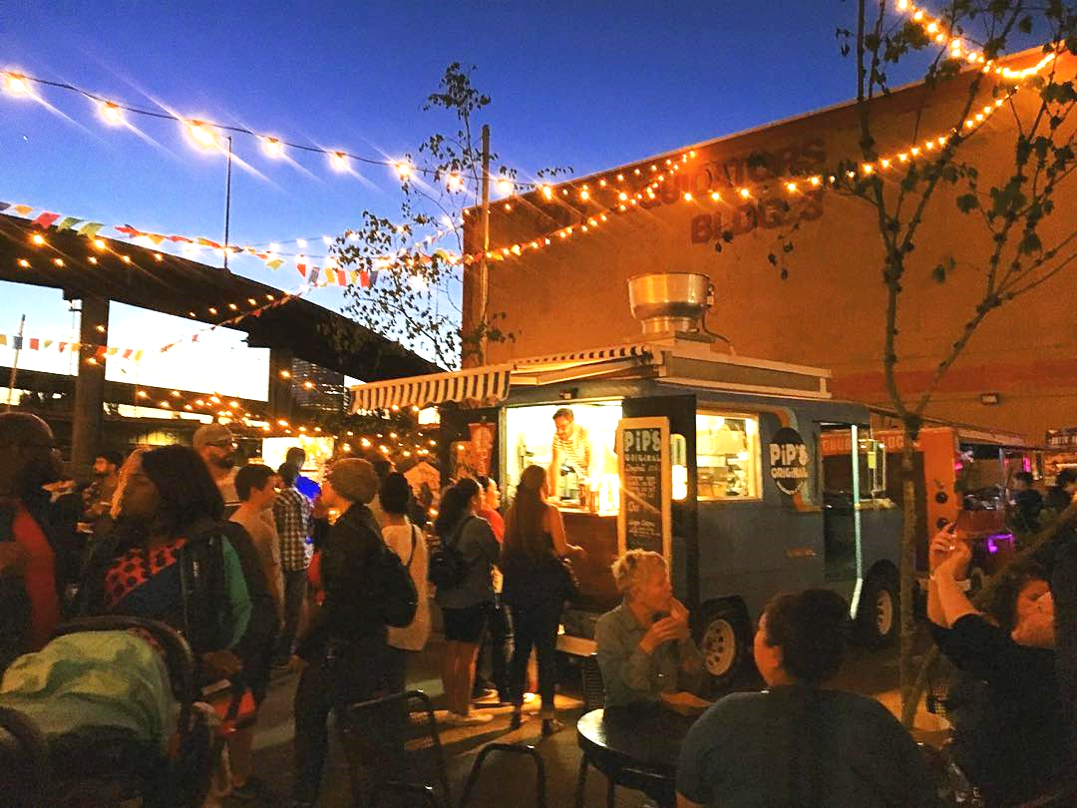
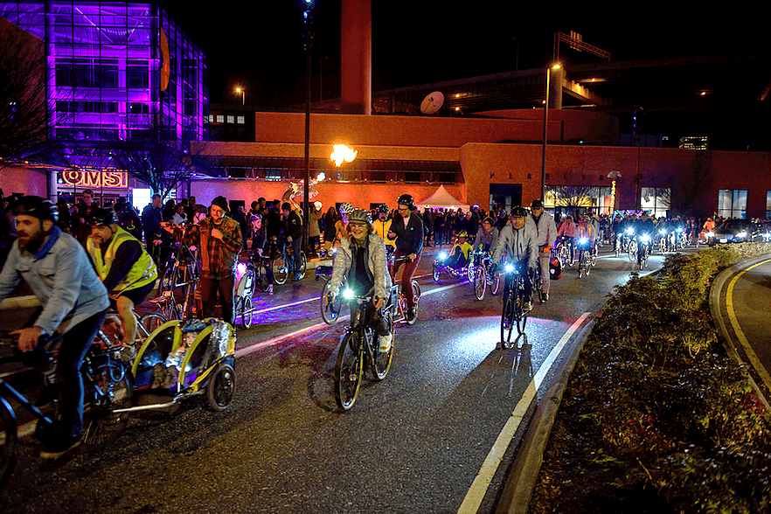
Community Support (District Payers)
Secured Support Letters for 395 Parcels from 103 Owners
Support Represents 53.65% of District (2019)
58.85 in 2020
59.75 in 2021

Slide 31
Commissioner Sharon Meieran, Multnomah Co.
Bobby Lee, Prosper Portland
Juliana Lukasik, ESD Advisor // @Large Films
Nancy Stueber, OMSI
Randy Lauer, American Medical Response
Don Miller, City Team Ministries
Angie Garcia, Escuela Viva

